Slide 1
CSEM

Slide 2
1. To reconfigure and test a recently developed surface-towed CSEM system
2. To assess if/how an ROV- or AUV-based CSEM system can/should be built at MBARI to carry out repeat surveys of fluid flow systems at high spatial resolution and in a wide range of water depths

Slide 3
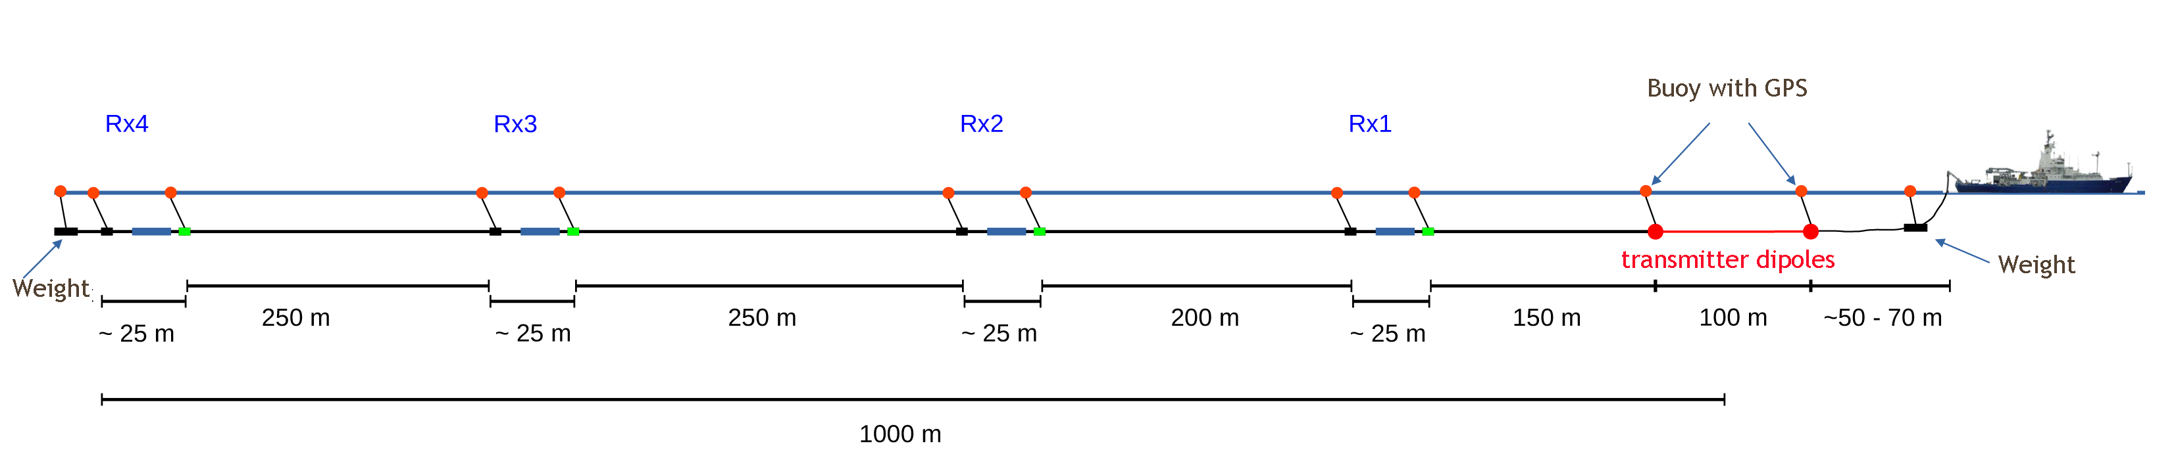
To reconfigure and test a recently developed surface-towed CSEM system

Slide 4
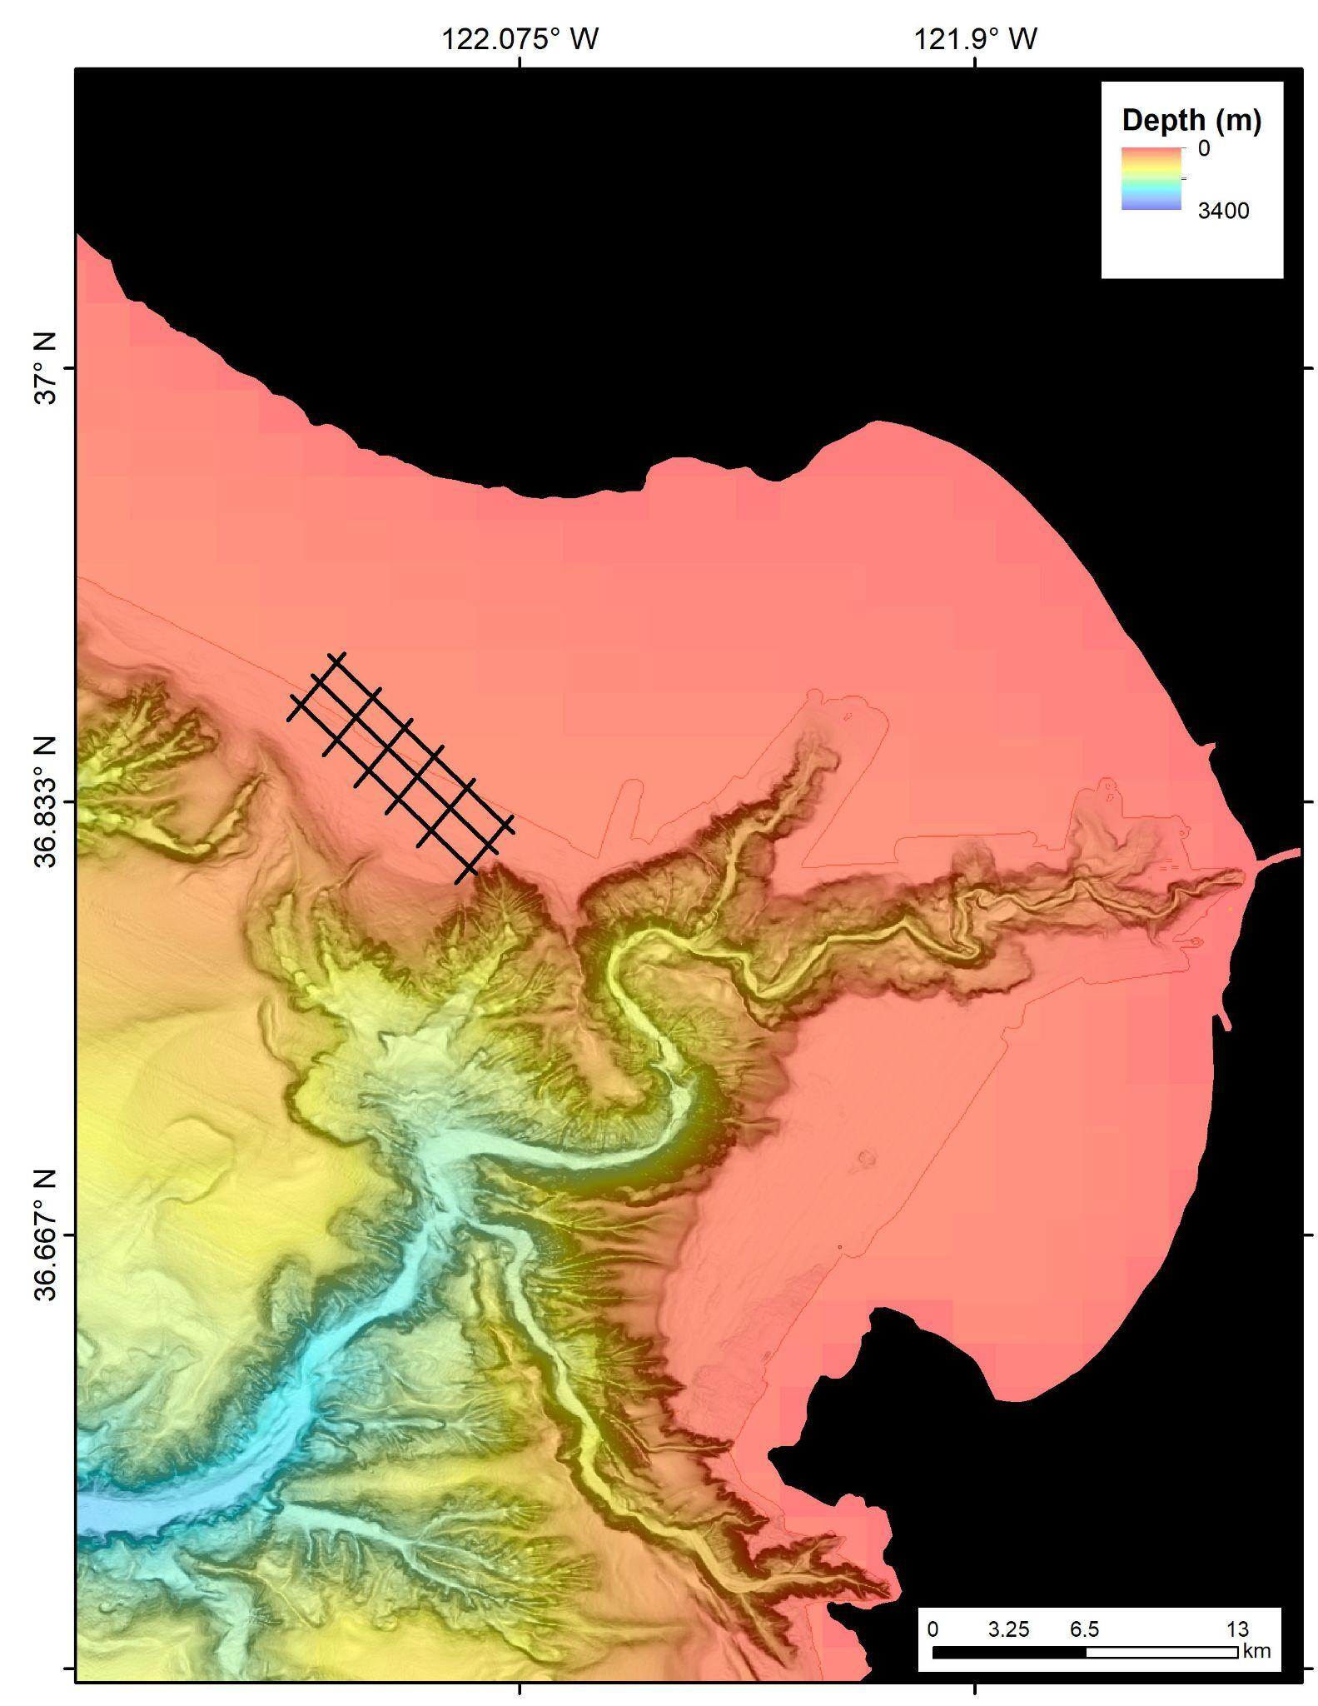
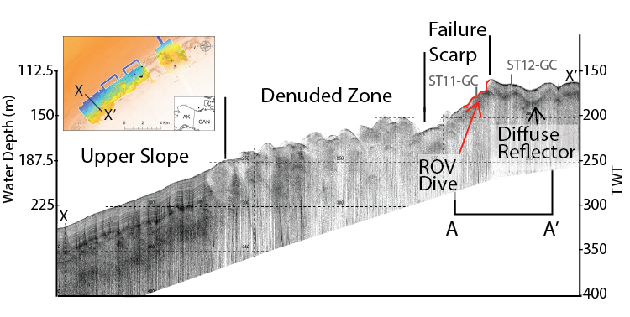
To reconfigure and test a recently developed surface-towed CSEM system

Slide 5
Budget
  Reconfiguration of SWAN system - $30,000
  Permitting and contingency plan - $5,000
  4 ship days + 4 mob days - $22,000
  Freight costs and customs - $10,000
  Consumables - $5,000
Monterey

Slide 6
Team
Personnel
Science
Charlie Paull, Roberto Gwiazda
Engineering
Alana Sherman (230 hrs) – project manager (transferred to new hire?)
Jon Erickson (360 hrs)
Paul McGill (80 hrs)
Dave Caress
DMO
Erik Trauschke (40 hrs)
Eric Fitzgerald (20 hrs)
Erich Rienecker (80 hrs)
Knute Brekke (80 hrs)
Monterey

Slide 7
Ship requirements
  R/V Shana Rae or Fulmar
  4 ship days + 4 mob days in September 2024
Monterey

Slide 8
Work plan 2024
Task | Month (2024)
 | Jan | Feb | Mar | Apr | May | Jun | Jul | Aug | Sep | Oct | Nov | Dec
Synthetic modeling for Canadian Arctic
Adapt MBARI winch for deployment of SWAN system, or procure one
Rienecker visit to GEOMAR
Delivery of SWAN system to MBARI
Adapt SWAN system for deployment
Execute joint test and science survey in Monterey Bay
Process and invert CSEM data
Others
Permitting issues
Liability and insurance issues
Identify vessel and book
Monterey

Slide 9
Work plan 2025
  Deployment/recovery of SWAN in the Canadian Arctic – August 2025
Monterey

Slide 10
Change in plans?
Risks related to towing close to shore (?)

