Slide 1
CSEM Deployment
Johann Voigtlander

Slide 2
What is CSEM?
Controlled-Source Electromagnetics (CSEM) – Surface Towed
Geophysical method using an EM source to map subsurface resistivity.
A surface-towed electric dipole transmits low-frequency signals into the water and seafloor.
EM fields diffuse downward; their behavior changes with subsurface resistivity.
Receivers measure amplitude and phase of returning fields.
Data reveal conductive and resistive layers, enabling 1D/2D/3D resistivity models.
Particularly useful for identifying geologic structures, fluids, and conductive/ resistive layers beneath the seafloor.

Slide 3
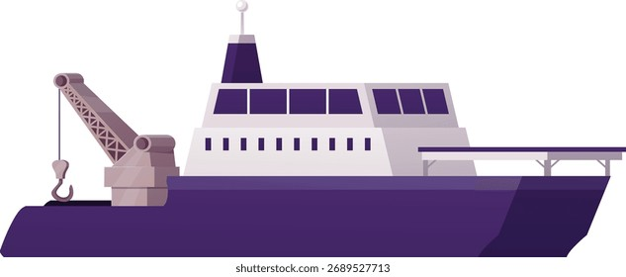
CSEM Setup
GPS Loggers on surface floats
Weight
RX2
RX1
TX2
TX1
Receiver Dataloggers
Records electromagnetic return signal
Transmitter Dipoles
Electrically connected to ship
Creates electromagnetic signal
~600m

Slide 4
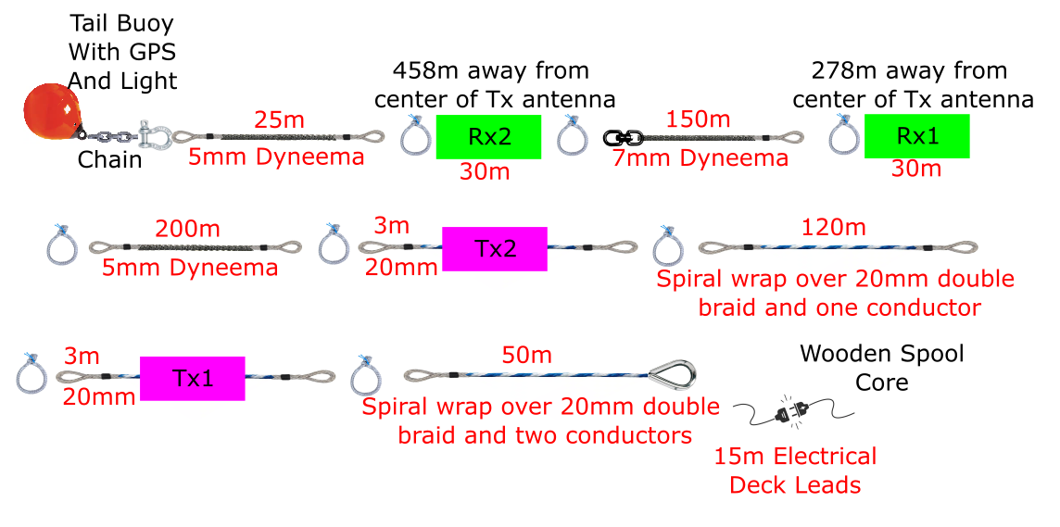
Lines on winch

Slide 5
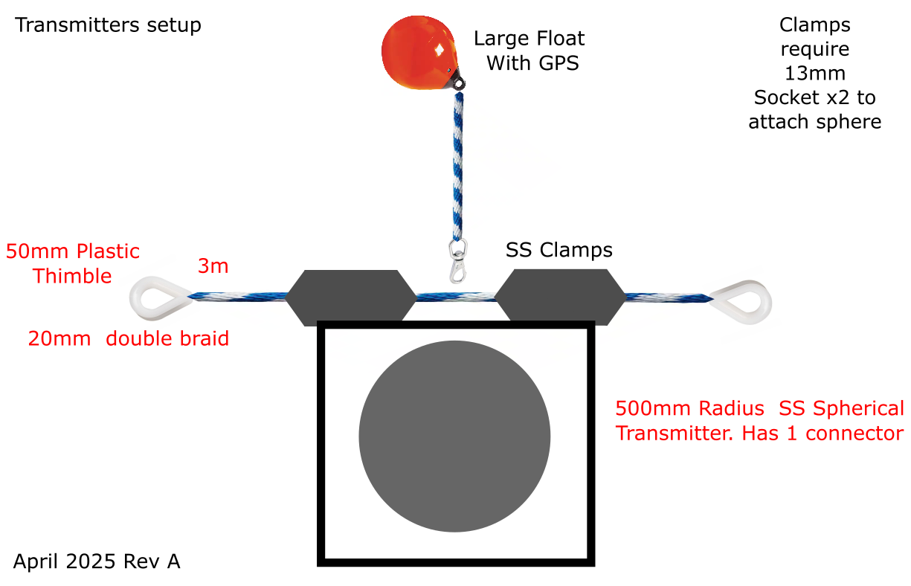
Transmitter Details

Slide 6
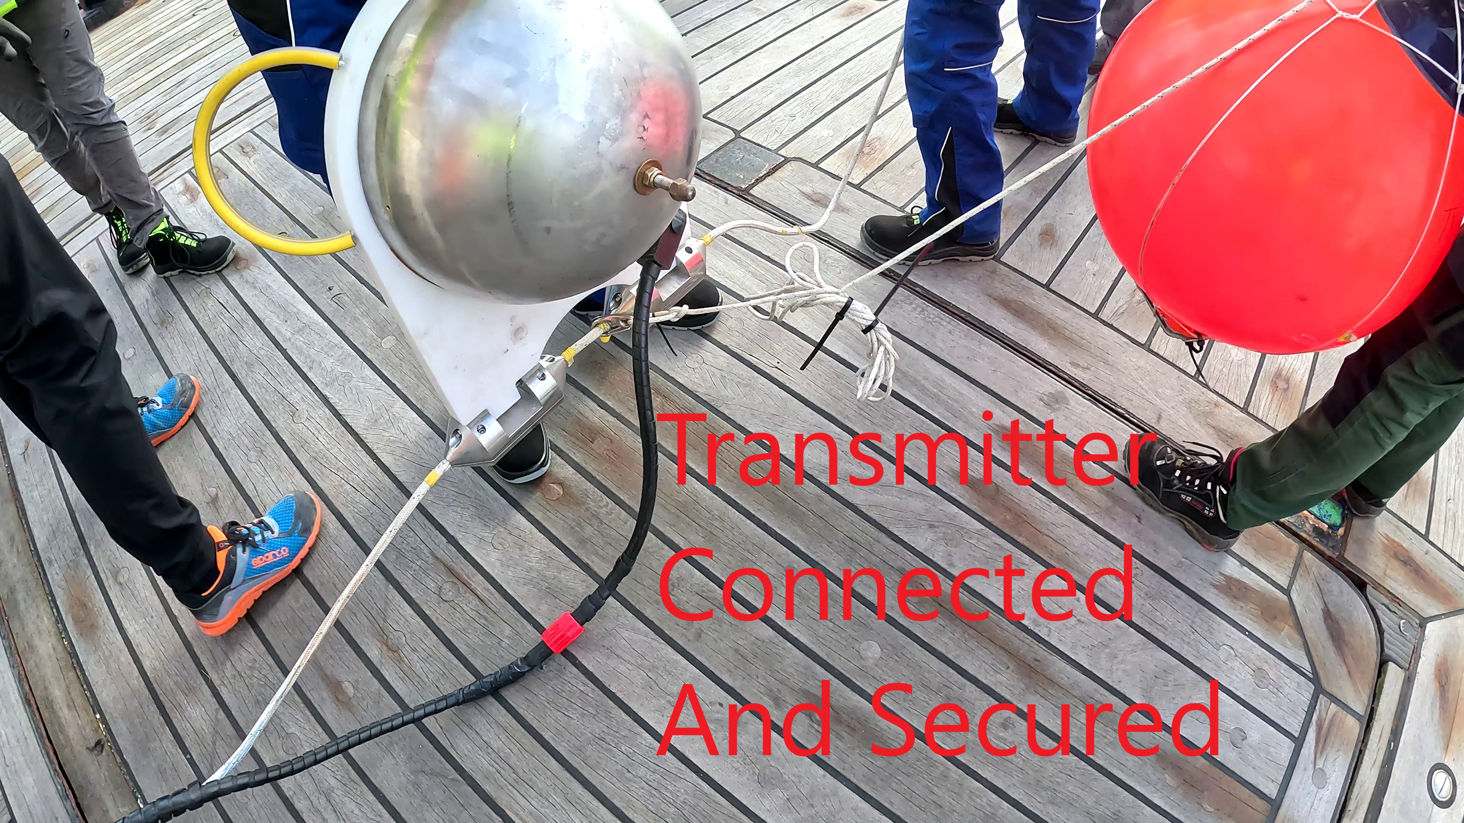
Transmitter Details (cont)

Slide 7
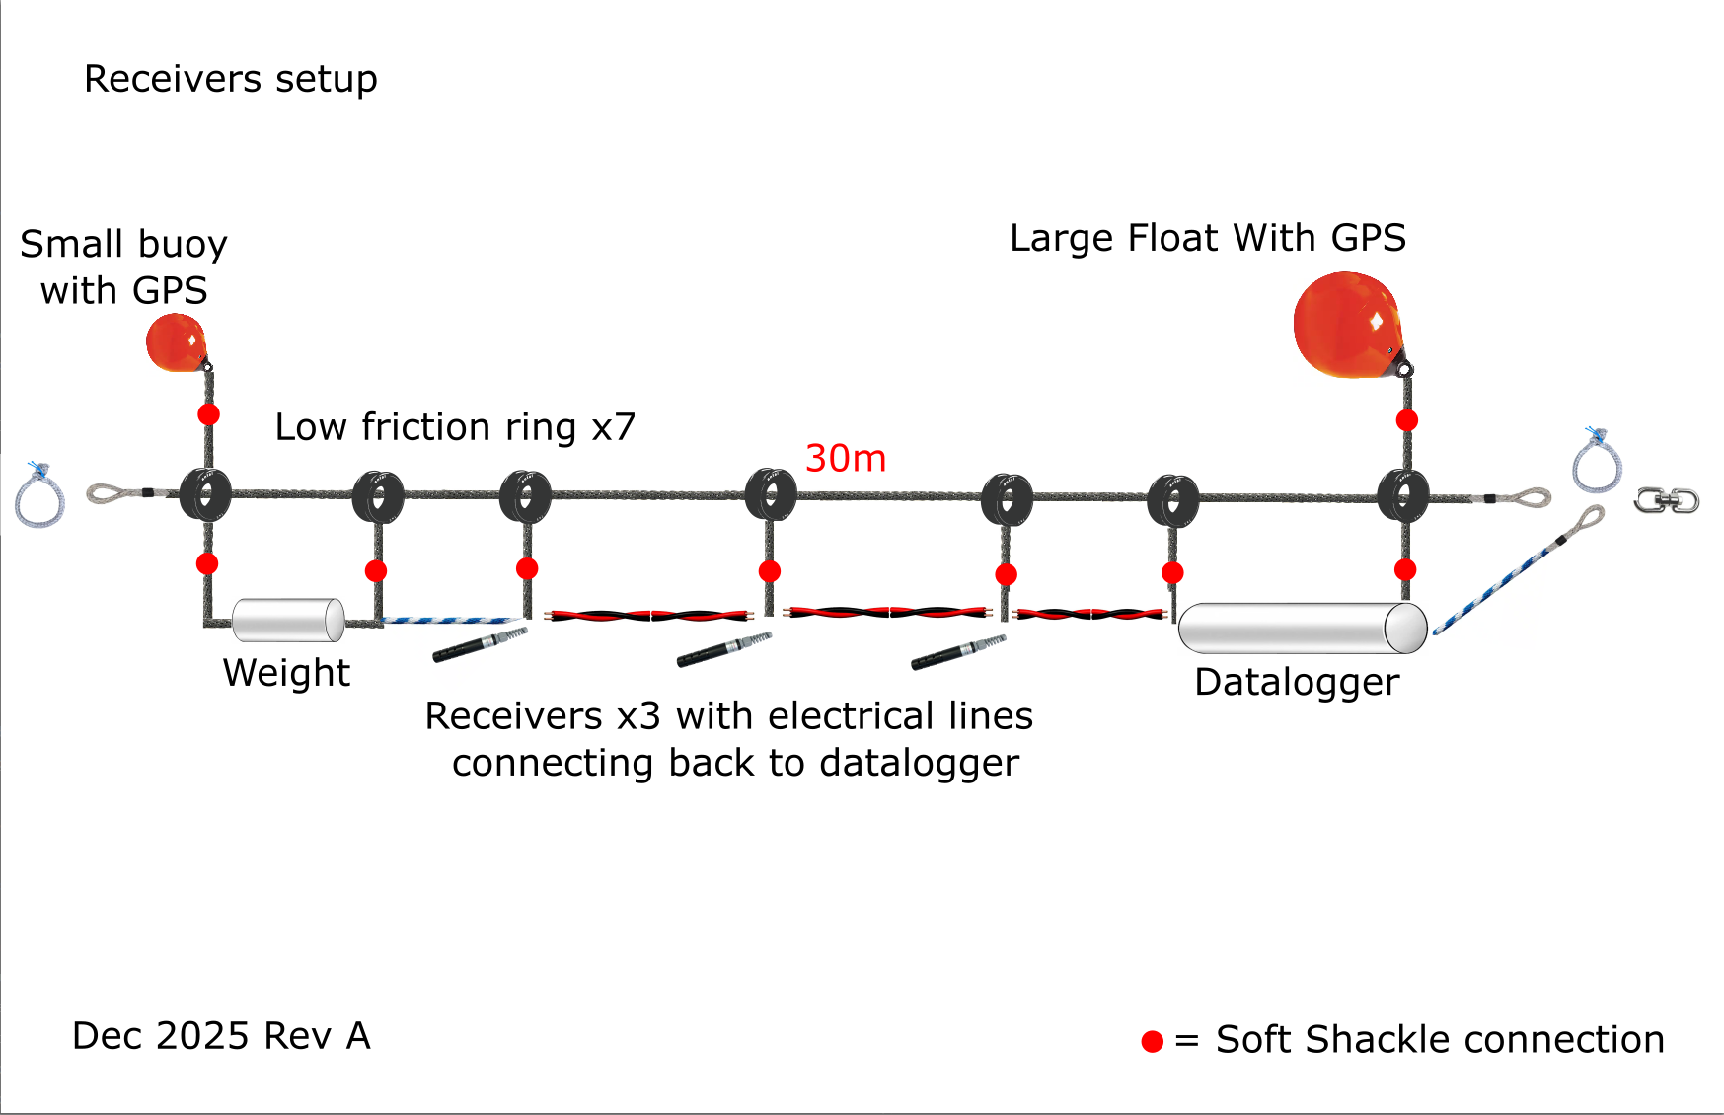
Receiver details
Notes:
Commissioned in 1964 as one of the world’s first deep-ocean submersibles
MBARI’s strategy was different. Take a platform designed to support offshore oil production, turn it into a broadly capable scientific research tool, and…

Slide 8
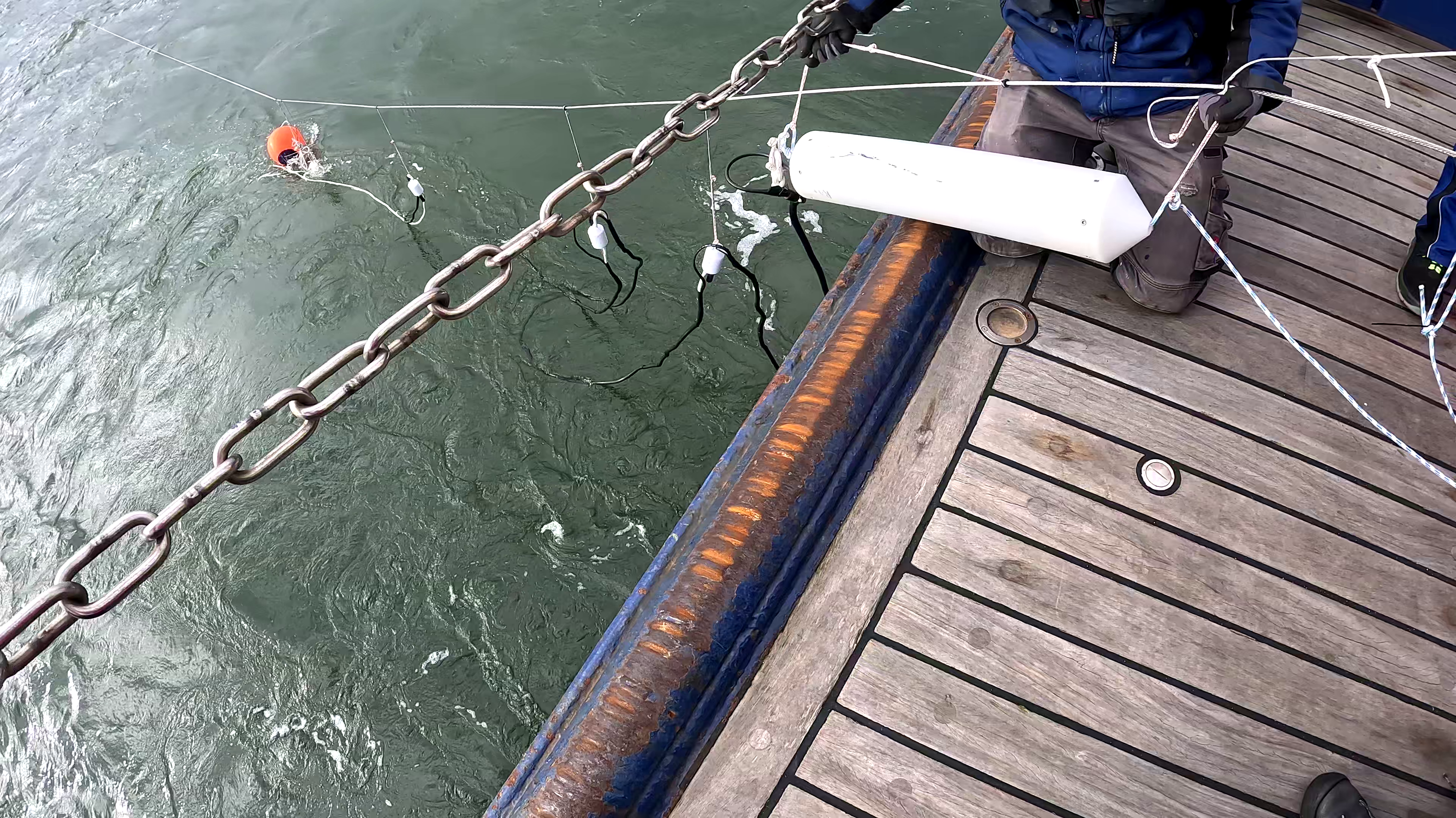
Receiver details (cont)
Notes:
Commissioned in 1964 as one of the world’s first deep-ocean submersibles
MBARI’s strategy was different. Take a platform designed to support offshore oil production, turn it into a broadly capable scientific research tool, and…

Slide 9
Deployment Strategy
Time to deploy: ~1 hour
We will need to be positioned before our start point
Speed: ~1-1.5 knots
May have to adjust speed during RX and TX deployments
Crew:
1 on winch
3 on deck
1 interpreter?
Deploy weight
Deploy RX2
Deploy RX1
Deploy TX2
Deploy TX1
Turn system on
Weight
RX2
RX1
TX2
TX1

Slide 10
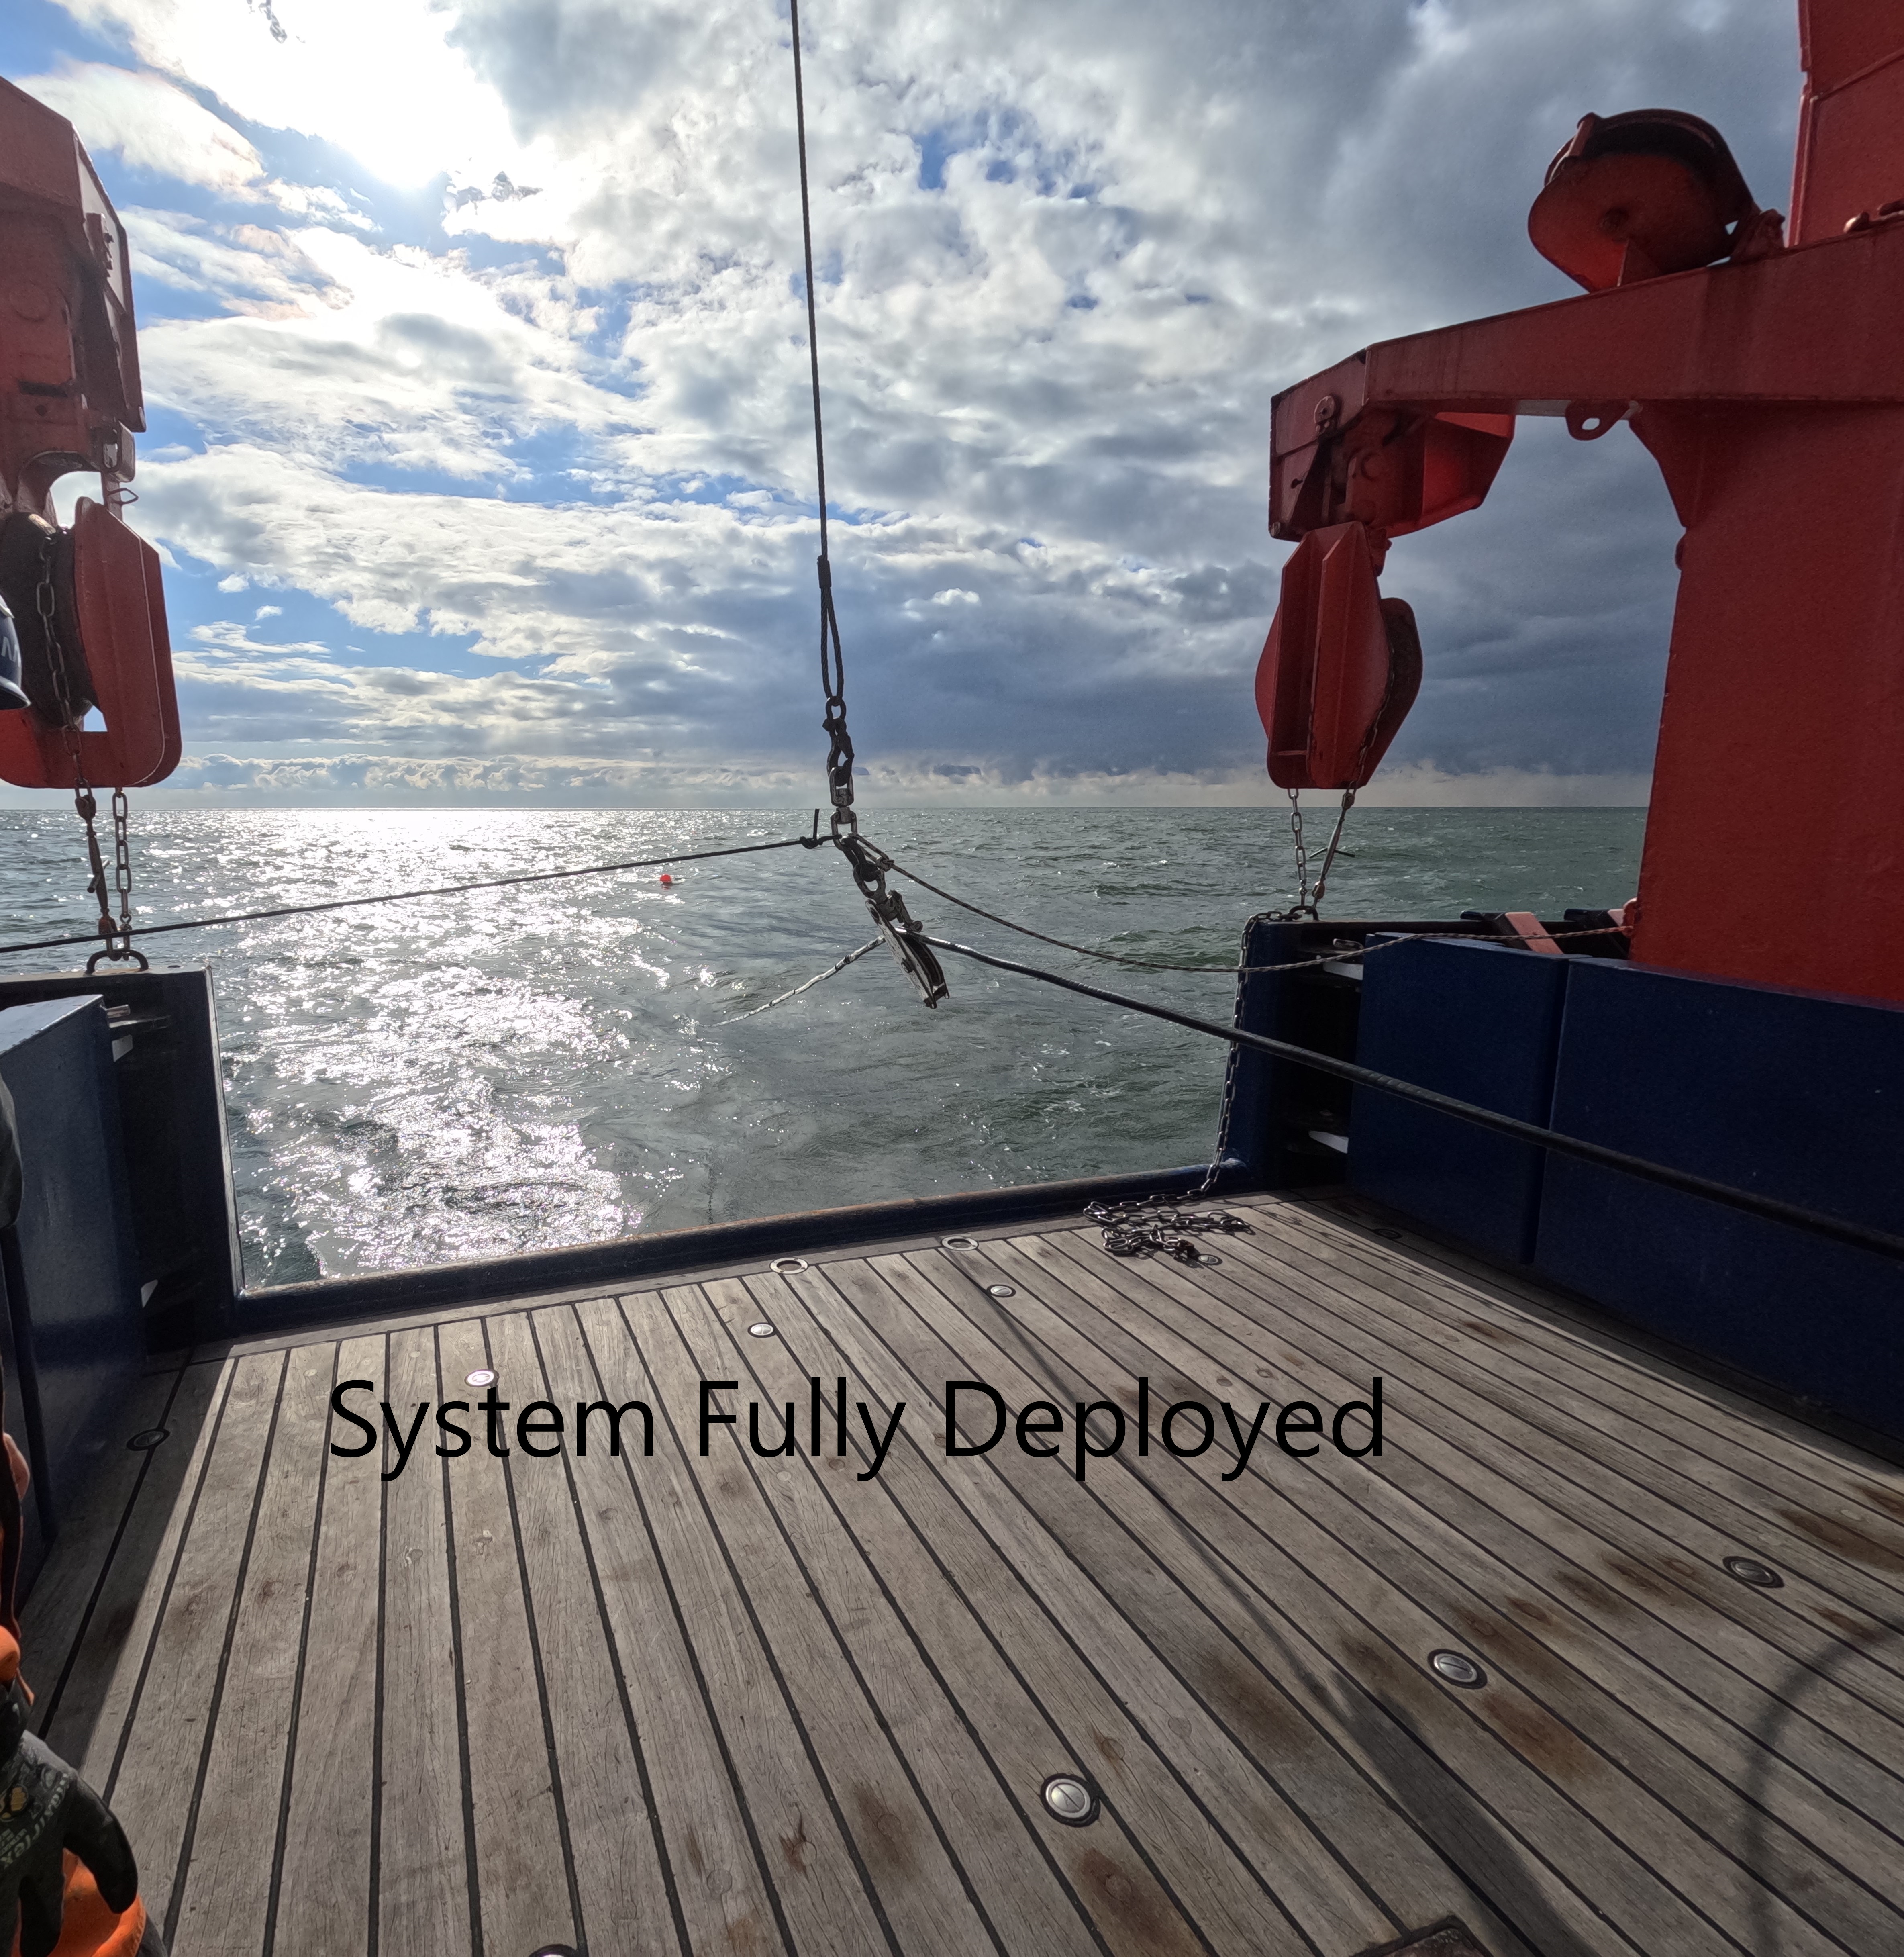
Towing the system
1 person watching gear
15 minute monitoring
Bridge monitoring forward obstacles
Weight
RX2
RX1
TX2
TX1

Slide 11
Recovery Strategy
Time to recover: ~1 hour
Speed: ~1 knot
Crew:
1 on winch
3 on deck
1 interpreter?
Power system off
Recover TX1
Recover TX2
Recover RX1
Recover RX2
Recover weight
Weight
RX2
RX1
TX2
TX1

