Slide 1

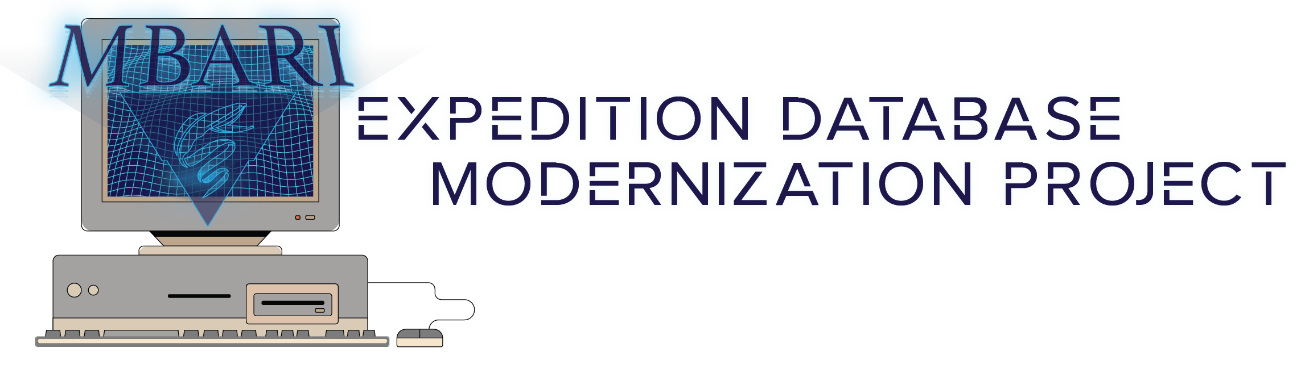
Team 1 Final Presentation
Notes:
Assigned to - Leah
This is the MBARI expedition database modernization project team 1 final presentation.

Slide 2
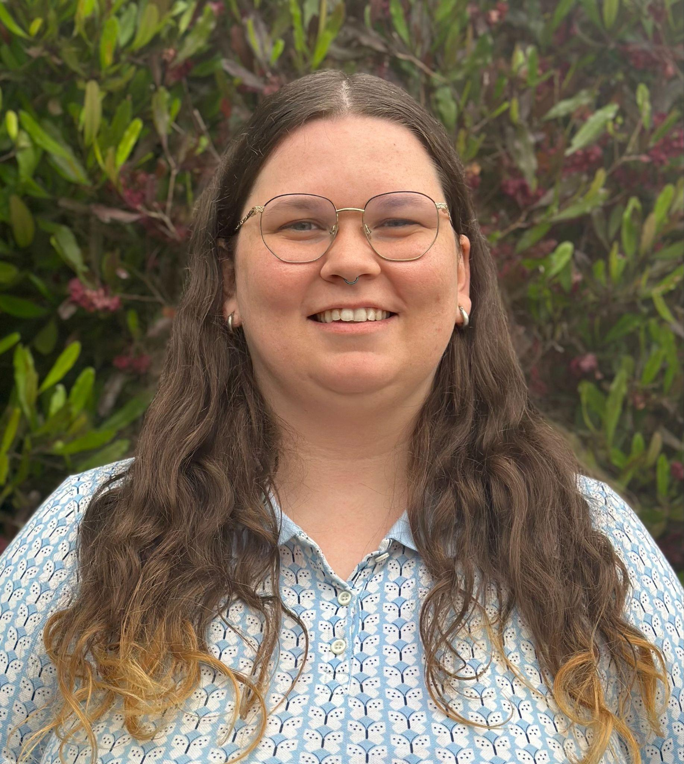
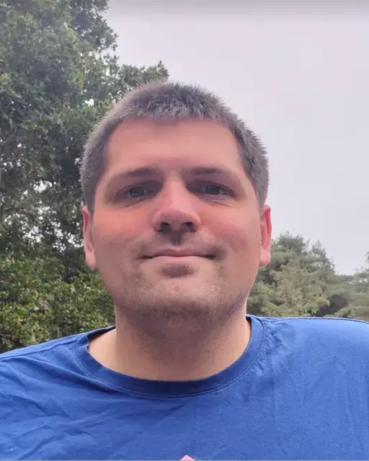
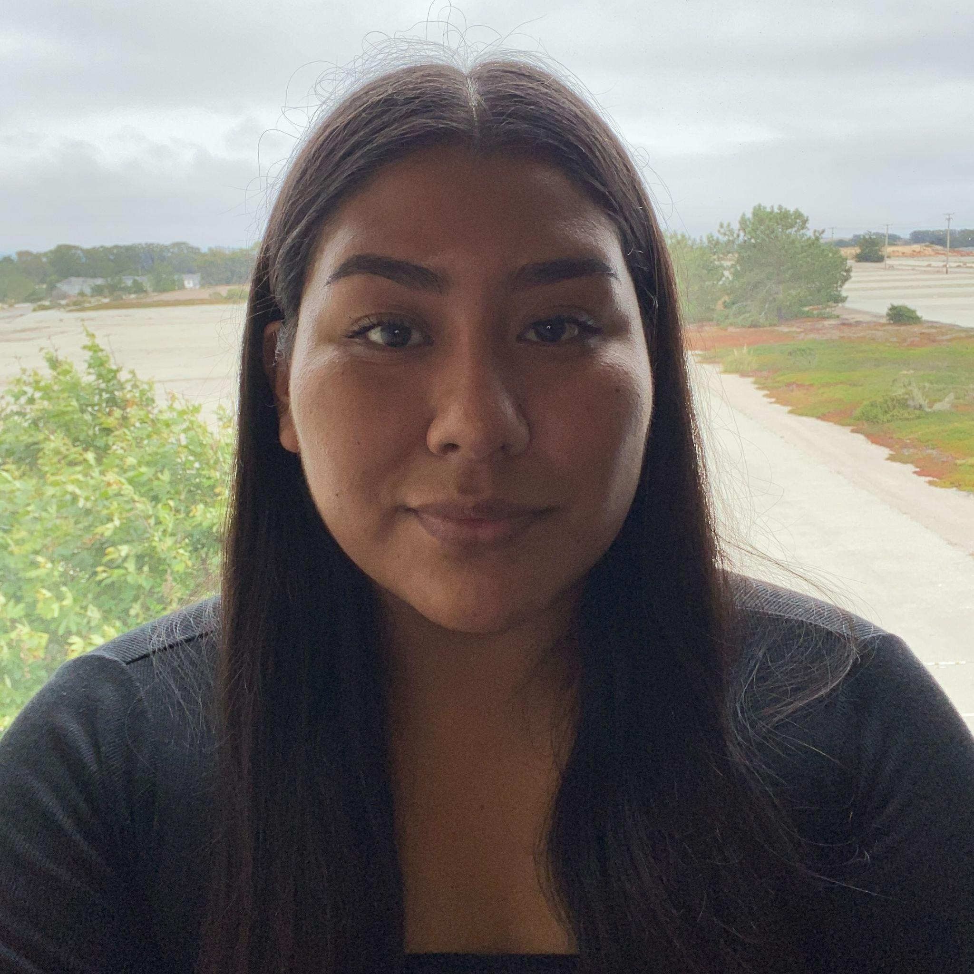

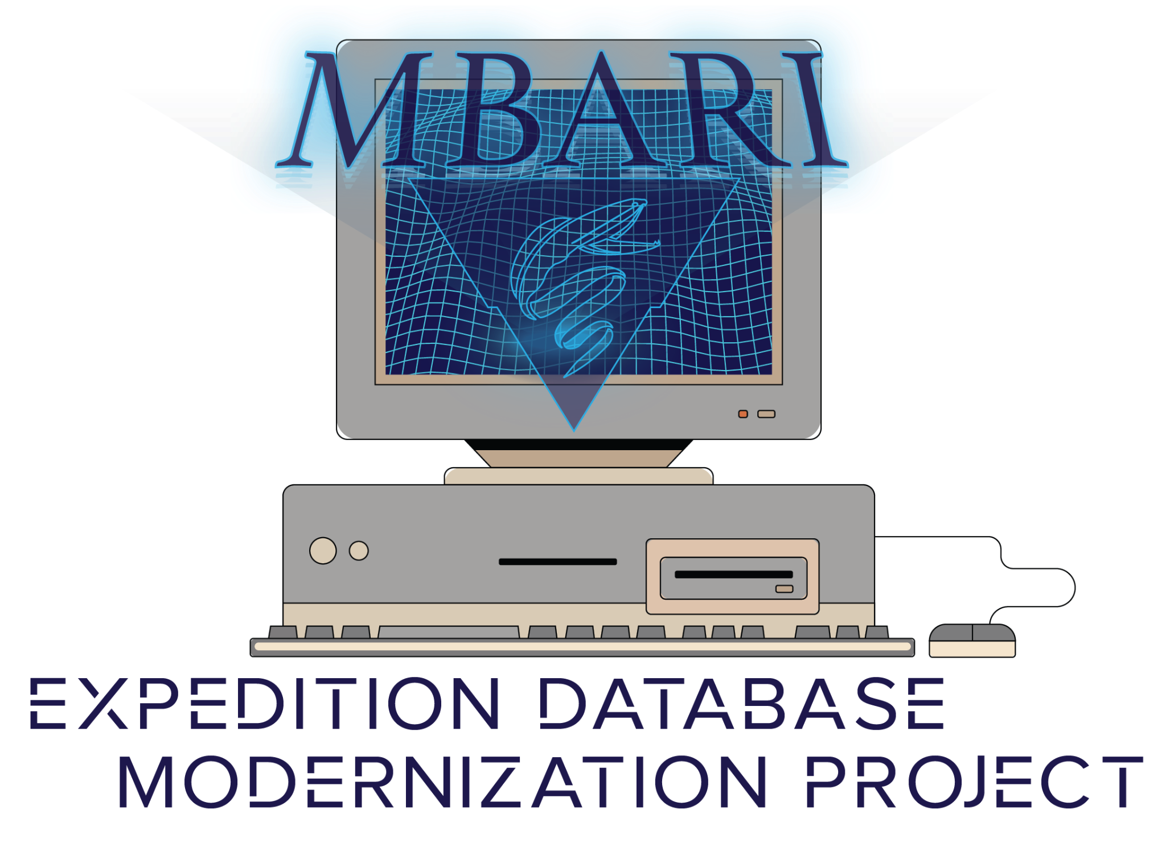
LEAH BAKER
MICHAEL BRADLEY
MEET THE
TEAM
BETZABE RUIZ
GEOFFREY VASAYA
Notes:
EACH INTRODUCE EACH OTHER

Slide 3
BACKGROUND // MOTIVATION // OBJECTIVE
Mission critical tool used to schedule ship times and log expedition data
  Built 25 years ago on Perl
  Currently near the end of its life
  $25,000 a year in legacy software support
Create new database and web application on a modern software stack
  Maintain current functionality with a modern UI
  Greenfield project
  Fully functional app by semesters end
Notes:
Assigned to - Geoffrey
The MBARI expedition database is a mission-critical tool used to schedule ship times and log expedition data. The current version was built on Perl 25 years ago and is near the end of its life.
Our goal was to rebuild the database and web app from the ground up using a modern software stack, maintaining current functionality with a modern UI. This will free up time and money for MBARI.

Slide 4
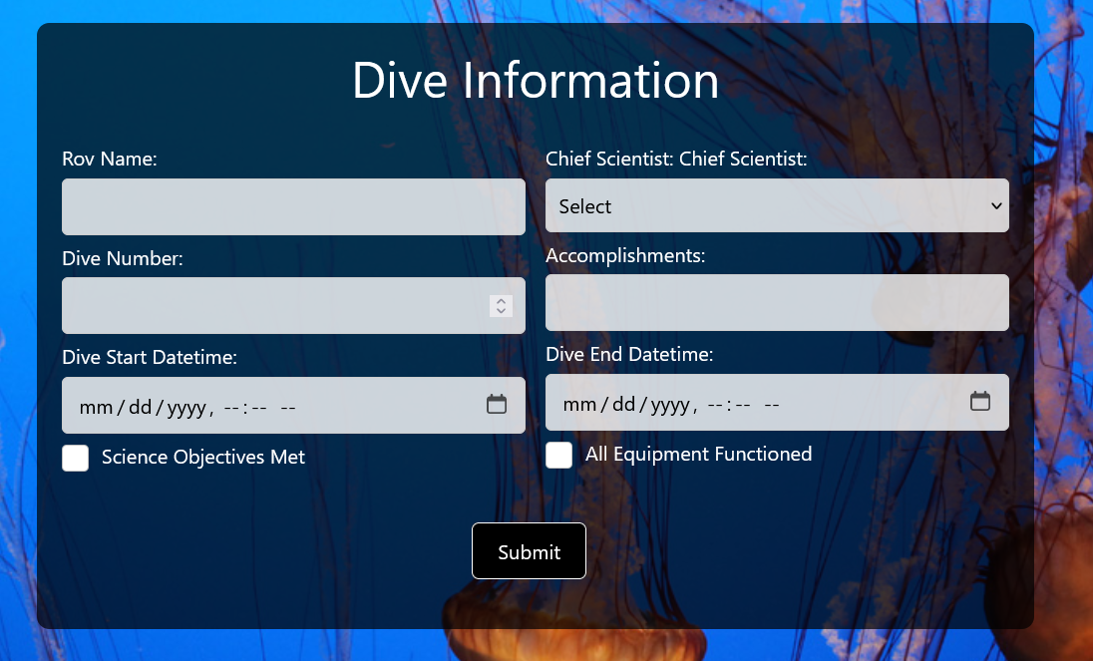
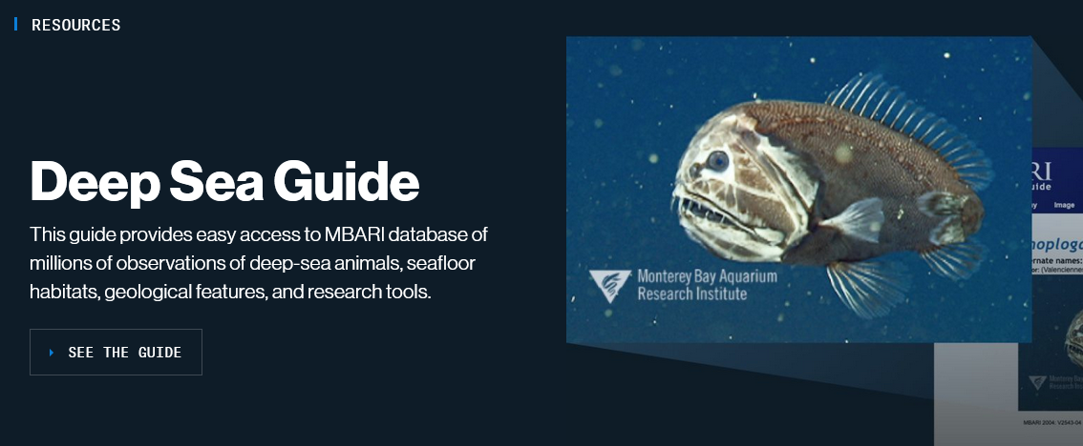
THE FRONTEND
Our Site
A mix of HTML, CSS, and Bootstrap
  Gives the site a modern feel
  Easy JavaScript Integration
Used MBARI’s site for design inspiration
  Dark Colors with white text
  Lots of sea creatures
MBARI’s Site
Notes:
Assigned to - Betsy
With a mix of HTML, CSS, and Bootstrap, we’ve given the site a modern look and feel. These tools also easily integrate with JavaScript to interact with the back end.
We used MBARI’s website as inspiration, with lots of dark colors, white text, and high-quality photos of Marine life.

Slide 5
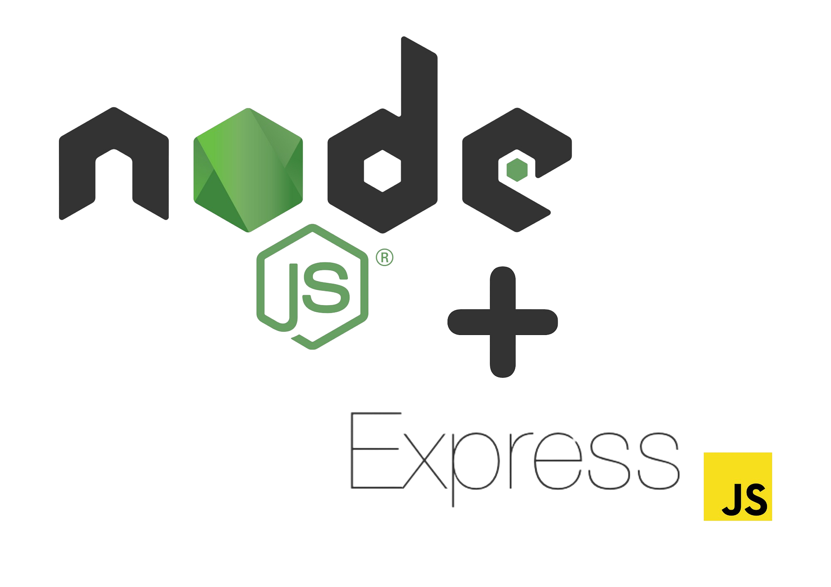
THE BACKEND
Node JS
  High performance in real time
  Allows for multiple connections
  Scalability
Express JS
  Allows for middleware
  Makes routing less complicated
Commonly used backend framework
  Will be supported for years to come
  Easy to approach for beginners
Notes:
Assigned to - Michael
For our backend framework, we chose to use Node JS + Express JS. Node gave us high performance in real-time and supported multiple connections. It is also scalable, meaning a large organization like MBARI shouldn’t have problems implementing it on a larger scale.
Using express with node allowed for the use of middleware and made routing much less complicated by doing a lot of the work in the background.
Node + express is a very commonly used backend framework, meaning it will be supported for years to come. It is also approachable for beginners. This ensures that future developers can build off of our work. It is also very versatile for different types of databases.

Slide 6
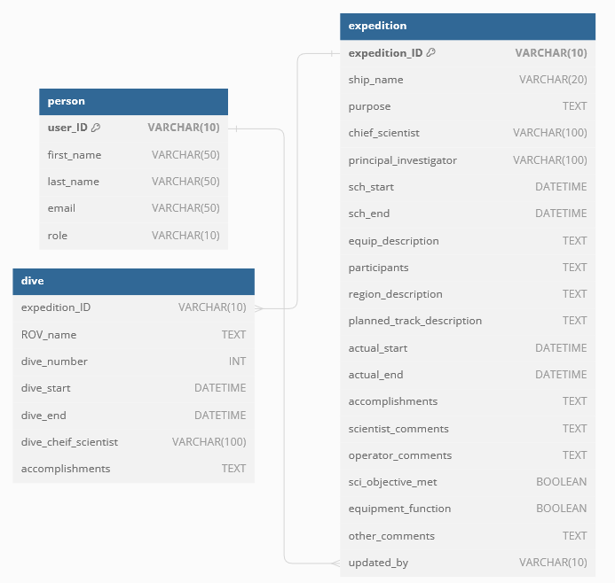
THE DATABASE
Relational Database built in MySQL
  Provides ease of use vs non relational
  Can be updated and modified easily
Simple three table design
  Makes the database approachable
  Easier to work with in the backend
Multiple revisions
  Mentor feedback and comments
  Functionality
Notes:
Assigned to - Leah
Our database went through multiple revisions as we got feedback and comments from our mentor. We landed on a three-table relational database we built in MySQL. By having just three tables, we’ve ensured that the database is approachable and easy to integrate into the web app. The expedition table covers everything about an expedition, from planning to completion. The dive table keeps track of the dives for each expedition. And finally, the person table keeps track of user information like name, role, and ID number.

Slide 7
REFLECTION // FUTURE WORK
Reflection:
  First greenfield project
  Experience in full stack development
  Working with a client
Future Work:
  Full testing with Selenium
  Build a user facing interface to make changes to the database schema
  An inbox system for cruise approval
Notes:
Assigned to - Betsy & Michael
Reflection:
This was all of our first time working on a greenfield project. Building this system from the ground up gave us full-stack development experience and also taught us to work with a client to meet their specific needs.
Future work:
We originally wanted to test our website with selenium but ran out of time to do so.
There are a few things that could be added to this project in the future but that we did not originally plan for, including:
A user interface to facilitate smoother updates to the database schema and web app (Schema Evolution)
An inbox system to notify logistics coordinators of cruises needing approval, as well as tell employees when their cruise requests have been approved.

Slide 8
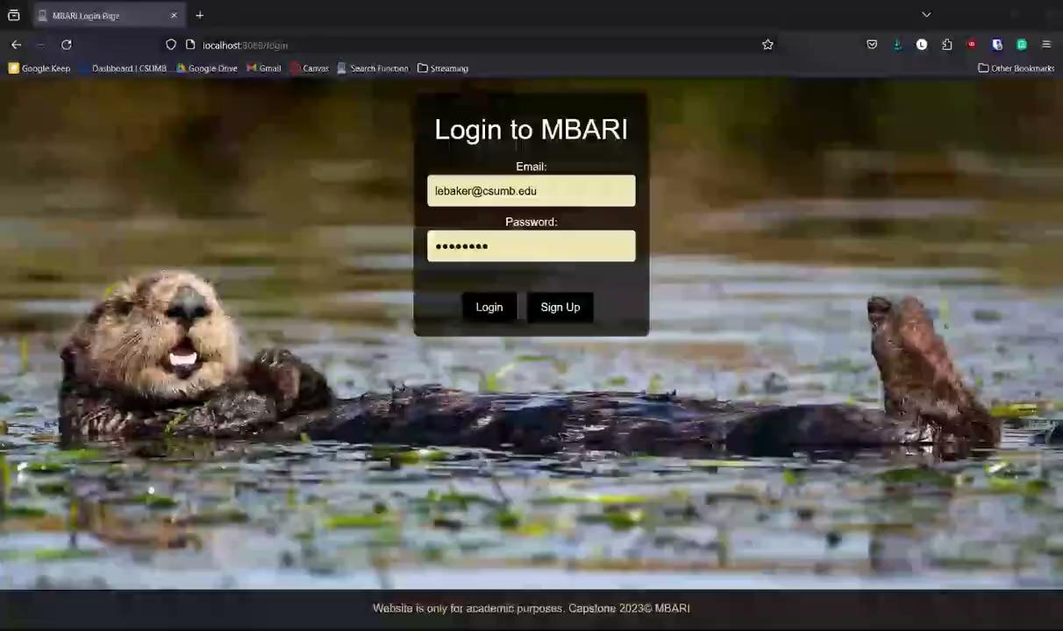
RESULTS
Notes:
demonstration (if applicable)
*DO WE WANT TO DEMO IN OUR PRESENTATION???

Slide 9
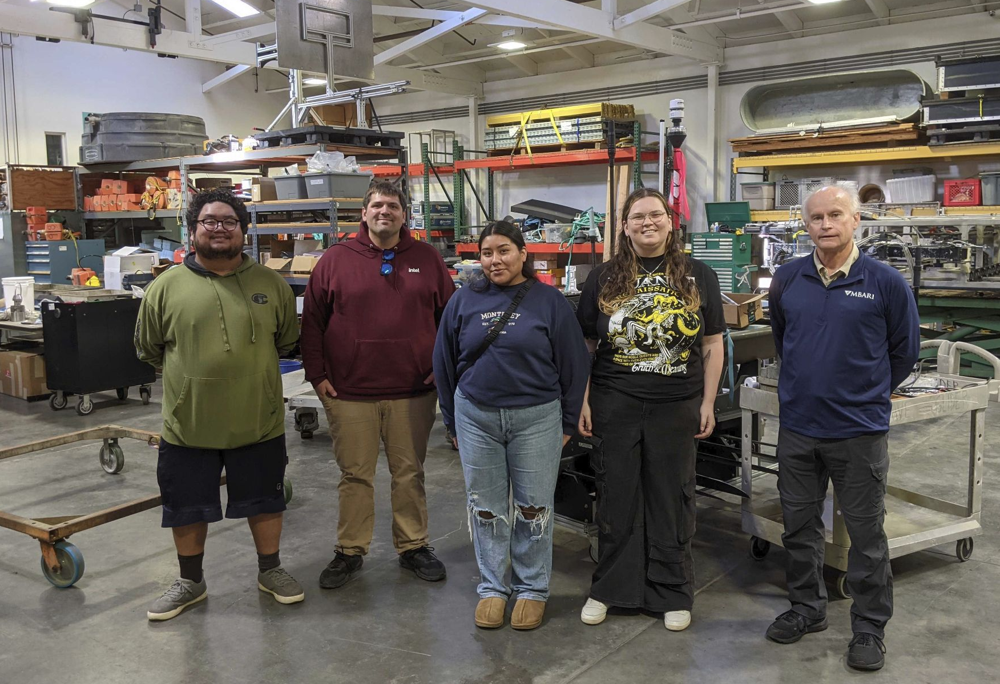
THANK YOU!
Special Thanks to our Mentor Mike McCann and the whole team at MBARI!
Notes:
Assigned to - Geoffrey
Thank you for your time, and a special thank you to our mentor, Mike McCann, and the whole team at MBARI for this opportunity.

