Slide 1

W&S VP Report
Marine Imaging Workshop
Monterey CA, USA, October 2025
Bill Kirkwood – Gerardo Acosta
IEEE OES AdCom Meeting: 14-15 June 2025, Brest, France

Slide 2
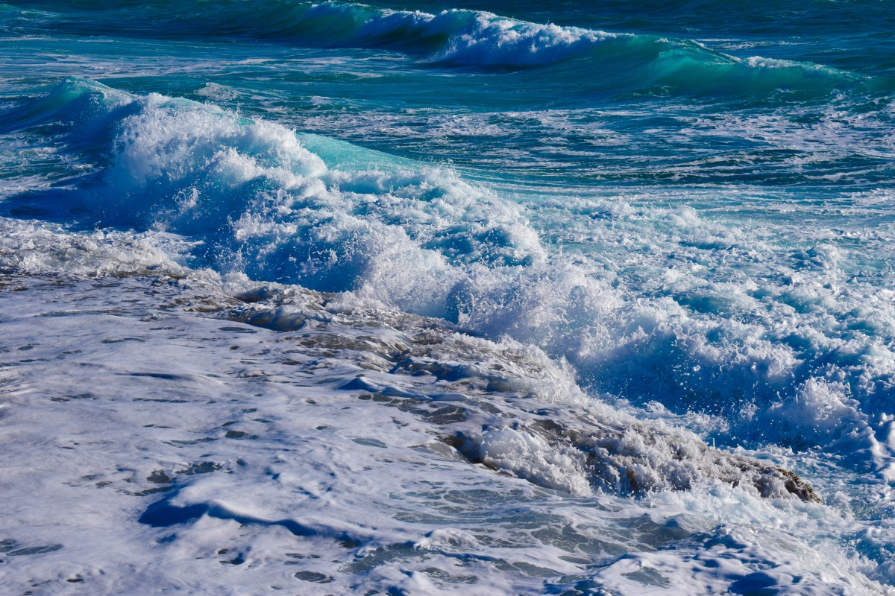
MIW 2024 - Monterey
Number of attendees (OES-non OES): 7 OES members, 173 non-members. (This will change as the new chair and team will need to join OES if they want our support – and they do)
Where were they from (international or US based): Norway, Scotland, British Columbia, Sweden, Ireland, Ontario Canada, New Zealand, Japan, Galapagos, England, France, South Africa, Germany, Denmark, Brazil, Newfoundland, Gibraltar, Tasmania, Australia, Japan, China, Nova Scotia, and from the US we had people from 17 different states including Washington DC.
How many presentations: 19 talks, 100 posters in 2 sessions, 6 breakout sessions/tutorials nothing submitted to JOE
Student branch chapter: none
OES chapter: none
IEEE OES AdCom Meeting: 14-15 June 2025, Brest, France

Slide 3
MIW 2024 - Monterey
Registration fee: Full reg $700 USD, Early bird $550, Student $350, Online $100 (we won’t do online again)
If financial supported, main use of the money: We hjad a loan from OES and paid it back.
Financial outcome: Slight surplus around $3500 (I’ll get the exact amount when I get home.
Will it be repeated? When?: It will be repeated, with or without OES. They are shooting for Spring of 2026
Please mention if there were inconveniences with the IEEE support – No more than the usual.
IEEE OES AdCom Meeting: 14-15 June 2025, Brest, France

