Slide 1

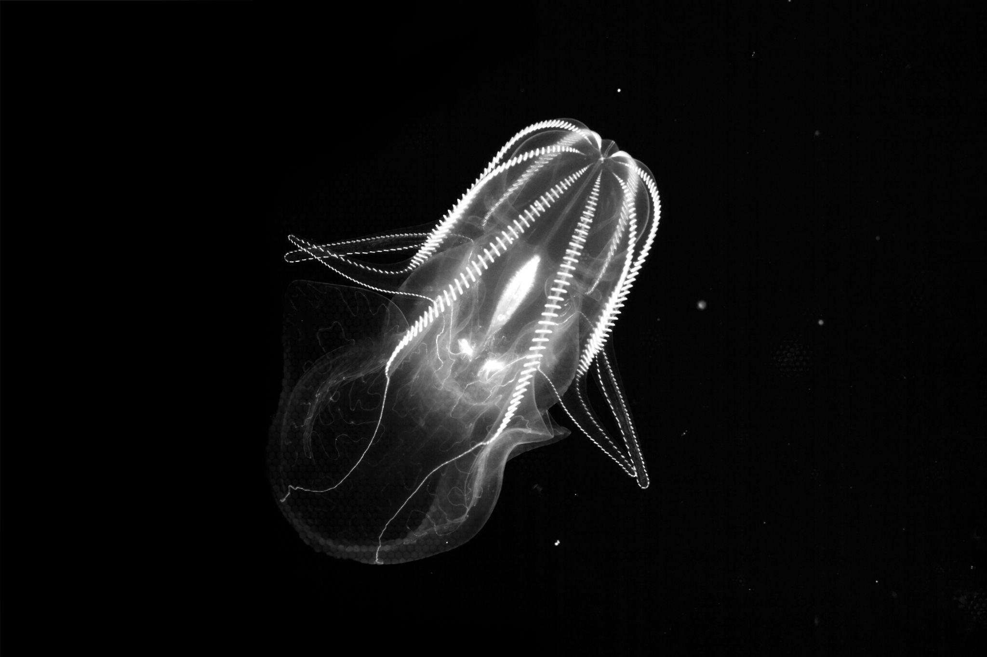
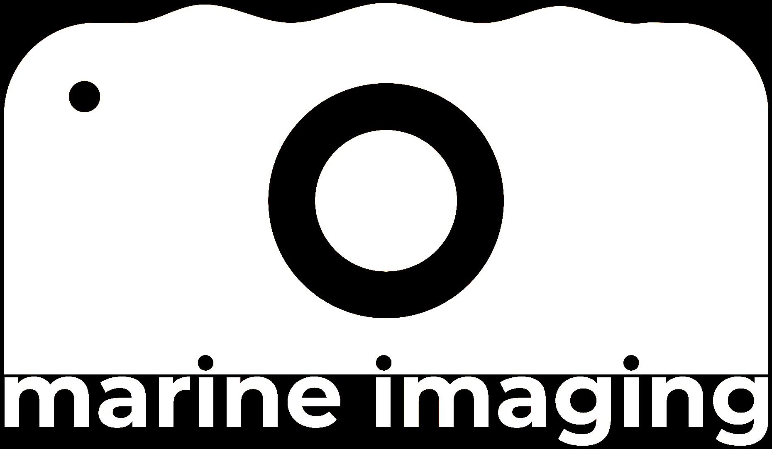

30 + talks
75 + posters with 3 minute lightning talks
3 Workshops
Lots of interactive time
Local events
5th Marine Imaging Workshop
(#MIW24)
Program now online!
October 7th to 10th 2024
Monterey Convention Center, CA
Image credit:
MBARI’s Bioinspiration Lab

