Slide 1
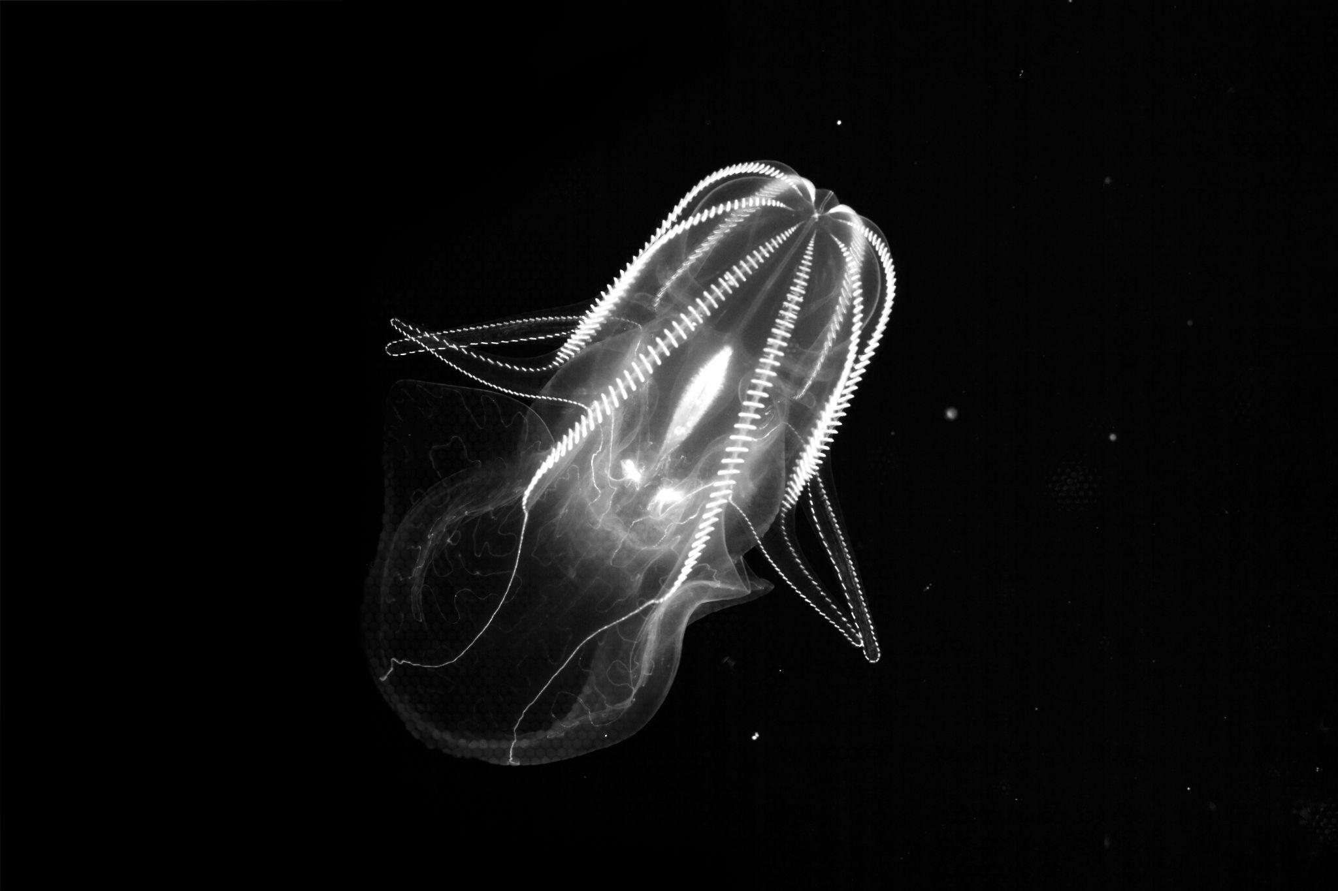

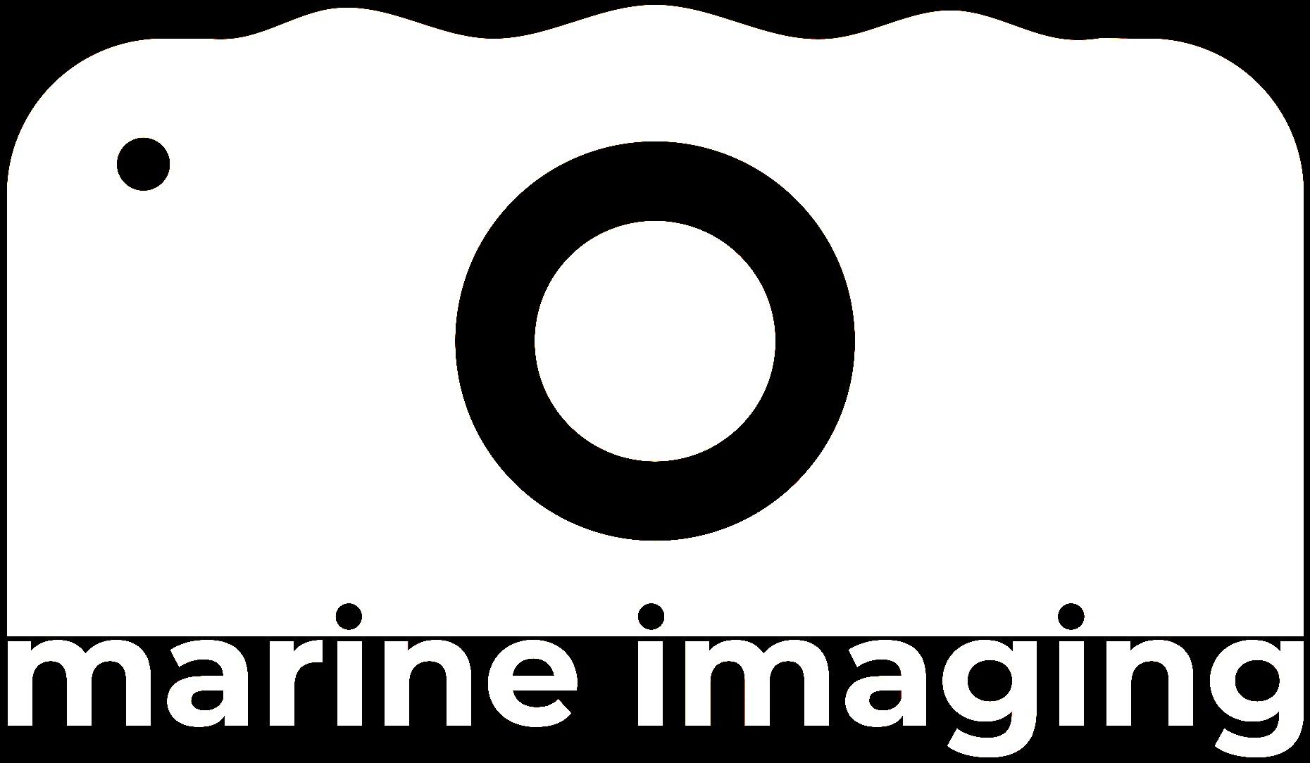

5th Marine Imaging Workshop
(#MIW24)
October 7th to 10th 2024
Monterey Convention Center, CA
Image credit:
MBARI’s Bioinspiration Lab

