Slide 1

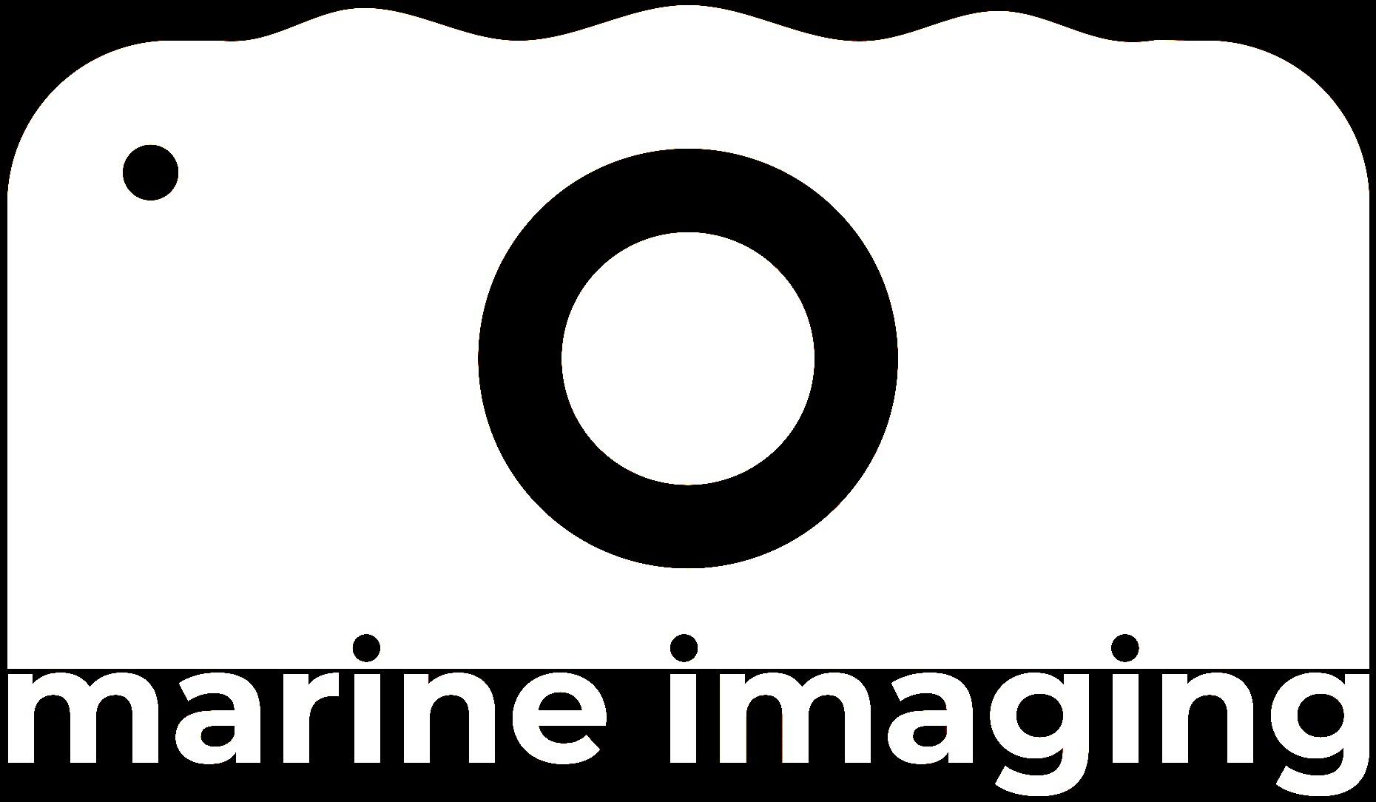

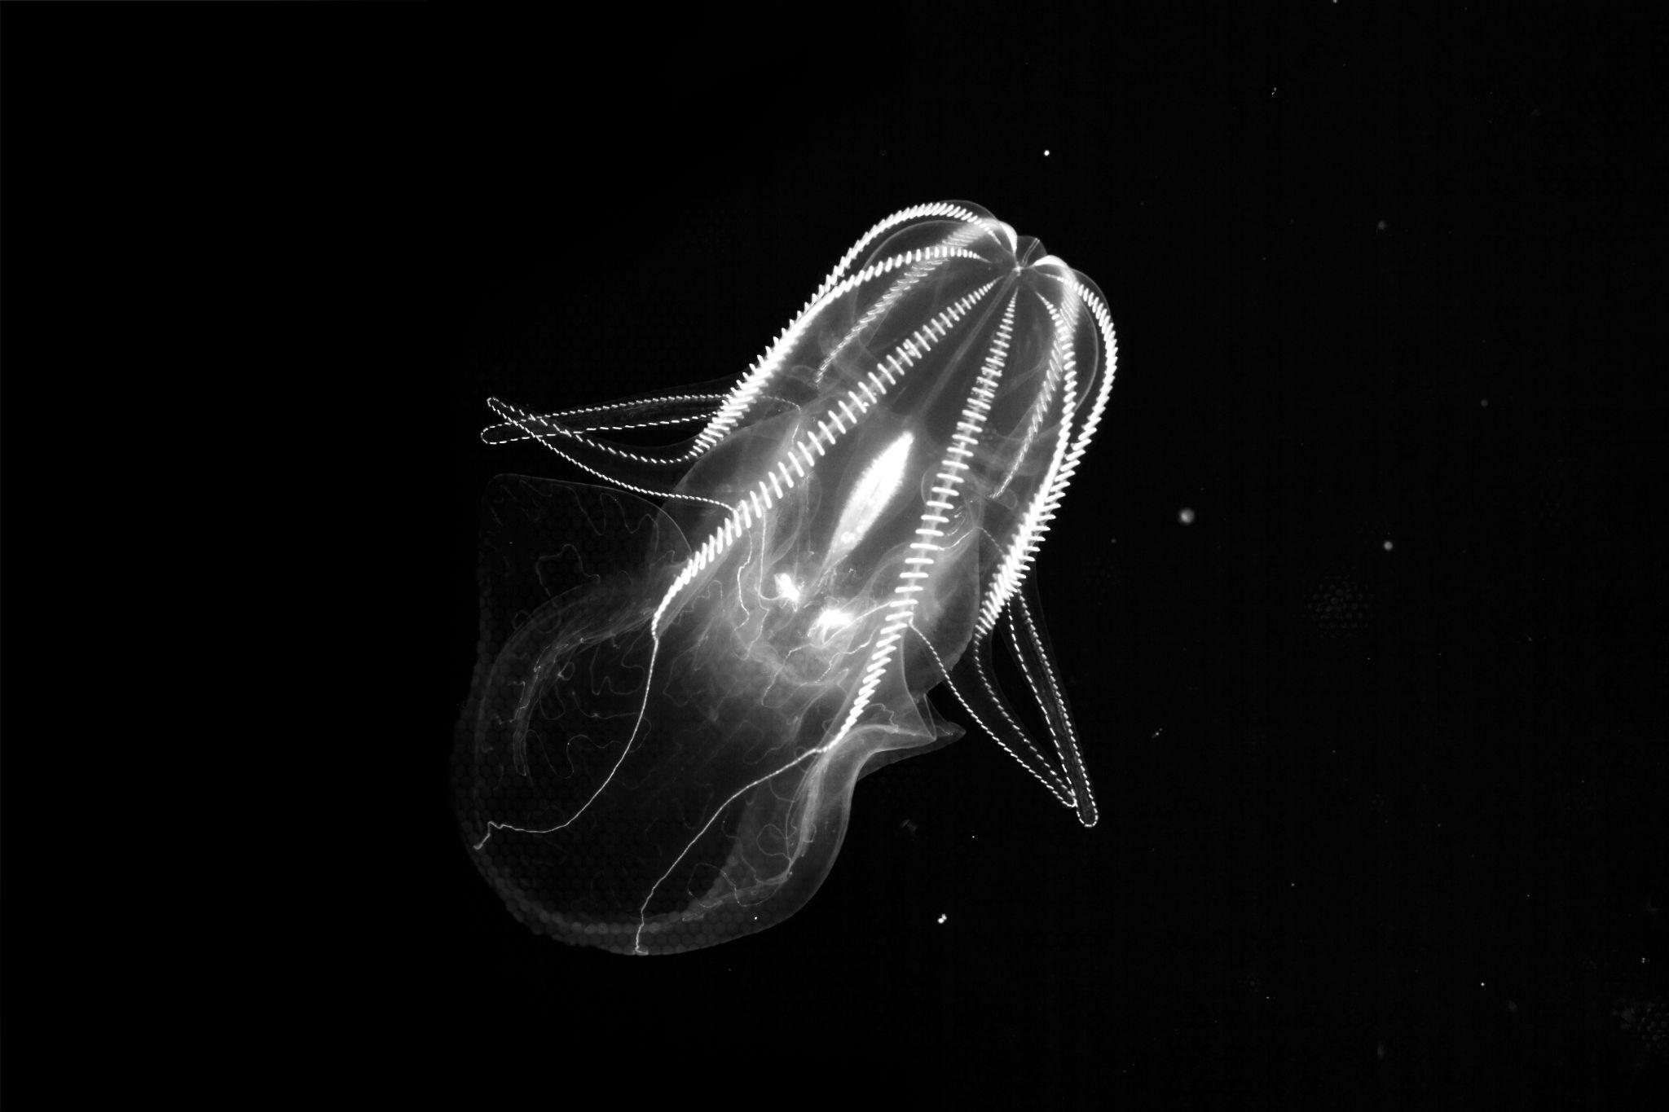
5th Marine Imaging Workshop
(#MIW24)
Coming to Monterey, CA
Fall 2024
Image credit:
MBARI’s Bioinspiration Lab

