Slide 1
902404 Marine Imaging Workshop
Marine Imagery is fundamental to ocean science and the largest quantity of data.
Using imagery to understand the ocean and it’s changing conditions is a primary method across all science disciplines
MBARI is a recognized leader in marine imagery and now working with IEEE’s Oceanic Engineering Society we are looking to advance further the field for all types of marine imagery
In the Fall of 2024 IEEE-OES, working with the research staff of MBARI, will bring together scientists and engineers in Monterey to share the current state of the art and discuss future plans for Marine Imagery in a meeting every other year
A guiding principal we are trying to establish for imagery data and community is FAIR making science data findable, accessible, inter-operational and reusable.

Slide 2

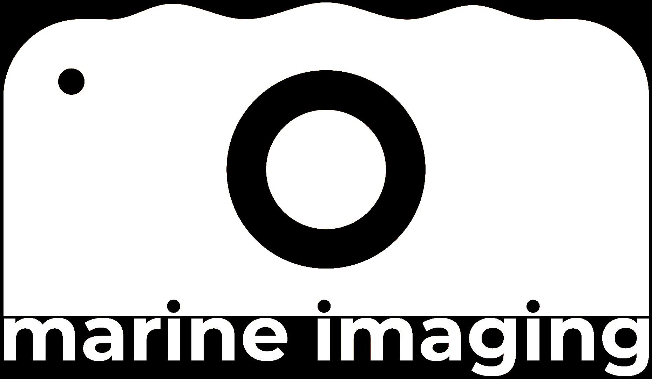
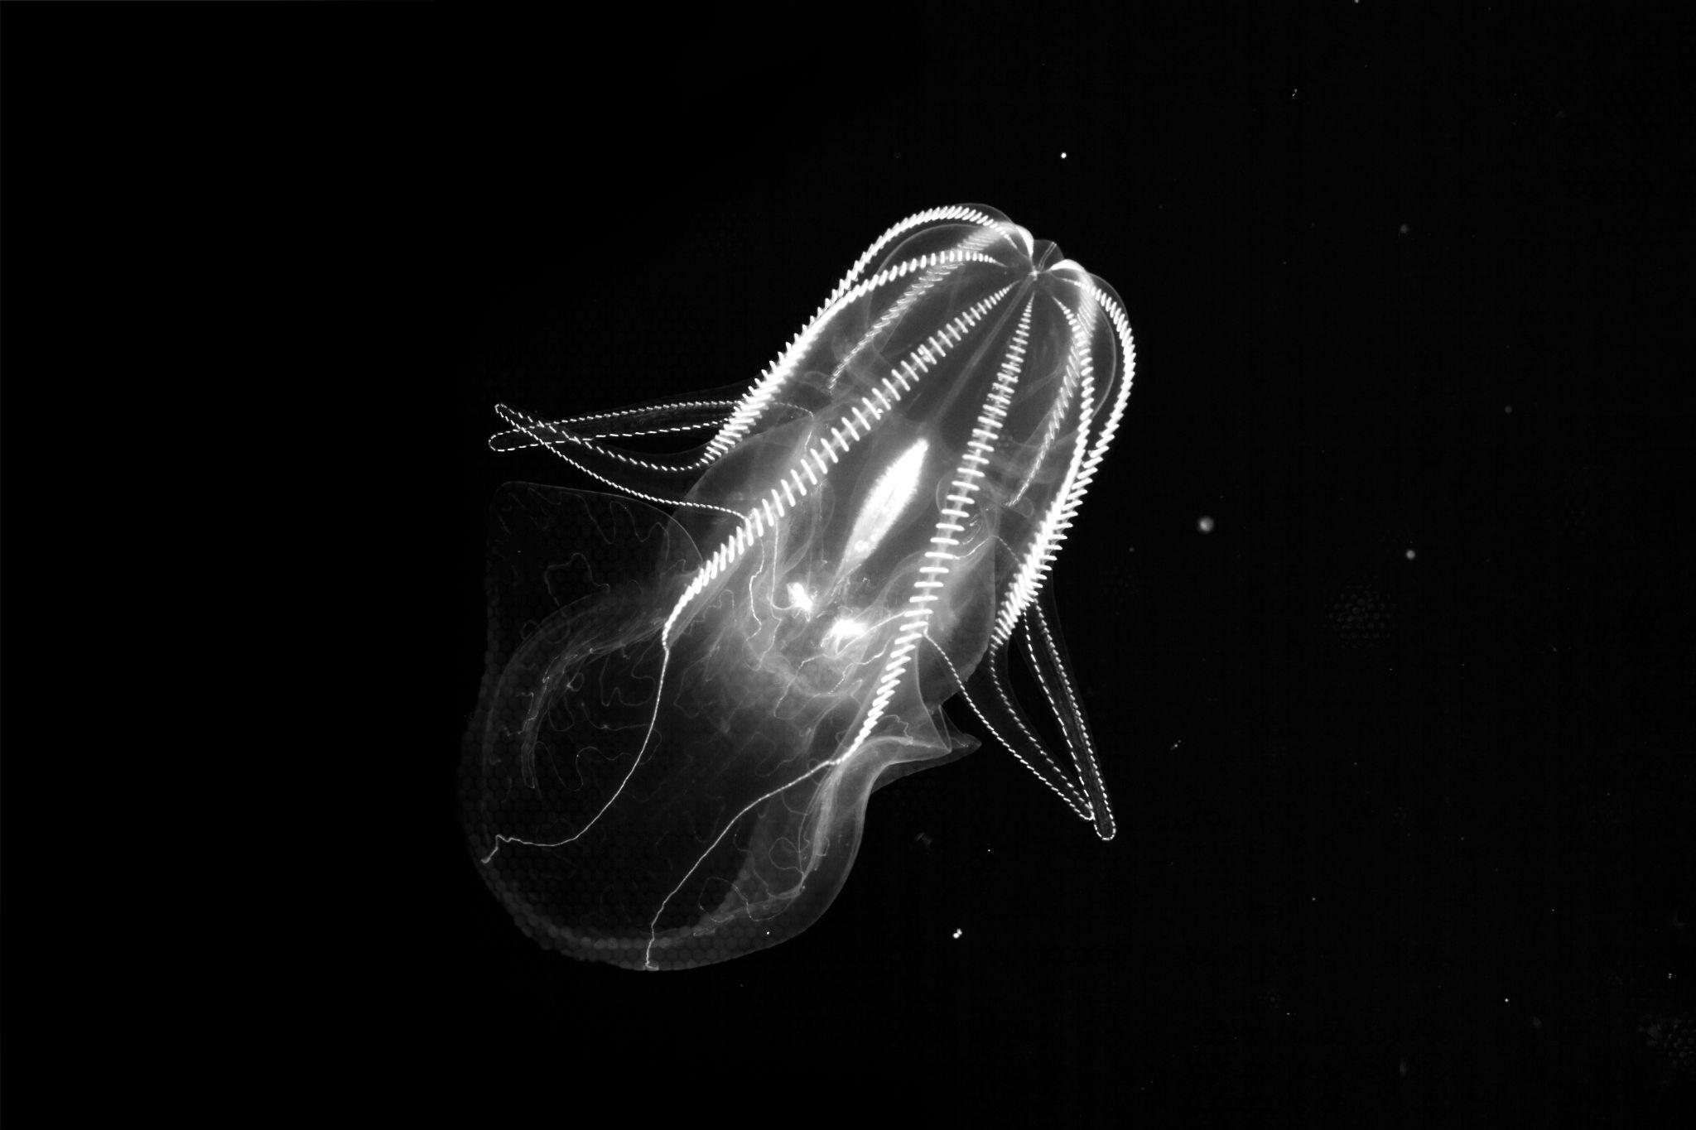

902404 Marine Imaging Workshop
5th Marine Imaging Workshop
(#MIW24)
October 7th to 10th 2024
Monterey Convention Center, CA
Image credit:
MBARI’s Bioinspiration Lab

