Slide 1
Dealing with the Data Deluge
Past: Building on a Rich History
Kevin Gomes, John Ryan, Kakani Katija

Slide 2
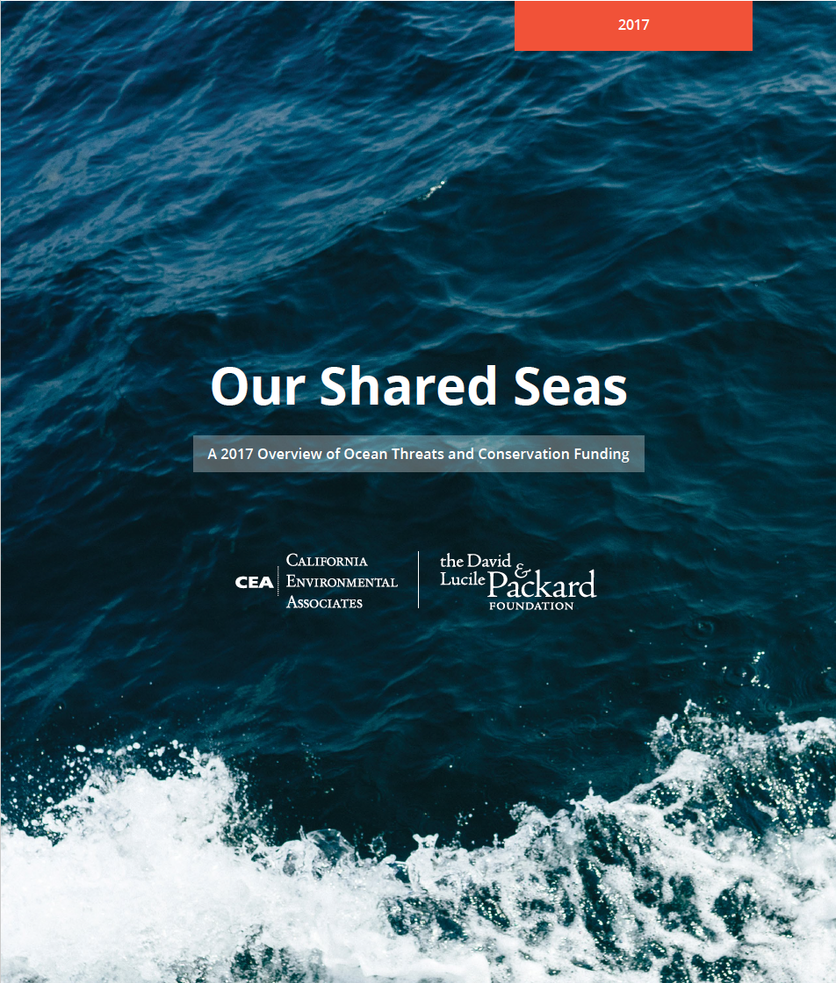
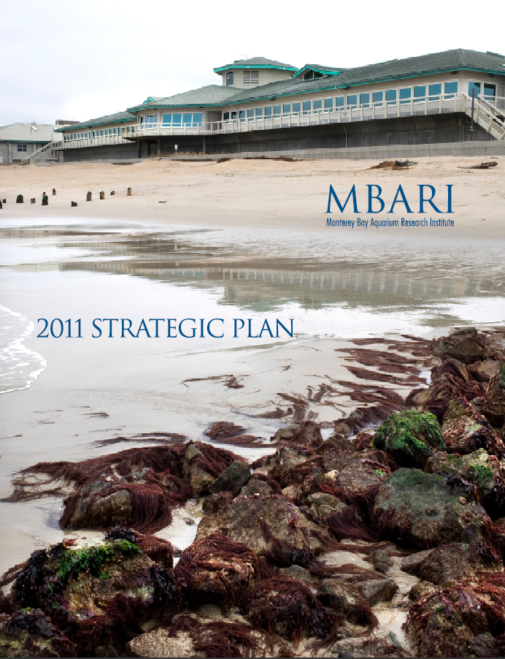
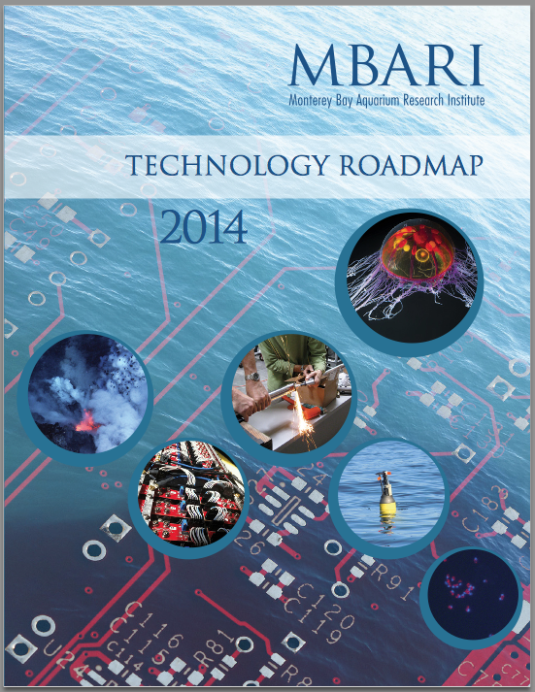
Defining the goals for data
Improving scientific capacity to understand and manage all of these compounding pressures
Seamlessly merge molecular, biological and environmental data
Assimilate observations into four-dimensional, coupled physical and biological models
Develop tools to preserve, explore, and mine multi-disciplinary data sets
Notes:
Note that we are giving them these documents.
Four organizational themes:
Biogeochemical Cycles
Ecosystem Processes
Ocean Visualization
Exploration and Discovery
Three tactics:
Consider priorities of the Aquarium and Packard Foundation
Leverage collaborations/grants
Promote E&O and tech transfer

Slide 3
To achieve those goals
Data Management
Data Integration
Data Access

Slide 4
The pieces and processes
MBARI
Storage
  5 clustered storage servers
  520 TB of storage
  40 Gb client connections
  LTO tape library = 10 PB storage
Expandable
  Add 5.6 PB in current space
  Another frame adds 15.8 PB
  Could expand with more
  physical space
Compute (VMWare)
Databases (RDBMS, NoSQL, etc.)
Storage (IBM Titan)
Network

Slide 5
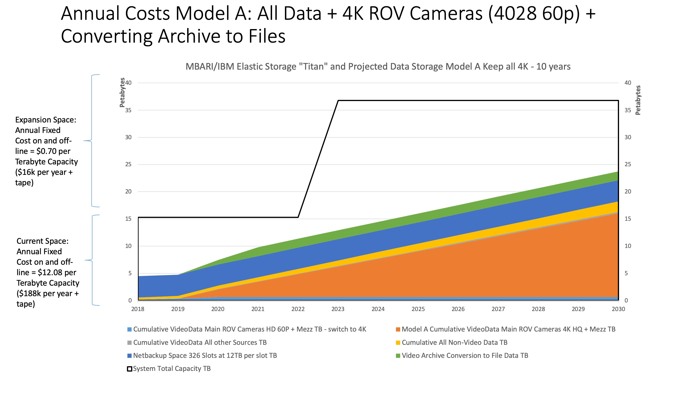

Slide 6
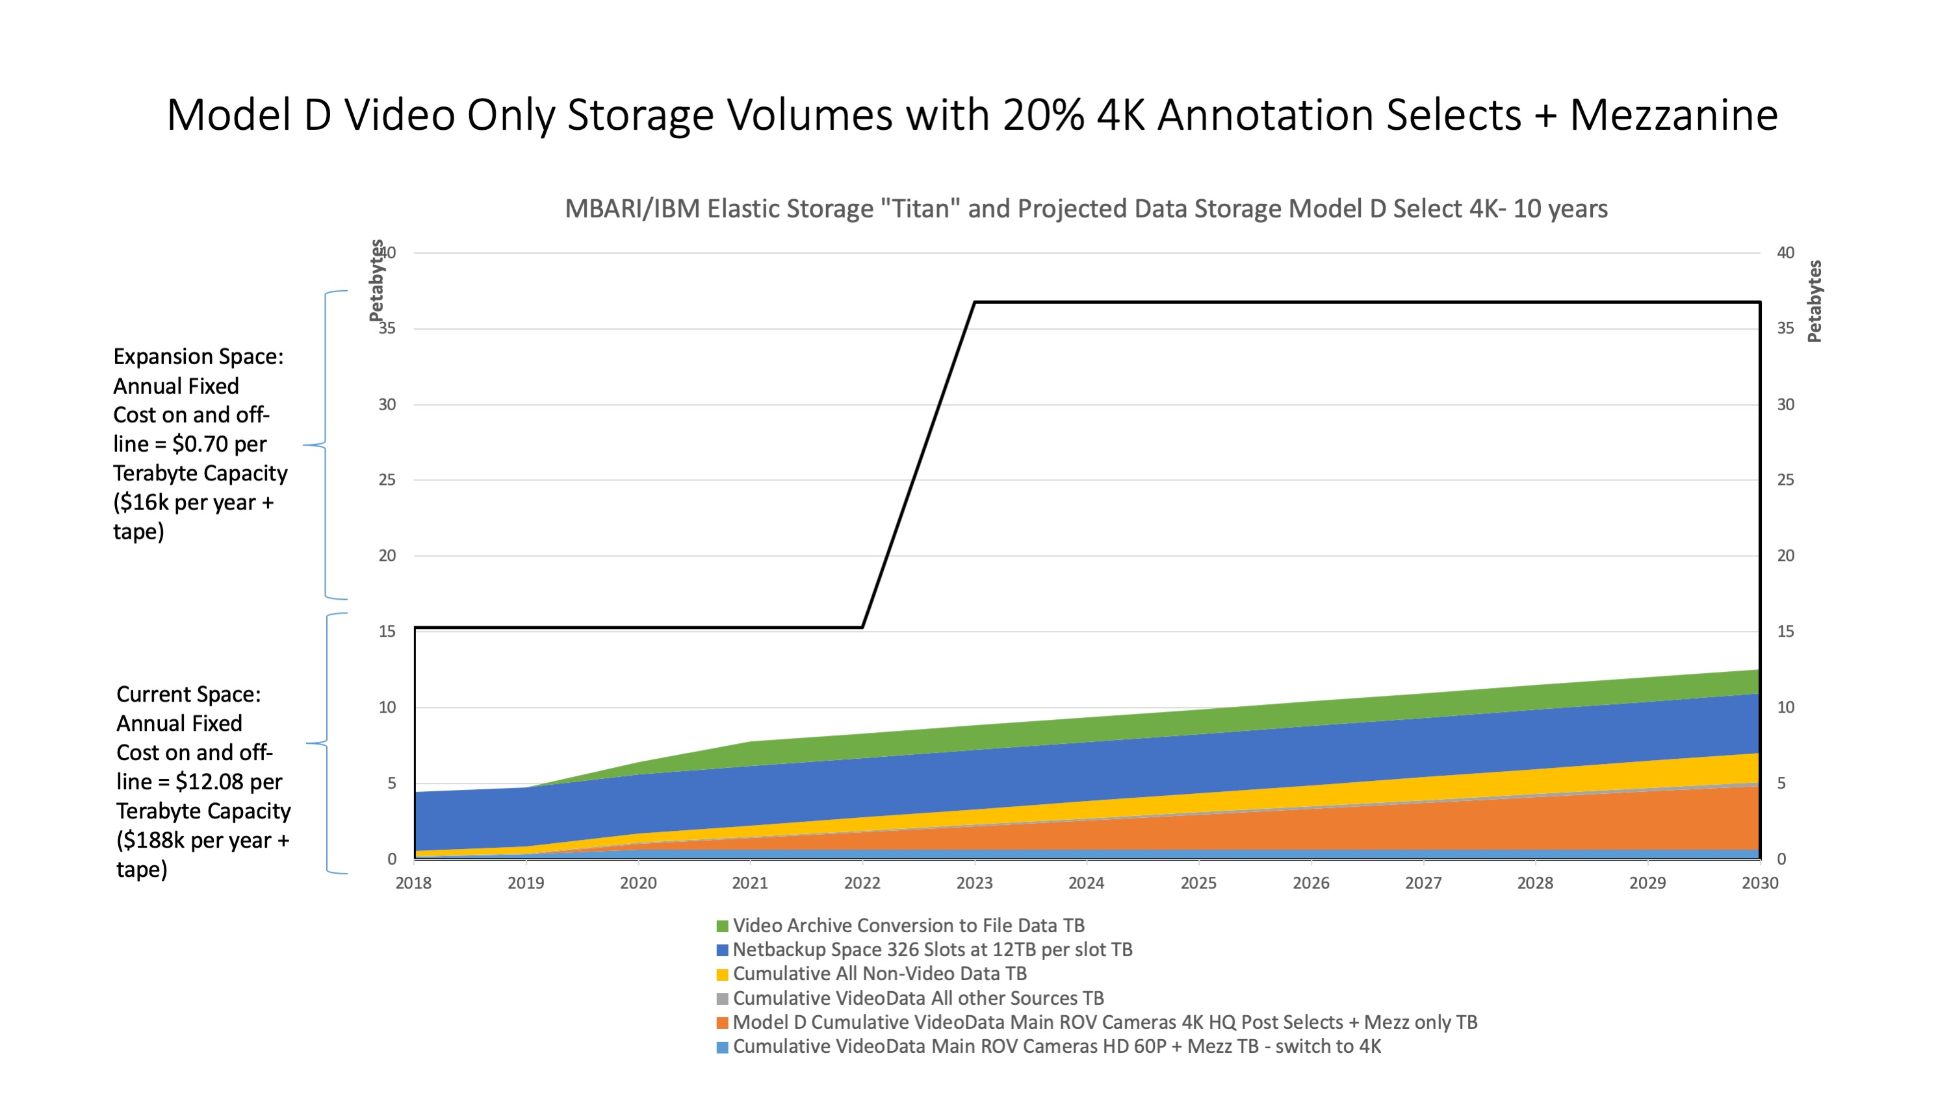

Slide 7
The pieces and processes
MBARI
Compute
  VMWare vSphere
  6 physical hosts
  384 virtual processors
  2.3 TB of RAM across cluster
  50 TB for VM local disks
Expandable
  Can add more RAM to increase
  memory capacity
  Can add more hosts to increase
  processor counts
  Can add more storage shelves to
  increase VM local disk space
Compute (VMWare)
Databases (RDBMS, NoSQL, etc.)
Storage (IBM Titan)
Network

Slide 8
The pieces and processes
MBARI
Leveraging Cloud Resources
  Will be times we need cloud
  Large, parallel, ephemeral jobs
  Unique hardware architectures
  Unique services
Network Crucial
  Currently at 1Gb
  Expandable to 10Gb
Cloud (AWS, GCP, Azure)
Containers (Docker)
Containers (ECS/EKS, GCE, AC)
Compute (VMWare)
Compute (EC2, GCE, Azure)
Databases (RDBMS, NoSQL, etc.)
Databases (RDS, DynamoDB, etc.)
Storage (IBM Titan)
Storage (S3, GCS, AS)
Network
Network

Slide 9
The pieces and processes
MBARI
Application level
  Data sources and applications
  Labs, platforms, instruments, processes
Integration applications
  Experiment/collaboration management
  Data integration
Integration and Collaboration Apps (ODSS, STOQS)
Applications (BOG, VARS, Dorado, ESP, etc.)
Cloud (AWS, GCP, Azure)
Containers (Docker)
Containers (ECS/EKS, GCE, AC)
Compute (VMWare)
Compute (EC2, GCE, Azure)
Databases (RDBMS, NoSQL, etc.)
Databases (RDS, DynamoDB, etc.)
Storage (IBM Titan)
Storage (S3, GCS, AS)
Network
Network

Slide 10
The pieces and processes
Data Services
CeNCOOS (IOOS)
IOOS DAC
SOCCOM
MBARI
NOAA / NDBC
Genomic Databases
Berkeley Seismology Network
…
Leverage external data services
Integration and Collaboration Apps (ODSS, STOQS)
Applications (BOG, VARS, Dorado, ESP, etc.)
Cloud (AWS, GCP, Azure)
Containers (Docker)
Containers (ECS/EKS, GCE, AC)
Compute (VMWare)
Compute (EC2, GCE, Azure)
Databases (RDBMS, NoSQL, etc.)
Databases (RDS, DynamoDB, etc.)
Storage (IBM Titan)
Storage (S3, GCS, AS)
Network
Network

Slide 11
The pieces and processes
Data Services
Catalog and Access (FAIR)
CeNCOOS (IOOS)
ERDDAP
HYRAX
Jupyter
Custom
…
IOOS DAC
SOCCOM
MBARI
NOAA / NDBC
Genomic Databases
Berkeley Seismology Network
…
Integration and Collaboration Apps (ODSS, STOQS)
Applications (BOG, VARS, Dorado, ESP, etc.)
Cloud (AWS, GCP, Azure)
Containers (Docker)
Containers (ECS/EKS, GCE, AC)
Compute (VMWare)
Compute (EC2, GCE, Azure)
Databases (RDBMS, NoSQL, etc.)
Databases (RDS, DynamoDB, etc.)
Storage (IBM Titan)
Storage (S3, GCS, AS)
Network
Network

Slide 12
The pieces and processes
Data Services
Catalog and Access (FAIR)
CeNCOOS (IOOS)
Stakeholders
Requirements
Prototype
IOOS DAC
ERDDAP
HYRAX
Jupyter
Custom
…
SOCCOM
MBARI
NOAA / NDBC
Genomic Databases
Integration Architecture
Berkeley Seismology Network
…
Integration and Collaboration Apps (ODSS, STOQS)
Applications (BOG, VARS, Dorado, ESP, etc.)
Cloud (AWS, GCP, Azure)
Containers (Docker)
Containers (ECS/EKS, GCE, AC)
Compute (VMWare)
Compute (EC2, GCE, Azure)
Databases (RDBMS, NoSQL, etc.)
Databases (RDS, DynamoDB, etc.)
Storage (IBM Titan)
Storage (S3, GCS, AS)
Network
Network

Slide 13
The pieces and processes
Data Services
Catalog and Access (FAIR)
CeNCOOS (IOOS)
Stakeholders
Requirements
Prototype
IOOS DAC
ERDDAP
HYRAX
Jupyter
Custom
…
SOCCOM
MBARI
NOAA / NDBC
Genomic Databases
Integration Architecture
Berkeley Seismology Network
…
Integration and Collaboration Apps (ODSS, STOQS)
Applications (BOG, VARS, Dorado, ESP, etc.)
Cloud (AWS, GCP, Azure)
Data Management
Containers (Docker)
Containers (ECS/EKS, GCE, AC)
Compute (VMWare)
Compute (EC2, GCE, Azure)
Databases (RDBMS, NoSQL, etc.)
Databases (RDS, DynamoDB, etc.)
Storage (IBM Titan)
Storage (S3, GCS, AS)
Network
Network

Slide 14
The pieces and processes
Data Services
Catalog and Access (FAIR)
CeNCOOS (IOOS)
Stakeholders
Requirements
Prototype
IOOS DAC
ERDDAP
HYRAX
Jupyter
Custom
…
SOCCOM
MBARI
NOAA / NDBC
Genomic Databases
Data Integration
Integration Architecture
Berkeley Seismology Network
…
Integration and Collaboration Apps (ODSS, STOQS)
Applications (BOG, VARS, Dorado, ESP, etc.)
Cloud (AWS, GCP, Azure)
Data Management
Containers (Docker)
Containers (ECS/EKS, GCE, AC)
Compute (VMWare)
Compute (EC2, GCE, Azure)
Databases (RDBMS, NoSQL, etc.)
Databases (RDS, DynamoDB, etc.)
Storage (IBM Titan)
Storage (S3, GCS, AS)
Network
Network

Slide 15
The pieces and processes
Data Services
Data Access
Catalog and Access (FAIR)
CeNCOOS (IOOS)
Stakeholders
Requirements
Prototype
IOOS DAC
ERDDAP
HYRAX
Jupyter
Custom
…
SOCCOM
MBARI
NOAA / NDBC
Genomic Databases
Data Integration
Integration Architecture
Berkeley Seismology Network
…
Integration and Collaboration Apps (ODSS, STOQS)
Applications (BOG, VARS, Dorado, ESP, etc.)
Cloud (AWS, GCP, Azure)
Data Management
Containers (Docker)
Containers (ECS/EKS, GCE, AC)
Compute (VMWare)
Compute (EC2, GCE, Azure)
Databases (RDBMS, NoSQL, etc.)
Databases (RDS, DynamoDB, etc.)
Storage (IBM Titan)
Storage (S3, GCS, AS)
Network
Network

Slide 16
Skills and Expertise
Should we talk about this here or in Kakani’s?
In house skill development
Collaboration
Bring in experienced hires

Slide 17
Questions?

