Slide 1
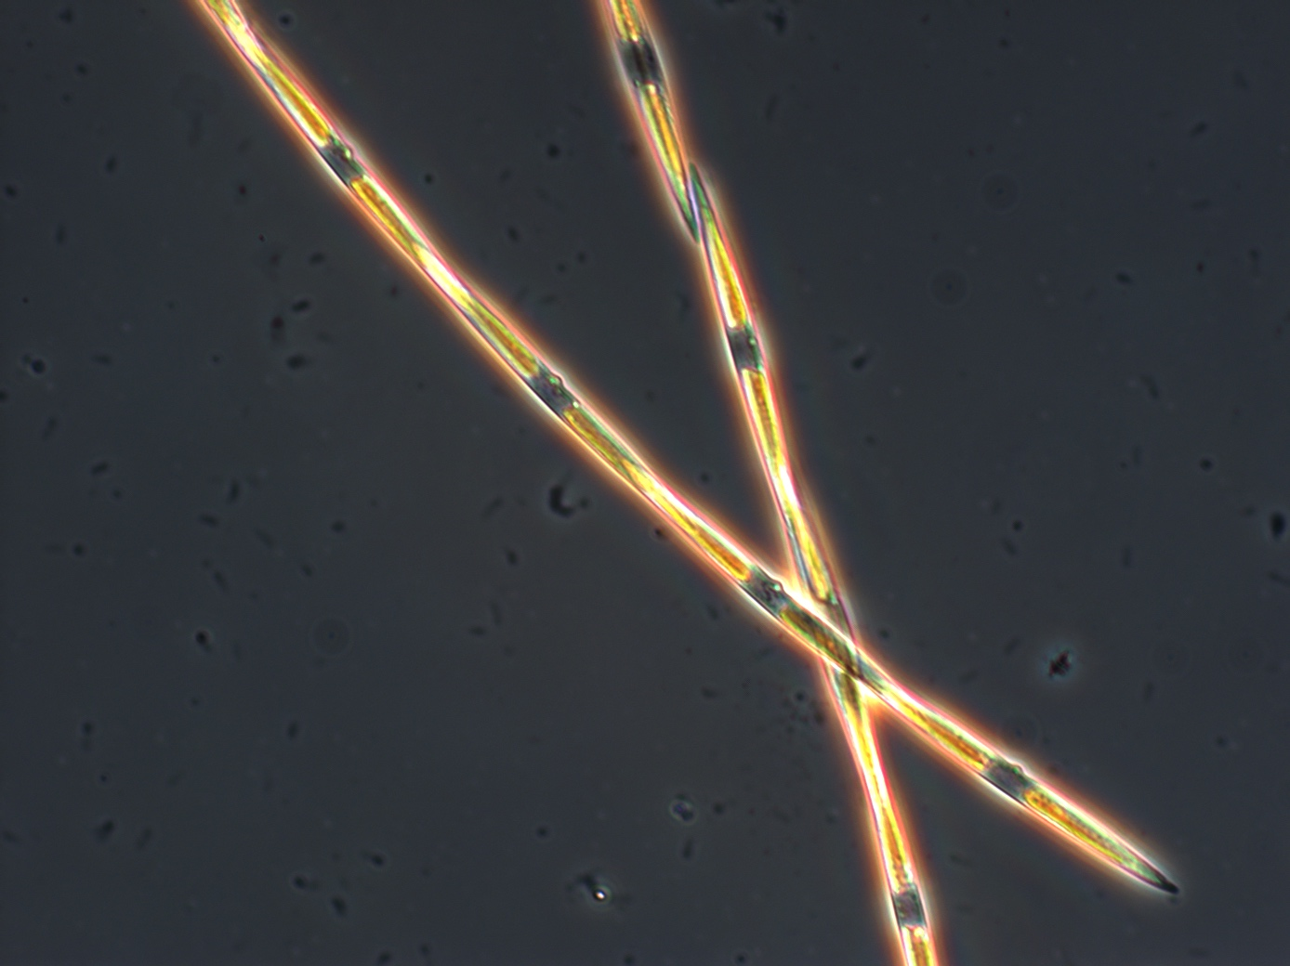
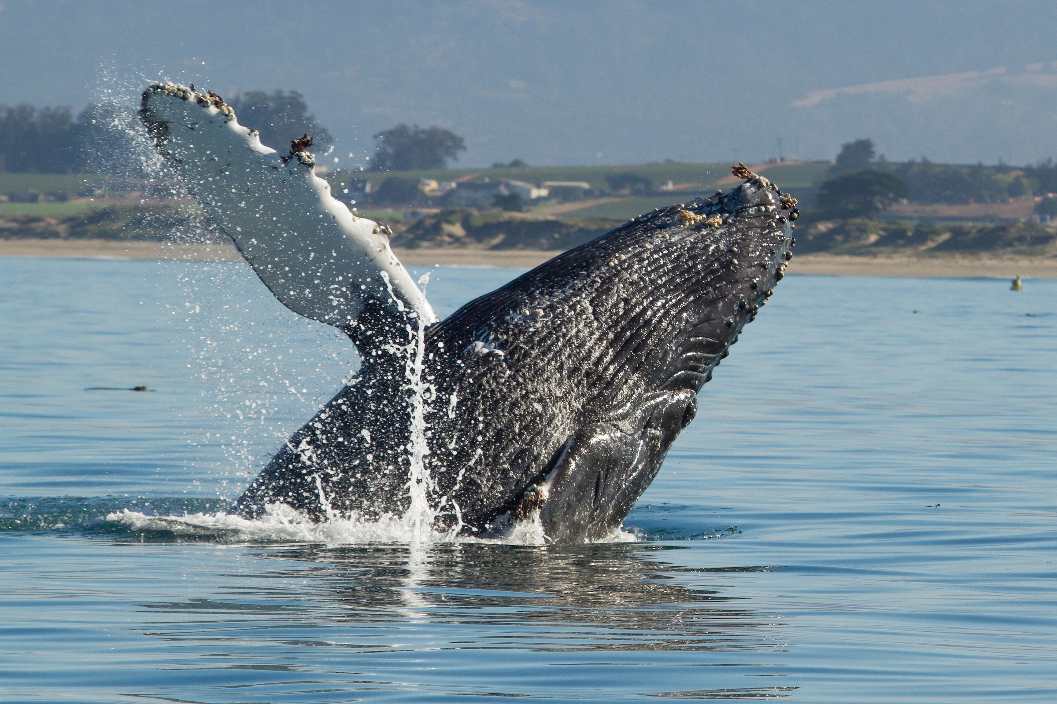
Data: Present – Impact

Slide 2
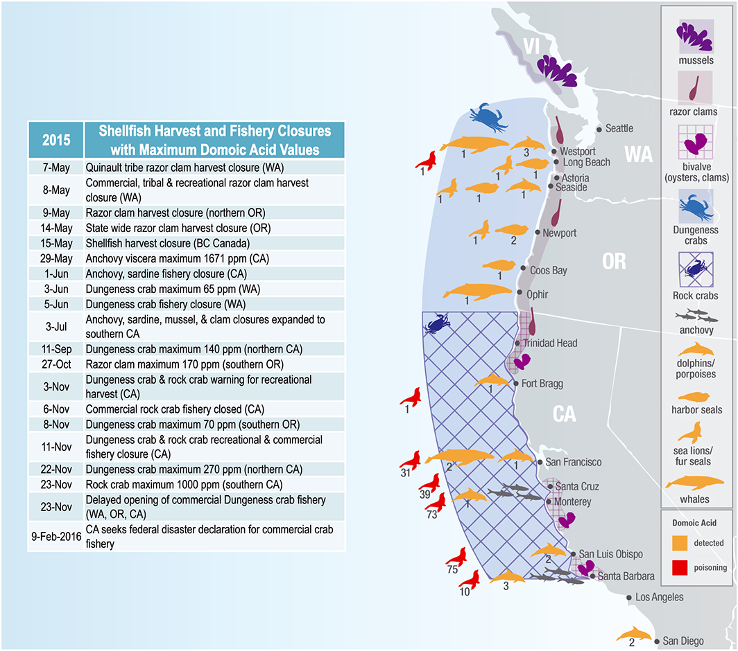
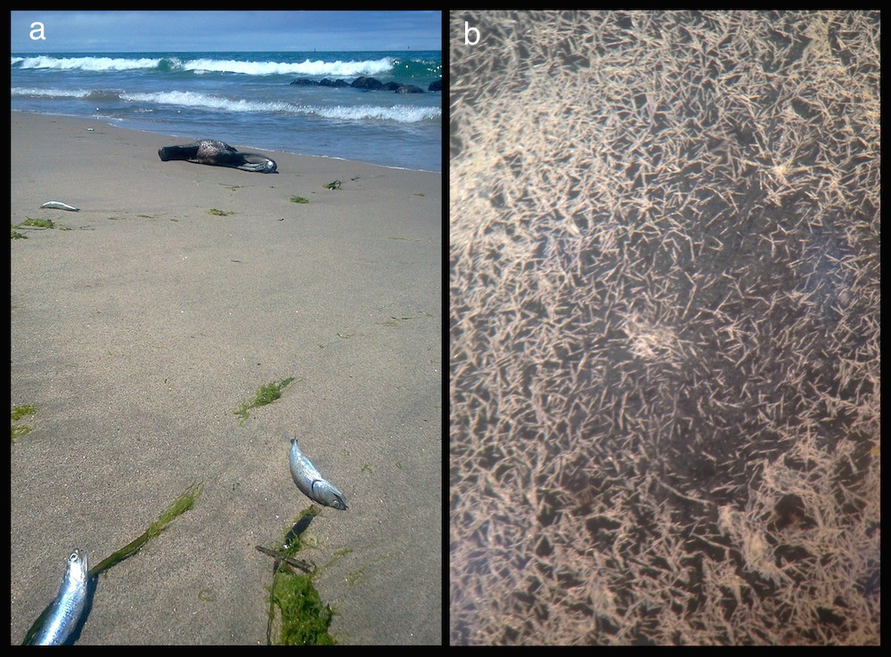
1. Harmful Algal Blooms (HABs)
McCabe et al., 2016
Ryan et al., 2017; Bowers et al., 2018

Slide 3
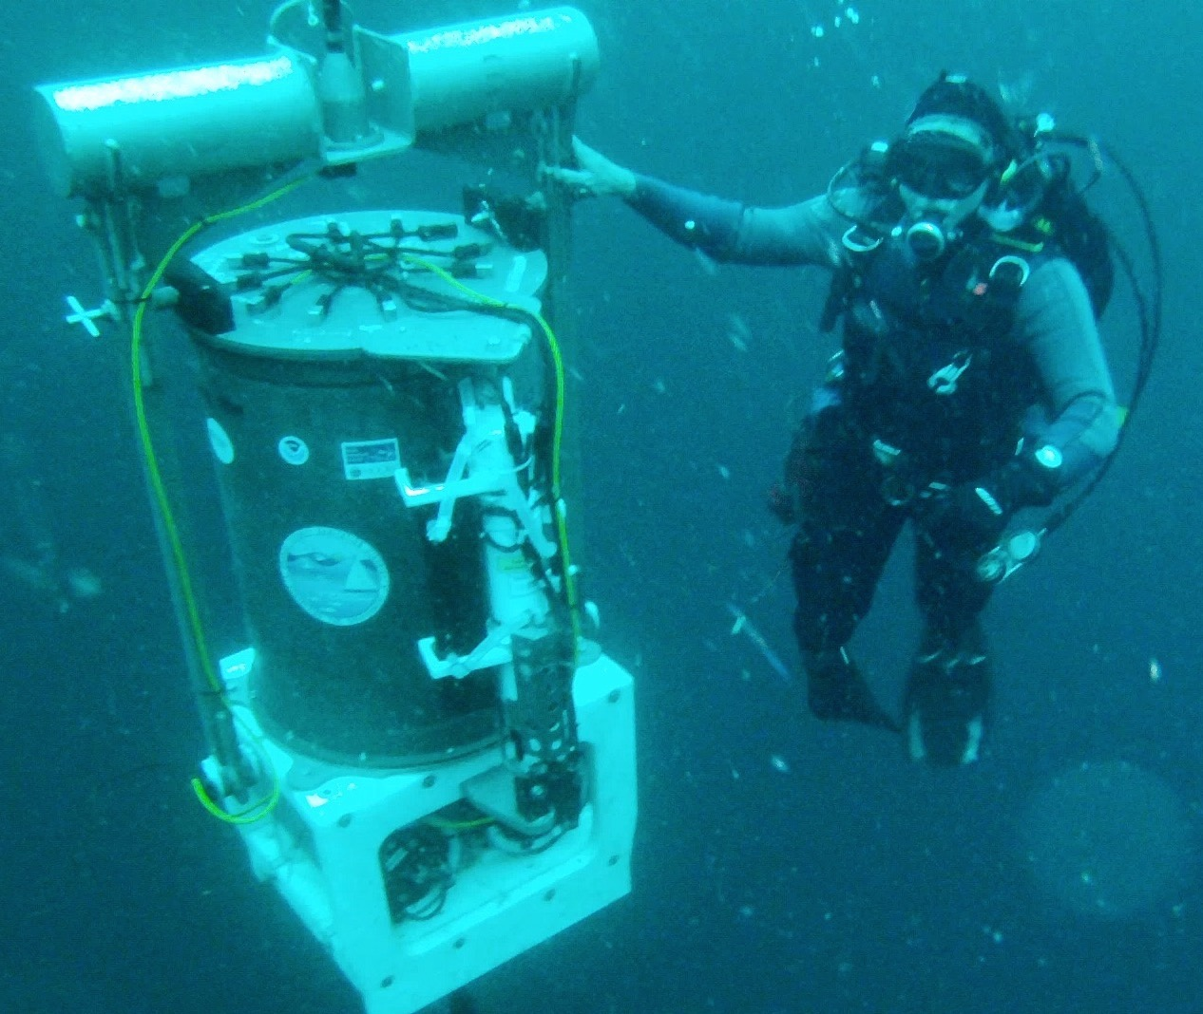
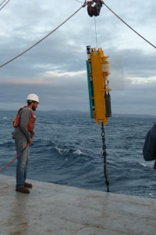
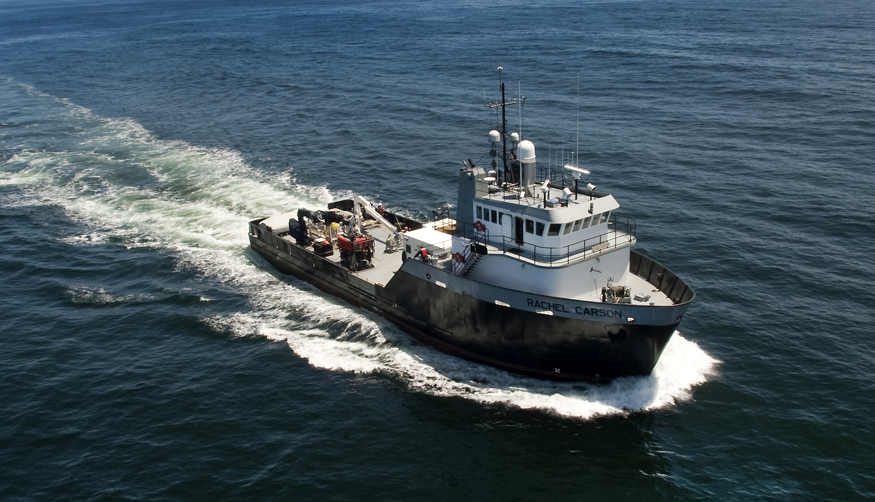
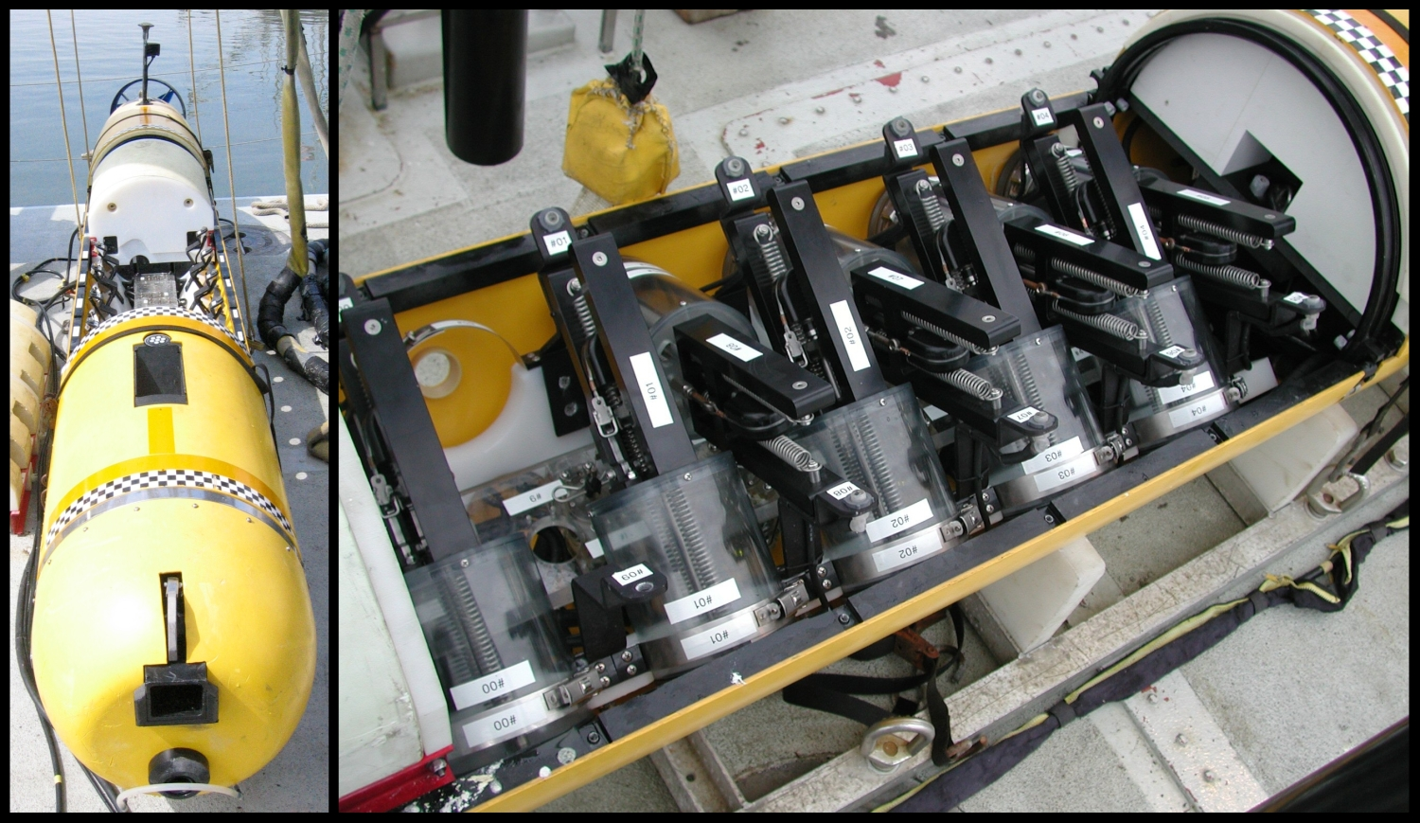
Impact: technology integration for effective research

Slide 4
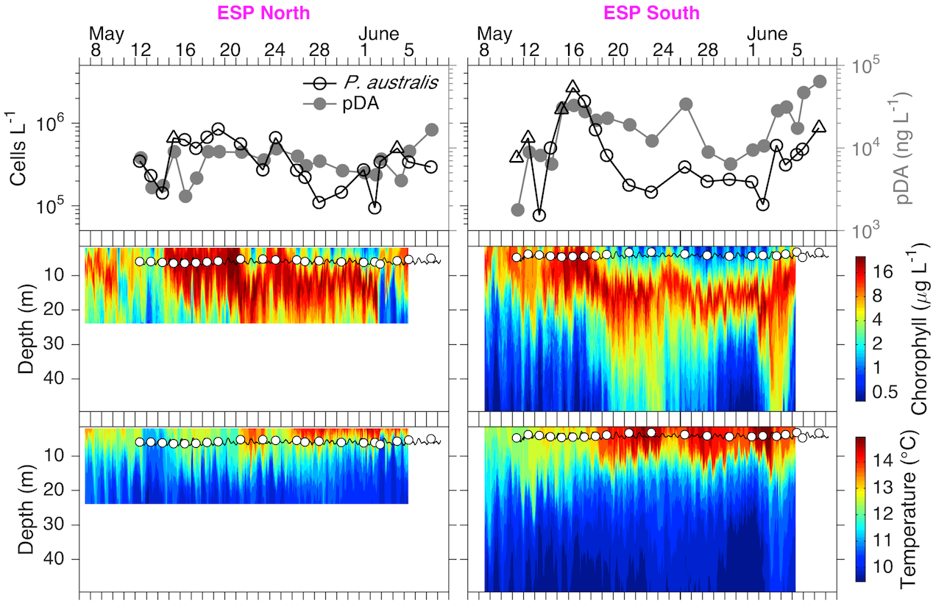
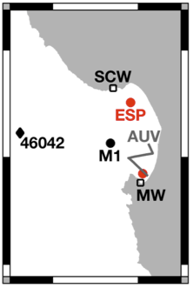
Impact: technology integration for effective research
ESP North
ESP South

Slide 5
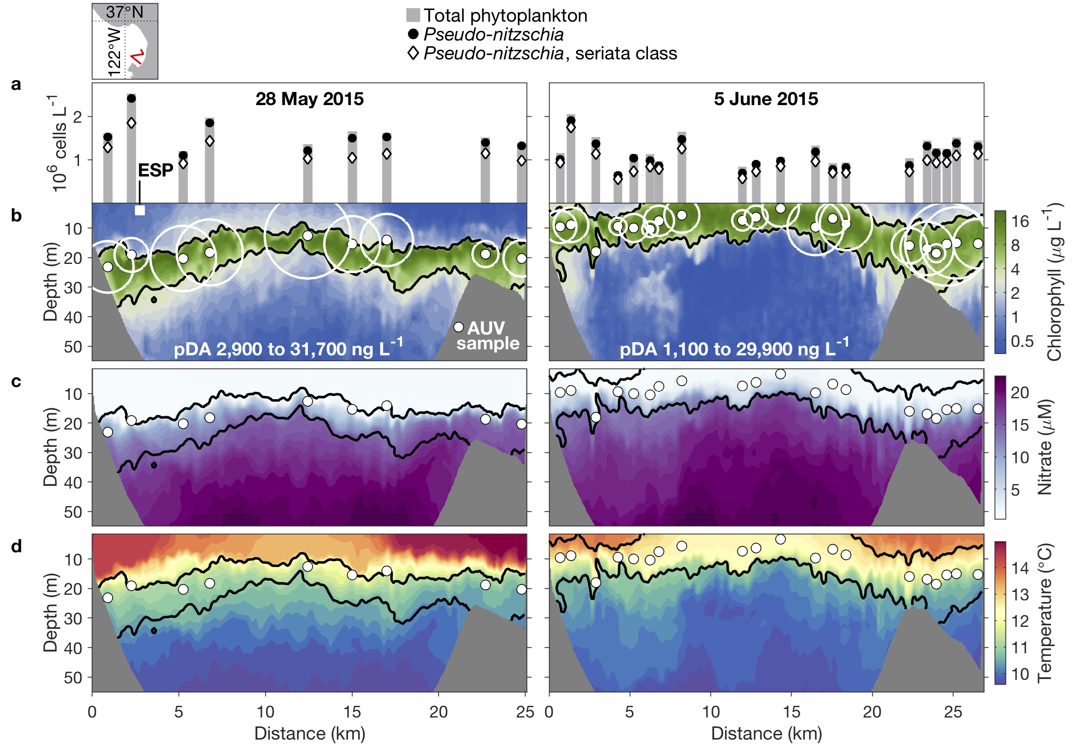
Impact: understanding HAB causality

Slide 6
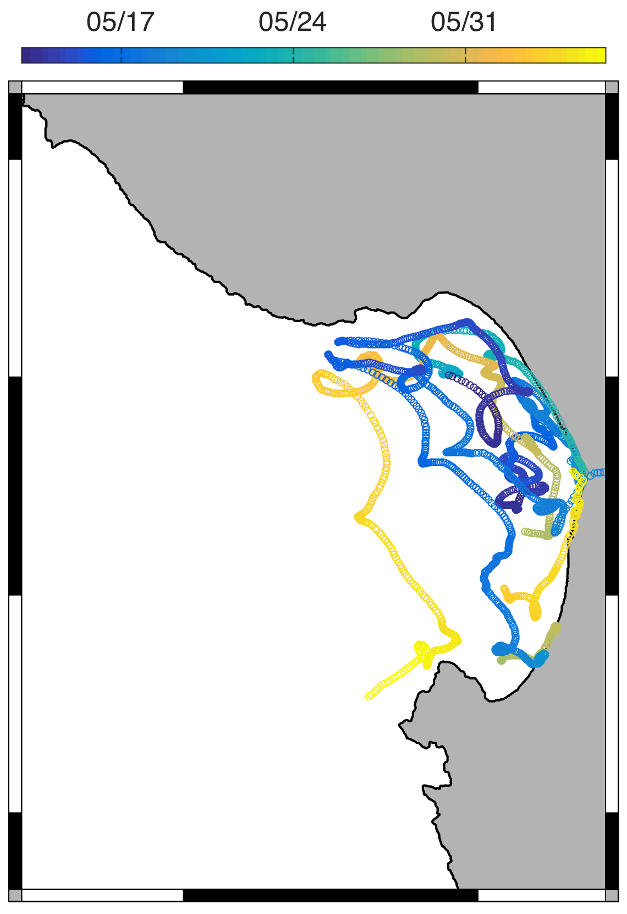
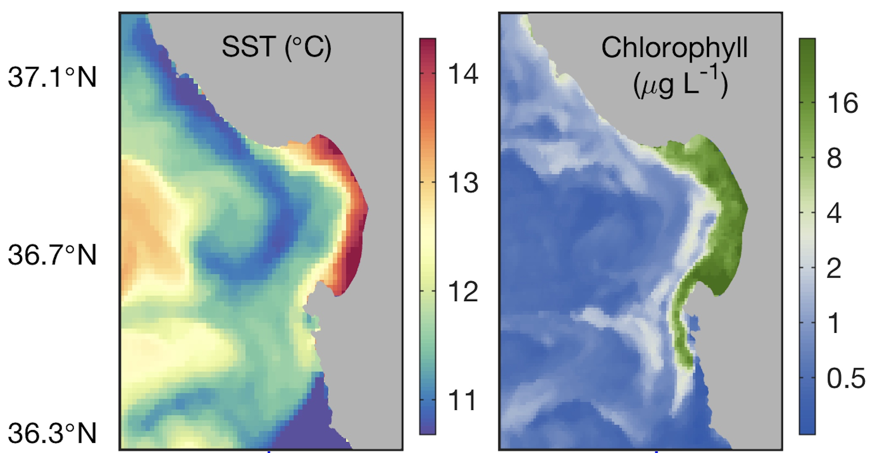
Impact: understanding HAB causality

Slide 7
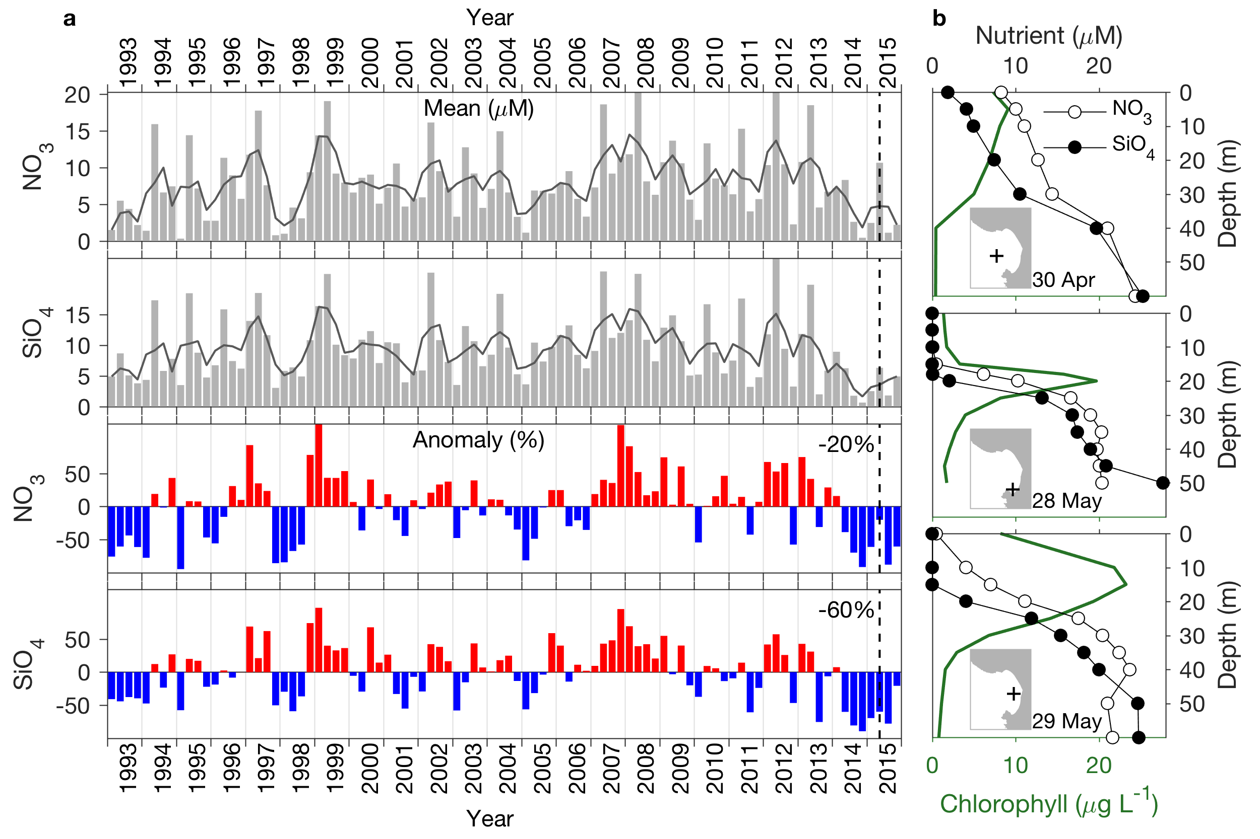
Impact: understanding HAB causality

Slide 8
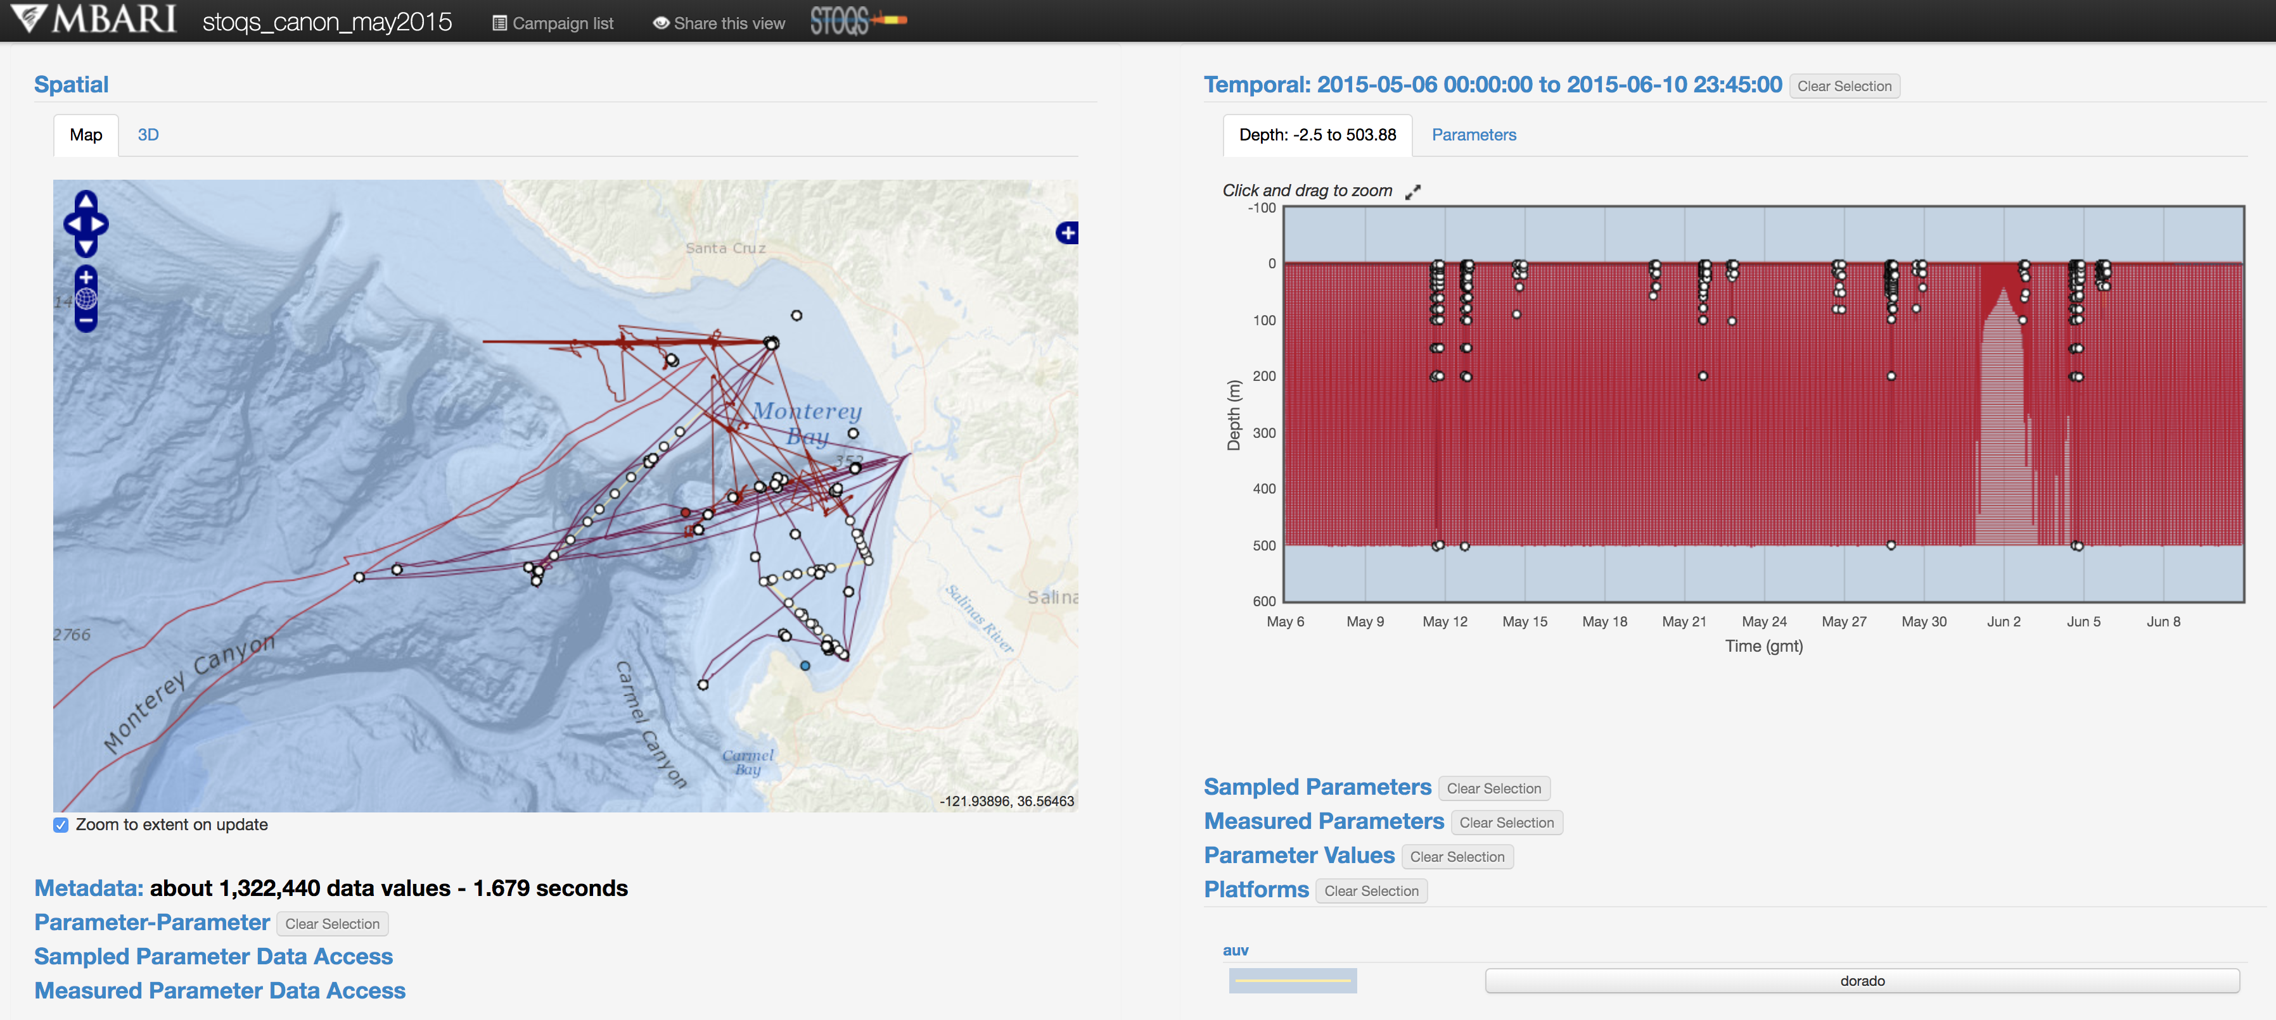
Impact: helping researchers collaborate effectively

Slide 9
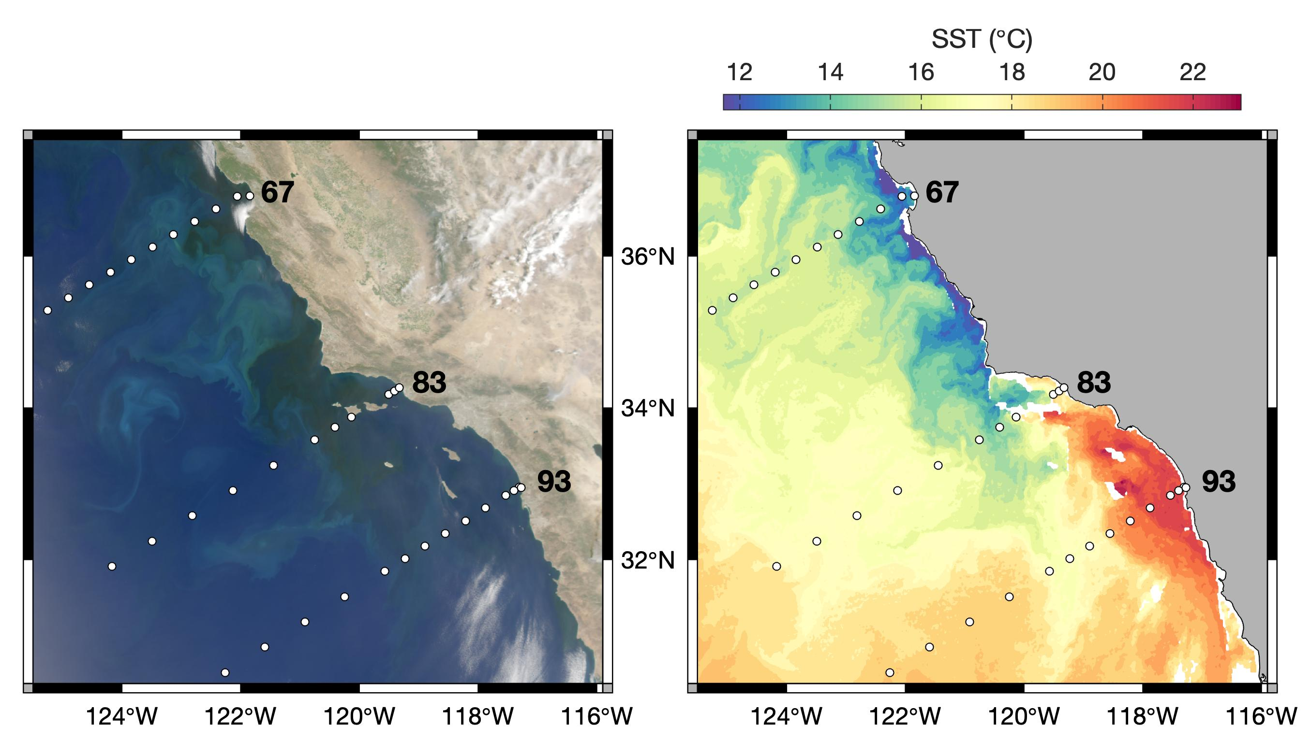
Impact: shaping future research
New NOAA ECOHAB project
with Scripps Institution of Oceanography, Southern California Coastal Ocean Observing System, and Southern California Coastal Water Research Project

Slide 10
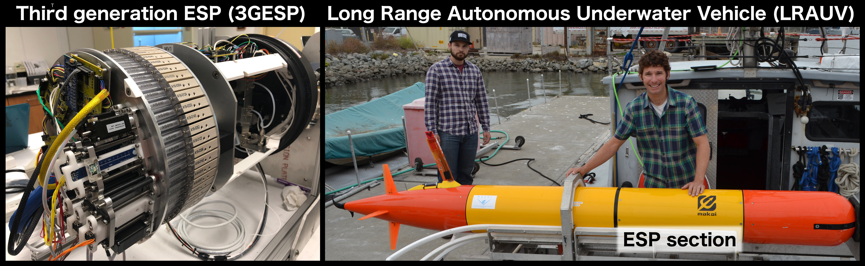
Impact: shaping future research
New NOAA ECOHAB project
with Scripps Institution of Oceanography, Southern California Coastal Ocean Observing System, and Southern California Coastal Water Research Project

Slide 11
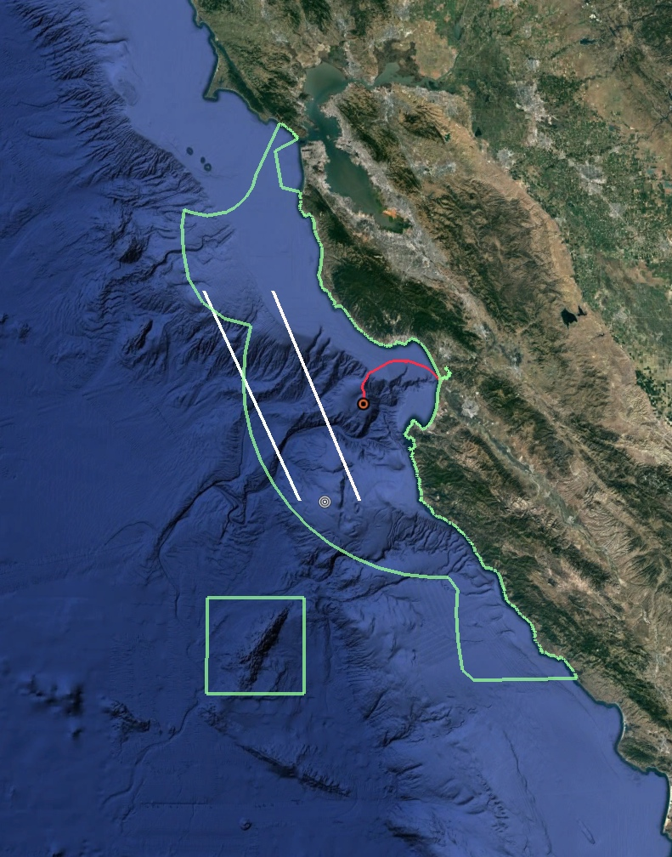
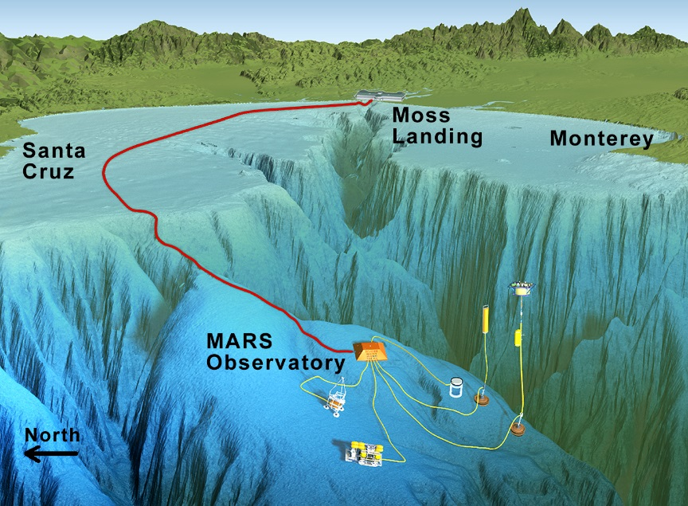
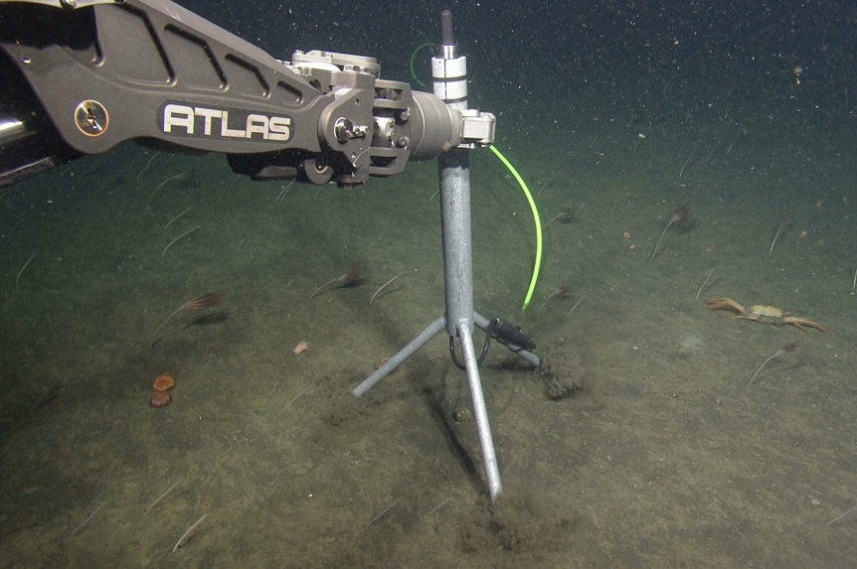
2. The ocean soundscape
MARS
SOSUS

Slide 12
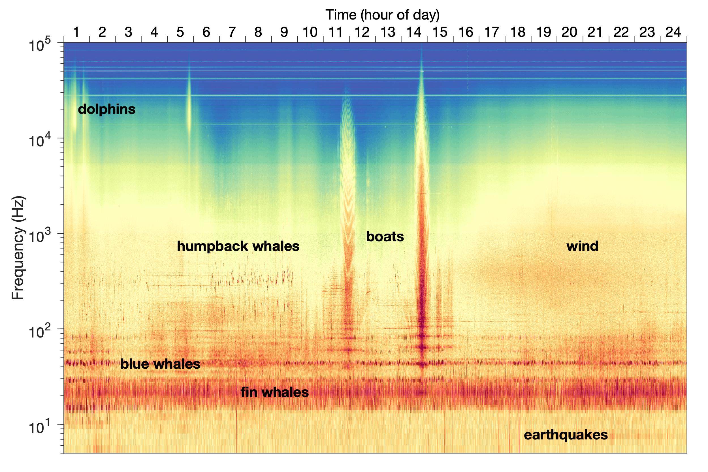
The ocean soundscape

Slide 13
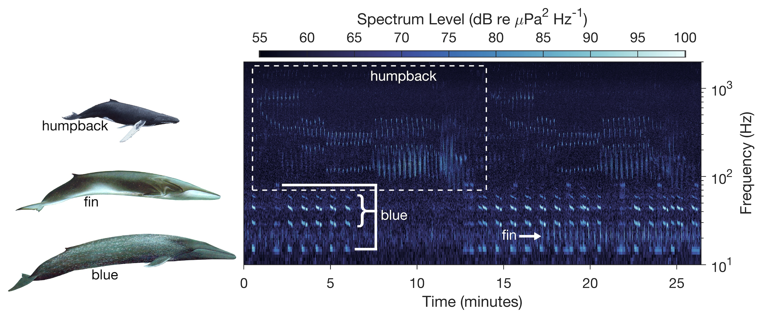
Impact: understanding ocean life in Monterey Bay National Marine Sanctuary
Whale images by Larry Foster

Slide 14
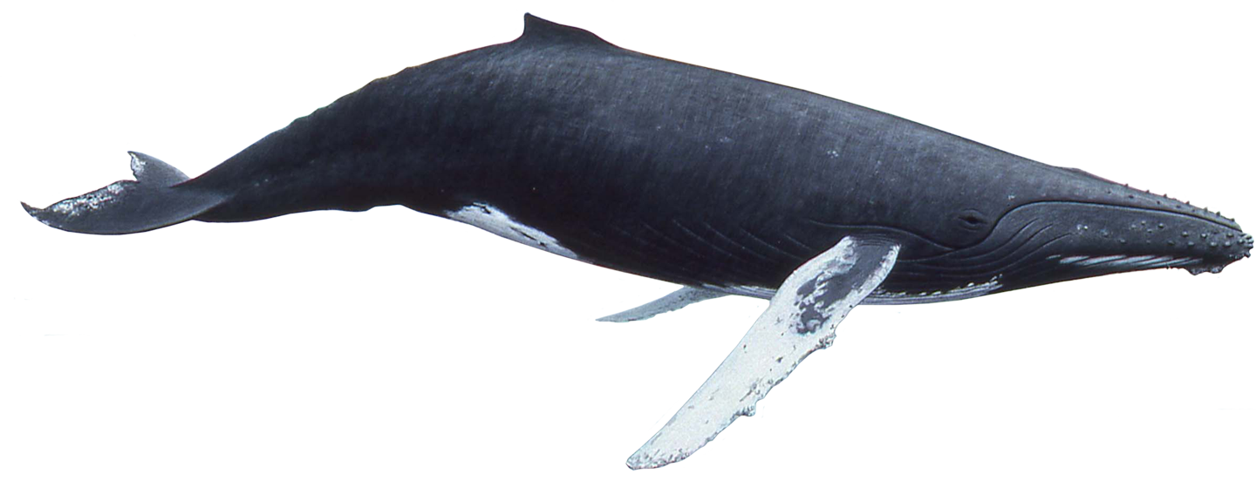
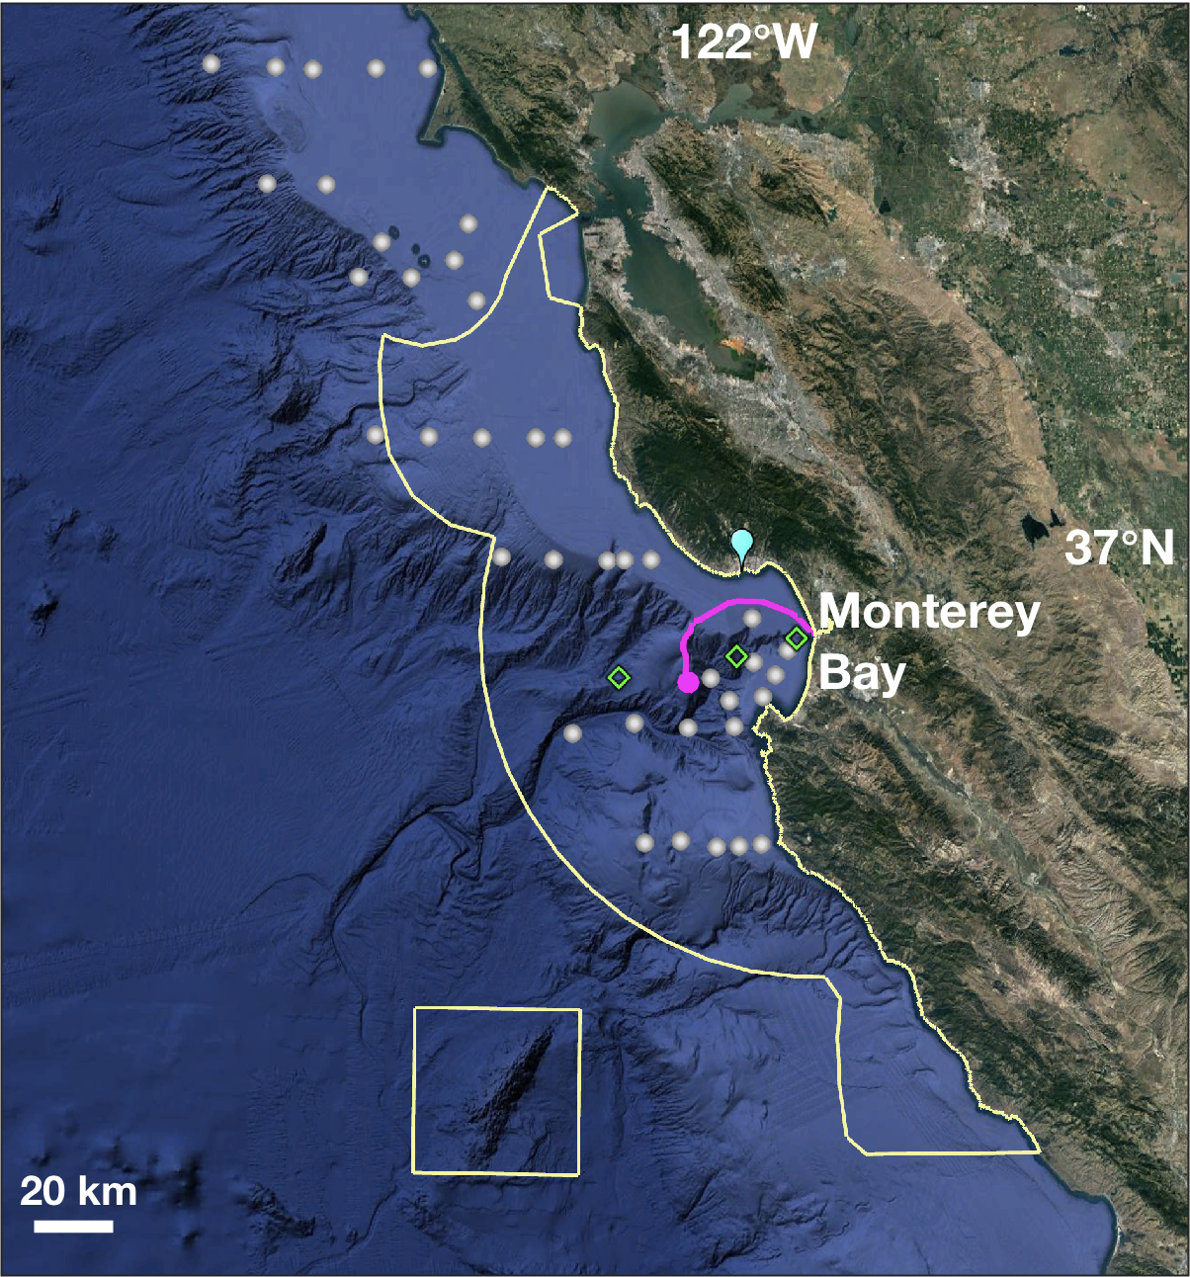
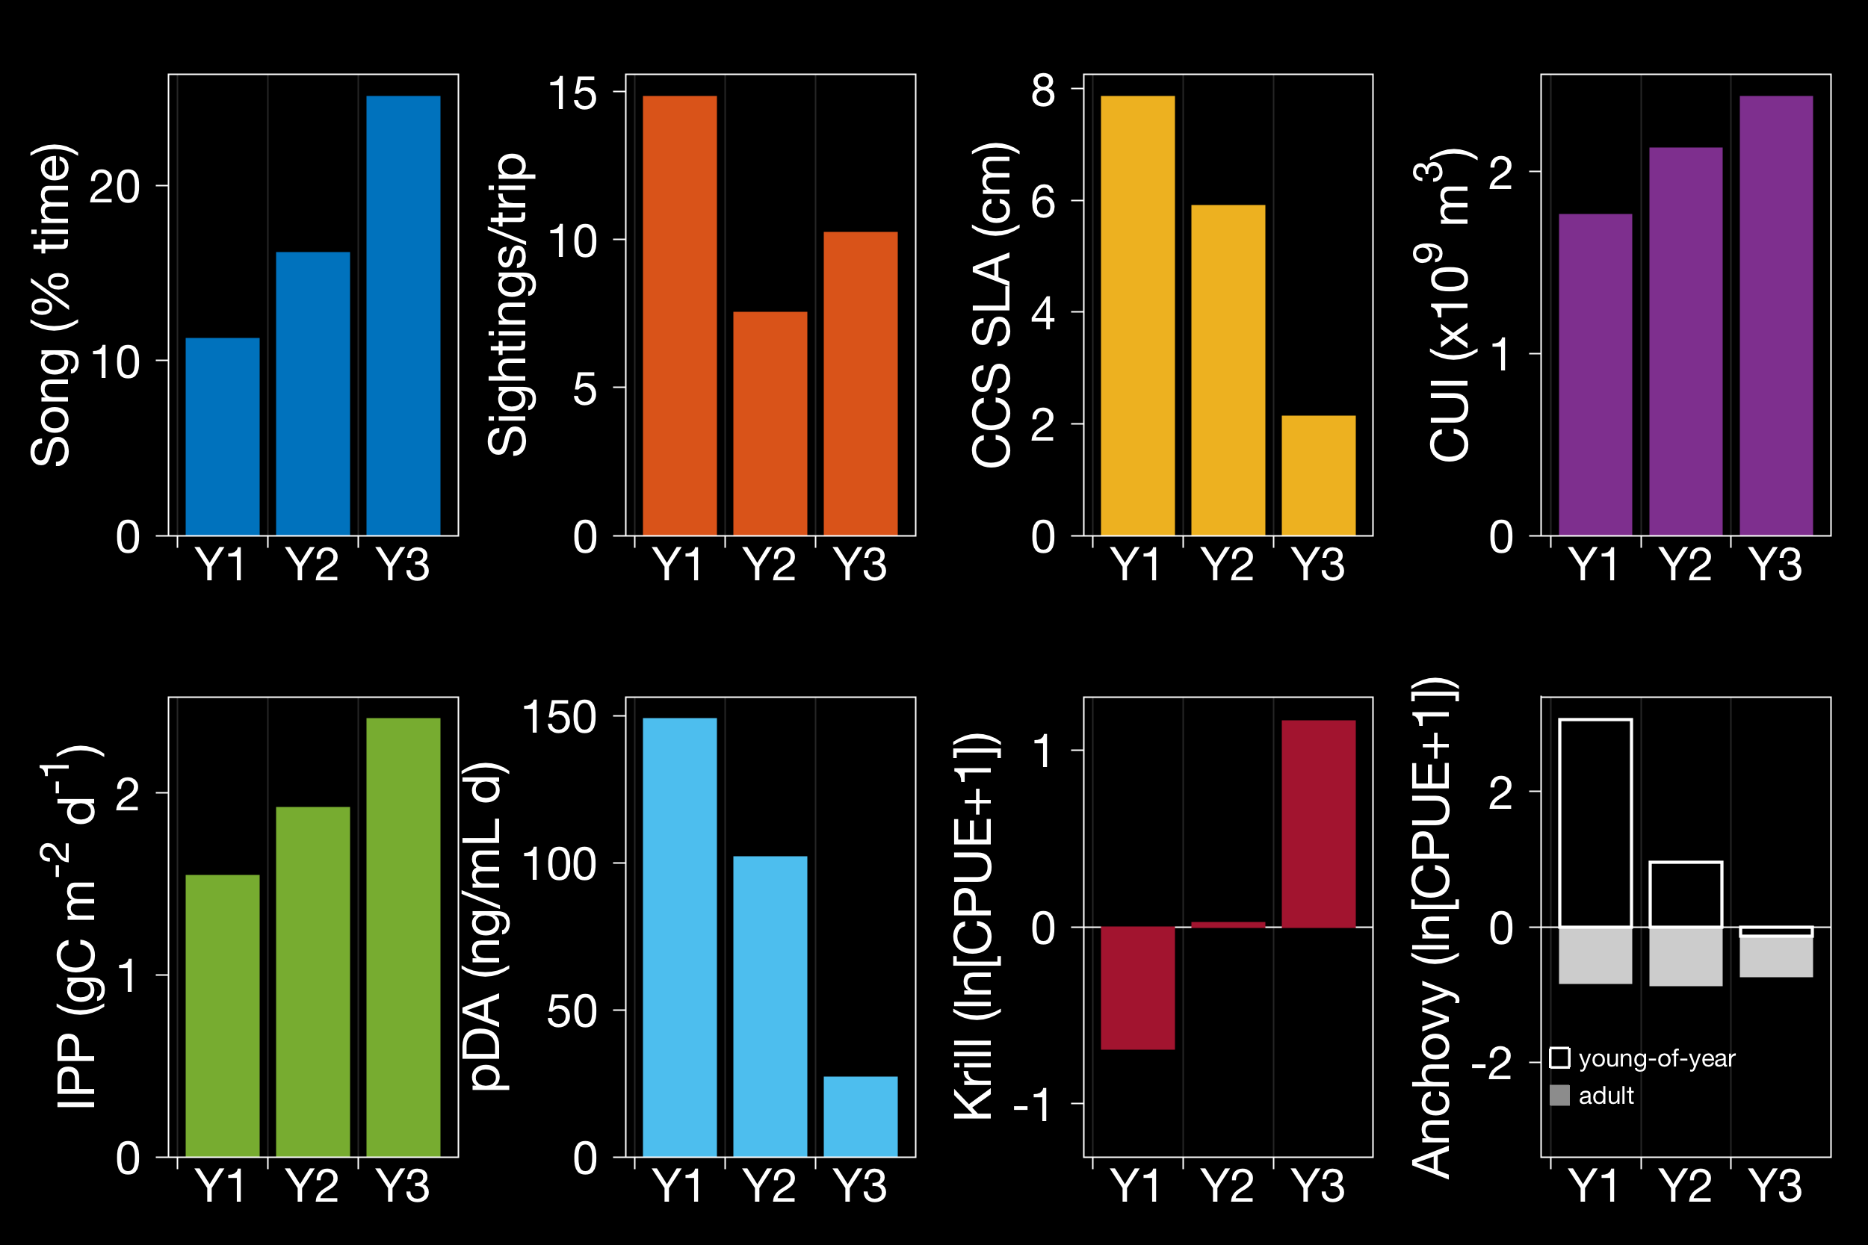
Impact: understanding ocean life in Monterey Bay National Marine Sanctuary

Slide 15
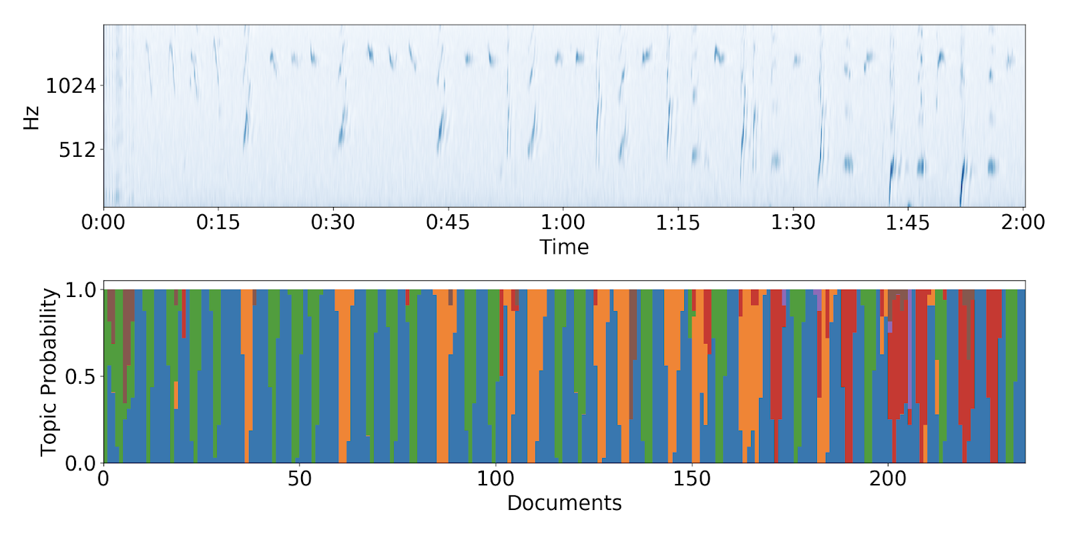
Impact: understanding ocean life in Monterey Bay National Marine Sanctuary

Slide 16
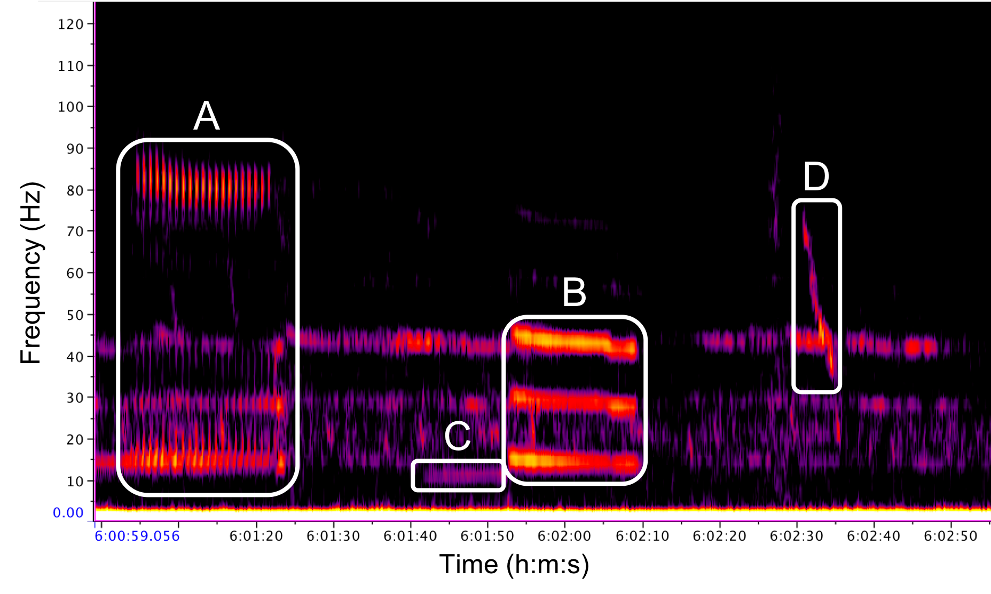
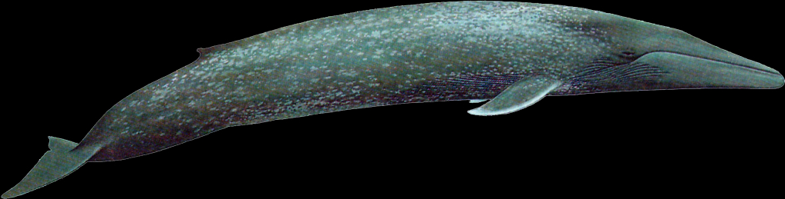
Impact: understanding ocean life in Monterey Bay National Marine Sanctuary

Slide 17
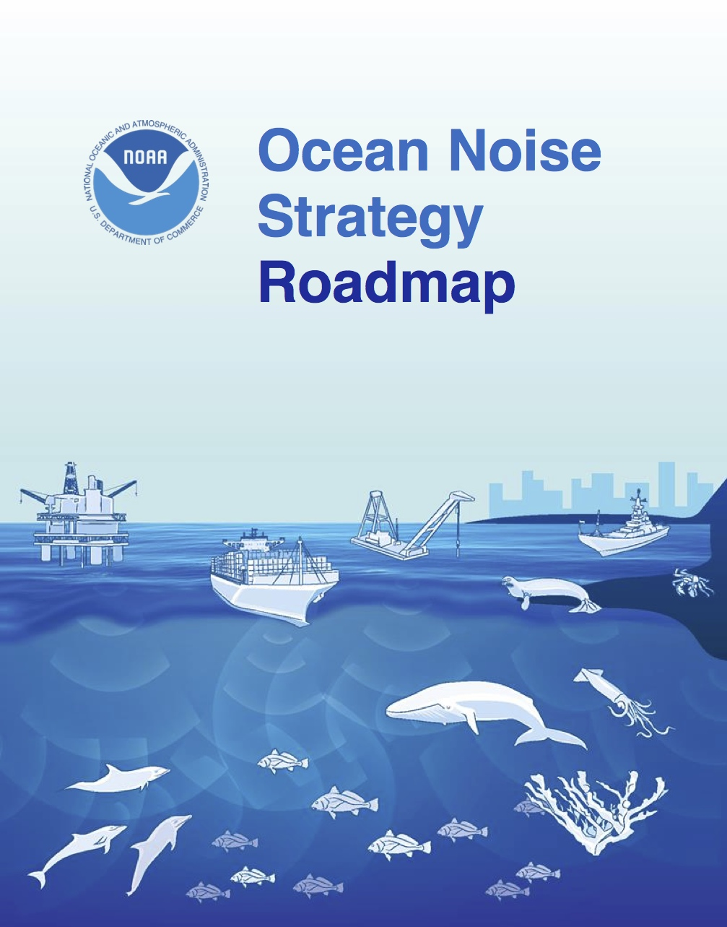
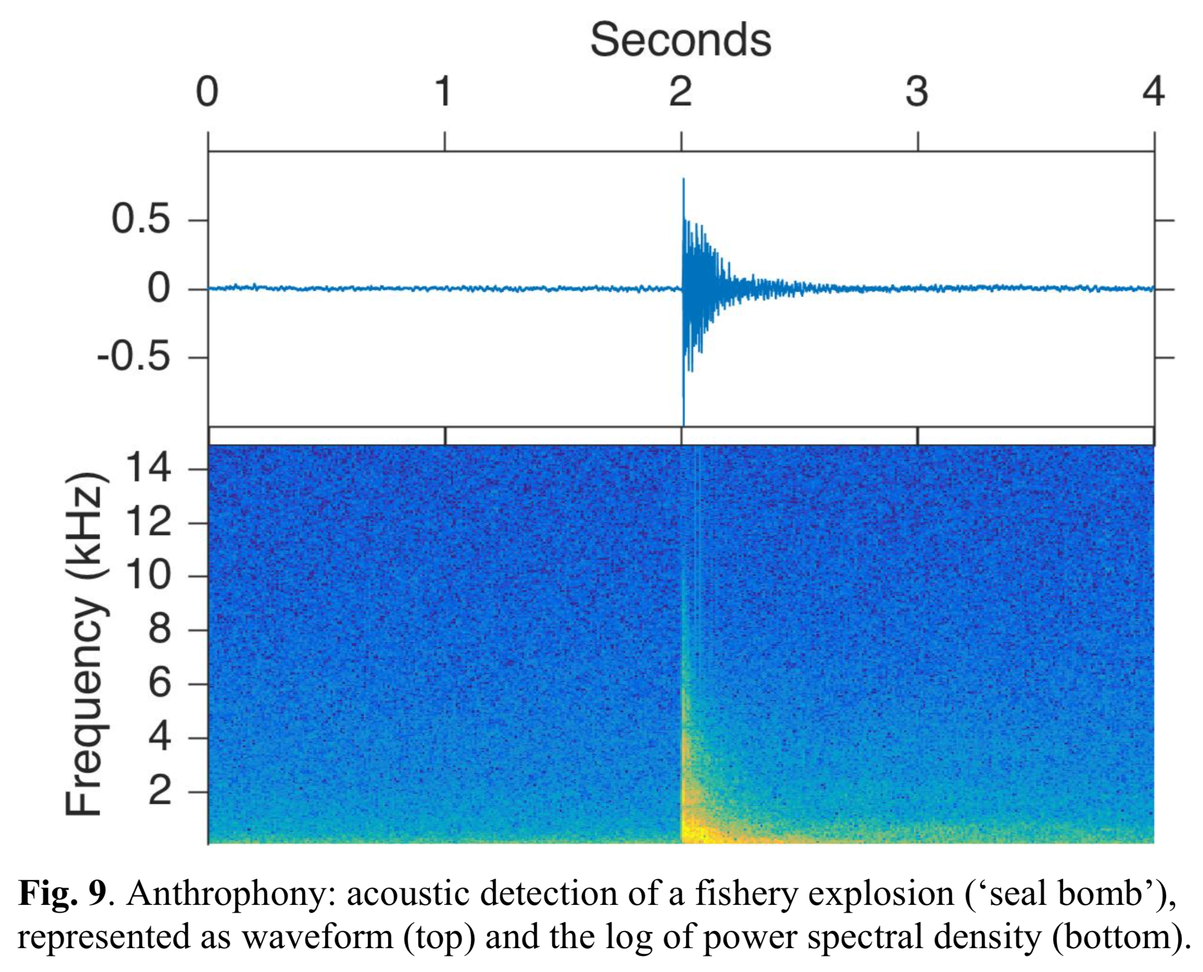

Impact: understanding human impacts in Monterey Bay National Marine Sanctuary

Slide 18
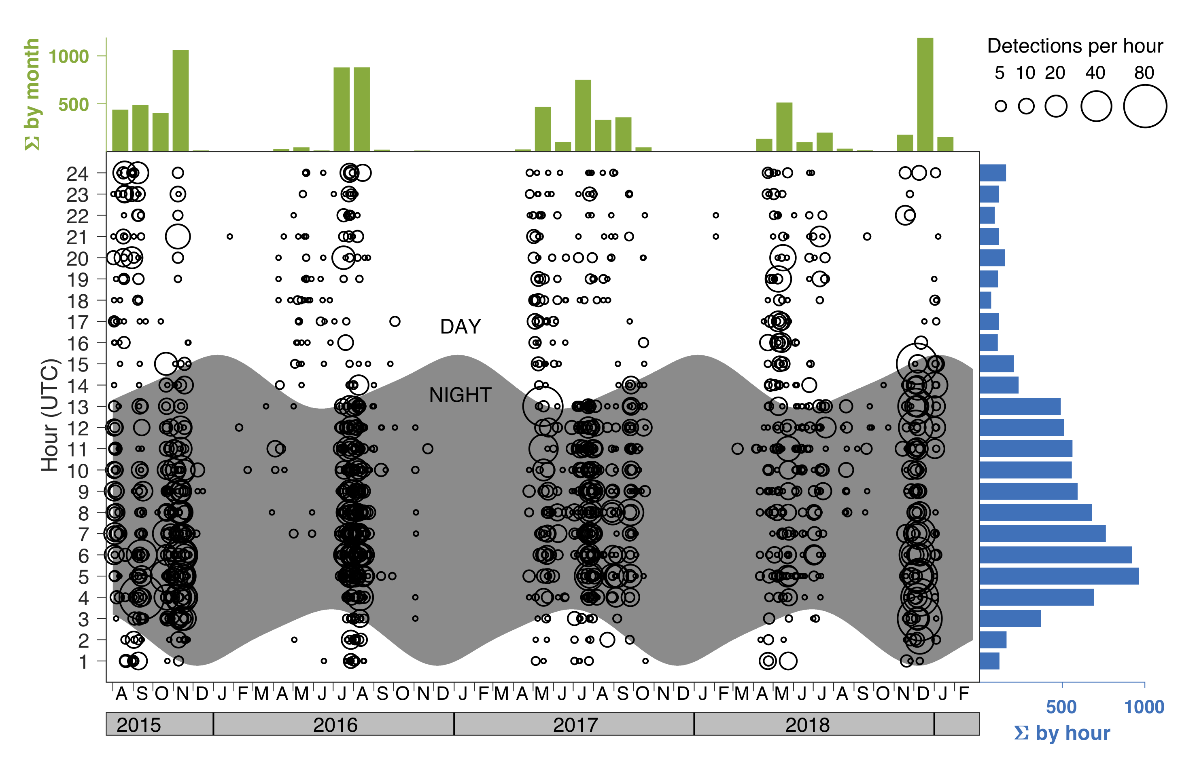
Impact: understanding human impacts in Monterey Bay National Marine Sanctuary

Slide 19
Impact: new research collaborations with NOAA and NPS

Slide 20
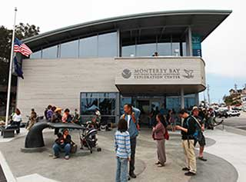
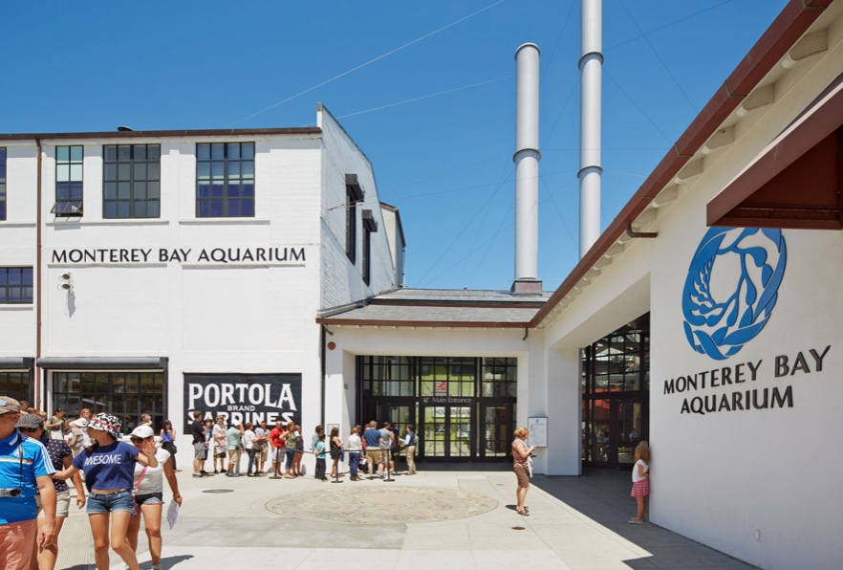
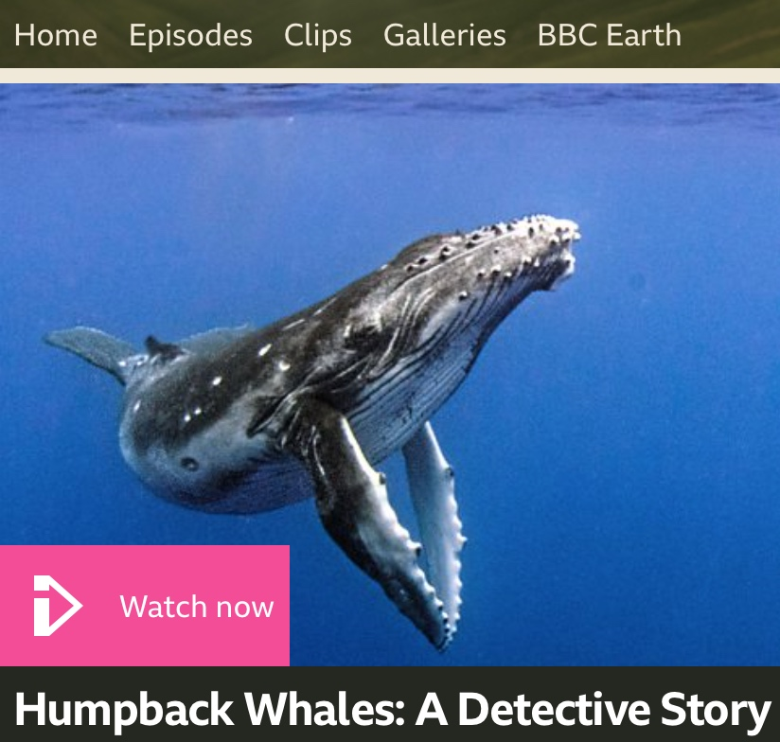
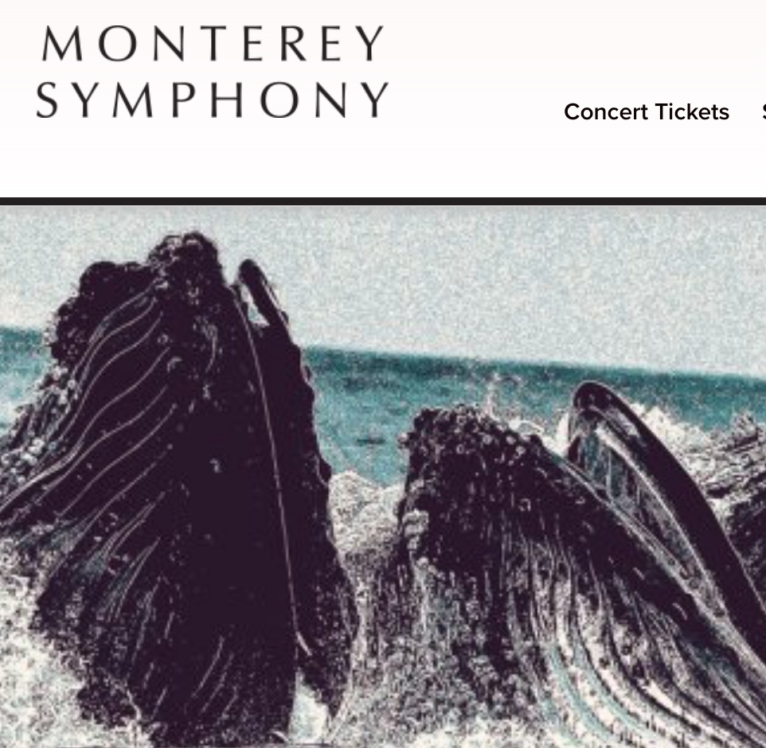
Impact: Education & Outreach
Student projects

