Slide 2
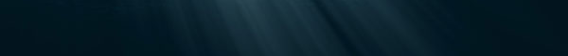
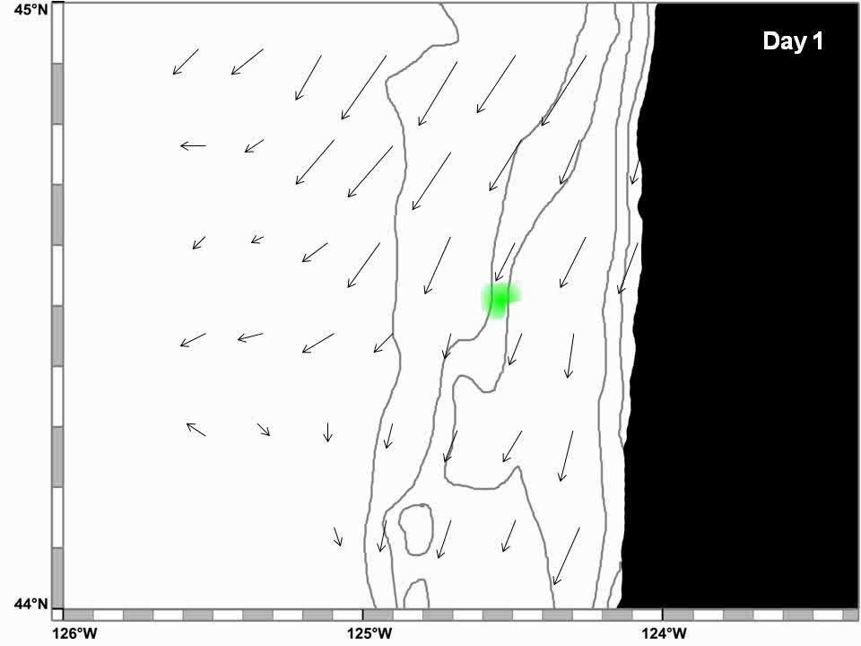
A Complex Ocean

Slide 3
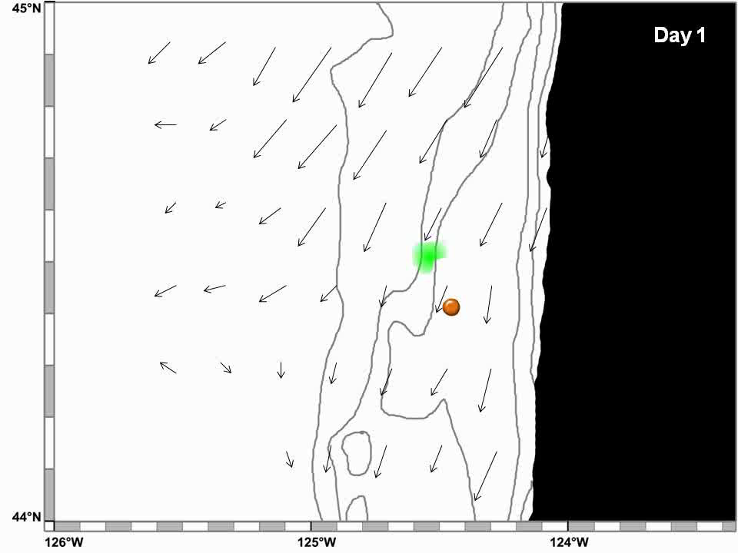
Observing a Complex Ocean: Stationary

Slide 4
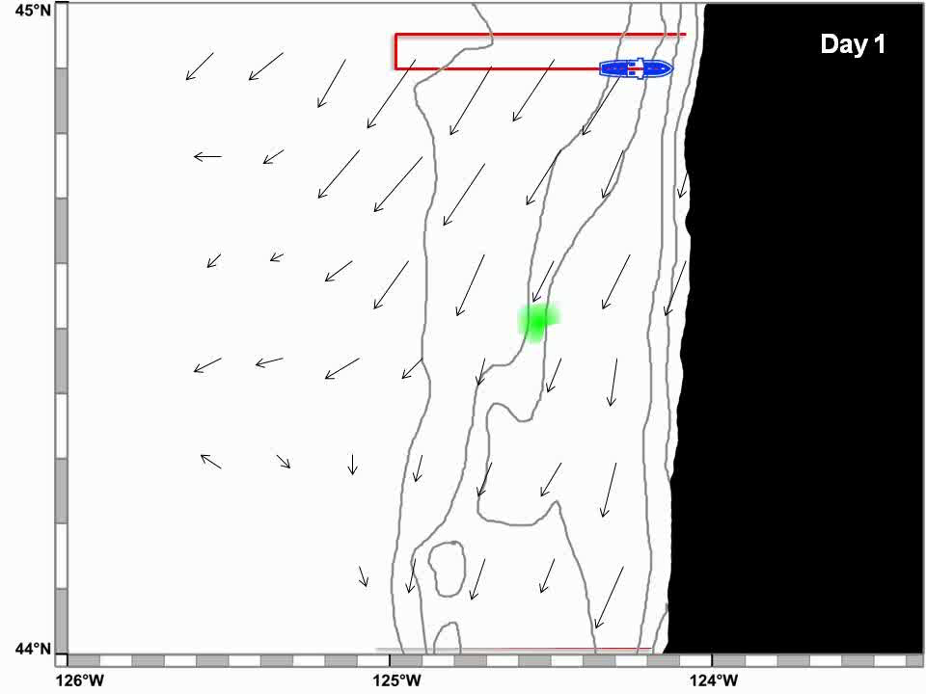
Observing a Complex Ocean: Geographic Grid

Slide 5
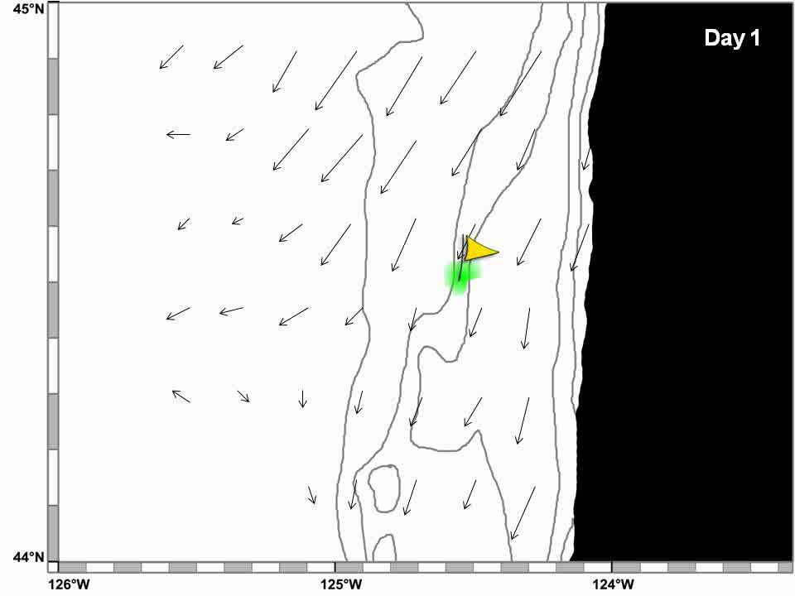
Observing a Complex Ocean: Going with the Flow

Slide 6
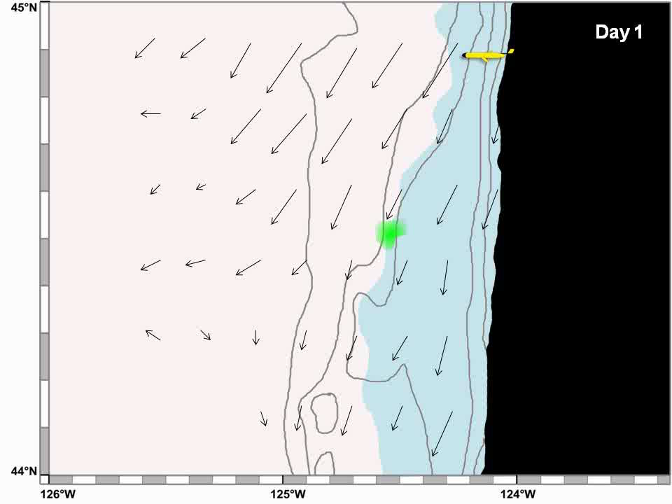
Observing a Complex Ocean: Hunting and Tracking

Slide 7
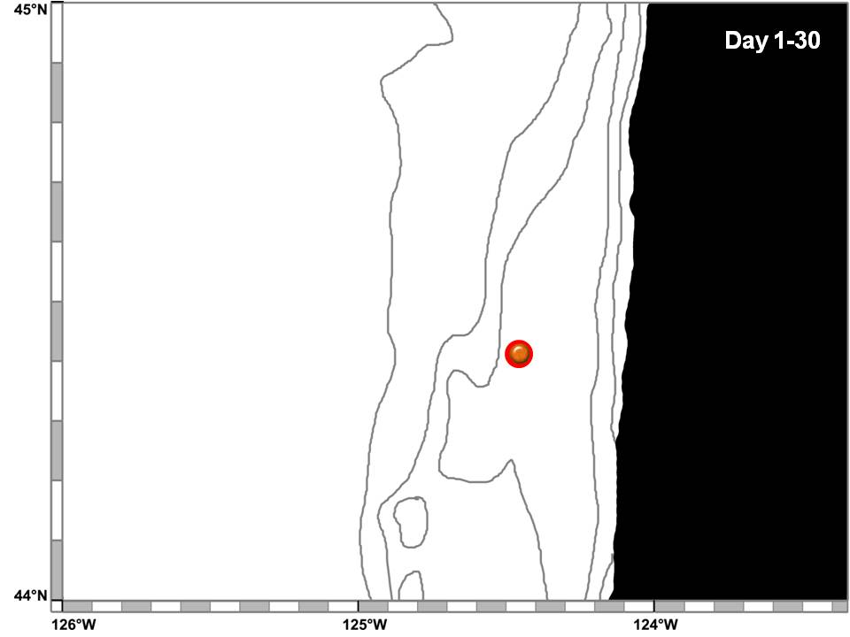
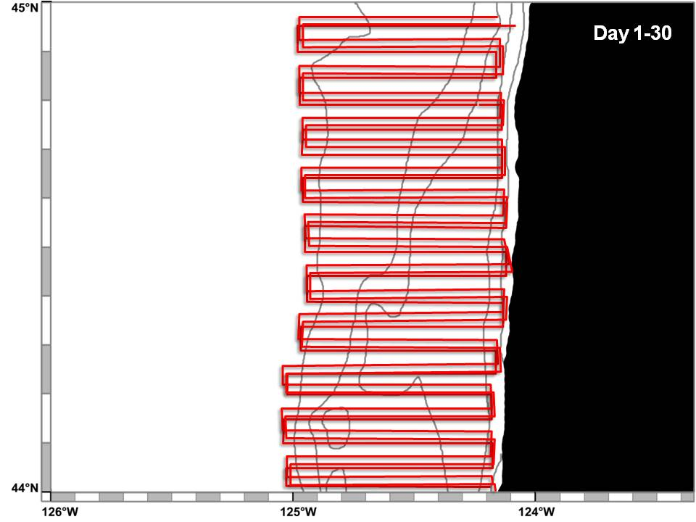
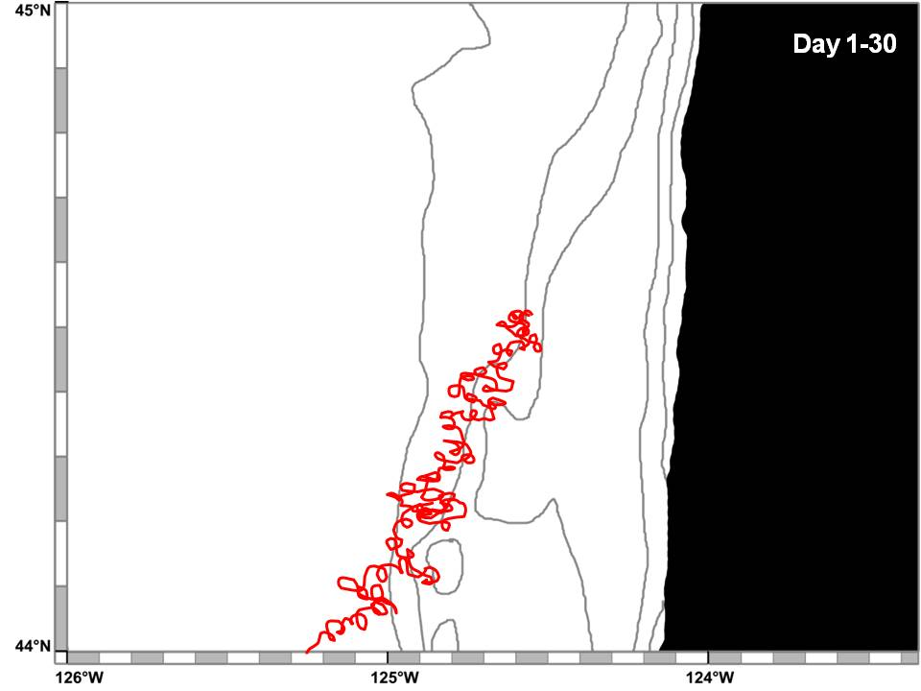
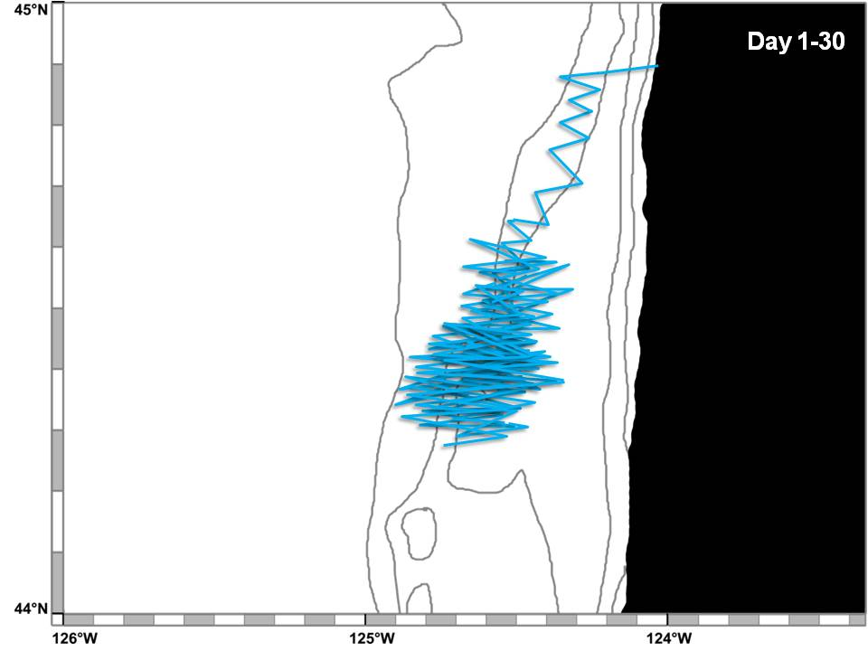
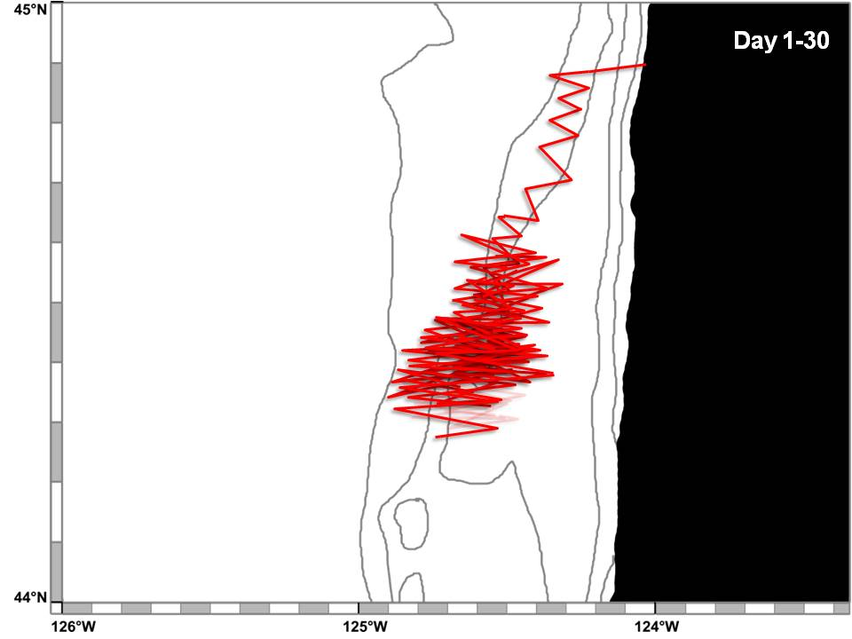
A New Reference Frame
Fixed
Geographic
Physical
Biological

Slide 8
A New Reference Frame
Fixed
Geographic
Physical
Biological

