Slide 1
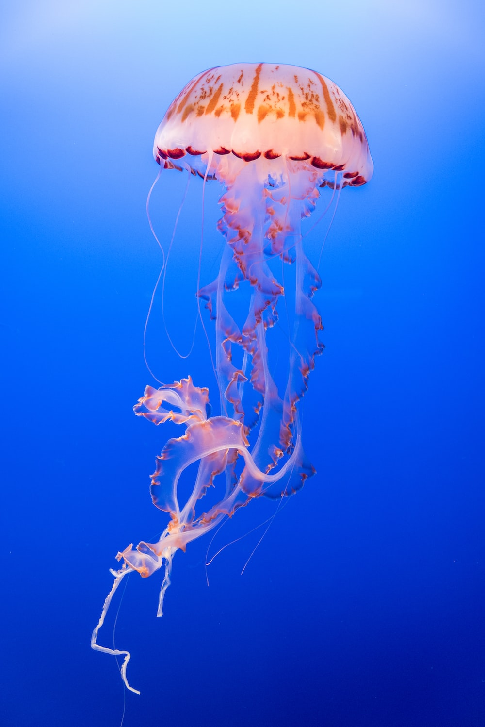

Monterey, California
FALL of 2024

