Slide 1
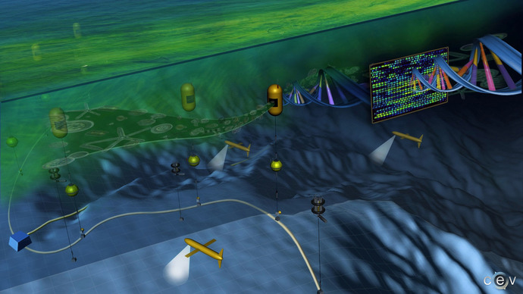
Center for Environmental Visualization, Univ. of Washington - 2010
Notes:
Ginger Armburst and John Delany at UW had this illustration made a little over a decade ago. Where they envisioned
Retrieve information from the field directly, under natural conditions, and eliminate the traditional requirement for shore-side analyses of retrieved samples

Slide 2
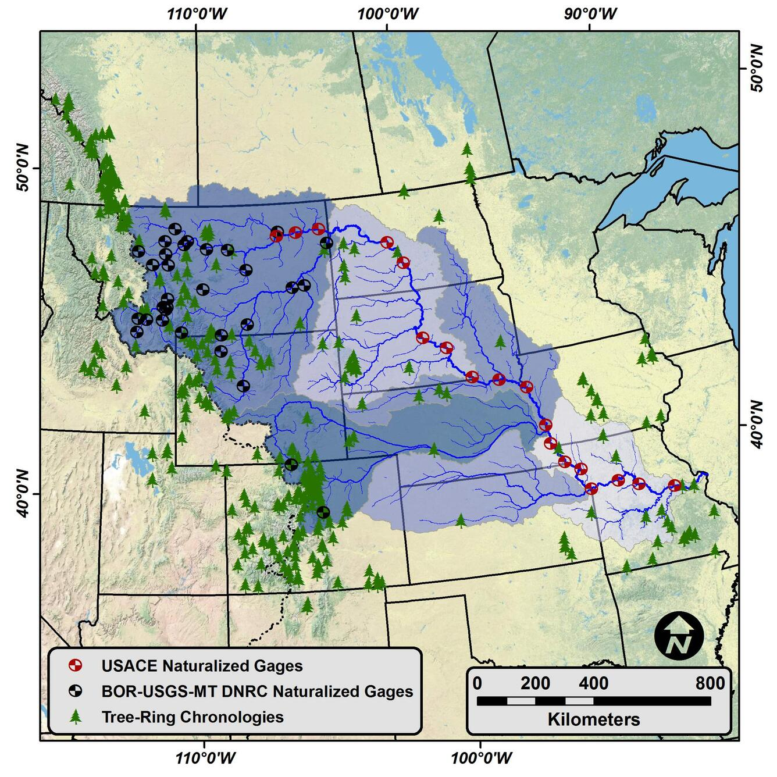
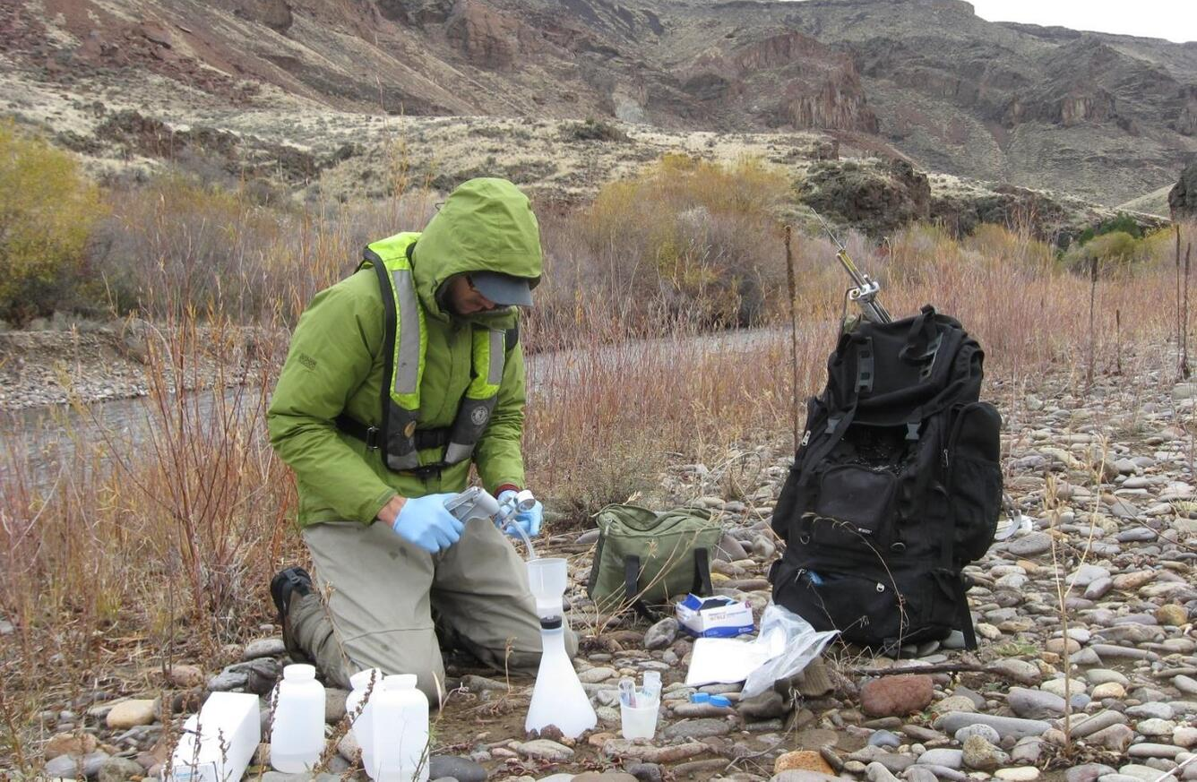
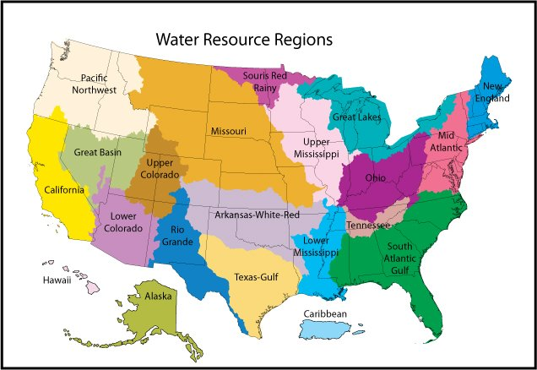

Slide 3
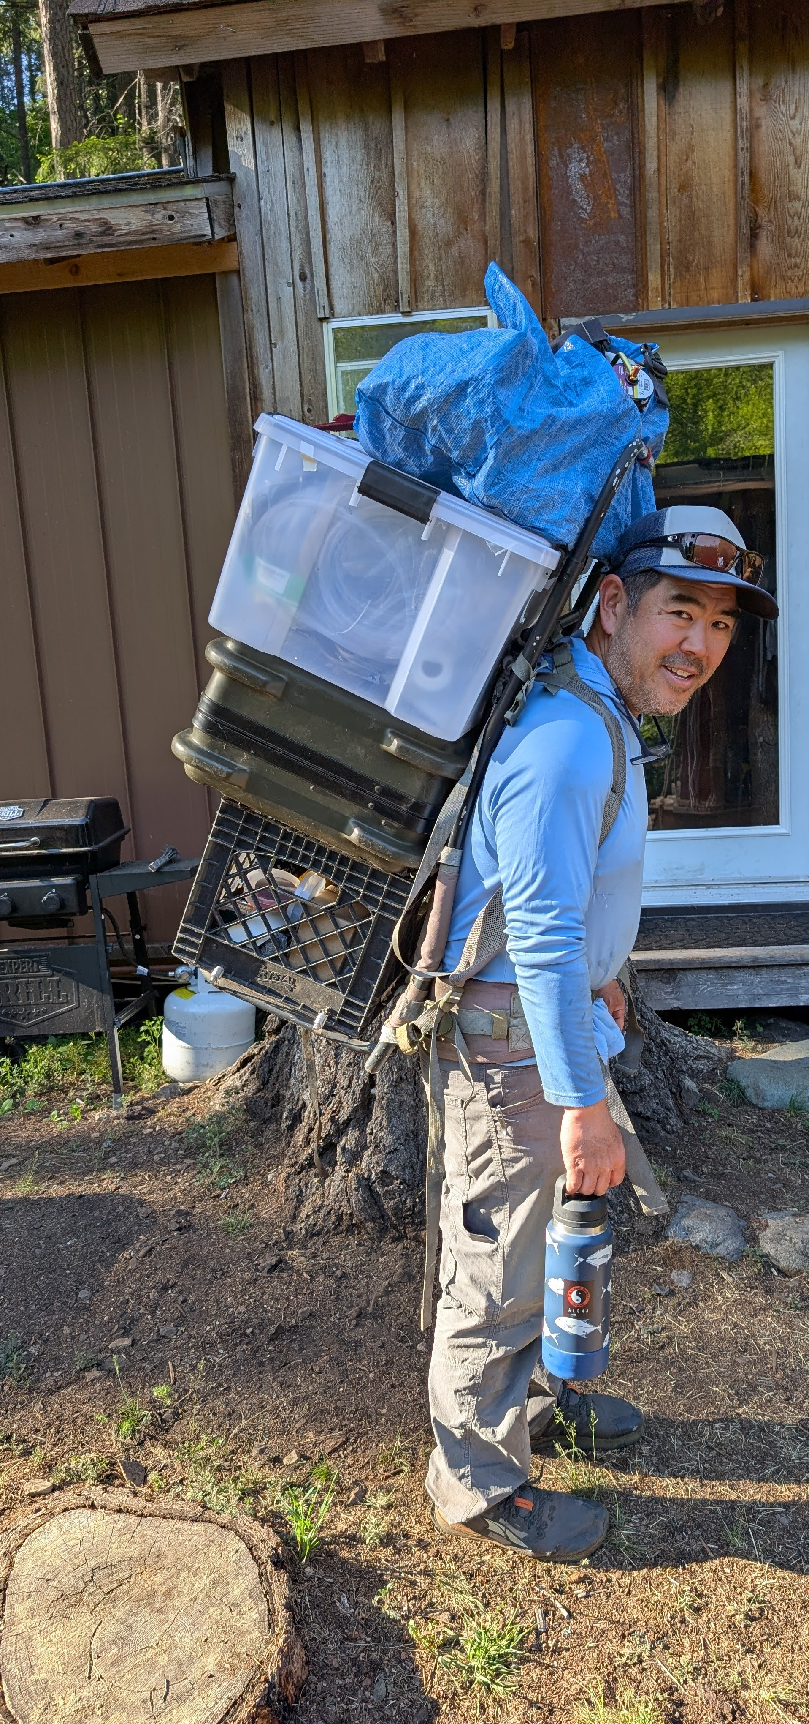
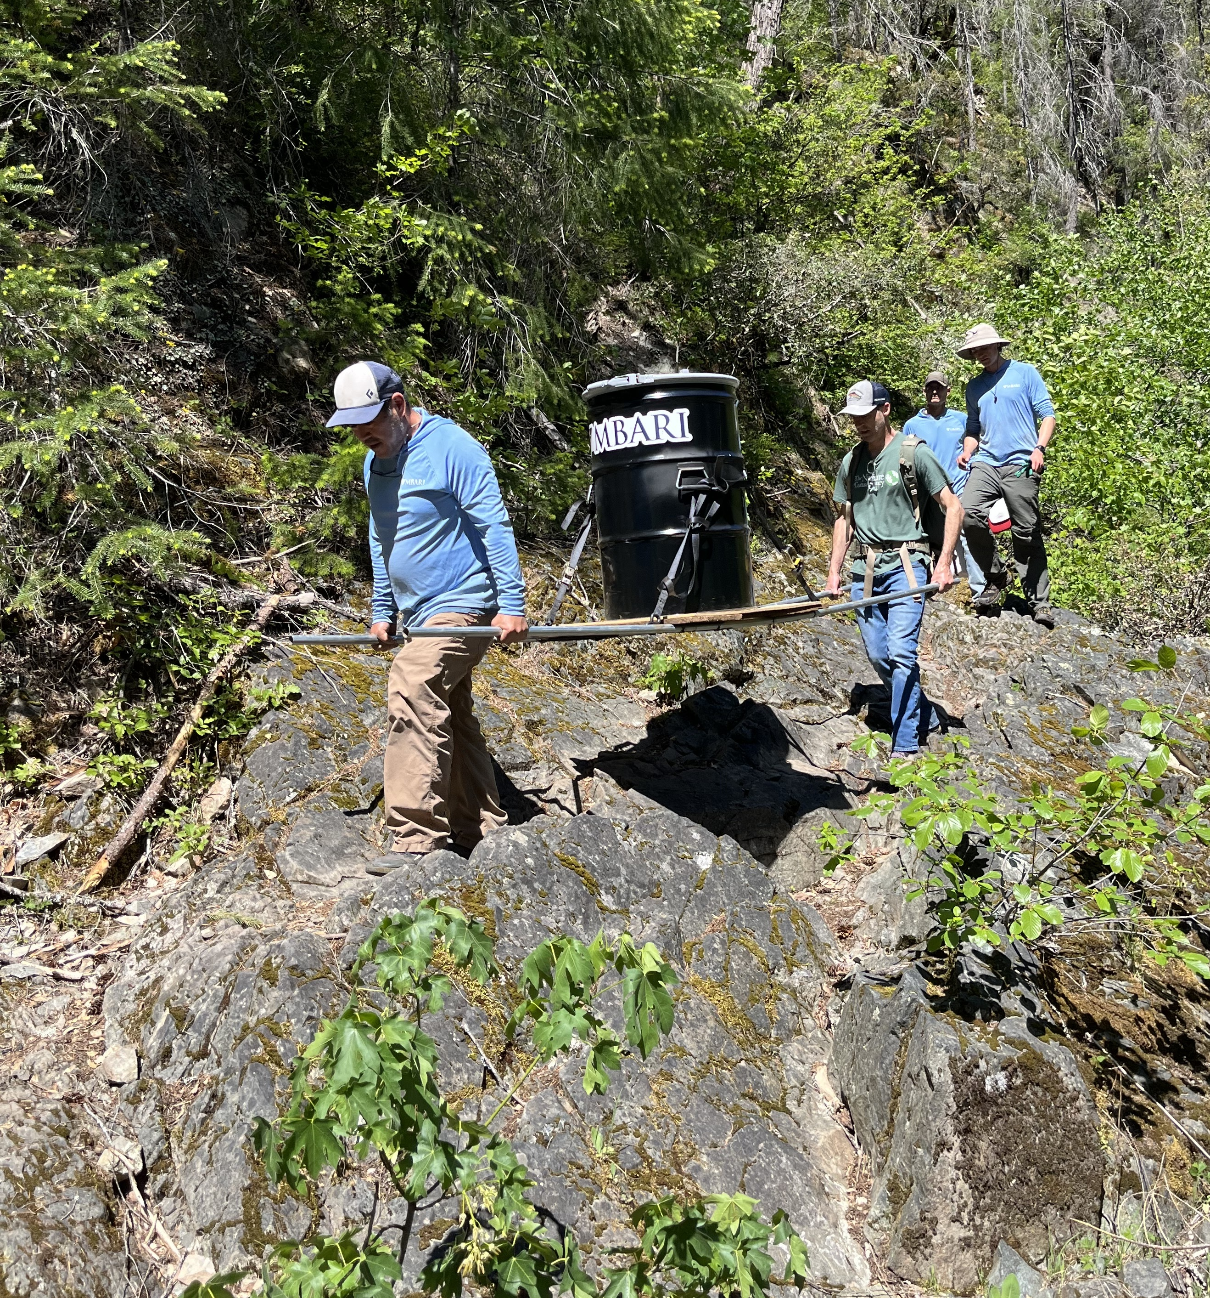
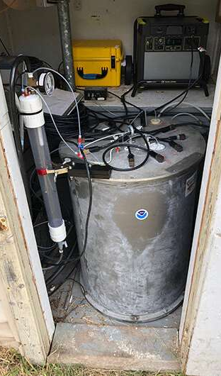
Notes:
Once you have everything ready, you need to carry (quite literally) everything out into the field and hook it up.
This could be its own presentation, and is very application specific, so I’m not going to dive into much. I’d be very happy to talk more about this later with anyone who is interested.

Slide 4
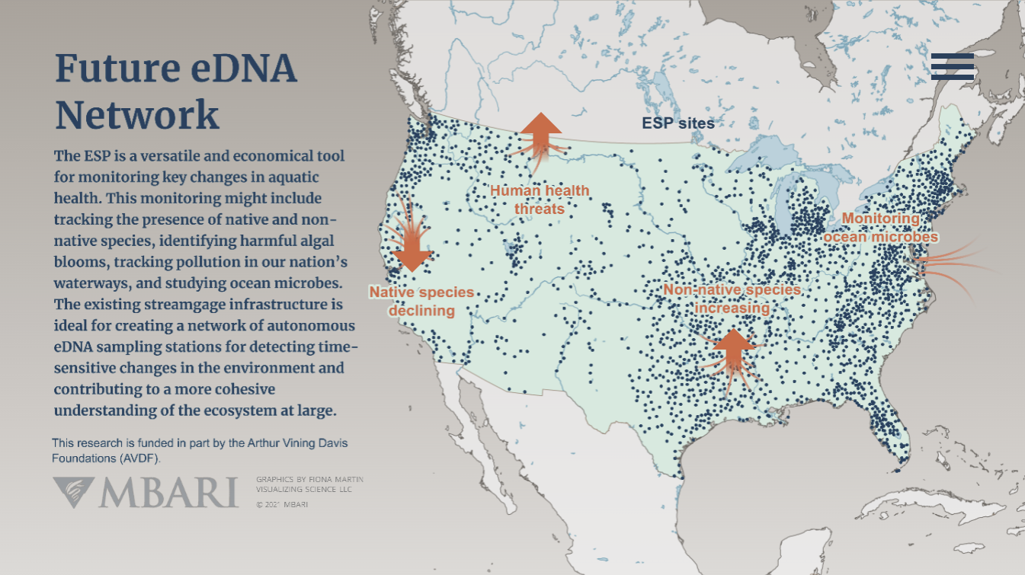

Slide 5
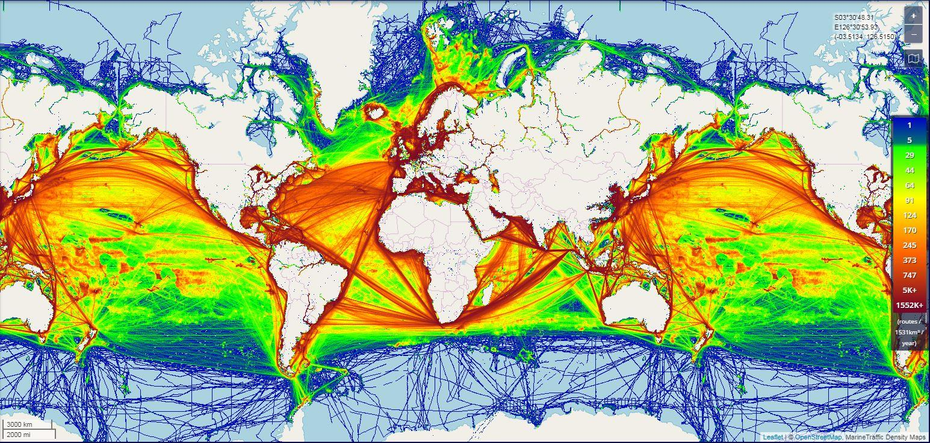

Slide 7
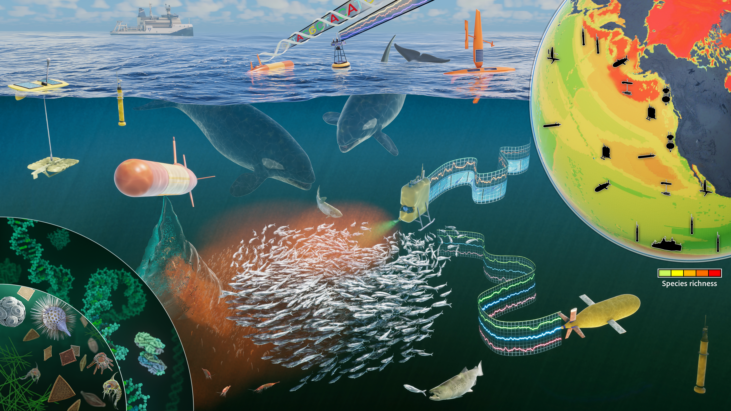
Notes:
Conceptualizing the future of biodiversity observations in the ocean is easy and we can envision what these advanced technologies might look like to make these observations. Where we have numerous crewed and uncrewed platforms collecting biological data through omics technologies and also the environmental data used to contextualize these observations.
However, developing functional technologies that are cheap, easy to use and robust has proven to be very difficult. As we witness yesterday, there were a number of talk about new sampling technologies. There has been a rise in the number of autonomous sampling instruments over the last 5 or so years, providing renewed hope in making progress towards realizing these conceptual illustrations.

