Slide 1
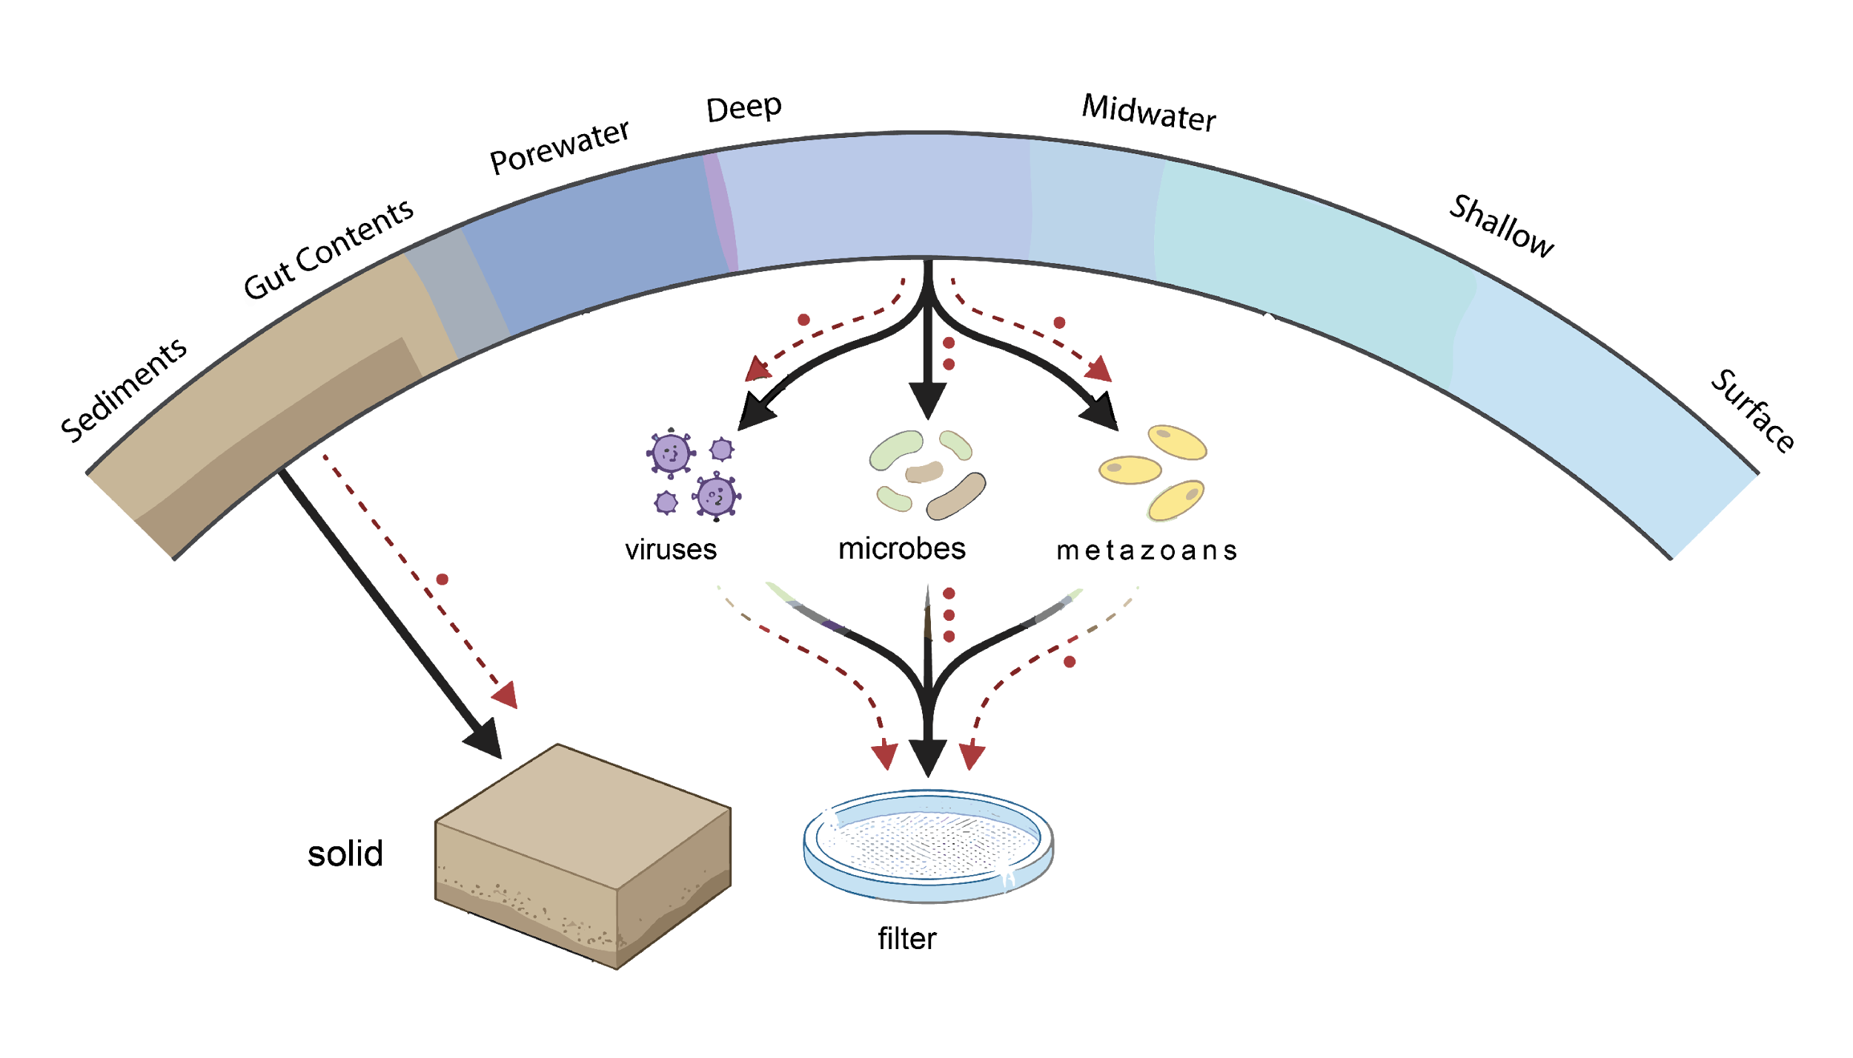
The Landscape: What We Observed
sea ice
Range: Manual Niskin Bottles, Passive Samplers, Fully Automated Samplers
Filter Types: 0.22 to 5+ um, various filter materials and formats (Sterivex, 25 mm, PVDF, MCE)
Preservation: Flash frozen, -80C, RNAlater, DNA/RNA Shield, room temp
Platforms: Research Vessels, Sailing Boat ROV, AUVs, Moorings, Ship Underway,
Volume Req’s: 1: to 100L depending on environment, target and analytical method

