Slide 1
Ventana FO can redesign
Purpose to explain existing infrastructure
Elaborate on upgrades we believe necessary going forward
Brainstorm on new infrastructure for hardware budget inputs
Guestimates for labor budget inputs

Slide 2
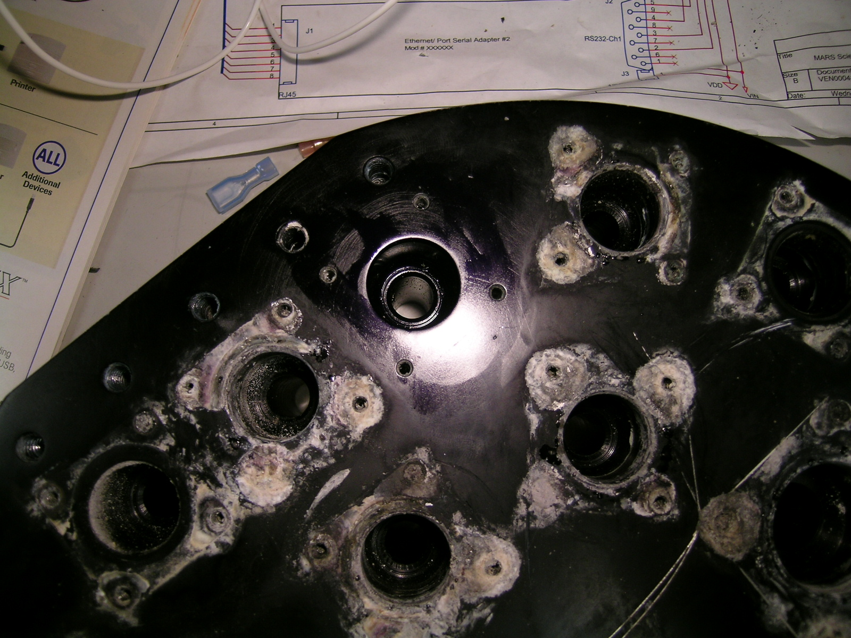

Slide 3
Infrastructure to support
DC (12/24 Volt) Switching of 24 devices/instruments/camera.
AC (120V) switching of 3 channels (at least 6 for upgrade)
26 isolated serial data streams of various protocols and speeds.
16 NTSC camera inputs with 8 outputs to topside using a custom switch card. We need to keep around 8 to 10 of these.
Fiber Optic CWDM infrastructure for auxiliary HD cameras, Ethernet plant, network switches for both core vehicle and science interface needs.
Communication to the GSS control infrastructure with a custom Microcard using the adopted modbus standard.
Single full spectrum fiber available for science instruments testing.

Slide 4
Upgrades proposed
Enhanced resistance to corrosion, Ti housing if power can be dissipated properly. SS BCR connectors.
More HDSDI viewing Cameras, qty 6?
More Ethernet bandwidth with a managed switch
Better Fiber flexibility and enhanced access to more fiber IO
1 hybrid port/connector that supports both 120 VAC and single mode fiber
Newest FOCAL Mux technology, 907X expected to support till 2050 by MOOG. Concern over fiber loss overhead < by 10 dB.
Proper porting for several penetrations for IO.

Slide 5
Current FO Can guts
FOCAL 903 MUX, 1 fiber gives 8 NTSC, 26 serial 232/485 9600/115kbaud
Tri switch Cards to backplane, 6 qty for 18 channels of DC/serial switching (custom card - djo) 2006
8 ch of video isolation (custom card - okuda) 2002
16 ch of serial isolation (custom card, qty 2 - okuda) 2000
16 ch of NTSC input – 8 ch of output – (Okuda/French/Risi) custom video mix card 2016? Needs updated
FO micro card for control from GSS topside – French/Risi) custom card 2014? May need updated
AC quad block for switching, 4 channels

Slide 6
Replacement possibilities
Can mechanicals need to be replaced regardless of internals.
Stuff a new backplane board and replace cards with modern components and enhancements.
Use WAGO modules and MBARI relay card presently used in GSS control can. Video plant (both HDSDI and NTSC) would need similar infrastructure we have now
Some other infrastructure perhaps a smaller backplane and chassis layout.
Most likely we want to go with the 907X mux unless something else comes up. Caution however as this hardware has 10 db less overhead than the focal 903

Slide 7
Fiber Infrastructure
6 Fibers in tether/winch slip rings, but only 4 thru deck cable, plans to upgrade but significant effort.
Current Fiber allocation, all single mode.
  903 Focal Mux
  4K main camera
  Ethernet and qty 2 HDSDI cameras via 7 channel CWDM Focal 914.
  Science/Engineering/Spare, entire spectrum.
Desire to make fiber optics more accessible and use all 6.
Addition of a second fiber port with AC power and fiber.
At present the fibers come from the termination oil enclosure into the 1 atm FO can. New design should bring out more to customers.

