Slide 1
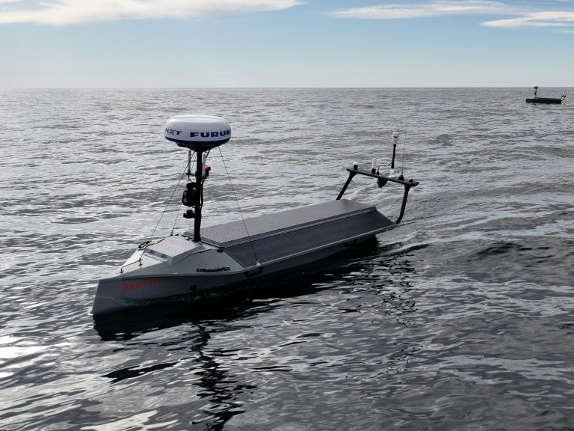
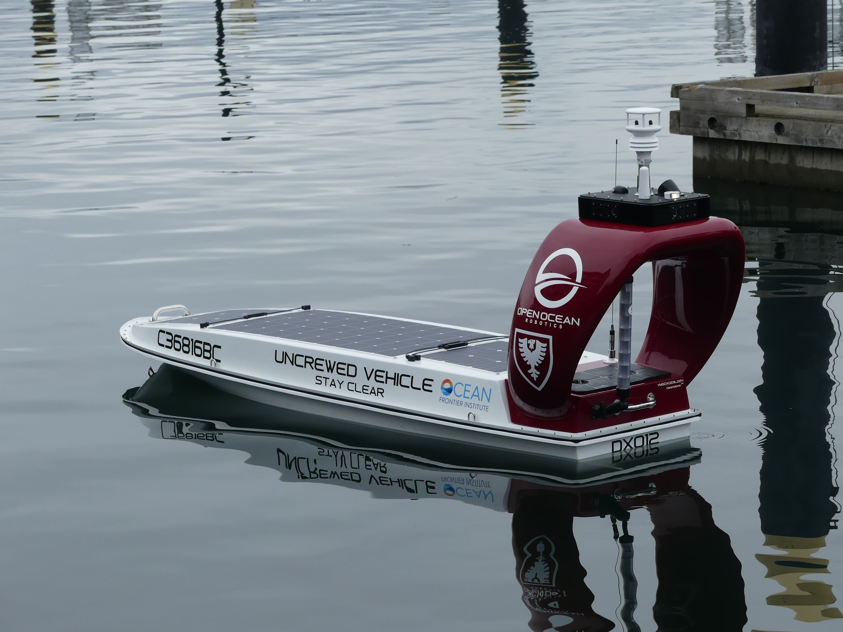
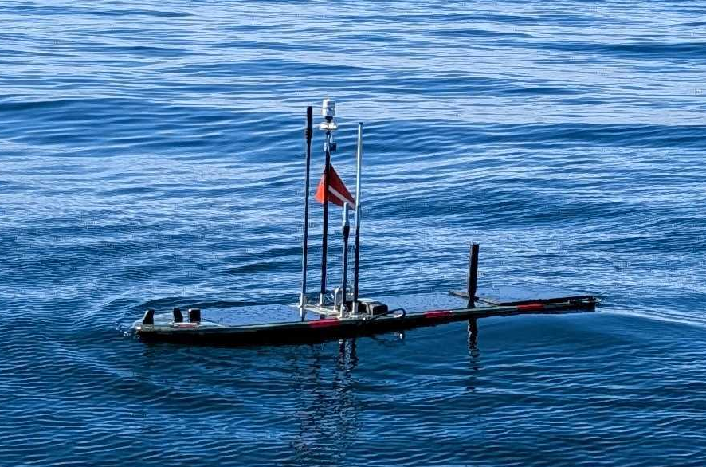
PURCHASE REVIEW · OCTOBER 1, 2026
Seasats Lightfish
MBARI New ASV
Selecting a Autonomous Surface Vehicle
Open Ocean Robotics DataXplorer
Erik Trauschke, Brian Kieft, Chris Wahl, Quinn Shemet
Liquid Robotics Wave Glider

Slide 2




History
Current fleet is obsolete
We currently have 3 Wave Glider SV3-200s: obsolete, but still functional.
Maintainability at risk
We have some spare parts, but long-term maintainability is not guaranteed.
Not suited to every use case
Works for current users, but not suitable for some potential users (e.g., mapping).
Requirements gathered from labs
Collected needs from MBARI labs that currently use, or want to use, an ASV.
MBARI's current Wave Glider SV3-200

Slide 3











Requirements
Payload size, weight & power
Duration
Range
Data needs
90 × 30 × 30 cm (81 L), 30 kg, 120 W max, 2 kWh for payload
Up to 6 months; main usage under 1 month
Up to 160 nm; main usage under 20 nm
A few labs need a high-speed link (20 Mbps); most do not
Vehicle noise
Deployments outside Moss Landing
Self-operated by lab
Maneuverability & speed
As low as possible to support highly sensitive sonar payloads
Needed by some labs; platform must ship easily
Most prefer ops by ASO; some want to drive themselves
Keep up with AUV/glider; boat-less dock launch; consistent mapping speed
Event response
Vendor relations
Ship operations
Recommendation
Rapid transit and high maneuverability to respond to events
Low-level vehicle access needed for some use cases
Deployment / recovery with RV Paragon
To meet most of the requirements:
electric propeller-driven vehicle

Slide 4






Payload Challenges
Water-property sensors
Bioacoustics
Mapping
Most chemical and optical sensors (CTD, CO₂, fluorometer, etc.) work on any vehicle
Requires a low-noise vehicle and high pitch/roll stability
Requires maneuverability, consistent speed and enough battery power
ANY VEHICLE
FAVORS WAVE GLIDER
PROP-DRIVEN ONLY
ESP
Data relay
AUV intervention / deployment / recovery
Large payload, likely doesn’t fit the Wave Glider; needs 2 kWh of battery (more if cooling is necessary)
Requires consistent speed; Wave Glider can barely keep up with LRAUV and would not work for Dorado
Needs towing capacity, high speed and high maneuverability
PROP-DRIVEN
PROP-DRIVEN
PROP-DRIVEN
Takeaway: only bioacoustics favors the Wave Glider; most other payloads need a prop-driven vehicle

Slide 5
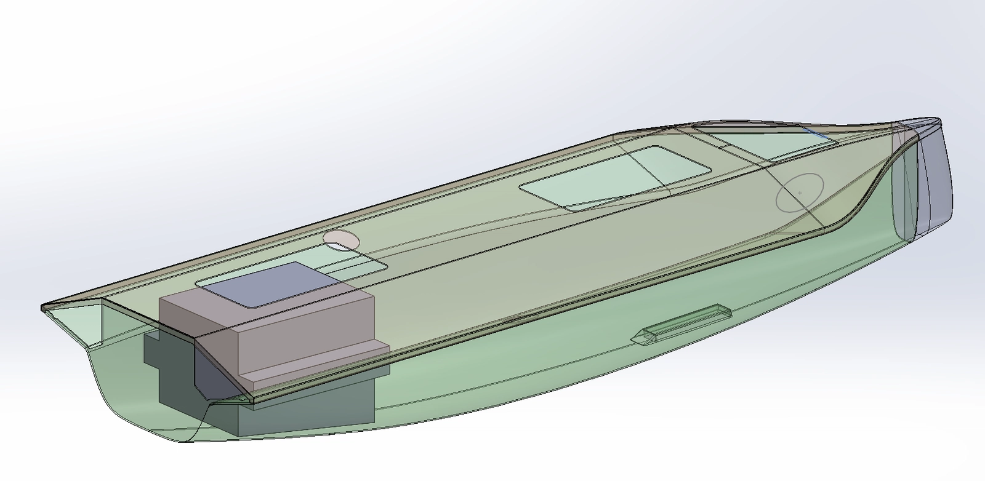
CHOICE 1 Seasats Lightfish
3.5 m
4.0 kWh
4.5 kn
6 mo
Length
Li-ion battery
Sprint speed
Endurance
Dimensions | 3.5 × 1.0 m (11.4 × 3.4 ft); 0.8 m draft
Weight | 132 kg base, up to 181 kg fully loaded
Payload | 77 L bay, up to 30 kg
Payload power | 20-30 W steady; bursts to 300+ W
Energy | 4.0 kWh Li-ion battery + 415 W solar (opt. methanol generator)
Speed | 4.5 kn sprint / 2 kn cruise
Range | ~575 nm on battery alone; 6,000+ nm with solar
Propulsion | Electric (Torqeedo, ~3 HP equiv.), weedless prop
Comms | LTE, Iridium SBD/Certus; optional Starlink, MANET
Vendor | Seasats (San Diego, CA)
Hull concept (left) and Lightfish underway (top). Source: Seasats.

Slide 6
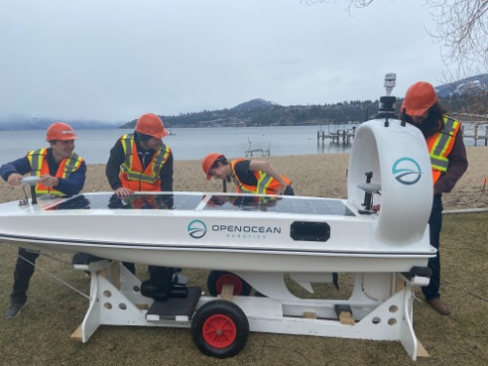
CHOICE 2 Open Ocean Robotics DataXplorer
3.7 m
3.5-17.5 kWh
6 kn
500 nm
Length
Battery options
Max speed
Range, max battery
Dimensions | 3.7 × 0.9 m (12.2 × 2.9 ft); 0.5 m draft
Weight | 143 kg (std. battery) to 204 kg (max battery)
Payload | Up to 50 kg
Energy | 3.5 kWh std., expandable to 17.5 kWh; 270 W solar
Speed | 2 kn cruise / 6 kn max
Range | ~100 nm on std. battery; up to 500 nm with max battery
Propulsion | Electric, ~3 HP equivalent
Hull | Patented self-righting design
Comms | 4G cellular, Iridium Certus-100, AIS Class B
Vendor | Open Ocean Robotics (Victoria, BC)
Field assembly (left) and DataXplorer on the water (top). Source: Open Ocean Robotics.

Slide 7

CHOICE 3 Liquid Robotics Wave Glider SV3-300
1 yr
45 kg
1 kn
4.5 kWh
Endurance
Max payload
Typical speed
Max battery
Dimensions | 3.05 m float + 2.13 m sub, 4 m umbilical
Weight | ~150 kg (vehicle only)
Payload | Up to 45 kg / 93 L; up to 7 modular bays
Payload power | 5-20 W average; 360 W peak
Energy | 0.9-4.5 kWh battery + 150 W solar
Speed | ~0.8 - 1 kn typical / 3 kn max
Endurance | Up to 1 year at sea
Propulsion | Wave-powered fins + electric thruster backup
Comms | Iridium 9602/RUDICS, cellular option, WiFi, Starlink
Vendor | Liquid Robotics / Boeing (Sunnyvale, CA)
Photo: one of MBARI's current Wave Glider SV3-200s.
Wave-driven: not the recommended electric-propeller design

Slide 8
Comparison of Vehicles
 | Seasats Lightfish | Open Ocean DataXplorer | Liquid Robotics Wave Glider SV3
Length | 3.5 m | 3.7 m | 3.05 m float + 2.13 m sub
Weight | 132-181 kg | 143-204 kg | ~150 kg
Payload | 77 L / up to 30 kg | Up to 50 kg | Up to 45 kg / 93 L
Energy storage | 4.0 kWh + 415 W solar | 3.5-17.5 kWh + 270 W solar | 0.9-4.5 kWh + 150 W solar
Speed | 4.5 kn sprint / 2 kn cruise | 6 kn max / 2 kn cruise | 3 kn max / 0.8 - 1 kn typical
Range / endurance | ~575 nm battery; 6,000+ nm w/ solar | ~100 nm std.; 500 nm max battery | Up to 1 year at sea
Propulsion | Electric propeller | Electric propeller | Wave energy + electric backup
Data link | LTE, Iridium SBD/Certus, Starlink | 4G, Iridium Certus-100 | Iridium 9602, cellular, WiFi, Starlink
Rough cost | ~$300K | ~$300K | ~$300K
Electric propeller (recommended) | ✓ Yes | ✓ Yes | ✕ No (wave-driven)

Slide 9
Requirements & Feature Matrix
Seasats Lightfish
Open Ocean DataXplorer
Wave Glider SV3
Maneuverability & speed
Station keeping, mapping lines
Electric propeller; no issues noted
Electric propeller; no issues noted
Speed not consistent; can't station keep or run mapping lines
MEETS
MEETS
FAILS
Low noise
Sensitive sonar payloads
Possibly fails; unknown until payload is integrated
Possibly fails; unknown until payload is integrated
Quiet, wave-driven platform
RISK
RISK
MEETS
Payload bay
Must fit the ESP
Large, open payload bay
Somewhat restricted, but large enough for ESP
Small bay; likely can't fit the ESP
STRONG
ADEQUATE
WEAK
Data & user interface
Science data, command & control
Good data and user interface
Very sophisticated data and user interface
Hard science data download; poor C2 user experience
GOOD
STRONG
WEAK
Vendor support
Low-level access & modifications
Very strong support for low-level vehicle access
Some openness to low-level access
Little support beyond what we already do
STRONG
ADEQUATE
WEAK
Event response
Rapid transit to events
~1 kn typical; slow to reach events, hard to use for intervention
MEETS
High speed and agility
MEETS
High speed and agility
FAILS
Stability
Roll / platform stability
Keel improves stability
Least roll stability of the three
Best stability (glider design)
MODERATE
WEAK
STRONG

Slide 10
Thank you!
Questions?
www.mbari.org

