Slide 1
Monterey Bay Aquarium
Research Institute
MBARI New ASV
YOUR NAME HERE

Slide 2
WaveGlider phaseout plan
- Current WaveGliders are obsolete but functional
- We still can get some parts repaired/sourced but can’t rely on that going forward
- We have 3 WG operational, have spares for certain things but not everything
- Planning to not replace fleet wholesale, just move to deploying some of the payloads
to the new platform (allows to spread cost out over several years)
- Still have software support from LR, we should be able to run our WaveGlider for the
foreseeable future
- This will allow for some projects to keep using the old WGs if necessary, will improve the
spares situation
- will have to assess during proposal cycle how many new vehicles to buy outright, note
that it’s not just the cost of the vehicle but also for essential spares to run them
- Note that we are not planning to increase ASV operations as a whole, we are still limited
by how much personnel we have to support ops

Slide 3
Selection Process
1.) Gather requirements
2.) Determine if all can be met with a single vehicle type (this decision is not due now)
3.) Limit search to a small category of vehicles
4.) Select vehicle out of list above based on cost, usability, reliability and supportability
5.) Request new vehicle in 2026 Proposal Cycle for purchase 2027
Notes:
Request feedback from users at each step to make sure everyone’s needs are
considered (there can’t be a guarantee that everyone’s needs are met)

Slide 4
Current progress
1.) Gather requirements
- some groups responded with requirements (thanks!)
- requirements were merged into single spec that should meet all reported needs
- some vehicle categories that meet this spec have been investigated
2.) Determine if all can be met with a single vehicle type
- currently in process
- we have some flexibility since we are not planning to buy a whole fleet in 2027
3.) ...

Slide 5
MBARI payload requirements questionnaire results
Payload size, weight and power:
90x30x30cm = 81l, 60 lbs, 60W
Duration
up to 6 months (most only need 1 month)
Range
up to 160 nm, (most only need <20nm)
Data needs
few need high speed link (20 MBps), most do not
Deployment outside of ML
needed by some labs
Self-operated
most prefer ops by ASO, some want to drive themselves

Slide 6
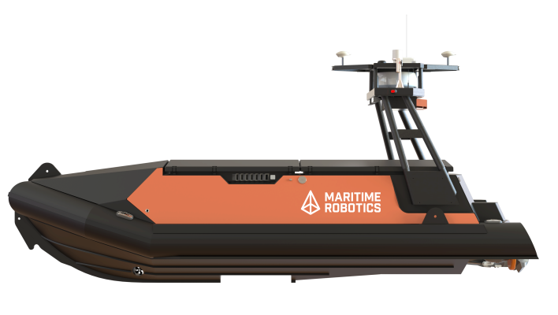
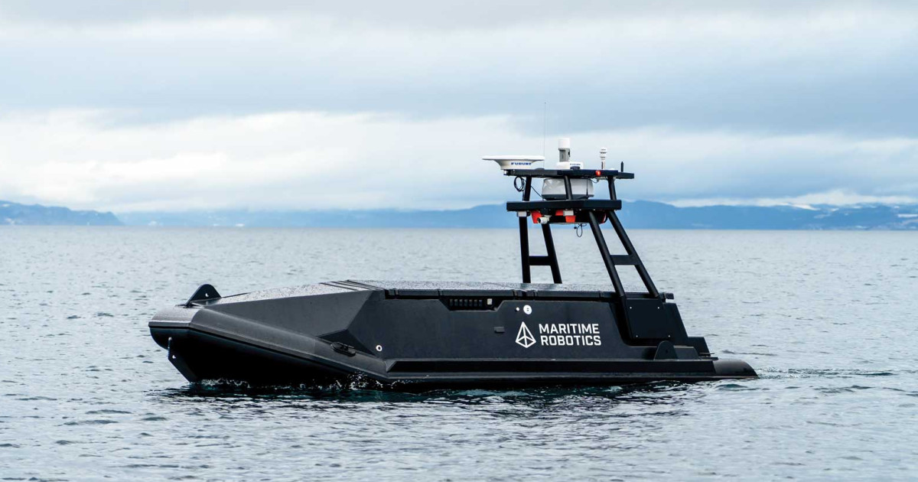
Maritime Robotics Mariner
- Length: 6m (19.8ft)
- payload: 400kg
- weight: 2000 kg
- draft: 0.5m
- speed: 24kn
- range: 200nm

Slide 7
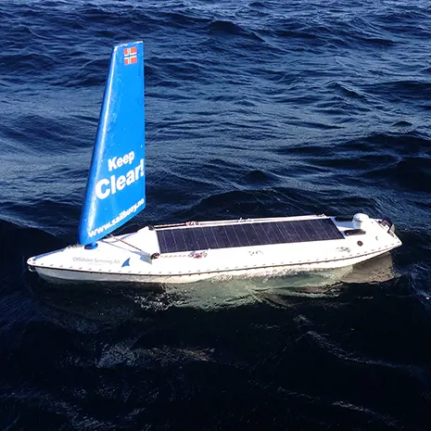
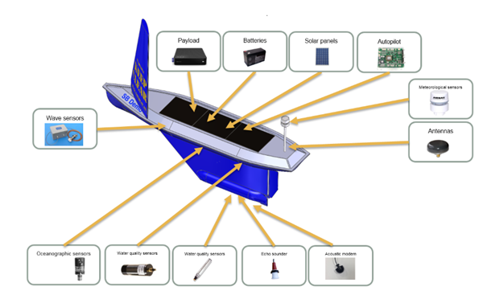
Sailbuoy
- Length: 2m (6.6ft)
- payload: 60l / 15kg / 30W
- weight: 60kg +
- draft ?

Slide 8
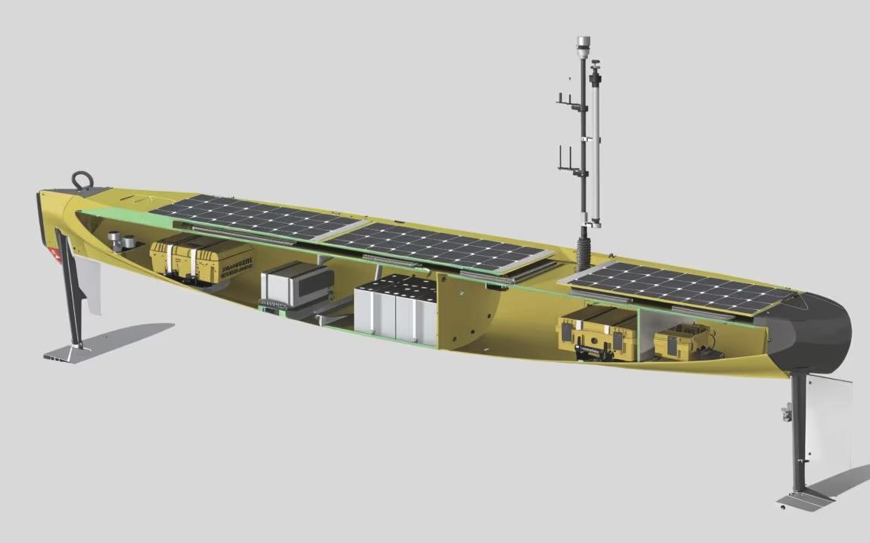
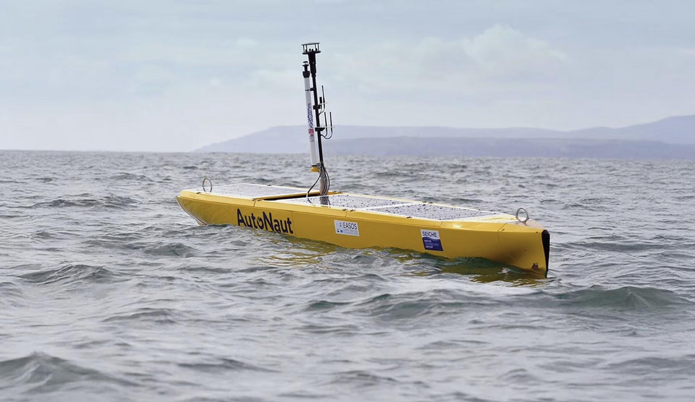
Autonaut 3.5
- Length: 3.5m (11.5ft)
- payload: 270l / 40kg
- weight: 180 kg+
- draft 0.6m
- speed: ?
- range: ?

Slide 9
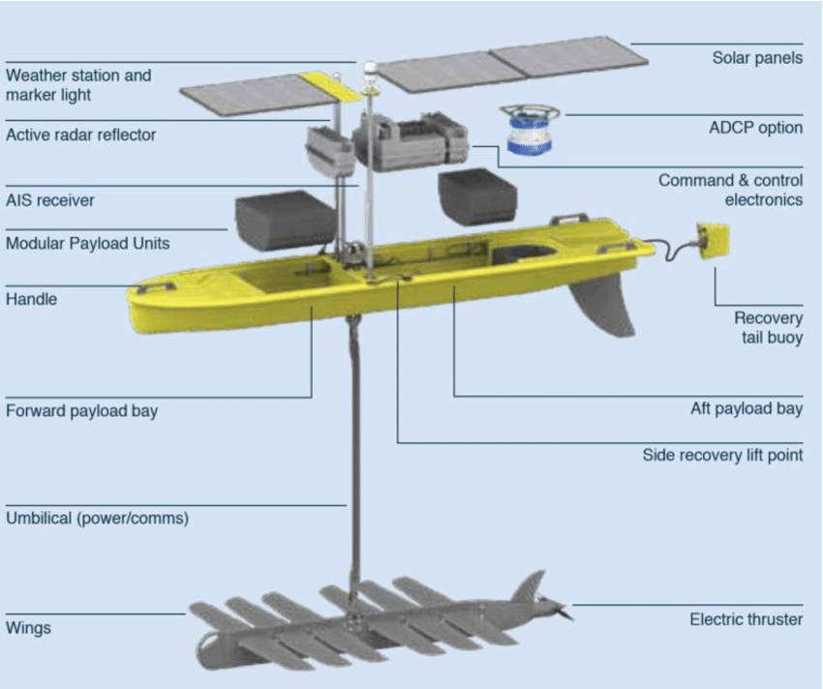
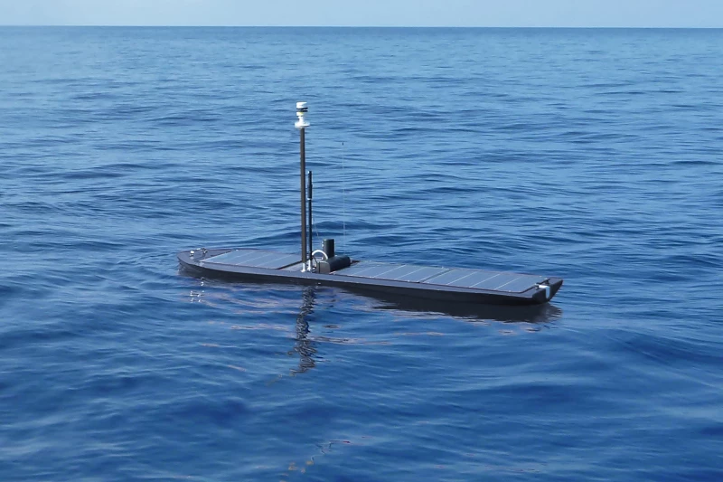
WaveGlider SV3-300
- Length: 3.05m (10ft)
- payload: 93l / 45kg / 360W
- weight: 150kg
- draft 4m (8m)
- speed: 0.8 – 2kn
- range: (360nm)

Slide 10
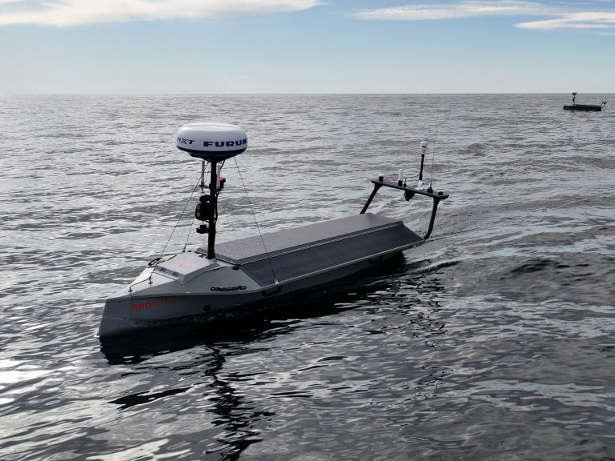
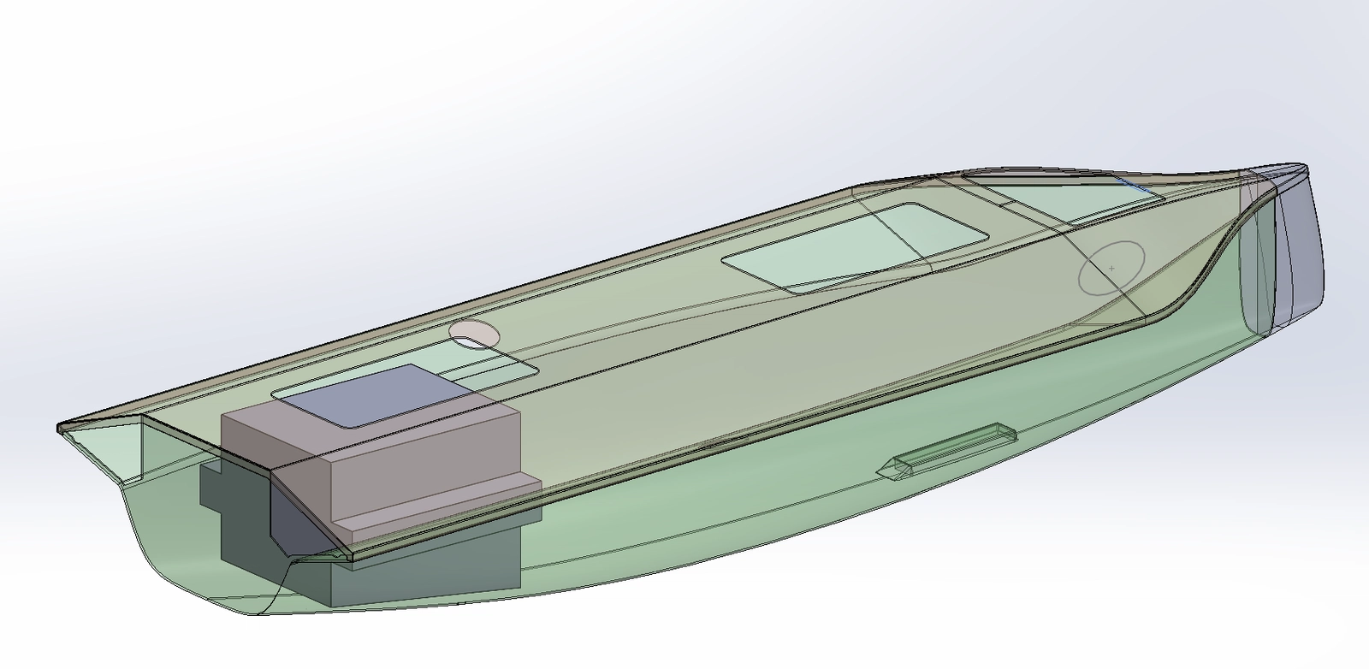
SeaSats LightFish
- Length: 3.50m (11.4ft)
- payload: 77l / 30kg / up to 300W
- weight: 190kg
- draft: 0.8m
- speed: 4kn
- range: 575 nm

Slide 11
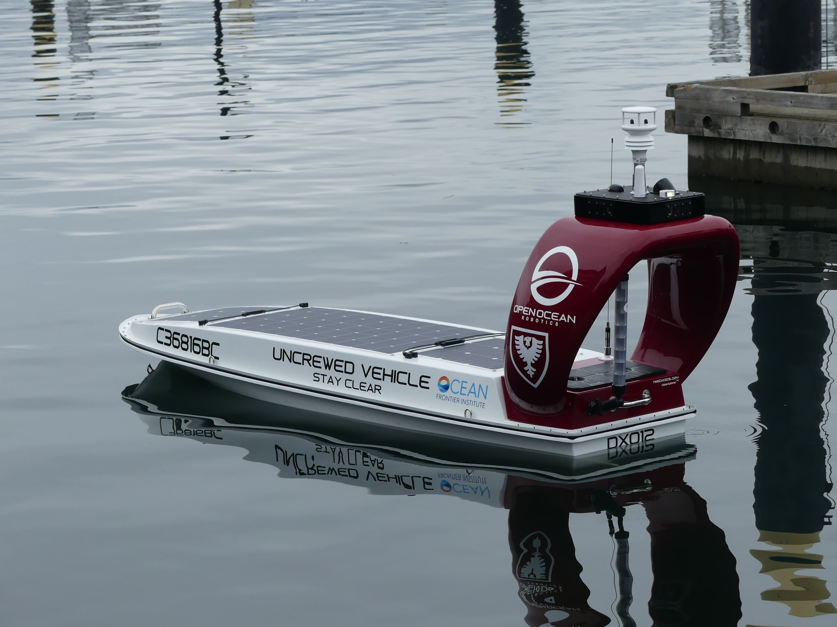
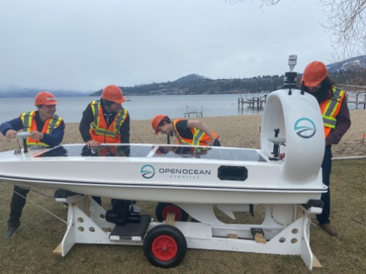
Open Ocean DataXplorer
- Length: 3.7m (12.2ft)
- payload: 50kg / 300W
- weight: 200kg
- draft 0.5m
- speed 2-6kn
- range: 500nm

Slide 12
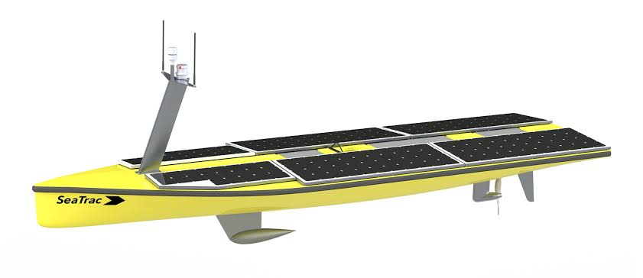
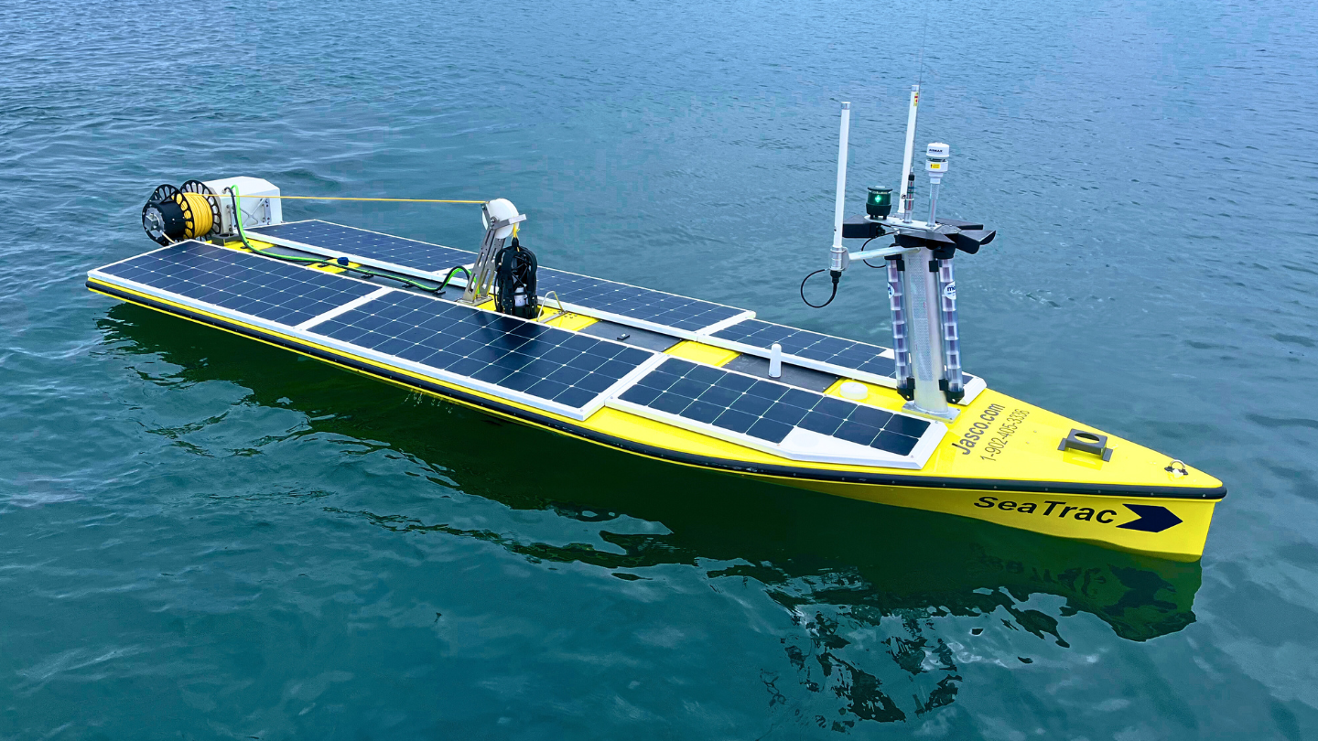
Seatrac
- Length: 4.8m (15.7ft)
- payload: 70kg / 500W
- weight: 250kg +
- draft: 0.4m
- speed: 3 kn (4.5 max)
- range: ? (>1 month out)

Slide 13
Thank you!
Questions?
www.mbari.org

