Slide 1
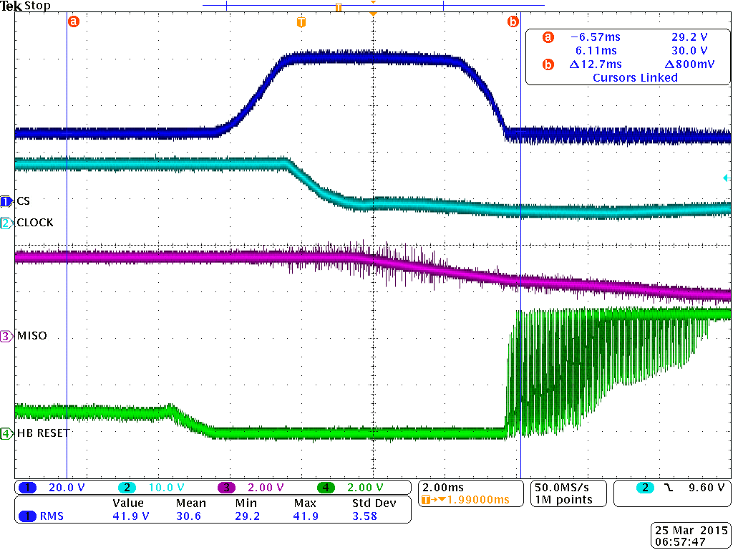
Batt Voltage
12VDC
3.3 VDC
Batt Current
1.6A/Volt

