Slide 1
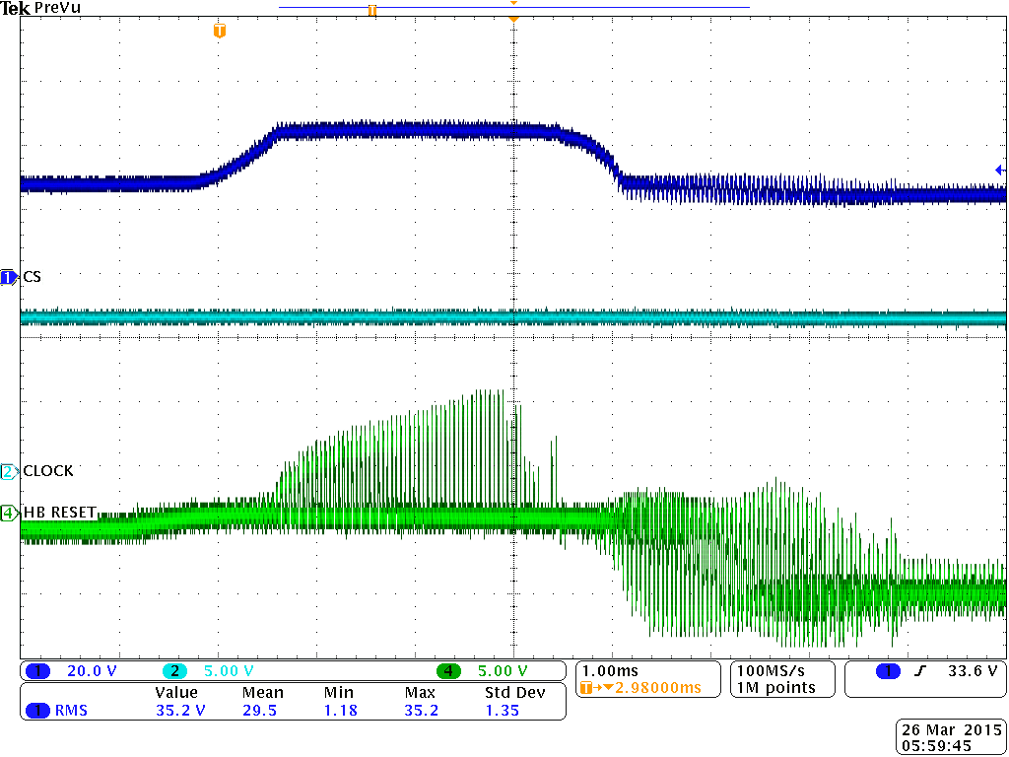
Battery Bus
Battery Bus
174 W-msec from Excel Calc
-380 uSec to 4.2 mSec
17% duty cycle per MSO4034 meas.
6A * 43V * 4.58mSec *.17 = 200 W-msec
TCP312 Current Probe on 1N6286A 1A/V arrow toward diode +Elmo term.

