Slide 1
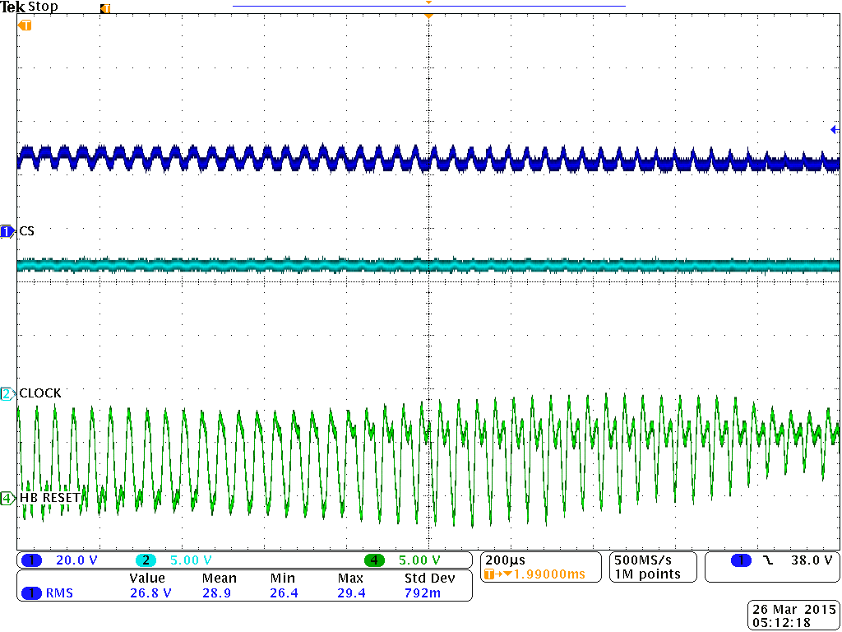
Battery Bus
12VDC Bus
TCP312 Current Probe on 1N6286A 1A/V

