Slide 1
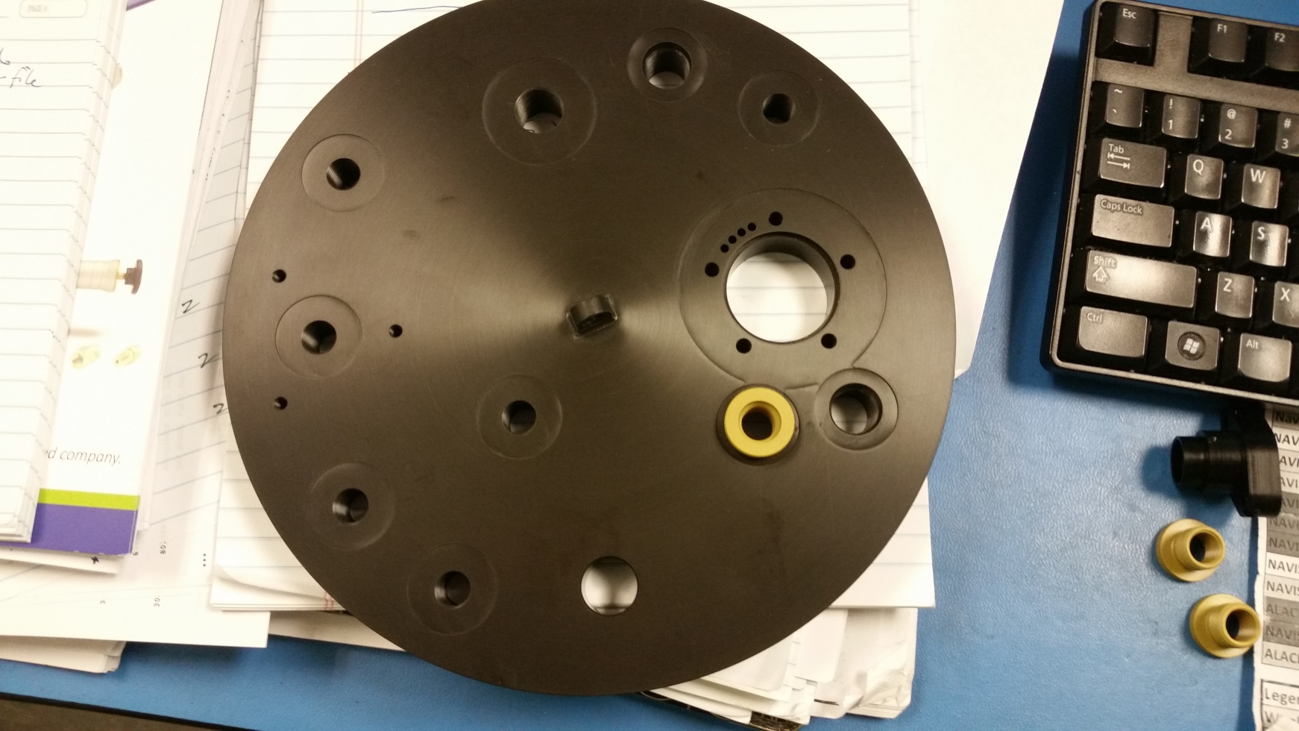
MBARI CPF Endcap 88106P
Pressure transducer port

