Slide 1
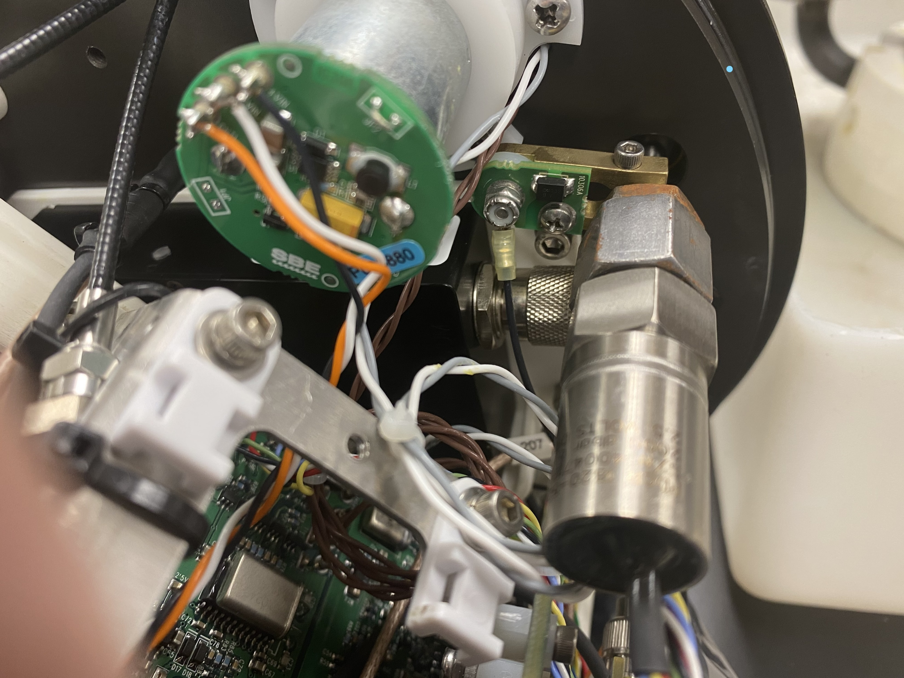
Seabird 41 Transorb CCA
Wired connection to housing
Seabird 41 pressure transducer. Wet parts are isolated from housing but exposed to seawater.

