Slide 1
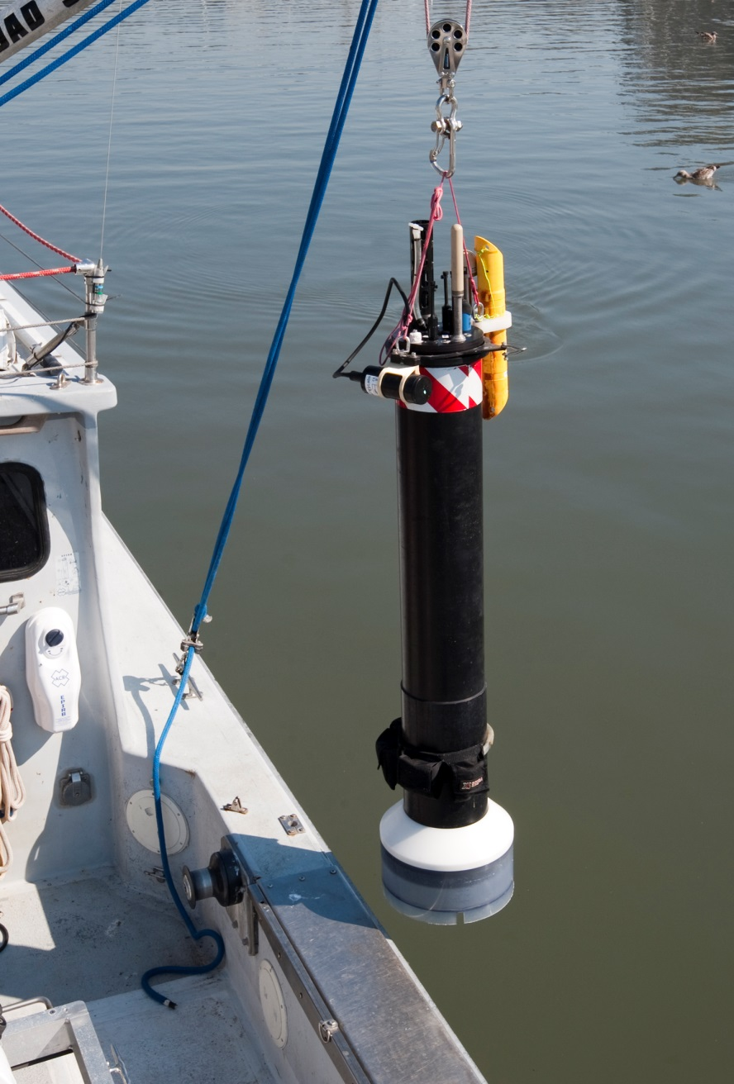
Lost CTD
Inlet
Lost Antenna
and Stem
1.6 meters
(64 Inches)

