Slide 1
Coastal Profiling Float
High Density Battery Pack
Concept Design Review

Slide 2
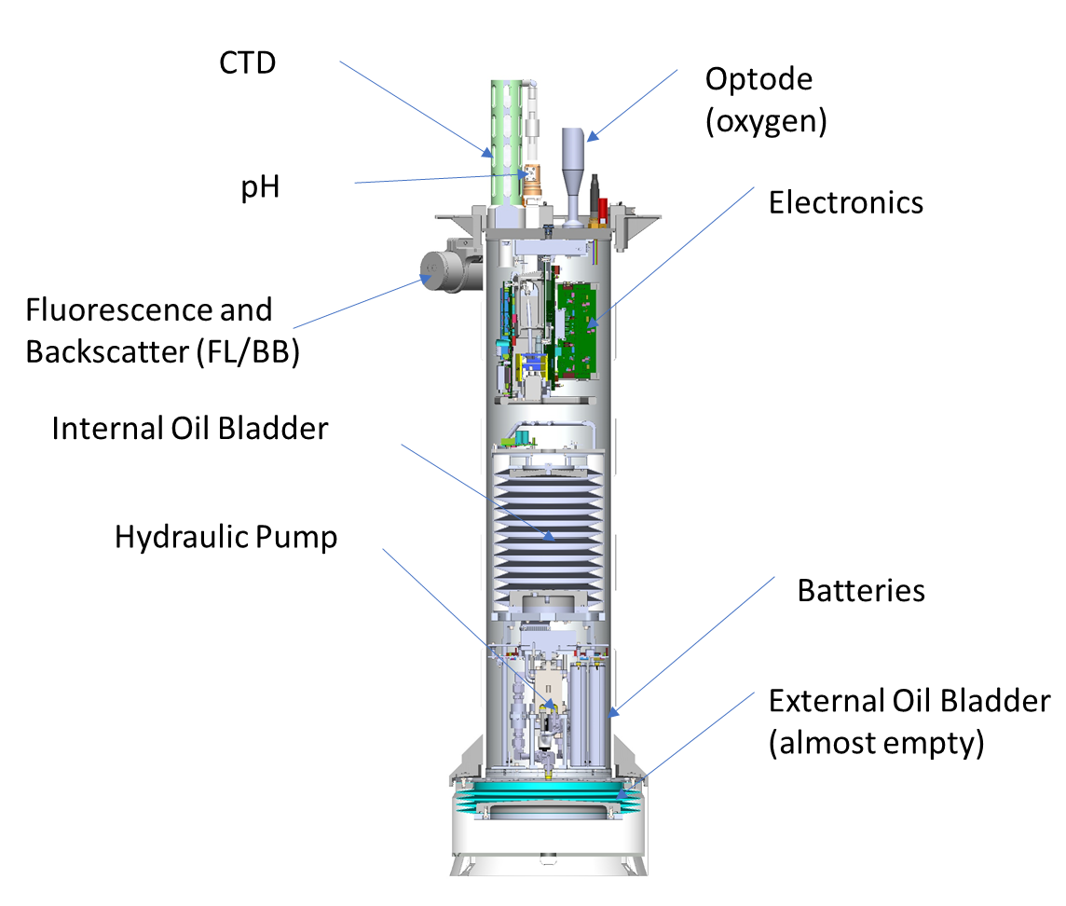
Executive Overview (Gene)
Maximizing battery pack energy density is crucially important to many MBARI development projects
The CPF is the first project to pursue a soup to nuts “high density” pack design here at MBARI
We need to find the right balance between safety and energy density
Personnel safety is priority 1.
high density = Joules/cm^3, Joules/kgf, Joules/$

Slide 3
Current Safety Requirements (Ed)
Summary of Ed’s req’ts document

Slide 4
System Concept (Gene)
System block diagram with bullet points

Slide 5
Mechanical Concept (Gene)
SW Drawings with bullet points
I’m not sure if this should go here or later in the presentation

Slide 6
BPM Concept (Chad)
BPM block diagram(s) with bullet points

Slide 7
LHE Concept (Ed)
Block Diagram with bullet points

Slide 8
Software concept (Eric and maybe Gene)
Block diagrams with bullet points

