Slide 1
Depth Control & Mission Operations
Coastal Profiling Float
By Brian Ha
Notes:
80% on Depth Control
20% on Mission Operations.

Slide 2
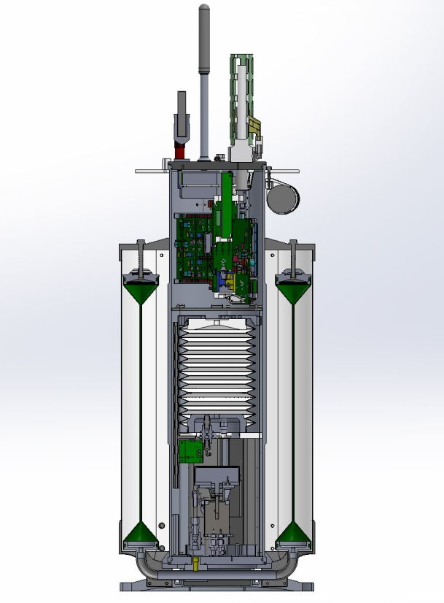
What is a Coastal Profiling Float (CPF)?
A CPF is an oceanographic instrument platform optimized for making subsurface measurements in coastal areas.
It measures CTD, pH, nitrate, oxygen, fluorescence, backscatter, and sunlight.
Buoyancy is adjusted by pumping oil into and out of an outer bladder. Specifically, we have control over the pump speed.
Biogeochemical Sensors
Electronics
Inner Oil Bladder (full)
Outer Oil Bladder (empty)
Hydraulic Pump

Slide 3
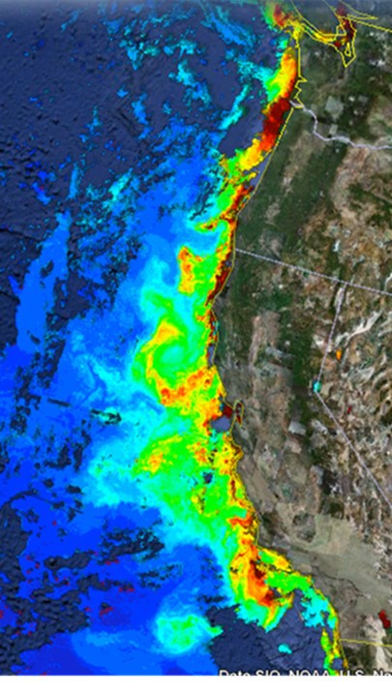
Why CPFs?
MODIS Chlorophyll
June 28, 2011
Science-based policy for marine resources requires an understanding of primary production rates.¹
Coastal areas represent only 5-10% of the global surface area, yet they are estimated to contribute as much as 10-30% of global primary production.²
No observing system currently exists with the resolution and frequency required to understand coastal ecosystem processes.
Notes:
Start with a statement of what the picture is.
Be sure to tie it in with science-based policy: “You can see how complex it is…”

Slide 4
Typical Mission Profile
Slide Credit: Nick Raymond, 2016 MBARI Intern
5. Relay Data via Iridium Satellites
1. Deploy & Descend
2. Drift Due to Ocean Current
4. Take Measurements During Ascent
3. Descend to Target Depth or Anchor on Bottom
Notes:
Start by describing the mission profile.
Next, be sure to point out that the float is designed to operate 2-3 years.
Lastly, point out the following:
We use the subsurface currents to counter drift on the surface.
We don’t want to strike the bottom of the ocean.
They are the motivation for a good depth controller.
Both of these motivate my first project:

Slide 5
CPF Depth Control
Project #1 of 2

Slide 6
The Depth Control Problem
Due to the underlying physics, the current depth controller results in an undamped oscillation about a target depth.
This wastes battery energy, significantly shortening the lifespan of a CPF.
A new controller is required…

Slide 7
Basics of Feedback Control
Desired
Depth

Slide 8
Basics of Feedback Control
Desired
Depth
Measured
Depth

Slide 9
Basics of Feedback Control
Desired
Depth
+
-
Measured
Depth

Slide 10
Basics of Feedback Control
Depth
Error
Desired
Depth
+
-
Measured
Depth

Slide 11
Basics of Feedback Control
Depth
Error
Pump
Speed
Desired
Depth
Controller
+
-
Measured
Depth

Slide 12
Basics of Feedback Control
Depth
Error
Pump
Speed
Desired
Depth
Controller
CPF
New
Depth
+
-
Measured
Depth

Slide 13
Basics of Feedback Control
Depth
Error
Pump
Speed
Desired
Depth
Controller
CPF
New
Depth
+
-
Measured
Depth

Slide 14
Basics of Feedback Control
Depth
Error
Pump
Speed
Desired
Depth
Controller
CPF
New
Depth
+
-
Measured
Depth

Slide 15
Basics of Feedback Control
Depth
Error
Pump
Speed
Desired
Depth
Controller
CPF
New
Depth
+
-
Measured
Depth
The controller is an equation that relates depth error to pump speed.

Slide 16
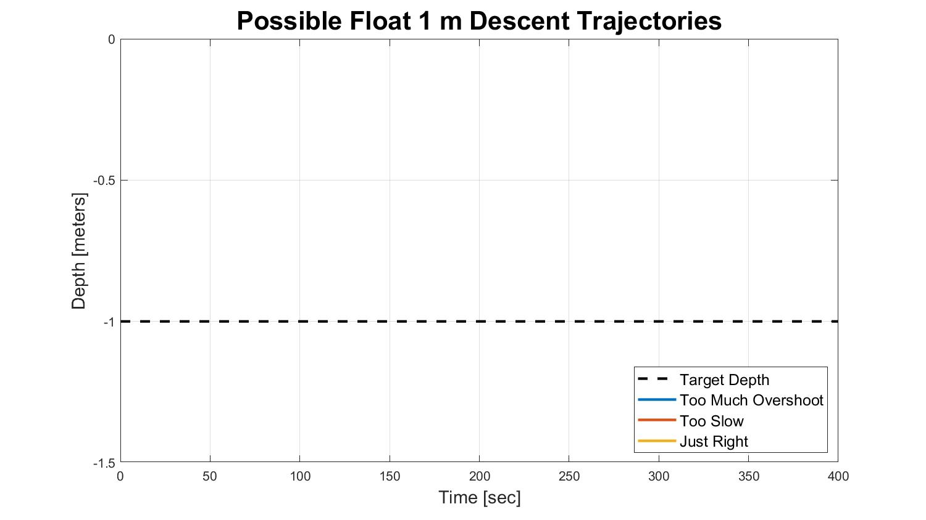

Slide 17
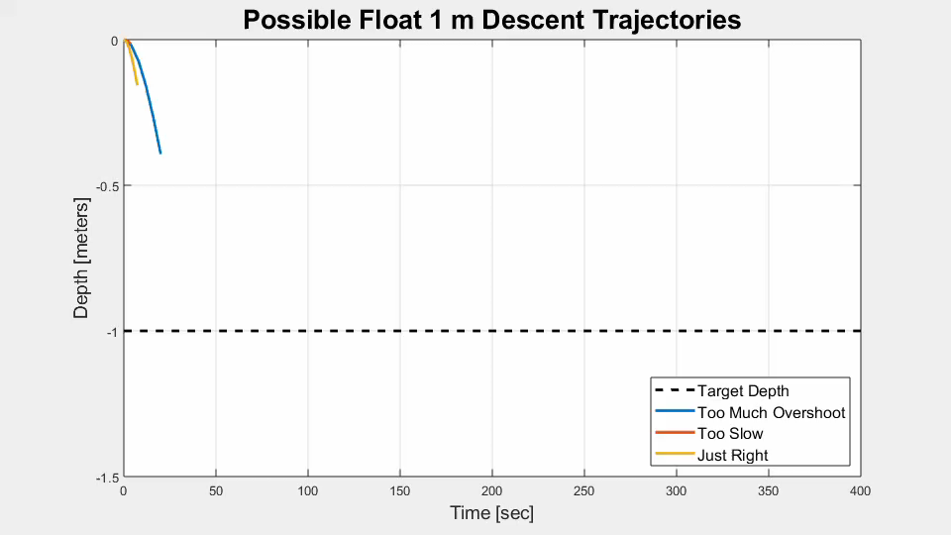

Slide 18
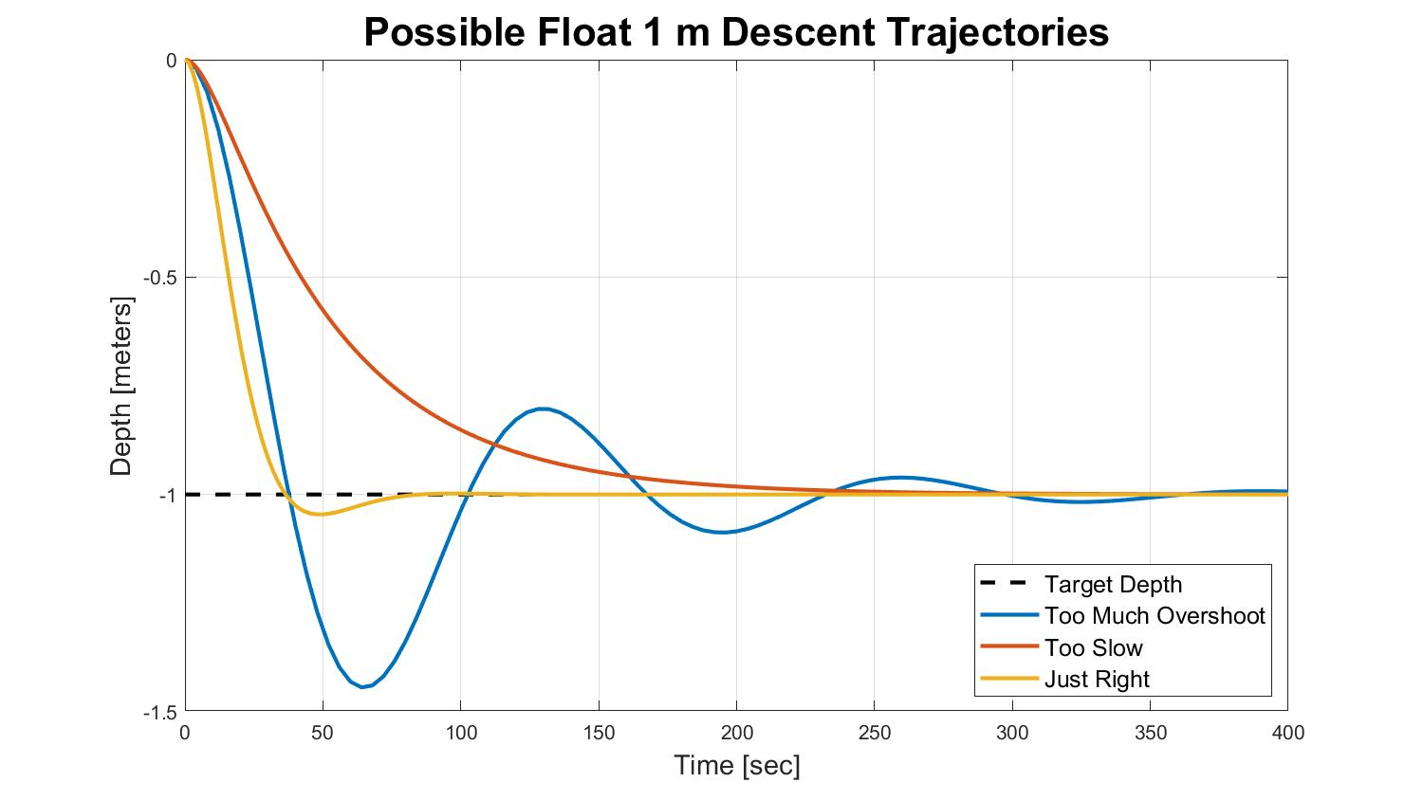
Too Much
Overshoot is Bad.

Slide 19
Requirement: No more than (roughly) 25%
Too Much
Overshoot is Bad.

Slide 20
Long Convergence Times are Bad.

Slide 21
Requirement: (roughly) 50-150 seconds for 1 m
Long Convergence Times are Bad.

Slide 22
New Controller:
Dual Lead Compensator

Slide 23
New Controller:
Dual Lead Compensator
(Again, it’s just an equation that takes in
depth error and spits out pump speed)

Slide 24
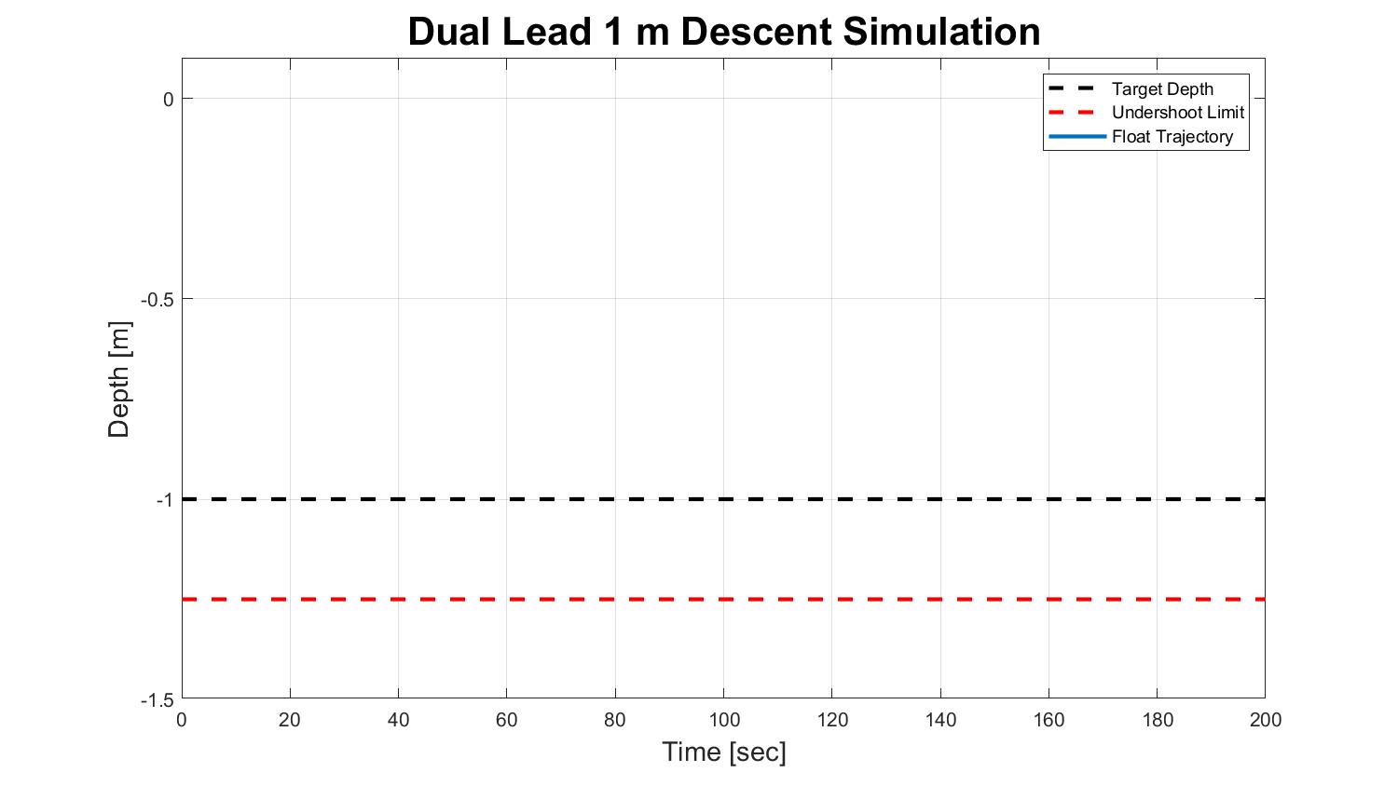

Slide 25
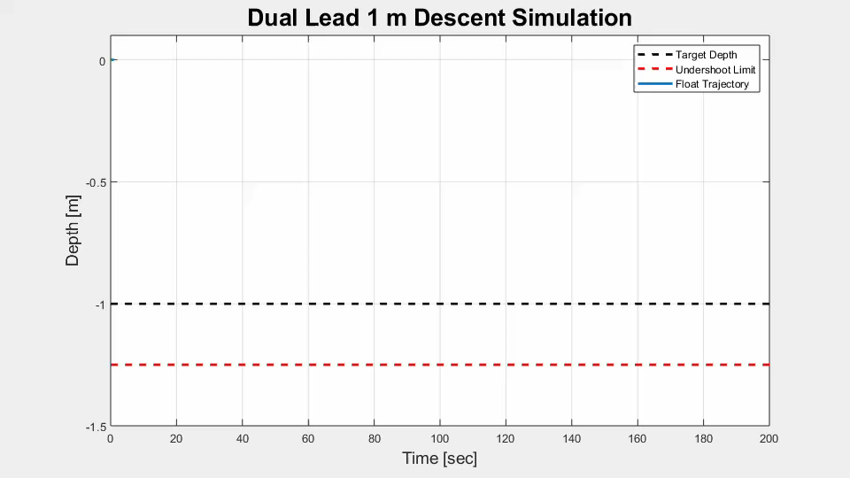
Notes:
Mention that it meets the undershoot and convergence time requirements.

Slide 26
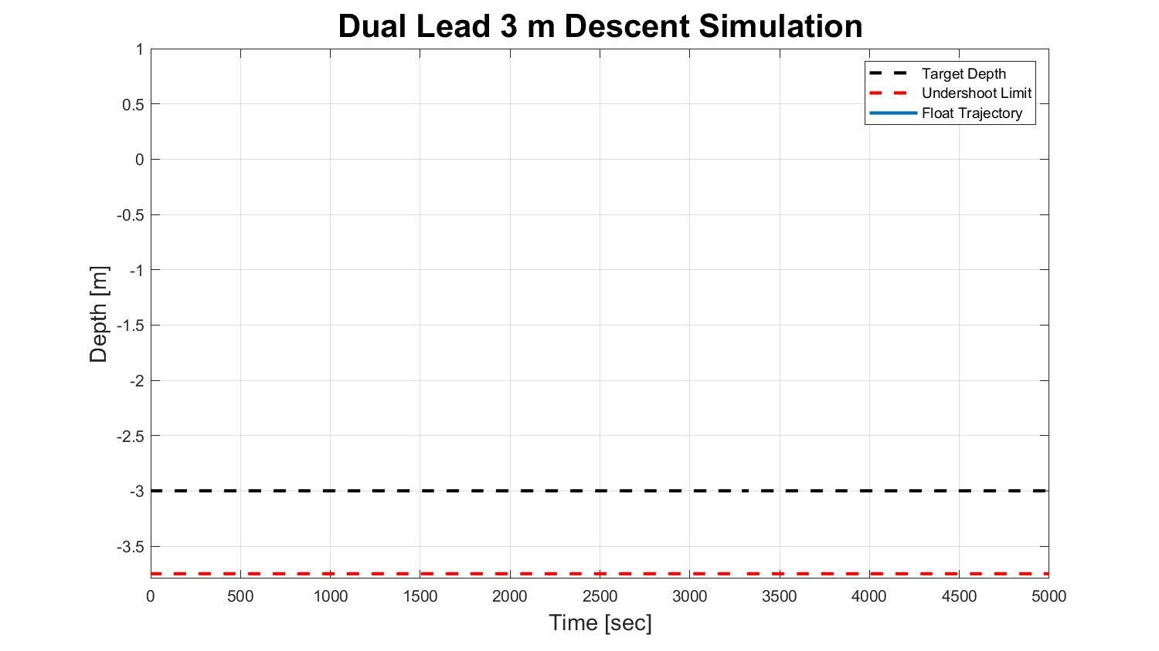

Slide 27
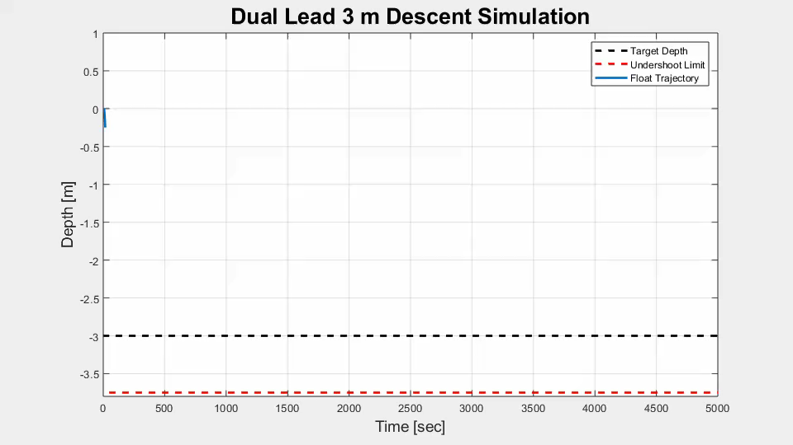
Notes:
Mention that the convergence time is now more than an hour long and that the float rises above its starting depth. This was BAD.

Slide 28
New Controller:
Dual Lead Compensator

Slide 29
New Controller:
Dual Lead Compensator
+ Error Governor

Slide 30
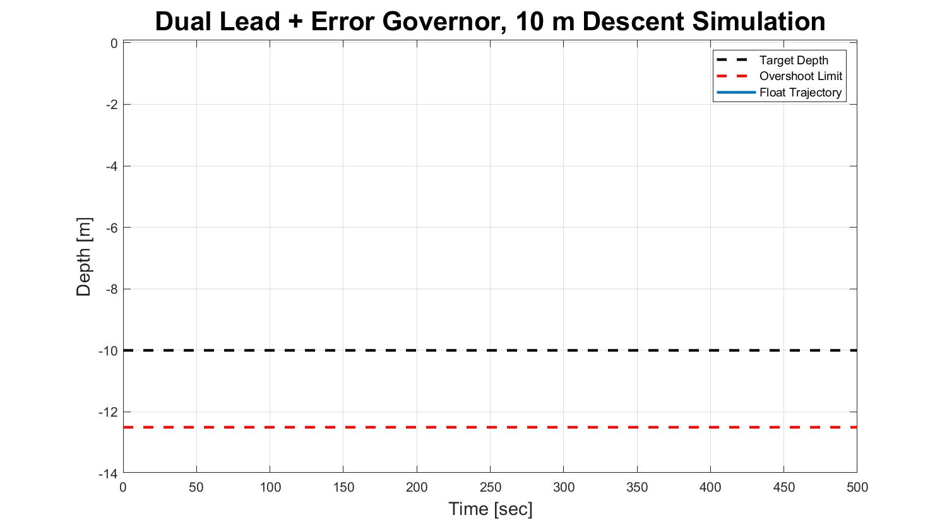

Slide 31
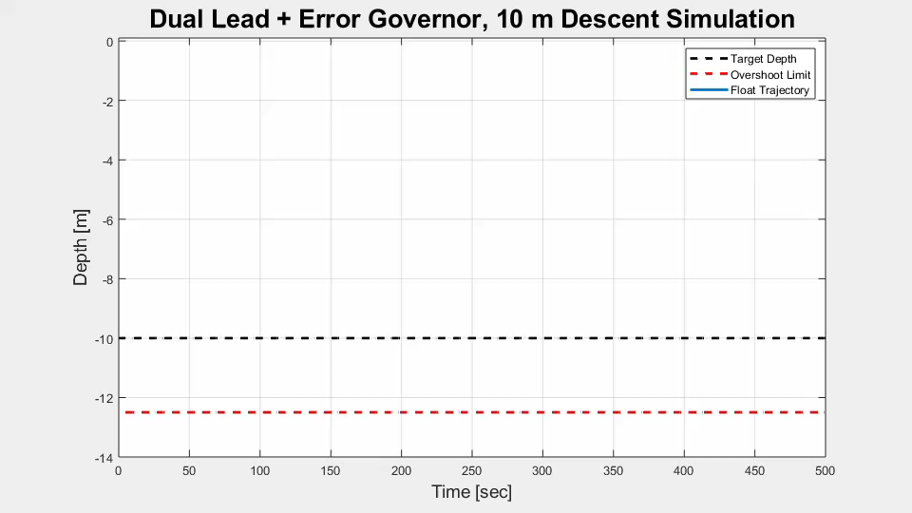

Slide 32
Next Steps
Program controller in C#.
Try it in the test tank!

Slide 33
CPF Mission Operations
Project #2 of 2

Slide 34
Typical Mission Profile
Slide Credit: Nick Raymond, 2016 MBARI Intern
5. Relay Data via Iridium Satellites
1. Deploy & Descend
2. Drift Due to Ocean Current
4. Take Measurements During Ascent
3. Descend to Target Depth or Anchor on Bottom
Notes:
We use the subsurface currents to navigate.
We don’t want to strike the bottom of the ocean.
Both of these motivate my first project:

Slide 35
The Mission Operations Problem
Currently, CPF data is processed by hand.
  Data is downloaded as an email attachment
  MATLAB and C# scripts are executed manually to visualize the data
  Commands are typed up and emailed back.
As the CPF fleet transitions from development into operations, this workflow will not scale.
Mission operations-specific software is needed.

Slide 36
Requirements
Data processing should be completely automatic.
A graphical user interface (GUI) should allow users to review data
The GUI should provide validation of commands

Slide 37
Notes:
This slide was intentionally left blank. It serves as a cue for me to transition to Google Chrome to view the website at https://cpf.mbari.org.

Slide 38
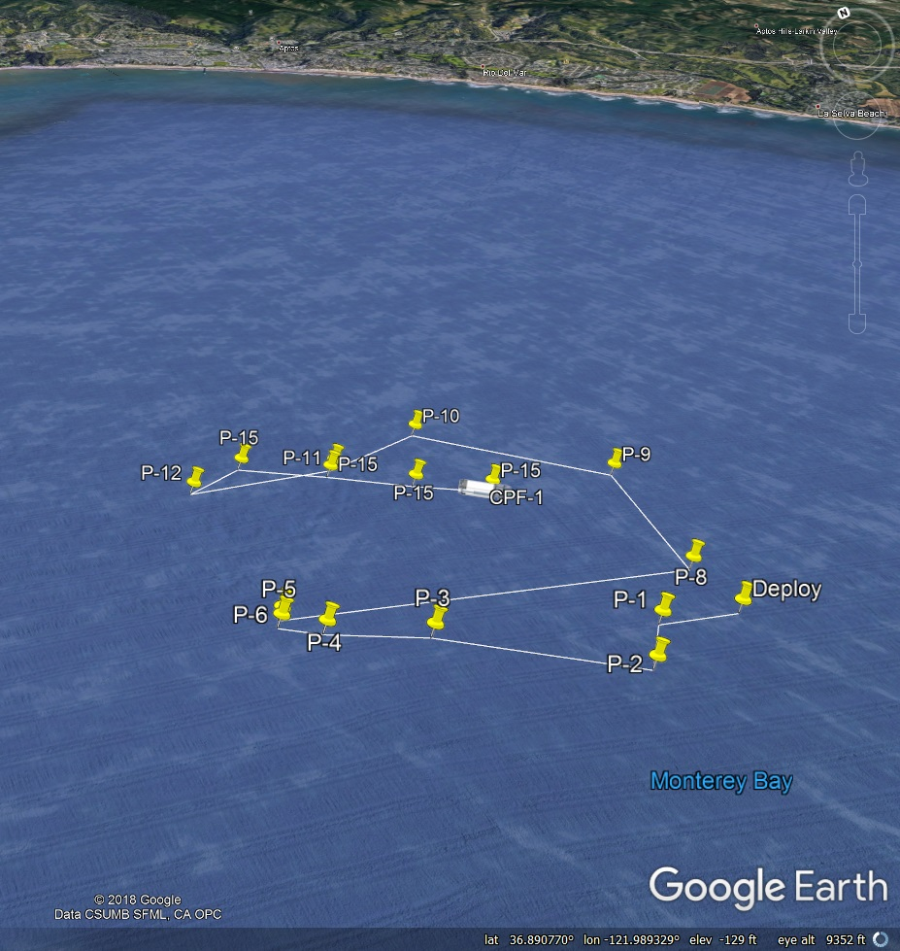
Tracking
A .kml file is automatically updated for each CPF whenever new location data is received
Users can view these .kml files in Google Earth to check CPF drift.

Slide 39


Acknowledgements
Gene Massion
Doug Conlin, Joe Gomez, Pat Allen, and Mike Neal
George Matsumoto and Linda Kuhnz
The 2018 MBARI Interns

Slide 40
References
Ryther, J. H. (1969) Photosynthesis and fish production in the sea. Science, 166, 72-76.
Benway, et. al. (Editors), 2015. An interdisciplinary science plan for research in North American continental margin systems. Report of the Coastal CARbon Synthesis (CCARS) community workshop, August 19-21, 2014, Ocean Carbon and Biogeochemistry Program and North American Carbon Program, 68 pp.

Slide 41
Backup Slides

Slide 42
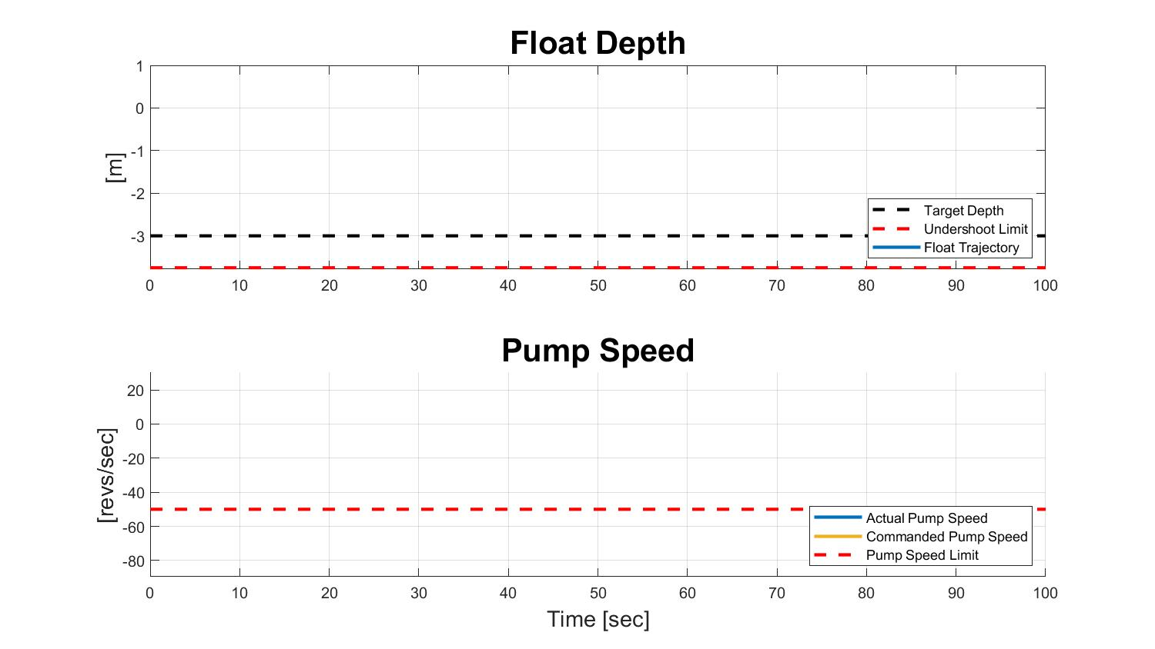

Slide 43
