Slide 1
Command & Control
Coastal Profiling Float

Slide 2
Overview

Slide 3
Profiling Floats - Background
Used for subsurface measurements
Cheap!
Widespread use (ARGO)
BioGeoChem
Show Profile

Slide 4
Profiling Floats – How They Move

Slide 5
Profiling Floats – How They Move

Slide 6
COASTAL Profiling Floats
List differences compared to deep water
Risk of running aground
Risk of colliding with the ground

Slide 7
Prototypes

Slide 8
CPF Depth Control
Project #1

Slide 9
Basics of Feedback Control
Desired
Depth

Slide 10
Basics of Feedback Control
Desired
Depth
Measured
Depth

Slide 11
Basics of Feedback Control
Desired
Depth
+
-
Measured
Depth

Slide 12
Basics of Feedback Control
Desired
Depth
Depth Difference
+
-
Measured
Depth

Slide 13
Basics of Feedback Control
Desired
Depth
Depth Difference
Pump
Speed
Controller
+
-
Measured
Depth

Slide 14
Basics of Feedback Control
Desired
Depth
Depth Difference
Pump
Speed
Controller
CPF
+
-
Measured
Depth

Slide 15
Basics of Feedback Control
Desired
Depth
Depth Difference
Pump
Speed
New
Depth
Controller
CPF
+
-
Measured
Depth

Slide 16
Basics of Feedback Control
Desired
Depth
Depth Difference
Pump
Speed
New
Depth
Controller
CPF
+
-
Measured
Depth

Slide 17
Basics of Feedback Control
Desired
Depth
Depth Difference
Pump
Speed
New
Depth
Controller
CPF
+
-
It is a mathematical relationship.
Measured
Depth

Slide 18
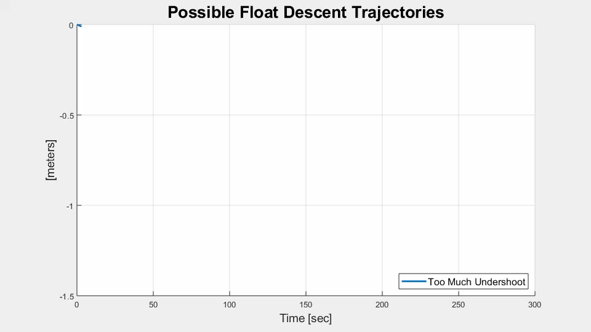

Slide 19
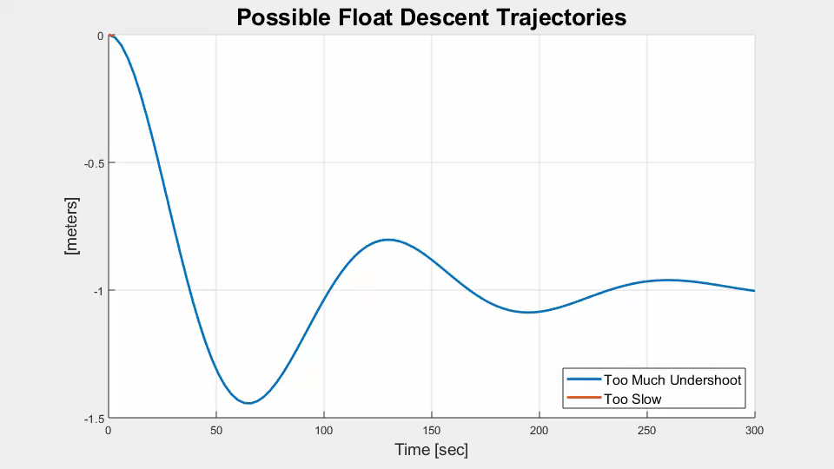

Slide 20
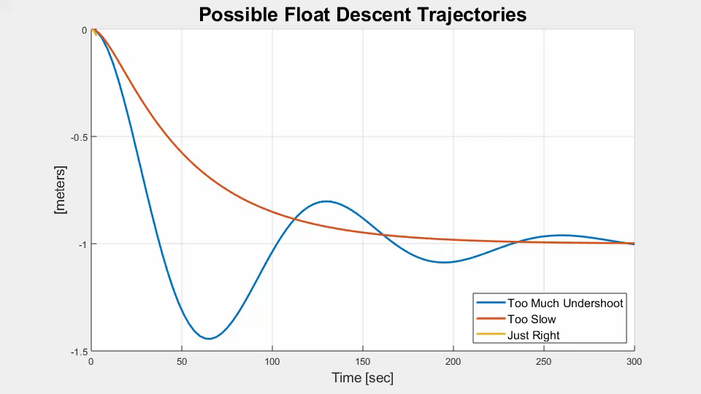

Slide 21
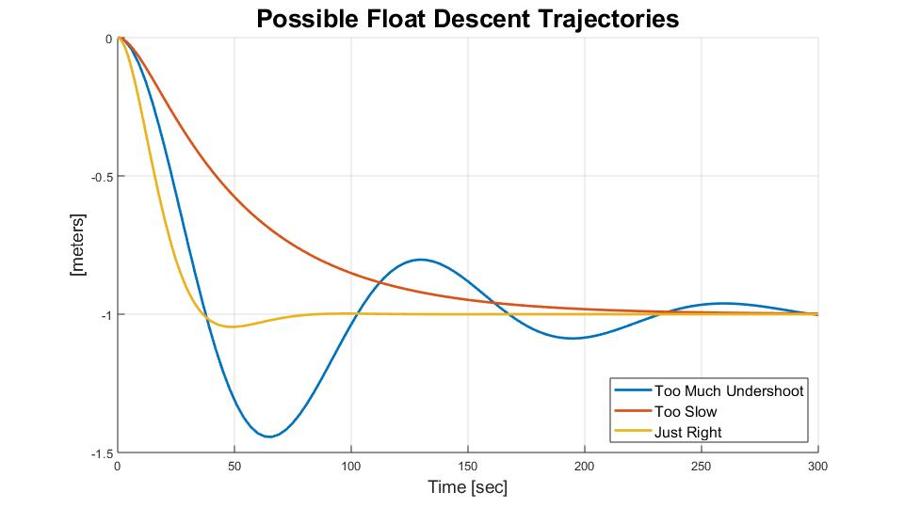
Too Much Undershoot is Bad.

Slide 22
Too Much Undershoot is Bad.
Requirement: No more than 25%

Slide 23
New Controller:
Dual Lead Compensator

Slide 24
New Controller:
Dual Lead Compensator
It’s a mathematical relationship.

Slide 25
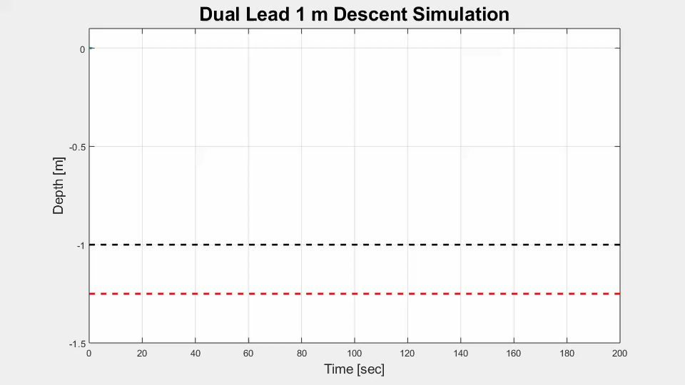

Slide 26
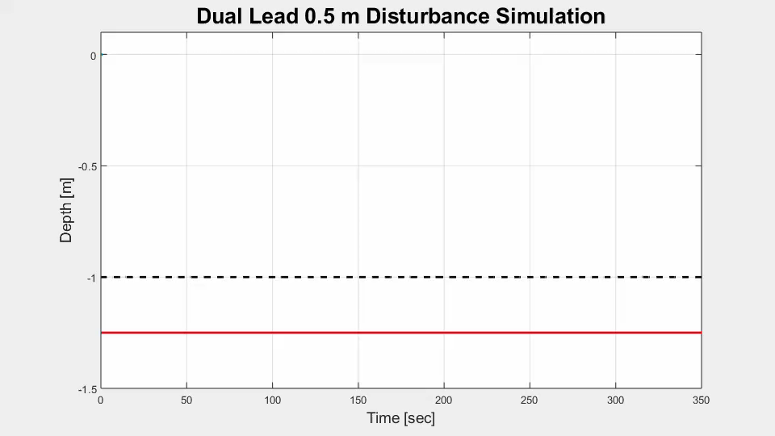

Slide 27
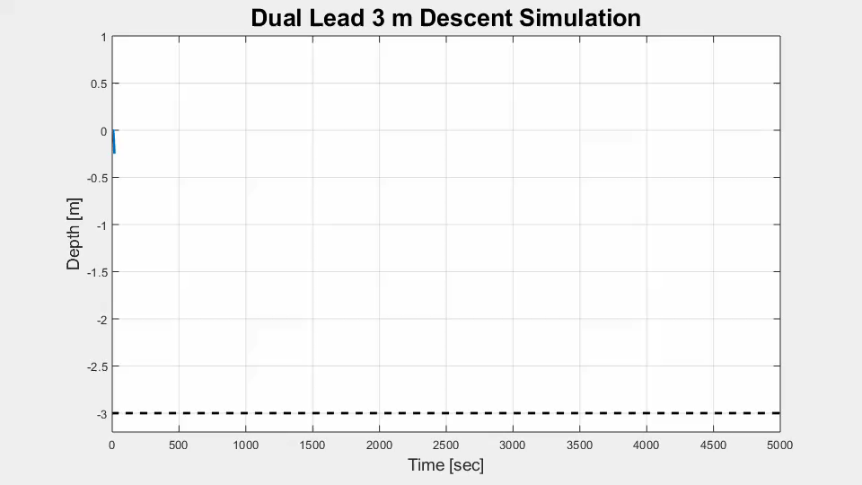

Slide 28
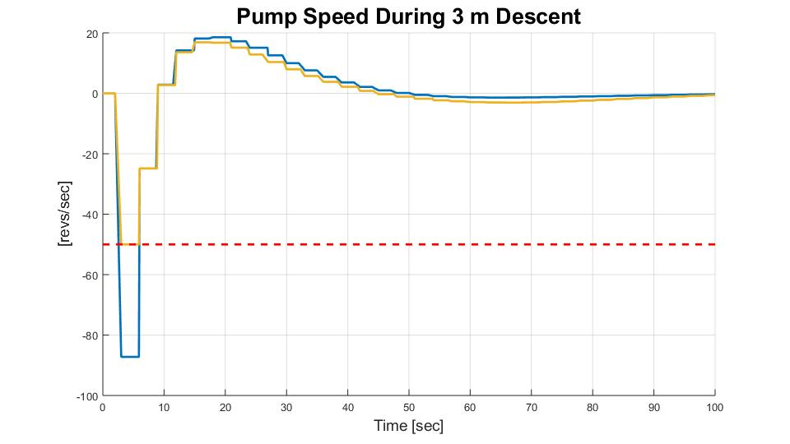

Slide 29
New Controller:
Dual Lead Compensator

Slide 30
New Controller:
Dual Lead Compensator
+ Error Governor

Slide 31
Dual Lead + Error Governor

Slide 32
Implementation

Slide 33
CPF Command Software
Project #2

