Slide 1
Depth Control & Mission Operations
Coastal Profiling Float
By Brian Ha

Slide 2
What is a Coastal Profiling Float (CPF)?
CTD - characterizes physical properties of water
pH – fundamental measurement that drives biogeochemical processes
oxygen, nitrate (fertilizer for primary production)
fluorescence, proxy measurement for amount of chlorophyll
backscatter, measures the amount of particles in water (living or dead)
optical radiation (sunlight, including underwater)

Slide 3
Why CPFs?
Science based policy management (e.g. commercial and recreational salmon industry) requires measurements of a system this complex (see chlorophyll pic)
Policy requires an understanding of primary production
Primary production means bottom of the food chain
AUVs cost 250-500k, requires a person to recover and deploy, run a few weeks.
CPFs cost 30-50k, chuck em over the side and forget until EOL.
Argo, (global observing system), is optimized for deep water measurements of heat content. They stay away from coasts because the heat content of the ocean is in the deep water.
CPFs navigate (via currents)

Slide 4
Typical Mission Profile
Heave it over the side, anchor on the bottom.
Makes measurements on ascent to the surface
Telemeters the data on the surface
Anchors on the bottom. Repeat 2 -4 until significant drift.
Then., if there is a current in the (roughly) opposite direction to the undesired drift, park at that depth and drift
ADCP – acoustic Doppler current profile (too big and too much power for a CPF, and requires a Eulerian flow field)
Instead, the plan is use model projections or inertial
Risks : drifting onshore or offshore (mitigation find advantageous current)

Slide 5
CPF Depth Control
Project #1 of 2

Slide 6
The Depth Control Problem
Depth Control
Necessary for mission profile
Current depth control is oscillatory
List differences compared to deep water
Risk of running aground
Risk of colliding with the ground
It’s ok for ARGO to undershoot by 100 m
It’s not OK for a CPF
ARGO can’t park, CPF can.
Needs better velocity and depth control
CPF is designed to park on the bottom (in order to mitigate drift)
ARGO has 0.260 L of delta buoyancy. They can’t get through the natural density profile in some parks of the world (i.e. think mouth of river)
CPF has 3.5 L worth of delta buoyancy.

Slide 7
Basics of Feedback Control
Desired
Depth

Slide 8
Basics of Feedback Control
Desired
Depth
Measured
Depth

Slide 9
Basics of Feedback Control
Desired
Depth
+
-
Measured
Depth

Slide 10
Basics of Feedback Control
Depth Difference
Desired
Depth
+
-
Measured
Depth

Slide 11
Basics of Feedback Control
Depth Difference
Pump
Speed
Desired
Depth
Controller
+
-
Measured
Depth

Slide 12
Basics of Feedback Control
Depth Difference
Pump
Speed
Desired
Depth
Controller
CPF
+
-
Measured
Depth

Slide 13
Basics of Feedback Control
Depth Difference
Pump
Speed
Desired
Depth
Controller
CPF
New
Depth
+
-
Measured
Depth

Slide 14
Basics of Feedback Control
Depth Difference
Pump
Speed
Desired
Depth
Controller
CPF
New
Depth
+
-
Measured
Depth

Slide 15
Basics of Feedback Control
Depth Difference
Pump
Speed
Desired
Depth
Controller
CPF
New
Depth
+
-
It’s a mathematical relationship.
Measured
Depth

Slide 16
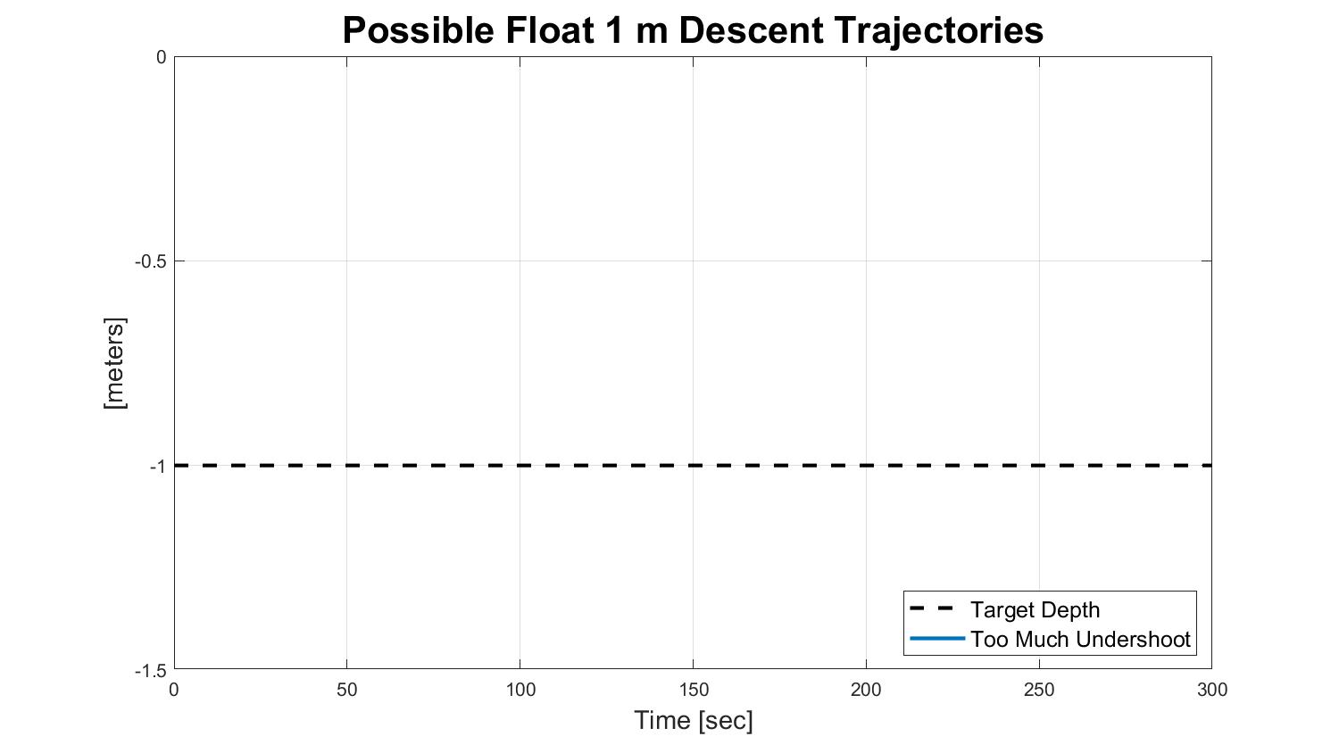

Slide 17
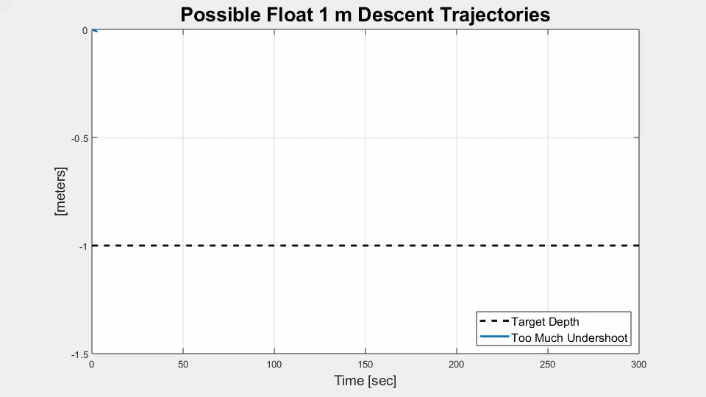

Slide 18
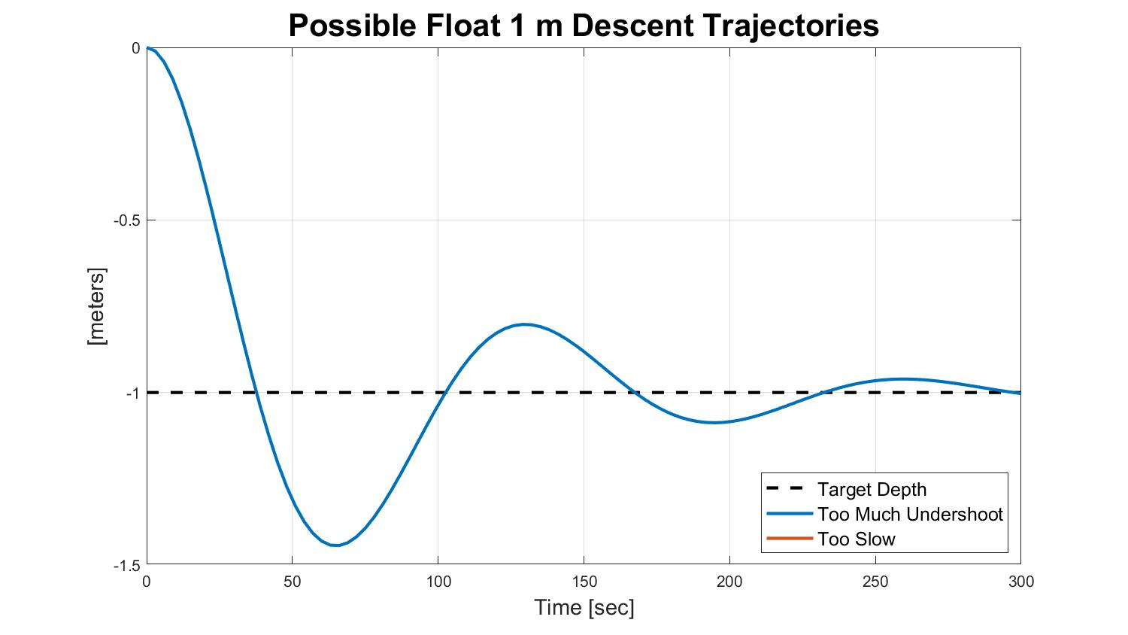

Slide 19
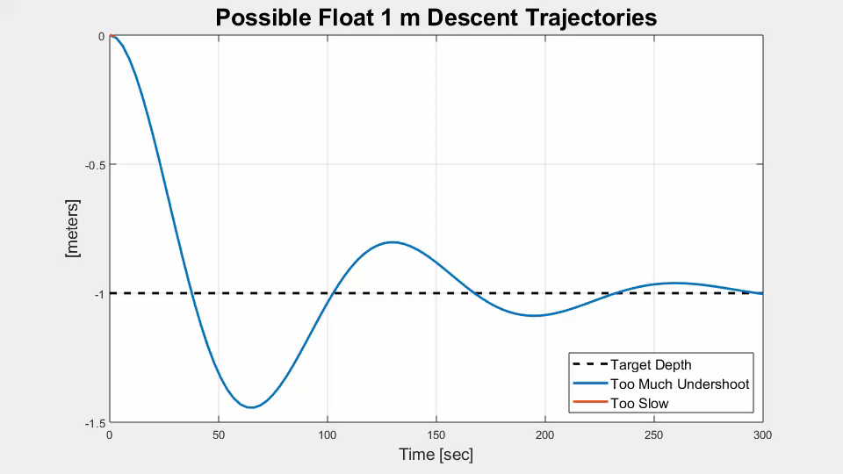

Slide 20
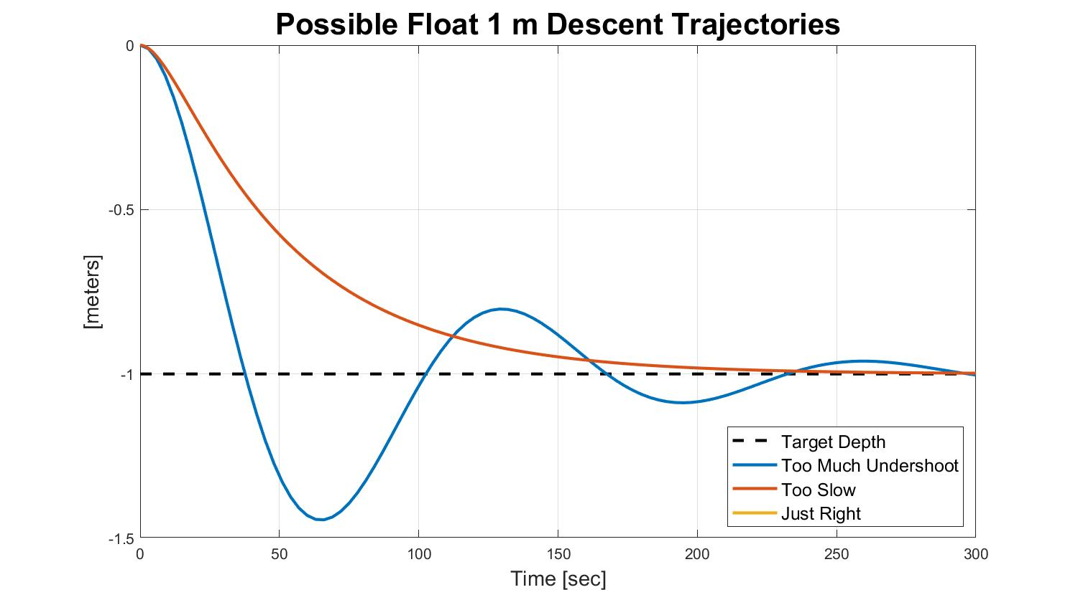

Slide 21
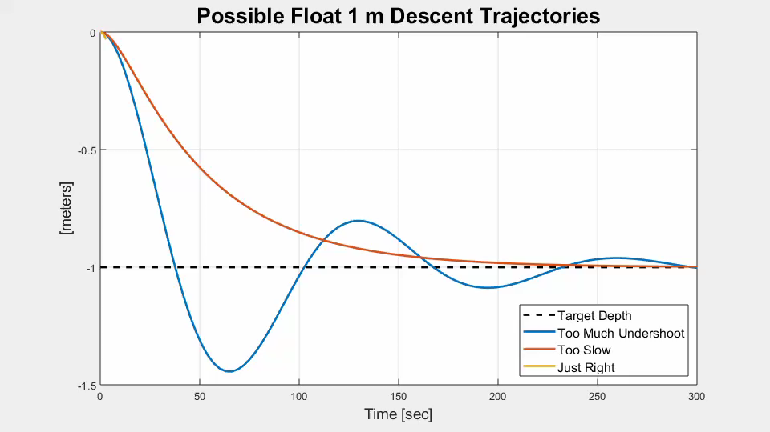

Slide 22
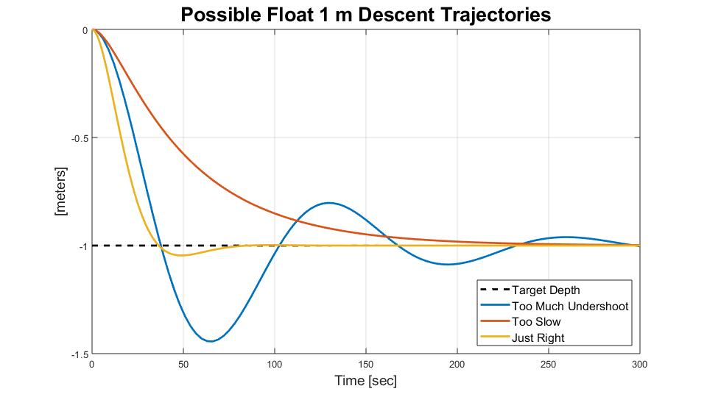
Too Much Undershoot is Bad.

Slide 23
Too Much Undershoot is Bad.
Requirement: No more than roughly 25%

Slide 24
New Controller:
Dual Lead Compensator

Slide 25
New Controller:
Dual Lead Compensator
(It’s an equation that takes in depth
difference and spits out pump speed)

Slide 26
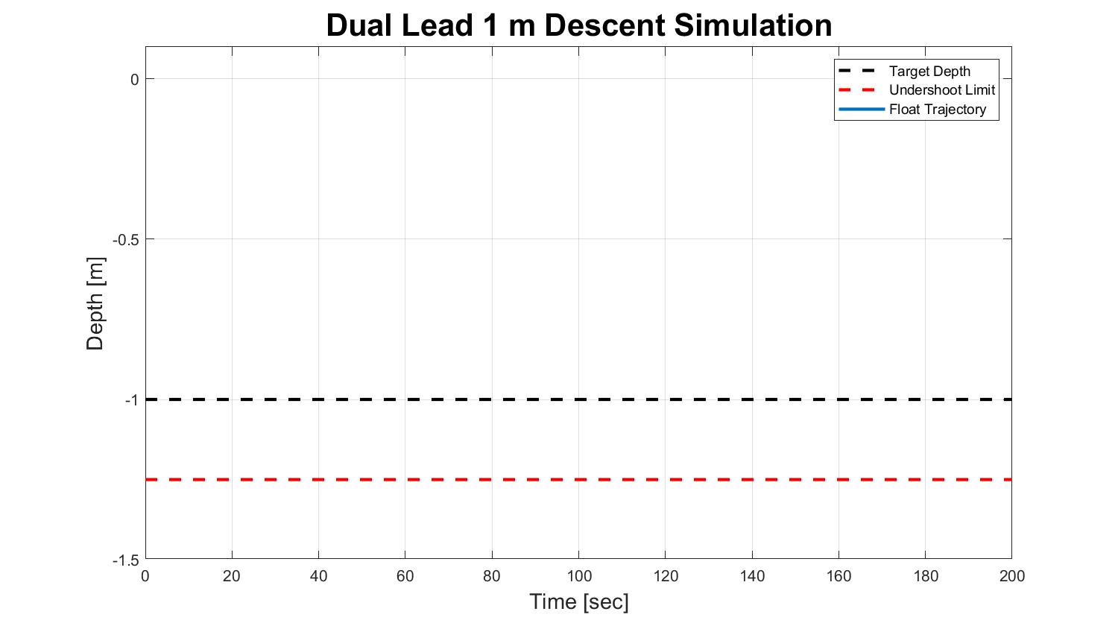

Slide 27
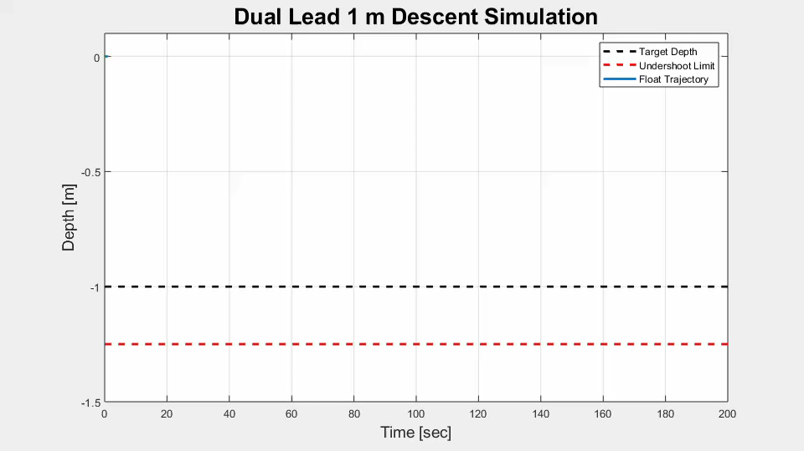

Slide 28
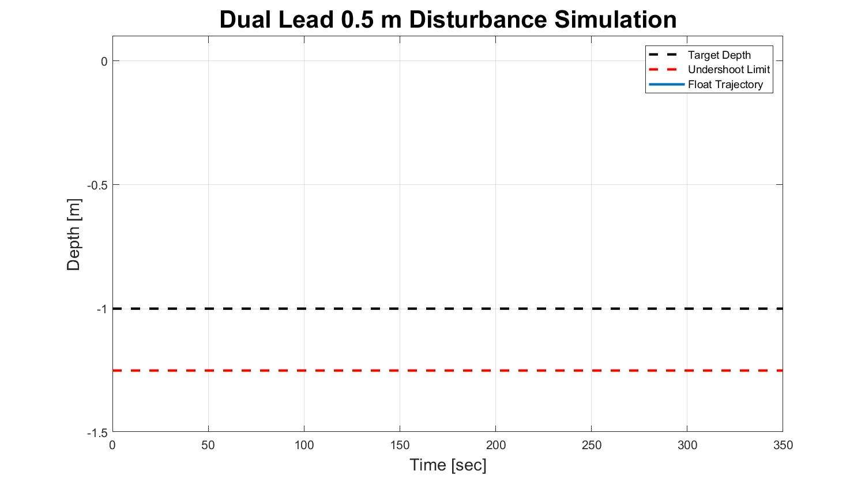

Slide 29
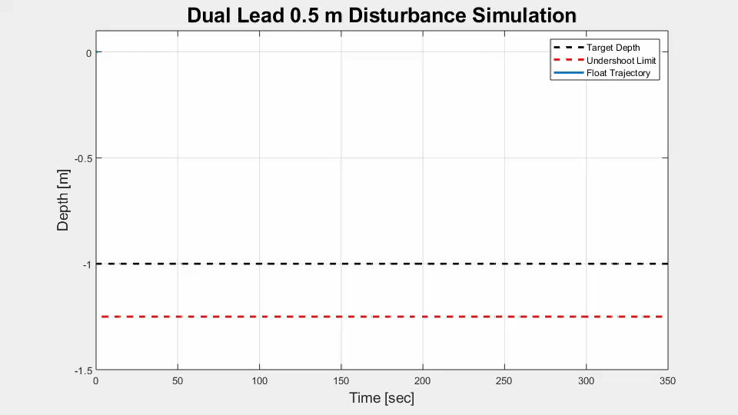

Slide 30
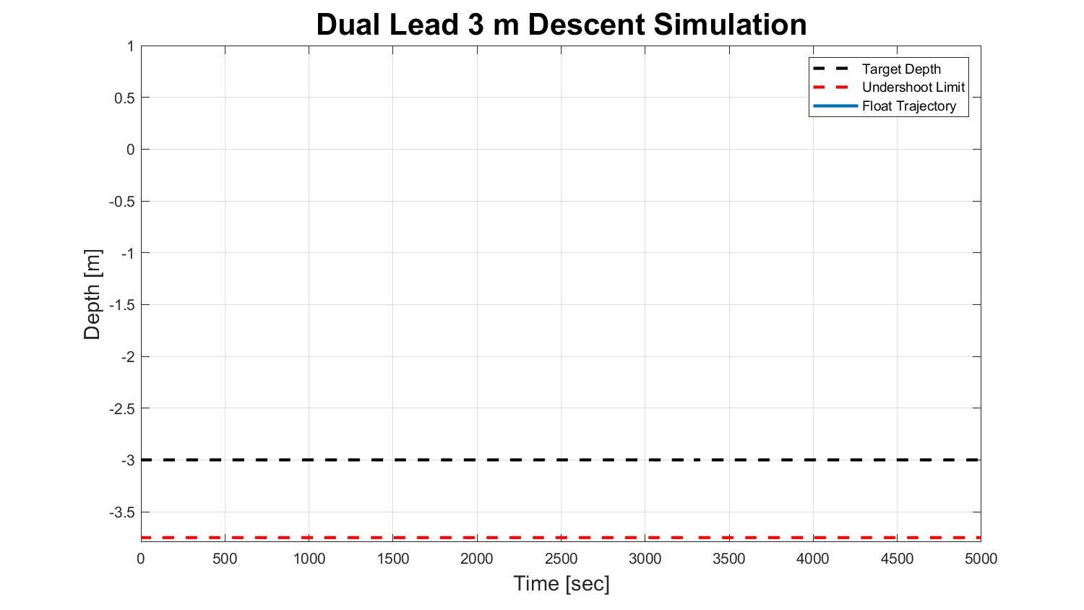

Slide 31
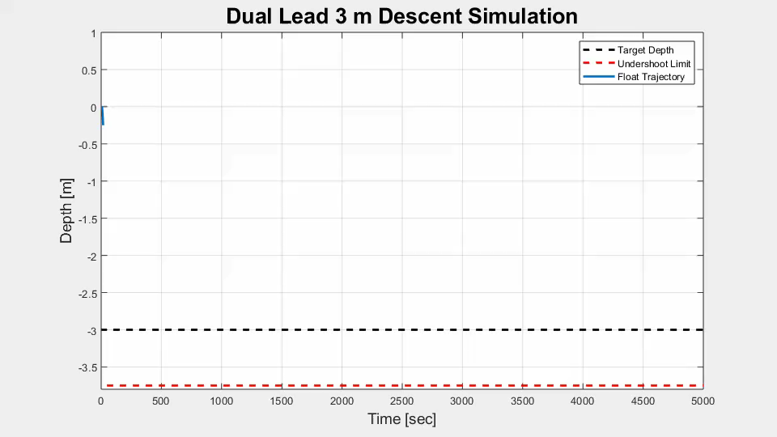

Slide 32
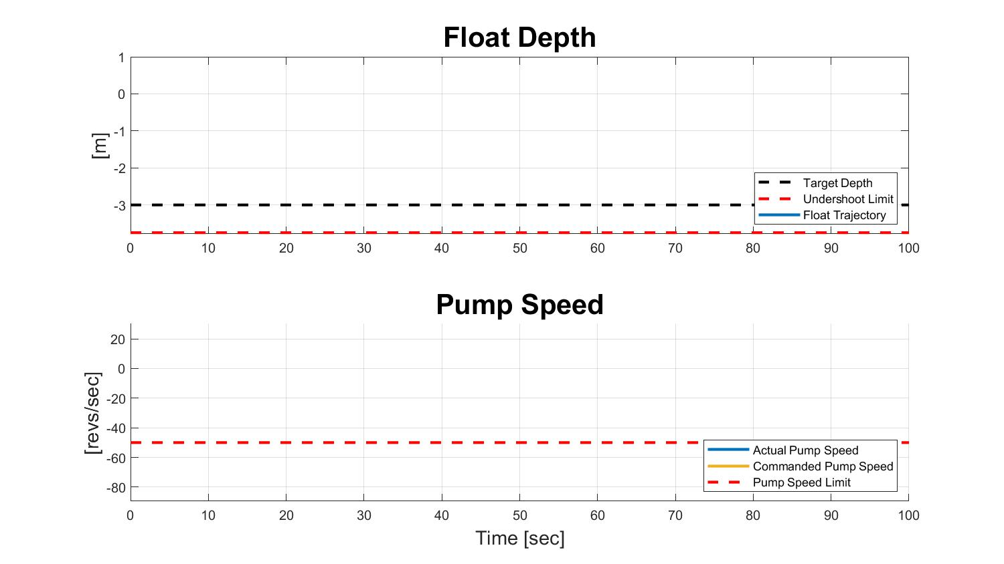

Slide 33
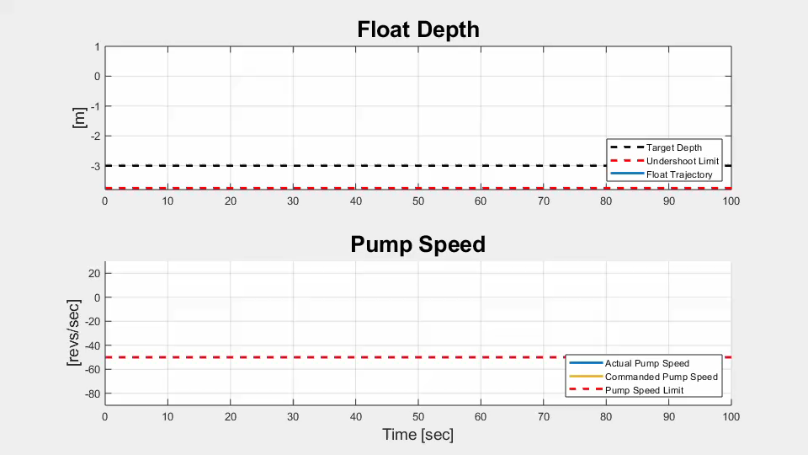

Slide 34
New Controller:
Dual Lead Compensator

Slide 35
New Controller:
Dual Lead Compensator
+ Difference Governor

Slide 36
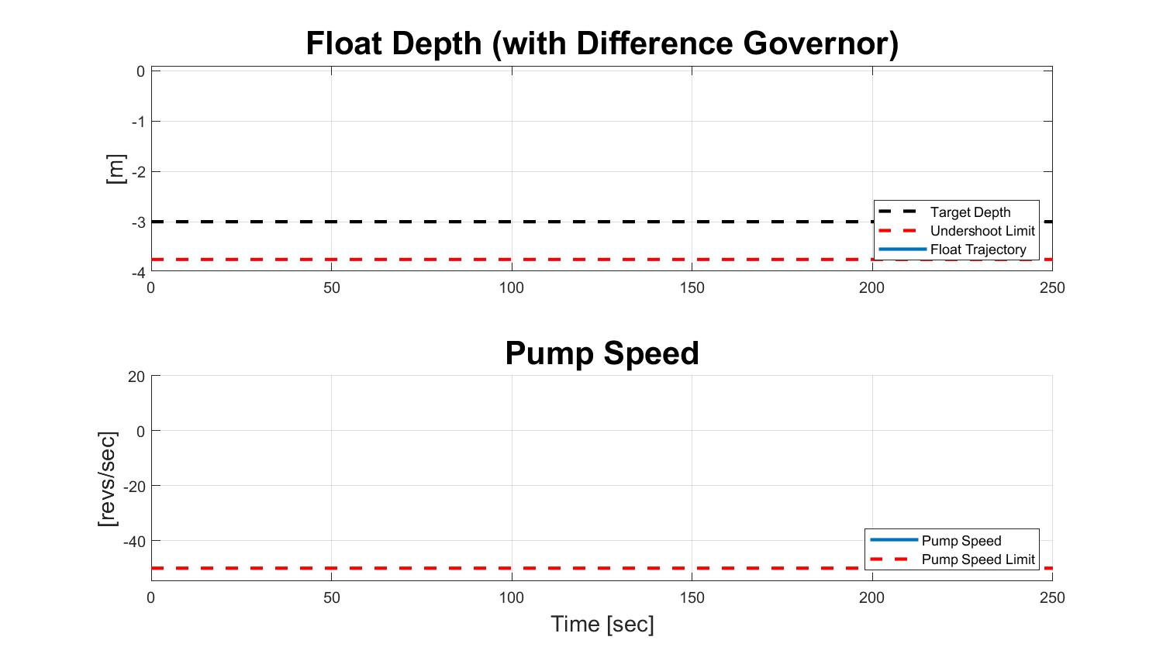

Slide 37
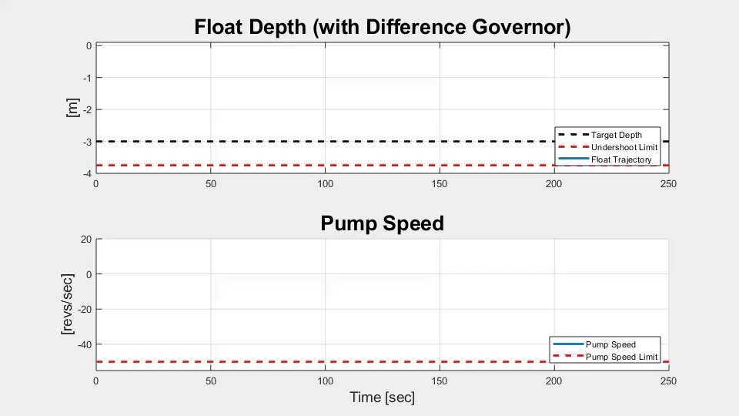

Slide 38
Next Steps
Program controller in C#.
Try it in the test tank!

Slide 39
CPF Mission Operations
Project #2 of 2

Slide 40
Problem

Slide 41
Mission Profile

Slide 42
Google Earth

Slide 43
Acknowledgements
Gene Massion
Doug, Joe, Pat, and Mike
George and Linda
The 2018 MBARI Interns
Packard Foundation
MBARI

Slide 44
References

