Slide 1
Command & Control
Coastal Profiling Float

Slide 2
Overview

Slide 3
Profiling Floats - Background
Used for subsurface measurements
Cheap!
Widespread use (ARGO)
BioGeoChem
Show Profile

Slide 4
Profiling Floats – How They Move

Slide 5
Profiling Floats – How They Move

Slide 6
COASTAL Profiling Floats
List differences compared to deep water
Risk of running aground
Risk of colliding with the ground

Slide 7
Prototypes

Slide 8
CPF Depth Control
Project #1

Slide 9
Basics of Feedback Control
CPF
Notes:
Walk through block diagram
Define what a control law is
Describe benefits/tradeoffs of feedback
Define overshoot, settling time

Slide 10
Basics of Feedback Control
Pump Speed
Actual
Depth
CPF

Slide 11
Basics of Feedback Control
Pump Speed
Actual
Depth
CPF
Depth Sensor

Slide 12
Basics of Feedback Control
Desired
Depth
Actual
Depth
Pump Speed
CPF
+
-
Depth Sensor

Slide 13
Basics of Feedback Control
Desired
Depth
Actual
Depth
Error
Pump Speed
CPF
+
-
Depth Sensor

Slide 14
Basics of Feedback Control
Desired
Depth
Actual
Depth
Error
Pump Speed
Controller
CPF
+
-
Depth Sensor

Slide 15
Basics of Feedback Control
Desired
Depth
Actual
Depth
Error
Pump Speed
Controller
CPF
+
-
Depth Sensor

Slide 16
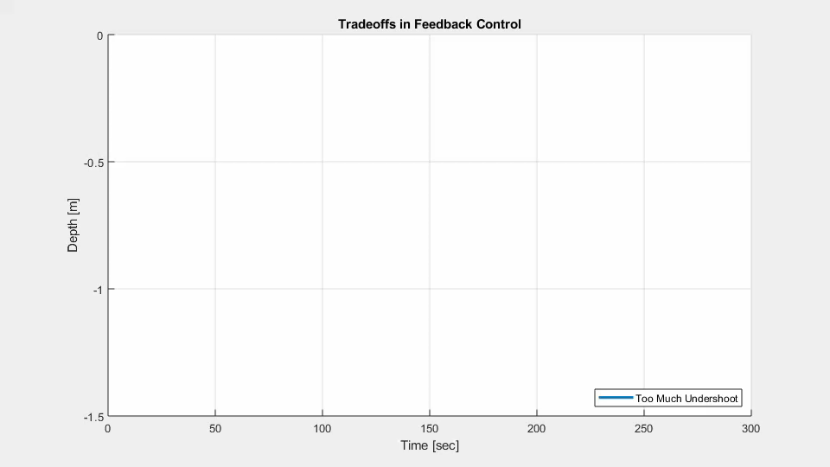

Slide 17
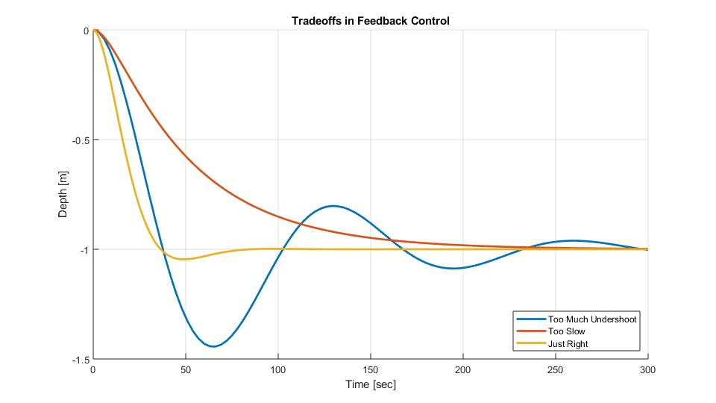
Too Much Undershoot is Bad

Slide 18
Requirement: No more than 25%
Too Much Undershoot is Bad

Slide 19
Old Controller
Proportional-Integral-Derivative (PID)

Slide 20
New Controller
Dual Lead Compensator

Slide 21
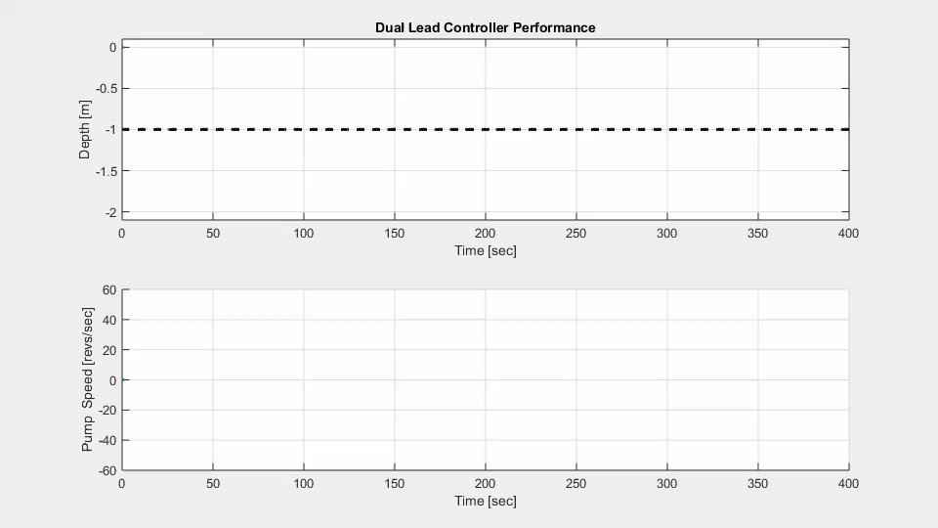

Slide 22
1 Meter Step Performance

Slide 23
2 Meter Step Performance

Slide 24
Dual Lead + Error Governor

Slide 25
Implementation

Slide 26
CPF Command Software
Project #2

