Slide 1
Development of an Oceanographic Current Meter Using a Low-Cost Inertial Measurement Unit
Charlie Watkins

Slide 2

Science motivation
The MBARI Chemical Sensor Lab is interested in understanding the health of the ocean
Coastal regions contribute nearly half of global new primary production despite comprising only 10% of ocean area
Net coastal production is a complicated, dynamic system
Monitoring coastal processes can be crucial to understanding fisheries, air-sea CO2 flux, and overall ocean health

Slide 3
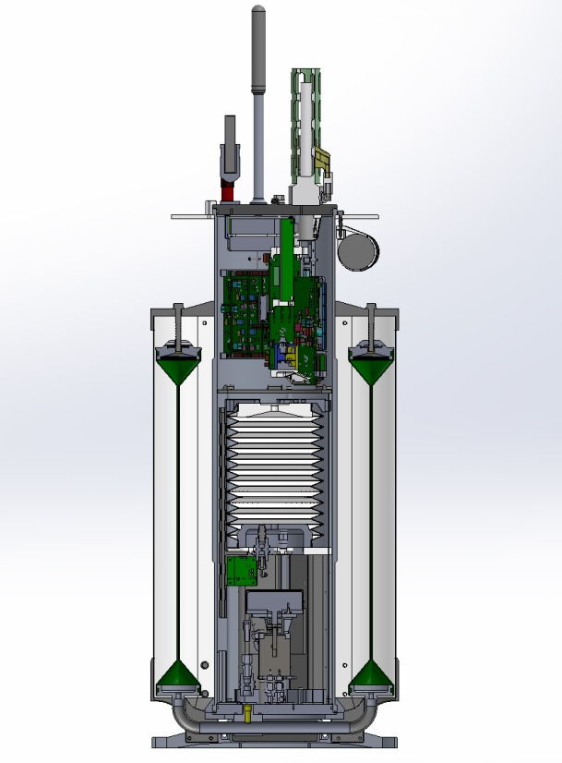
Coastal Profiling Float
Biogeochemical Sensors
Profiling floats are a practical solution to collecting data on a wide range of temporal and spatial scales (maybe the only solution?)
CPF supports standard biogeochemical sensor suite (CTD, O2, pH, Nitrate, Chlorophyll, and Backscatter)
The CPF is designed to dive as deep as 500 m, park on the ocean floor or at a user-specified depth, and ascend/descend at a rate from 0-50 cm/s
Measurements are typically taken on ascent, but can be taken on descent
Outer oil bladder
Inner oil bladder

Slide 4
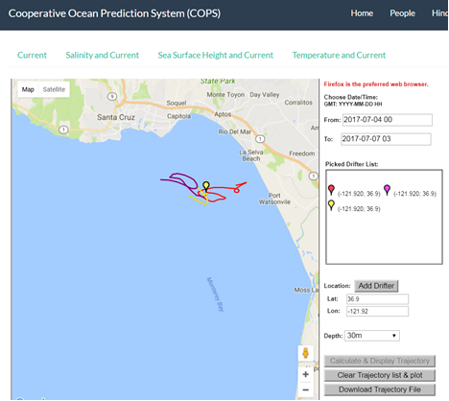
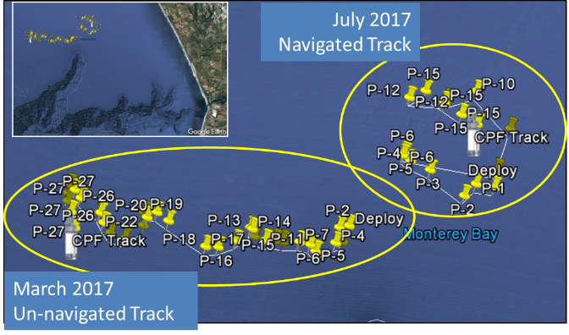
Motivation: Oceanographic Current Meter for Float Navigation
  Profiling floats can control depth but not horizontal position
Risk identified: Floats may drift out of desired measurement area
Proposed solution: Use ROMS 3D numerical predictive current models to find countervailing current for navigation (Locally, there is almost always a countervailing current)
Problem: Models are not sufficiently accurate at depth (shown experimentally)
  New solution: Measure approximate current velocity + direction while profiling
    Existing current meters are too big, too power-hungry, impractical
    Inertial Measurement Units fit our constraints better but velocity is calculated from acceleration
My problem: Develop an IMU based oceanographic current measurement instrument and evaluate its performance. Compare measured performance to science needs
Notes:
Note: Explain countervailing currents

Slide 5
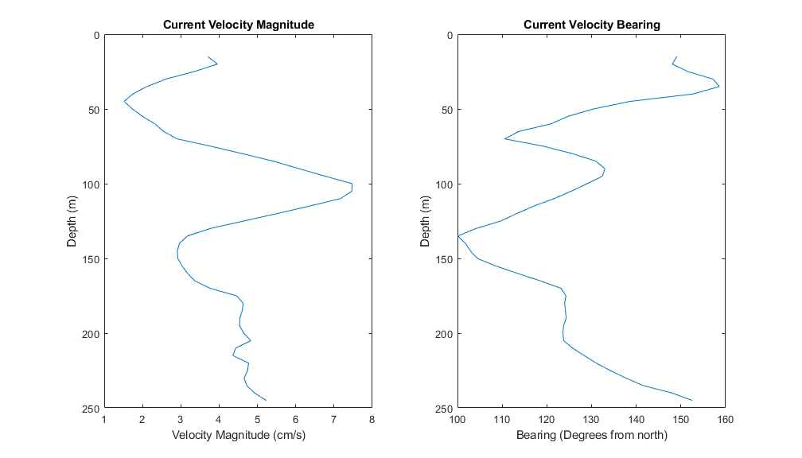
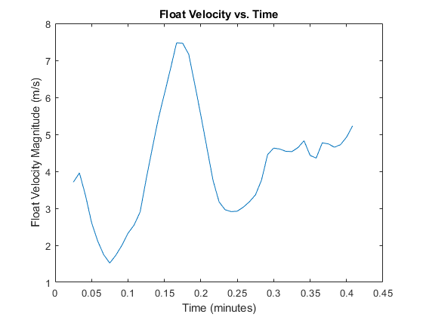
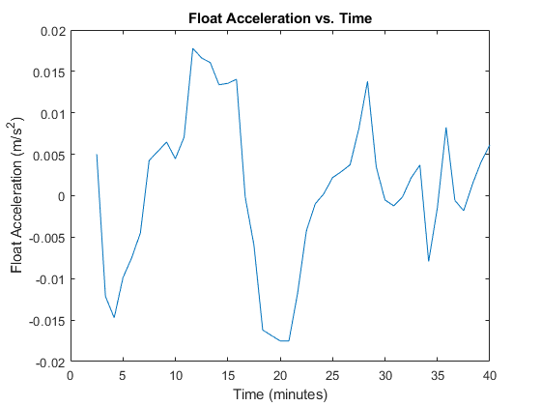

Real world current profiles
Using data from a typical day measured at the M1 Buoy’s ADCP, we can see what a typical current profile looks like
Using the current profile and the CPF’s ascent speed of 10 cm/s, we can find the velocities that the float will experience with respect to time
Then, by differentiating that signal, we can get an idea of the accelerations experienced by the float
Approximate drift calculations for reference:
(5 cm/s)*(4 hours) = 720 m
$$T≈20 mins$$
$f≈.001 Hz$

Slide 6

Methodology
Understand science needs
  Ask: “What are we trying to do?”
Develop proposed solutions
  Pick the top contenders that seem feasible
Evaluate pros + cons with stakeholders and pick one to pursue
  Define metrics for evaluation: Size, cost, power consumption, and sufficient performance
  Analyze, prototype risky elements
Develop IMU model → design test fixture → acquire data → develop algorithms → refine, Repeat

Slide 7
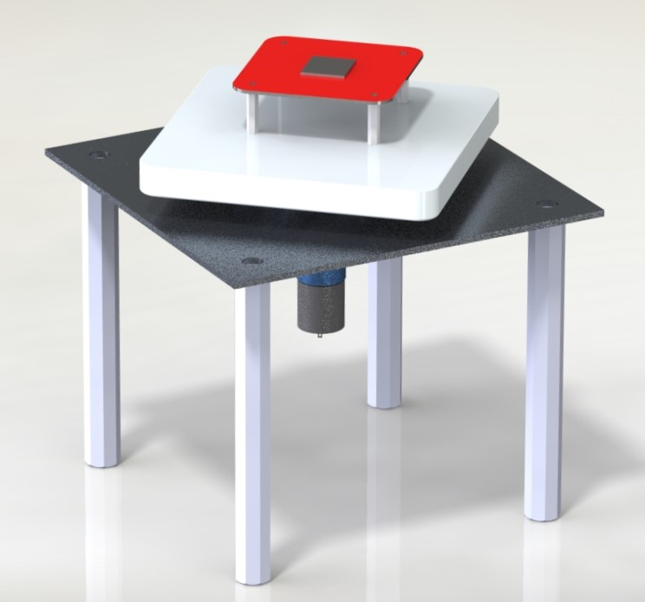
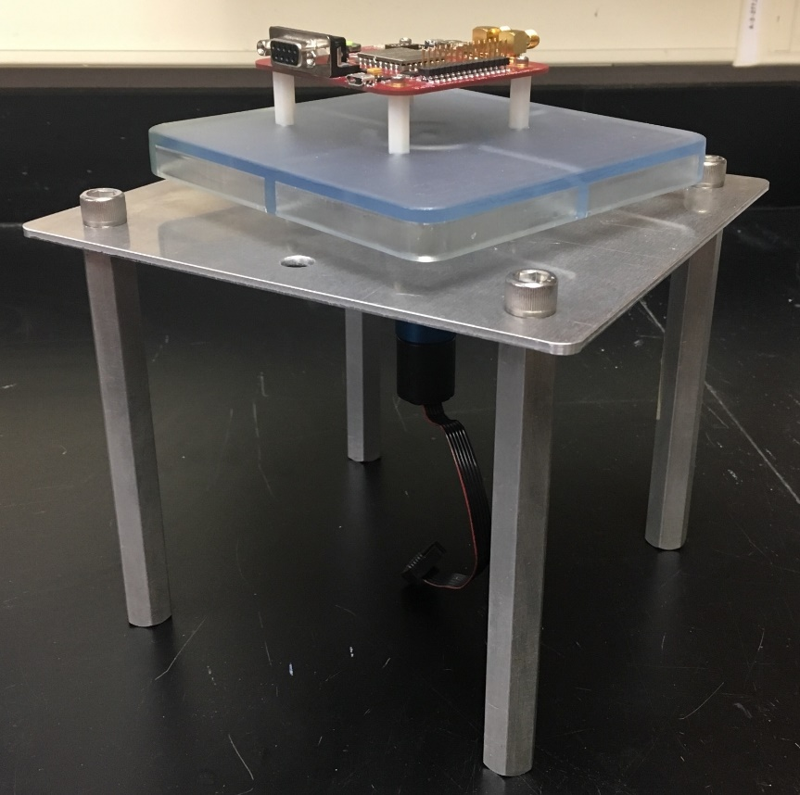

Rate Table Design
Standard IMU test fixture – produces a know centripetal acceleration due to eccentric rotation
$$a_{c}=ω^{2}r$$
$a_{c}$ = Centripetal acceleration (m/s²)
$ω$ = Angular velocity (rad/s)
$r$ = Radius of rotation (m)

Slide 8
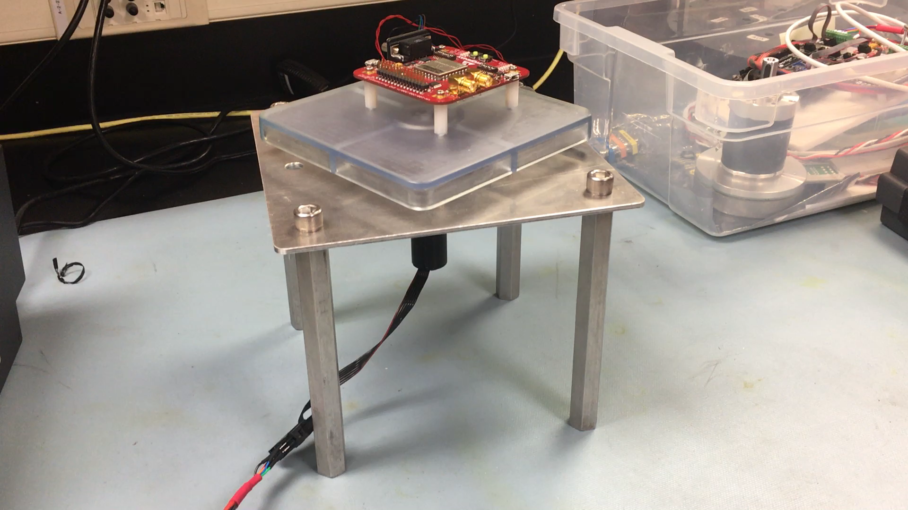

Slide 9
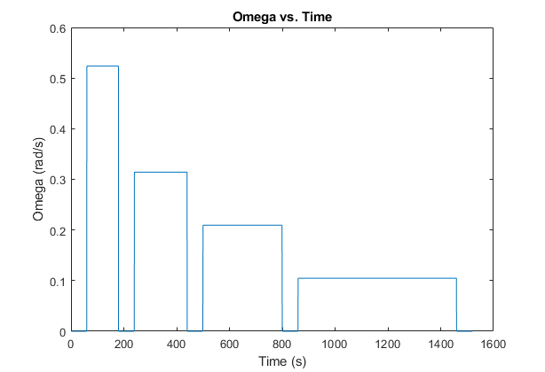
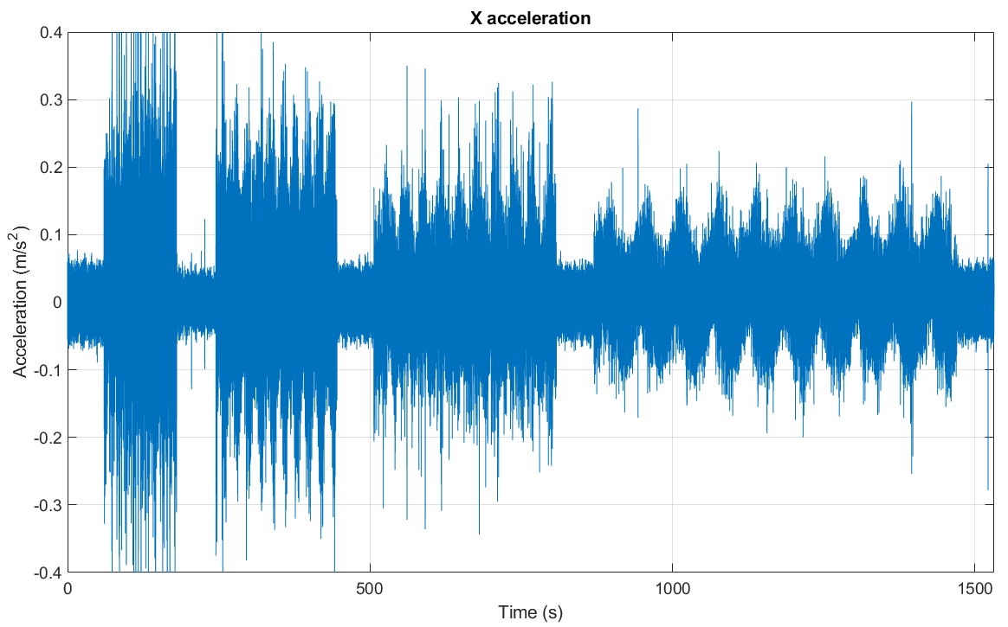
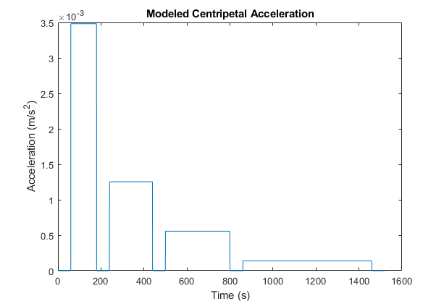
Model Development → Data Collection

Slide 10
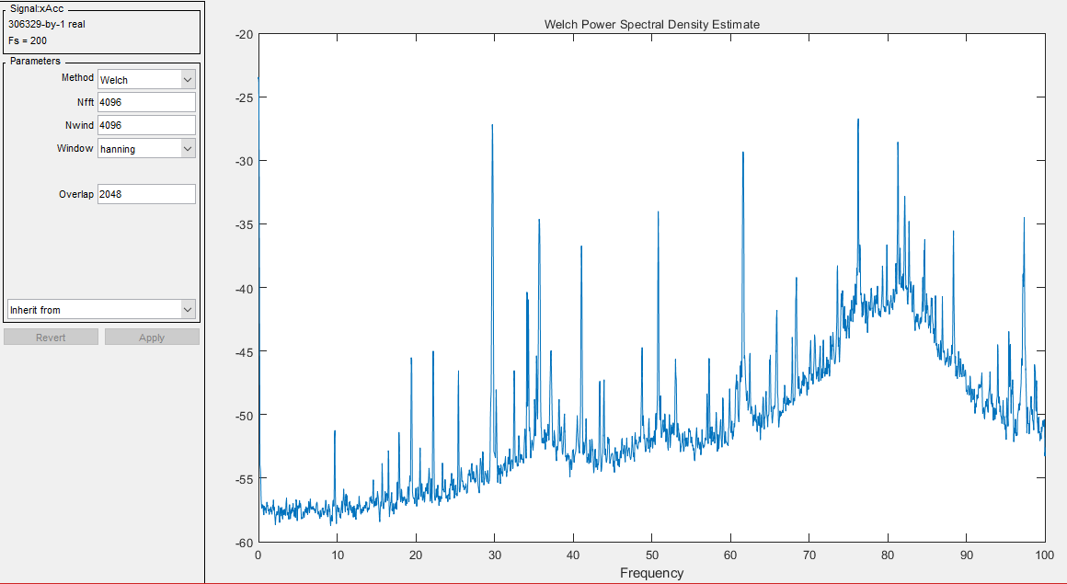
Signal processing workflow
The first step is to analyze our measured signal and figure out what parts are noise, and what parts are the signal of interest
This drives our signal processing approach
Note the signal of interest is very low frequency (<.25Hz)
Power Spectral Density (PSD) analysis shows what frequencies contribute large components to the total signal
Notes:
Point out that we have gone from time domain to freq. domain

Slide 11
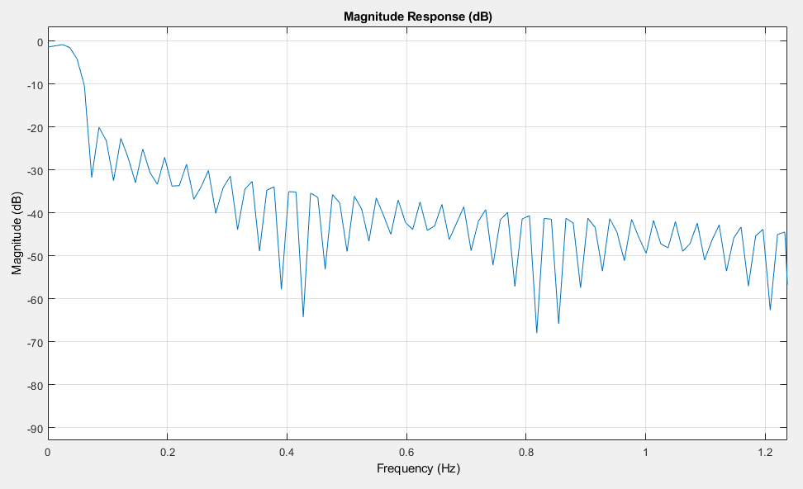
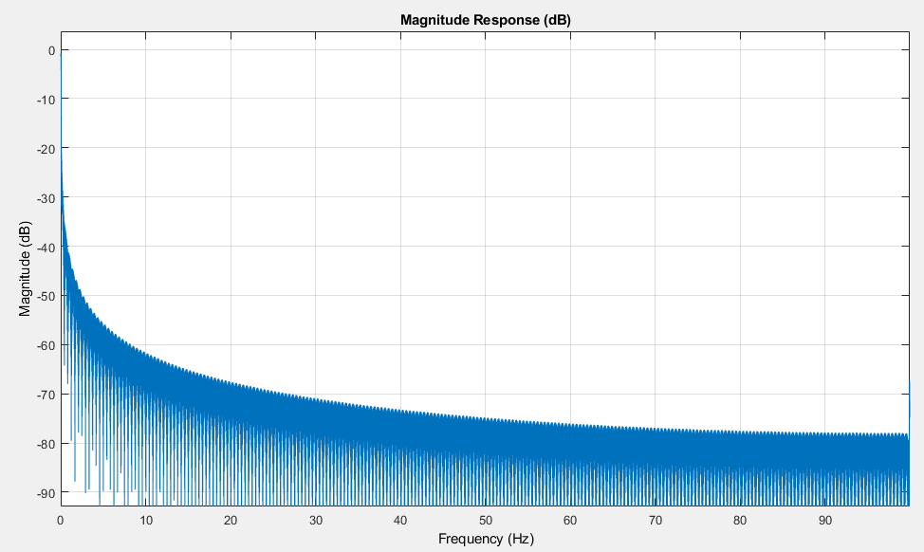
Signal processing workflow
Next, we use a Low Pass filter to remove high frequency noise components from the signal
Design a LPF to pass the signal of interest and attenuate the noise using the Matlab Signal Processing Toolbox (sptool)
Notes:
Explain what these plots of the transfer functions mean – what is a dB

Slide 12
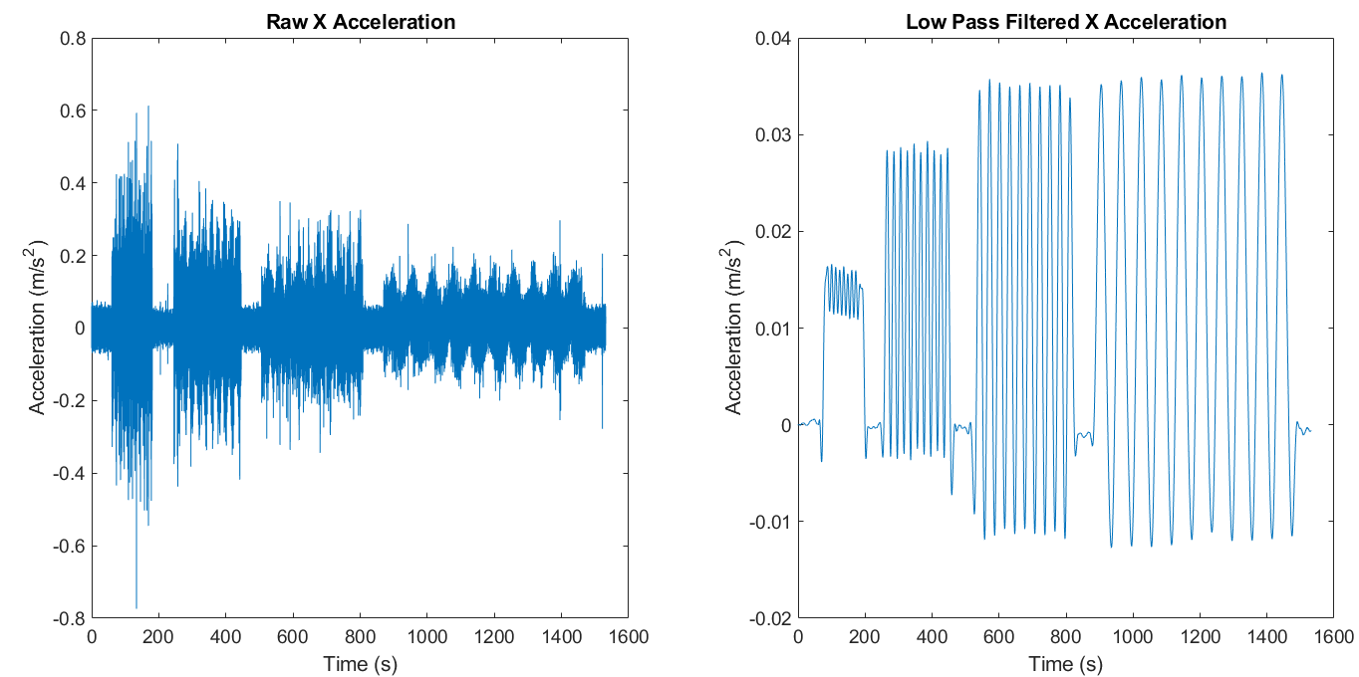

Signal Processing Results
$$T≈60s$$
Low Pass Filtering successfully removes most high-frequency noise from the signal – but leaves oscillation caused by gravity

Slide 13
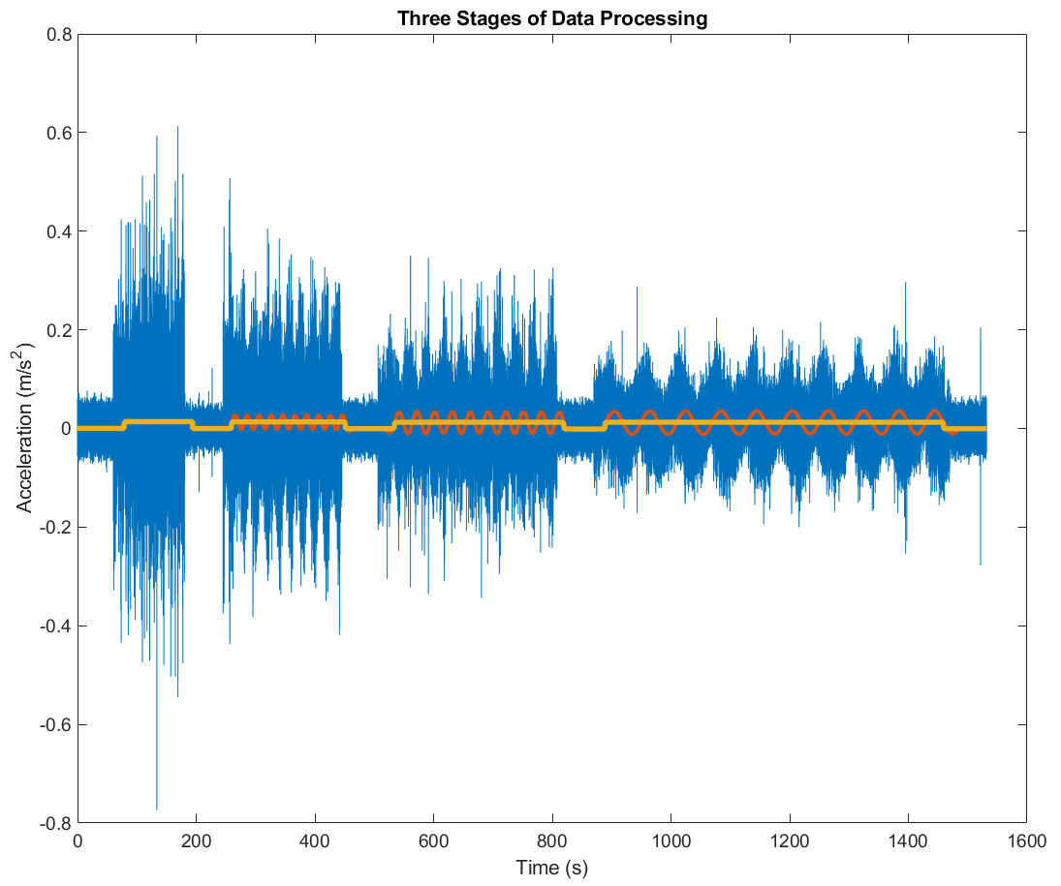
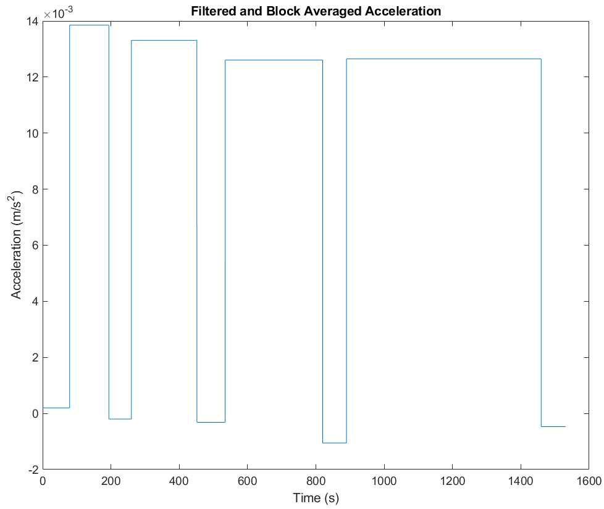
Signal Processing Results
Due to the size of the data set, low pass filtering has limited ability to block the frequencies close to our signal of interest
Manual block averaging is a decent solution, but could be improved in the future

Slide 14
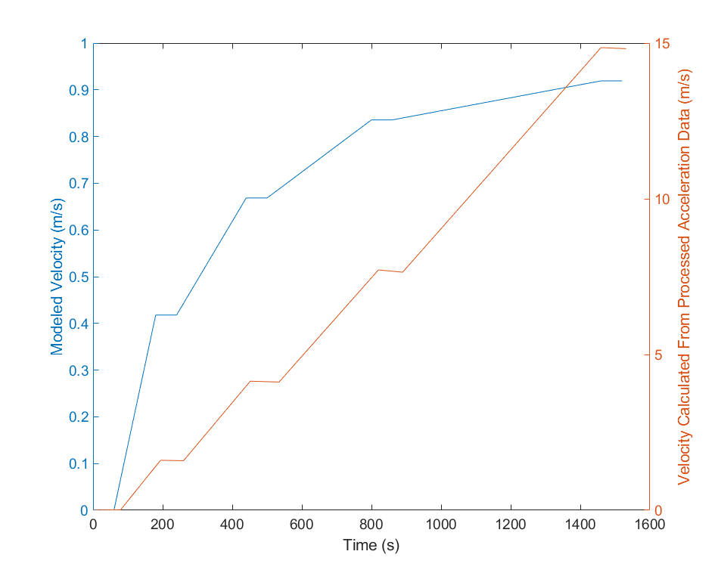
Model vs. Calculated Velocities
The shape of the data and general trends look as expected
However, there is a scale factor that we have so far been unable to account for
  This may be an artifact of the data processing, or a result of the IMU’s bias and drift
The data processing approach overall has proven to be effective, but further refinement in the apparatus and model will be required

Slide 15
Next Steps
Need to understand why the magnitude of the processed signal does not correspond to our model
  Need a motor with a wider range of velocities
  Need to understand and model the accelerometer drift better
Add the ability to collect longer duration data sets, likely using wireless communications
Then, refine and reapply the signal processing workflow to new data, and identify the minimum discernable velocity signal that can be measured using this IMU
Finally, build a self-powered IMU data logger, put it in the CPF, test in the test tank, then take it to sea

Slide 16
Acknowledgements
My Mentor, Gene Massion
Intern Coordinator, George Matsumoto
The Chemical Sensor Lab – Ken Johnson, Carole Sakomoto, Peter Walz, Luke Coletti, Tanya Maurer, Josh Plant, and Keaton Mertz
The EE Tech Lab – Jose Rosal, Jim Montgomery, Tom Marion, and Paul Coenen
The Machine Shop - Mike Parker, Mark Tynes, Jerry Allen, and Ray Thompson
Yanwu Zhang
Brian Kieft
My fellow interns
The David and Lucile Packard Foundation
MBARI

Slide 17
Show the signal – can’t see signal of interest
Power spectral density analysis
Apply averaging/filtering
Binning data (Could be as big as 10m – see current profile)
Show filtered vs unfiltered
End goal: binned, filtered, rough estimate of velocity
NB: Discuss gravitational component – we can filter it
Raw data -> figure out what’s data and what’s noise (spectral analysis, look at the data, …) filter out the noise, smooth the resulting signal, integrate to get velocity.

Slide 18
Materials/Methods
Understand the science needs and risks you did this – motivation and cpf slides
Come up with some concepts and ways to mitigate risks I did this
Evaluate the concepts against the science needs I did this
Discuss the pros and cons with the stakeholders I didt this
Pick what looks like the best concept I did this
go for it unless or until it proves not the best concept You
Develop an analysis/test/evaluation strategy you
What are we trying to measure
oh crap, these are really small signals (ocean current profile analysis slides)
Is it even feasible to do with the proposed IMU approach – Probably not to the smallest velocities we’d like to measure but probably for the middle and upper ranges – This is consistent with the original Intern project question which was “Develop a IMU based oceanographic current measurement instrument and evaluate it’s performance as a function of the performance (cost) of the IMU
Develop the system You
What kind of test fixture will work for this and future IMUs (don’t reinvent the wheel, check the literature, do the calculations) slide or 2
Get the data, develop signal processing algorithms repeat –appropriate for evaluating the IMU
Data processing approach – model it, get the data, plot it against the model, spectral analysis, design data process eliminate outliers, smooth the data, analyze for desired final end product (velocity profile), refine model, and approach
Next steps
Run test with acceleration profile similar to the real world.
put it in the real world

Slide 19
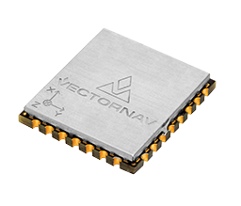
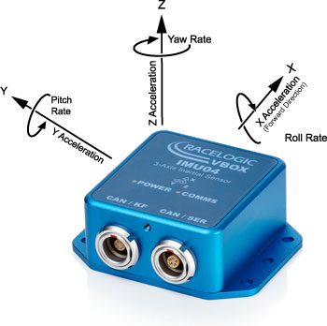
Inertial Measurement Units (IMUs)
A 9-axis IMU combines an accelerometer, gyroscope, and magnetometer – these measure linear acceleration, angular velocity, and earth’s magnetic field strength
IMUs, along with other sensors, are used routinely in inertial navigation systems to compute position and velocity
  Too big, expensive, and high-power for CPF
MEMS (Microelectromechanical systems) IMUs are already in the appropriate size, cost, and power consumption range, and are rapidly improving in performance
Notes:
Discuss: Pick a technology on the uphill slope (moore’s law)

