Slide 1

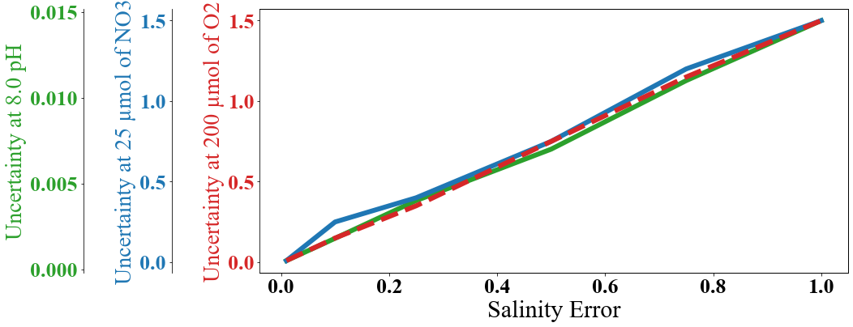
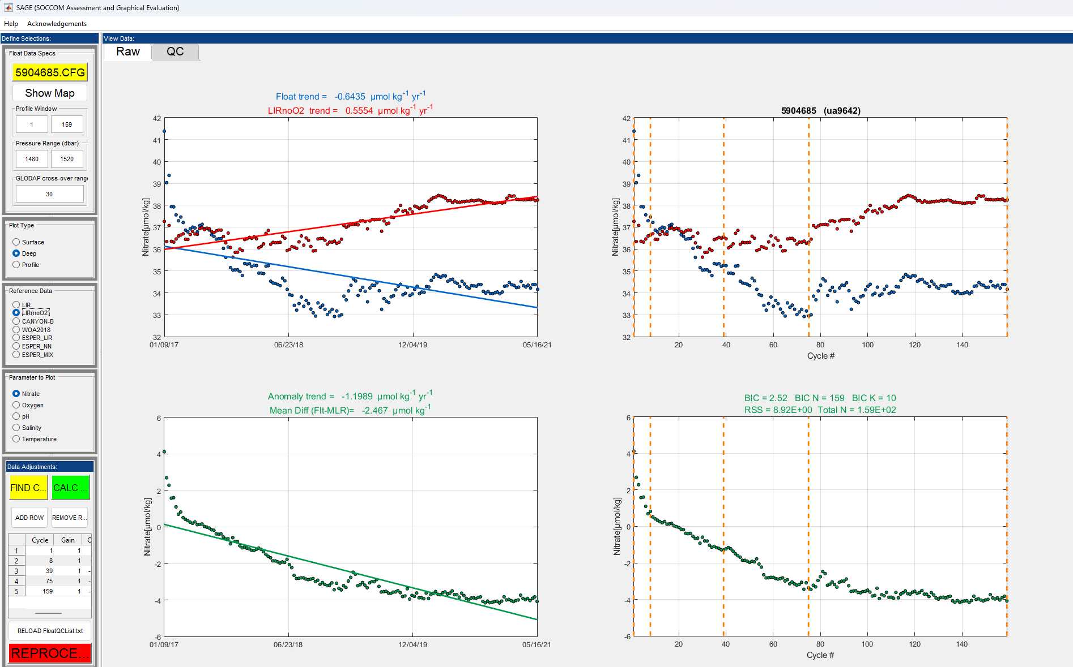
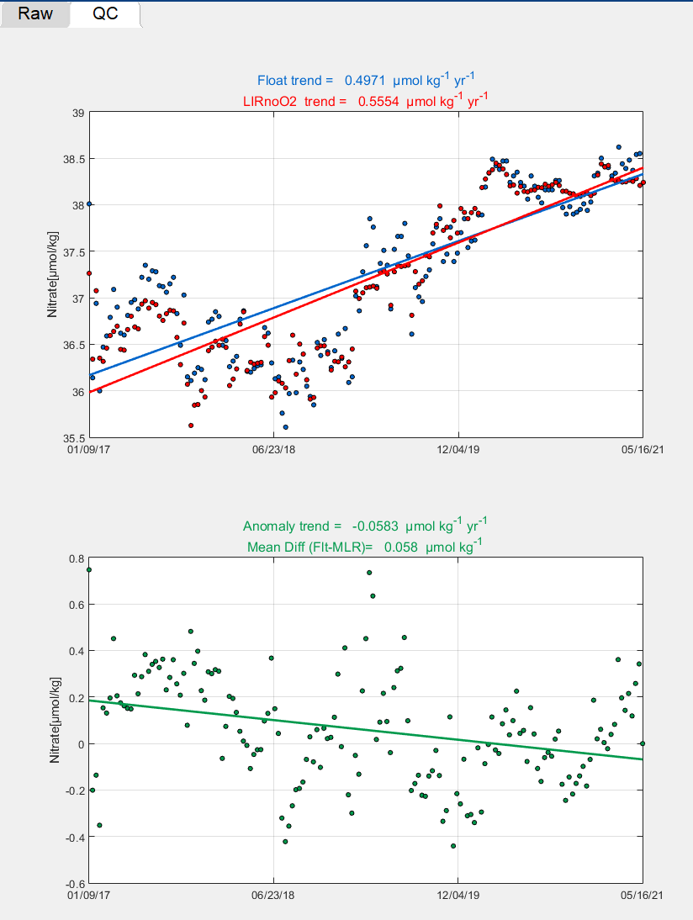

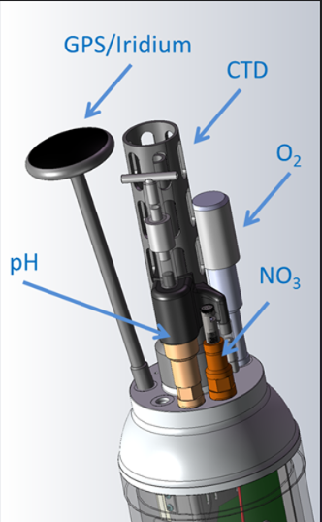
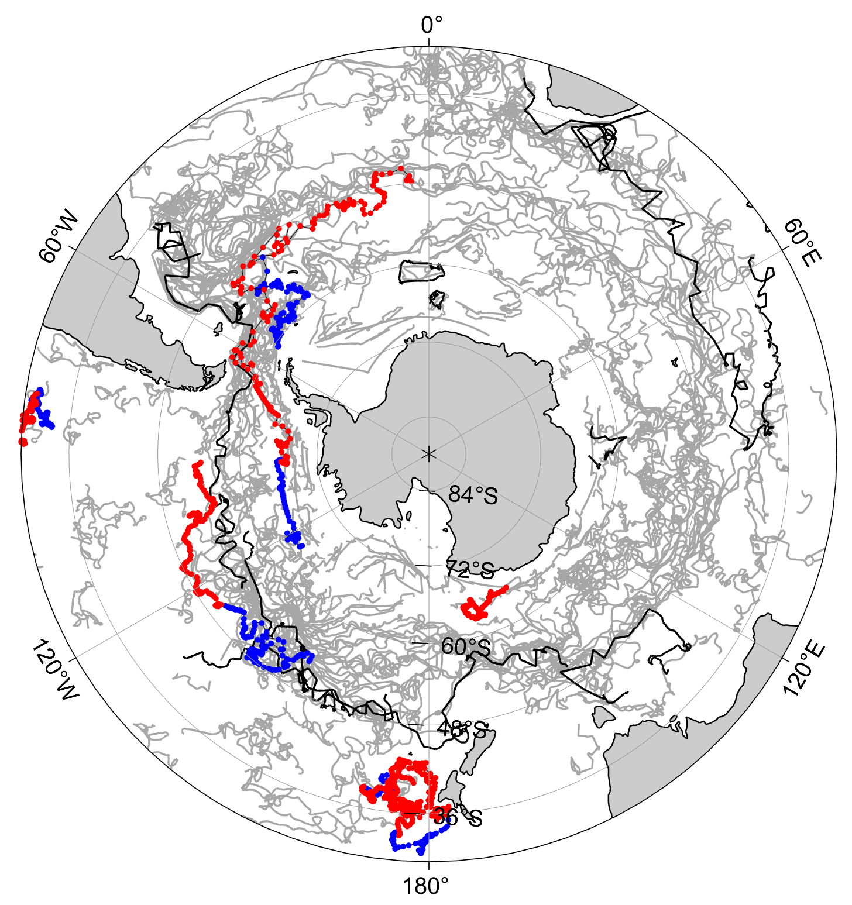
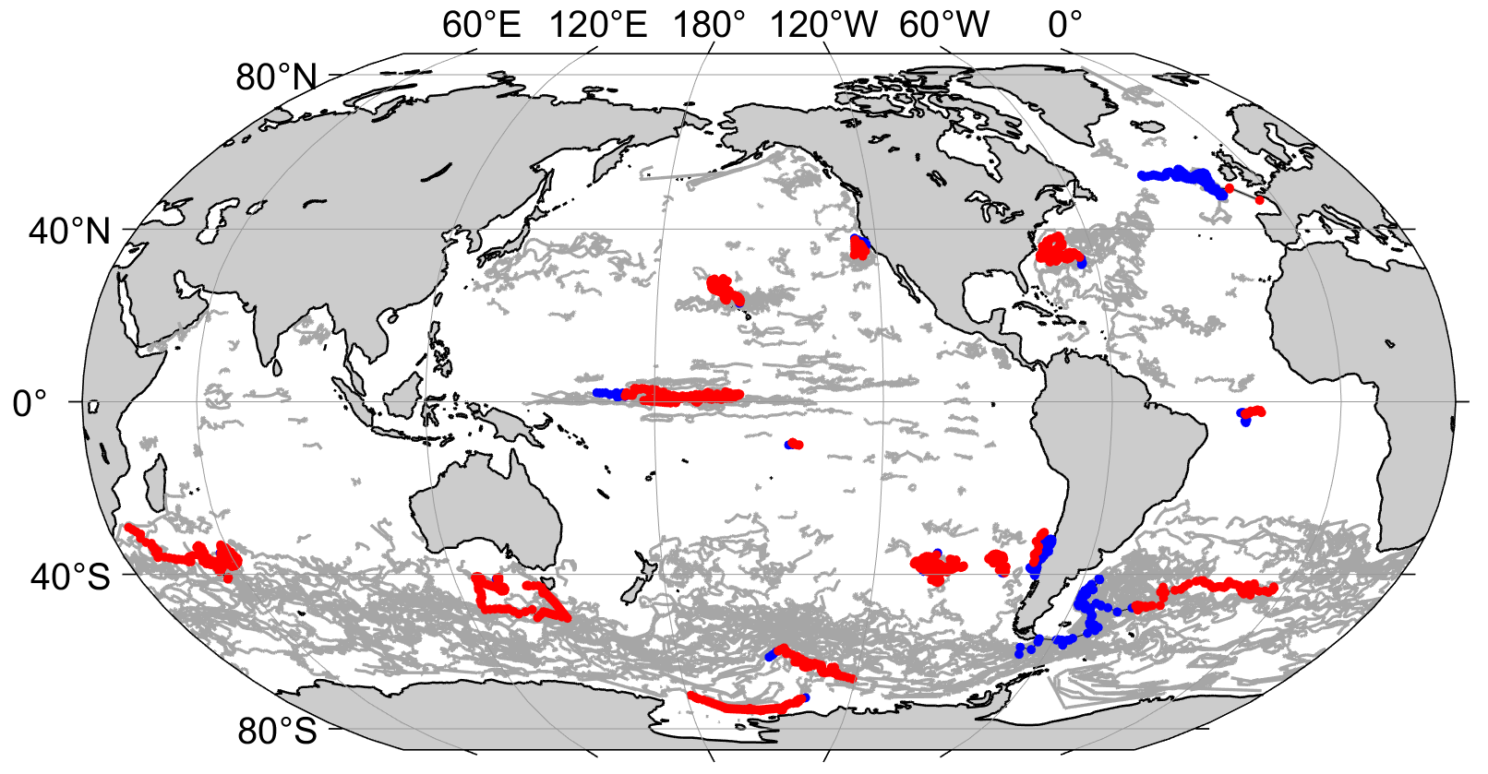
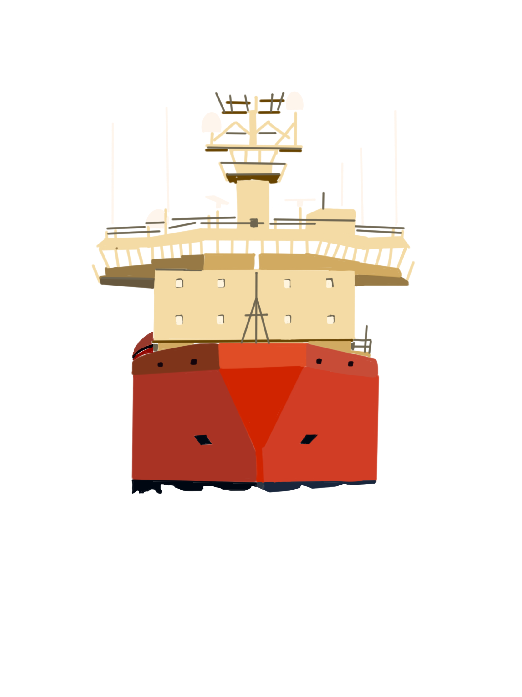









ADVANCEMENTS IN BIOGEOCHEMICAL DATA RECOVERY FOR GO-BGC AND SOCCOM PROFILING FLOATS
Nicola Guisewhite^{[1]}, Tanya Maurer, Josh Plant, Yuichiro Takeshita, Ken Johnson, Emily Clark
The Monterey Bay Aquarium Research Institute (MBARI), nicolag@mbari.org^{[1]}
#0934
BGC Argo Floats- A Sensor Network
Recovering BGC Data When Float Salinity is Bad
Recovering BGC Data When Float Oxygen is Bad
Between the GO-BGC and SOCCOM Biogeochemical (BGC) Argo Profiling Float programs, over 500 BGC-Argo floats have been deployed and over 37,000 profiles have been collected. Each float is equipped with a network of BGC sensors that operate with:
If vital sensors fail (such as the CTD or oxygen optode), uncertainties in other sensor parameters can be impacted.
Catastrophic salinity failures can propagate through to raw BGC parameter data. A salinity product can substitute for failed salinity during delayed-mode BGC parameter processing.
BGC data impacted by salinity failure can be recovered on dead floats using the following steps:
Most algorithms utilized in BGC float data quality control require oxygen as an input. In cases of optode failure, quality control methods can lean on alternative reference algorithms that do not require oxygen with minimal increases to parameter uncertainty.
SENSOR FUSION
Healthy Salinity
Salinity Error
Failed Salinity
Figure 1: Impact of Salinity error on BGC parameters based on WMO #5905988. Error from failed salinity (orange shaded region) can be improved by substituting failed salinity with a salinity product. Uncertainties introduced by using a salinity product should be within the acceptable error range of a healthy salinity sensor (purple shading).
Data from independent sensors are used synergistically in processing and quality control procedures, enhancing accuracies of key BGC parameters.
Figure 3: Quality Control on Sage. The GUI above shows the raw (left) and quality controlled (right) data produced when selecting a “no O2” option from available reference algorithms (highlighted square).
Select a salinity product, and match product data to afflicted float.
Compare the processed parameter data with and without the product.
Determine product success based on magnitude of parameter error and inflated product error.
Table 1: Parameter uncertainty from quality control reference algorithms. Uncertainties obtained from Carter et al 2018 ^{[2]} reflect an increase in error when oxygen is not an available parameter, but an error still within standard precision for each parameter.
VITAL SENSORS
RAW DATA PROCESSING
BGC PARAMETERS
The product used for operations at MBARI is ARMOR3D^{[1]}
.
Parameter | Uncertainty with O (μmol / kg) | Uncertainty without O (μmol / kg)
Nitrate | -0.02 (± 0.86) | 0.05 (± 1.27)
pH | 0.001 (± 0.011) | 0.001 (± 0.024)
PRESSURE
CHLOROPHYLL
How does healthy float salinity data compare to product data?
RAW SENSOR OUTPUT
IRRADIANCE
Acceptable error magnitude determined float by float
BACKSCATTER
SALINITY
NITRATE
TEMPERATURE
PH
Figure 2: Salinity failures and BGC Data Recovery among SOCCOM BGC-Argo Floats. Delayed recovery methods are operational for 831 profiles for 7 floats (healthy salinity profiles in blue, failed salinity profiles in red). Black float tracks indicate candidates for future BGC data recovery due to salinity failure, while all other SOCCOM float data are represented by gray tracks.
GPS + RTC
OXYGEN
QUALITY CONTROL
ADJUSTED OXYGEN
ADJUSTED NITRATE AND PH
Figure 4: Oxygen failures and BGC Data Recovery among GOBGC and SOCCOM BGC-Argo Floats. Real-time recovery methods are operational for 1713 profiles for 16 floats (healthy oxygen profiles in blue, failed oxygen profiles in red). All other GOBGC and SOCCOM float data are represented by gray tracks.
What if a member of the sensor network fails?
While less than 1% of GOBGC and SOCCOM BGC-Argo Float profiles are impacted by a vital sensor failure, each profile is extremely valuable, especially when collected in data-limited regions and seasons.
Data Recovery is the most efficient way to counter act a sensor failure and increase quantity and quality of BGC-Argo Float Data.
Conclusions and Acknowledgements
Data Recovery has become the most cost-effective method for obtaining more BGC-Argo Float data, and the MBARI data team continues to improve and explore methods for increased quantity and quality of data.
2,544 profiles of BGC data recovered
$814,000+ worth of BGC data recovered
References: [1] ARMOR3d – Greiner, E., Verbrugge, N., Mulet, S., Guinehut, S. (2023) Ocean 3D temperature, salinity, geopotential heights, geostrophic currents and 2D mixed layer depth product. https://catalogue.marine.copernicus.eu/documents/QUID/CMEMS-MOB-QUID-015-012.pdf [2] Carter, B.R., Feely, R.A., Williams, N.L., Dickson, A.G., Fong, M.B. and Takeshita, Y. (2018), Updated methods for global locally interpolated estimation of alkalinity, pH, and nitrate. Limnol. Oceanogr. Methods, 16: 119-131. https://doi.org/10.1002/lom3.10232 [3] Carter, B.R., Bittig, H.C., Fassbender, A.J., Sharp, J.D., Takeshita, Y., Xu, Y.-Y., Álvarez, M., Wanninkhof, R., Feely, R.A. and Barbero, L. (2021), New and updated global empirical seawater property estimation routines. Limnol Oceanogr Methods, 19: 785-809. https://doi.org/10.1002/lom3.10461 [4] Argo quality control manual – Schmechtig, C., Wong, A., Maurer, T.L., Bittig, H., Thierry, V. (2023). Argo quality control manual for biogeochemical data. https://doi.org/10.13155/40879
Notes:
Amount (percent) of salinity failures
Amount (percent) of this lost data recovered.

Slide 2
Salinity Error Vs. BGC Parameter Uncertainty
Healthy Salinity
Salinity Error
Failed Salinity
Figure 1: Impact of Salinity error on BGC parameters. Errors from failed salinity sensors (orange shaded region) like that onboard float WMO #5905988 can be improved upon by substituting the failed salinity with a salinity product. Uncertainties introduced by using a salinity product should be within the range of acceptable error as from a healthy salinity sensor (purple shading).
VITAL SENSORS
RAW DATA PROCESSING
BGC PARAMETERS
PRESSURE
CHLORPHYLL A
RAW SENSOR OUTPUT
IRRADIANCE
BACK SCATTER
SALINITY
NITRATE
TEMPERATURE
PH
GPS + RTC
OXYGEN
QUALITY CONTROL
References: [1] ARMOR3d – Greiner, E., Verbrugge, N., Mulet, S., Guinehut, S. (2023) Ocean 3D temperature, salinity, geopotential heights, geostrophic currents and 2D mixed layer depth product. https://catalogue.marine.copernicus.eu/documents/QUID/CMEMS-MOB-QUID-015-012.pdf [2] Carter, B.R., Feely, R.A., Williams, N.L., Dickson, A.G., Fong, M.B. and Takeshita, Y. (2018), Updated methods for global locally interpolated estimation of alkalinity, pH, and nitrate. Limnol. Oceanogr. Methods, 16: 119-131. https://doi.org/10.1002/lom3.10232 [3] Carter, B.R., Bittig, H.C., Fassbender, A.J., Sharp, J.D., Takeshita, Y., Xu, Y.-Y., Álvarez, M., Wanninkhof, R., Feely, R.A. and Barbero, L. (2021), New and updated global empirical seawater property estimation routines. Limnol Oceanogr Methods, 19: 785-809. https://doi.org/10.1002/lom3.10461 [4] Argo quality control manual – Schmechtig, C., Wong, A., Maurer, T.L., Bittig, H., Thierry, V. (2023). Argo quality control manual for biogeochemical data. https://doi.org/10.13155/40879
ADJUSTED OXYGEN
ADJUSTED NTRATE AND PH

Slide 3
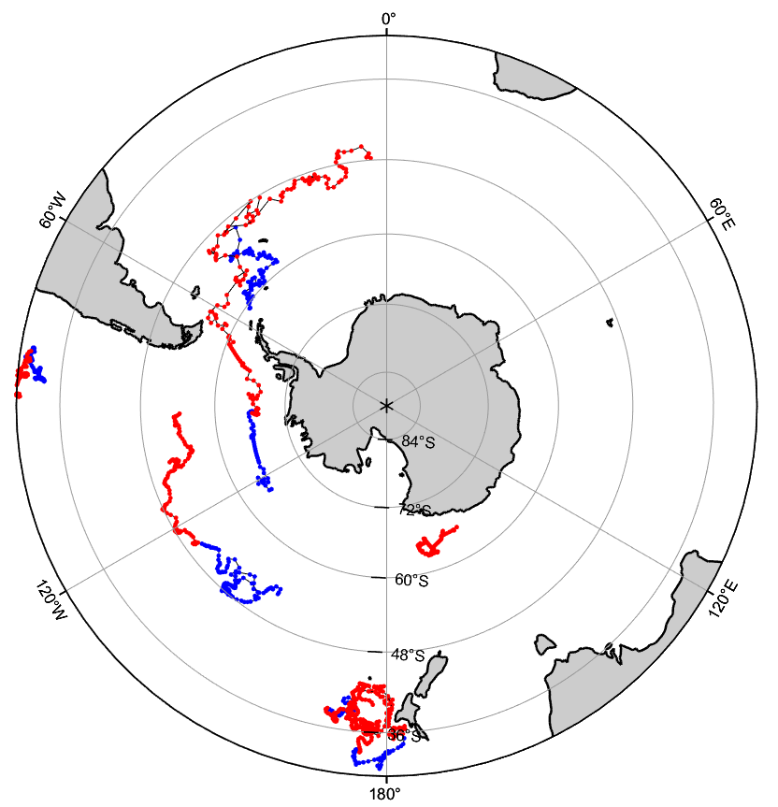


ADVANCEMENTS IN BIOGEOCHEMICAL DATA RECOVERY FOR GO-BGC AND SOCCOM PROFILING FLOATS
Nicola Guisewhite^{[1]}, Tanya Maurer, Josh Plant, Yuichiro Takeshita, Ken Johnson, Emily Clark
The Monterey Bay Aquarium Research Institute (MBARI), nicolag@mbari.org^{[1]}
BGC Argo Floats- A Sensor Network
Recovering BGC Data When Float Salinity is Bad
Recovering BGC Data When Float Oxygen is Bad
Between the GO-BGC and SOCCOM Biogeochemical (BGC) Argo Profiling Float programs, over 500 BGC-Argo floats have been deployed and over 37000 profiles have been collected. Each float is equipped with a network of BGC sensors that operate with sensor fusion.
Catastrophic PSAL failures can propagate through the raw BGC parameter data:
BGC data impacted by salinity failure can be recovered on dead floats using the following steps:
Oxygen optode failures greatly impact the ability to quality control of float parameters including Nitrate and pH.
Quality Control of Nitrate and pH:
In cases of oxygen failure, quality control methods can substitute Eq. 8 of Carter et al. 2017, which does not include oxygen as an input.
Table 1: Impact of Salinity error on BGC parameters. Errors in salinity can increase error in BGC parameters close to/ beyond the standard precision of a parameter.
Float observations of Nitrate and pH
Locally interpolated estimates of Nitrate and pH
BGC Argo Parameter | Average Fleet Precision | Maximum error with 0.5 psu error in Salinity
Oxygen (μmol / kg) | 2.0 | 1.1
Nitrate (μmol / kg) | 0.5 | 0.8
pH | 0.008 | 0.0075
Eq. 7 of Carter et al. 2017 is used to obtain estimates for quality control, but this requires float oxygen (as AOU) as an input!
Figure 1: Visual of salinity failures
SENSOR FUSION
Benefit: Each member of the sensor network collaborates with other observations to produce abundant, high quality BGC observations.
Table 3: Difference in parameter uncertainty between Eq. 7 and Eq. 8. The parameter uncertainties obtained from Tables 2 and 3 of Carter et al 2017 reflect an increase in error when oxygen is not an available parameter, but an error still within standard precision for each parameter.
Risk: If one sensor fails, it can impact observations across the rest of the sensor network.
Parameter | Carter et al. 2017 Equation # | Parameters Used | Uncertainty (μmol / kg)
Nitrate | 7 | S, θ, AOU | -0.02 (± 0.86)
 | 8 | S, θ | 0.05 (± 1.27)
pH | 7 | z, S, θ, AOU | 0.001 (± 0.011)
 | 8 | z, S, θ | 0.001 (± 0.024)
BGC Data Recovery
Select a salinity proxy, and match proxy data to afflicted float.
Compare the processed parameter data with and without the proxy.
Determine proxy success based on magnitude of parameter error and inflated proxy error.
MANY BGC OBSERVATIONS
TEMP
OXYGEN
SALINITY
For example, if salinity fails, many BGC observations including nitrate and pH can be compromised:
The Data Team at MBARI has implemented methods to recover data negatively impacted by a sensor issue or failure.
The proxy used for operations at MBARI is ARMOR3D.
Figure 2: Caption that contains informationa about the plot that you see to the left.
How does healthy salinity data compare to proxy data?
Acceptable error magnitude determined float by float.
Table 2: Salinity Recovery Impact on BGC Data. This recovery method is operational for 830+ profiles from 7 SOCCOM floats, and will be implemented in the occurrence of future salinity failures.
Table 4: Impact of Eq. 8 on BGC Data. Using Eq. 8 during the quality control process has allowed for the recovery of ###+ profiles from #### floats. Future quality control procedures will be performed using an updated Eq. 7 and eq. 8 from Carter et al. 2021.
MANY BGC OBSERVATIONS
TEMP
OXYGEN
SALINITY RECOVERY METHOD
Percent of Salinity Failures | Percent of Impacted Data Recovered | # of Observations Recovered
Percent of Oxygen Failures | Percent of Impacted Data Recovered | # of Observations Recovered
Conclusions and Acknowledgements
Data Recovery has become the most effective method for obtaining more BGC-Argo Float data, and the MBARI data team continues to improve and explore continued methods for increased quantity and quality of data.
Percent of Salinity Failures | Percent of Impacted Data Recovered | # of Observations Recovered
Notes:
Amount (percent) of salinity failures
Amount (percent) of this lost data recovered.

Slide 4
ADVANCEMENTS IN BIOGEOCHEMICAL DATA RECOVERY FOR GO-BGC AND SOCCOM PROFILING FLOATS
Nicola Guisewhite^{[1]}, Tanya Maurer, Josh Plant, Yuichiro Takeshita, Ken Johnson, Emily Clark
The Monterey Bay Aquarium Research Institute (MBARI), nicolag@mbari.org^{[1]}
Introduction
GO-BGC and SOCCOM Biogeochemical (BGC) Argo Profiling Floats collect biogeochemical profiles from 2000m to surface throughout the global oceans Between the two programs, over 500 BGC-Argo floats have been deployed and over 37000 profiles have been collected. Each BGC-Argo Float is equipped with a sensor suite capable of collecting observations including temperature, pressure, salinity, oxygen, nitrate, pH, backscatter, fluorescence and more. The sensors on board each BGC-Argo Float operate with sensor fusion, meaning each sensor acts as a member of the sensor network and collaborates with other sensor observations to produce a variety of abundant and high quality BGC observations. However, if one sensor fails, there is the potential for data loss across the entire sensor network. Data loss can often appear catastrophic, but the data team at MBARI has worked to mitigate the impact of sensor issues in both BGC-Argo Float arrays and has developed and implemented a number of methods to accurately recover data that is negatively impacted by a sensor issue or failure. This study focuses on recovery methods or failed salinity and oxygen sensors, where the data team as successfully recovered ######### observations, equivalent to $######### worth of BGC-Argo Float Data.
Recovering BGC Data When Float Salinity is Bad
Recovering BGC Data When Float Oxygen is Bad
BGC Data Recovery: Looking Ahead
Catastrophic PSAL failures can propagate through the raw BGC parameter data:
Caption for table
BGC data impacted by salinity failure can be recovered on dead floats using the following steps:
This data recovery method is operational for 830+ profiles and ##### observations on 7 SOCCOM floats, and will be implemented in future salinity failures.
Oxygen optode failures greatly impact the ability to quality control of float parameters including Nitrate and pH.
Quality Control of Nitrate and pH:
In cases of oxygen failure, quality control methods can be adapted from Equation 7 to Equation 8 of Carter et al. 2017, which does not include oxygen as an input.
Caption of table
The methods for recovering BGC data from a loss of PSAL or Oxygen are have been accepted by the BGC-Argo community and are actively being implemented in the quality control of GO-BGC and SOCCOM BGC-Argo Float Data. However, on top of implementing accepted data recovery techniques, the data team at MBARI also works to develop new methods to continue to improve data recovery techniques.
For example, pH pump offset.
SCRAP – add in section highlighting the sensor network -> The problem and the solution WITH FIGURES.
BGC Argo Parameter | Average Fleet Precision | Maximum error with 0.5 psu error in Salinity
Oxygen (μmol / kg) | 2.0 | 1.1
Nitrate (μmol / kg) | 0.5 | 0.8
pH | 0.008 | 0.0075
Locally interpolated estimates of Nitrate and pH
Float observations of Nitrate and pH
Figure 1: Caption that contains informationa about the plot that you see to the left.
MBARI uses Equation 7 of Carter et al. 2017 to obtain estimates for quality control, but this requires float oxygen as apparent oxygen utilization (AOU) as an input!
Parameter | Carter et al. 2017 Equation # | Parameters Used | Uncertainty (μmol / kg)
Nitrate | 7 | S, θ, AOU | -0.02 (± 0.86)
 | 8 | S, θ | 0.05 (± 1.27)
pH | 7 | z, S, θ, AOU | 0.001 (± 0.011)
 | 8 | z, S, θ | 0.001 (± 0.024)
Select a salinity proxy, and match proxy data to afflicted float.
Compare the processed parameter data with and without the proxy.
Determine proxy success based on magnitude of parameter error and inflated proxy error.
Acknowledgements
SOCCOM and GOBGC statements
The proxy used for operations at MBARI is ARMOR3D.
How does healthy salinity data compare to proxy data?
Figure 2: Caption that contains informationa about the plot that you see to the left.
Acceptable error magnitude determined float by float.
References ^{ARMOR3d, TWO Carter Papers}

Slide 5
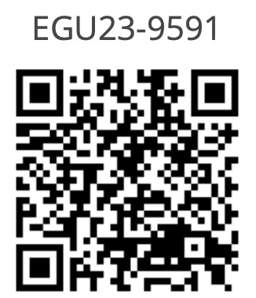



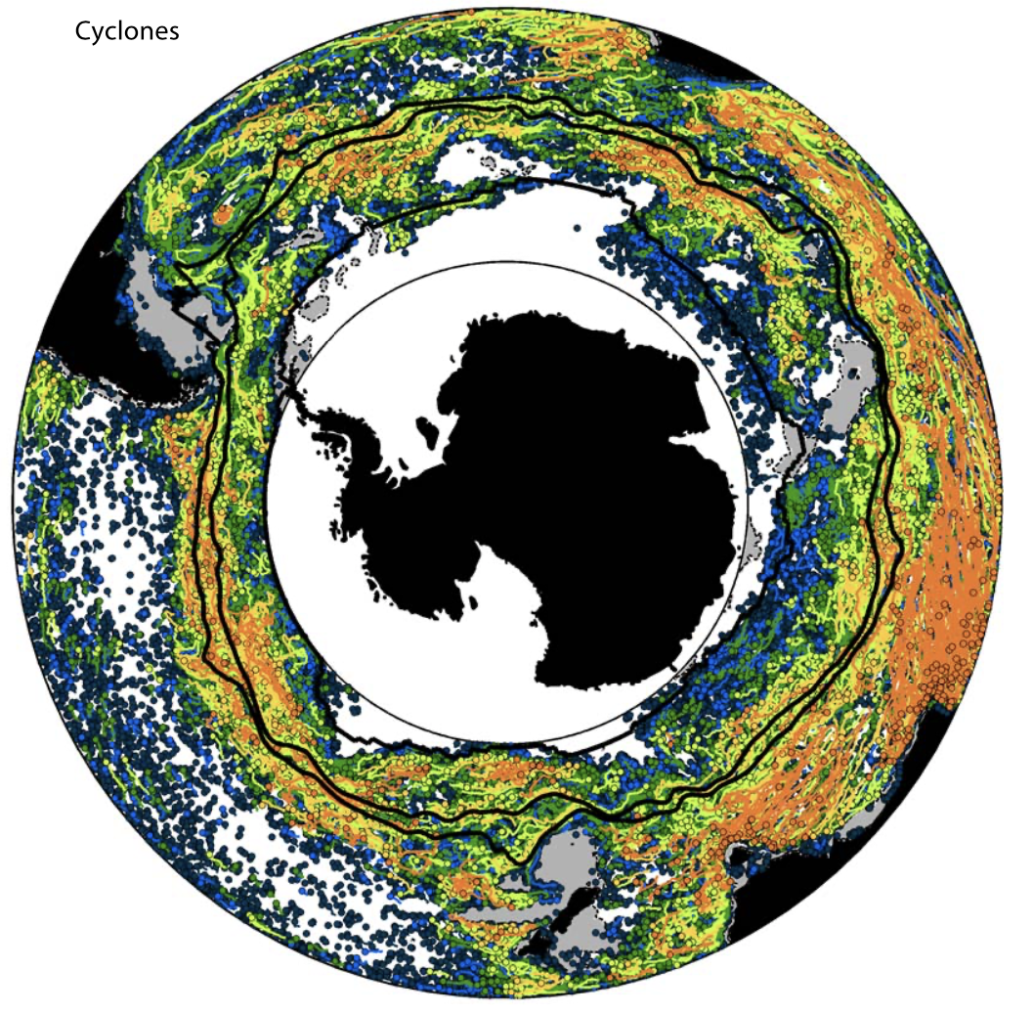
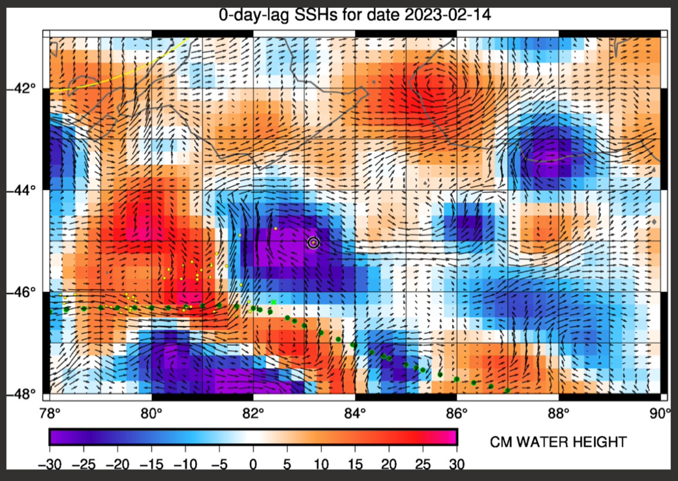
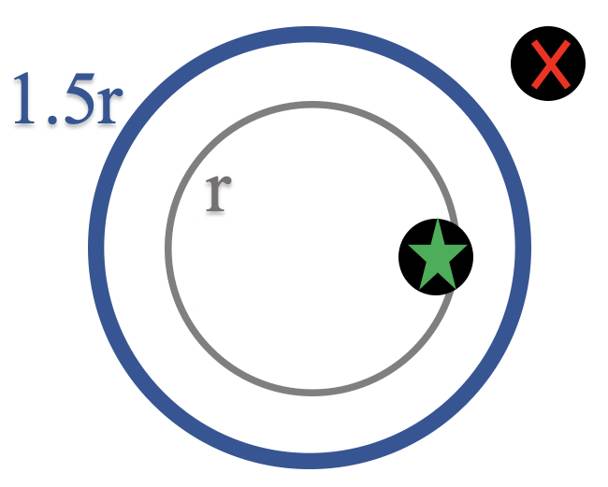
EXPLORING THE IMPACT OF EDDIES ON SOUTHERN OCEAN BIOGEOCHEMICAL STRUCTURE USING BGC-ARGO FLOAT OBSERVATIONS
Nicola Guisewhite^{[1]}, Don Chambers^{[2]}, Veronica Tamsitt, Nancy Williams
The University of South Florida College of Marine Science, nicolag@usf.edu^{[1]}, donc@usf.edu^{[2]}
Each season and frontal zone of the ACC has unique biogeochemical properties. We group all of our matchups by frontal zone and season to reduce bias between the mean biogeochemical property within each grouping (Figure 5).
Even with our profiles grouped by similar regions and seasons of biogeochemical variability, our profiles contain information from both eddies and the larger-scale ocean state. To isolate eddy-induced signals, we calculated anomalies within each grouping relative to a mean background state.
For profiles of temperature, salinity, oxygen and nitrate, the mean background state used to calculate anomaly profiles is represented by gridded monthly averages from World Ocean Atlas (WOA)^{[7]} (Figure 6).
We interpret the differences away from zero in the anomaly profiles as being caused by eddies. In order to quantify if the differences in biogeochemical properties differ between cyclonic, anticyclonic and non-eddy profiles, we calculated the statistical mean and standard error for temperature, salinity, oxygen, and nitrate for each grouping (Figure 7).
Introduction
Regional and Temporal Segregation of Profiles
Comparing Biogeochemical Properties between Eddy Types
Eddies are vortices that form due to interactions between currents, between currents and bathymetry, from direct wind forcing or from turbulent instabilities. Eddies are extremely variable; they can vary in age, amplitude, propagation speed, and rotational direction. Both cyclonic and anticyclonic eddies can contribute to variability in biogeochemical properties in oceans through processes including eddy stirring, eddy trapping and eddy pumping^{[1]}, leading to changes in nutrient enhancement or depletion, and changes in biological productivity.
The Antarctic Circumpolar Current (ACC) allows for the Southern Ocean to be a center for inter-basin exchange of heat and nutrients which fuels global ocean circulation. Turbulent instabilities caused by interactions between the jets of the ACC, bathymetry, and other currents make the Southern Ocean a region of significant eddy activity^{[2]}, suggesting that eddies may play an important role on the biogeochemical structure there (Figure 1). However, the Southern Ocean is largely under-sampled (especially in winter), leaving significant gaps in understanding how the Southern Ocean and its biogeochemical properties are impacted in a changing climate.
The use of autonomous vehicles (AVs), including floats like those used by the Southern Ocean Carbon and Climate Observations and Modeling (SOCCOM) Project, is beginning to transform our ability to obtain biogeochemistry data in the Southern Ocean by obtaining in-situ samples in data-limited regions and seasons^{[3]}. These floats frequently encounter eddies, providing a baseline of biogeochemical properties within eddies in the Southern Ocean.
This research aims to answer the following question: Are there differences between cyclonic, anticyclonic and non-eddy profiles in the Southern Ocean?
We compare the statistical mean and standard error of the anomaly profiles across eddy type, frontal zones and seasons to determine if differences between eddy types within a seasonal and regional grouping exist.
From our comparisons of temperature, salinity, oxygen and nitrate, we have found significant differences in biogeochemical properties between eddy type that vary based on property, region and season. In addition, we have been able to identify some eddy types in our groupings as potential sources of upwelling and/or downwelling. However, we recognize that our results may also be representing interannual variability, especially in our oxygen and nitrate results. The BGC-Argo Float data from SOCCOM covers a time span from 2014-2021, while our background state data for oxygen and nitrate from WOA is averaged over all available decades starting in 1955.
Since our non-eddy profiles for oxygen and nitrate also contain variability caused by the background state, our next step will be to create a double-anomaly by removing the non-eddy signature from our eddy profiles. By doing this, we hope to remove the interannual signals in our background state and narrow down the variability caused by eddies.
This research was funded by The National Science Foundation, Division of Polar Programs (NSF OPP – 2048840), the University of South Florida and by the Wells Fargo Fellowship in Marine Science. The SOCCOM data were collected and made freely available by the Southern Ocean Carbon and Climate Observations and Modeling (SOCCOM) Project funded by the National Science Foundation, Division of Polar Programs (NSF PLR -1425989 and OPP-1936222), supplemented by NASA, and by the International Argo Program and the NOAA programs that contribute to it. (http://www.argo.ucsd.edu(link is external), http://argo.jcommops.org(link is external)). The Argo Program is part of the Global Ocean Observing System.
A
C
B
D
Figure 5: Organization of SOCCOM BGC-Argo Float Profiles. The plot above shows how the data profiles are organized into groupings by basin (A), eddy type (B), Frontal Zone (C) and the season (D).
Figure 1: Map of eddies in the Southern Ocean from Frenger et al. 2015. Each dot in this map represents a cyclonic eddy between 1997 and 2010. Over that same time, nearly one million eddies were identified in the Southern Ocean^{[2]}. Despite their abundance, most studies which explore Southern Ocean biogeochemistry do not consider eddies because eddies are often smaller than the typical resolution (111 by 111 km) of model estimates^{[4]}. In addition, many of these studies limit their analysis to spring and summer seasons to focus on biological impacts, leaving winter significantly understudied^{[5]}.
Calculating Anomalies, Statistical Mean, and Standard Error
Eddies can be identified using satellite altimeters by looking for closed contours of sea-surface height anomalies (Figure 3).
This study uses the AVISO eddy database which contains the location of each detected eddy (the center of the closed contour) over time at 1-day steps, the eddy type, and the radius of maximum velocity (r) from the center^{[6]}. Using this data, we determined which SOCCOM BGC-Argo profiles were collected outside of an eddy or within an eddy by determining where the profile was collected relative to the center given by the database (Figure 4).
BGC-Argo Floats
Eddy Altimetry and Eddy Matchups
A BGC-Argo Float is an autonomous vehicle that drifts with ocean currents at a depth of 1000 meters. Every 10 days, it sinks to 2000 meters depth, then rises to the surface and collects temperature, salinity, pressure, and biogeochemical measurements (dissolved nitrogen, oxygen, and pH) at discrete depths, then transmits the profile data to satellites before starting the cycle again (Figure 2).
In this study, we examine our scientific question by using 10-day samplings collected by ~200 BGC-Argo Floats deployed by SOCCOM between 2014 and 2021. We separated the float profiles into those within a cyclonic eddy, within an anticyclonic eddy, and not within any identifiable eddy. We examine profiles from all seasons, but limit our region of interest to the Pacific Basin because it represents the least sampled basin of the Southern Ocean.
Figure 6: Float, WOA, and Anomaly Profile Example. From surface to depth, the float and WOA profiles (left) are extremely similar in their overall trend and differ only with small variations. This indicates that the large-scale influences used to create the WOA profile is also present within float profile. Removing the large-scale influence results in an anomaly profile (right) that highlights the small variations between the float profile and the WOA profile.
Figure 7: Example of Comparing the Statistical Mean and Standard Error of Different Eddy Types. The figure above shows the mean (bold lines) and standard error (dashed lines) of oxygen anomalies for cyclonic, anticyclonic and non-eddy profiles in the Subantarctic Zone across all seasons (right) and the mean of all float profile corresponding to the same season and region (left). The mean float profile aids in determining if we are seeing regions of potential upwelling or downwelling being caused by an eddy type.
Figure 3: Sea-Surface Height observed by Satellite Altimetry. This plot shows the sea-surface heights where positive anomalies are indicative of anticyclonic eddies and negative anomalies are indicative of cyclonic eddies. Overlaid on the satellite altimetry observations are current velocities calculated from the HYCOM Model.
Summary and Next Steps
Figure 2: Argo Float Profiling Cycle. This image from NOAA’s Global Ocean Monitoring and Observing Program illustrates the 10 day profiling cycle of an Argo Float. This cycle will repeat for 4-5 years until the float dies.
Acknowledgements
Figure 4: Creating an Eddy Matchup with 1.5r as the Eddy Boundary. We compared the times and locations of identified eddies to the times and locations of the SOCCOM-BGC Argo Floats. If a profile is within 1.5r of an eddy at a given time, it was marked as a match (green star) and the eddy type that corresponds to the matchup is stored. If a profile is not within 1.5r of an eddy at a given time, it was marked as a non-eddy profile (red cross).
Figure 7: Example of Mean and Standard Error profiles. The above plot shows an example of the mean and standard error profiles calculated from profiles of oxygen from summer cyclonic eddies in the Subantarctic Zone (grey). This calculation was repeated for each biogeochemical variable, eddy type, season, and frontal zone.
References ^{[1]} McGillicudy, D.J., Mechanisms of Physical-Biological-Biogeochemical Interaction at the Oceanic Mesoscale. The Annual Review of Marine Science, 2016. 8 p. 125-159 ^{[2]} Frenger, I., et al., Southern Ocean eddy phenomenology. Journal of Geophysical Research: Oceans, 2015. 120(11): p. 7413-7449. ^{[3]} Johnson, K. S., et al., SOCCOM float data - Snapshot 2022-05-19. In Southern Ocean Carbon and Climate Observations and Modeling (SOCCOM) Float Data Archive. UC San Diego Library Digital Collections, 2022. https://doi.org/10.6075/J0MC905G ^{[4]} Bushinsky, S.M., et al., Reassessing Southern Ocean Air-Sea CO2 Flux Estimates With the Addition of Biogeochemical Float Observations. Global Biogeochemical Cycles, 2019. 33(11): p. 1370-1388. ^{[5]} Frenger, I., et al., Imprint of Southern Ocean mesoscale eddies on chlorophyll. Biogeosciences, 2018. 15(15): p. 4781-4798 ^{[6]} Pegliasco, C., et al., META3.1exp: a new global mesoscale eddy trajectory atlas derived from altimetry. Earth Syst. Sci., 2022. Data 14, p 1087–1107. https://doi.org/10.5194/essd-14-1087-2022 ^{[7]}World Ocean Atlas

Slide 6


ADVANCEMENTS IN BIOGEOCHEMICAL DATA RECOVERY FOR GO-BGC AND SOCCOM PROFILING FLOATS
Nicola Guisewhite^{[1]}, Tanya Maurer, Josh Plant, Yuichiro Takeshita, Ken Johnson, Emily Clark
The Monterey Bay Aquarium Research Institute (MBARI), nicolag@mbari.org^{[1]}
Introduction
However, if one sensor fails, there is the potential for data loss across the entire sensor network. Data loss can often appear catastrophic, but the data team at MBARI has worked to mitigate the impact of sensor issues in both BGC-Argo Float arrays and has developed and implemented a number of methods to accurately recover data that is negatively impacted by a sensor issue or failure. This study focuses on recovery methods or failed salinity and oxygen sensors, where the data team as successfully recovered ######### observations, equivalent to $######### worth of BGC-Argo Float Data.
As a result, over ######## observations have been recovered, improving the quality of over ###### profiles and restoring about $########## worth of BGC-Argo Float Data.
Recovering BGC Data When Float Salinity is Bad
Recovering BGC Data When Float Oxygen is Bad
BGC Data Recovery: Looking Ahead
Table of how salinity failures impact oxygen, nitrogen, pH
Map of psal failures
Flow chart showing recovery
Table?map of Recovered data
Other information to prep for both PSAL and noO2:
Sensor imformation
Further detail on data recovery
Number of living failed salinity – what to expect in future
NO Oxygen – but everything is actually still okay
The methods for recovering BGC data from a loss of PSAL or Oxygen are have been accepted by the BGC-Argo community and are actively being implemented in the quality control of GO-BGC and SOCCOM BGC Float Data. However, on top of implementing accepted data recovery techniques, the data team at MBARI also works to develop new methods to be accepted for the potential to recover lost data.
For example, pH pump offset.
Acknowledgements
SOCCOM and GOBGC statements
References ^{[1]} McGillicudy, D.J., Mechanisms of Physical-Biological-Biogeochemical Interaction at the Oceanic Mesoscale. The Annual Review of Marine Science, 2016. 8 p. 125-159 ^{[2]} Frenger, I., et al., Southern Ocean eddy phenomenology. Journal of Geophysical Research: Oceans, 2015. 120(11): p. 7413-7449. ^{[3]} Johnson, K. S., et al., SOCCOM float data - Snapshot 2022-05-19. In Southern Ocean Carbon and Climate Observations and Modeling (SOCCOM) Float Data Archive. UC San Diego Library Digital Collections, 2022. https://doi.org/10.6075/J0MC905G ^{[4]} Bushinsky, S.M., et al., Reassessing Southern Ocean Air-Sea CO2 Flux Estimates With the Addition of Biogeochemical Float Observations. Global Biogeochemical Cycles, 2019. 33(11): p. 1370-1388. ^{[5]} Frenger, I., et al., Imprint of Southern Ocean mesoscale eddies on chlorophyll. Biogeosciences, 2018. 15(15): p. 4781-4798 ^{[6]} Pegliasco, C., et al., META3.1exp: a new global mesoscale eddy trajectory atlas derived from altimetry. Earth Syst. Sci., 2022. Data 14, p 1087–1107. https://doi.org/10.5194/essd-14-1087-2022 ^{[7]}World Ocean Atlas

Slide 7
Cite: Armor3D; Carter for LIRv2 paper
BGC Argo Parameter | Average Fleet Precision | Maximum error with 0.5 psu error in Salinity
Oxygen (μmol / kg) | 2.0 | 1.1
Nitrate (μmol / kg) | 0.5 | 0.8
pH | 0.008 | 0.0075

Slide 8
Locally integrated regression
Select a salinity proxy, and matchup proxy data to afflicted float.
MBARI uses ARMOR3D
Compare the processed parameter data with ‘healthy salinity” with use of the proxy
This is determined on a magnitude of added uncertainty float-by-float basis.
Process parameter data with use of proxy, and inflate the error
Using a proxy with inevitably impart error, but will impart less error than bad salinity.
Select a salinity proxy, and match proxy data to afflicted float.
Compare the processed parameter data with and without the proxy.
Determine proxy success based on magnitude of parameter error and inflated proxy error.
Select a salinity proxy, and matchup proxy data to afflicted float.
MBARI uses ARMOR3D
Compare the processed parameter data with and without use of proxy
How to tell if proxy is an improvement.
Process parameter data with use of proxy, and inflate the error
Using a proxy with inevitably impart error, but will impart less error than bad salinity.
The proxy used for operations at MBARI is ARMOR3D.
How does healthy salinity data compare to proxy data?
Acceptable error magnitude determined float by float.

Slide 9
BGC Argo Parameter | Average Fleet Precision | Maximum error with 0.5 psu error in Salinity
Oxygen (μmol / kg) | 2.0 | 1.1
Nitrate (μmol / kg) | 0.5 | 0.8
pH | 0.008 | 0.0075
Parameter | Carter et al. 2017 Equation # | Parameters Used | Uncertainty (μmol / kg)
Nitrate | 7 | S, θ, AOU | -0.02 (± 0.86)
 | 8 | S, θ | 0.05 (± 1.27)
pH | 7 | z, S, θ, AOU | 0.001 (± 0.011)
 | 8 | z, S, θ | 0.001 (± 0.024)
Locally interpolated estimates of Nitrate and pH
Float observations of Nitrate and pH
MBARI uses Equation 7 of Carter et al. 2017 to obtain parameter estimates for quality control, but this requires float oxygen as apparent oxygen utilization (AOU) as an input!

Slide 10
SOCCOM and GOBGC statements
MANY BGC OBSERVATIONS
TEMP
OXYGEN
SALINITY
References ^{ARMOR3d, TWO Carter Papers}

Slide 11
Math Performed
Price of float / average number of profiles = price of each profile
Number of profiles you want to do math on * price of each profile = number you want to show!
For example – Coastal Float costs = $1000, 100 profiles – 10$ per cycle
Improvements to Float – Float $1000, 150 profiles - $6.67 per cycle (cut a third of the cost)

