Slide 1
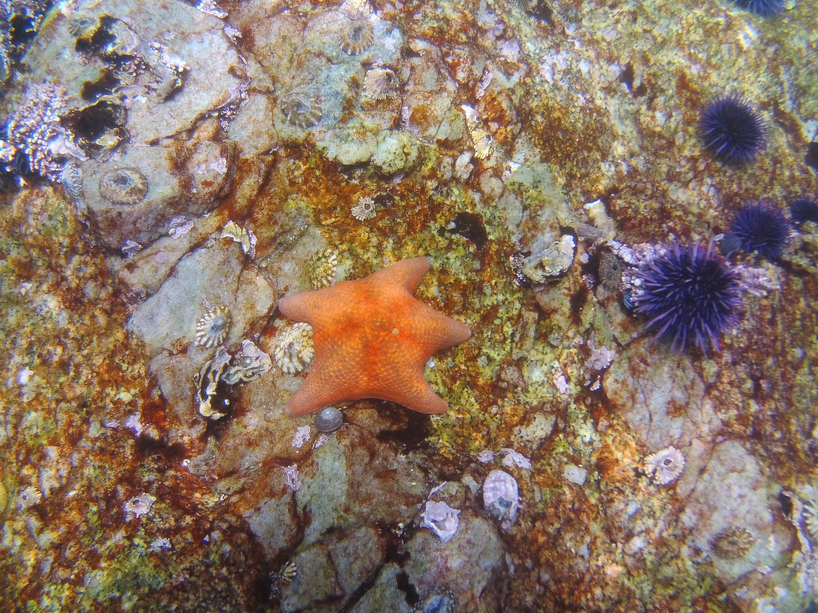
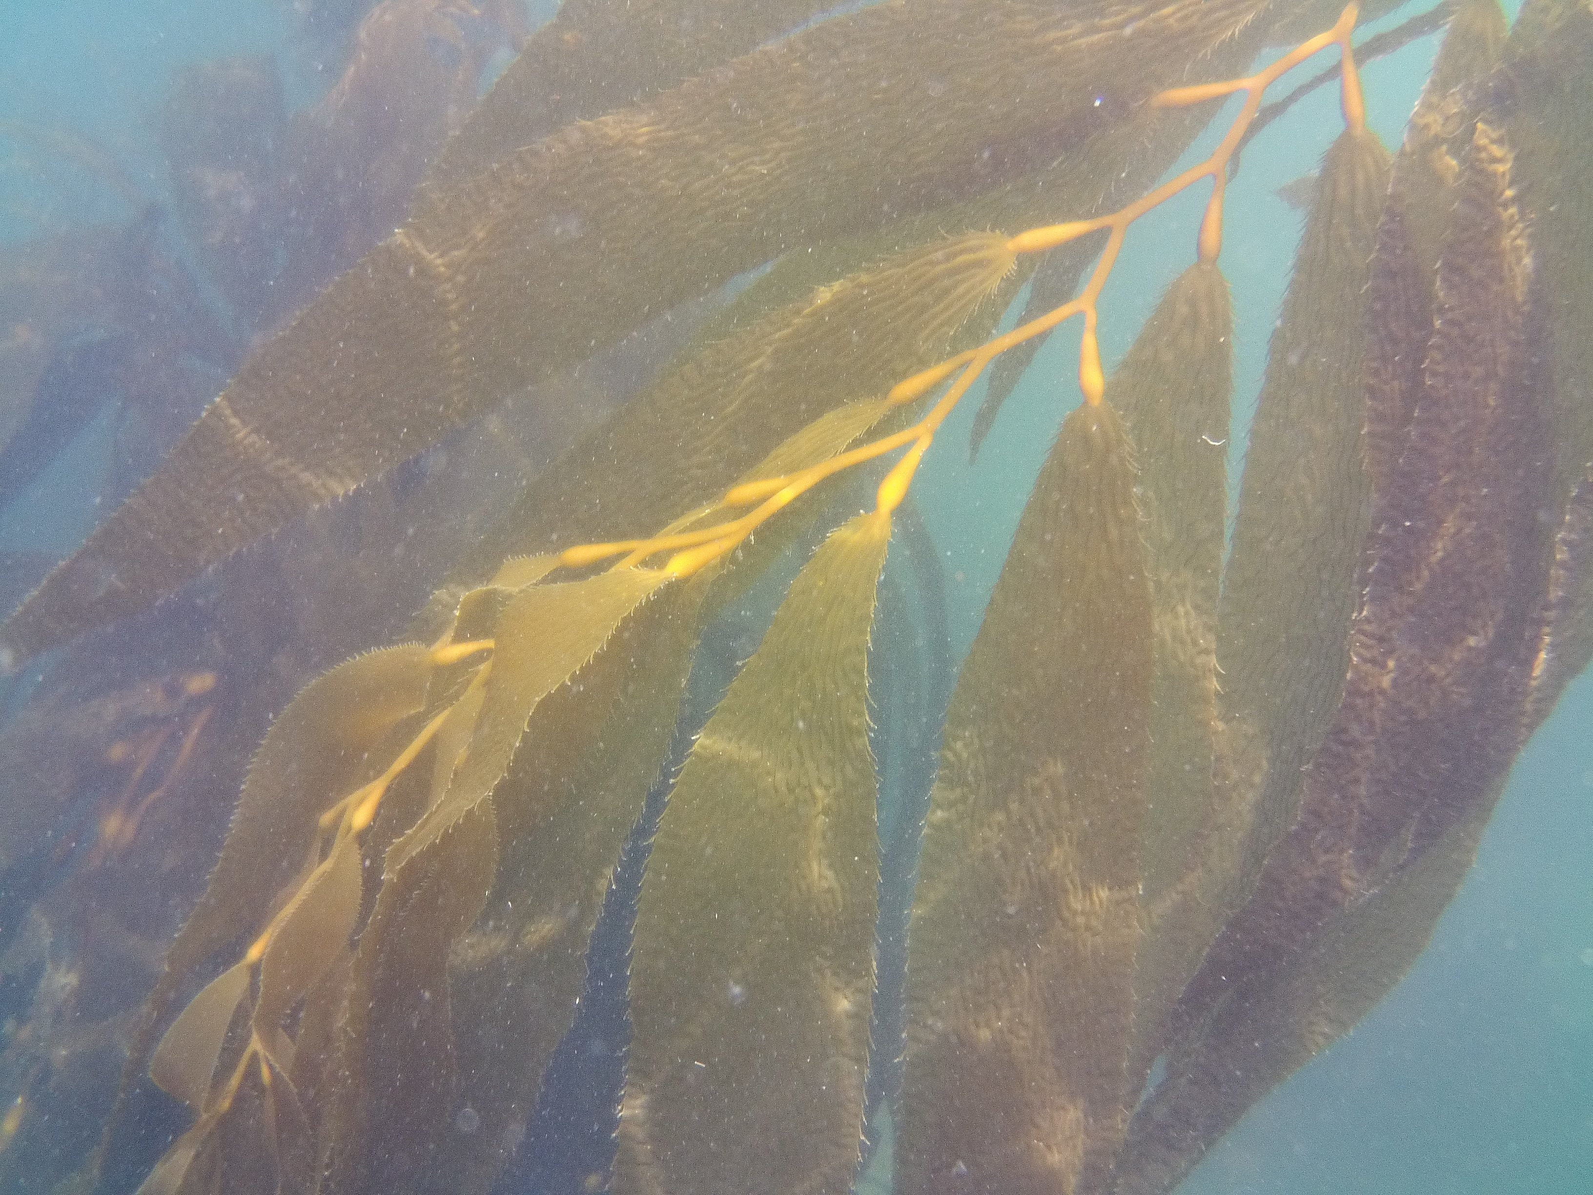
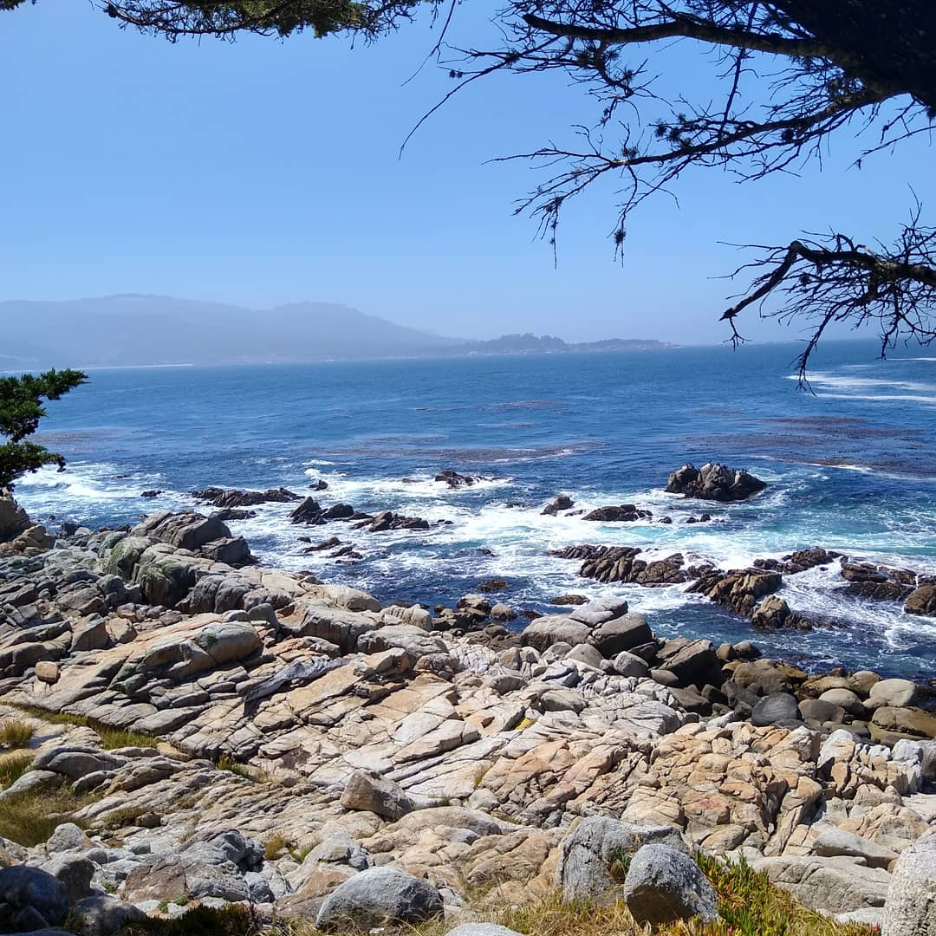

Evaluating the VN-100 IMU/AHRS as an Inertial Current Meter in Coastal Profiling Floats
Luke Dorrian
Notes:
Personal Introduction

Slide 2
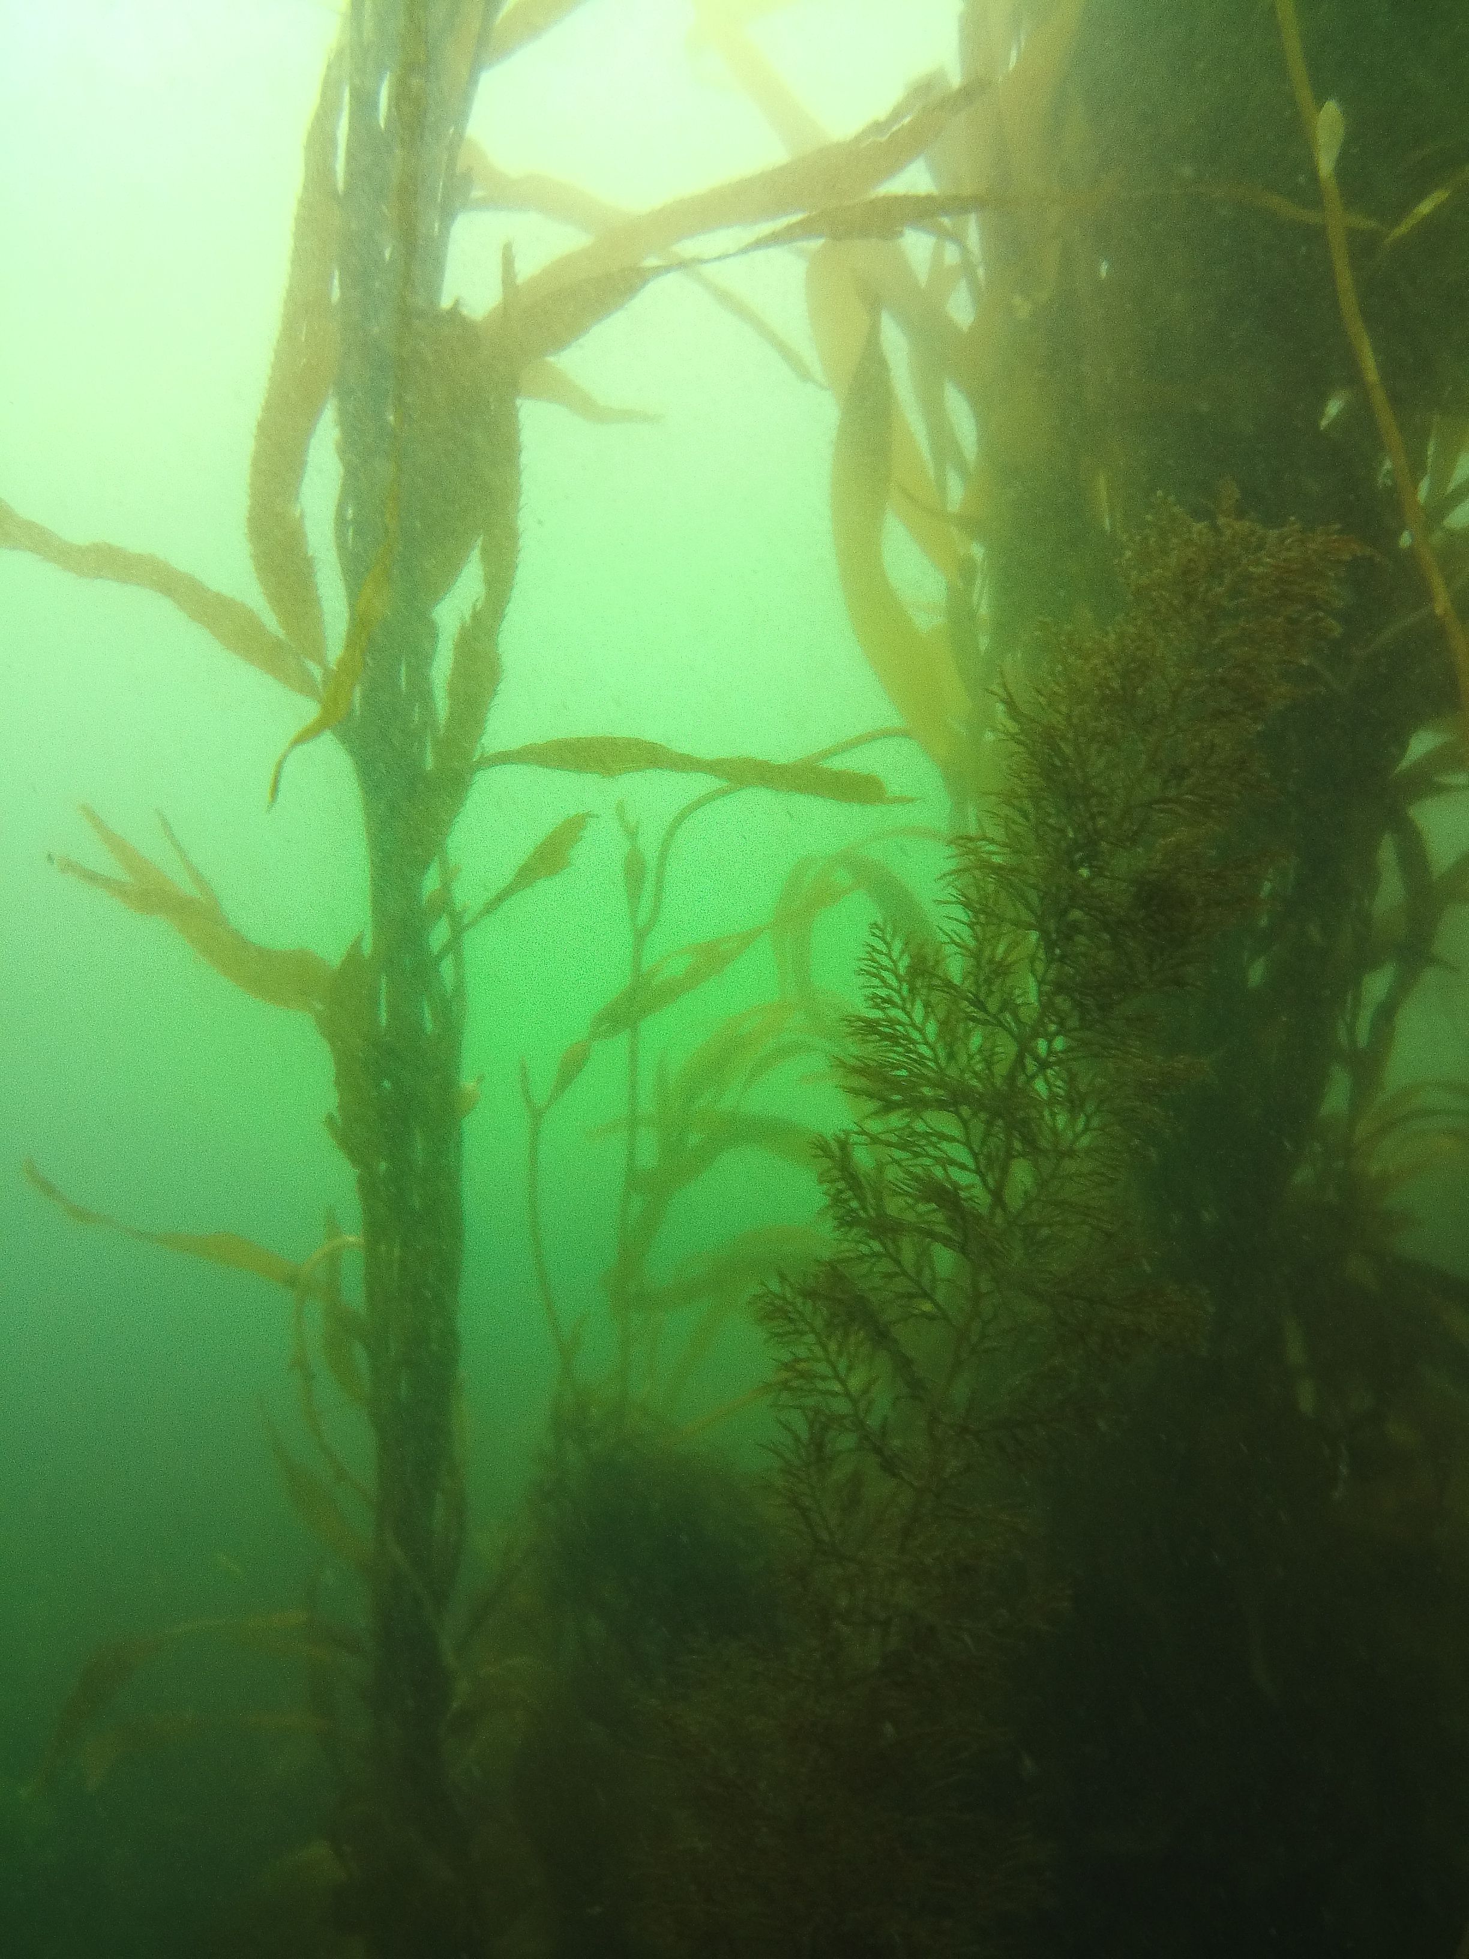

The Coastal Seas
Coastal seas account for the vast majority of marine and primary production and fishery contributions [Burke L. et al. (2001)]
If we want to know more about the impact of climate change on the oceans and our fisheries i.e. “the health of the ocean”, we must set up continuous coastal observation systems
Long term, economically sustainable coastal observation systems are recommended to understand the impact of climate change on our oceans and fisheries [A Science Plan for Carbon Cycle Research in North American Coastal Waters 2016, Ocean Carbon and Bio. Program and NA Carbon Program; https://www.nsf.gov/news/special_reports/big_ideas/]
Notes:
The coastal seas basically are the entire ocean’s marine production. In order to understand the health of local fisheries and the ocean as a whole, we must set up continuous observation systems there. Mention some of the properties we need to measure at the coast

Slide 3
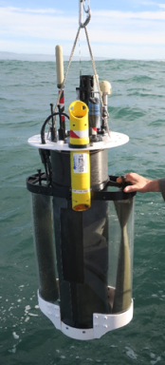
The Coastal Profiling Float
Built to be autonomous, and ideally it should take continuous biogeochemical measurements for years without any human interference
Unlike the profiling floats used in the open ocean, CPFs must avoid drifting out to sea or onto the shore
We intend to use the currents to keep the CPF in its assigned region
Credit: Gene Massion
Notes:
Unlike the current floats maintained by the Argo program, we care where CPFs go. We need the CPFs to stay within the coast or an assigned region to collect continuous data there. Add CPF Mission Cycle.

Slide 4
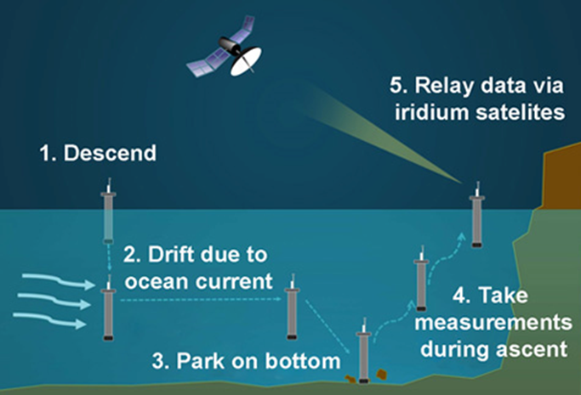
A Typical CPF Mission Cycle
Credit: MBARI Website
How can we measure the drifts of the CPF over the bottomhow fast the currents are going when the CPF is moving at the same speed as the water around it?

Slide 5
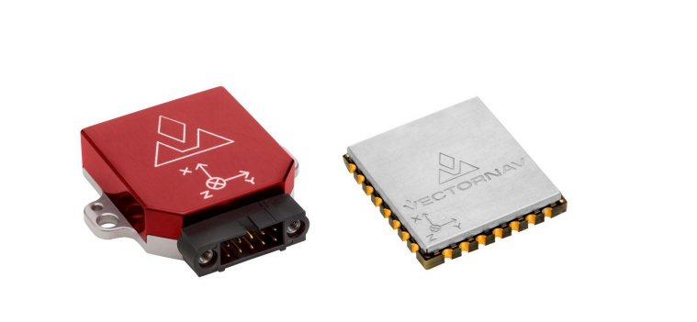

What is an Inertial Measurement Unit (IMU)?
An Inertial Measurement Unit is a system that estimates an object’s attitude, angular rate, and orientation using an array of accelerometers, magnetometers, and gyroscopes
We can get velocity by integrating acceleration $v=\int_{t_{i}}^{t_{f}}{a\left(t\right)dt}$
Very expensive, large and power hungry tactical grade IMUs are often used in airplane, land vehicle and submarine navigation
Credit: VectorNav Technologies VN-100 User Manual

Slide 6
Purpose of Internship
Even with recent technological advances in low-cost MEMS-based systems, most “tactical-grade” IMUs cost thousands to tens of thousands of dollars and require a GPS and/or velocity sensor
Most uses of IMUs in navigation tolerate a certain degree of measurement error and are also usually corrected with a coupled GPS system [CH Robotics]
This is a high-risk project. The vendor specs aren’t enough to evaluate the sensor for our purposes and we need to evaluate the performance of the low-cost VN-100 IMU to see if it is worth investing in a more accurate system.
Notes:
What is the lower limit of detection for the VN-100 IMU? Based on this data, we can decide whether or not it is worth investing in a more precise IMU that will properly measure the type of accelerations we would see in the coastal regions. According to some data accelerations seen would range +- 0.005

Slide 7
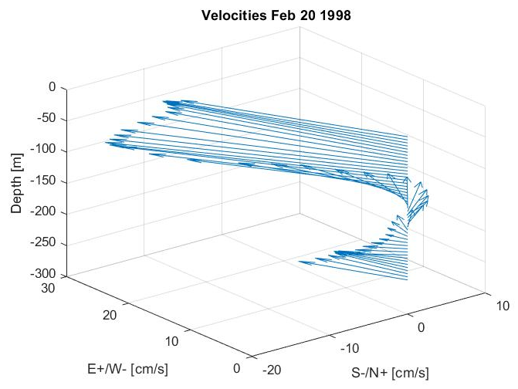
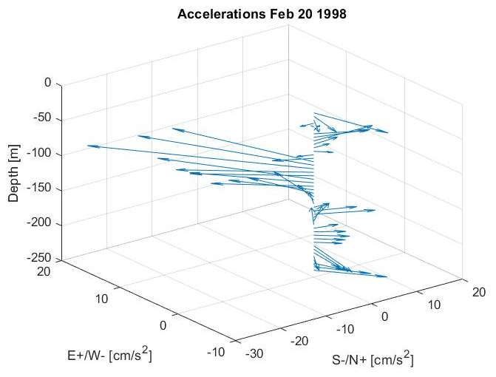
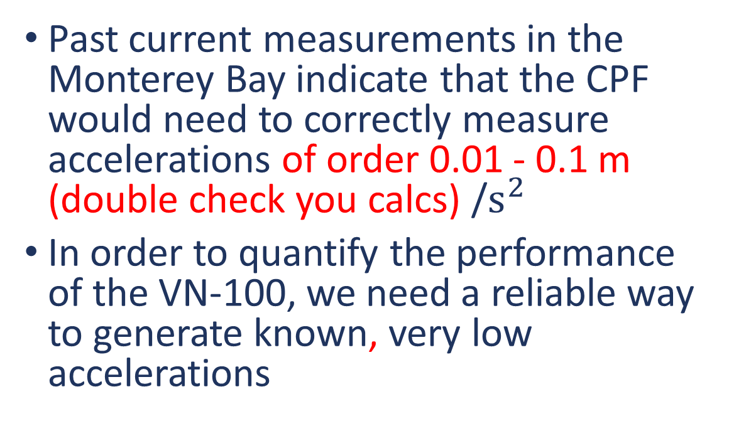
Purpose of Internship
Past current measurements in the Monterey Bay indicate that the CPF would need to correctly measure accelerations of order 0.01 - 0.1 m (double check you calcs) /$s^{2}$
In order to quantify the performance of the VN-100, we need a reliable way to generate known, very low accelerations
Notes:
Elaborate on lower limit of detection

Slide 8
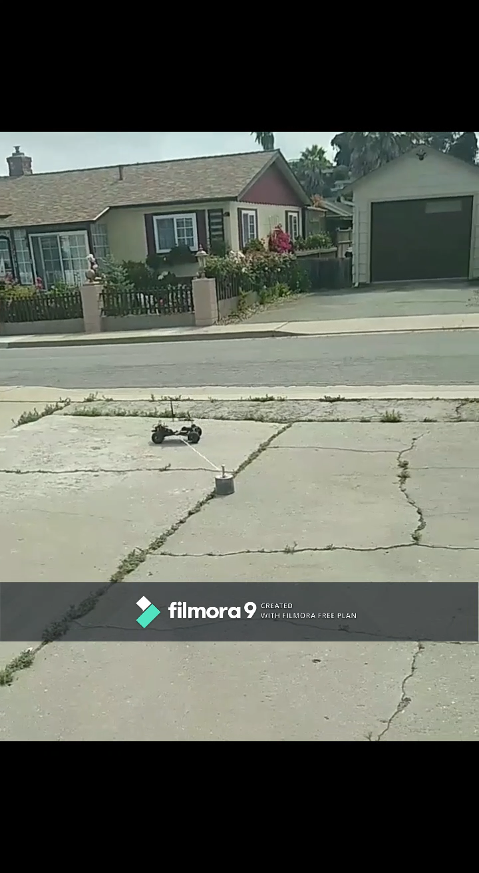

Slide 9
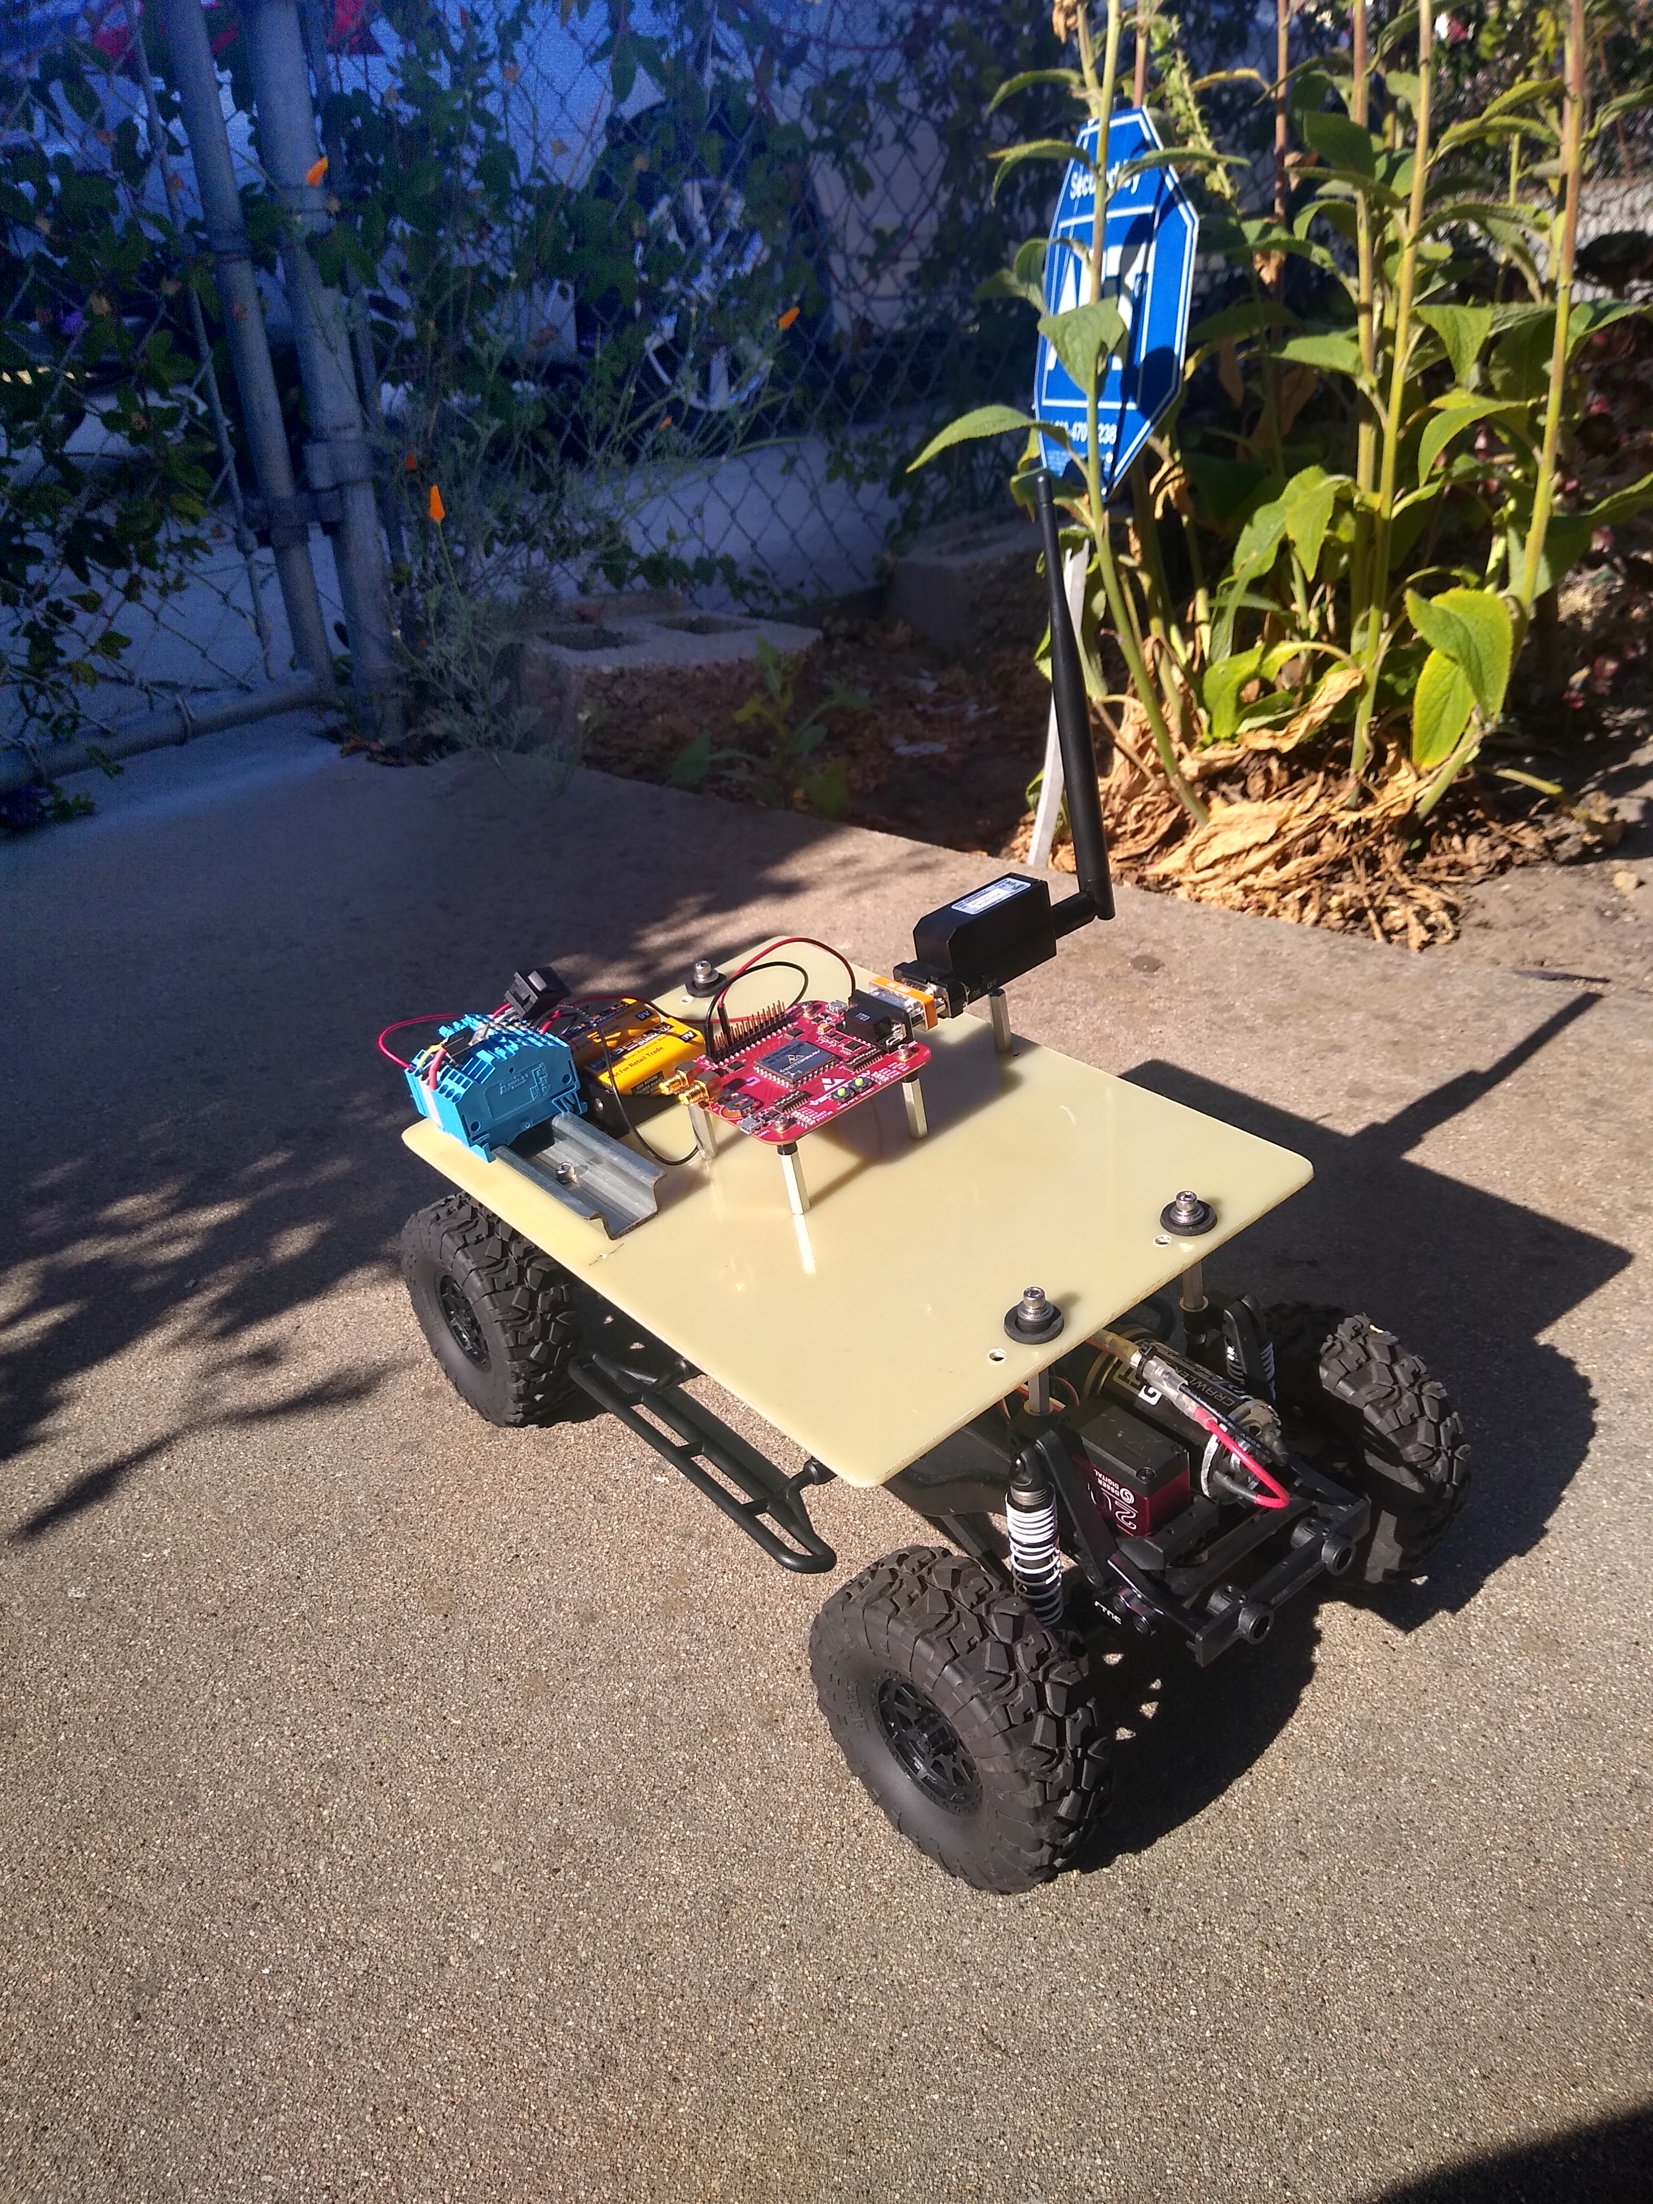
The Experimental Method
The RC Crawler drives in a circle at a constant speed, resulting in a constant acceleration pointing towards the circle center.
Acceleration is integrated to estimate the velocity of the RC Crawler which are compared to the recorded speed measured with a stopwatch
When deployed on the CPF, the acceleration data will be logged on a SD card and on the CPF to be transmitted via satellite while at the surface
Notes:
ROSEMARY, insert short video of it going around?

Slide 10
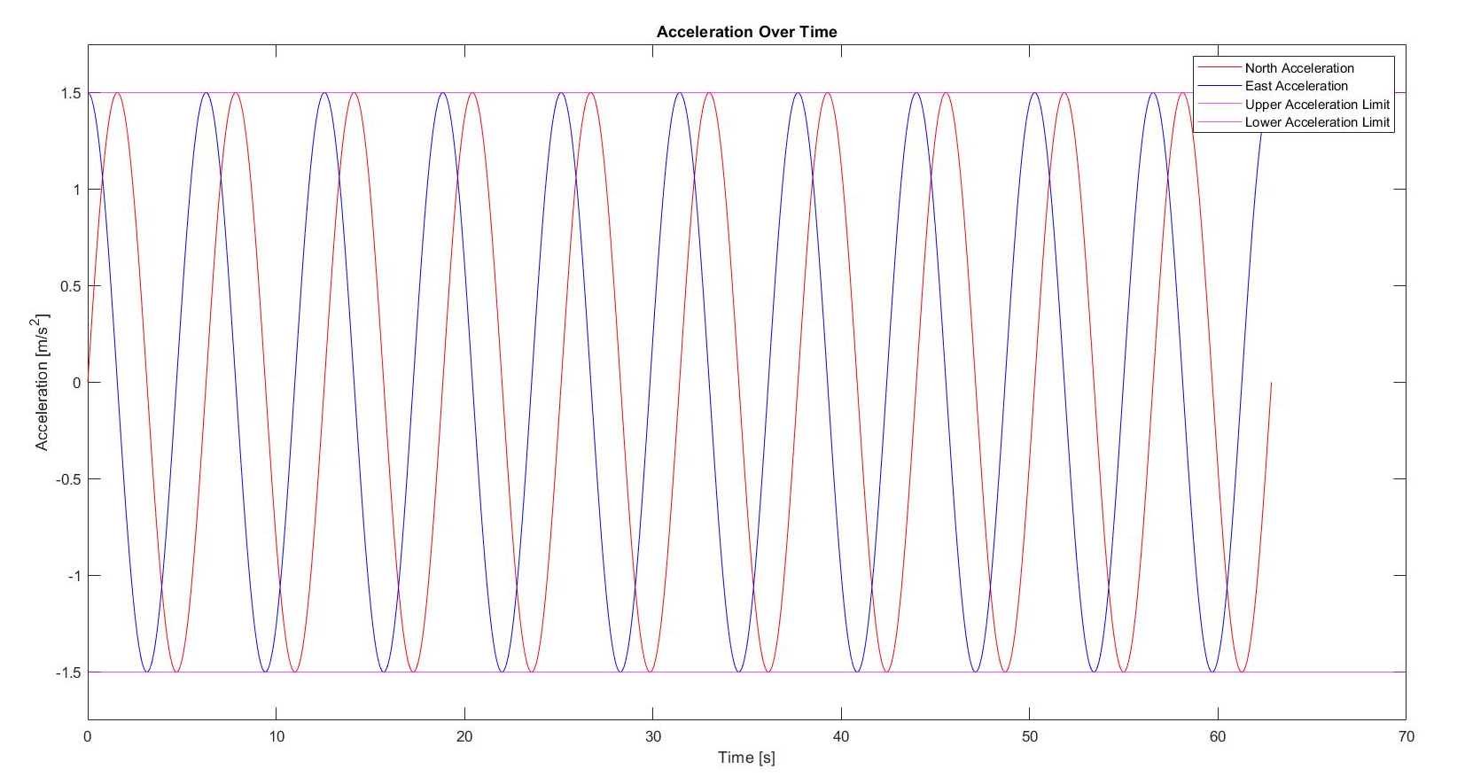
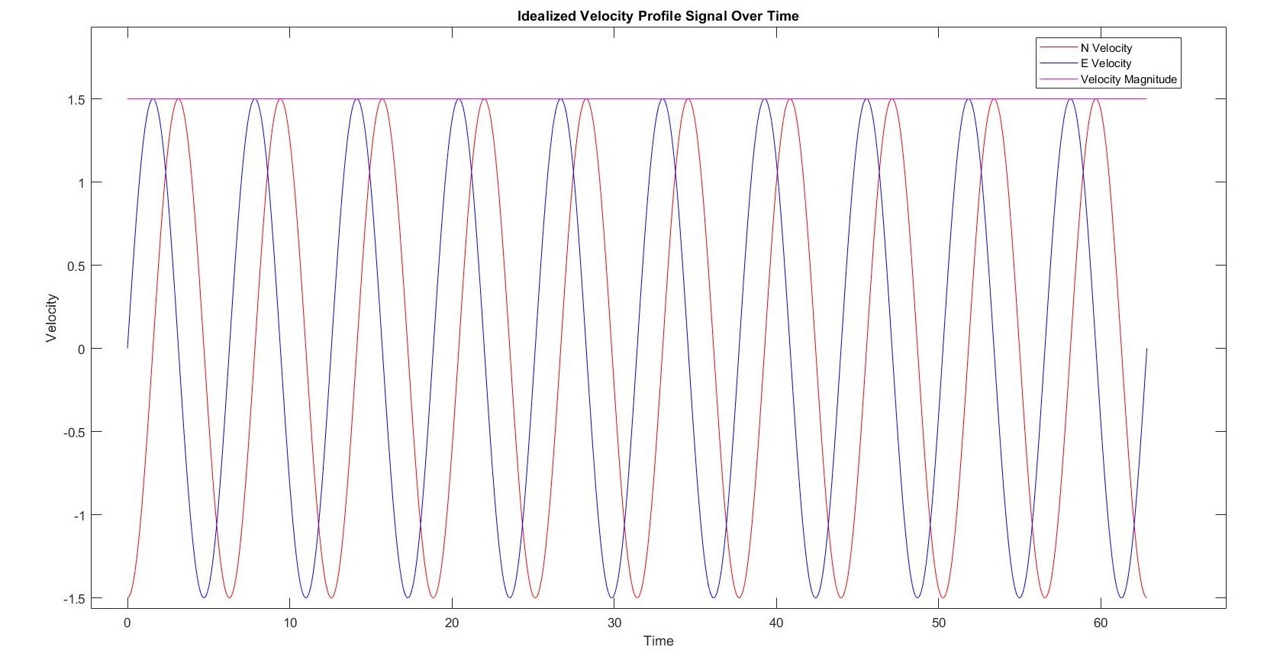
Interpreting the data
The VN-100 uses the Earth’s magnetic field and MEMS gyros to measure acceleration in a true North-East-Down reference frame while also accounting for gravity
Going in a circle, the North and East acceleration components will alter sinusoidally
The magnitude and period of the calculated velocity vector should match the measured speed of the crawler
Notes:
NED explanation, looking for the sinusoidal signal, PICTURE WITH VECTORSThe amplitude of the acceleration data ideally would match the centripetal acceleration magnitude
The amplitude of the velocity mag, maybe skip, just mention sinusoidal wave in results

Slide 11
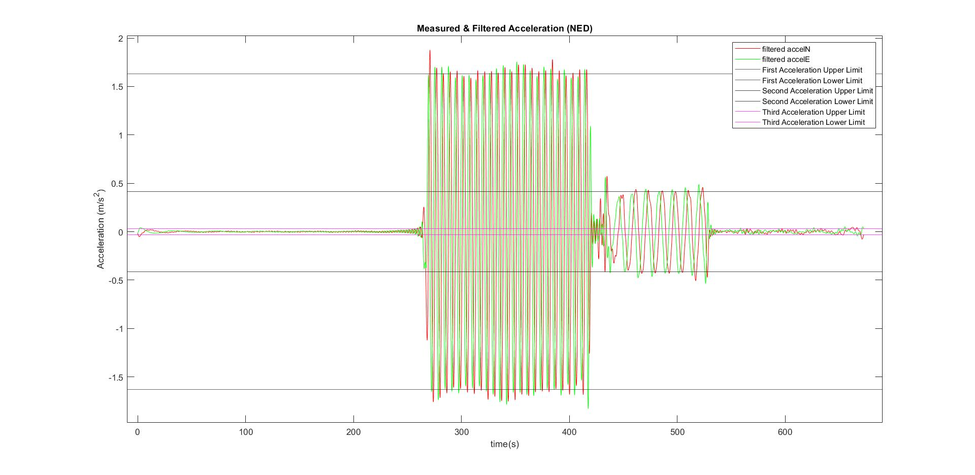



Results
A = 1.63 m/$s^{2}$
A = 0.4158 m/$s^{2}$
Static Data
A = 0.0308 m/$s^{2}$

Slide 12
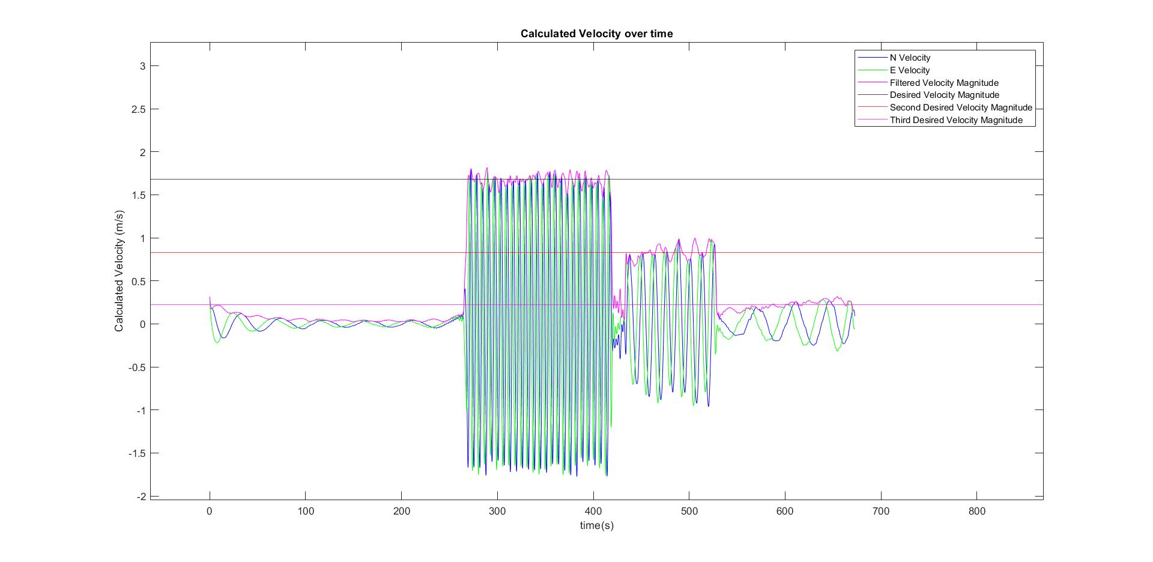
Results
v = 1.684m/s
v = 0.828 m/s
Static Data
v = 0.2258 m/s
Notes:
Explain issue with bandpass filtering on static data, then go through the modes, then show with the really low acceleration we still have the signal but the velocity profile would be wrong

Slide 13
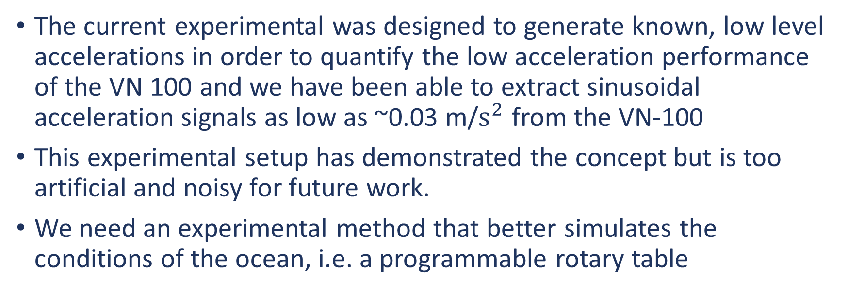
Conclusions
The current experimental was designed to generate known, low level accelerations in order to quantify the low acceleration performance of the VN 100 and we have been able to extract sinusoidal acceleration signals as low as ~0.03 m/$s^{2}$ from the VN-100
This experimental setup has demonstrated the concept but is too artificial and noisy for future work.
We need an experimental method that better simulates the conditions of the ocean, i.e. a programmable rotary table
Notes:
Mention internal vibration of the earth, other factors, like power plants, cars driving nearby, electronics, 0.03 m/s is 3/1000 of a g

Slide 14
The Path Forward
The data from the VN-100 is promising
Significantly lower acceleration signals can likely still be extracted from the VN-100 with a more comprehensive signal processing approach and experimental method more representative of the real world oceanic velocity/acceleration profiles.
With a more accurate (expensive) IMU and better signal processing filtering, it is likely that we can accurately determine current velocities adequate to navigate to make the CPF for long term science experiments aimed at better understanding the “health of the ocean”. a viable system for continuous coastal ocean observation
Notes:
Wavelet processing, rotary table introduction? “PROOF OF CONCEPT”

Slide 15
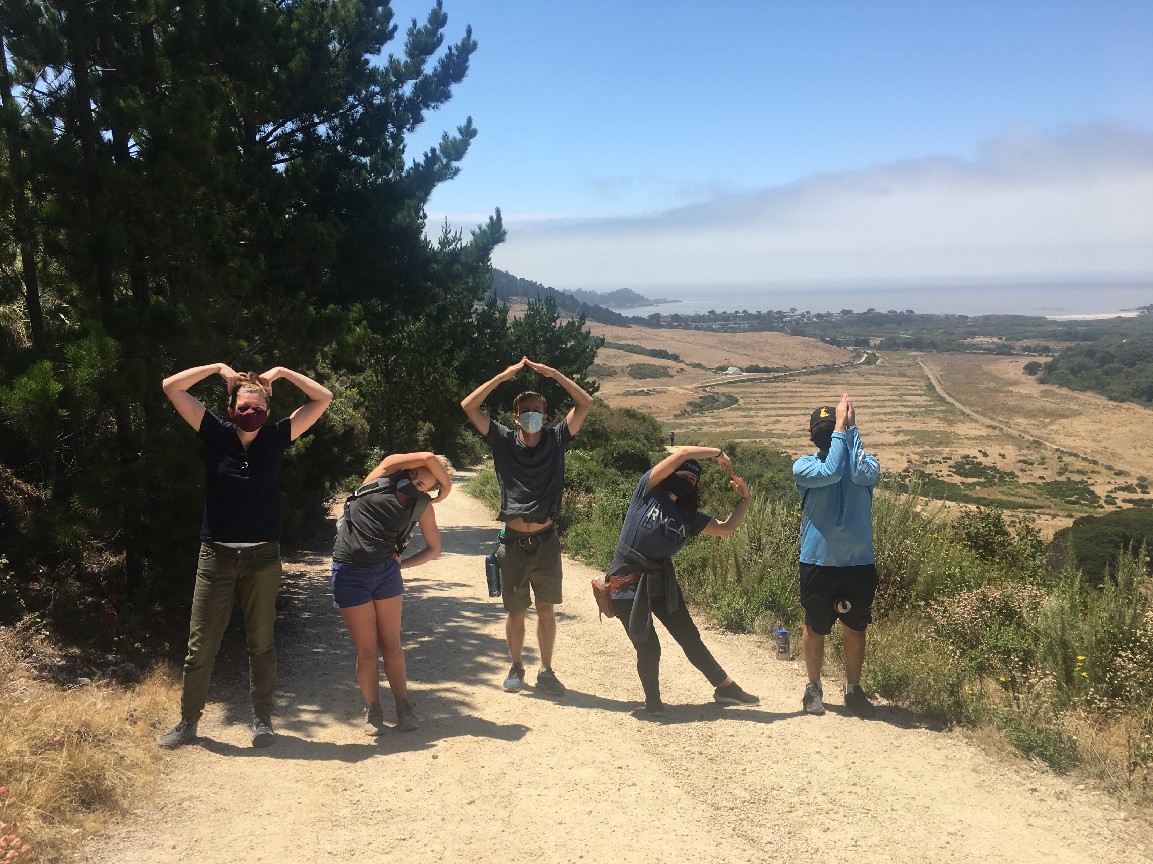
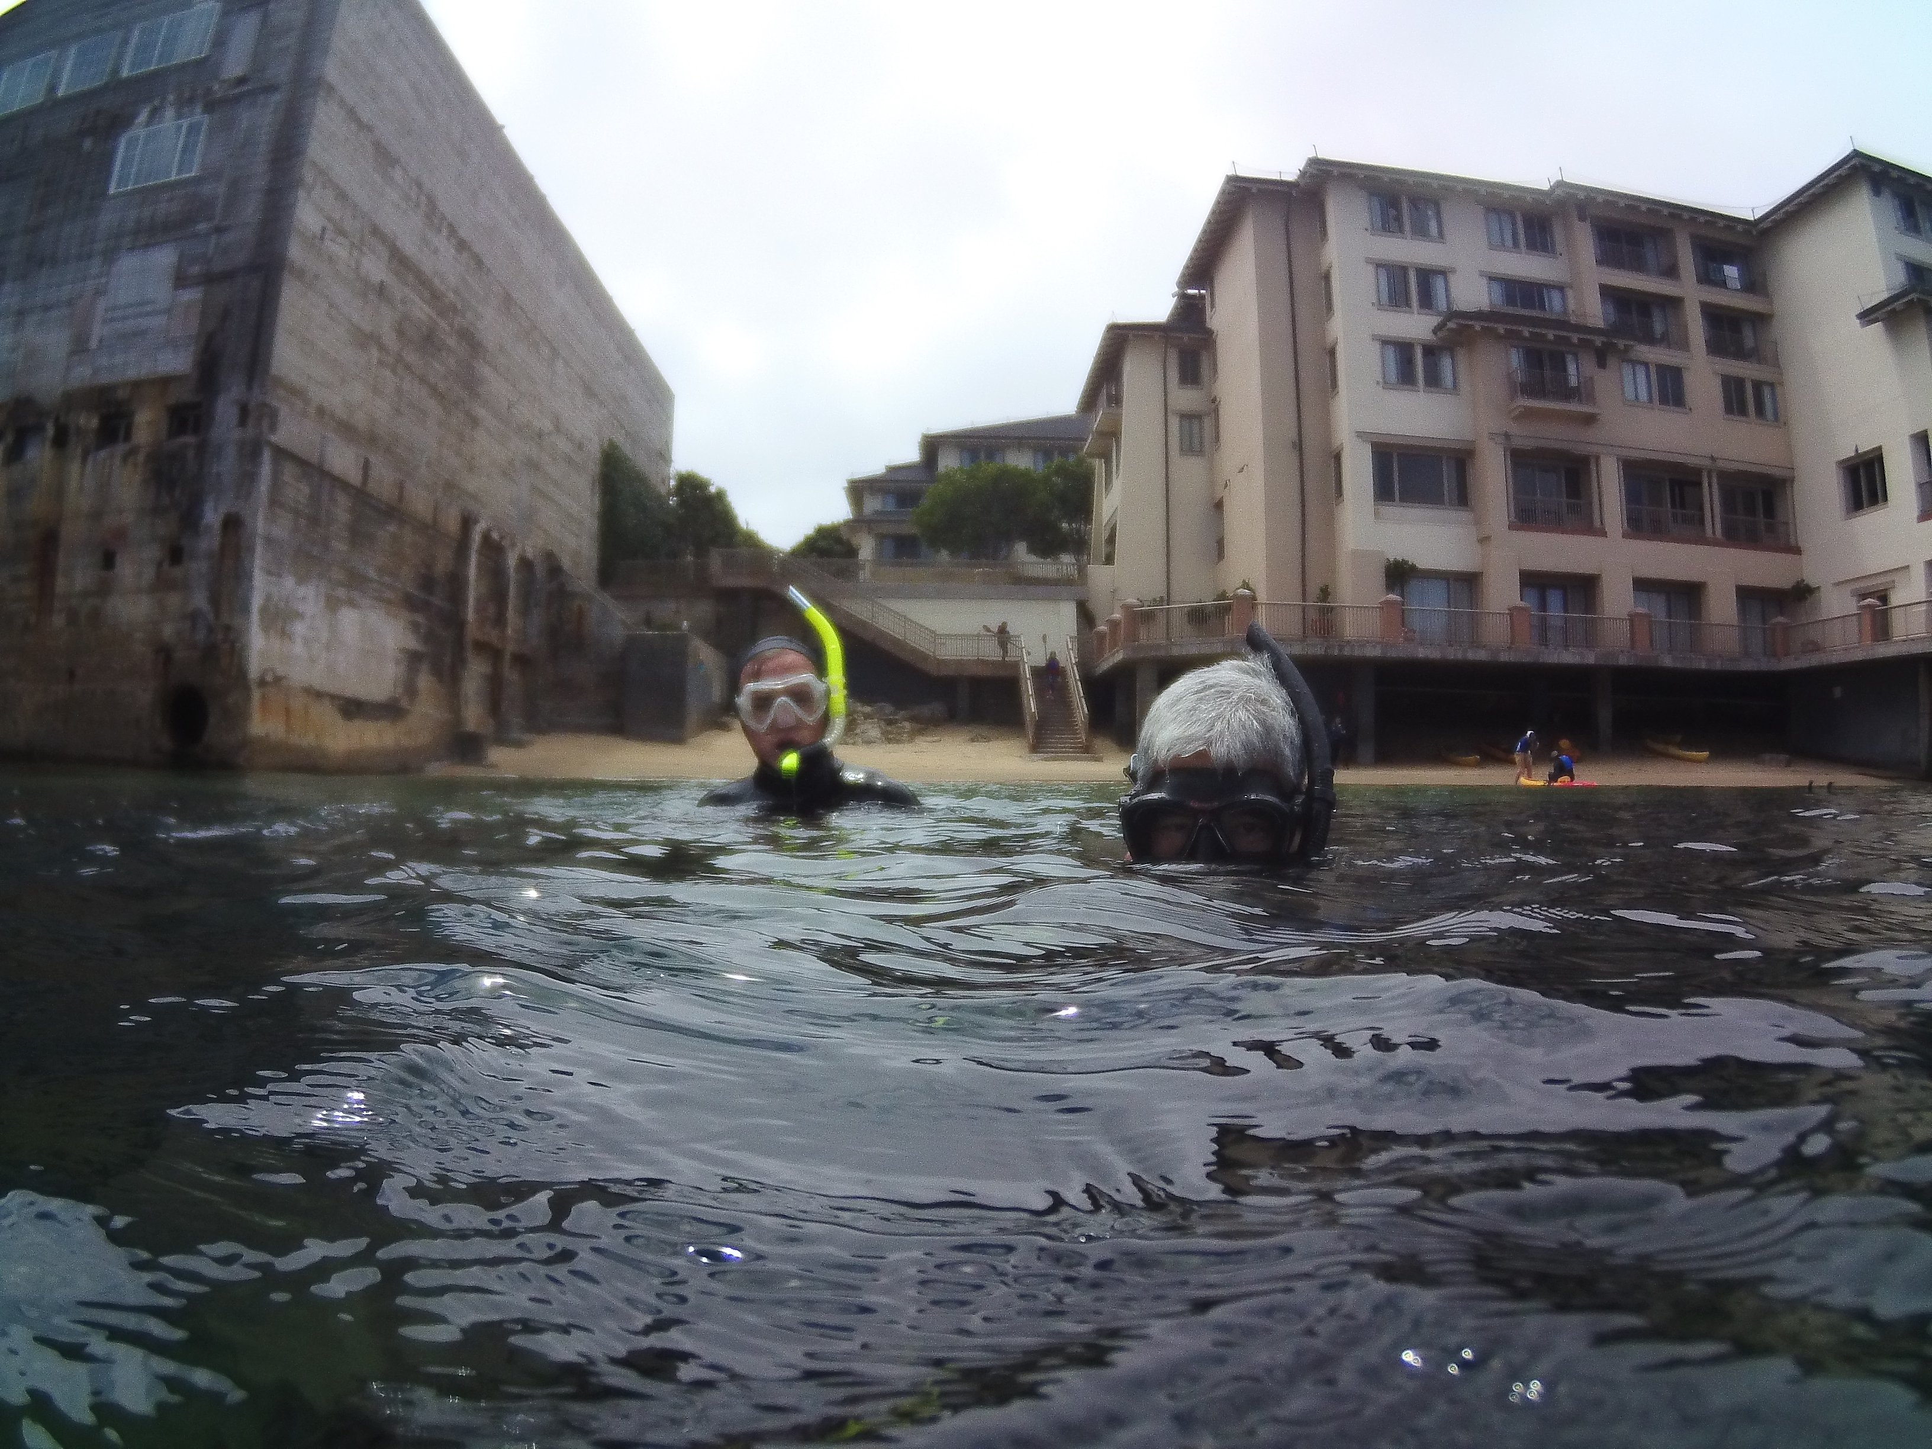


Thank you to:
Gene Massion
George Matsumoto
Megan Bassett
VectorNav Support Team
Zee Ziccarelli
Credit: Addie Norgaard

Slide 16
References
Burke L., Yumiko K., Kassem K., Revenga C., Spalding M., McAllister D., (2001). Pilot Analysis of Global Ecosystems: Coastal Ecosystems. The World Resources Institute: 2-4. http://pdf.wri.org/page_coastal.pdf
VectorNav Technologies (2017). VN-100 IMU/AHRS. https://www.vectornav.com/docs/default-source/documentation/vn-100-documentation/vn-100-user-manual-(um001).pdf?sfvrsn=b49fe6b9_32
CH Robotics – Using Accelerometers to Determine Position and Velocity. http://www.chrobotics.com/library/accel-position-velocity
Notes:
Cite mbari webpage

Slide 17
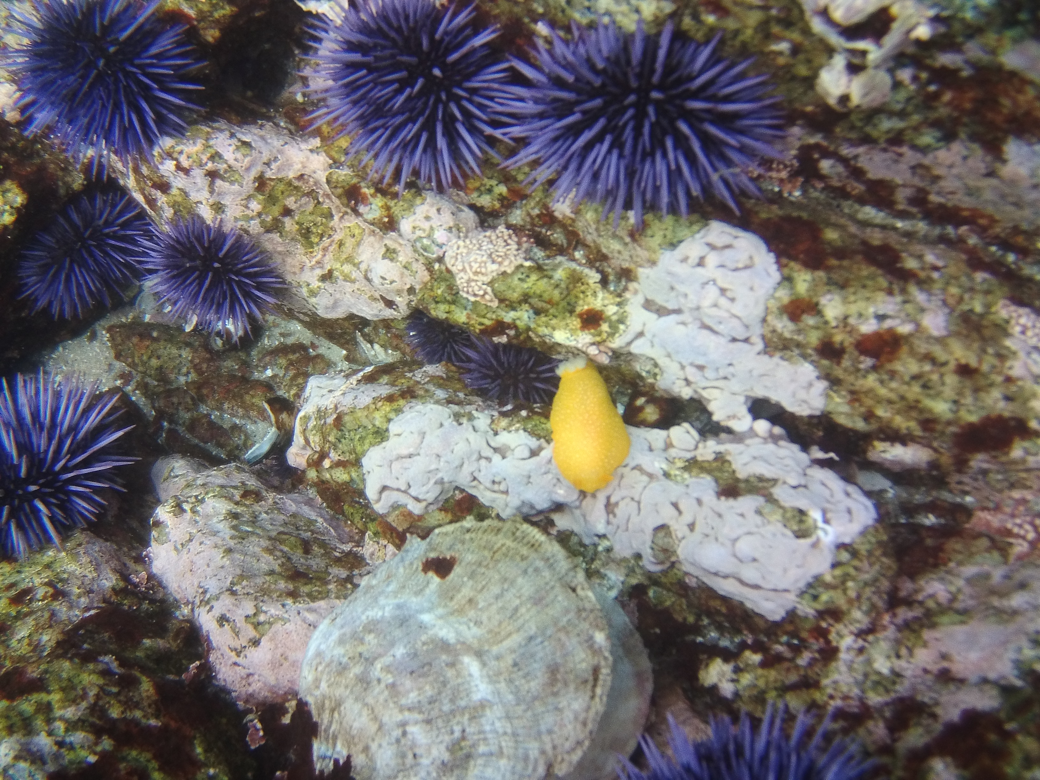
Questions?

