Slide 1
CPF – Velocity Estimation Program
Nick Raymond & Gene Massion
MBARI

Slide 2
Objective
Test methodology for processing accel data
Determine workflow to obtain vel. estimate
Next step:
  Once complete, perform sensitivity analysis over range of accel. and vel. settings with linear stage.

Slide 3

Method
Import:
raw accelerometer data (XYZ)
Detrend:
remove trend in accel. data
Filter 01:
Denoise
vs.
Moving Avg.
Numerical integration
Velocity Estimate
Filter 02:
Freq. selective filtering of velocity estiamte
Simulation of desired velocity profile

Slide 4
PSD of Acceleration Signal
Does not have WGN
Simulation – 100 Hz signal, 10 mins
Experiment – 100 Hz signal, 10 mins

Slide 5
PSD of Acceleration Signal - zoom
Does not have AWGN
Simulation – 100 Hz signal, 10 mins
Experiment – 100 Hz signal, 10 mins

Slide 6
Experimental Accel

Slide 7
Experimental Accel
Programmed Acceleration = 150 mm/sec^2
Denoise filter: Mu = 0.005
Moving Average filter: N = 100 samples

Slide 8
Experiment Velocity Est.
Oscillating signal with 600 second period, 0.0017 Hz
Apply non-linear signal by subtracting 12th order polynomial curve.

Slide 9
Experiment Velocity Est.
Programmed Velocity = 200 mm/sec

Slide 10
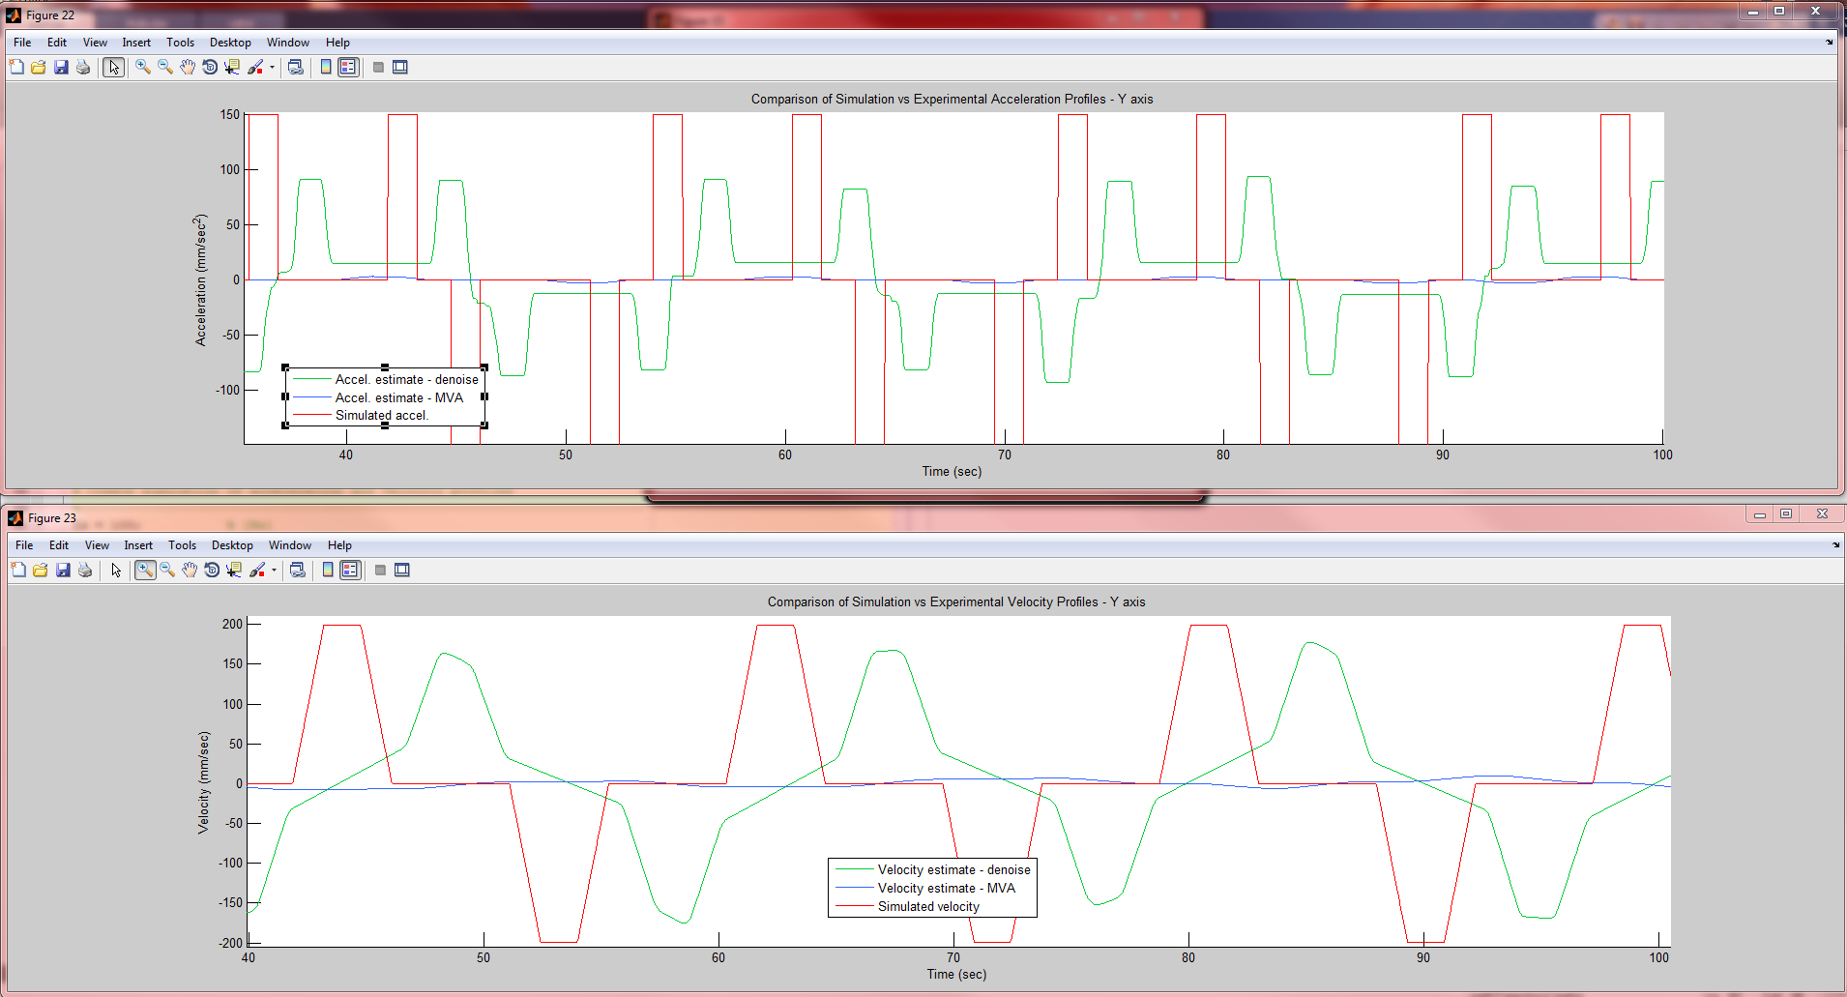
V = 200 mm/sec, A = 150 mm/sec^2
Mu = 0.0003
N = 7000

Slide 11
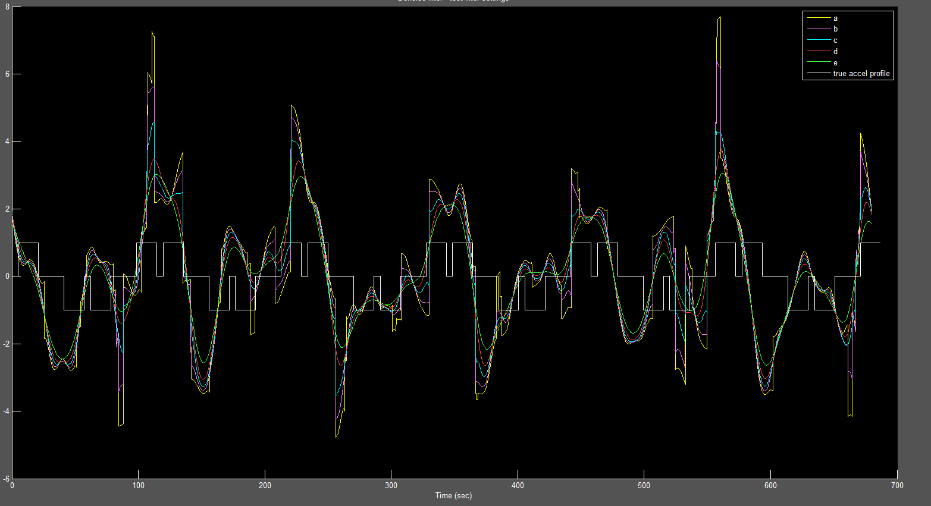
Mu = 0.0011, -0.0002
Rho = 1

Slide 12
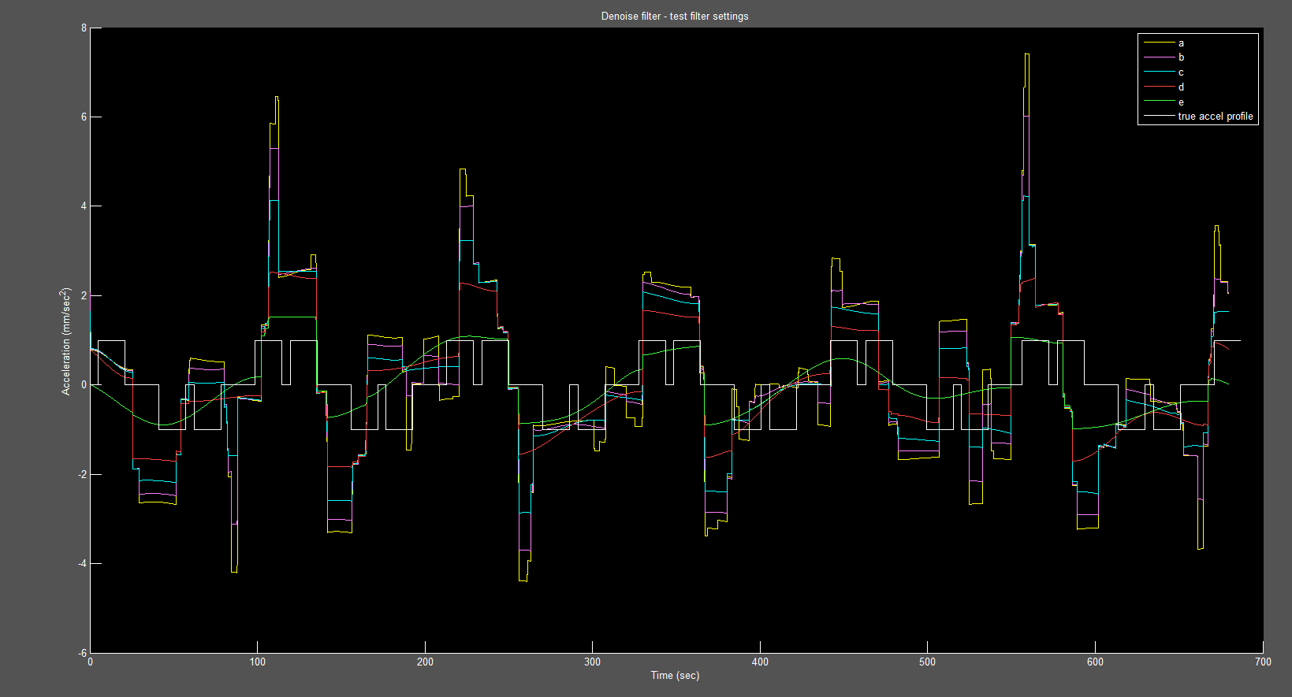
Mu = 0.0011, -0.0002
Rho = 10

Slide 13
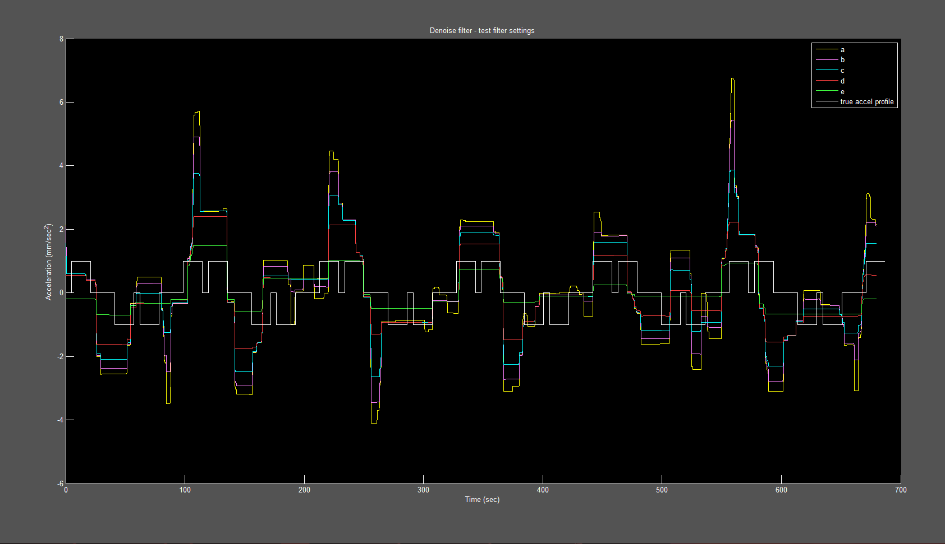
Mu = 0.0011, -0.0002
Rho = 100

Slide 14
Freq. Selective Filtering
%Fstop1 = 0.01; % First Stopband Frequency
%Fpass1 = 0.05; % First Passband Frequency
%Fpass2 = 0.2; % Second Passband Frequency
%Fstop2 = 0.5; % Second Stopband Frequency
IIR filter – Butterworth bandpass
FIR filter –bandpass

Slide 15
Accel Profiles
Ringing in filter
Zoom in.

