Slide 1
Coastal Profiling Float
Linear Translation Stage Tests
Nick Raymond & Gene Massion
Meeting with Andy Hamilton

Slide 2
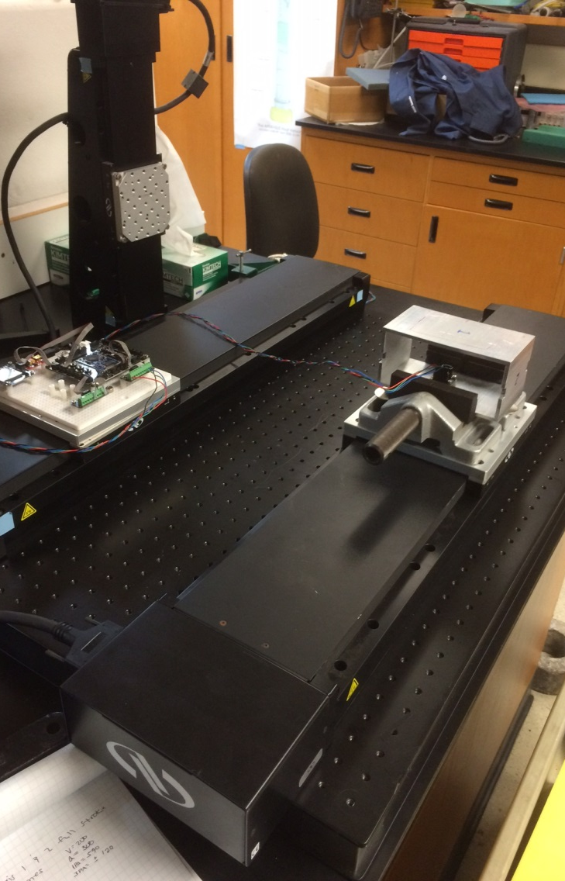
Overview
Research objective
  Determine smallest detectable acceleration
  Apply filtering to remove noise.
  Look at filter freq. response and output
  Evaluate velocity estimate.
Approach
  Run the linear translation stage
  Detrend then filter signals before numerical integration with trapezoid rule.
  Calculate the percent difference of velocity from expected result.

Slide 3
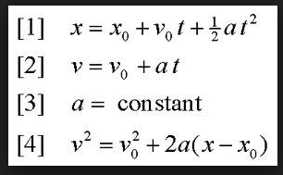
Experimental Trials
Run | Acceleration | Terminal Velocity | Total samples | Ramp time
 | mm/sec^2 | mm/sec | samples | sec
A | 50 | 200 | 500 | 4
B | 25 | 125 | 714 | 5
C | 10 | 80 | 1125 | 8
D | 5 | 60 | 1567 | 12
E | 1 | 25 | 3570 | 25
Limiting conditions:
Sample Rate: 100 Hz
Total length of table: 600 mm
Max velocity: 200 mm/sec
Max acceleration: 600 mm/sec^2

Slide 4
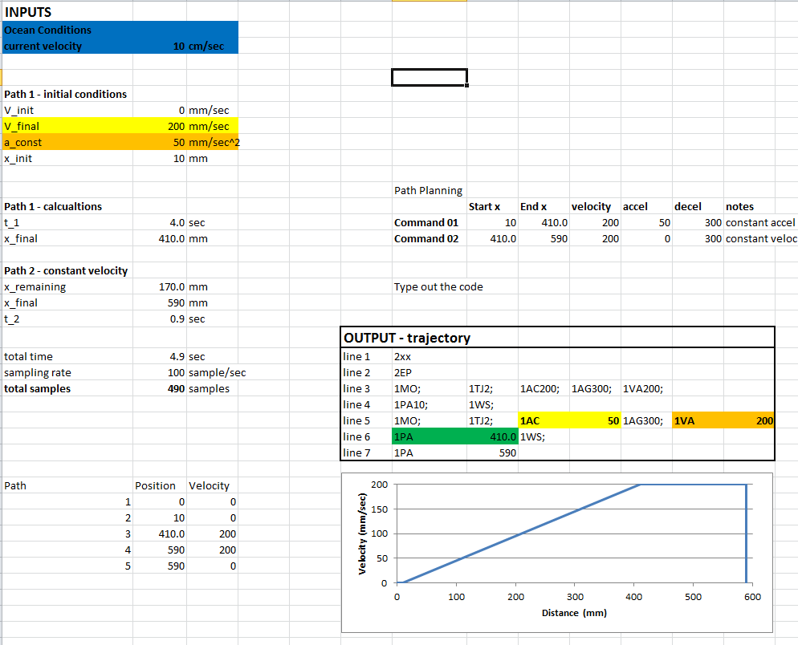
Run A

Slide 5
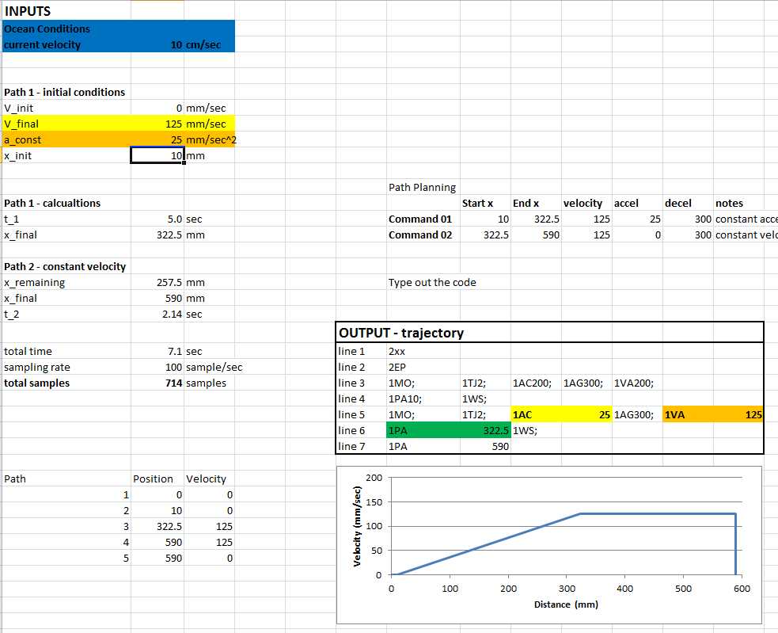
Run B

Slide 6
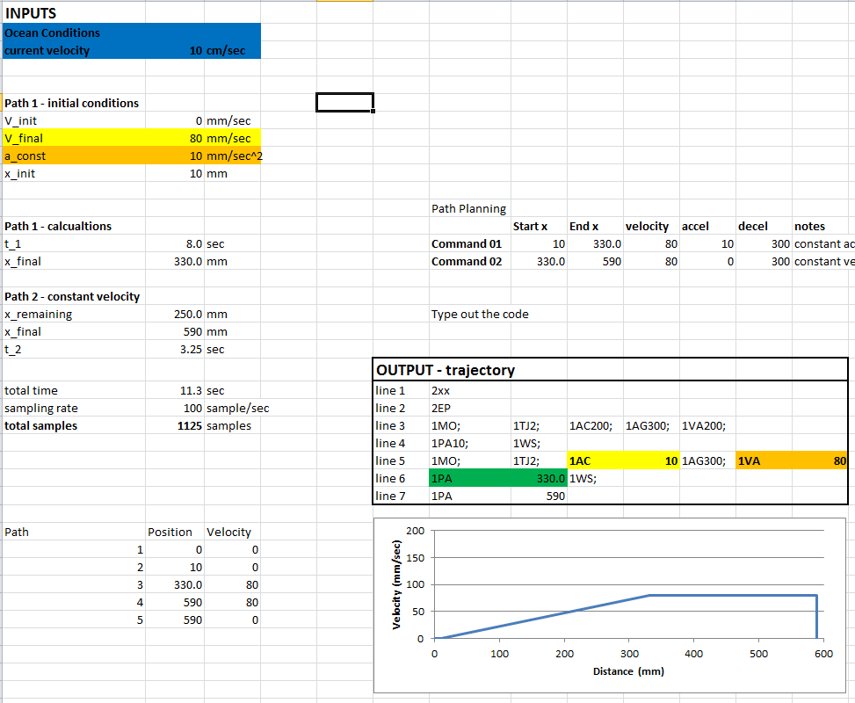
Run C

Slide 7
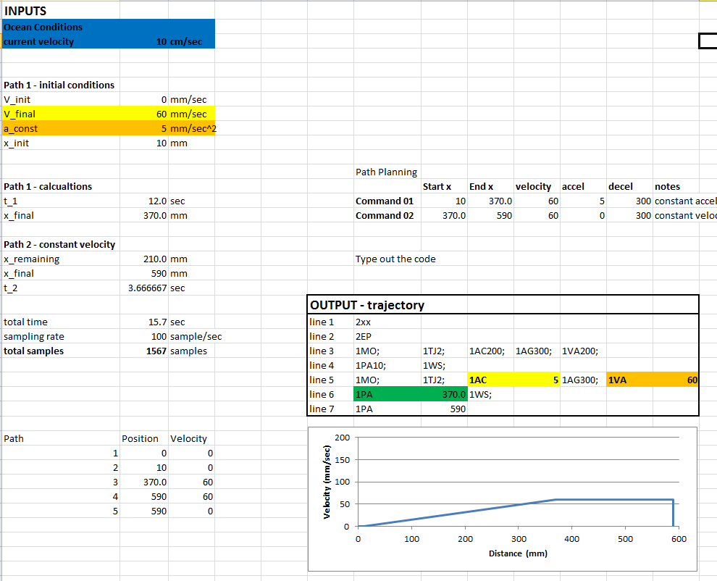
Run D

Slide 8
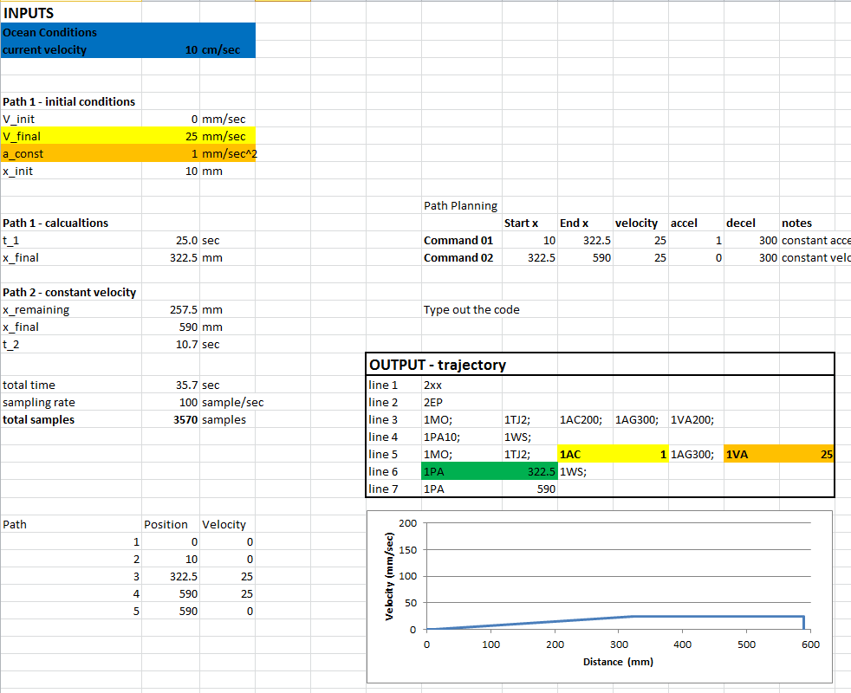
Run E

Slide 9
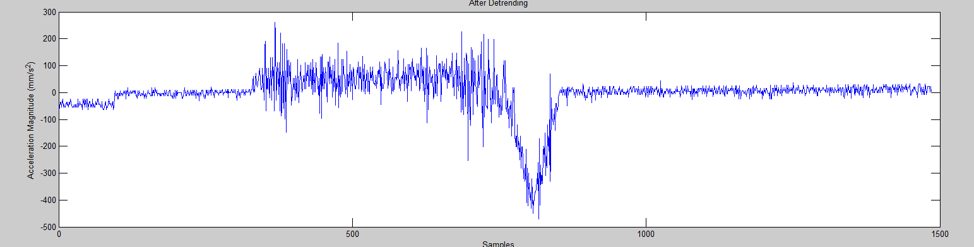
Detrend the data

Slide 10
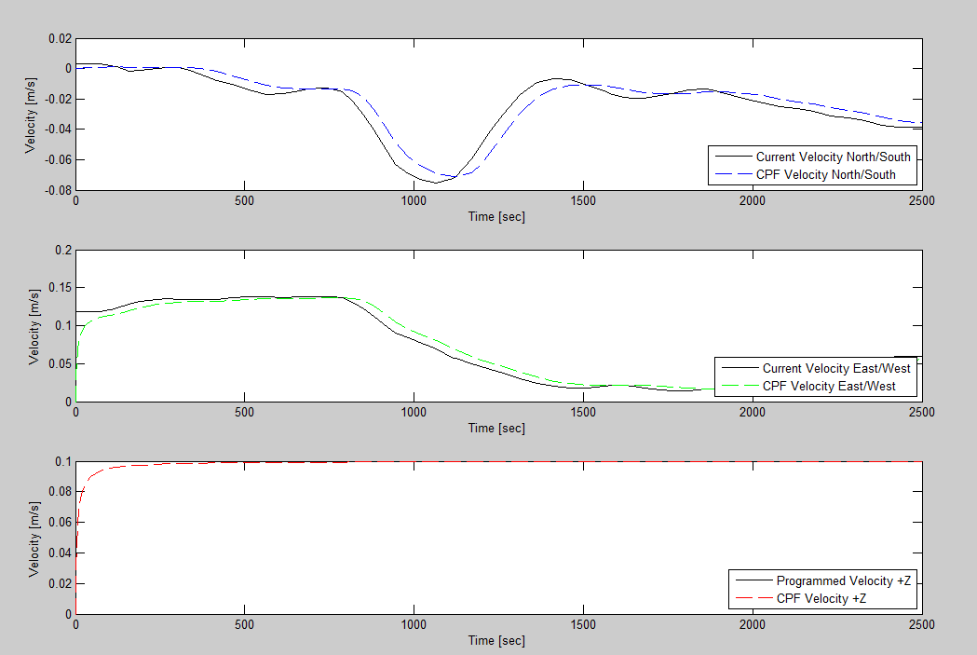
Historic Ocean Current Data – M1 Buoy

Slide 11
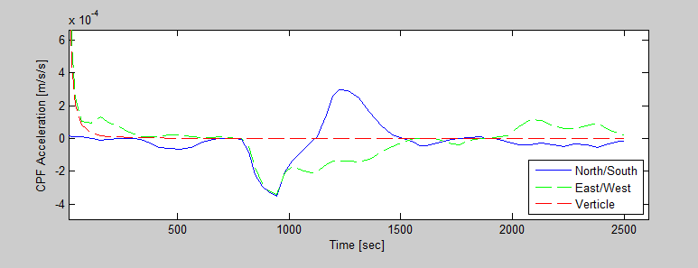
Simulink Model
Acceleration profile for OceanCurrent05

Slide 12
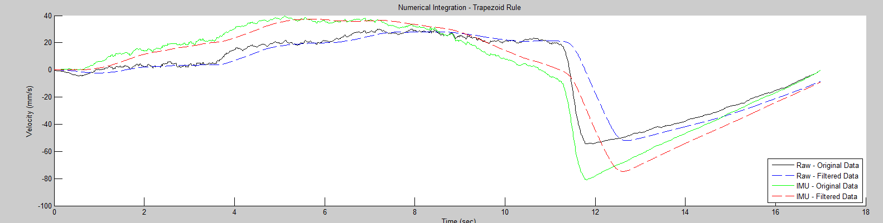
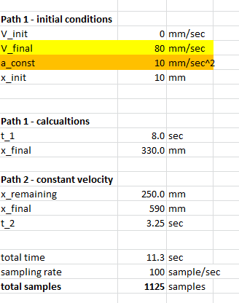
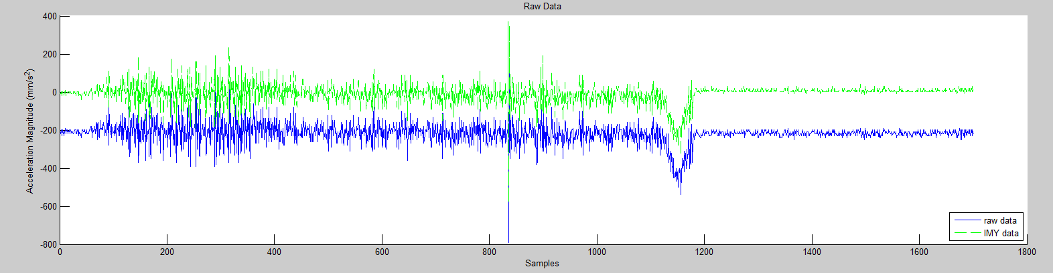
Comparison with and without Calibrating Accelerometer
Vfinal = 80 mm/sec
Trim 100 pts
MAV 100 pts

Slide 13
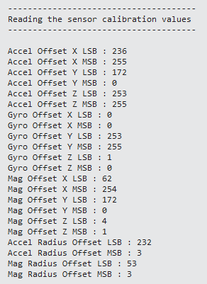
Run F – calibrated
Vfinal = 80 mm/sec
A = 10 mm/sec^2
Trim 100 pts
MAV 100 pts

Slide 14
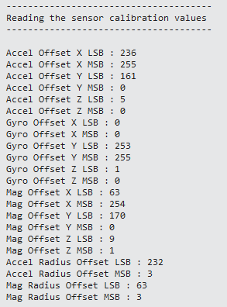
Run G - calibrated
Vfinal = 55 mm/sec
A = 5 mm/sec^2
Trim 100 pts
MAV 100 pts

Slide 15
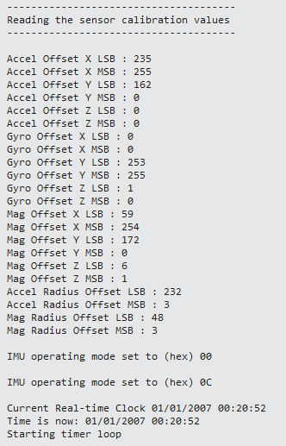
Run H - calibrated
Vfinal = 25 mm/sec
A = 1 mm/sec^2
Trim 100 pts
MAV 100 pts

Slide 16
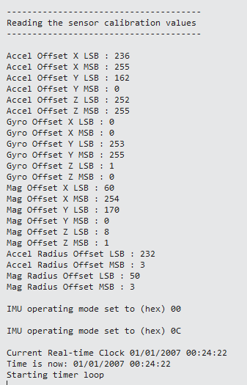
Run I - calibrated
Vfinal = 17 mm/sec
A = 0.5 mm/sec^2
Trim 100 pts
MAV 500 pts

Slide 17
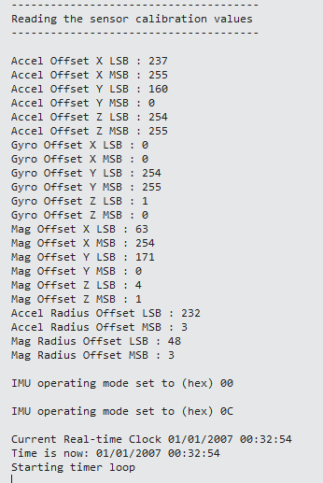
Run J - calibrated
Move backwards
Vfinal = 11 mm/sec
A = 0.2 mm/sec^2
Trim 100 pts
MAV 500 pts

