Slide 1
Coastal Profiling Float
Dynamic Simulation Review
Nick Raymond & Gene Massion
Meeting with Andy Hamilton

Slide 2
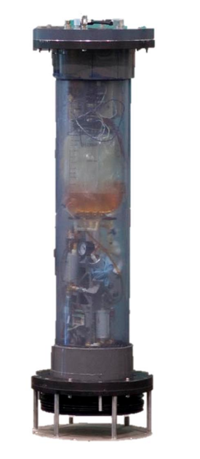
Overview
Research goal
  Prevent float from beaching itself.
  If float is too close to shore, have it drift out to deeper water.
Approach
  Identify favorable underwater currents while float drifts up to surface.
Internship Scope
  Estimate dynamics of float using current velocity profiles.
  Identify range of accelerations and determine feasibility of using IMU.
Replace with updated image?

Slide 3
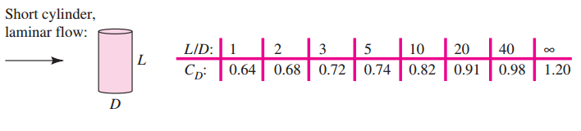
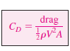
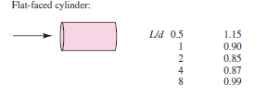
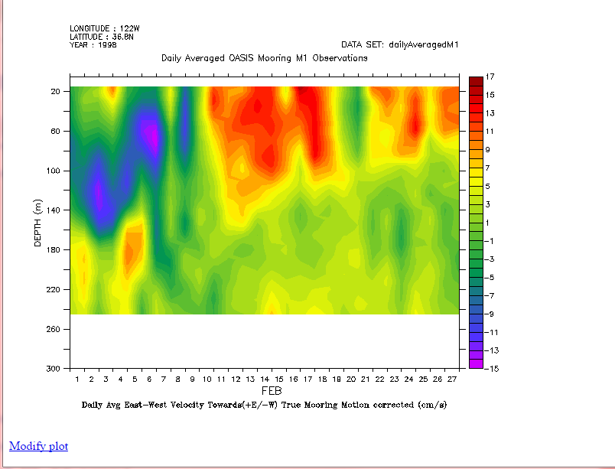
Assumptions
Shape
  Model bluff body as a cylinder.
  Length = 1.6 meters
  Diameter = 0.2 meters
  L/D = 8
  C_{D} ≈ 0.788 flor normal to radisu
  C_{D} ≈ 0.99 axially
CPF Motion
  Upward velocity constant at 0.1 m/s (+Z), controlled by closed-loop dive engine.
  North/South and East/West velocity independent of each other (XY).
  Current profiles obtained from MBARI M1 buoy Acoustic Doppler Current Profiler (mooring motion corrected).
Table 7.3 Drag of 3D Bodies Re > 10⁴
Radial Flow
Axial Flow
Reference: White 7th Ed, chapter 7.
Reference: MBARI Live Access to DATA

Slide 4
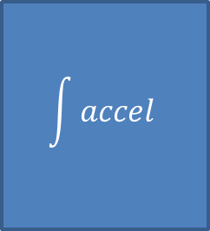
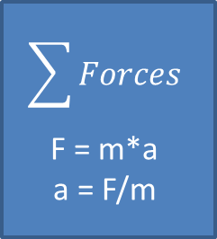
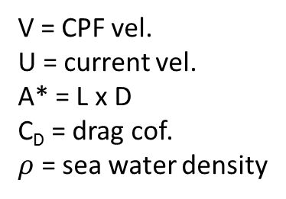
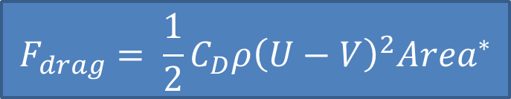
Dynamic Model
Input
Current Velocity Profiles
N/S & E/W
$$F_{drag}= \frac{1}{2}C_{D}ρ{\left(U−V\right)}^{2}{Area}^{∗}$$
V = CPF vel.
U = current vel.
A* = L x D
C_{D} = drag cof.
$ρ$ = sea water density
[U]
Calculate drag force
F_{drag}
$$\sum{Forces}$$
F = m*a
a = F/m
$$\int{accel}$$
Output
[N]
[m/s²]
[m/s]
[m/s]
CPF Velocity
[V]
CPF Velocity – feed back to drag force calculation
Note: characteristic area (A*) is cross section of cylinder normal to flow.

Slide 5
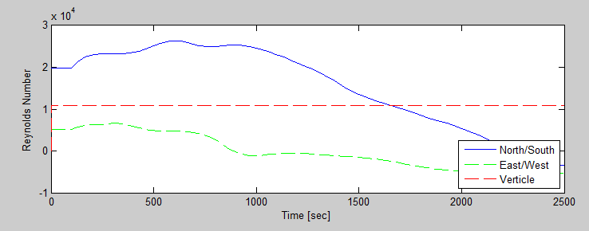
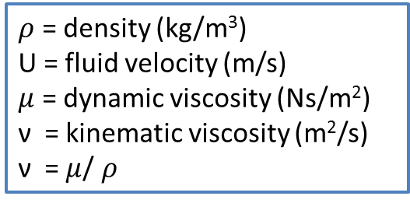

Reynolds Number
Drag coefficients only valid for Re ≥ 10⁴.
Simulation calculates Re at every step.
$ρ$ = density (kg/m³)
U = fluid velocity (m/s)
$μ$ = dynamic viscosity (Ns/m²)
ν = kinematic viscosity (m²/s)
ν = $μ$/ $ρ$
Inertial forces
$$Re= \frac{ρU^{2}}{μU/L}$$
Viscous forces

Slide 6
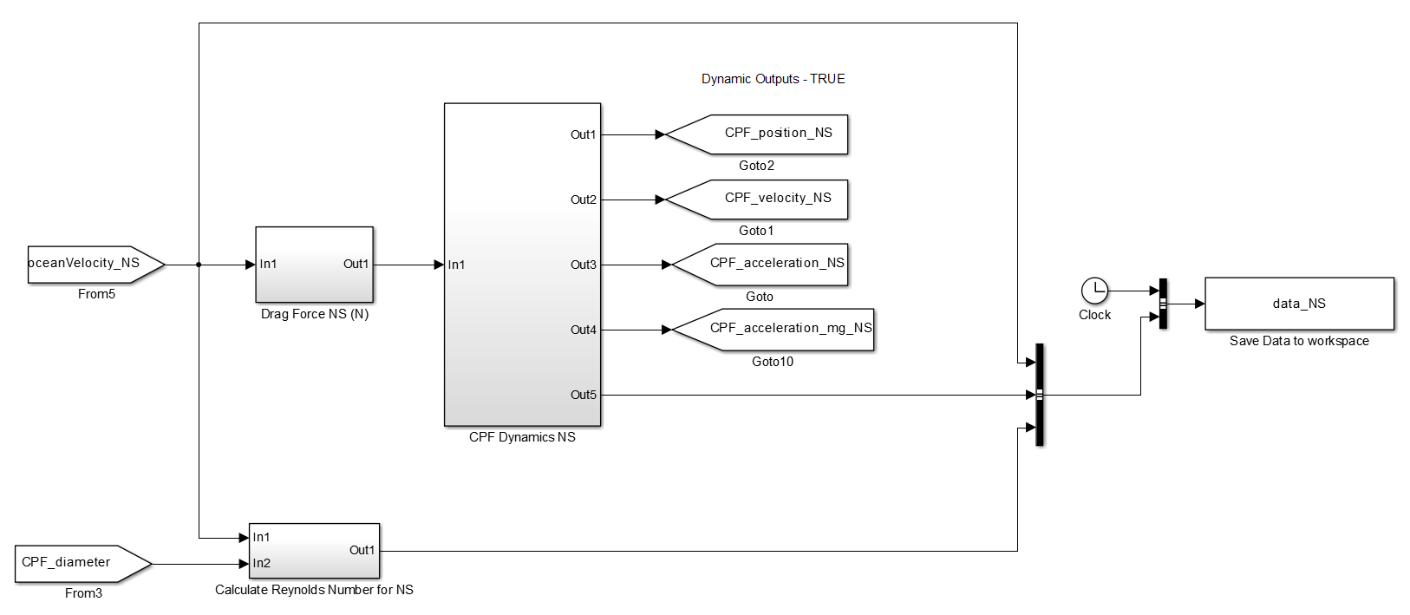
Simulink Model – 1D
Calculate dynamics
Output acceleration, velocity and positon
Input Current Velocity Profile
Save state variables to workspace
Calculate Drag Force
Calculate Re
Note: this represents one axis, it is repeated three times for N/S, E/W, and +Z.

Slide 7
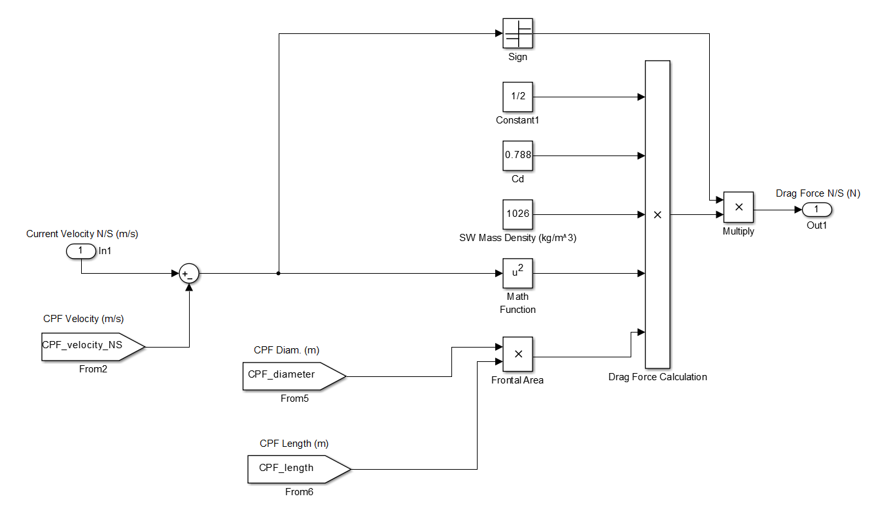
Drag Force Block

Slide 8
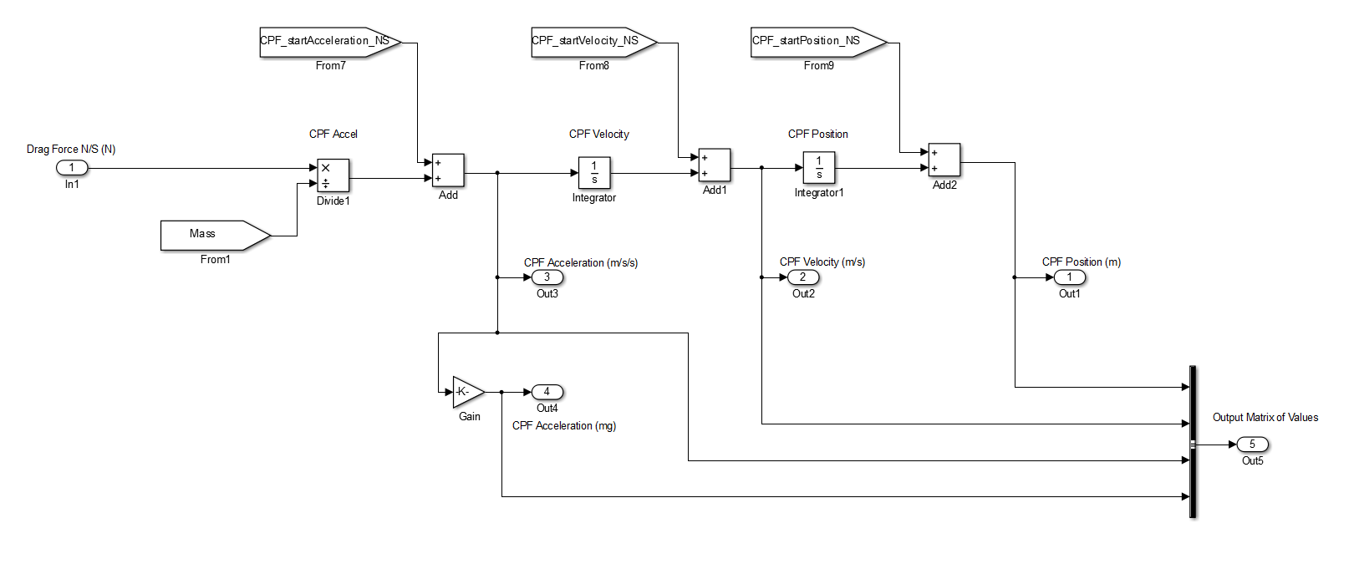
Dynamics Block

Slide 9
Example: Simulation Output
Position [m]
Reynolds Number
CPF Velocity [m/s]
Current Velocity [m/s]
CPF Acceleration [m/s²]
CPF Acceleration [mg]

