Slide 1
Coastal Profiling Float
BNO055 Noise Profile
Nick Raymond
& Gene Massion

Slide 2
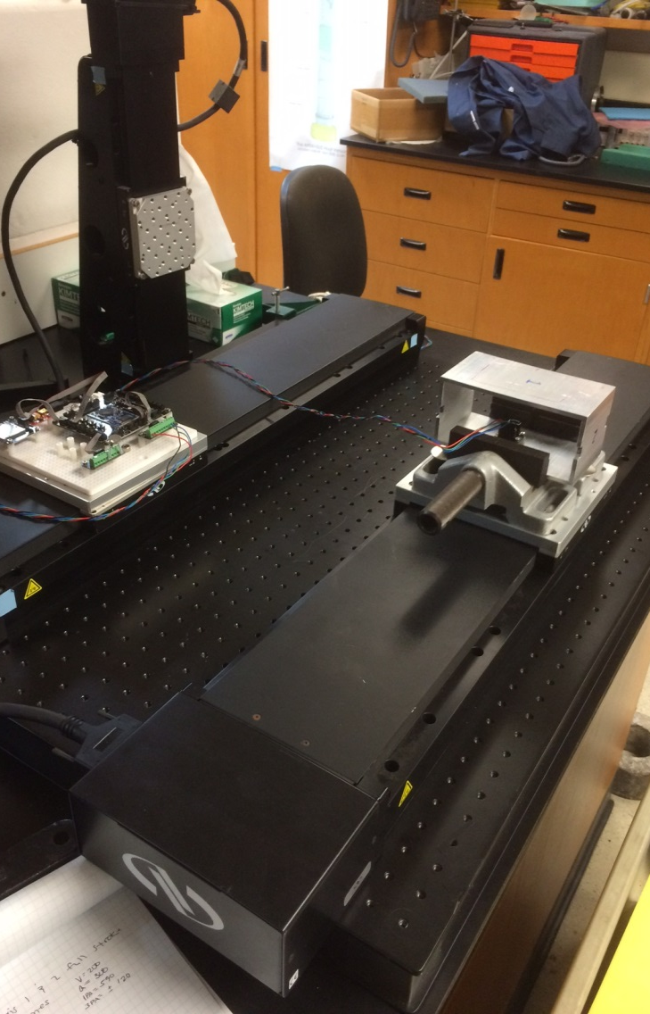
Overview
Research objective
  Characterize the noise profile of sensor
Approach
  Obtain data while sensor is stationary
  Use Welch method to obtain PSD
  Quantify error over range or 10 min, 1 hour, 5 hours

Slide 3
Noise Profile – 1 hour
Raw Accelerometer Data – linear accel output
After removing linear offset and filtering

Slide 4
Noise Power Spectrum Density
Sampling at 45 Hz
50% overlap

Slide 5
Moving Average Filter Freq. Response
N = 5000 samples

Slide 6
Noise Profile – 1 hour
Raw Accelerometer Data – linear accel output
After removing linear offset and filtering
Sample Rate = 100 Hz

Slide 7
Noise Power Spectrum Density
Dominant freq.
- 40 Hz
but as low as 1 hz – so filter need to suppress these low freq
Sampling at 100 Hz
50% overlap
Nfft = 8192

Slide 8
De-noise Filter Freq. Response
(mu = 0.05)
N = 10,000 samples
Nfft = 8192

Slide 9
Moving Average Filter Freq. Response
Dominant freq.
- 40 Hz
but as low as 1 hz – so filter need to suppress these low freq
Sampling at 100 Hz
50% overlap
Nfft = 8192

Slide 10
Test Table Flatness
Objective: determine if the translation table is twisted or not flat over the 600 mm.
Method: move accel at 50 mm intervals, stop for 20 sec and take accel reading, calculate average, RMS, Std, CI95%, and angle between.
Want to determine variability in stage measurements to determine how small of accel we can reliably detect.
Source file: C:\Users\nraymond\Downloads\01-Jun-2011-01-00-30_accelZ.txt
Matlab file: TableTiltError.m

Slide 11
Stationary Measurements: X-axis
Range: -28.16 to -28.00 mm/sec²

Slide 12
Stationary Measurements: Y-axis
Range: 182.57 to 182.91 mm/sec²

Slide 13
Stationary Measurements: Z-axis
Range: 983.74 to 984.24 mm/sec²

Slide 14
Variability of Sensor Readings
Standard Deviation, each point represents
20 seconds of data while sensor stationary.
Raw data output from sensor

Slide 15
Analyze Input Acceleration Signal
V_max = 200 mm/sec
A = 150 mm/sec^2

Slide 16
PSD of Simulated Acceleration Signal
Simulation Sample Rate
Fs = 100 Hz
Simulated Sample Rate
Fs = 1000 Hz

Slide 17
PSD of Simulated Acceleration Signal

