Slide 1
Coastal Profiling Float
BNO055 Noise Profile
Nick Raymond
& Gene Massion

Slide 2
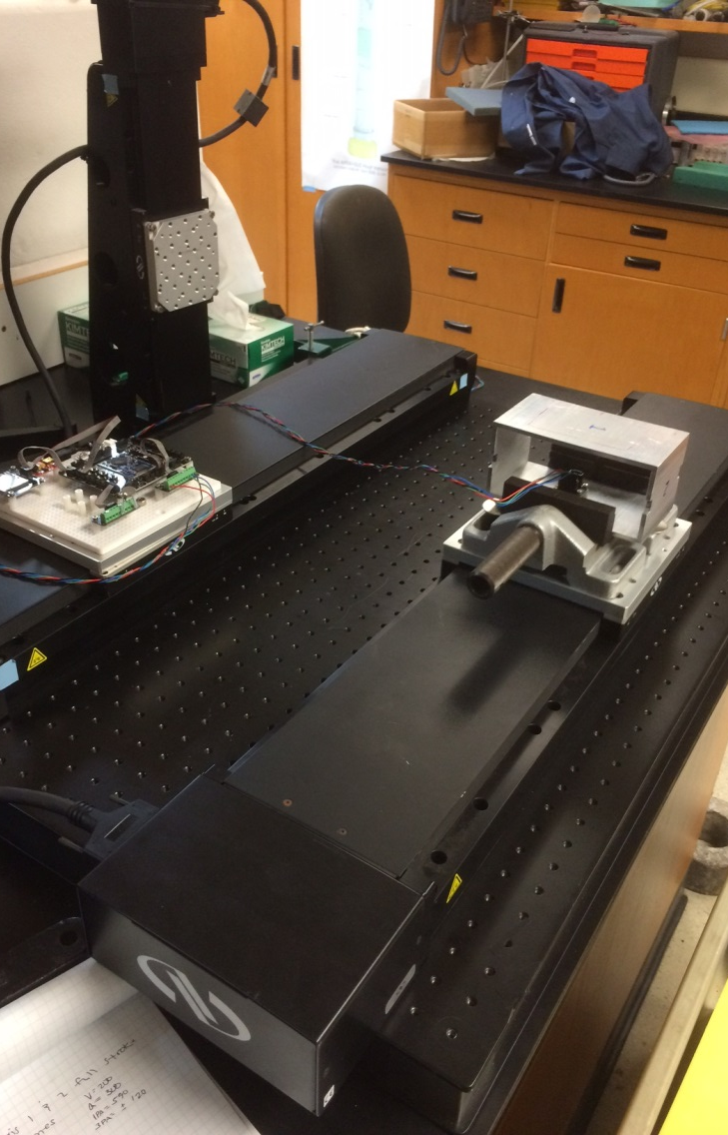
Overview
Research objective
  Determine error in velocity estimation for range of accelerations
Approach
  Vary constant acceleration and terminal velocity values
  Calculate the percent error of the estimate

Slide 3
Experiment Setup
Run | Accel (mm/sec^2) | Velocity (mm/sec)
A | 50 | 200
B | 25 | 125
C | 10 | 80
D | 5 | 60
E | 1 | 25
F | 10 | 80
G | 5 | 55
H | 1 | 25
I | 0.5 | 17
J | 0.2 | 11
Moving Average Filter with N = 100 samples.

Slide 4
A = 50 mm/s^2, V = 200 mm/s

Slide 5
A = 25 mm/s^2, V = 125 mm/s

Slide 6
A = 10 mm/s^2, V = 80 mm/s

Slide 7
A = 5 mm/s^2, V = 60 mm/s

Slide 8
A = 1 mm/s^2, V = 25 mm/s

Slide 9
A = 10 mm/s^2, V = 80 mm/s

Slide 10
A = 5 mm/s^2, V = 55 mm/s

Slide 11
A = 1 mm/s^2, V = 25 mm/s

Slide 12
A = 0.5 mm/s^2, V = 17 mm/s

Slide 13
A = 0.2 mm/s^2, V = 11 mm/s

Slide 14
With Denoise filter

Slide 15
V = 200, A = 150

Slide 16
V = 200, A = 150

Slide 17
V = 35, A = 5
N = 50 MVA
Mu = 0.01

Slide 18
V = 35, A = 5
N = 150 MVA
Mu = 0.005

Slide 19
Y axis – accel over 600 mm travel
V = 20mm/sec
A = 20 mm/sec^2

