Slide 1
EVALUATION OF
INERTIAL MEASUREMENT UNIT PERFORMANCE FOR
WATER COLUMN VELOCITY
ESTIMATION OF
COASTAL PROFILING FLOATS.
August 10, 2016
1330 - 1345
Nick Raymond
~
Gene Massion

Slide 2
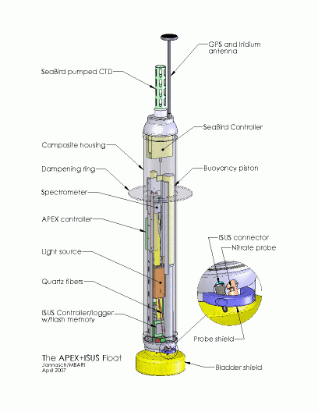
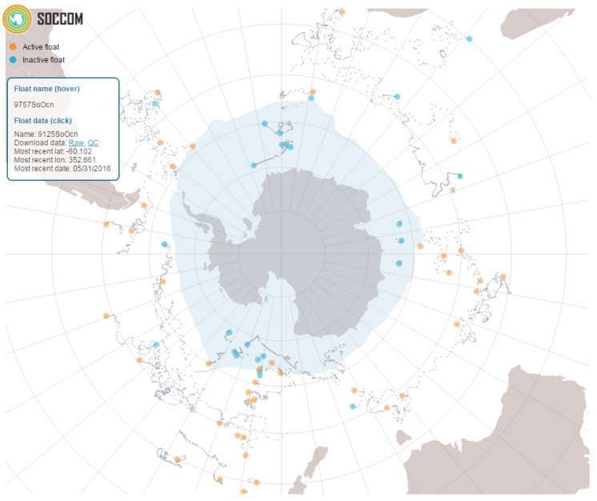
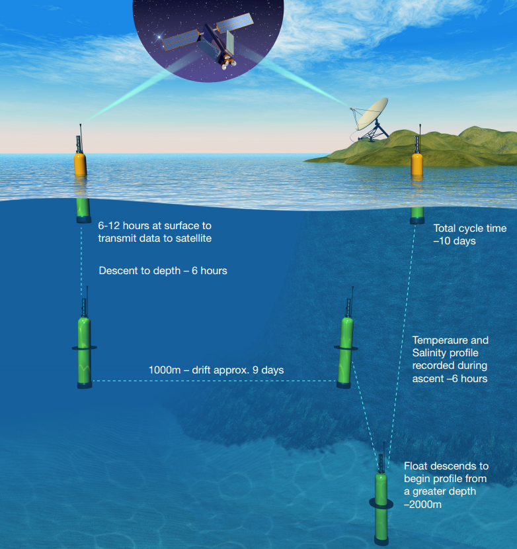
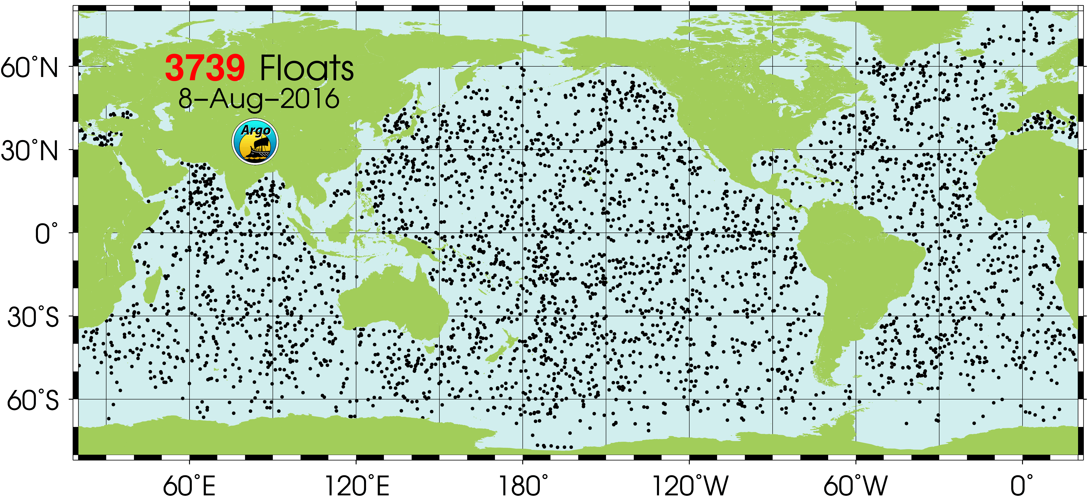
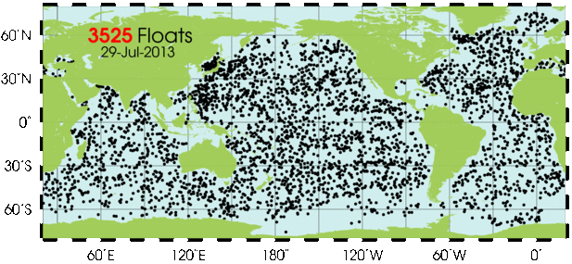
Profiling Floats
Update with better image
from Johnson publication
High Spatial and Temporal Resolution
Low Cost but Robust (+5 year deployment)
Image: soccom-float-visualization
Image: http://www.argo.ucsd.edu/
Image: http://www.argo.ucsd.edu/
Notes:
Argo is a global array of more than 3,000 free-drifting profiling floats that measures thetemperature and salinity of the upper 2000 m of the ocean.
This allows, for the first time, continuous monitoring of the temperature, salinity, and velocity of the upper ocean, with all data being relayed and made publicly available within hours after collection.
Argo float profiling for temperature/salinity has completely transformed ocean observing over the past 10 years.
SOCOM project wants to do the same for the carbon system, nitrate and oxygen, and net community production (including sea ice regions) by measuring biogeochemical parameters (pH, nitrate, oxygen, optics)

Slide 3
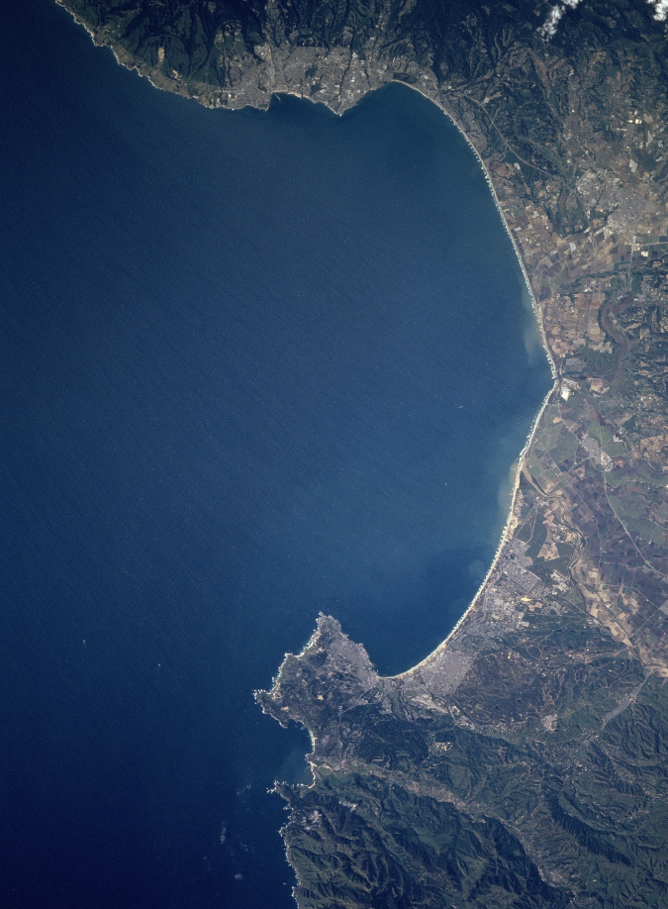
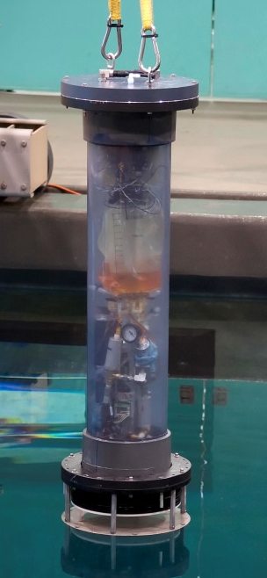
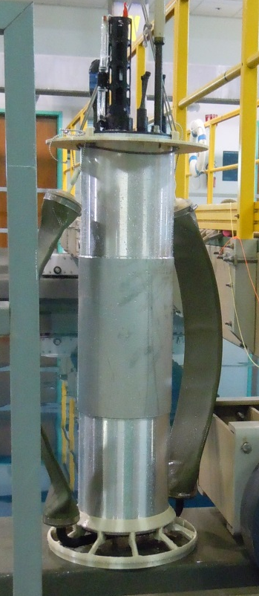
Coastal Profiling Floats
Tank Prototype
Sea
Prototype
Coastal environments are highly variable
Critical for understanding
  Hypoxia
  Acidification
  Anthropogenic Waste
Chem Sensor Lab’s Mission:
  Measure biogeochemical parameters
  pH, nitrate, oxygen, optics
  “Is net production changing on the
  West Coast of the US?”
Photo: Todd Walsh
Photo: Todd Walsh

Slide 4
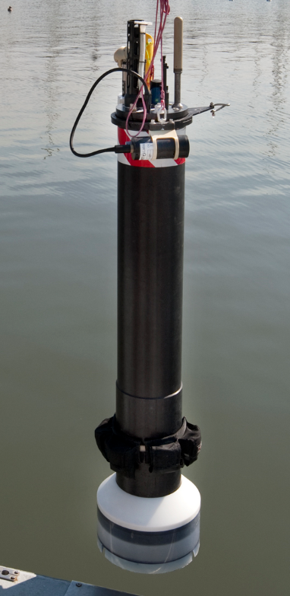
Overview
Engineering Challenge
  Prevent float from drifting onshore.
  If too close to shore, have CPF drift out to deeper water.
Proposed Approach
  Identify favorable underwater currents while float moves up the water column.
Internship Scope
  Model dynamics of float drifting in underwater currents
  Determine feasibility of using inexpensive IMU to estimate float velocity.
Photo: Gene Massion, MBARI.

Slide 5
(Optional ) Project Goals
Model Motion of CPF Drifting in Currents
  Estimate acceleration + velocity while drifting
  Determine min/max acceleration values
  Use historic current velocity data (input to model)
Estimate Velocity of Benchtop Prototype
  Build and program data logger
  Characterize sensor noise
  Signal processing/ filtering + evaluate performance
  Compare different filters/ filter parameters
Photo: Gene Massion, MBARI 2016

Slide 6
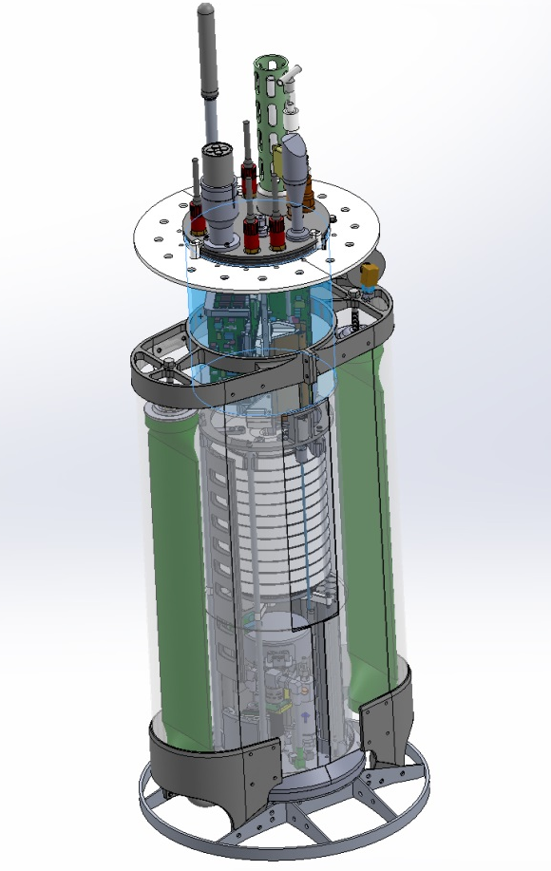
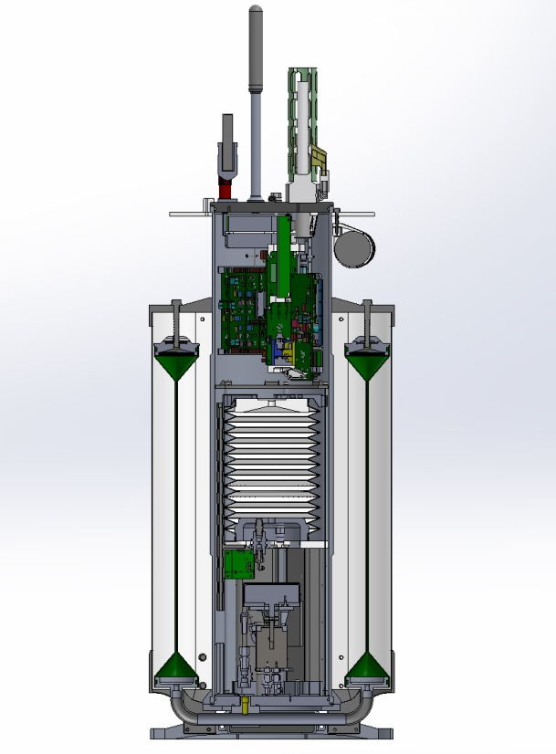
SYSTEM OVERVIEW
How CPF floats work
  Hydraulic ballast
  Sensors
  Data collection
Inertial measurement units
  Accelerometer
  Gyroscope
  Magnetometer
NOT used for position estimation.
Biogeochemical sensors
Add IMU
Microcontroller
Hydraulic bellows/bladder
Fluid reservoirs
Hydraulic pump
Image: Gene Massion, MBARI.

Slide 7
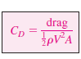
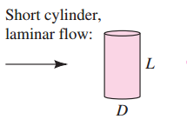
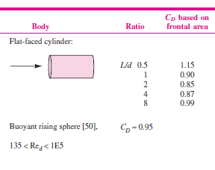
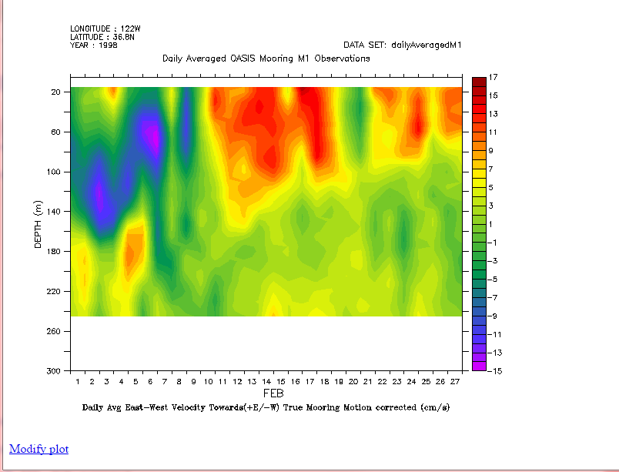
MODELING MOTION OF CPF
Table 7.3 Drag of 3D Bodies Re > 10⁴
Modeling Assumptions
  Model bluff body as a cylinder.
  Drag force is proportional to velocity.
  Upward velocity constant at 0.1 m/s (+Z), controlled by closed-loop dive engine.
  North/South and East/West velocity independent of each other
  Current profiles obtained from Acoustic Doppler Current Profiler (mooring motion corrected).
Drag coefficient: Radial Flow
Axial Flow
Reference: White 7th Ed, chapter 7.
Source: MBARI Live Access to DATA

Slide 8

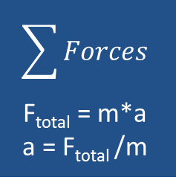
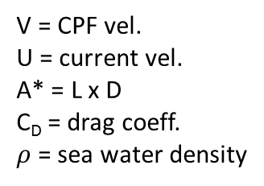

DYNAMIC MODEL
Input
V = CPF vel.
U = current vel.
A* = L x D
C_{D} = drag coeff.
$ρ$ = sea water density
$$F_{drag}= \frac{1}{2}C_{D}ρ{\left(U−V\right)}^{2}{Area}^{∗}$$
Current Velocity Profiles
N/S & E/W
$$\sum{Forces}$$
F_{total} = m*a
a = F_{total} /m
Output
[U]
Calculate drag force
F_{drag}
$$\int{accel}$$
[N]
[m/s²]
[m/s]
[m/s]
CPF Velocity
[V]
CPF Velocity – feed back to drag force calculation
Note: characteristic area (A*) is cross section of cylinder normal to flow.

Slide 9
DYNAMIC SIMULATION RESULTS
Units?
Mm/sec^2, meter/sec^2, mg?
Accelerations range:
  0.2 – 1 mm/sec^2
Velocity range
0 – 250 mm/sec^2
Based on results, project much more difficult than expected.
Requires more signal processing to reduce noise.
CPF Velocity [m/s]
CPF Acceleration [m/s²]
Notes:
Need to create new plots, thicker lines and larger font. Update the units.
Line width 2pt, text size 18

Slide 10
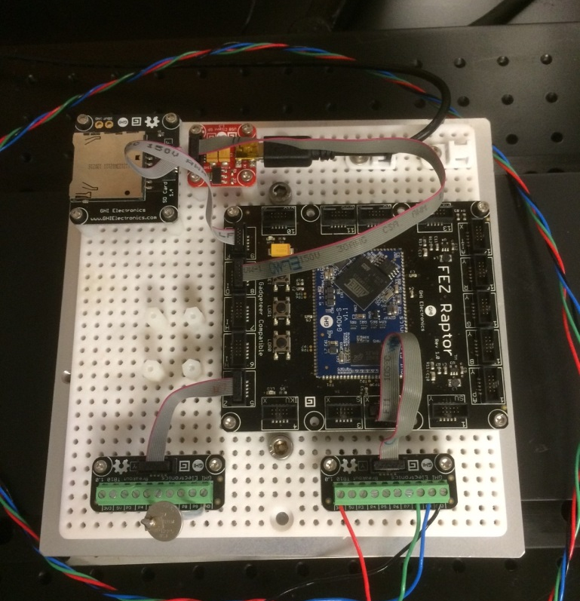
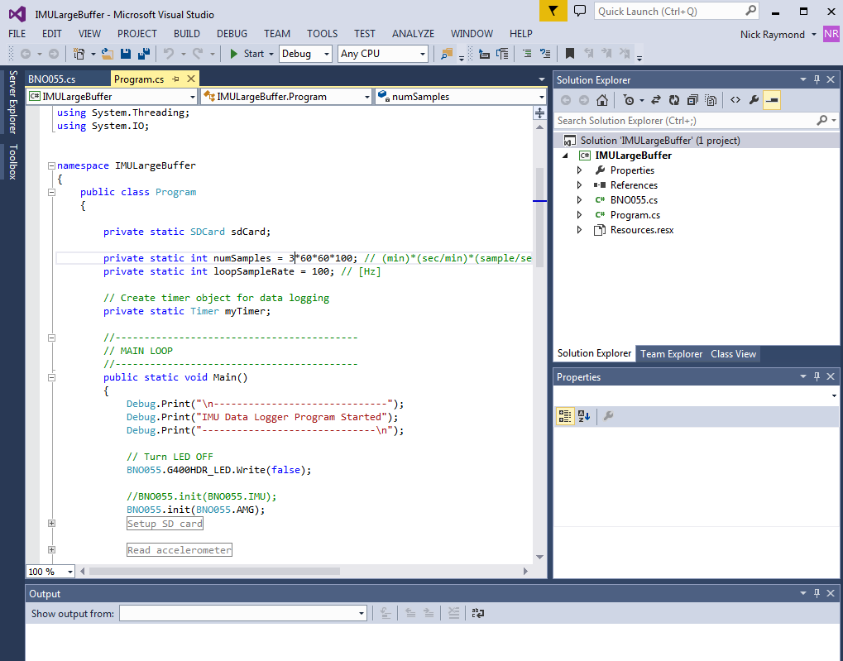
HARDWARE + SOFTWARE
Update with block diagram of modules and connections.
Update to show block diagram of signal flow from Sensor to SD card.
GHI Raptor Dev. Board + SD Card + RTC.
Firmware written in C# in Visual Studio.

Slide 11
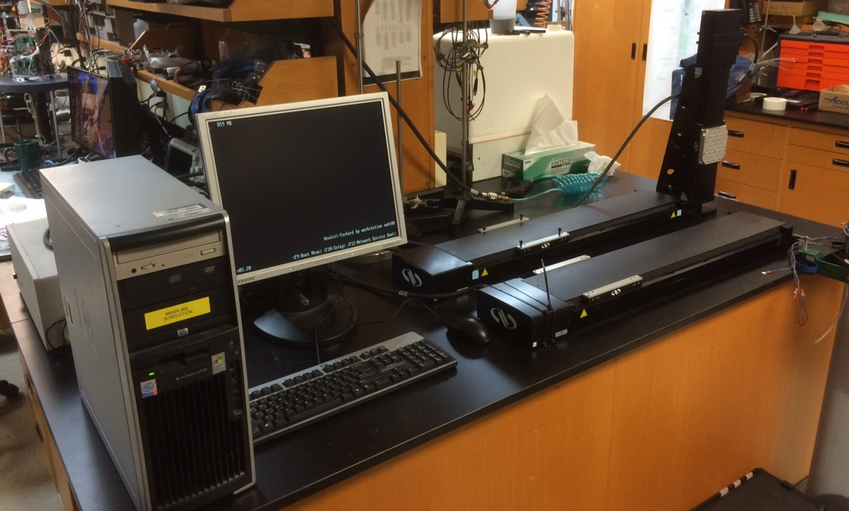
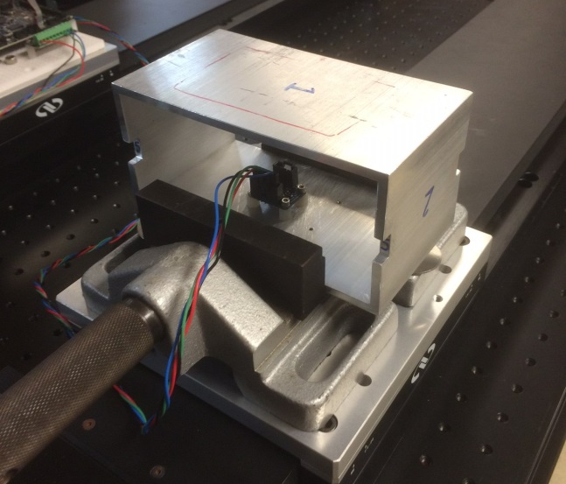
LINEAR TRANSLATION STAGE SETUP
Controller
Table
Sensor fixture

Slide 12
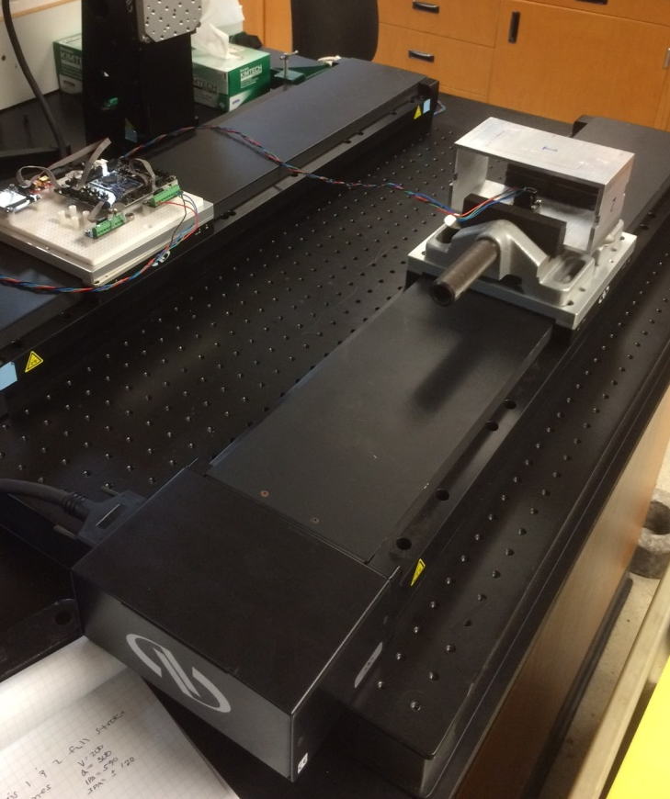
EXPERIMENT SETUP
Run | Accel (mm/sec^2) | Velocity (mm/sec)
A | 150 | 200
B | 40 | 100
C | 10 | 50
D | 5 | 35
E | 1 | 16
Acceleration Profile
Velocity Profile
V_max = 200 mm/sec
A = 150 mm/sec^2

Slide 13

Signal Processing
Import:
raw accelerometer data (XYZ)
Detrend:
remove trend in accel. data
Filter 01:
Denoise
vs.
Moving Avg.
Numerical integration
Velocity Estimate
Filter 02:
Freq. selective filtering of velocity estimate
Simulation of desired velocity profile

Slide 14
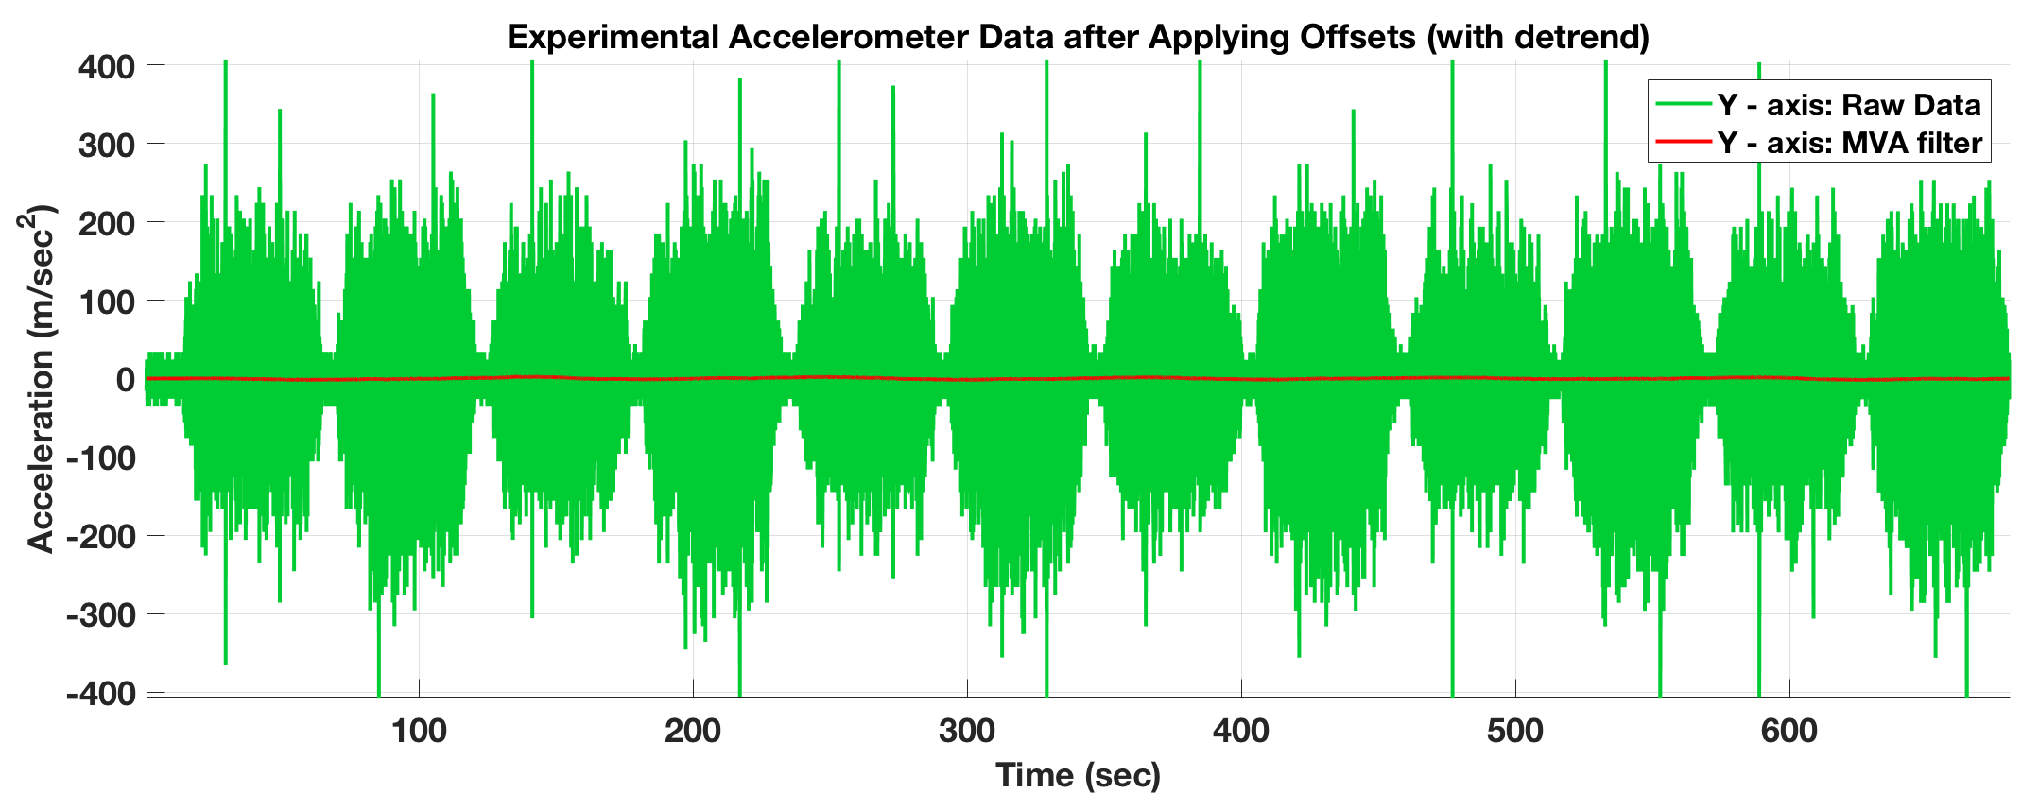
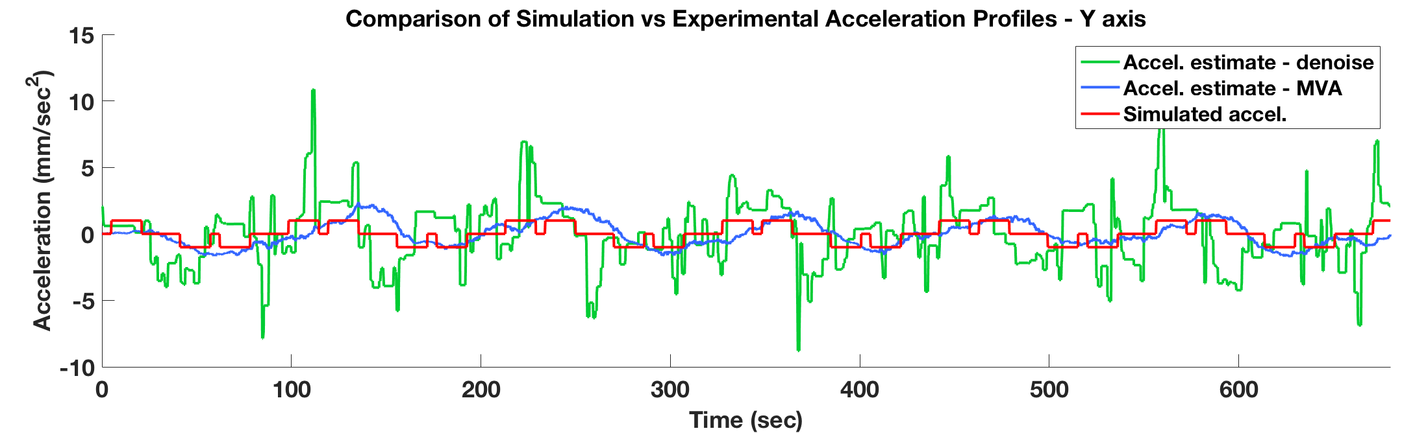
EXPERIMENTAL ACCELEROMETER DATA
Run E: A = 1mm/sec^2, V = 16 mm/sec

Slide 15
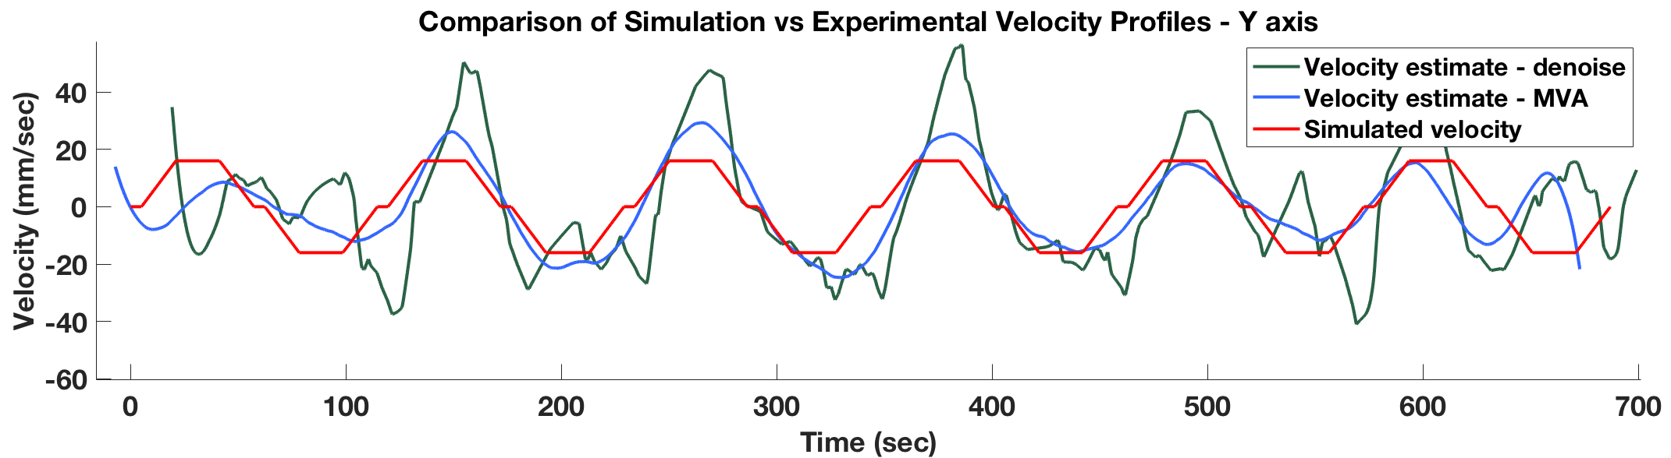
SMALL ACCELERATION MEASUREMENTS
Run E: A = 1mm/sec^2, V = 16 mm/sec

Slide 16
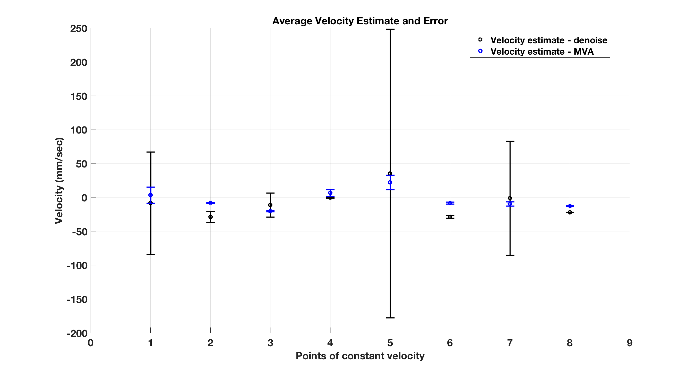
ERROR: LOW ACCELERATION MEASUREMENTS
Run E: A = 1mm/sec^2, V = 16 mm/sec
Update plot to show all five error plots
Notes:
Hello these are notes – do you see me?

Slide 17
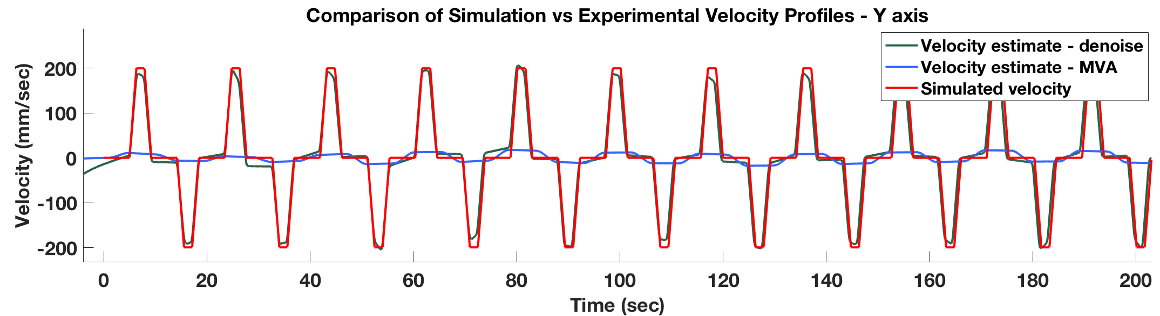
BIG ACCELERATION MEASUREMENTS
Run A: A = 150 mm/sec^2, V = 200 mm/sec
Update to show velocity estimate with good filter settings for Run A

Slide 18
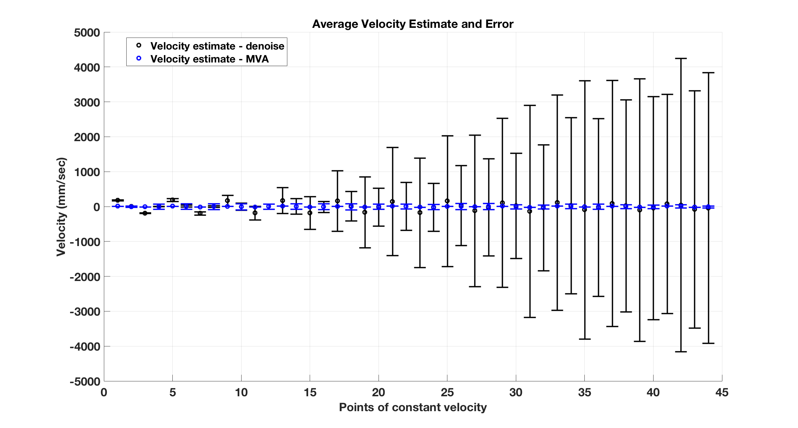
ERROR: BIG ACCELERATION MEASUREMENTS
Run E: A = 1mm/sec^2, V = 16 mm/sec
Update plot to show all five error plots
Notes:
Hello these are notes – do you see me?

Slide 19
CONCLUSION
Dynamic simulation modeling CPF motion drifting in underwater currents was created to determine maximum expected acceleration of 0.2 – 1 mm/sec^2.
It was shown that it is possible to use $20 sensor to estimate velocity for slowly moving objects, near expected dynamic range of CPF.
Three types of filtering methods were tested, with denoise and moving average filter having the best results (for the range of parameters tested).
While possible, the high noise level and limited resolution of the inexpensive sensor requires signal processing before reliable velocity estimates can be made.
Testing on the linear translation stage was completed, but more random profiles should be tested and filter settings need to be optimized in for further application.
NEED TO SIMPLIFY TEXT AND ADD IMAGE!

Slide 20
FUTURE WORK
Develop new motion paths for linear table to simulate vertical profiling motion given historic current velocity data.
Optimize band-pass filter (either IIR or FIR) to filter raw accelerometer data, as this avoids the need for the detrend() function.
Configure linear translation stage, determine minimum acceleration and rerun experiments over range of smaller accelerations.
Run experiments with sensor fusion data, and determine how to store onboard calibration offsets on the controller.
Design circuit board to integrate IMU into the Lemur board and mount to CPF float.

Slide 21
ACKNOWLEDGEMENTS
Gene
Mike
Jim
Jose
Denis
Ken + Chem lab
George
Linda

Slide 22
SOURCES

Slide 23
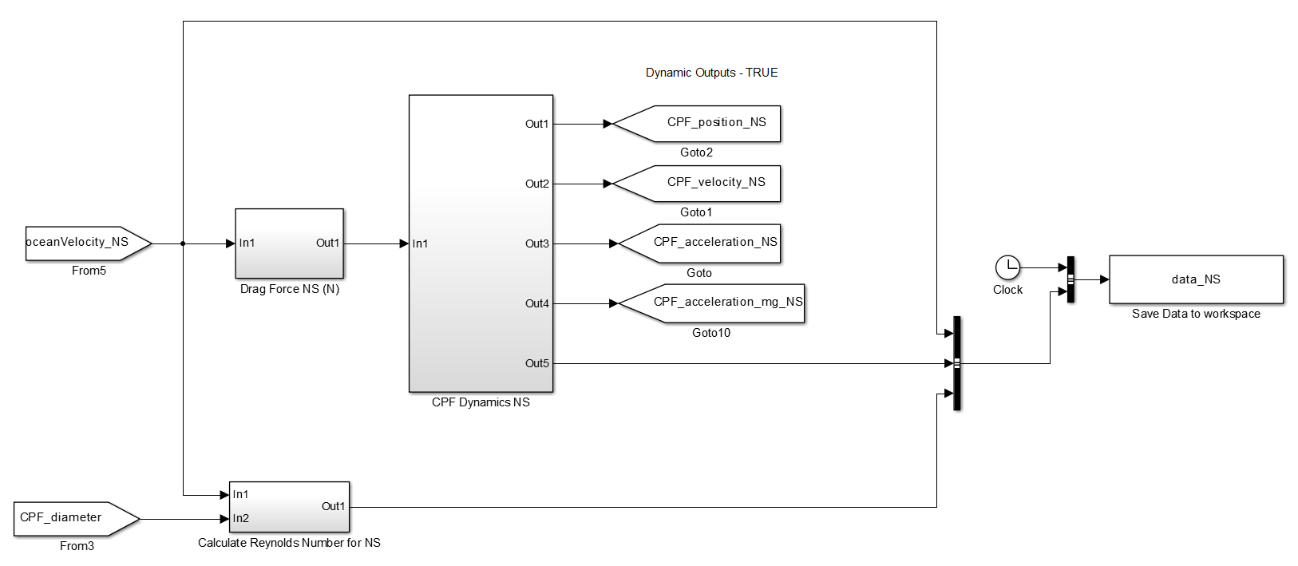
SIMULINK MODEL – 1D
Calculate dynamics
Output acceleration, velocity and positon
Input Current Velocity Profile
Save state variables to workspace
Calculate Drag Force
Calculate Re
Note: this represents one axis, it is repeated three times for N/S, E/W, and +Z.

Slide 24
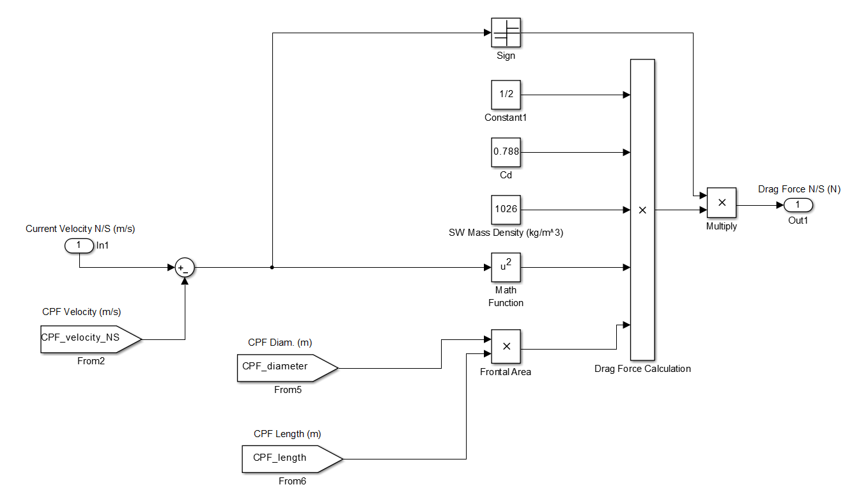
DRAG FORCE BLOCK

Slide 25
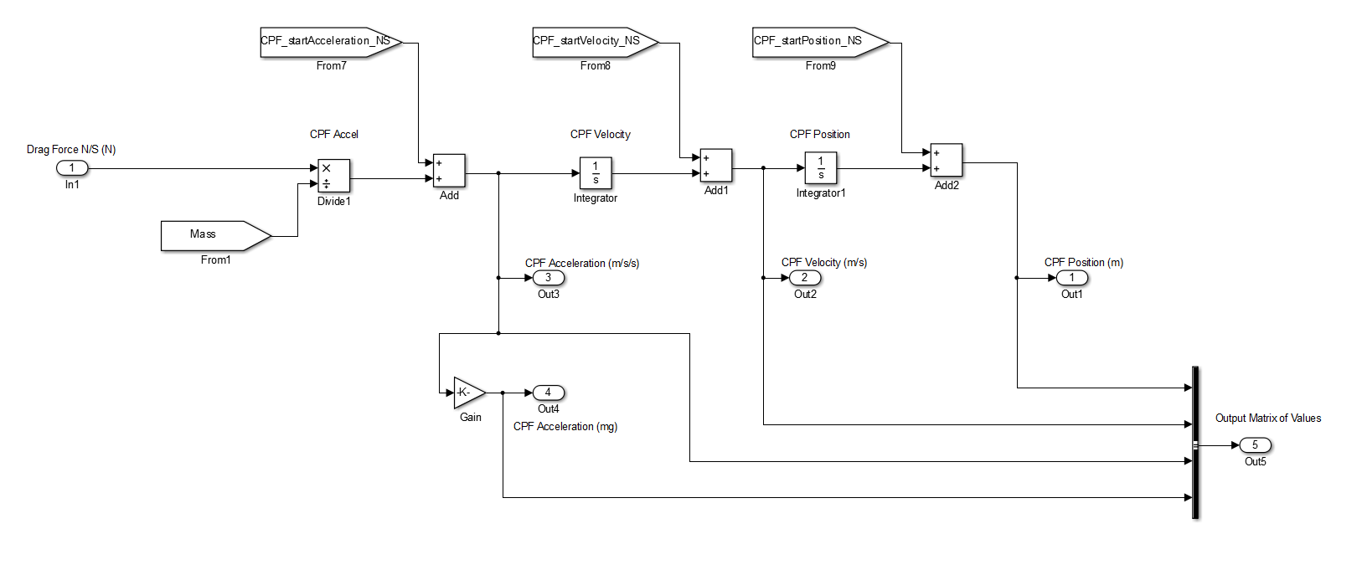
DYNAMICS BLOCK

Slide 26
SIMULATION OUTPUTS
Position [m]
Reynolds Number
CPF Velocity [m/s]
Current Velocity [m/s]
CPF Acceleration [m/s²]
CPF Acceleration [mg]

Slide 27
VERIFY FLATNESS OF LINEAR TABLE
Check flatness of linear table
Determine variability of static acceleration measurements
Movement interval of 50 mm
Velocity 25 mm/sec
Stationary for 20 seconds, then calculate average and Std.
Approximately 1 degree of sensor pitch, variable of 0.1 degree over 600 mm travel

