Slide 1
EVALUATION OF
INERTIAL MEASUREMENT UNIT PERFORMANCE FOR
WATER COLUMN VELOCITY
ESTIMATION OF
COASTAL PROFILING FLOATS.
August 10, 2016
1330 - 1345
Nick Raymond
~
Gene Massion

Slide 2
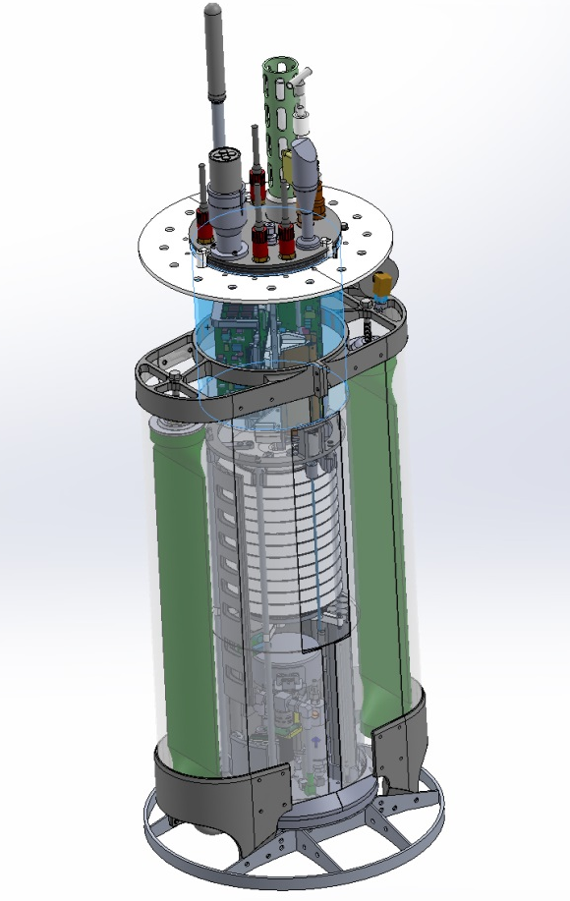
Presentation Outline
Project Overview – Science > Engineering > Internship
Profiling Floats – How they work
Float Mission Cycle
Estimating float velocity
Internship Workflow - my methodology
Float Dynamics & Benchtop Simulator – the MATH
  FBD
  Translation stage
Simulation vs Experimental Data – what to expect, and what we measured
High End Accelerations – LOOK IT WORKS! “I am a stud”
Low End Accelerations – LOOK, it kinda works….?
Performance Metric – how we can compare performance of filter
Conclusions – what I learned and accomplished
Future work – everything I still want to work on!

Slide 3

Project Overview
Monitor the health of the ocean
  How is net production changing on the West Coast of the US?
Biogeochemical measurements:
  CTD – standard measurements
  O₂ –oxygen for supporting aerobic life
  Nitrate - nutrients for primary producers
  Fluorescence – proxy for chlorophyll
  Backscatter – turbidity of ocean water
  Radiation – nasty stuff in the water?
MODIS Chlorophyll June 28, 2011
http://podaac-tools.jpl.nasa.gov/soto/
Notes:
Understanding complex coastal environments will require dense sensor networks.

Slide 4
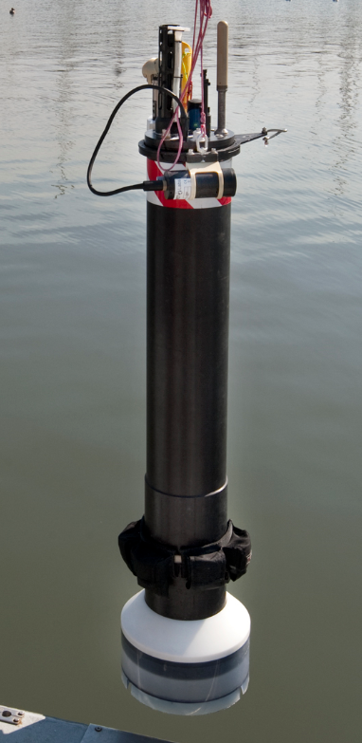
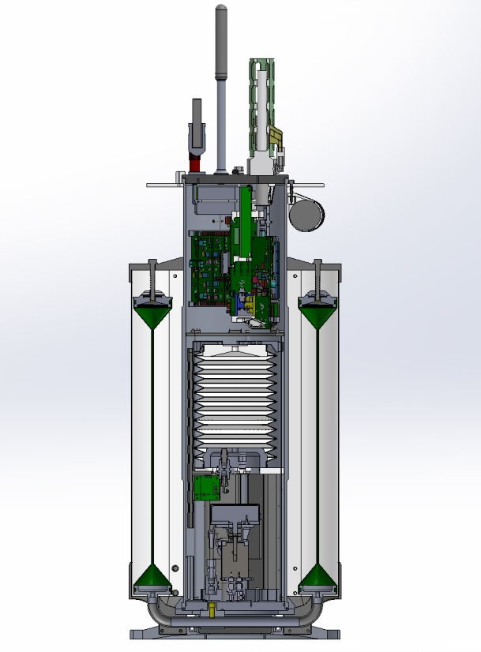
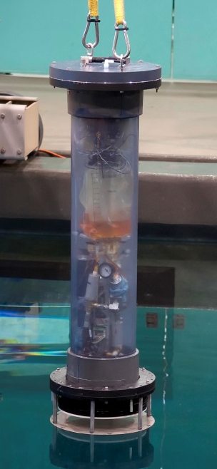
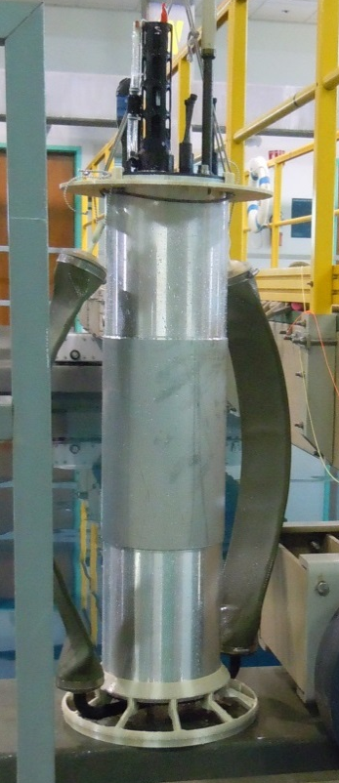
Profiling Float
Tank Prototype
How CPF floats profile
  Float starts neutral
  Pump oil into outer bladder, float volume increases, buoyancy increases, float rises
  Pump oil into inner bladder, float volume decreases, buoyancy decreases, float sinks
Inertial Measurement Unit (IMU)
  Includes accelerometer, gyroscopes, magnetometers in XYZ axes
  Can estimate orientation and velocity
Biogeochemical sensors
Add IMU
Microcontroller
Inner oil bladder
Outer oil bladder
Hydraulic pump
Image: Gene Massion, MBARI.

Slide 5
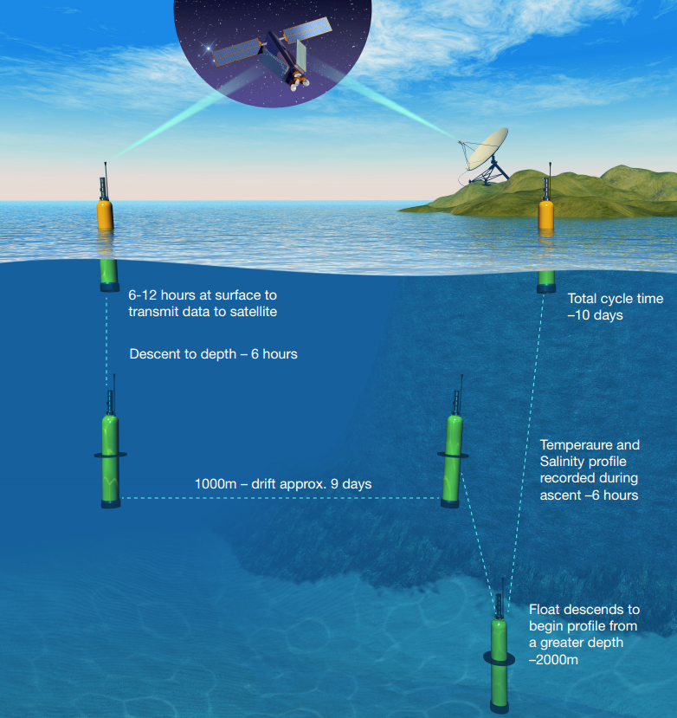
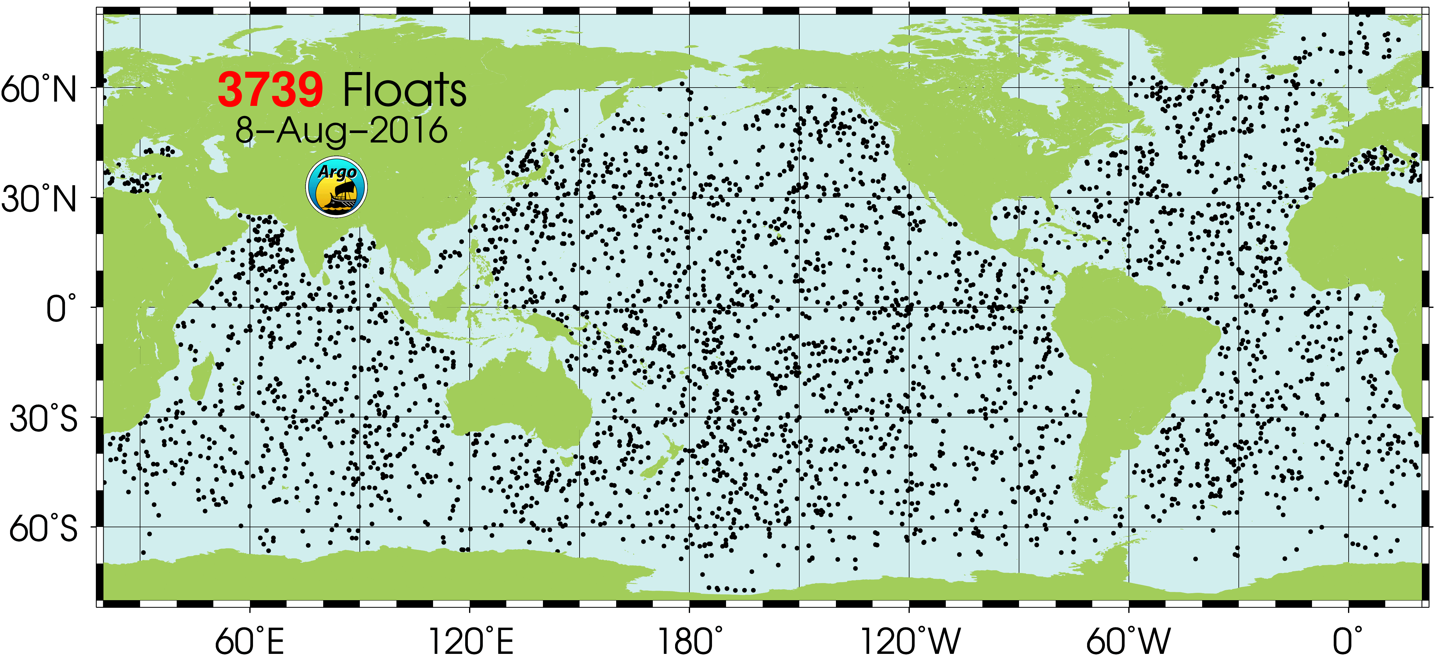
Float Mission Cycle
High Spatial and Temporal Resolution
Low Cost but Robust (+5 year deployment)
Warning!
GPS Signal
6-12 hours at surface to transmit data to satellite
Obtain GPS location, send data to satellite.
Coastal Profiling Floats >>> Near Land
Profiling floats >>> Open Ocean
Image: soccom-float-visualization
Dive down, ride strong current back to open water
Descends to depth
Sensor readings recorded during ascent.
500 to 1000 m – drift 1 to 9 days
Float descends and “parks” in the mud.
Image: http://www.argo.ucsd.edu/
Notes:
Argo is a global array of more than 3,000 free-drifting profiling floats that measures thetemperature and salinity of the upper 2000 m of the ocean.
This allows, for the first time, continuous monitoring of the temperature, salinity, and velocity of the upper ocean, with all data being relayed and made publicly available within hours after collection.
Argo float profiling for temperature/salinity has completely transformed ocean observing over the past 10 years.
SOCOM project wants to do the same for the carbon system, nitrate and oxygen, and net community production (including sea ice regions) by measuring biogeochemical parameters (pH, nitrate, oxygen, optics)

Slide 6
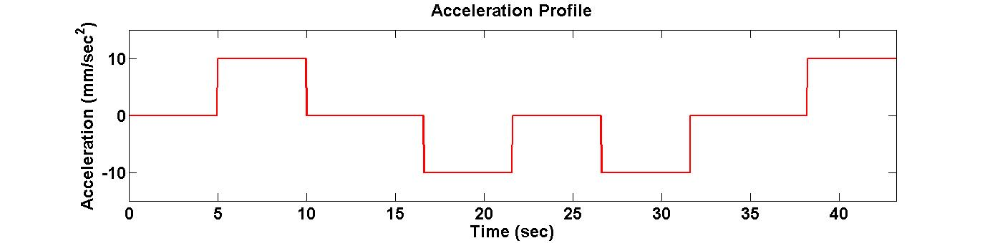
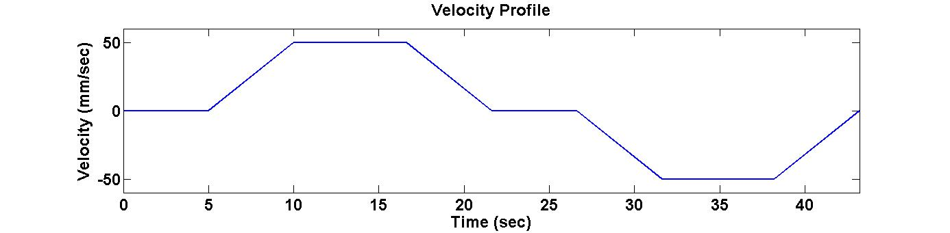
Estimating Float Velocity
Float Motion Underwater
What we
can measure
(accelerometer)
+50
+50
-50
-50
5 sec
What we
want to know
(underwater velocity)

Slide 7
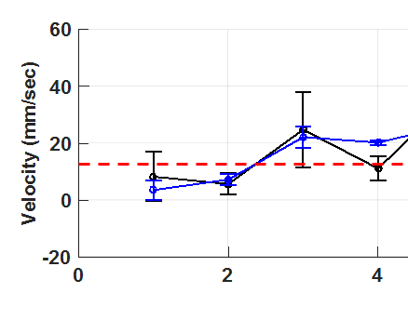
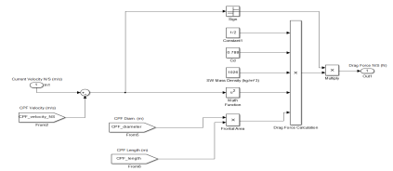
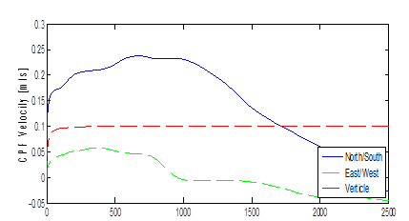

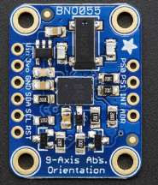
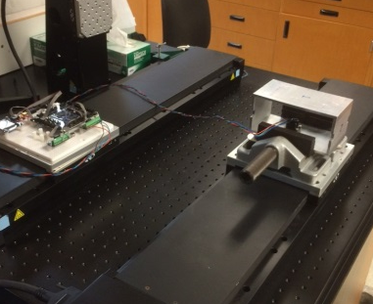
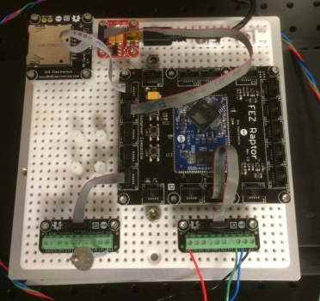
Workflow Overview
Model System
Evaluate Sensor
Build & Program Data Logger
Run Tests
Signal Processing
Evaluate Performance

Slide 8
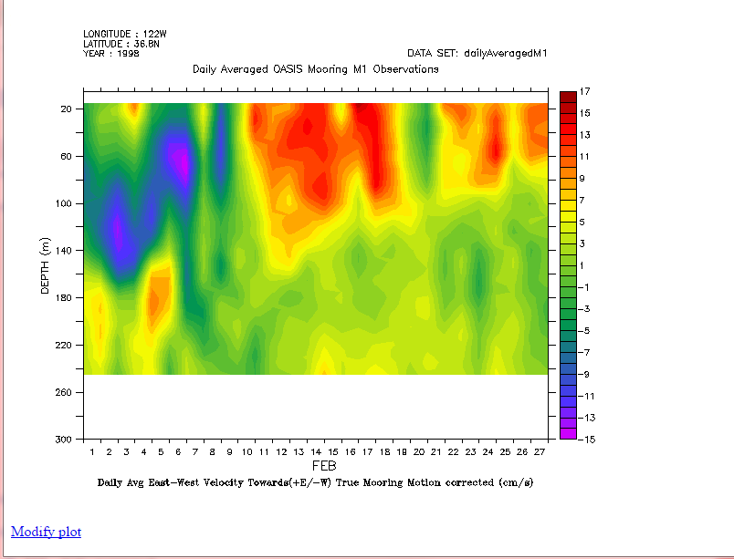
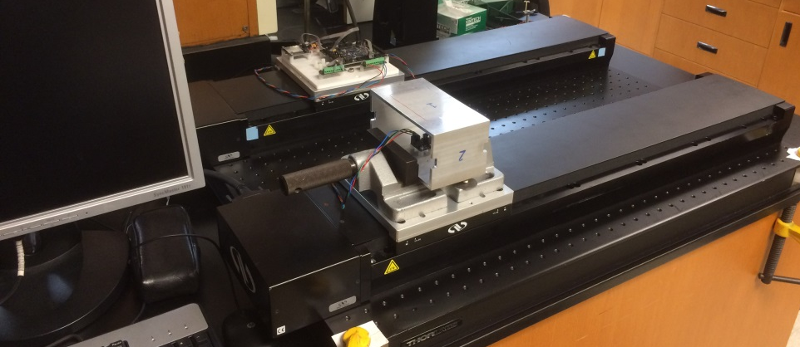
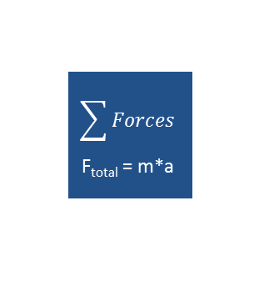

Float Dynamics & Benchtop Simulator
Acoustic Doppler Current Profile
Benchtop Simulator
Computer
Sensor
Microcontroller + SD Card
Table
Source: dods.mbari.org/lasOASIS
Run | Accel (mm/sec^2) | Velocity (mm/sec)
A | 150 | 200
B | 40 | 100
C | 10 | 50
D | 5 | 35
E | 1 | 16
Numerical Model of Float Dynamics
Drag force
F_{drag}
$$\sum{Forces}$$
F_{total} = m*a
$$\int{accel}$$
CPF Velocity
Notes:
Daily Average East-West velocioty (+E,/-W) True mooring motion correcter M1 buoy

Slide 9
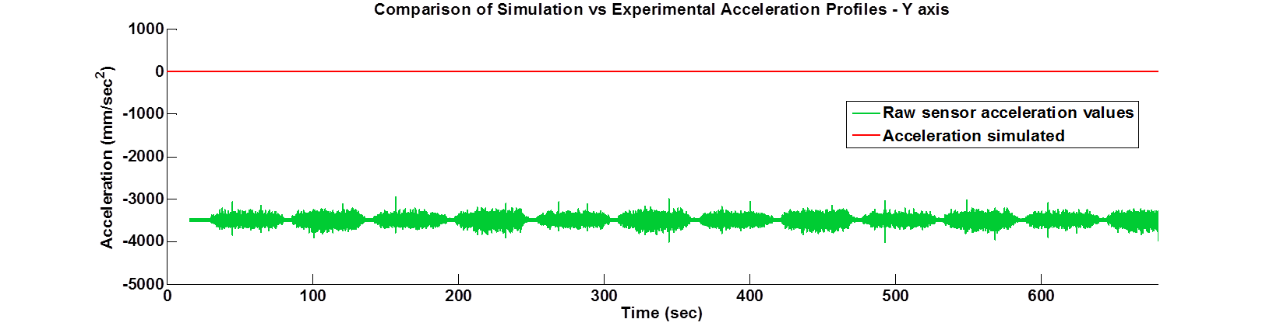
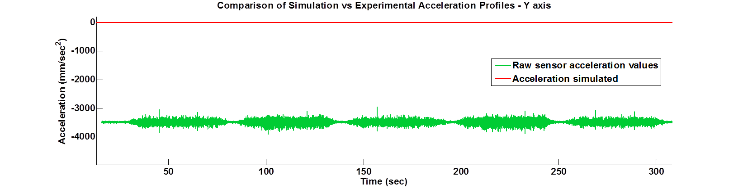
Simulation vs Experimental Data
Offset
Drift

Slide 10
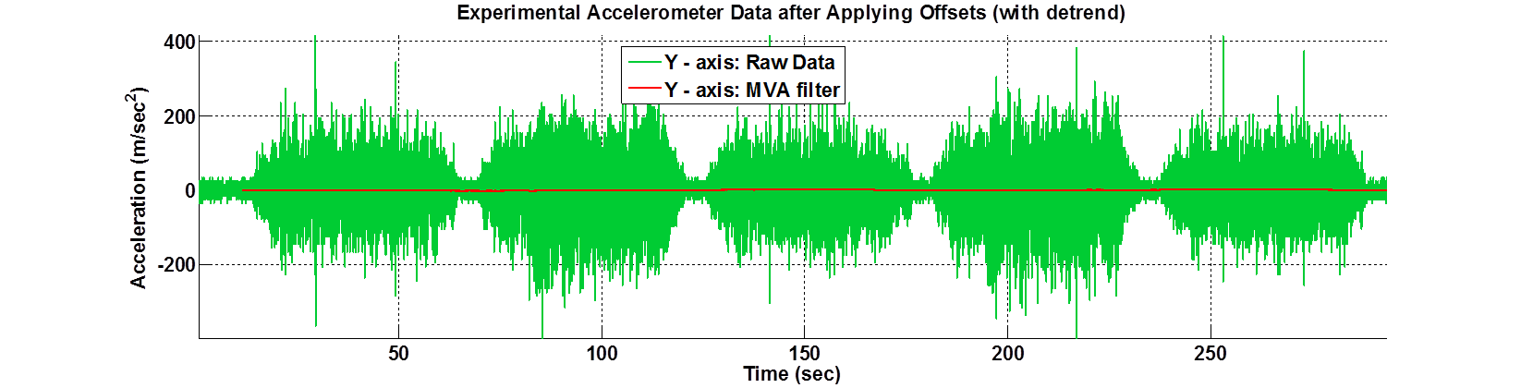
Simulation vs Experimental Data
(Zoom in)

Slide 11

Signal Processing
Numerical integration
Detrend
+
Filter
Velocity Estimate
Import:
accel. data
Filter
Filtering
  Results obtained with “denoise” filter, referenced from image processing literature
  Also tested:
    Moving average filter
    Frequencies selective filters (low-pass and band-pass)

Slide 12
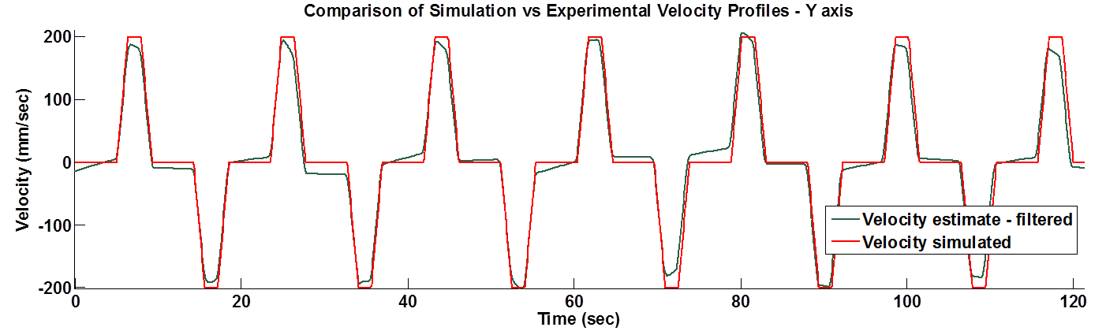
Velocity Estimate - Large Accelerations
Run A: Vel = 200 mm/sec^2; Accel = 150 mm/sec^2;

Slide 13
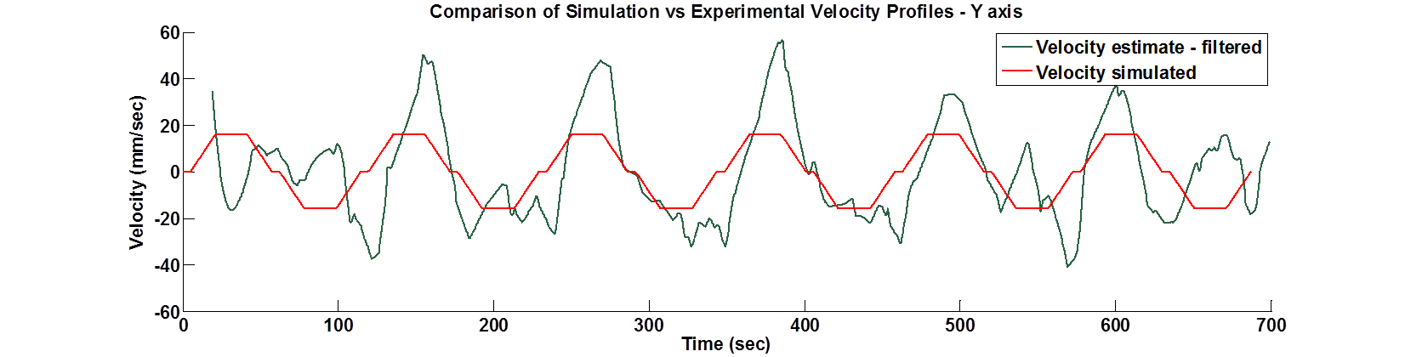
Velocity Estimate - Small Accelerations
Run A: Vel = 16 mm/sec^2; Accel = 1 mm/sec^2;

Slide 14
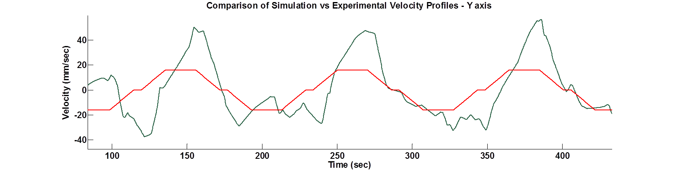
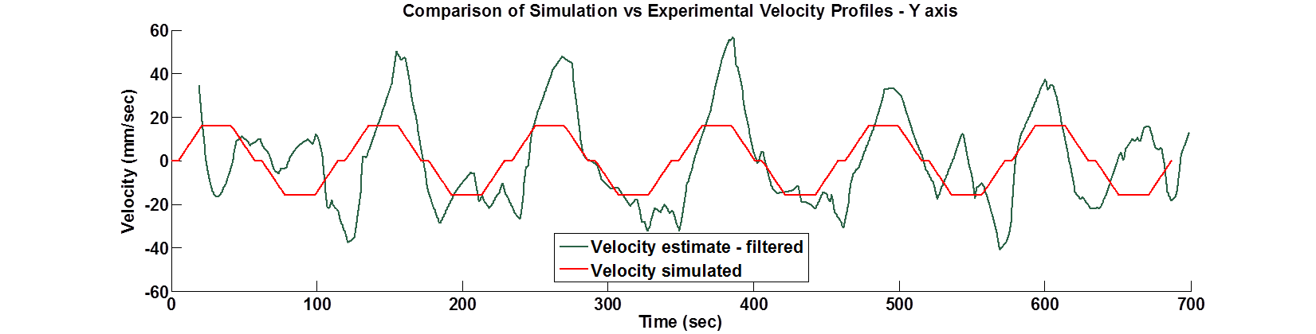
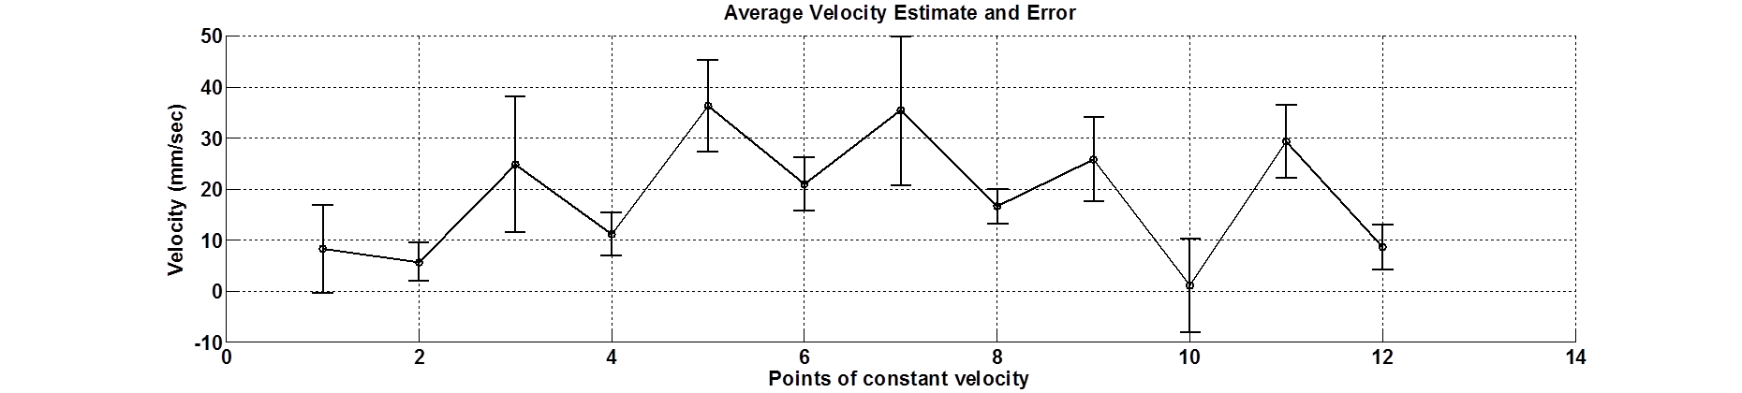
Performance Metric
Error bars = standard deviation
Velocity simulated

Slide 15
CONCLUSION
Created CPF simulation
  Determined range of accelerations and velocities
  Calculations based on measured underwater current profiles
Developed workflow to systematically evaluate IMU sensor
  Generated path trajectories from CPF simulation results
  Programmed linear table to emulate “ideal” motion profiles
  Investigated signal processing schemes
  Established metric for evaluating a range of signal processing approaches
Internship Outcomes
  Introduction to signal processing and filtering
  Gained experience programming in C#
  More complete understanding of “Systems Engineering”

Slide 16
FUTURE WORK
Develop translation stage that better simulates the dynamic model result
  Lower velocity and accel
  Motion paths more representative of ocean current profiles
Optimize signal processing workflow
  Better filtering and detrending techniques

Slide 17
ACKNOWLEDGEMENTS
Gene
Mike
Jim
Jose
Denis
Ken + Chem lab
George
Linda
Need to work on this!

