Slide 1
EVALUATION OF
INERTIAL MEASUREMENT UNIT PERFORMANCE FOR
WATER COLUMN VELOCITY
ESTIMATION OF
COASTAL PROFILING FLOATS.
August 10, 2016
1330 - 1345
Nick Raymond
~
Gene Massion

Slide 2

RESEARCH MOTIVATION
Monitor the health of the ocean
  Example: how is net production changing on the West Coast of the US, and how does it affect the salmon fishery?
Tools: biogeochemical sensors:
  CTD – standard measurements
  O₂ –measure of photosynthesis
  Nitrate - nutrients for primary producers
  Backscatter – suspended sediment/ bio-mass
Measurements
  Profiling floats are cost effective and robust
  Able to obtain large temporal and spatial measurements
MODIS Chlorophyll June 28, 2011
http://podaac-tools.jpl.nasa.gov/soto/
Notes:
Good afternoon everyone.
For my internship I worked with Ocean Engineer Gene Massion on the MBARI Coastal Profilng float project.
which is part of an initiative that the chemical sensor lab is working on to better understand complex coastal environments.
In order to better monitor the health of the ocean, they are developing a new autonomous profiling float designed for coastal deployments in dense sensor networks.
These coastal profiling floats, CPFs, will be outfitted with biogeochemical sensors for making long term measurements to help answer questions like: how is net production…
The photo on the right is satelite image showing floruence, a proxy for chlorophyll, along the west coast of the US, and highlights the significance of these regions.
But more information is needed, with greater fidelity and variety of measurements.
Luckily, profiling floats represent a cost effective and robust platforms suitbale for this task, as they are able to make large temporal and spatial measurements at significantly reduces costs )as compared to AUVs and some moorings).
But before I dive into my internship project, I would like to provide a brief oveview of typical coastal profiling float mission cycle, and highlight some operational considerations.

Slide 3
COASTAL PROFILING FLOATS
Estimate drift from GPS reading
Deploy at desired location
GPS Signal
Obtain GPS location, send data to shore via satellite
Use sensor readings from upwards profile to identify sub surface current roughly opposite to drift, then park at depth
Sensor readings recorded during ascent.
Drift due to ocean current
Float descends to depth or anchors on bottom
Notes:
Argo is a global array of more than 3,000 free-drifting profiling floats that measures thetemperature and salinity of the upper 2000 m of the ocean.
This allows, for the first time, continuous monitoring of the temperature, salinity, and velocity of the upper ocean, with all data being relayed and made publicly available within hours after collection.
Argo float profiling for temperature/salinity has completely transformed ocean observing over the past 10 years.
SOCOM project wants to do the same for the carbon system, nitrate and oxygen, and net community production (including sea ice regions) by measuring biogeochemical parameters (pH, nitrate, oxygen, optics)

Slide 4
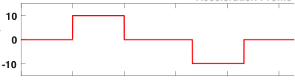
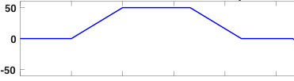
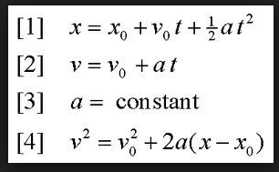
HOW TO ESTIMATE FLOAT VELOCITY
Simple case: assume 1D motion
5 sec
5 sec
What we
can measure:
accelerations
Acceleration
(mm/sec²)
+50
5 sec
5 sec
5 sec
-50
What we
want to know:
velocity
Velocity
(mm/sec⁾

Slide 5
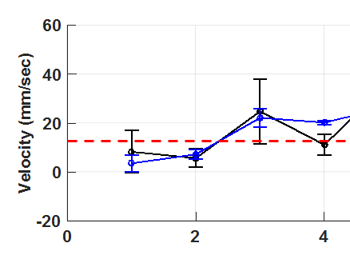
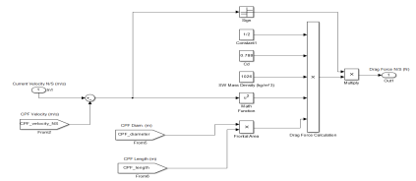
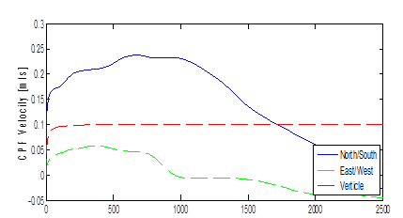

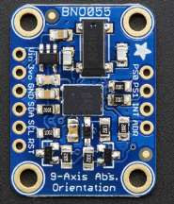
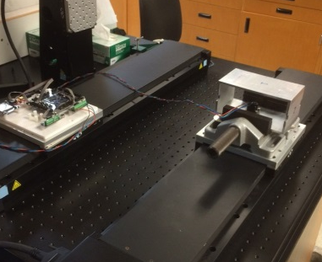
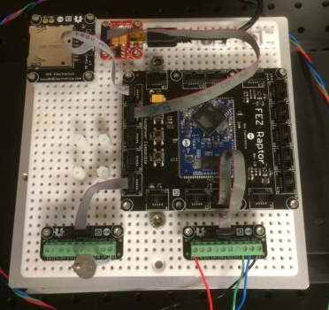
INTERNSHIP OBJECTIVES
Evaluate Performance
Model System
Signal Processing
Evaluate Sensor
Run Experiments
Build & Program Data Logger

Slide 6
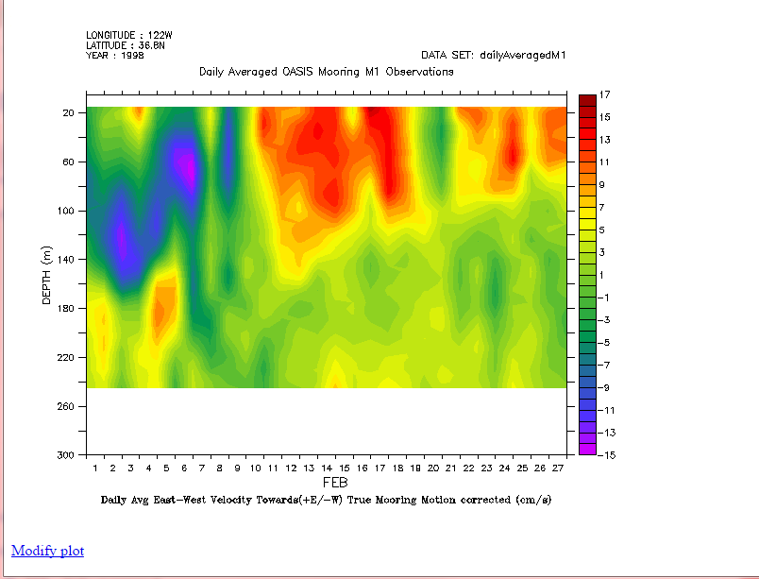
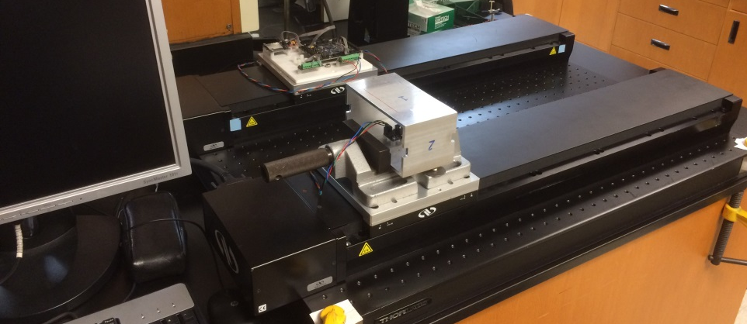
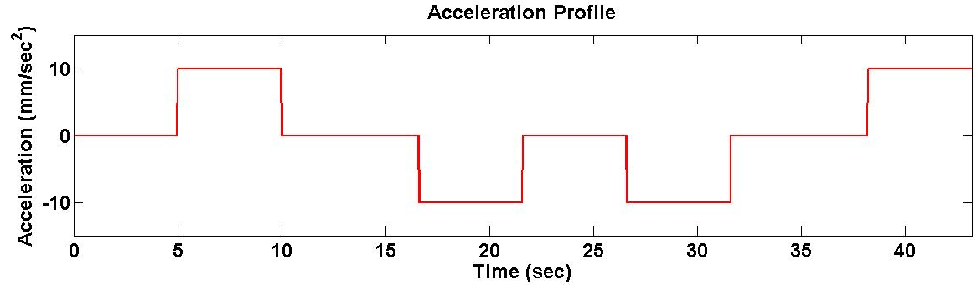
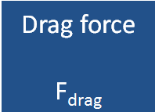
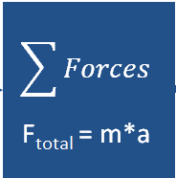

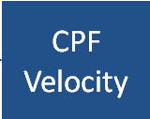
MODELING AND EXPERIMENTS
Typical Monterey Bay Current Record
Benchtop Simulator
Computer
Sensor
Microcontroller + SD Card
Table
Source: dods.mbari.org/lasOASIS
Run | Accel (mm/sec^2) | Velocity (mm/sec)
A | 150 | 200
B | 40 | 100
C | 10 | 50
D | 5 | 35
E | 1 | 16
Numerical Model of Float Dynamics
Notes:
Daily Average East-West velocioty (+E,/-W) True mooring motion correcter M1 buoy
Note: this plot shows that there it is possible to have currents running oppisite eachother within the water column (subsurface currents moving opposite to surface current)

Slide 7
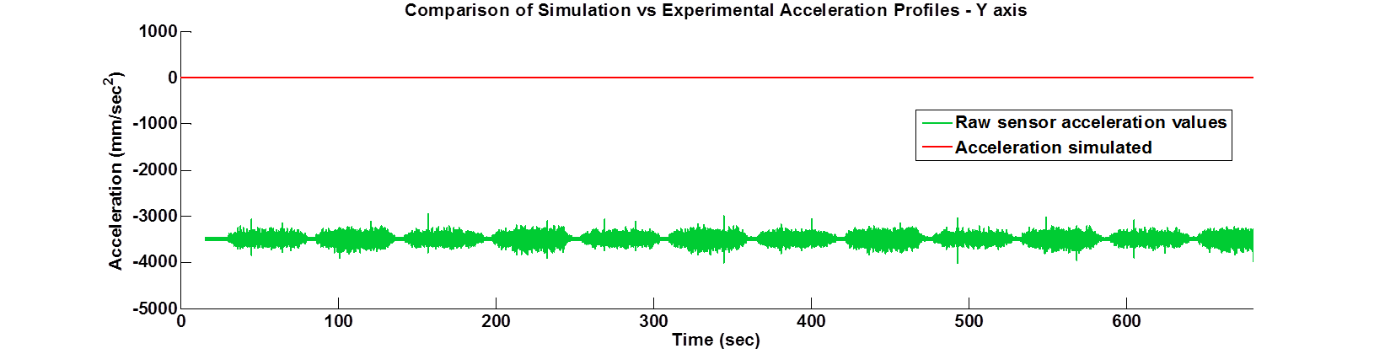
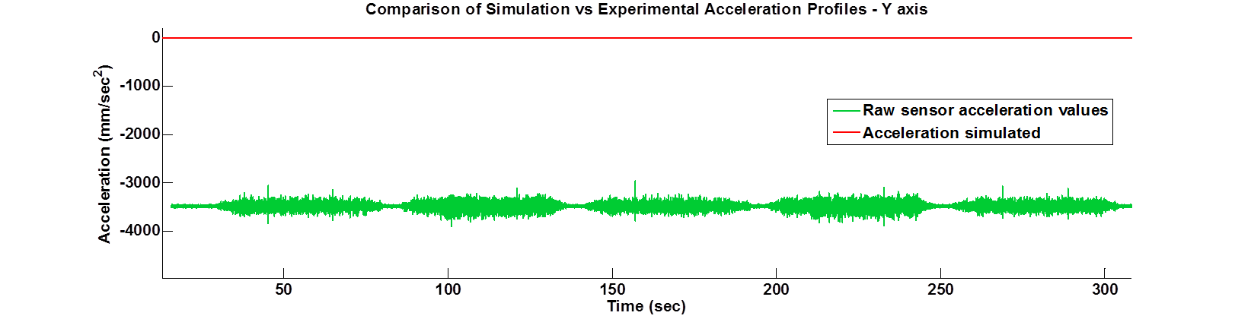
SENSOR MEASUREMENTS
Experimental Acceleration vs. Simulated Acceleration Profiles
Offset
Drift

Slide 8
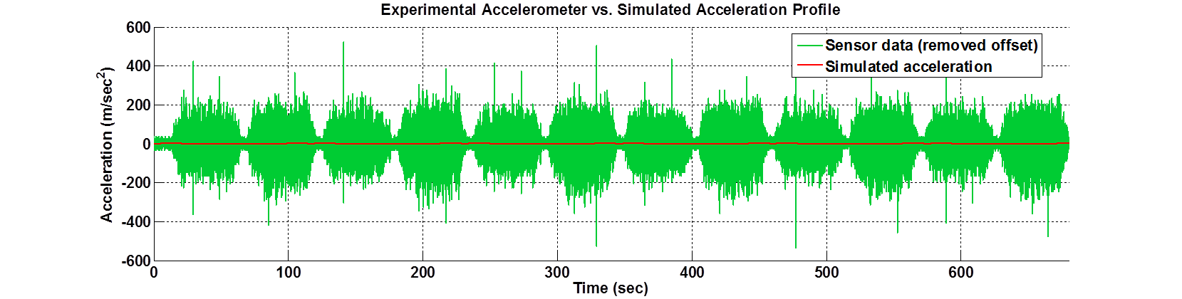
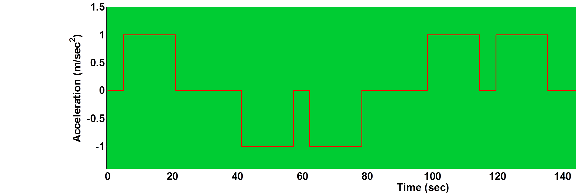
SIGNAL VS. NOISE
Experimental Acceleration vs. Simulated Acceleration Profiles
Longterm, use a $200 sensor instead of $20 sensor

Slide 9
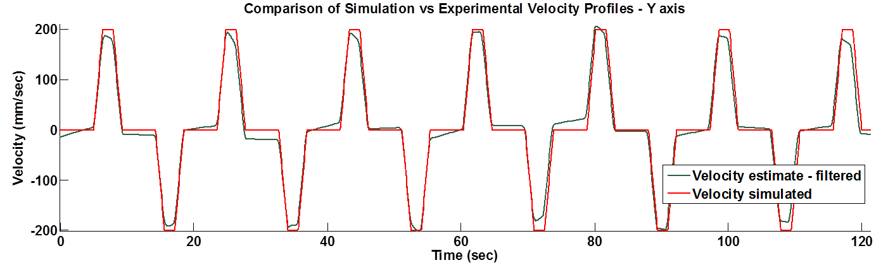
RESULTS - LARGE ACCELERATIONS
Run A: Vel = 200 mm/sec; Accel = 150 mm/sec²;

Slide 10
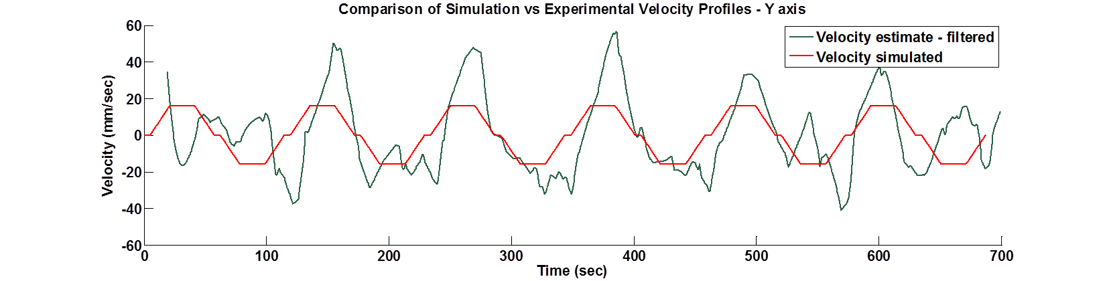
RESULTS - SMALL ACCELERATIONS
Run A: Vel = 16 mm/sec; Accel = 1 mm/sec²;
Notes:
We found our lower limit….

Slide 11
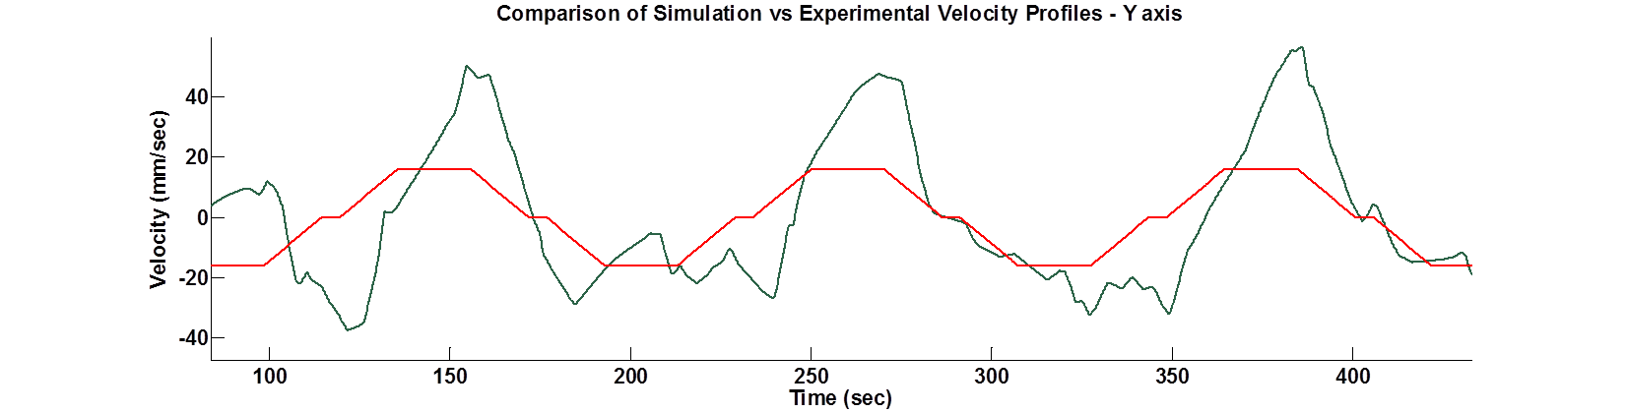
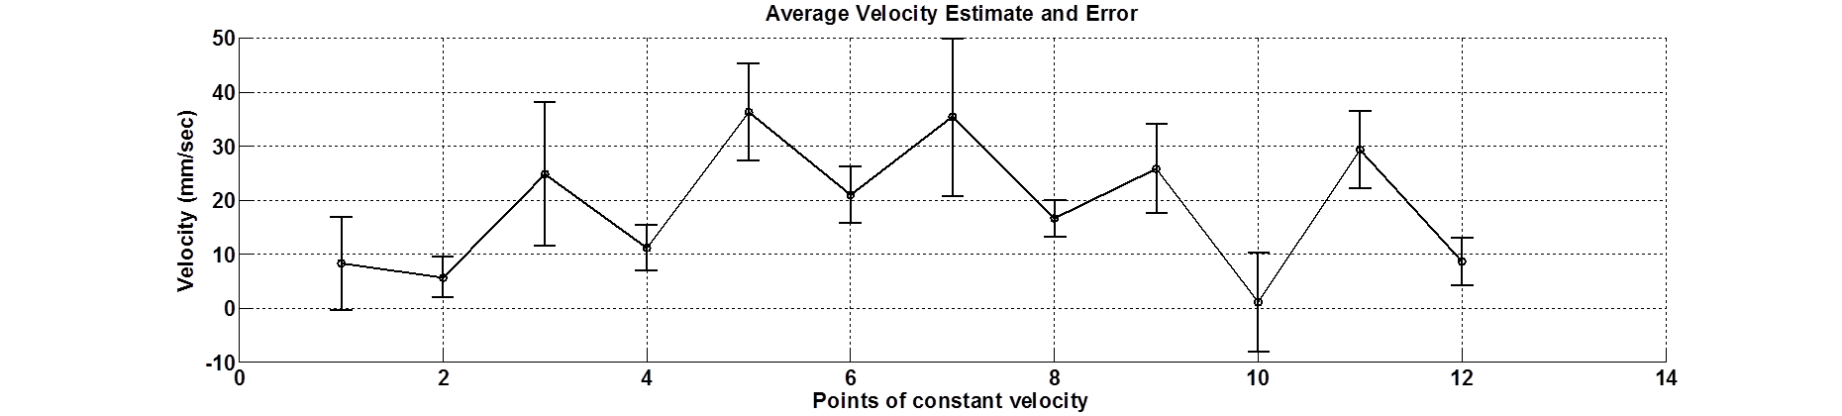
PERFORMANCE METRIC
Error bars = ±1 standard deviation
Velocity simulated

Slide 12
CONCLUSION
Created dynamic CPF simulation
  Determined range of expected accelerations and velocities
  Calculations based on measured underwater current profiles
Developed workflow to systematically evaluate different sensors
  Established metric to compare results from various signal processing approaches
  Internship scope focused on creating a workflow
  Future work can use this process to compare/optimize filter settings
Internship Outcomes
  Introduction to signal processing and filtering
  Gained experience programming in C# and microcontrollers
  More complete understanding of “Systems Engineering” and how it can be applied to evaluate new ideas, concepts, “out of the box” thinking

Slide 13
FUTURE WORK
Develop translation stage that better simulates the dynamic model result
  Run tests at lower acceleration settings
  Program motion paths more representative of ocean current profiles
Optimize signal processing and filter settings
  Better filtering and detrending techniques
  Frequency selective filtering may produce more robust results
Run tests with new sensors
  Evaluate performance of more expensive sensors
Integration of IMU hardware/software with CPF

Slide 14


ACKNOWLEDGEMENTS
Gene Massion
Ken Johnson + Chemical Sensor Group
Mike Parker
Denis Klimov
Andy Hamilton
George Matsumoto & Linda Kuhnz
MBARI staff
David and Lucile Packard Foundation
MBARI 2016 interns

Slide 15
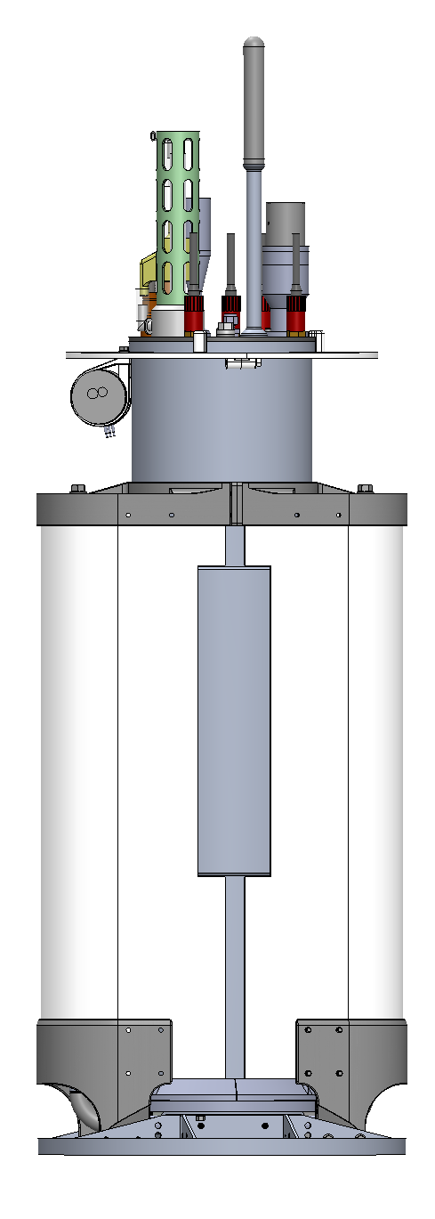
Thank you.
Image: Gene Massion, 2016

Slide 16
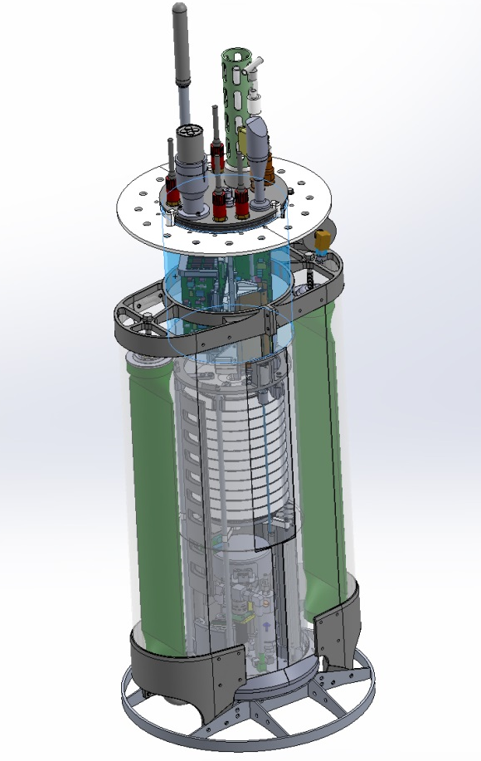
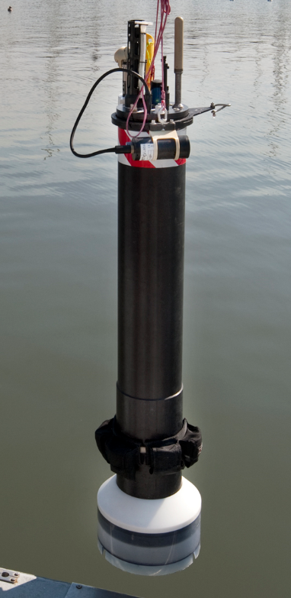
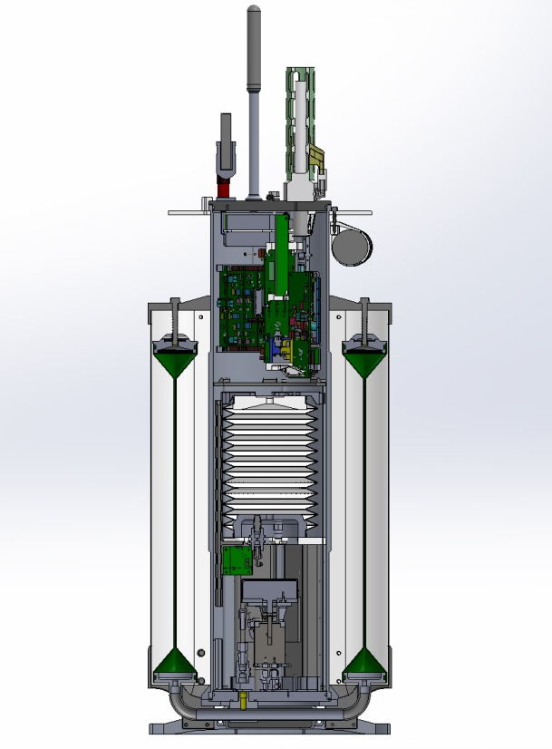
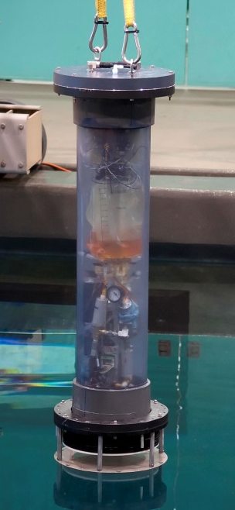
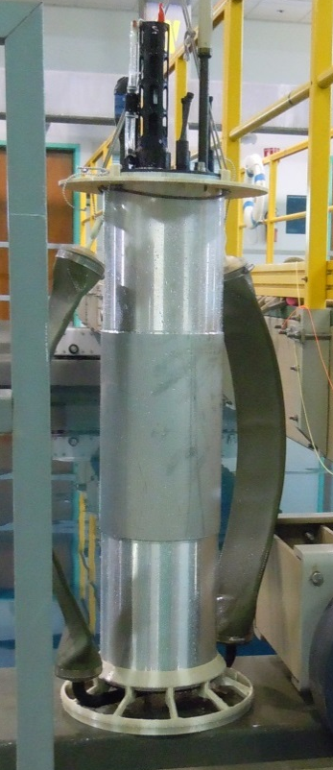
Profiling Float
Tank Prototype
How CPF floats profile
  Float starts neutral
  Pump oil into outer bladder, float volume increases, buoyancy increases, float rises
  Pump oil into inner bladder, float volume decreases, buoyancy decreases, float sinks
Inertial Measurement Unit (IMU)
  Includes accelerometer, gyroscopes, magnetometers in XYZ axes
  Can estimate orientation, velocity, and position
Biogeochemical sensors
Add IMU
Microcontroller
Inner oil bladder
Outer oil bladder
Hydraulic pump
Image: Gene Massion, MBARI.
Notes:
*

Slide 17

Signal Processing
Numerical integration
Detrend
+
Filter
Velocity Estimate
Import:
accel. data
Filter
Filtering
  Results obtained with “denoise” filter, referenced from image processing literature
  Also tested:
    Moving average filter
    Frequencies selective filters (low-pass and band-pass)

