Slide 1


Evaluation of inertial measurement unit performance for water column velocity estimation of coastal profiling floats.
Nick Raymond & Gene Massion
Summer Internship 2016

Slide 2
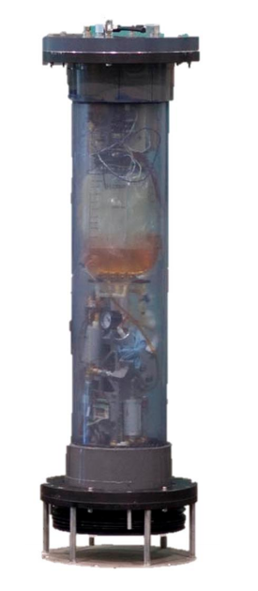
Overview
Research goal
  Prevent float from beaching itself.
  If float is too close to shore, have it drift out to deeper water.
Approach
  Identify favorable underwater currents while float drifts up to surface.
Internship Scope
  Estimate dynamics of float using current velocity profiles.
  Identify range of accelerations and determine feasibility of using IMU.

Slide 3
ACKNOWLEDGEMENTS

Slide 4
Profiling Floats

Slide 5
Coastal Profiling Floats

Slide 6
Project Goals
Model Motion of CPF Drifting in Currents
  Estimate acceleration + velocity while drifting
  Determine min/max acceleration values
  Use historic current velocity data (input to model)
Estimate Velocity of Benchtop Prototype
  Build and program data logger
  Characterize sensor noise
  Signal processing/ filtering + evaluate performance
  Compare different filters/ filter parameters

Slide 7
SYSTEM OVERVIEW
How floats work
  Hydraulic ballast
  Sensors
  Data collection
Inertial measurement units
  Accelerometer
  Gyroscope
  Magnetometer
  Sensor fusion
IMU strapdown measurements
  Measure accelerations
  Calculate speed + direction of CPF
  NOT ATTEMPTING TO ESTIMATE POSITION
Image of CPF parts
+ Image of IMU

Slide 8
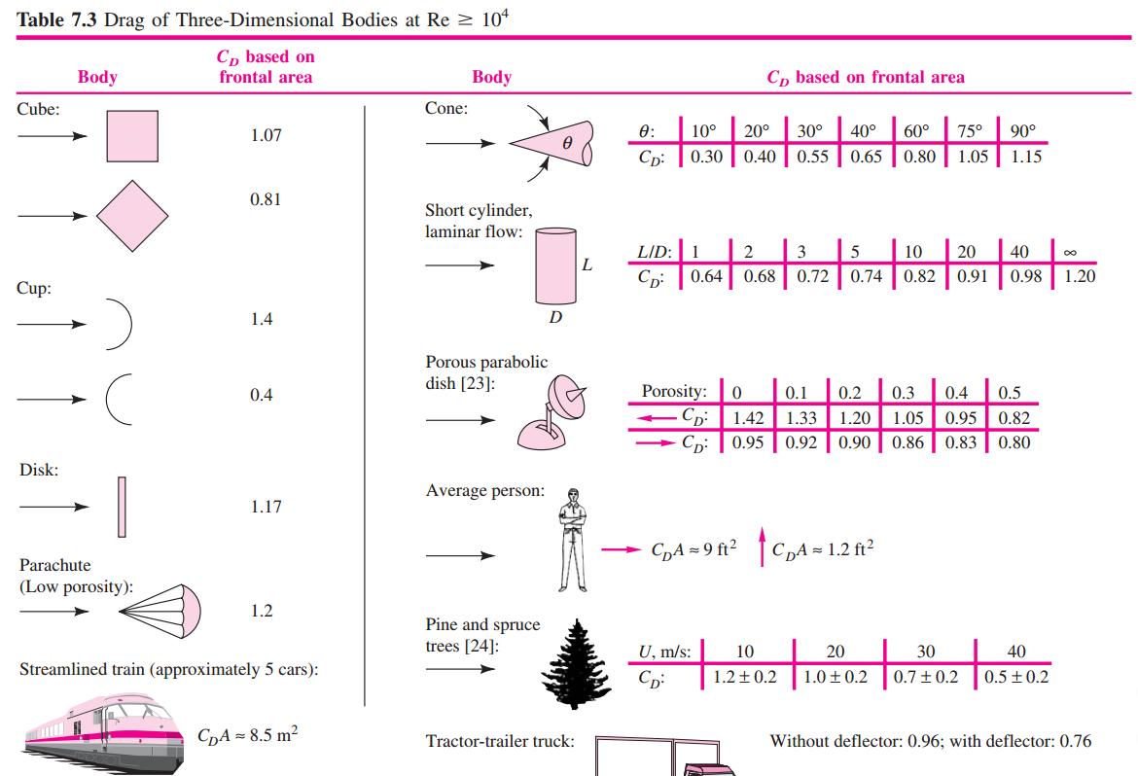
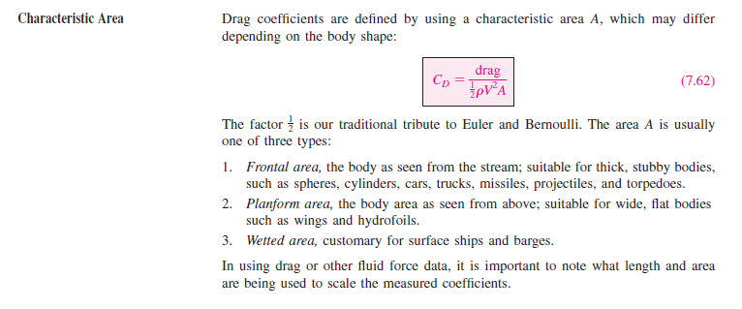
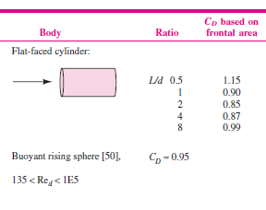
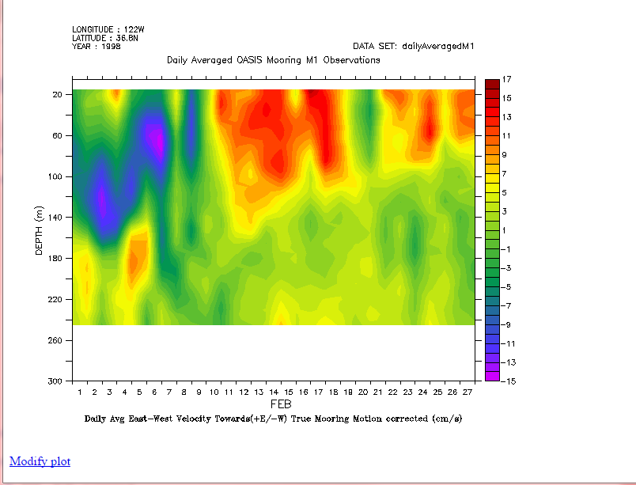
MODELING MOTION OF CPF
Radial Flow
Physical Parameters
  Model bluff body as a cylinder.
  L/D = 8
  C_{D} ≈ 0.788 flow normal to radius
  C_{D} ≈ 0.99 axially
Assumptions about Motion
  Upward velocity constant at 0.1 m/s (+Z), controlled by closed-loop dive engine.
  North/South and East/West velocity independent of each other (XY).
  Current profiles obtained from Acoustic Doppler Current Profiler (mooring motion corrected).
Table 7.3 Drag of 3D Bodies Re > 10⁴
Axial Flow
Reference: White 7th Ed, chapter 7.
Reference: MBARI Live Access to DATA

Slide 9
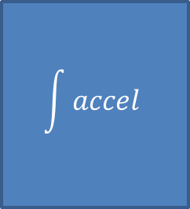
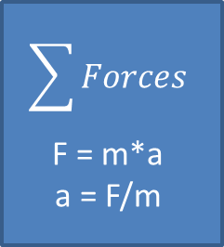
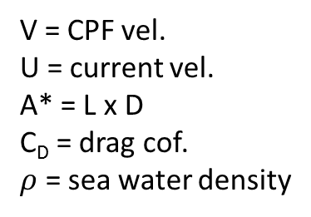
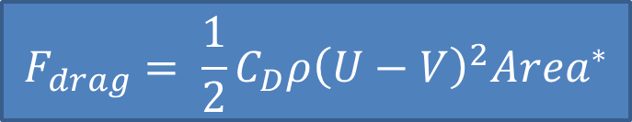
DYNAMIC MODEL
Input
Current Velocity Profiles
N/S & E/W
V = CPF vel.
U = current vel.
A* = L x D
C_{D} = drag cof.
$ρ$ = sea water density
$$F_{drag}= \frac{1}{2}C_{D}ρ{\left(U−V\right)}^{2}{Area}^{∗}$$
[U]
Calculate drag force
F_{drag}
$$\sum{Forces}$$
F = m*a
a = F/m
$$\int{accel}$$
Output
[N]
[m/s²]
[m/s]
[m/s]
CPF Velocity
[V]
CPF Velocity – feed back to drag force calculation
Note: characteristic area (A*) is cross section of cylinder normal to flow.

Slide 10
SIMULATION RESULTS
Position [m]
Reynolds Number
CPF Velocity [m/s]
Current Velocity [m/s]
CPF Acceleration [m/s²]
CPF Acceleration [mg]

Slide 11
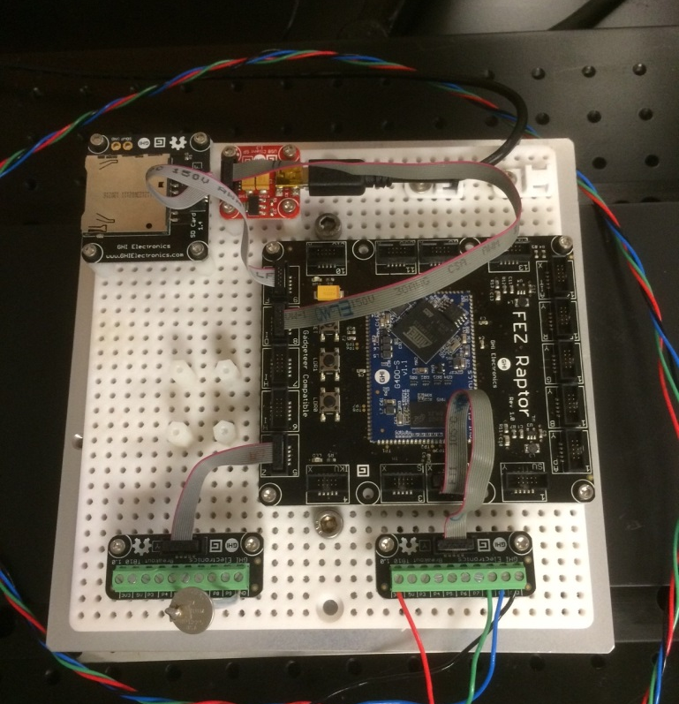
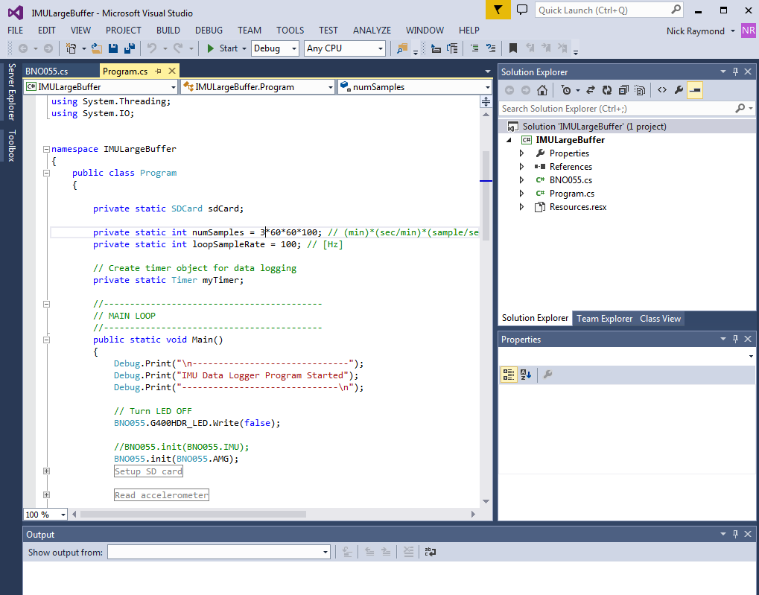
HARDWARE+ SOFTWARE
GHI Raptor Dev. Board + SD Card + RTC.
Firmware written in C# in Visual Studio.

Slide 12
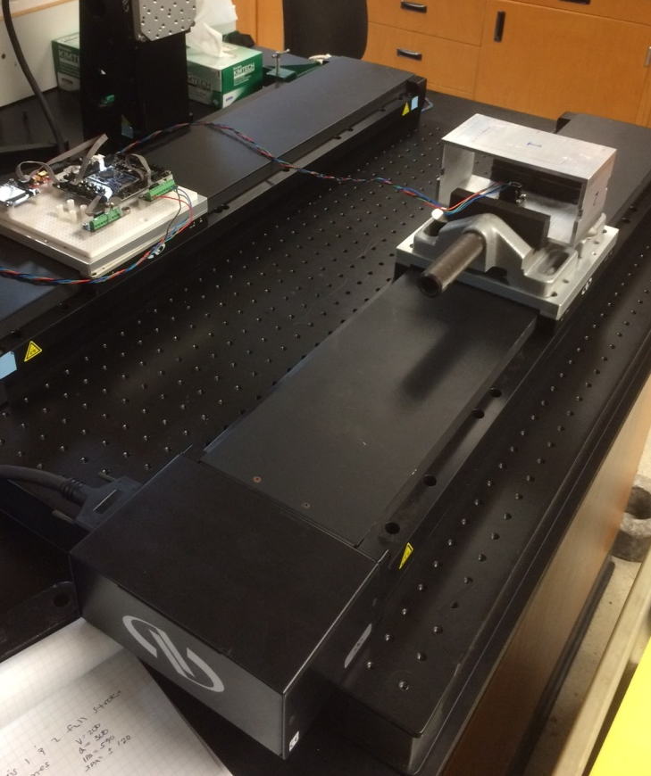
EXPERIMENT SETUP
Run | Accel (mm/sec^2) | Velocity (mm/sec)
A | 150 | 200
B | 40 | 100
C | 10 | 50
D | 5 | 35
E | 1 | 16
Acceleration Profile
Velocity Profile
V_max = 200 mm/sec
A = 150 mm/sec^2

Slide 13
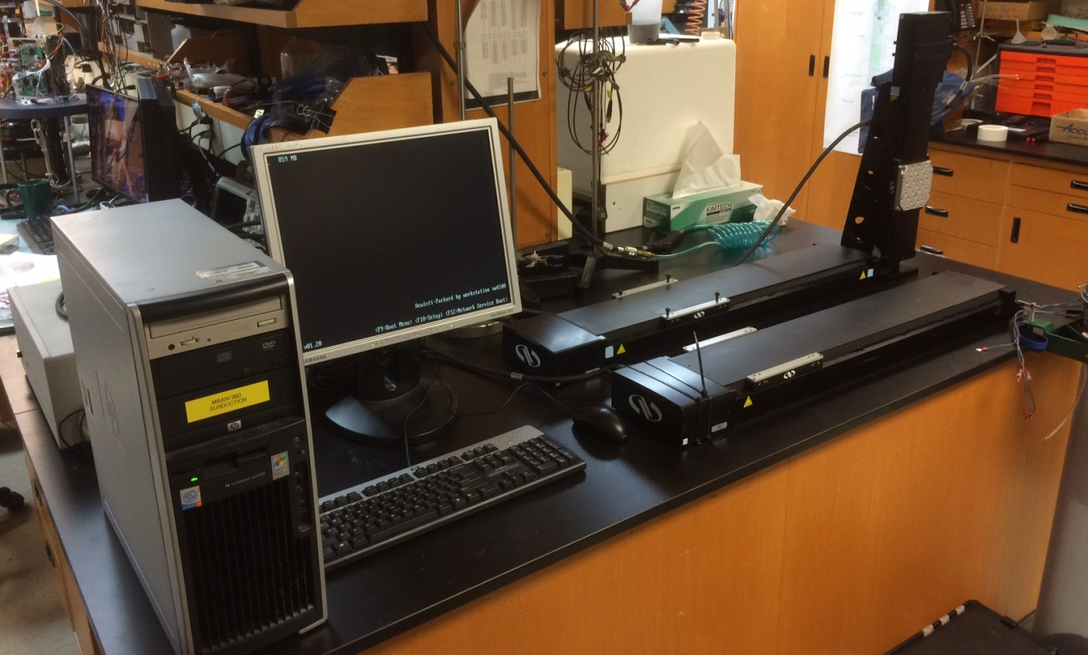
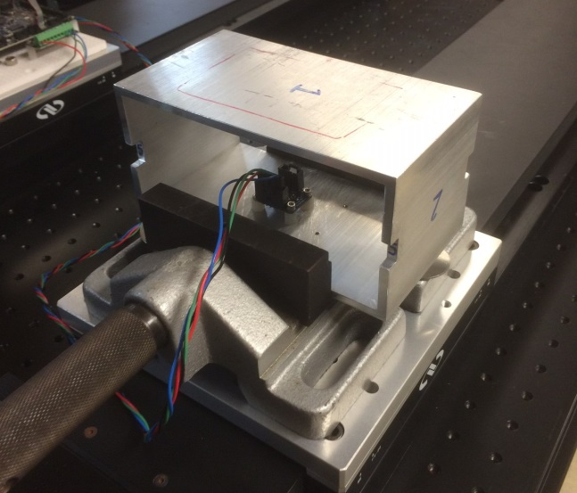
LINEAR TRANSLATION STAGE SETUP
Controller
Table
Sensor fixture

Slide 14

Signal Processing
Import:
raw accelerometer data (XYZ)
Detrend:
remove trend in accel. data
Filter 01:
Denoise
vs.
Moving Avg.
Numerical integration
Velocity Estimate
Filter 02:
Freq. selective filtering of velocity estimate
Simulation of desired velocity profile

Slide 15
EXPERIMENTAL ACCELEROMETER DATA

Slide 16
EXPERIMENT VELOCITY ESTIMATE
Oscillating signal with 600 second period, 0.0017 Hz
Apply non-linear signal by subtracting 12th order polynomial curve.

Slide 17
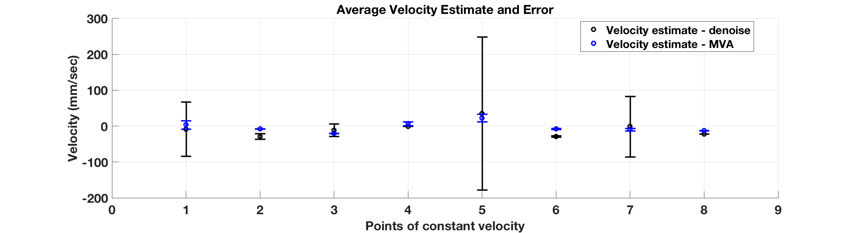
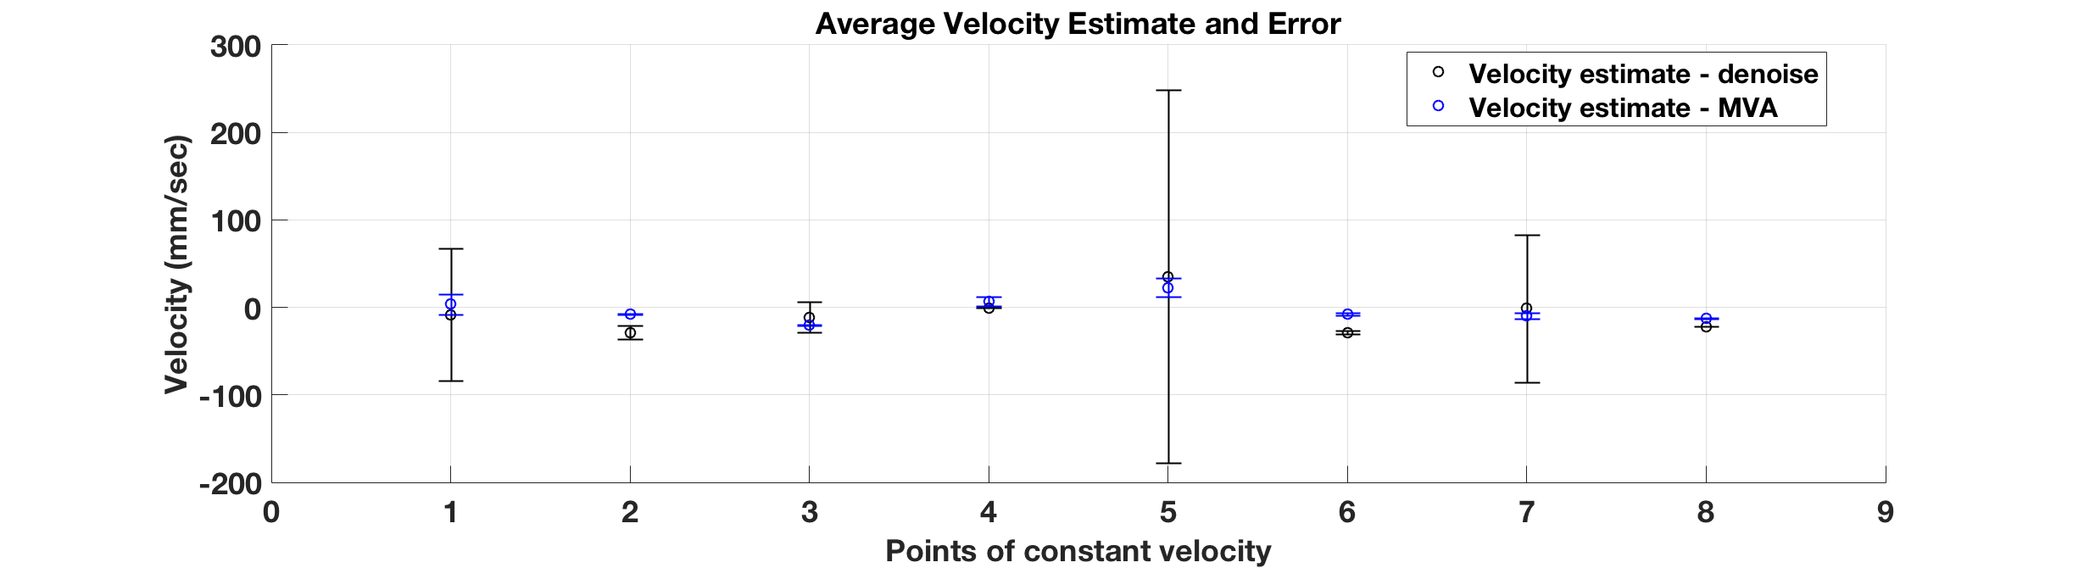
CHECK PLOTS

Slide 18
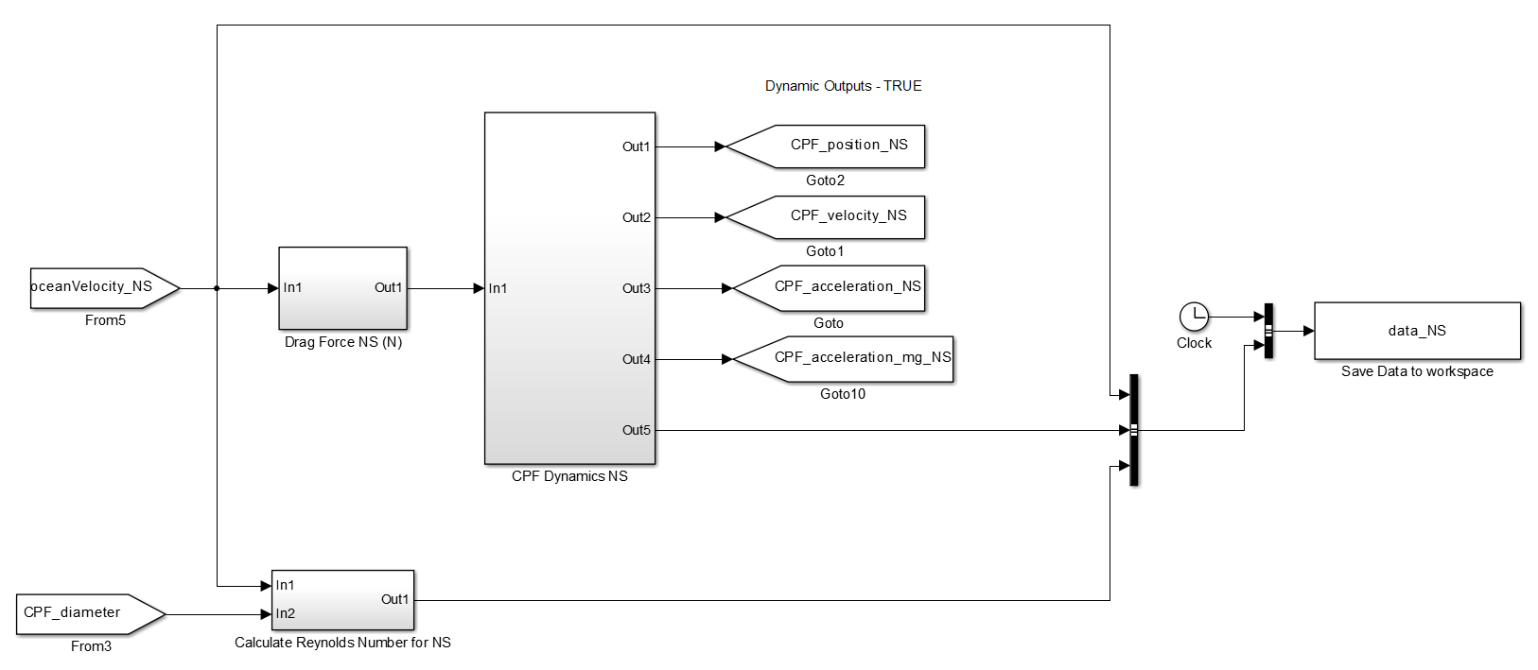
SIMULINK MODEL – 1D
Calculate dynamics
Output acceleration, velocity and positon
Input Current Velocity Profile
Save state variables to workspace
Calculate Drag Force
Calculate Re
Note: this represents one axis, it is repeated three times for N/S, E/W, and +Z.

Slide 19
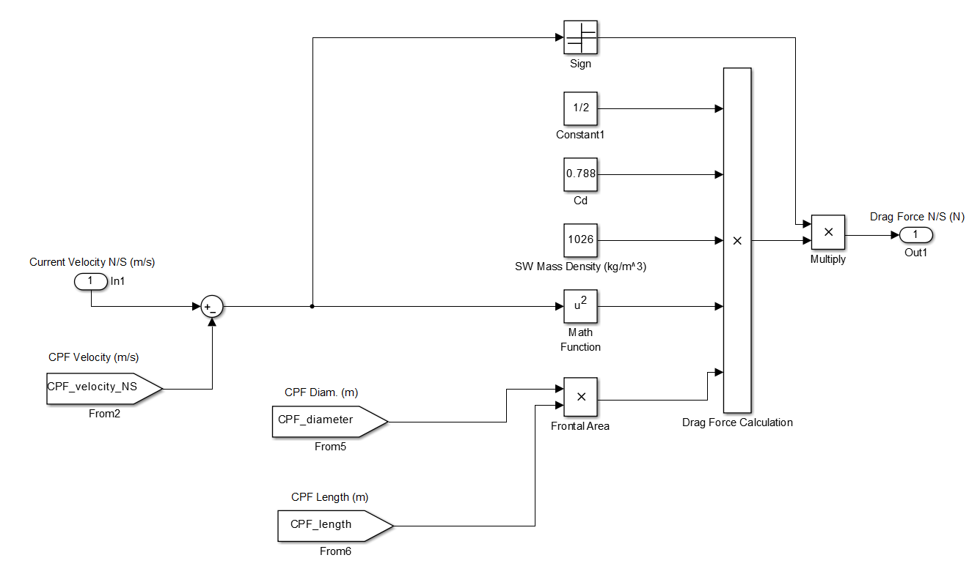
DRAG FORCE BLOCK

Slide 20
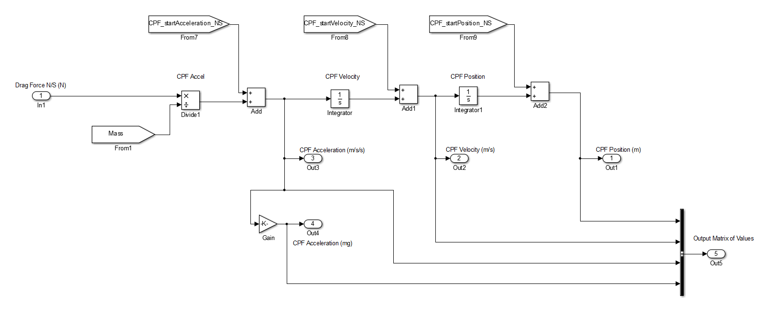
DYNAMICS BLOCK

Slide 21
SIMULATION OUTPUTS
Position [m]
Reynolds Number
CPF Velocity [m/s]
Current Velocity [m/s]
CPF Acceleration [m/s²]
CPF Acceleration [mg]

