Slide 1
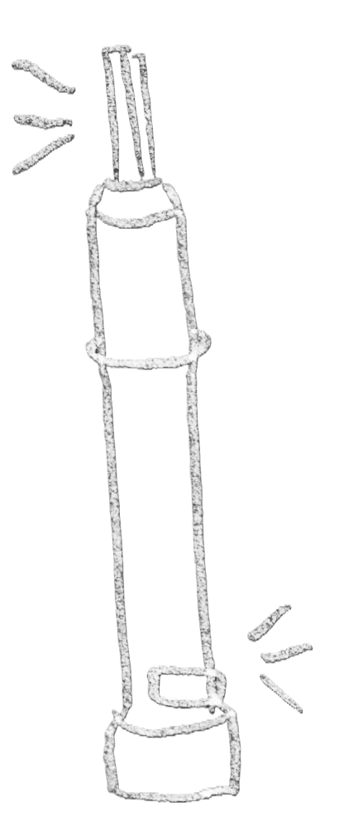

From Prototype to Platform: Making Better Engineering Decisions Through Testing

Slide 2
Timeline
Build a motor testbench to test buoyancy engine motors
Interpret results!
Understand how testing works on the CPF

Slide 3
Timeline
Build a motor testbench to test buoyancy engine motors
Interpret results!
Understand how testing works on the CPF

Slide 4
Timeline
Build a motor testbench to test buoyancy engine motors
Interpret results!
Understand how testing works on the CPF

Slide 5
Timeline
Build a motor testbench to test buoyancy engine motors
Interpret results!
Understand how testing works on the CPF

Slide 6
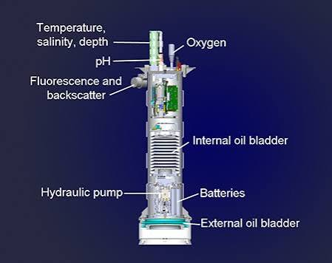
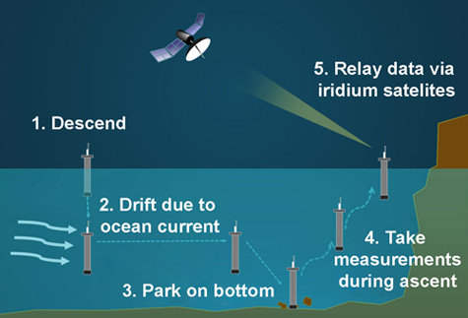
Coastal profiling float – designed to work in shallow waters
CPF Unique Capabilities
Closed Loop buoyancy system that controls platform velocity and depth
3.5-liter (delta)Volume (3-12X other profiling floats)

Slide 7
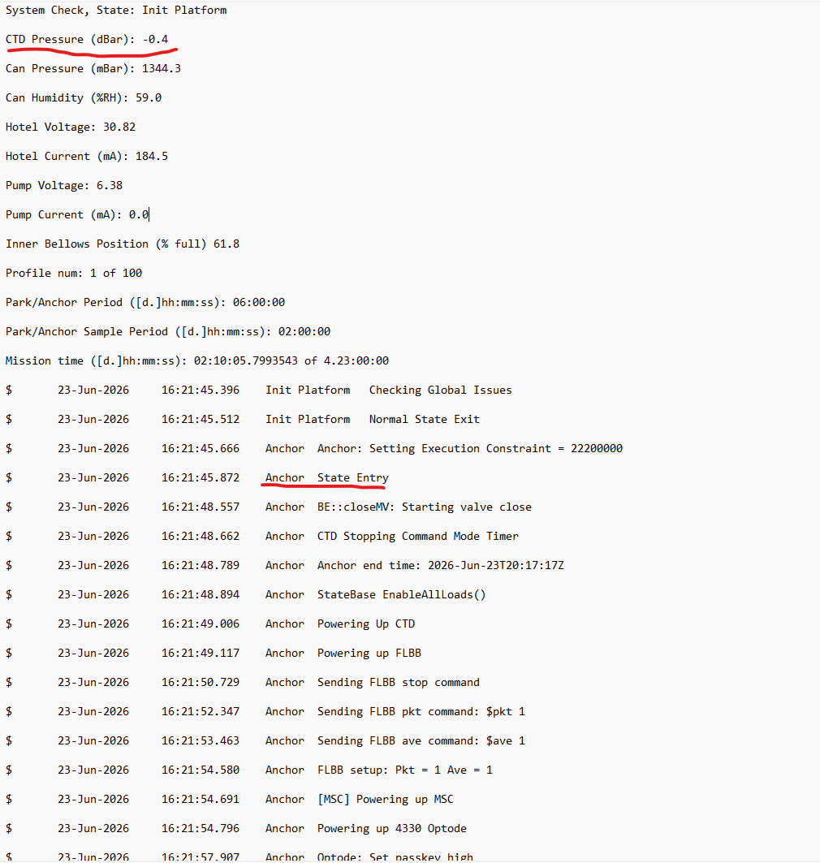
Testing stages for CPF
Test by analysis
Identify risks & mitigation tests
Prototype testing during design
Subsystem testing
System testing
Deployment Readiness Review

Slide 8
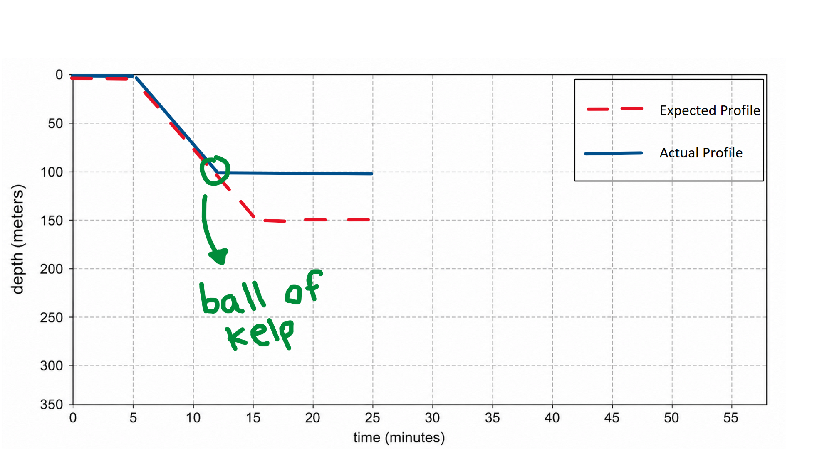
Testing onshore is more effective than at sea
Pressure simulator simulates an at sea profile
Simulate known problems
Do hundreds of profiles for low cost

Slide 9
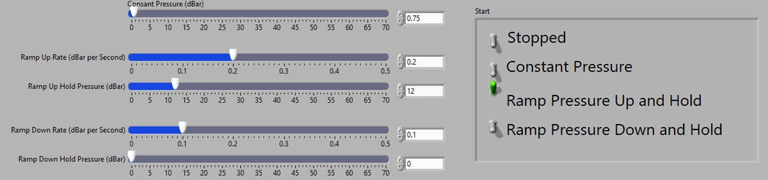
Benchtop Pressure Simulator
Goal: simulate an actual deployment on the bench and inject problems

Slide 10
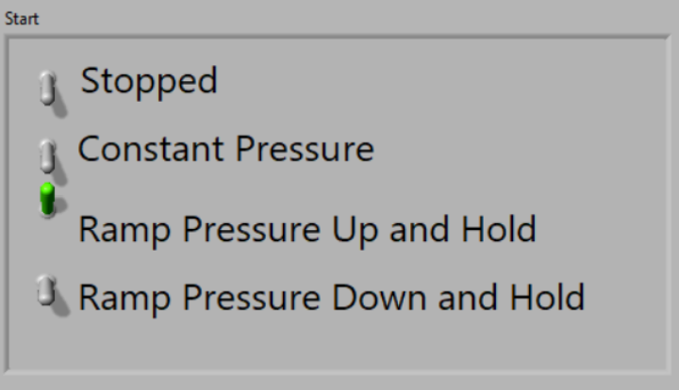
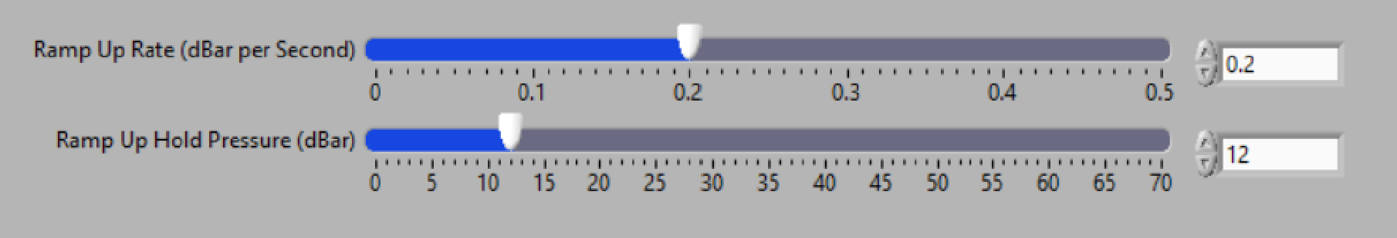
Benchtop Pressure Simulator
Goal: simulate an actual deployment on the bench and inject problems

Slide 11
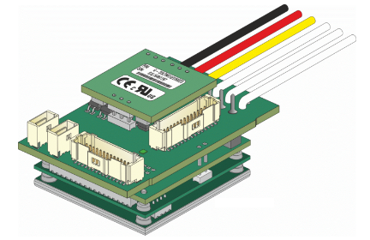
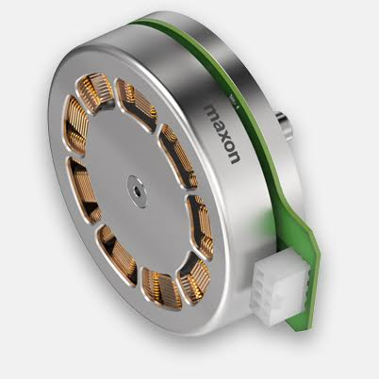
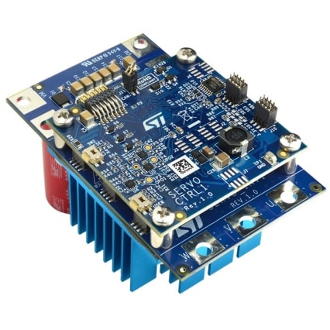
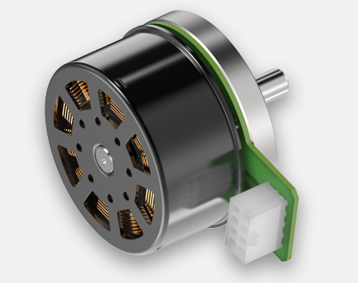
Characterizing Performance - Buoyancy Engine Testbench
Question 1: What motor controller + motor combination is most efficient for powering the buoyancy engine?
ELMO Twitter
MAXON EC90
Motor Controller + Motor Combinations
ELMO Twitter + EC90
ELMO Twitter + EC60
ST Micro + EC60
Future
ST Micro
MAXON EC60

Slide 12
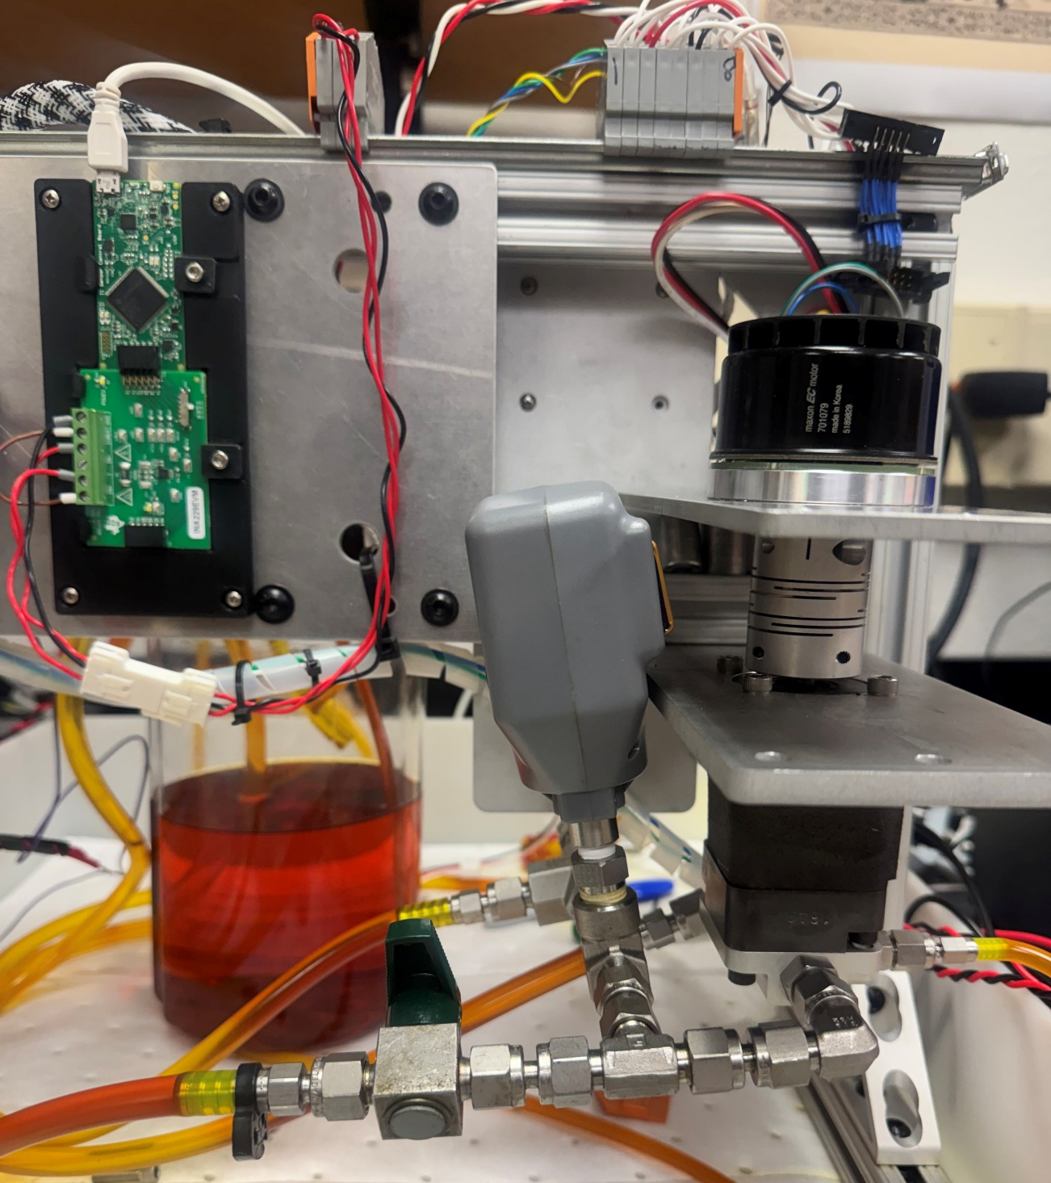
Existing Testbench

Slide 13
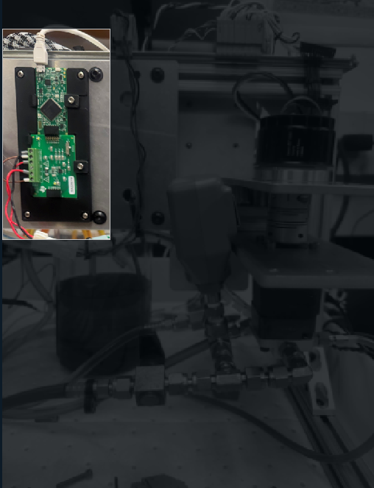
Existing Testbench
INA229 Current Monitor
4kHz Sampling frequency

Slide 14
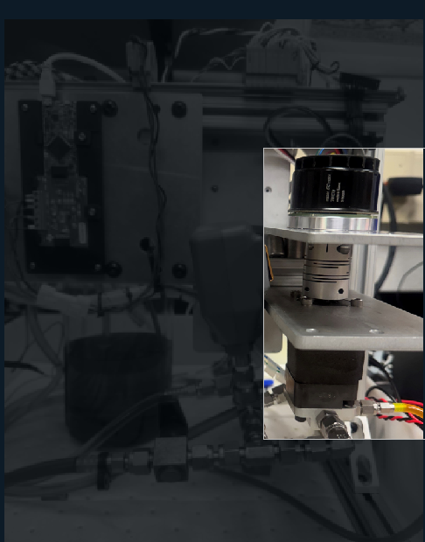
Existing Testbench
Motor (EC60 Pictured)
Pump

Slide 15
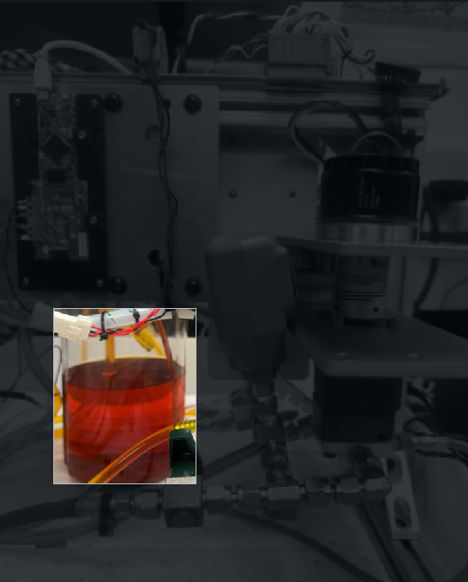
Existing Testbench
Oil Reservoir

Slide 16
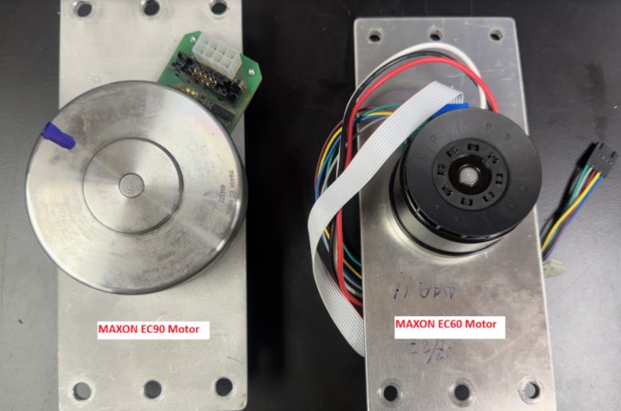
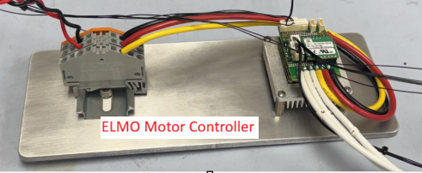
Modifying the testbench
Goal: easy to modify setup
WAGO Blocks
Multiple Motor Plates to accommodate various motors
5-10min to swap a motor
MAXON EC90
MAXON EC60

Slide 17
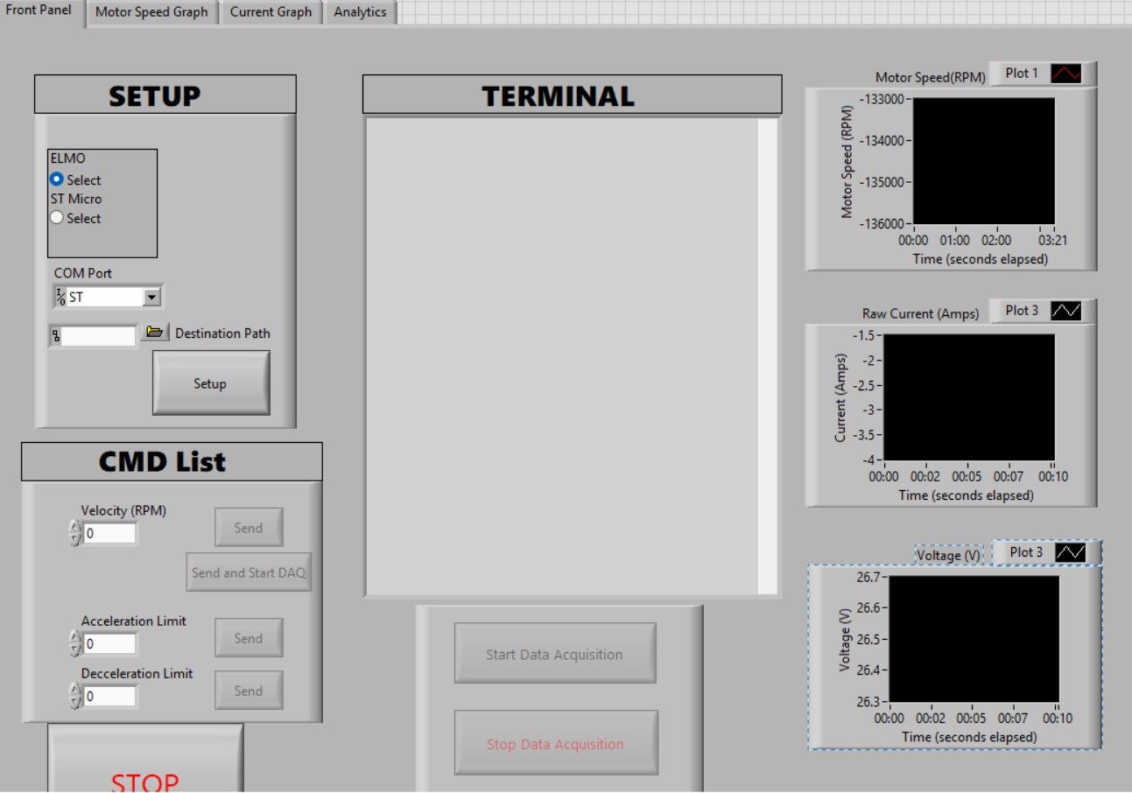
Designing a LabVIEW program
Easy to add other motor controllers
Simple commands and workflow
All in one (communication, logging, plotting, analysis)

Slide 18
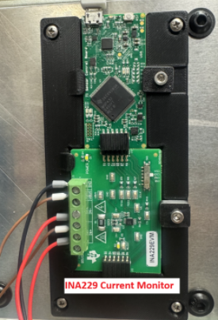
Method for testing continuous motor current draw
Use INA229 current monitoring module to measure current
4 kHz Sampling frequency, run for 5 seconds (20,000 samples)
Run test at 10 different load pressures (ranging from 0 to 420 dBar)
Gather average current over 20,000 samples for each load pressure
Repeat test for different motor + motor controller configs

Slide 19
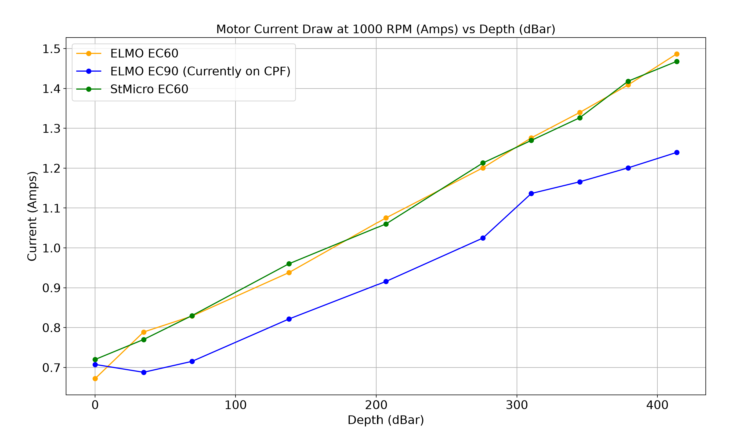
Results – Continuous Motion: Current Draw

Slide 20
Results – Continuous Motion: Current Draw
~15%

Slide 21
Putting the results into context
Given the buoyancy engine accounts for 60% of the float’s battery consumption over its lifetime…
Combination | #of profiles
ELMO EC90* | 200
ELMO EC60 | 182
ST Micro EC60 | 182
*Current CPF configuration

Slide 22
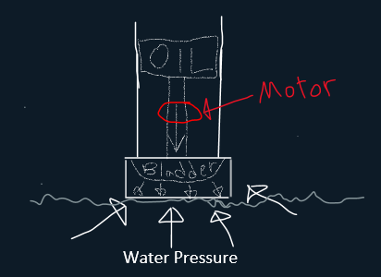
Characterizing Performance and mitigating risk: de-anchoring at 350 dBar
Risk: Can we even provide the required power to start up at depth?
Performance: between the Maxon EC60 and the Maxon EC90, which motor uses the least energy on startup (de-anchoring from seafloor)?
Motors are not 100% efficient

Slide 23
Method for testing energy required for startup at 350dbar
ELMO + Maxon EC90
0.1 seconds to accelerate to 1000 RPM
1 second to accelerate to 1000 RPM

Slide 24
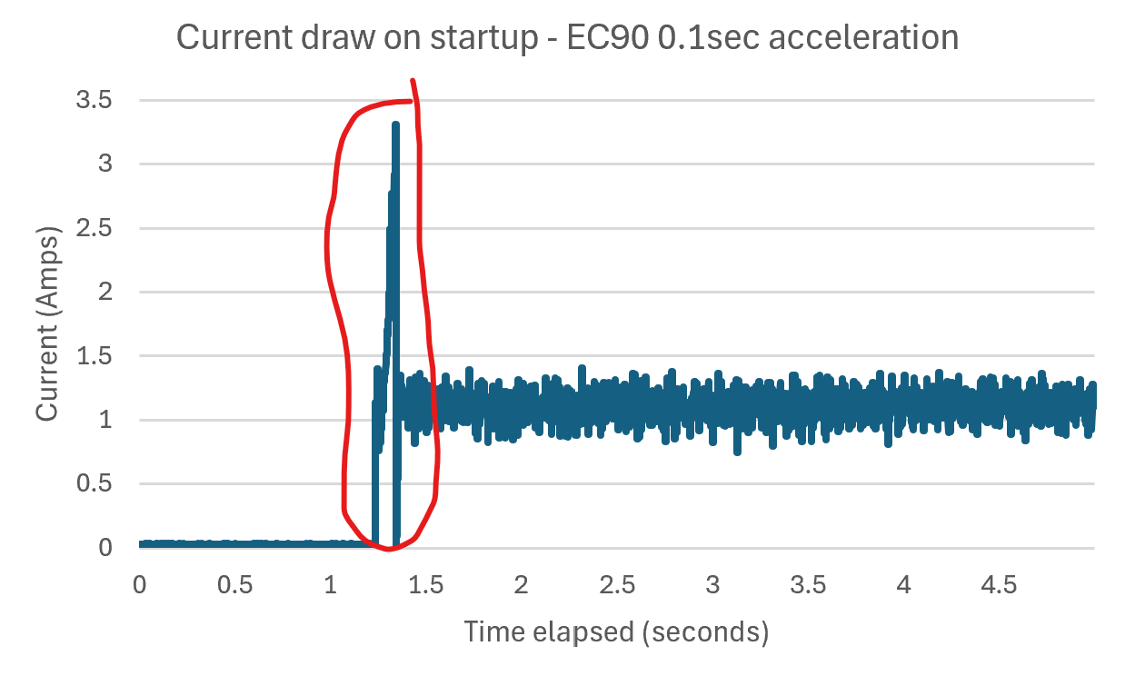
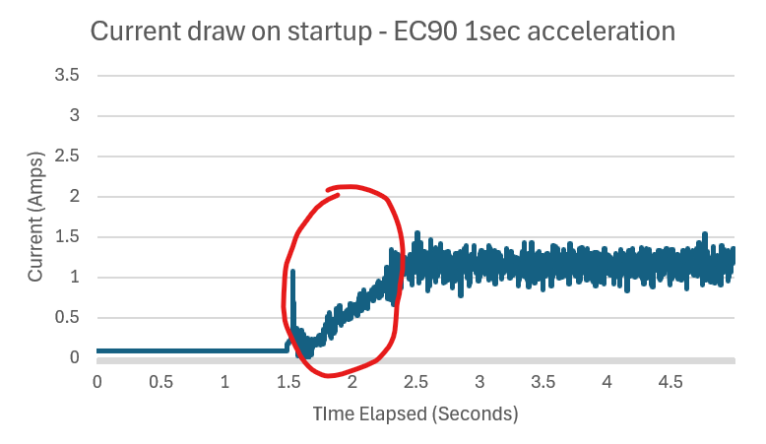
Results: Peak is within limits (<10amps)
Inst. Cur. ~3.4A
Inst. Curr. ~1.3A

Slide 25
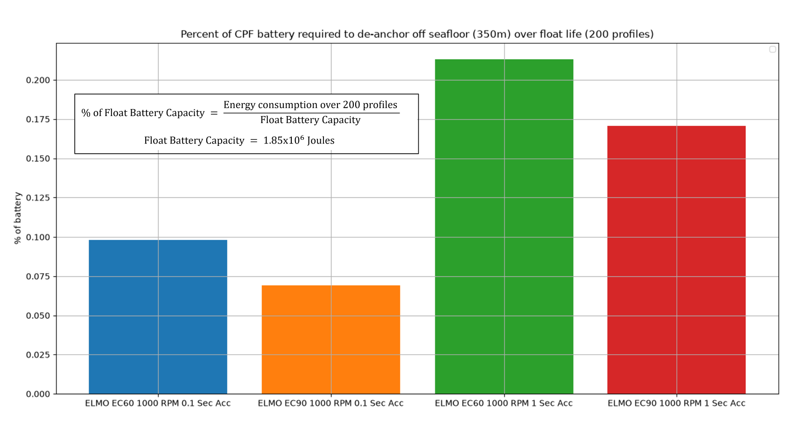
Results – Performance and Significance
3x performance difference
Insignificant relative to total energy available

Slide 26
Conclusion – What we learned

Slide 27
Questions?

Slide 28
CUT SLIDES

Slide 29
Building testbench control software
What are the goals?
  Supportable by other users
  Able to control motor …
What are the options?
Python
LabVIEW
Terminal
C/C++
What we decided
Labview (nice GUI driven real time control system very quickly)
  Easily learned by non-programmers
Easily modifiable

Slide 30
Refining the LabVIEW Program
Message 1
Message 2
Message 3

Slide 31
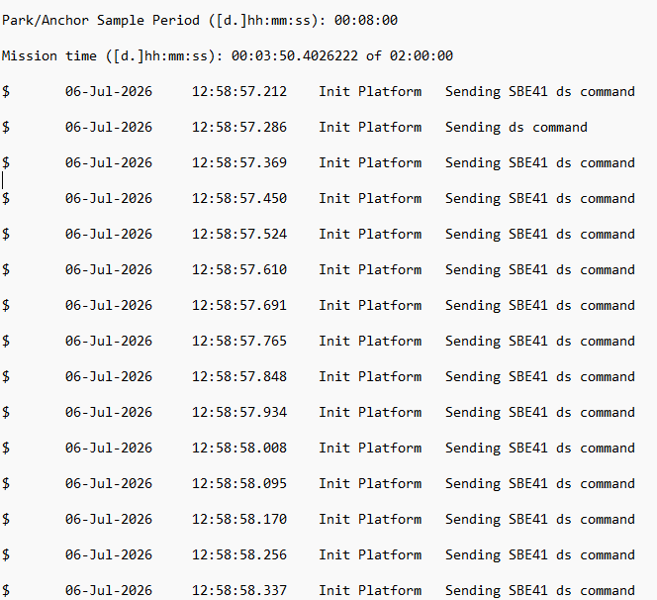
Subsystem test – CTD
CTD stopped communicating with CPF controller
Built test cables and test fixture to verify CTD was communicating properly
Plugged CTD back up to the controller and it worked fine

Slide 32
Procedure for testing
Message 1
Message 2
Message 3

Slide 33
Questions?
Message 1
Message 2
Message 3

Slide 34
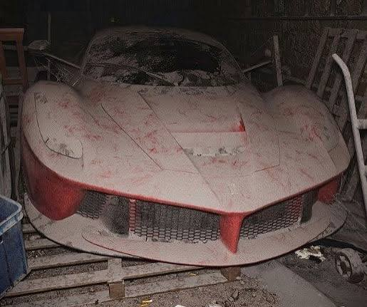
State of the CPF 10 weeks ago
Done dozens of missions
gone through a set of engineering improvements to reduce power consumption.
The last test showed a high humidity alarm.
Discovered broken O-ring

