Slide 1

From Prototype to Platform: Making Better Engineering Decisions Through Testing

Slide 2
Overview
Understand how testing works on the CPF
Use understanding to build a motor testbench software and answer questions about potential motors for the buoyancy engine
Results!

Slide 3
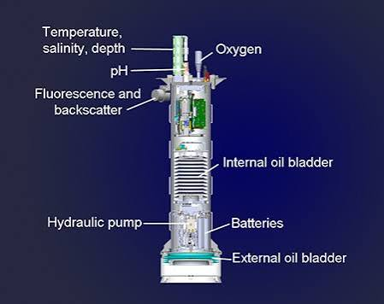
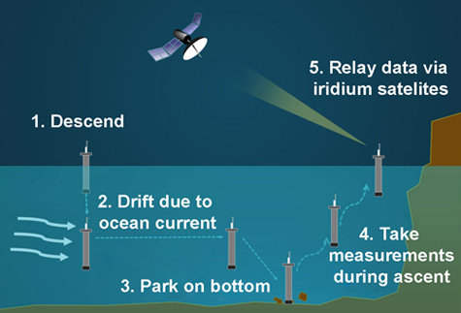
Introduction to the CPF
Coastal profiling float – designed to work in shallow waters up to 350 meters deep
Closed Loop buoyancy system that controls platform velocity and depth

Slide 4
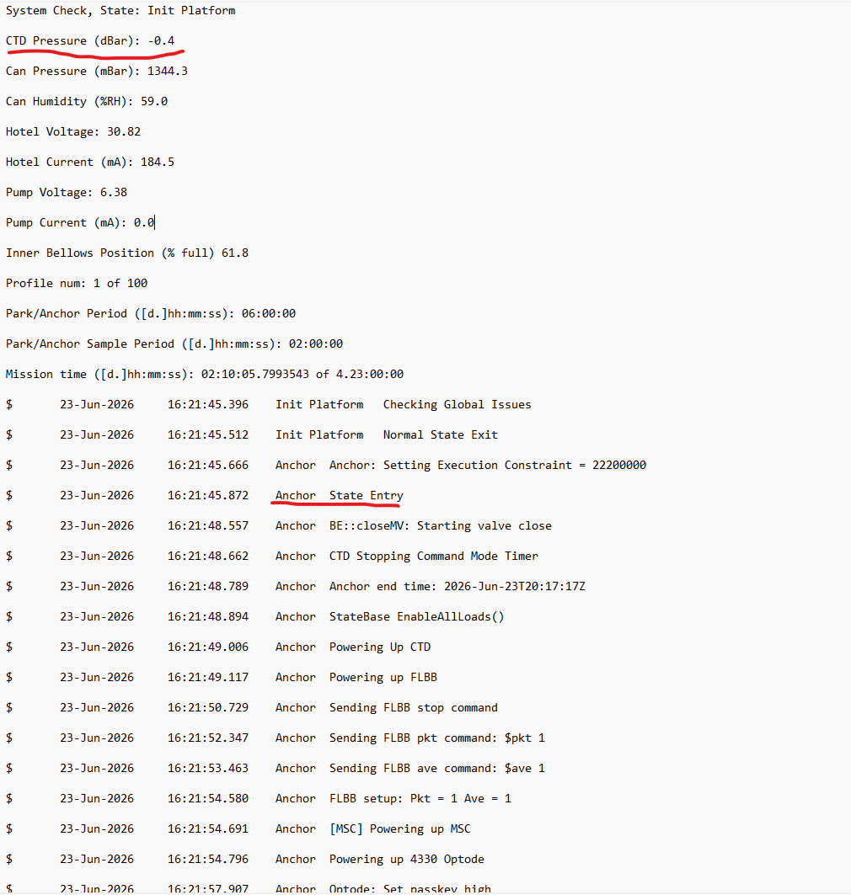
Testing Done on the CPF
Benchtop testing

Slide 5
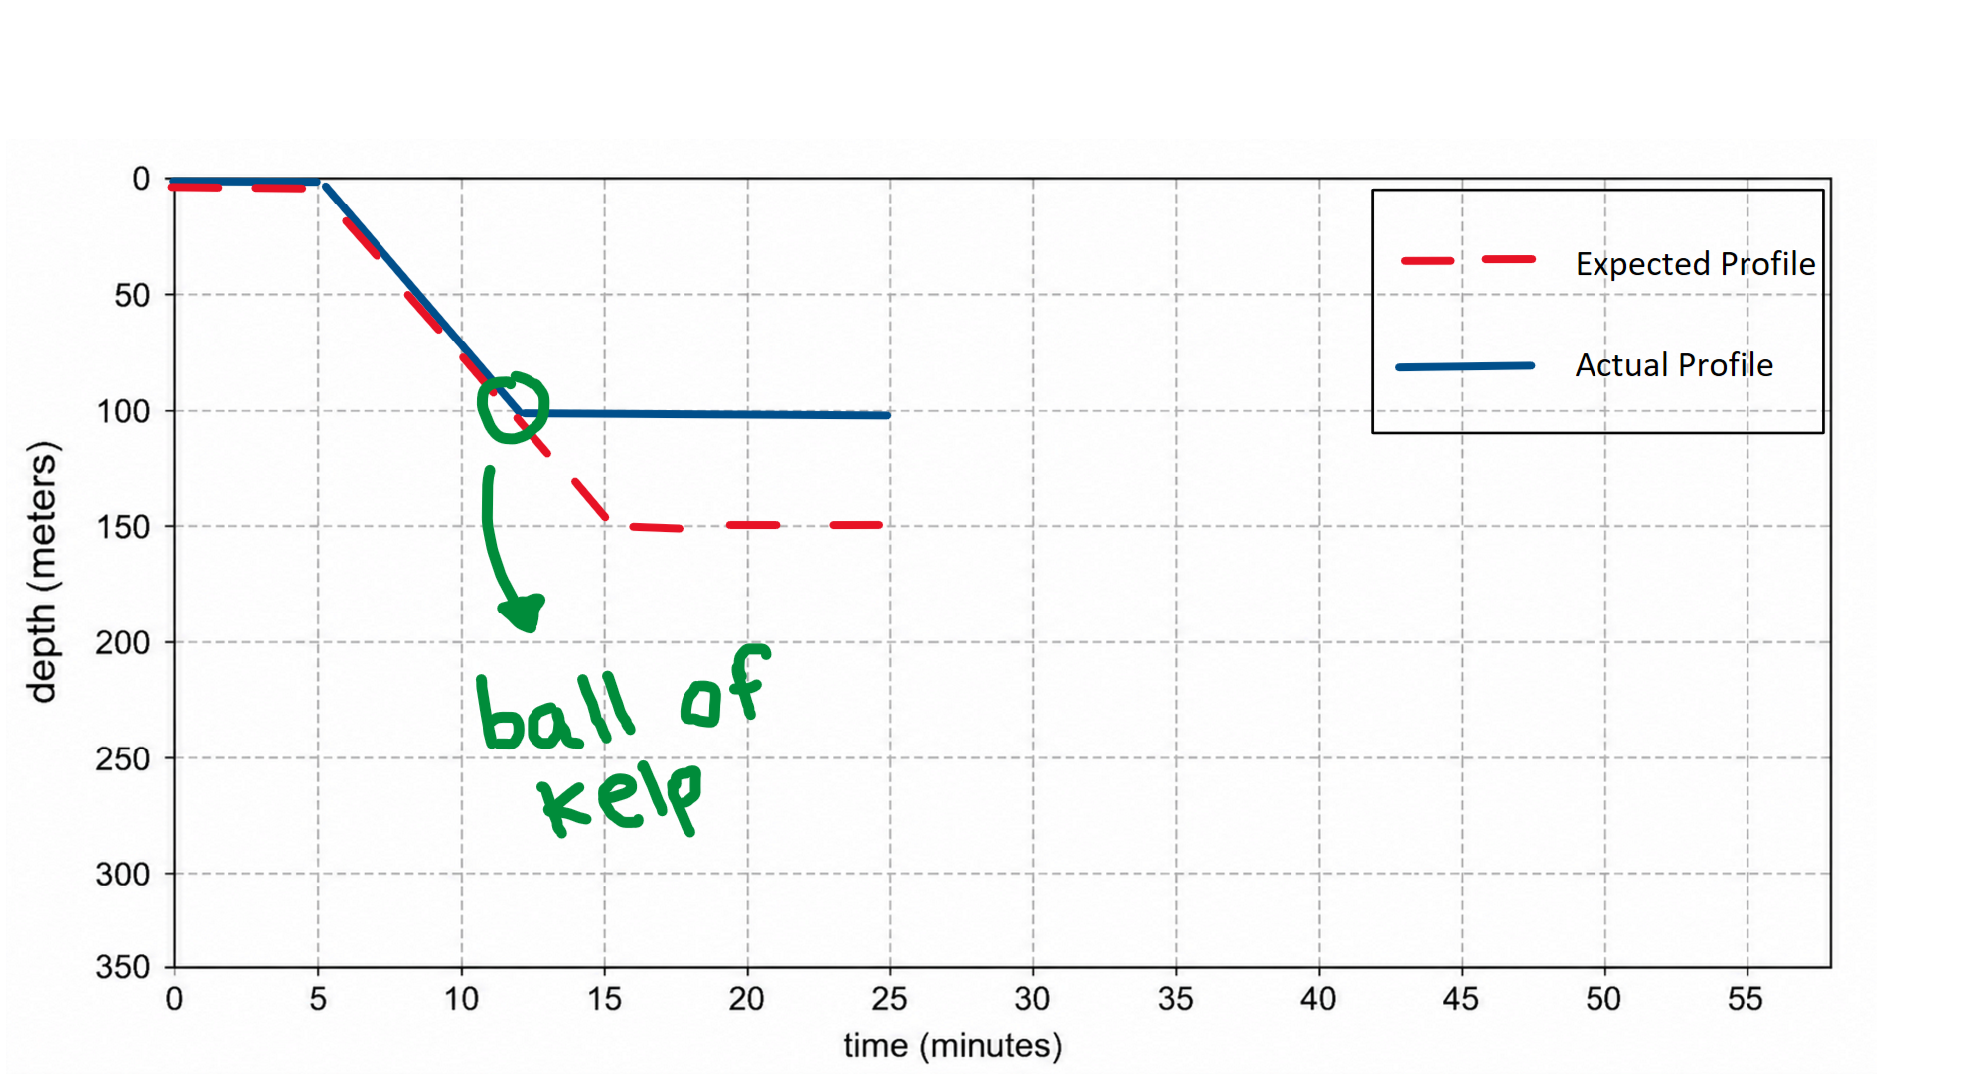
Benchtop Pressure Simulator
Goal: simulate an actual deployment on the bench and inject problems
Used a pressure simulator to simulate scenarios
Uncovered a CTD communication problem

Slide 6
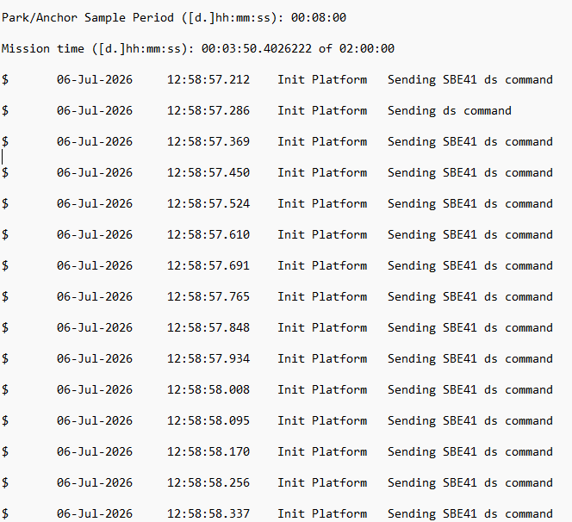
Subsystem test – CTD
CTD stopped communicating with CPF controller
Built test cables and test fixture to verify CTD was communicating properly
Plugged CTD back up to the controller and it worked fine

Slide 7
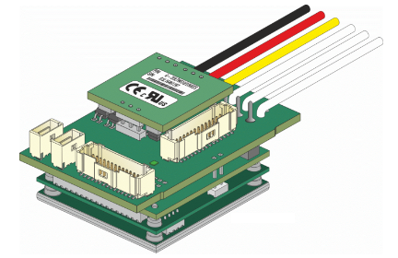
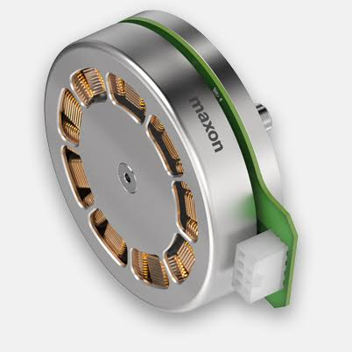
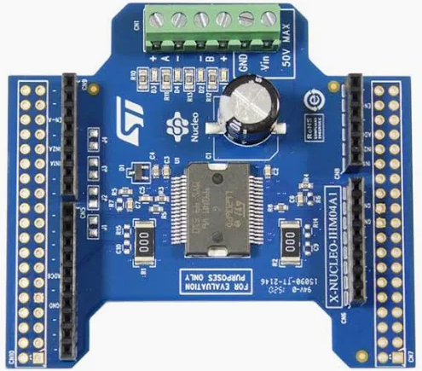
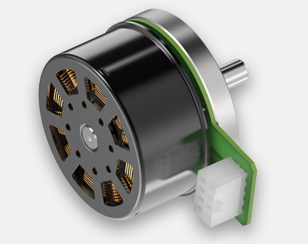
Characterizing Performance - Buoyancy Engine Testbench
Question 1: What motor controller + motor combination is most efficient for powering the buoyancy engine?
ELMO Twitter
MAXON EC90
Motor Controller + Motor Combinations
ELMO Twitter + EC90
ELMO Twitter + EC60
ST Micro + EC60
MAXON EC60

Slide 8
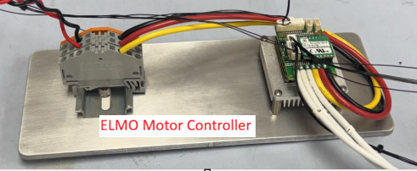
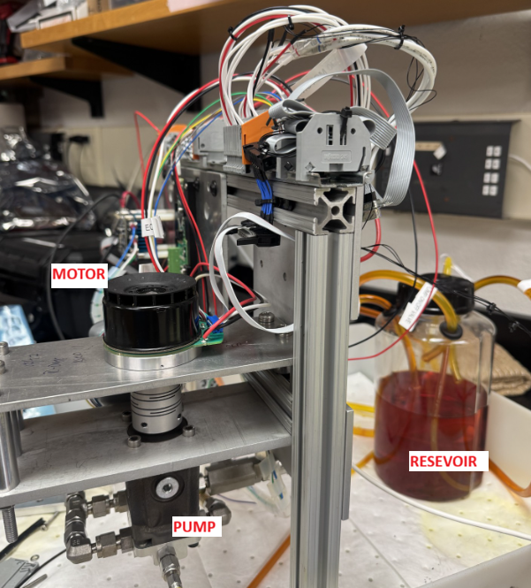
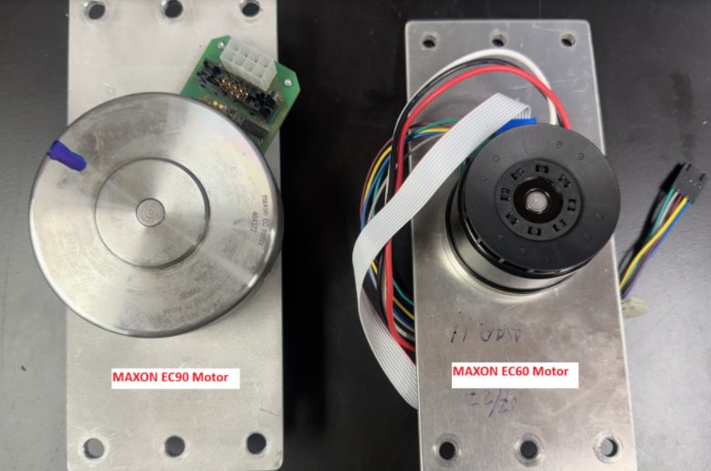
Building a testbench
Easy to modify setup
WAGO Blocks
Multiple Motor Plates
Spacers to accommodate various shaft couplers
Results (ex time to swap motors)

Slide 9
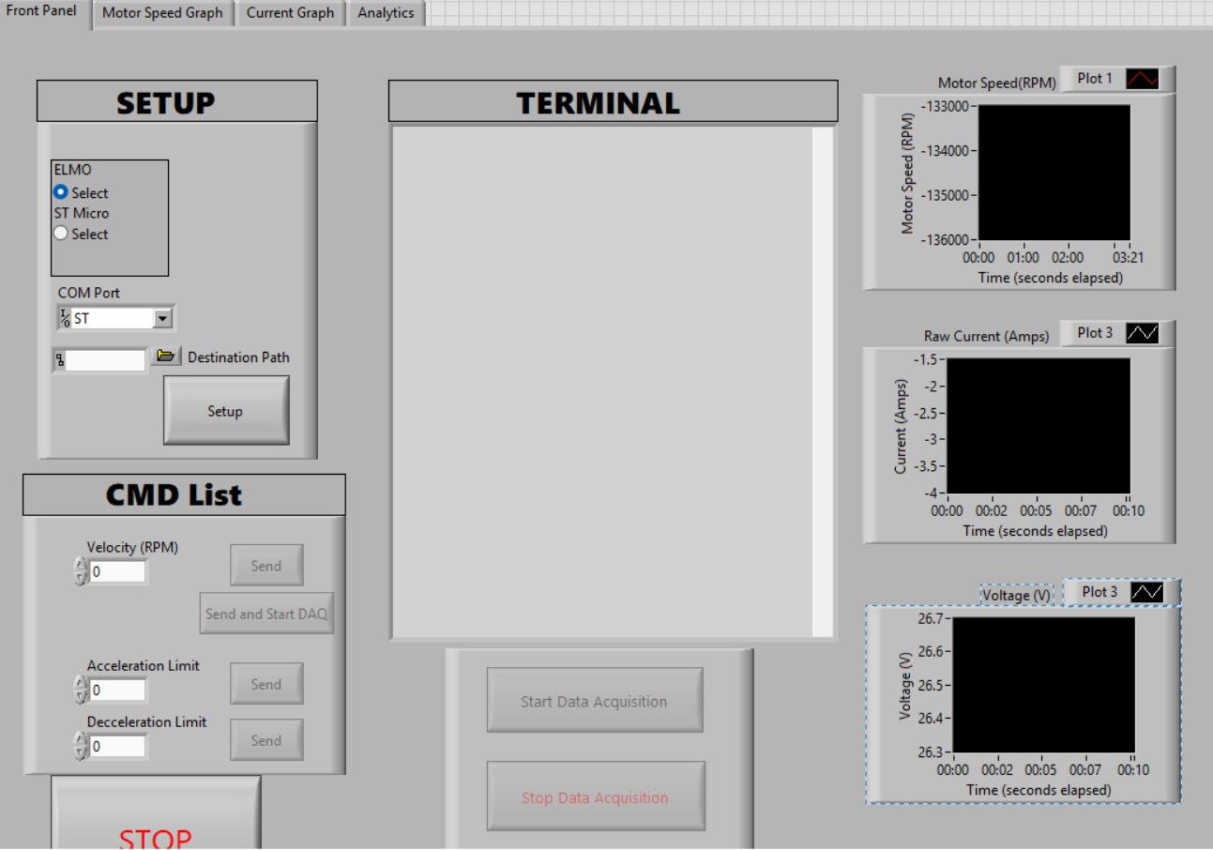
Designing a LabVIEW program
Easy to add other motor controllers
Simple commands and workflow
All in one (communication, logging, plotting, analysis)

Slide 10
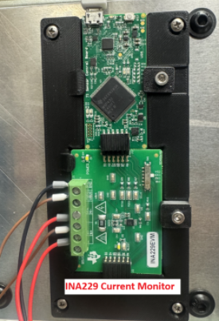
Method for testing continuous motor current draw
Use INA229 current monitoring module to measure current
4 kHz Sampling frequency, run for 5 seconds (20,000 samples)
Run test at 10 different load pressures (ranging from 0 to 420 dBar)
Gather average current over 20,000 samples for each load pressure
Repeat test for different motor + motor controller configs

Slide 11
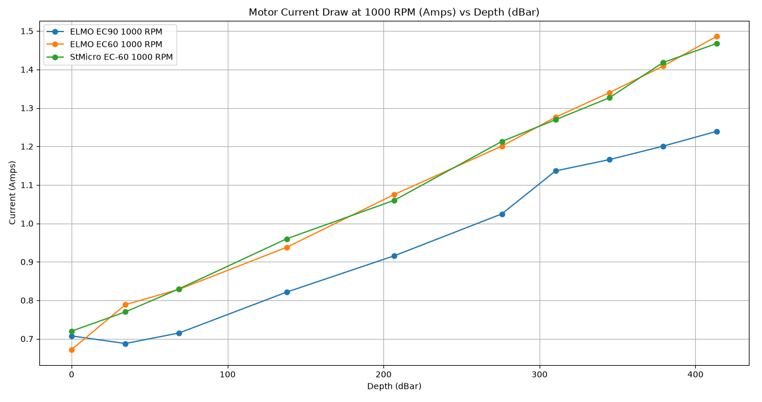
Results – Continuous Motion: Current Draw

Slide 12
Characterizing Performance and mitigatimg risk
Performance: between the Maxon EC60 and the Maxon EC90, which motor uses the least energy on startup (de-anchoring from seafloor)?
Risk: Can we even provide the required power to start up at depth?

Slide 13
Method for testing energy required for startup at 350dbar
ELMO Twitter
ELMO + Maxon EC60
ELMO + Maxon EC90
ELMO + Maxon EC90
Accelerate to 1000RPM over 0.1 seconds
Accelerate to 1000RPM over 1 second
Accelerate to 1000RPM over 0.1 seconds
Accelerate to 1000RPM over 1 second

Slide 14
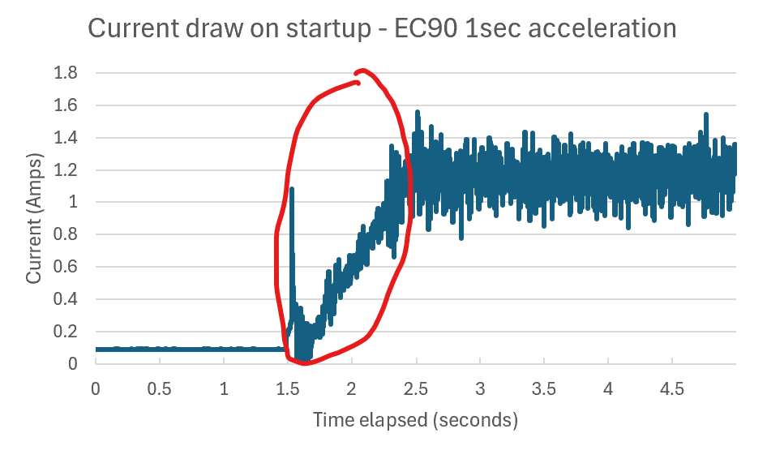
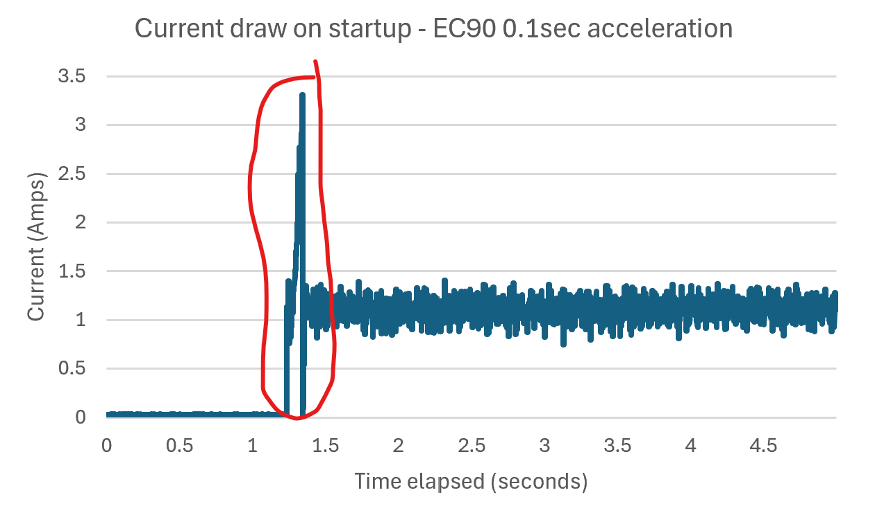
Results – Peak is within limits

Slide 15
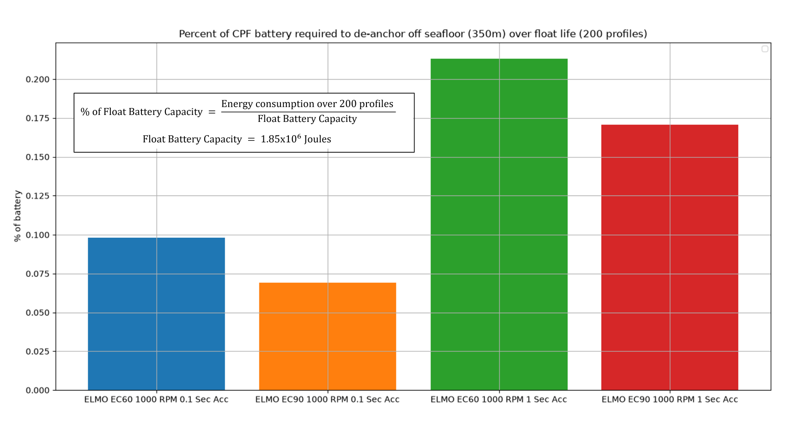
Results – Performance and Significance
3x performance difference
Insignificant relative to total energy available

Slide 16
Conclusion – What we learned

Slide 17
Questions?

Slide 18
CUT SLIDES

Slide 19
Building testbench control software
What are the goals?
  Supportable by other users
  Able to control motor …
What are the options?
Python
LabVIEW
Terminal
C/C++
What we decided
Labview (nice GUI driven real time control system very quickly)
  Easily learned by non-programmers
Easily modifiable

Slide 20
Refining the LabVIEW Program
Message 1
Message 2
Message 3

Slide 21
Procedure for testing
Message 1
Message 2
Message 3

Slide 22
Questions?
Message 1
Message 2
Message 3

Slide 23

State of the CPF 10 weeks ago
Done dozens of missions
gone through a set of engineering improvements to reduce power consumption.
The last test showed a high humidity alarm.
Discovered broken O-ring

