Slide 1
901206 Coastal Profiling Float Transition to Science Applications
Understanding coastal ocean health is severely limited by the lack of data
Solutions must economically scale to large coastal areas
  Example: the west coast salmon fishery spans Alaska to California
Profiling floats equipped with a suite of biogeochemical sensors may provide a cost effective solution for researchers and policy makers
Notes:
What’s the fundamental problem, question, or issue you are addressing?

Slide 2
901206 Coastal Profiling Float Transition to Science Applications
The CPF can serve as the data acquisition platform for a range of societally relevant issues including
  The effects of a warming climate
  Increased use of nitrogen fertilizers
  Ocean acidification
  Loss of sea ice
  Decreasing oxygen concentrations
Example: routine use of a CPF array could provide data needed to inform fishery managers making policy decisions.
Notes:
Why is it important/why should anyone care?

Slide 3
901206 Coastal Profiling Float Transition to Science Applications
MBARI has developed a coastal profiling float (CPF) designed to work in the coastal zones and upper 500 meters of the world’s oceans
The CPF leverages 20+ years of work by MBARI’s chemical sensor lab in developing sensors
  Including the associated infrastructure required to make the data useful to the research community
Notes:
What are we doing about it/what’s MBARI’s unique contribution?

Slide 4
901206 Coastal Profiling Float Transition to Science Applications
The primary goal for next year is to deploy our fleet of 3 CPFs in support of a range of science missions
The first science mission is aimed at understanding the development of high chlorophyll levels in the Monterey Bay
Colleagues, inside and outside of MBARI, have expressed interest in using our fleet of CPFs in a variety of missions and locations including the Arctic Ocean
Notes:
What are your project plans for next year (2022)?

Slide 5
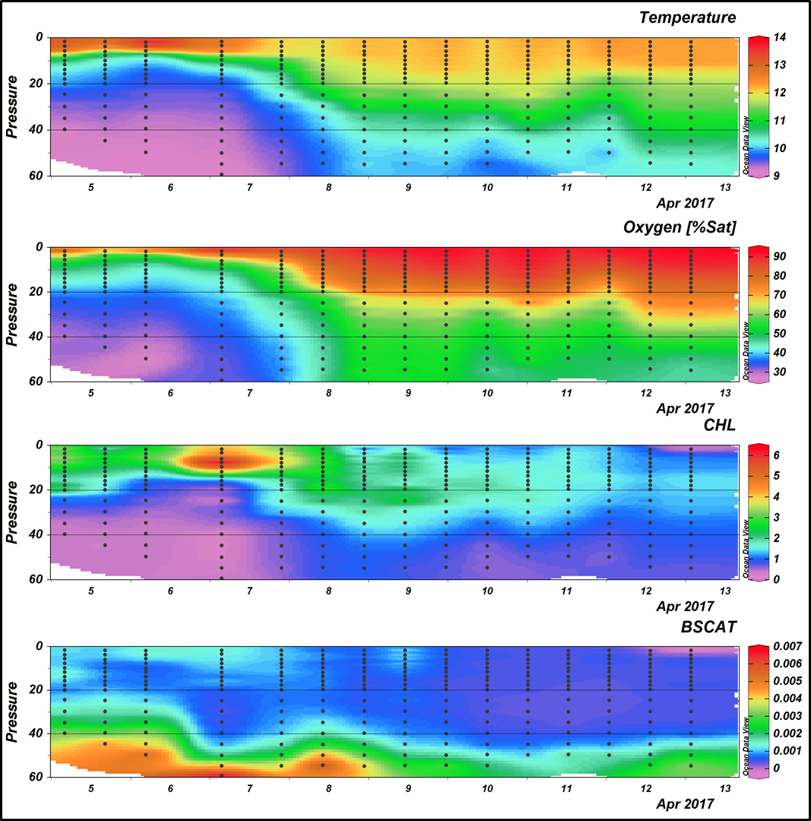
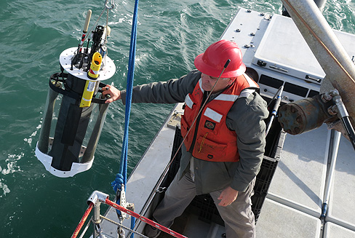
901206 Coastal Profiling Float Transition to Science Applications

