Slide 1

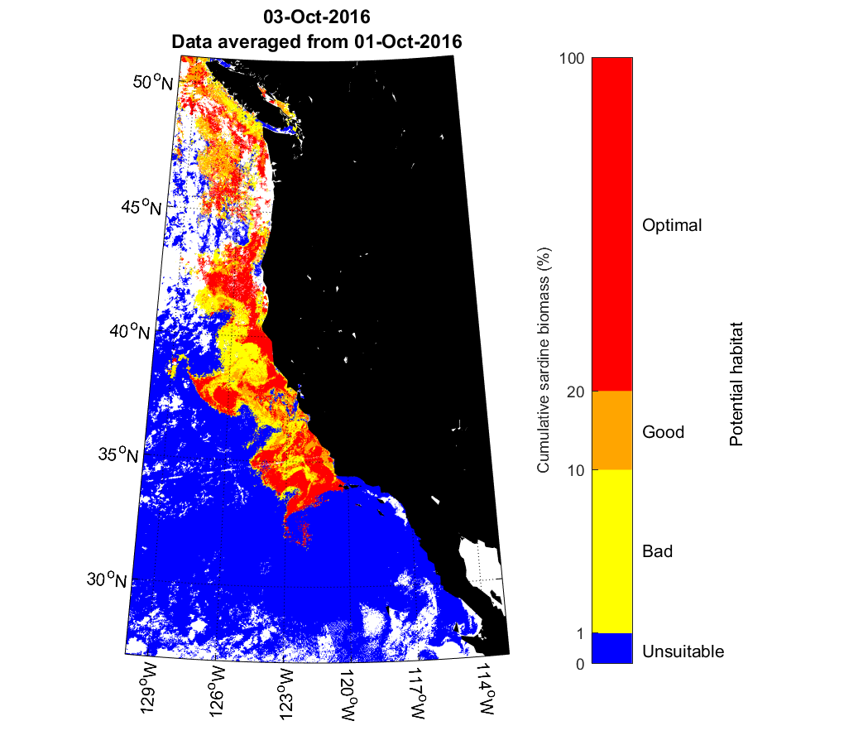
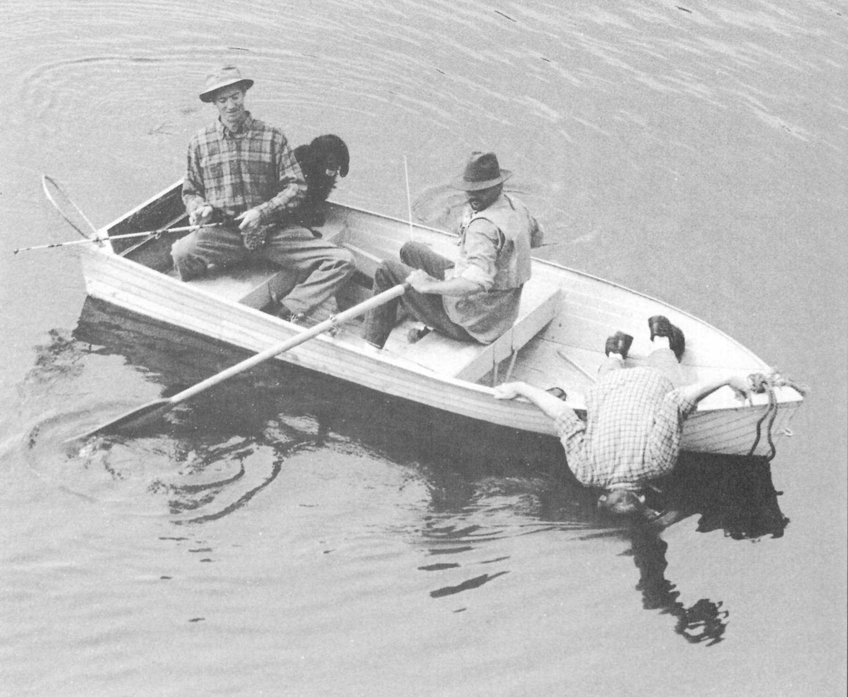
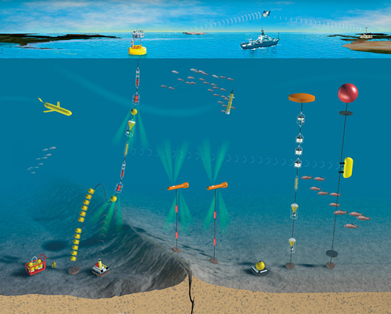
ALPS for managing Living Marine Resources
ALPS-II meeting
Scripps Seaside Forum
La Jolla, CA
February 23, 2017
SWFSC
Toby Garfield
SWFSC
La Jolla, CA

Slide 2
It’s not “if”
It’s “when?”

Slide 3
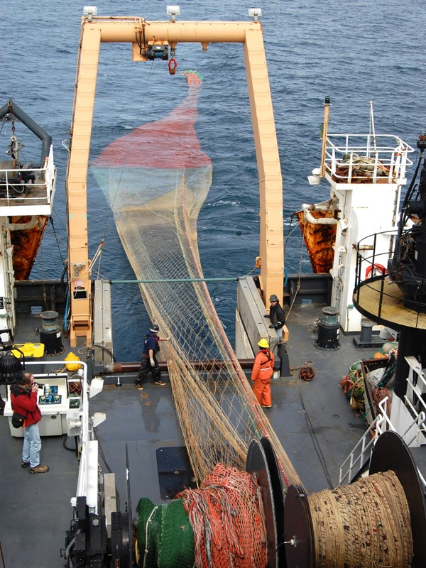
Managing Living Marine Resources
Requires all of the environmental data as presented over the last two days
Plus assessments of the species of interest
    available technologies labor intensive
    and require significant ship operations
Need to transition from grids to adaptive sampling monitoring
  As many management hurtles as scientific and engineering
Notes:
In modern ocean adaptive sampling, a goal characterizes the ideal future sampling among the possible choices, in an adaptive accord with the constraints and available forecasts that have assimilated all of the past data. This goal can be achieved either subjectively, with forecast information being combined with the a priori experience to intuitively choose the future sampling, or quantitatively, where forecast capabilities serve as input to a mathematical sampling criterion whose real-time, continued, optimization predicts the adapted sampling. The parameters of the adaptive sampling procedure are therefore the available forecasts, new data acquired during the forecast, the constraints and the goal, i.e. the properties to be optimized and the metrics used to measure these properties.

Slide 4
Some LMR areas needing increased and novel monitoring.
Scales from Tsunami to seasonal to ENSO to PDO to climate monitoring
Remote monitoring of primary and secondary productivity
Sustained Arctic and Antarctic observations
Monitoring ocean hypoxia and acidification
Better assessments of fishery stocks
Insights into the reproductive status of endangered orcas and other marine mammals
Reducing the bycatch of protected and rebuilding species
Assessing the health consequences of whale entanglement in fixed fishing gear
Reducing LMR interactions with shipping
Better monitoring of anthropogenic impacts on marine species

Slide 5
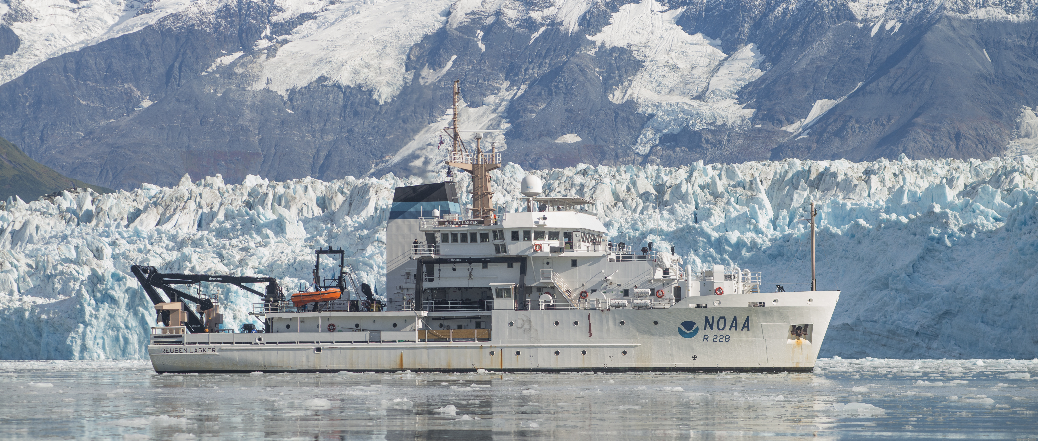
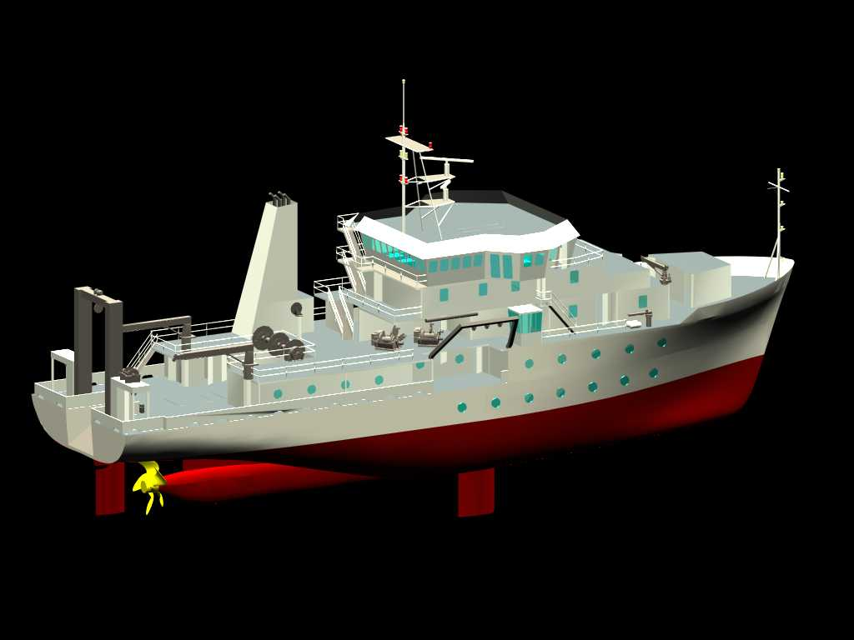
NOAA Ship Reuben Lasker
Commissioned in 2014
Mission
Acoustic and net surveys
Marine mammal and seabird surveys
Oceanographic and meteorological sampling
Habitat mapping
Sampling technology development
      Capabilities
Fish, Chemistry and Dry Laboratories
Side Sampling Station
Acoustic-Computer Laboratory
Controlled Environment Room
Scientist Ready Room
Labs interconnected and provided w/ stable power & UPS
Propulsion and auxiliary equipment tested to stringent vibration criteria
Acoustic sensors
Down-looking multi-frequency split-beam echosounders (EK60)
Multi-beam swath echosounder (ME70)
Omni-directional sonar (SX90)
Multi-beam imaging sonar (MS70)
ADCP current profiler
Additional hydrophones and transceivers for passive sonar, self-noise monitoring, acoustic releases, ROV and AUV tracking, net mensuration
Bow Configured to Reduce Bubble Sweepdown
Highly Skewed Quiet Propeller

Slide 6
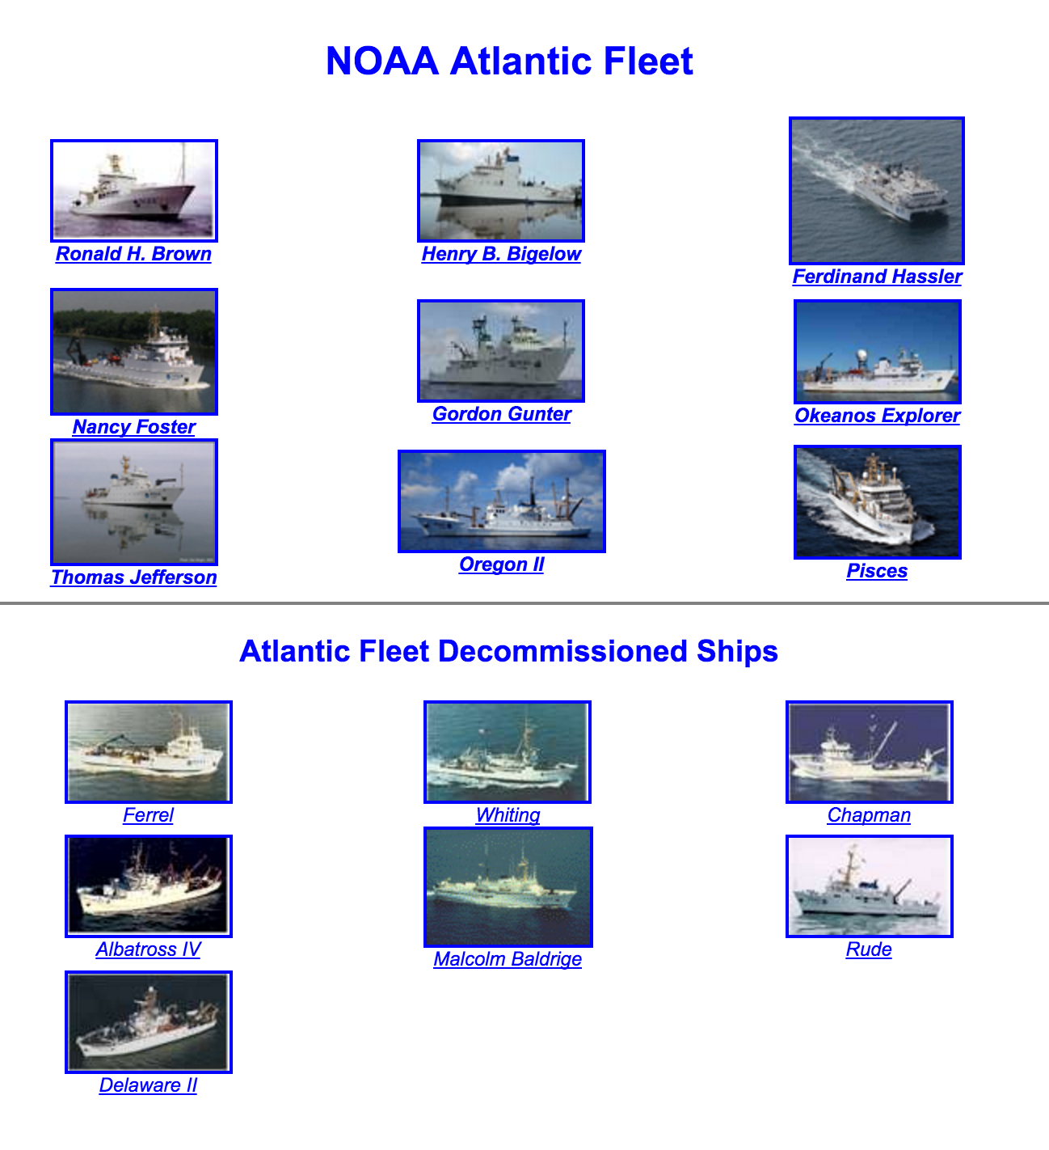
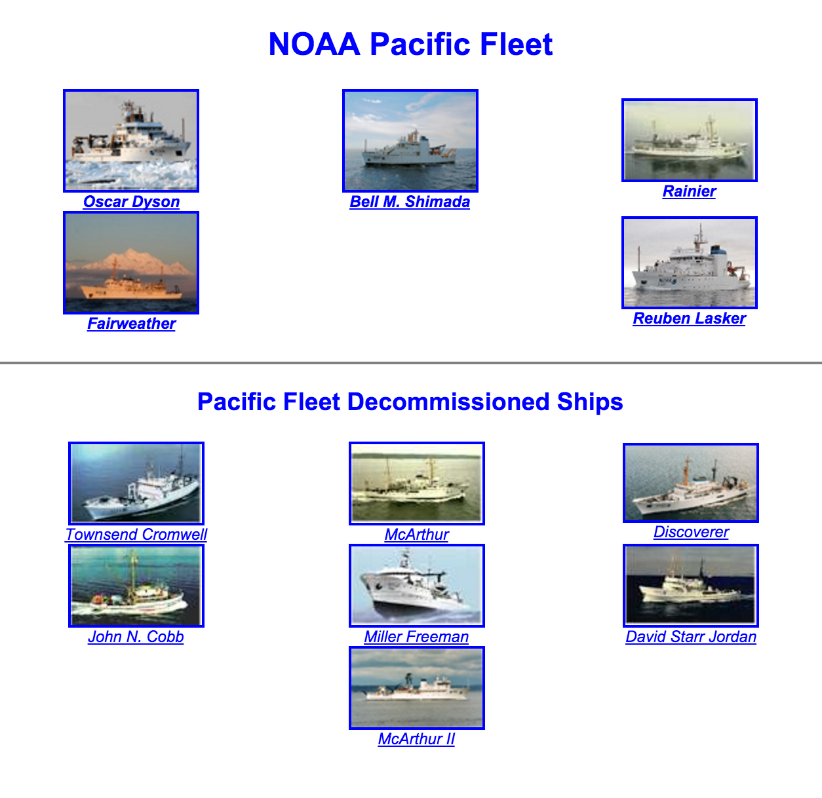
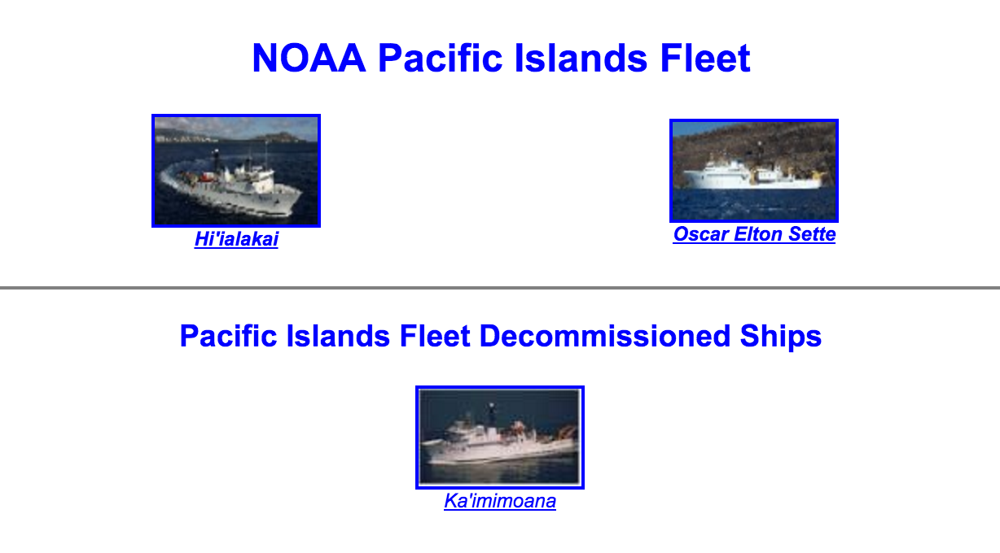
Fleet “snapshot”
16 active ships
15 decommissioned
First issue: the fleet won’t be getting bigger in the near future

Slide 7
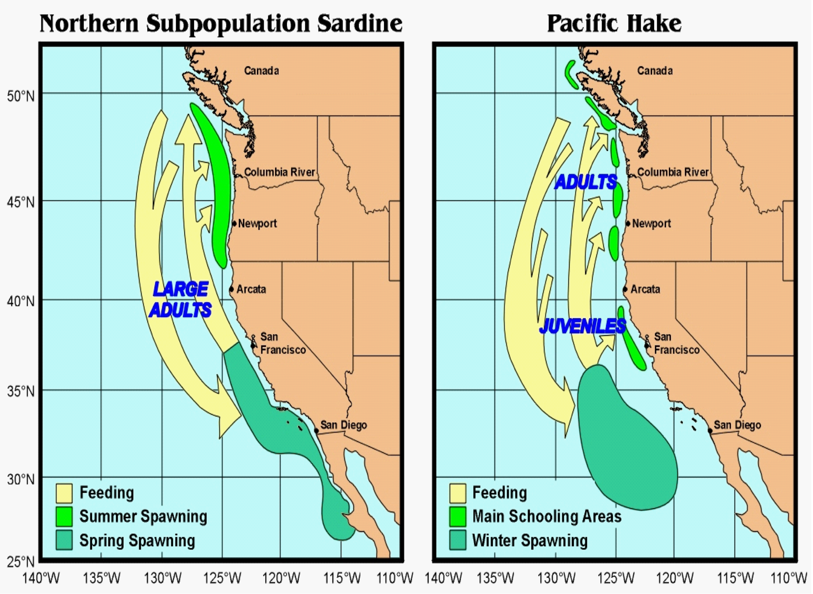
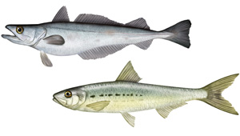
The second issue: accurate assessment of migrating stocks: ship sampling has to presume a spatially-static stock

Slide 8
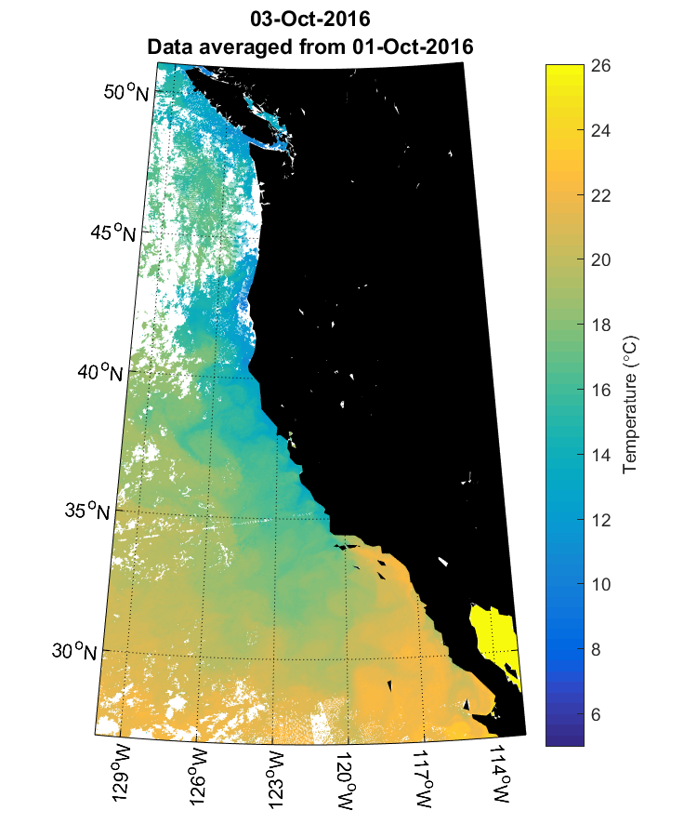

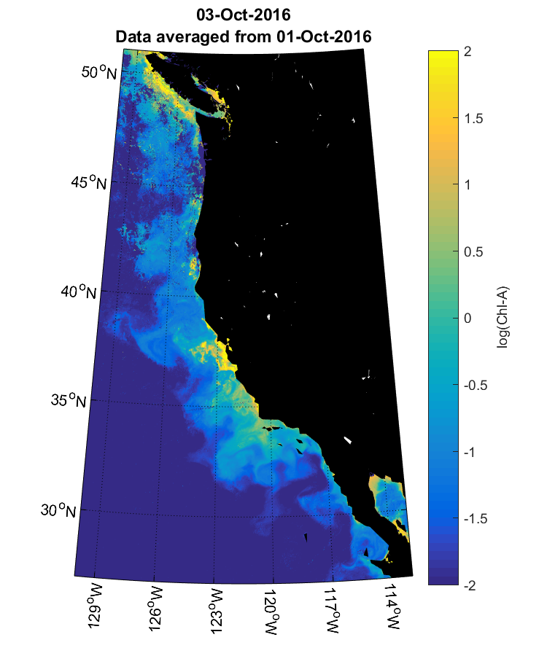

One solution: Habitat Prediction
Potential Habitat
Temperature
GAM
Chloropyhyll-A
From: Zwolinski and Renfree
Notes:
Inputs are used by GAM to output potential habitat
But where to get the data? Enter satellites

Slide 9
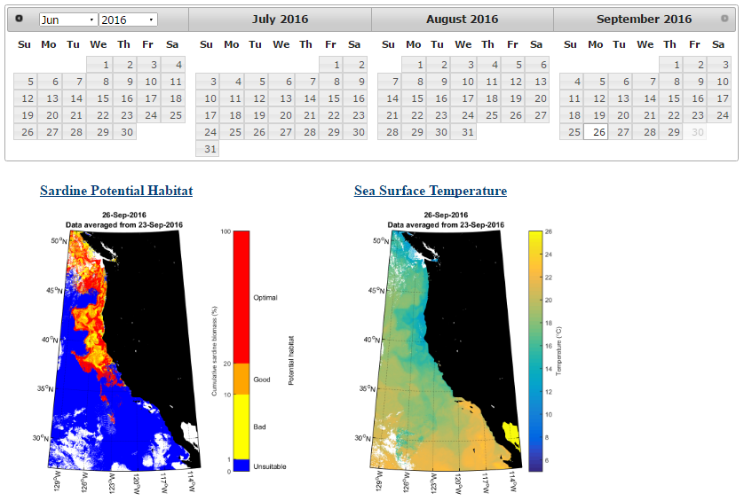
http://swfscdata.nmfs.noaa.gov/AST/sardineHabitat/habitat.asp
A tool for optimizing sampling schemes
Notes:
Have Matlab script that downloads sat data from ERDDAP, created habitat plots, and updated webpage

Slide 10
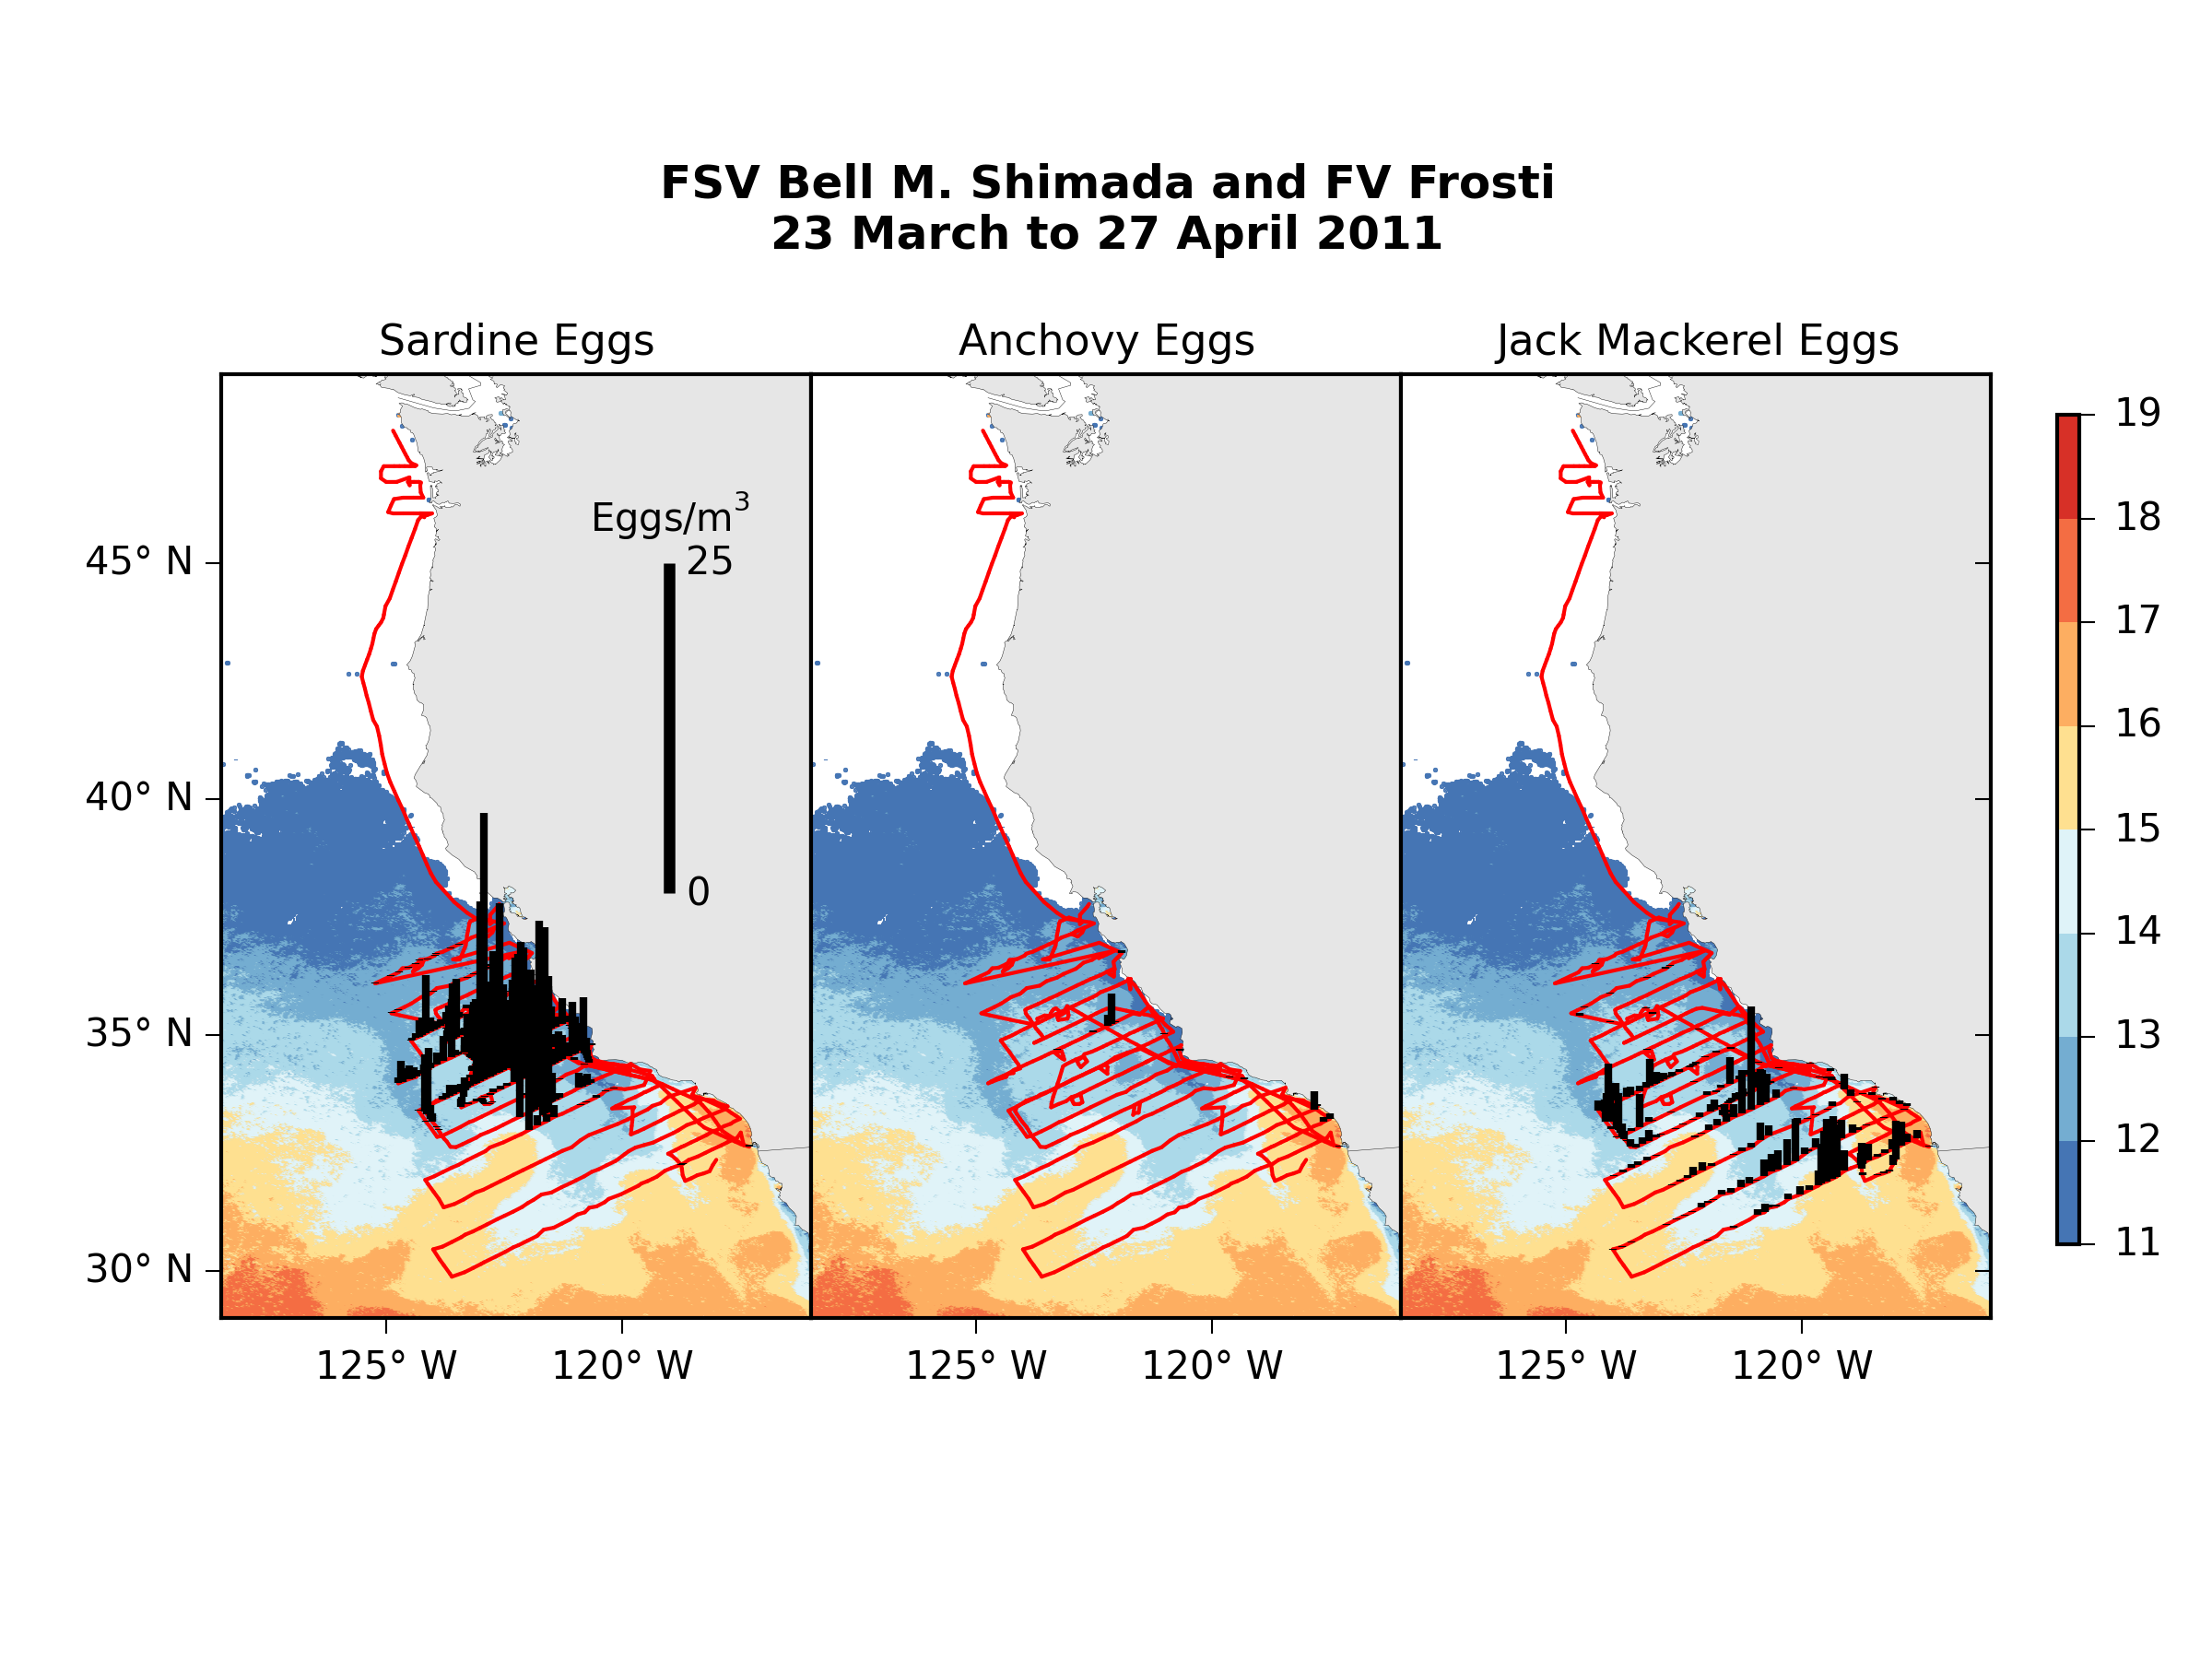
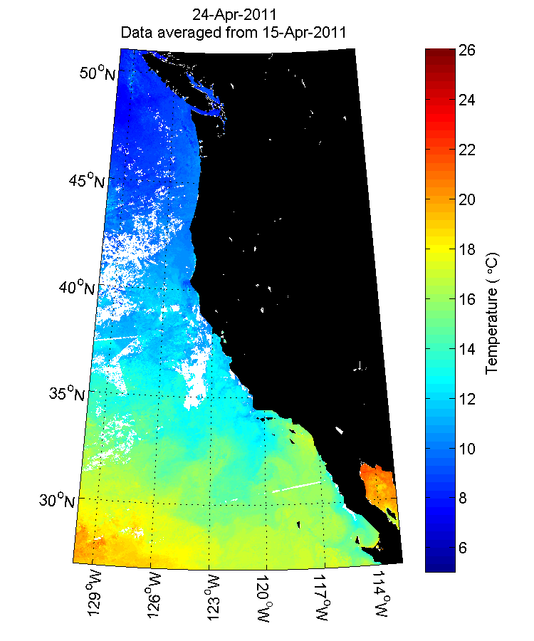
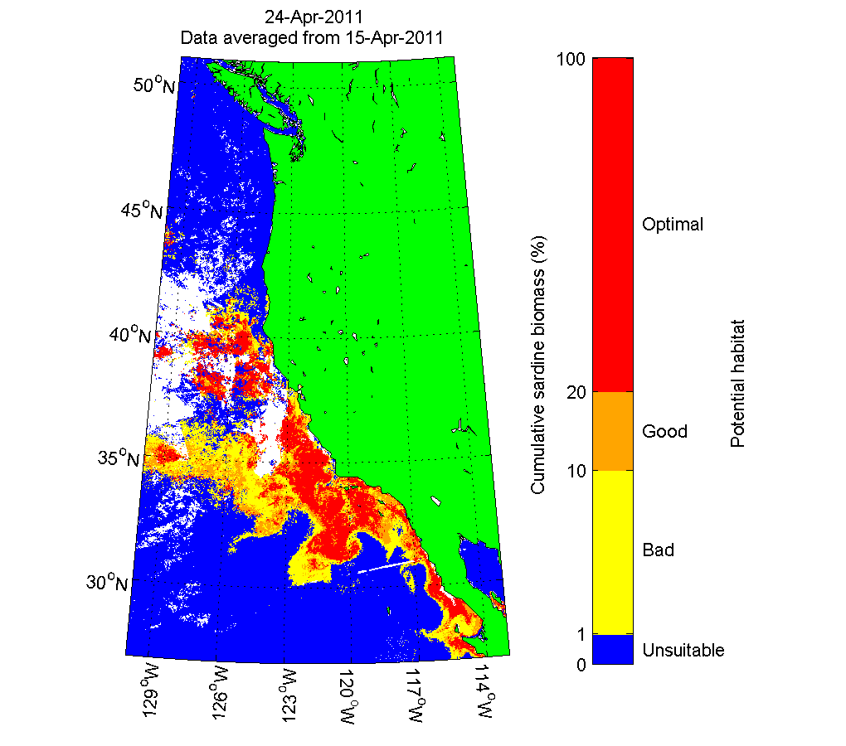
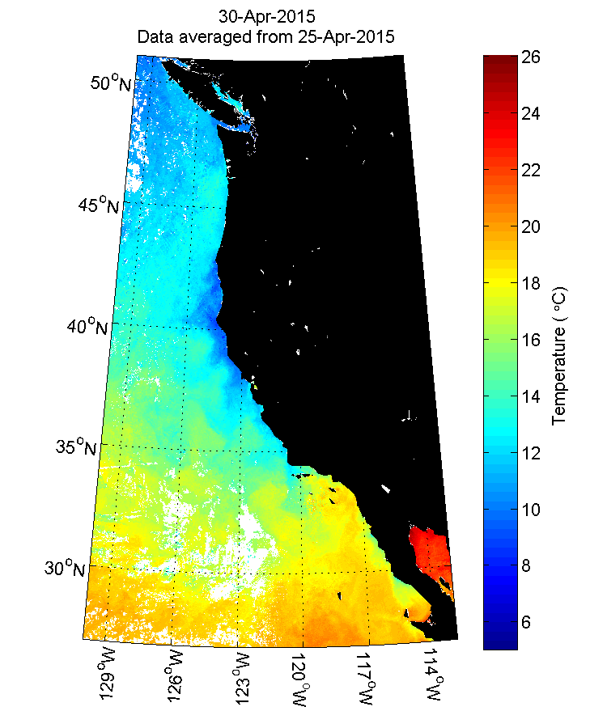
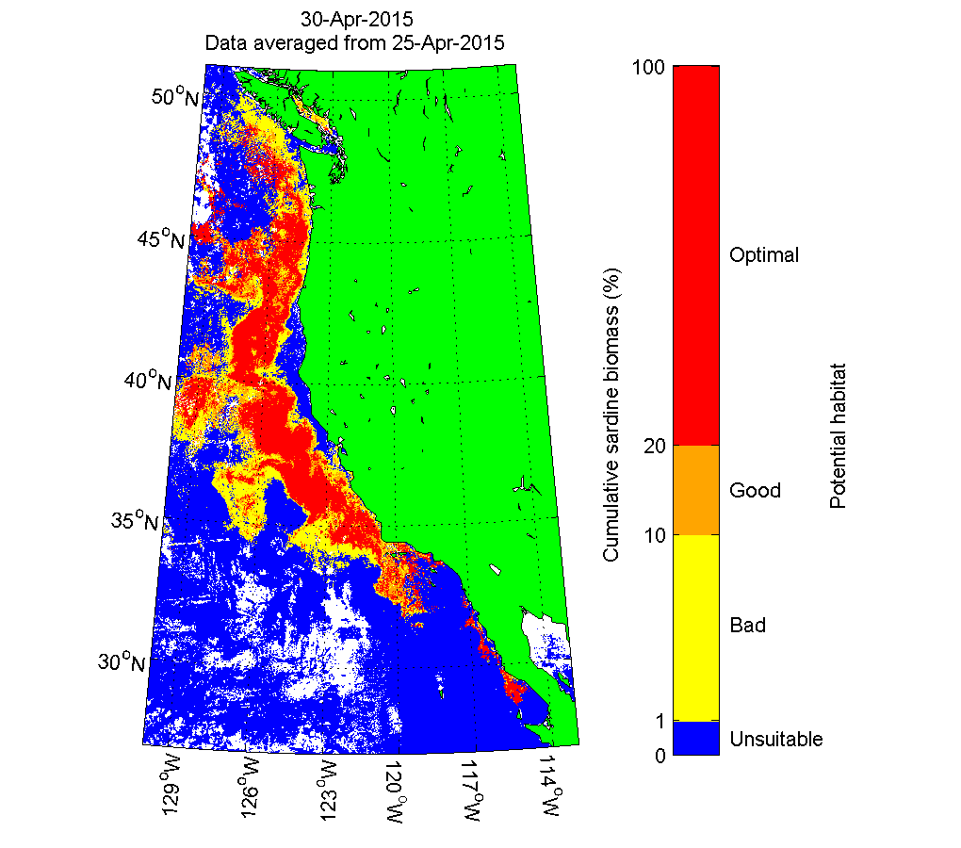
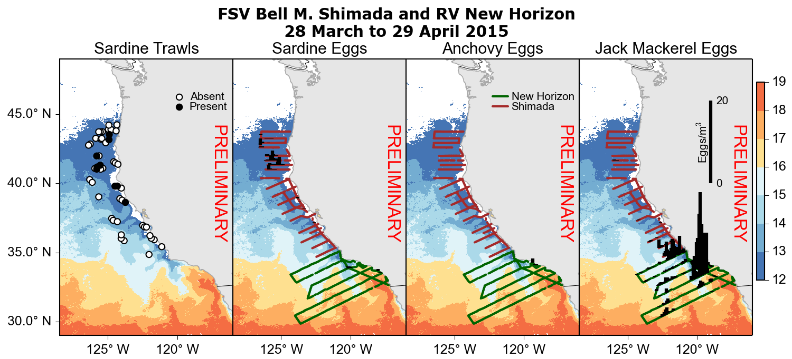
Models: forward projections can provide adaptive sampling (predicted “optimal habitat” using SST, Chl and SSH)
Northward shift/extension of habitat, surveys and sampling in 2015
2011
2015

Slide 11
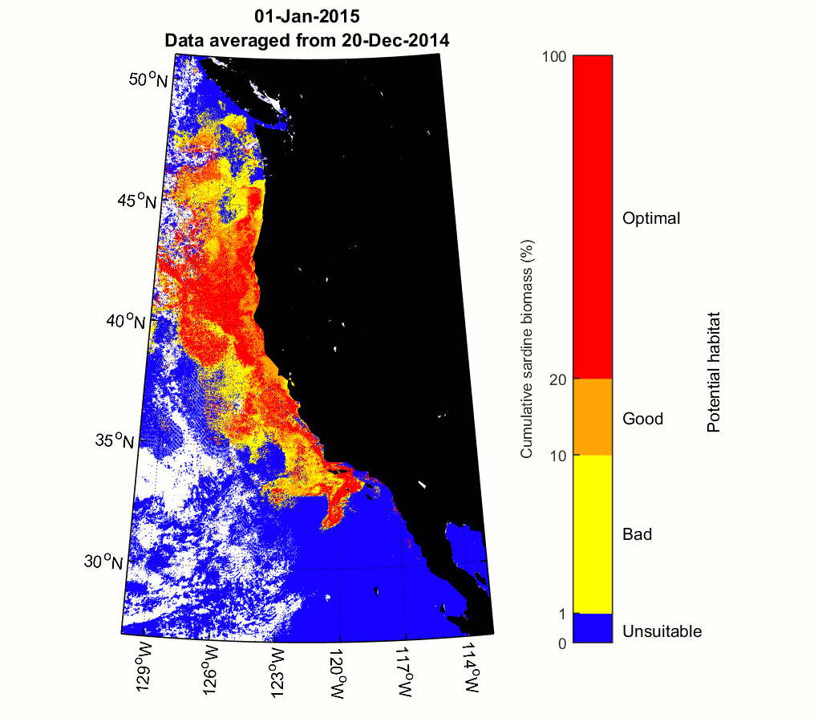
Ancillary Uses
Optimize survey design (adaptive sampling)
Assess near-shore habitat
Interpret trawl data
Delineate northern and southern sardine stocks
Interpret buoy data
The options are endless!!
Notes:
How we use it for our surveys, both pre and during
Talk about time-lapse
Tell people they can see me if they want more info

Slide 12
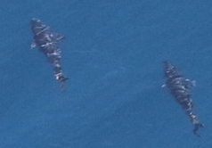
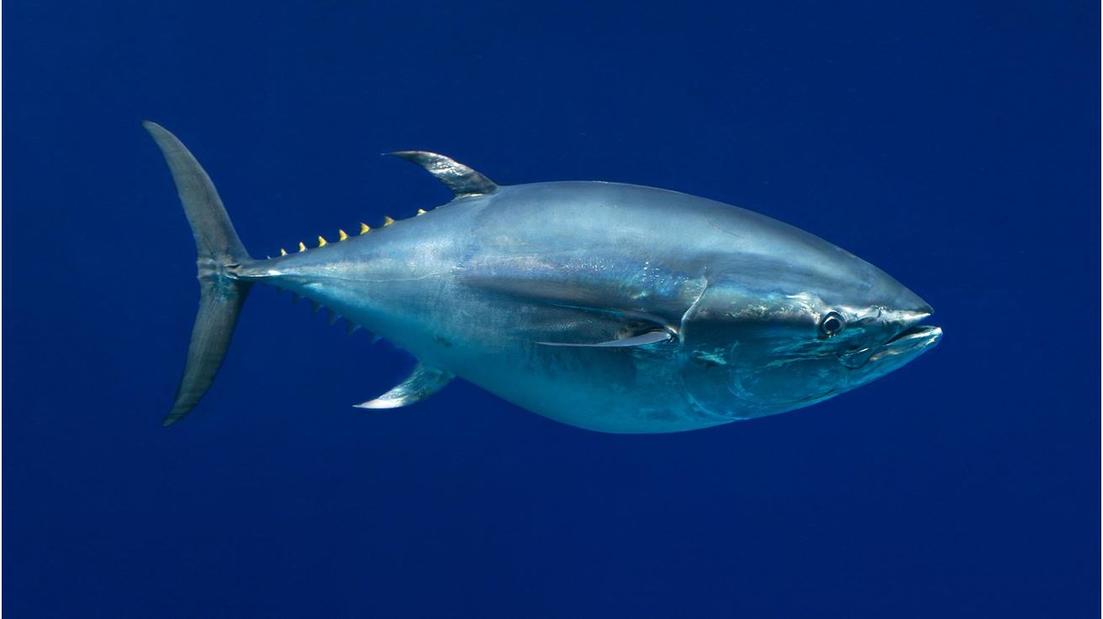
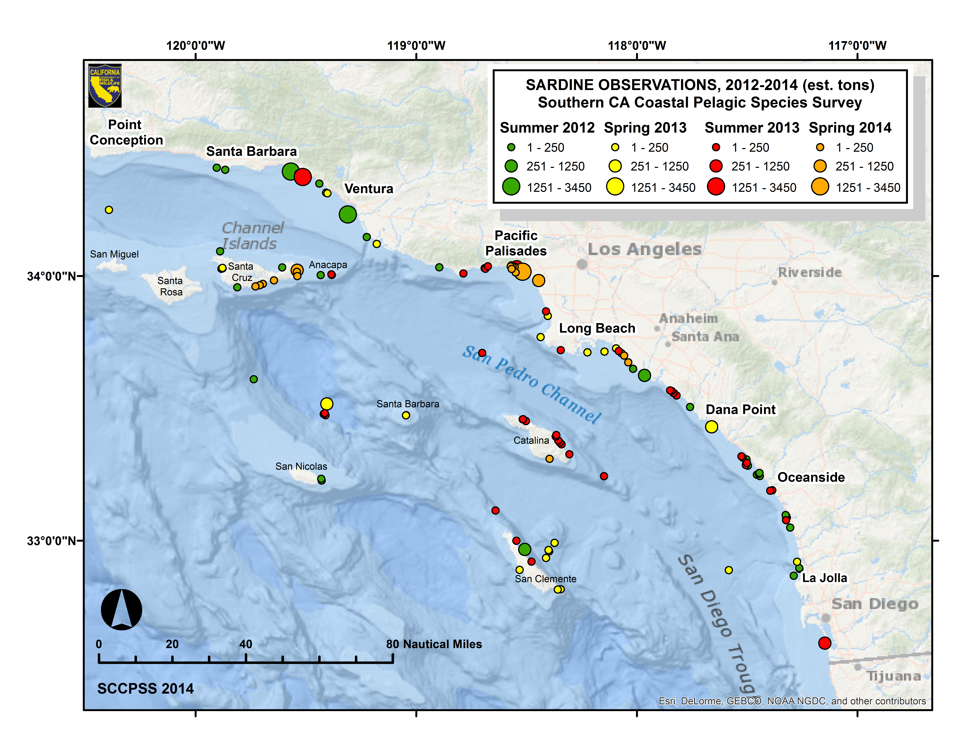
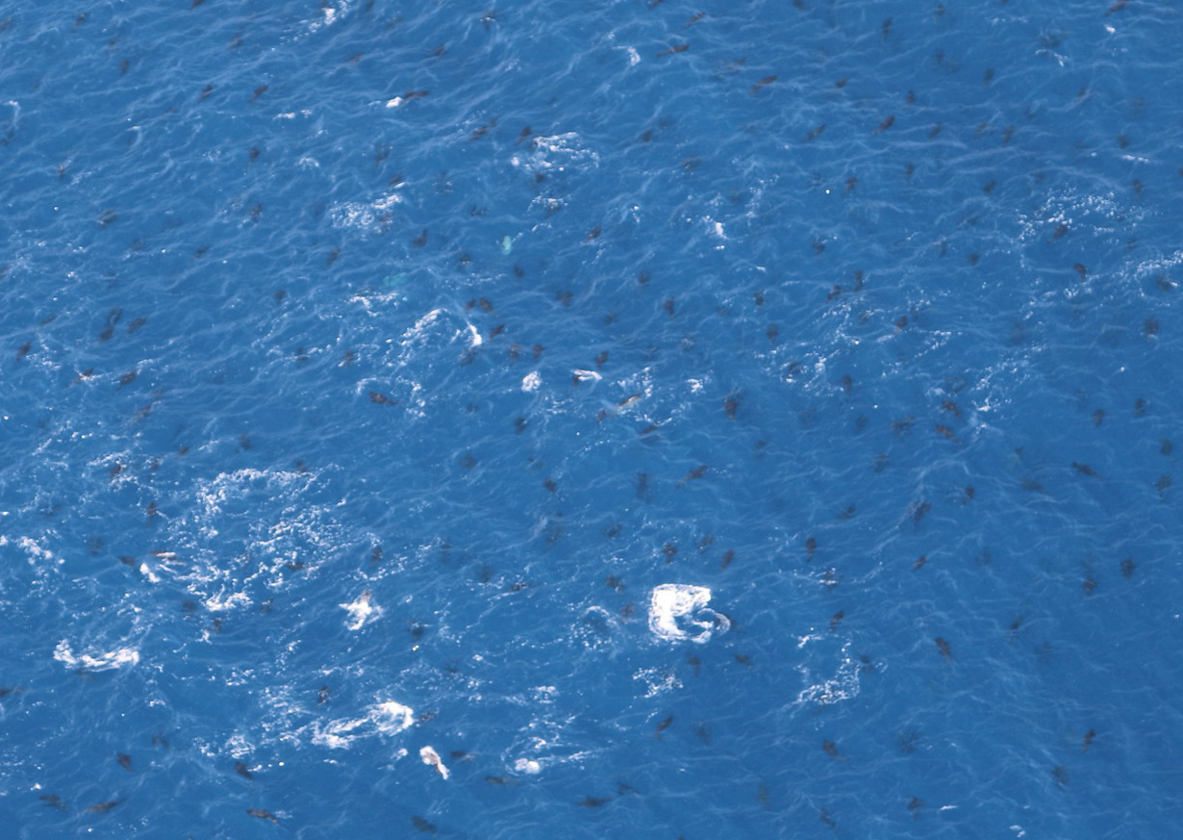
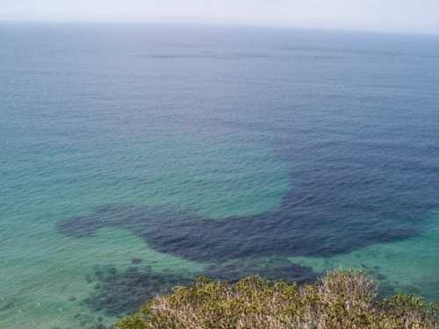
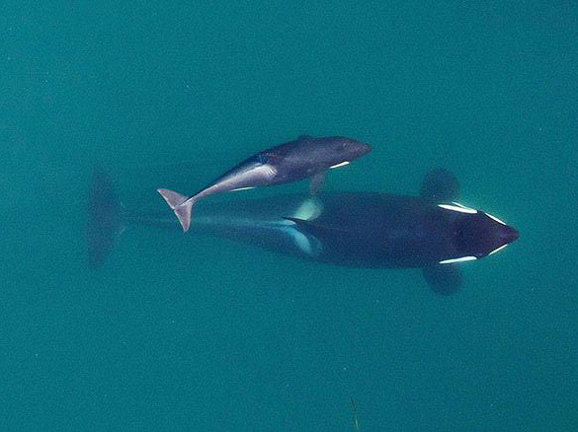
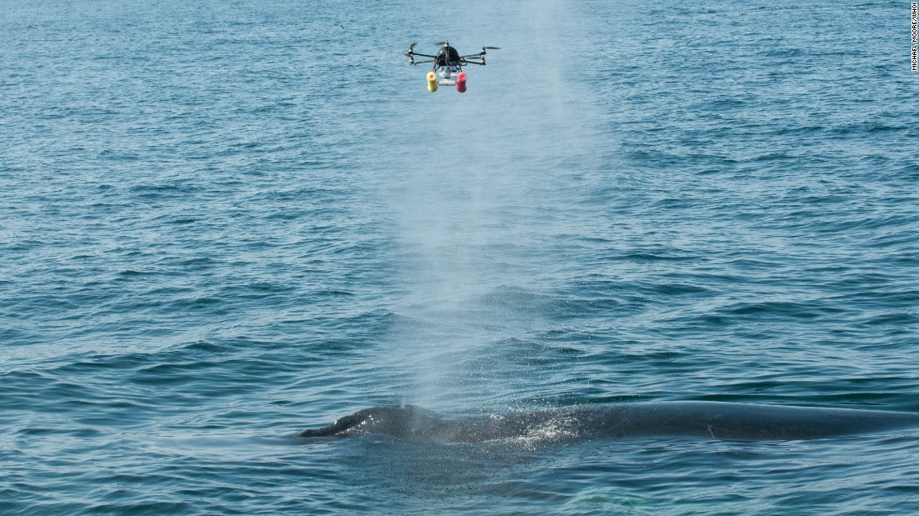
Bluefin tuna schools
Protected species: social behaviors, non-invasive sampling, etc.
Anchovy schools

Slide 13

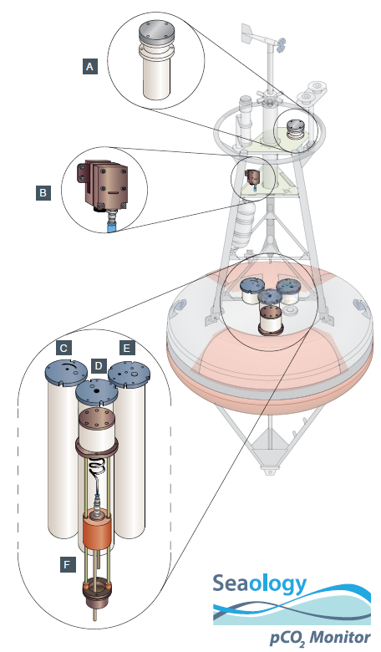
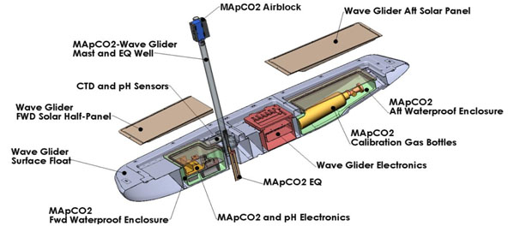
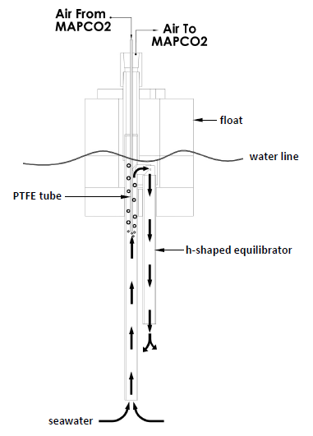
New technologies: Autonomous Surface Vessels (ASVs)
PMEL Carbon and Engineering groups adapted Moored Autonomous pCO₂ (MAPCO₂) system into an Autonomous Surface Vessel CO₂ (ASVCO₂) system for a wave glider
Communications
Air-block
Battery
Electronics
Calibration gas
Equilibrator
Sutton et al. 2014 ESSD
Work of PMEL Carbon Group: www.pmel.noaa.gov/co2. Contact: adrienne.sutton@noaa.gov
Notes:
The MAPCO2 and ASVCO2 make high-quality measurements of seawater and air CO2 for tracking anthropogenic CO2 ocean impacts. We’ve been doing this on moorings since 2004 and now on autonomous surface vessels since 2011. Both platforms involved extensive partnerships with other physical oceanographers and biologists for using these as multidisciplinary research and obs platforms. We sustain long-term MAPCO2 obs on 36 moorings around the globe.

Slide 14
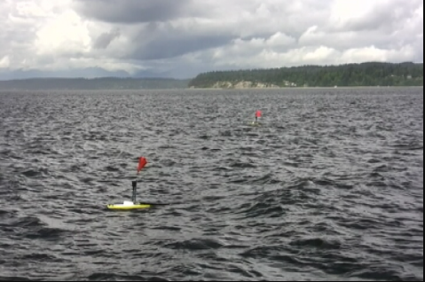
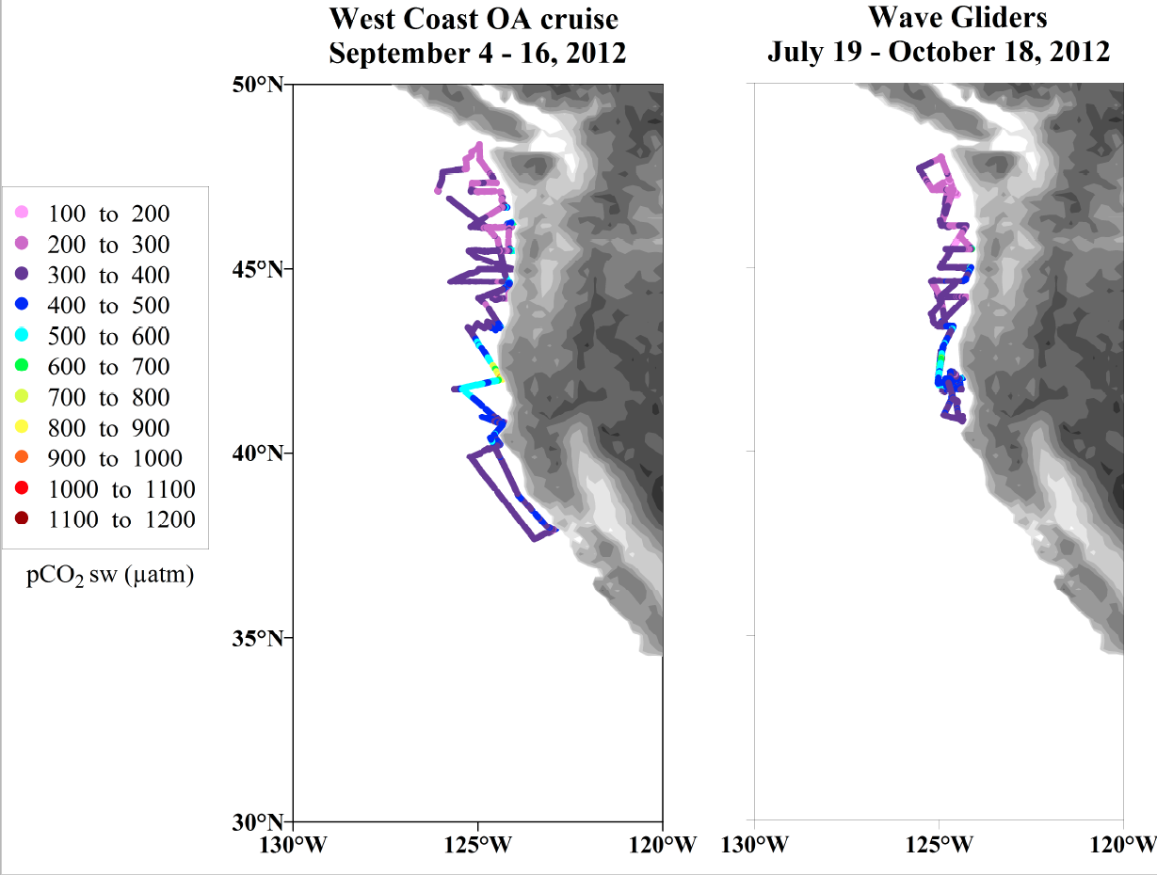
New technologies: Autonomous Surface Vessels (ASVs)
Wave glider ASVCO₂ deployments:
Washington/Oregon coast 2011, 2012, 2017
South Africa ~biannually since 2014
Gulf of Alaska/Prince William Sound 2014
Chukchi Sea 2015
Bering Sea 2016
ship of opportunity underway pCO₂
wave glider ASVCO₂
Video: won’t play, sorry
Notes:
Numerous deployments in a variety of environments. We’ve compared the ASVCO2 to high-quality MAPCO2 measurements on buoys and underway CO2 measurements on ships of opportunity.

Slide 15
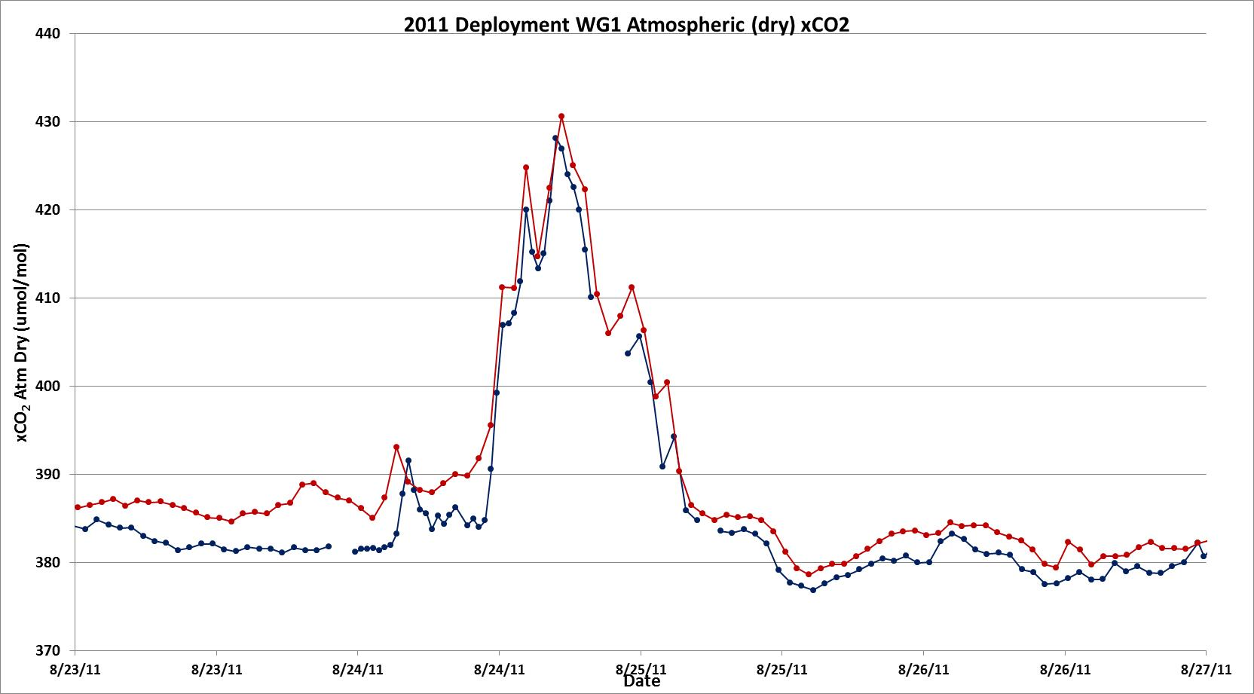
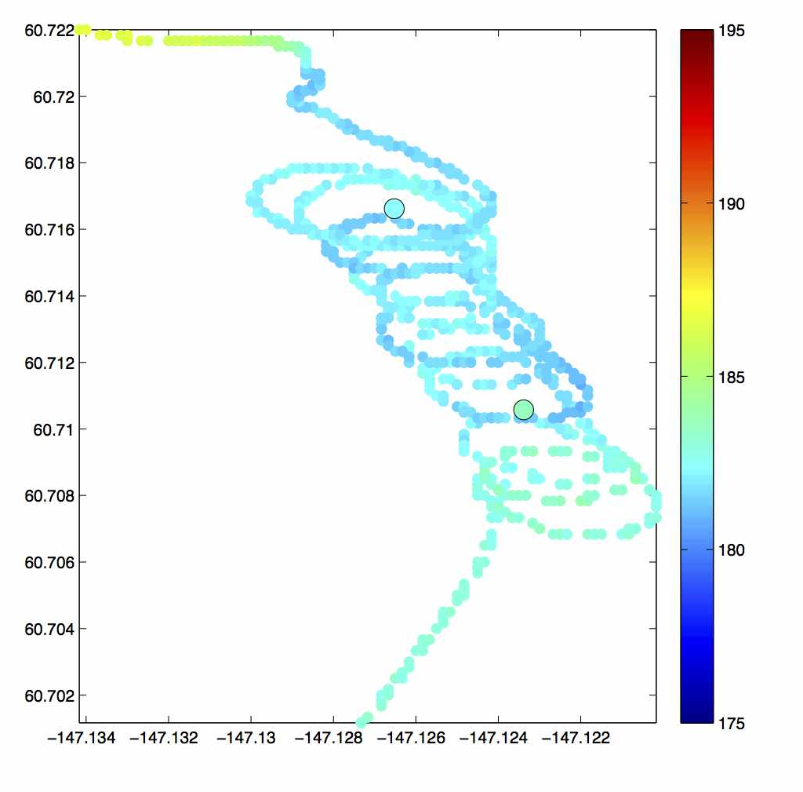
New technologies: Autonomous Surface Vessels (ASVs)
440
2011 U.S. West Coast deployment
ship of opportunity underway pCO₂
430
wave glider ASVCO₂
420
410
air xCO₂ (µmol/mol)
400
sw pCO₂ (µatm)
390
MAPCO₂
380
wave glider ASVCO₂
370
8/23
8/24
8/25
8/26
8/27
Lab testing and field comparisons suggest ASVCO₂ has uncertainty comparable to MAPCO₂ system (<2.0 µatm)
Additional field comparisons planned in 2017
2014 Gulf of AK
deployment
from: Wiley Evans
Notes:
More comparison examples.

Slide 16
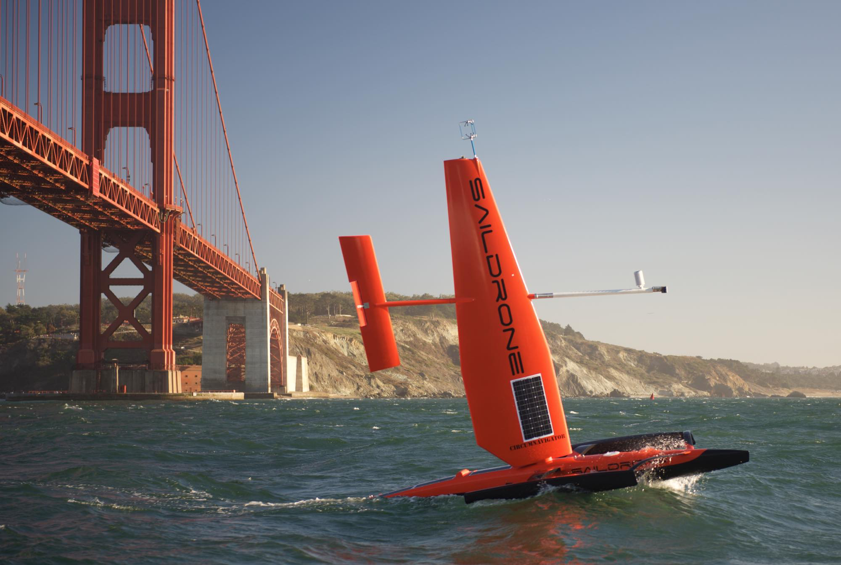
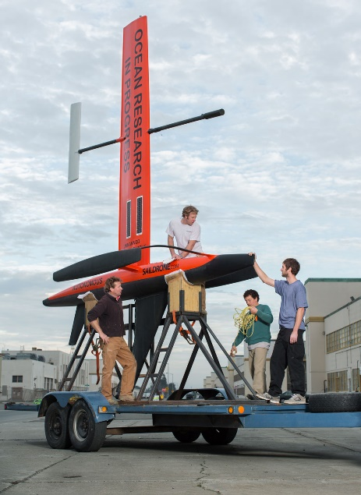
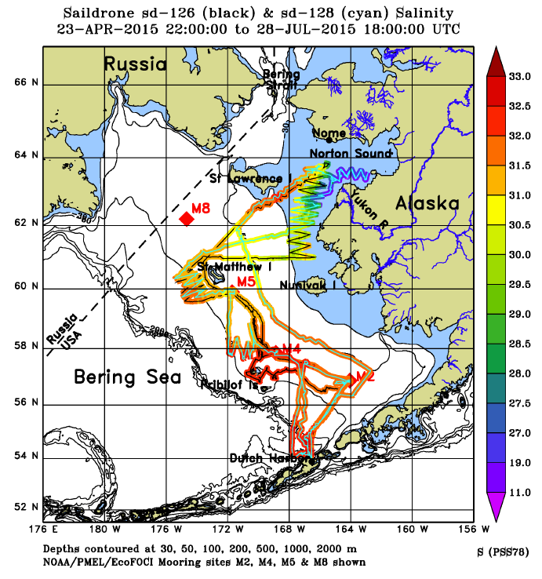
New technologies: Autonomous Surface Vessels (ASVs)
R&D to modify ASVCO₂ for Saildrones, deploy in the tropical Pacific 2017-2018
Additional Saildrone ASVCO₂ projects:
PMEL/ITAE, 2017, Bering Sea
CSIRO, 2018, Bass Strait
Notes:
Wave gliders are great for coastal applications. For open ocean applications, we are modifying ASVCO2 systems for deployment on Saildrones. We have funded projects for first deployments in the tropical Pacific and Bering Sea.

Slide 17
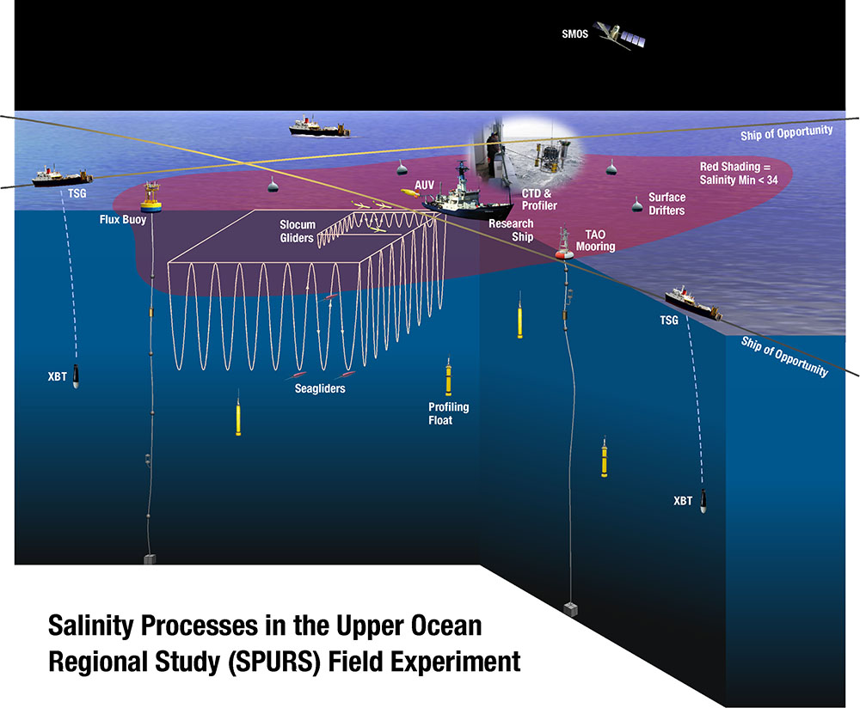
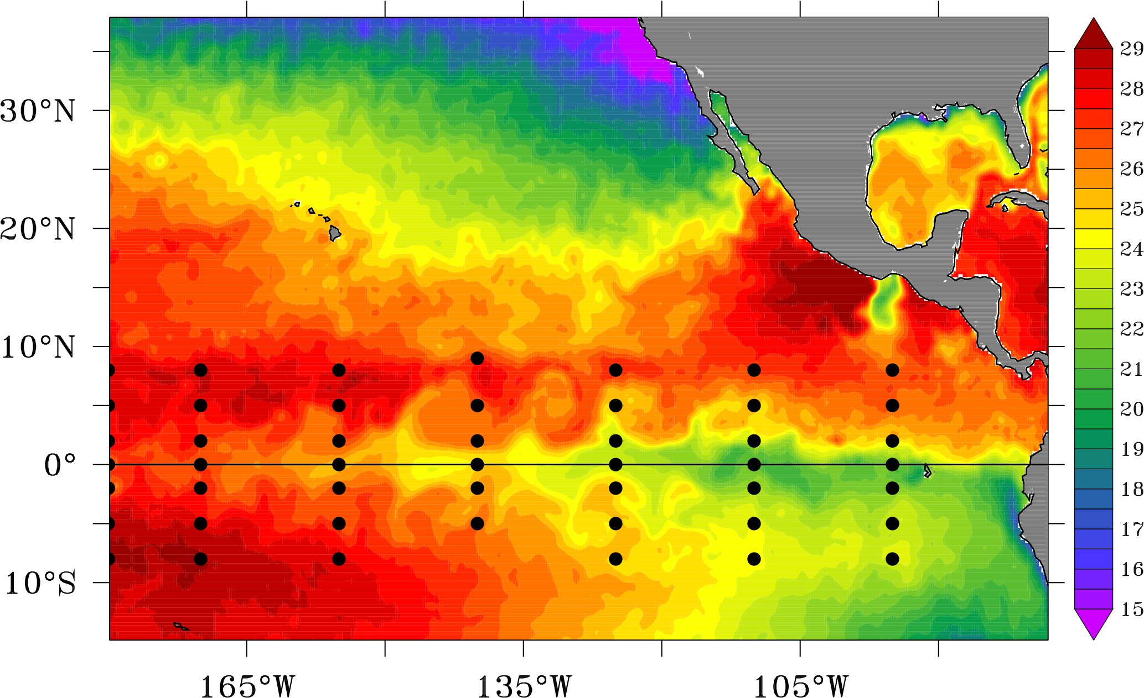
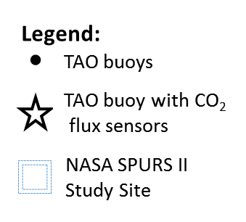
New technologies: Autonomous Surface Vessels (ASVs)
R&D to modify ASVCO₂ for Saildrones, deploy in the tropical Pacific 2017-2018
SST
Notes:
Images on planned tropical Pacific mission. First part of project will be participating in last field campaign of NASA SPURS-2 experiment. Then will test ability of Saildrone to map equatorial upwelling zone.

Slide 18
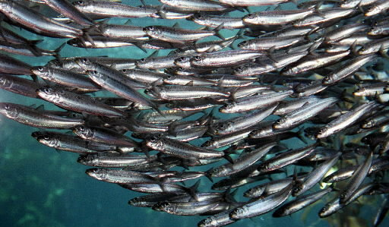
Use of autonomous platforms allows for the fixed monitoring and “mowing the lawn” surveys to be done remotely. The ship can then concentrate on targeted and adaptive sampling.
Autonomous sampling example
And opportunities for repeat sampling.

Slide 19
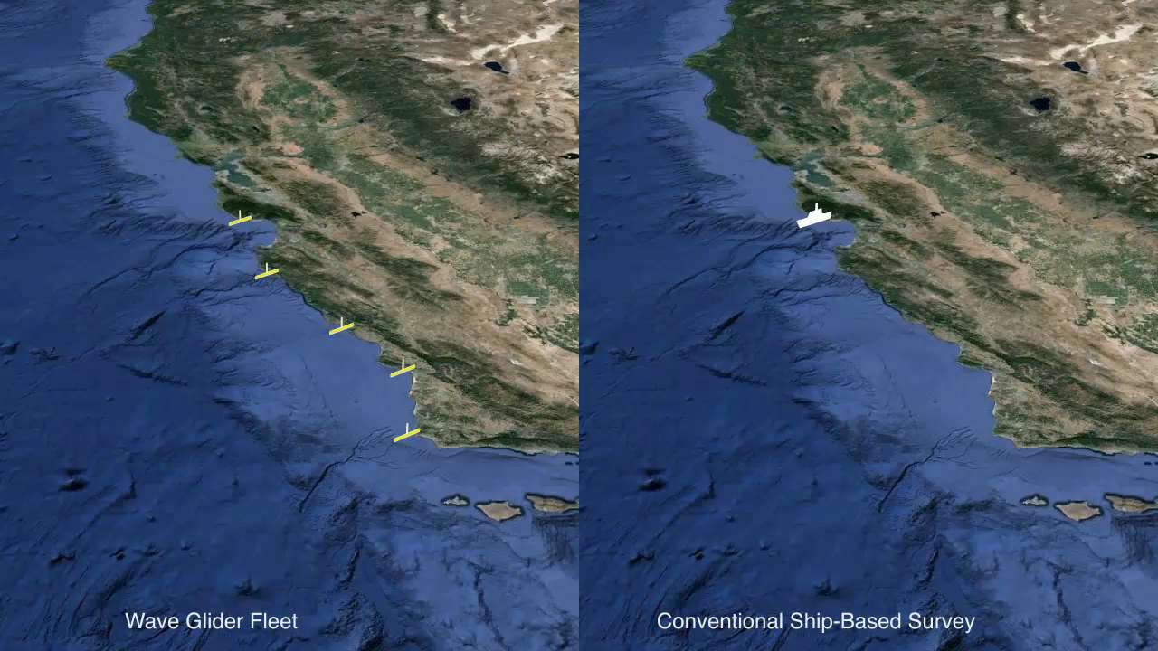

Slide 20
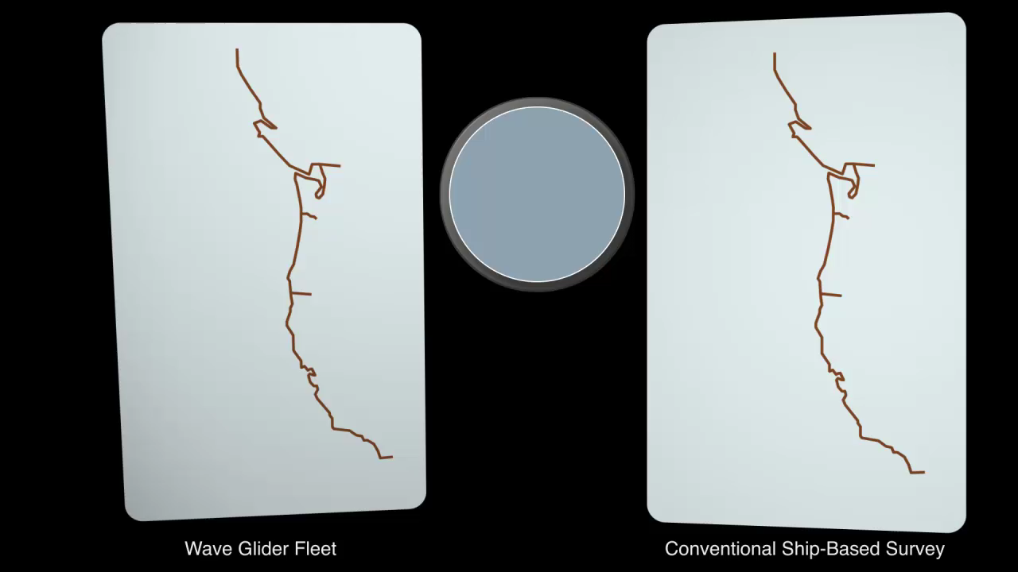

Slide 21
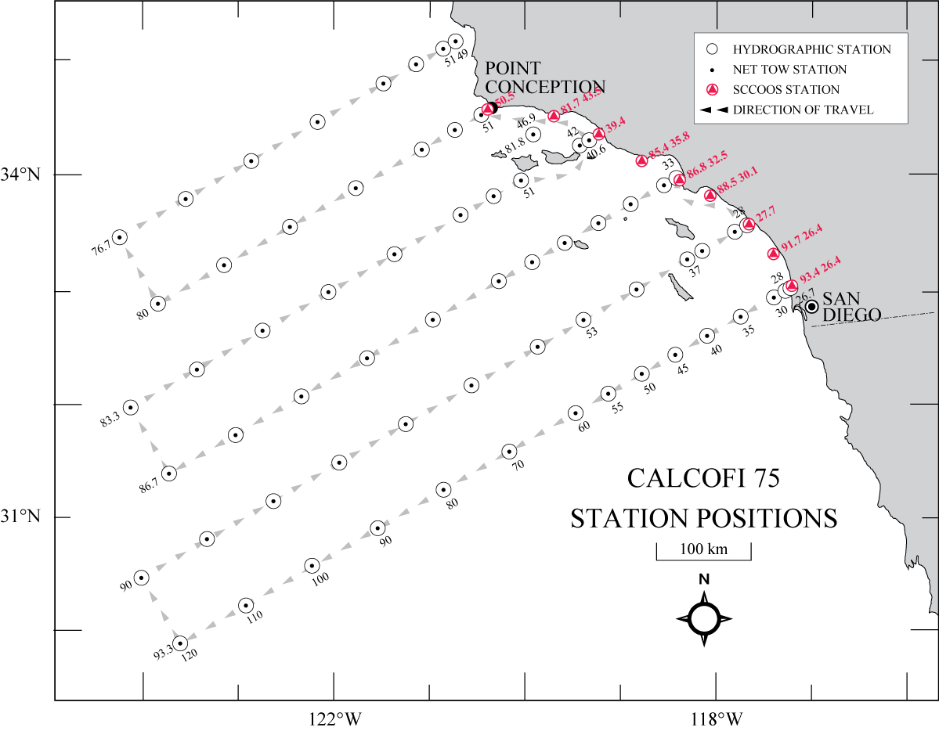
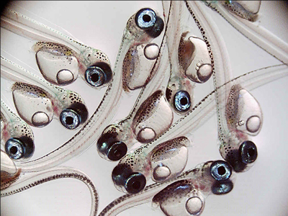
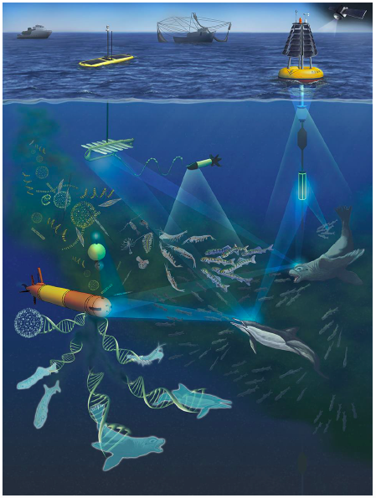
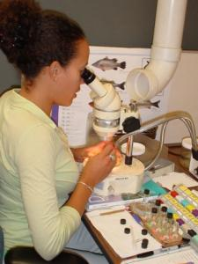
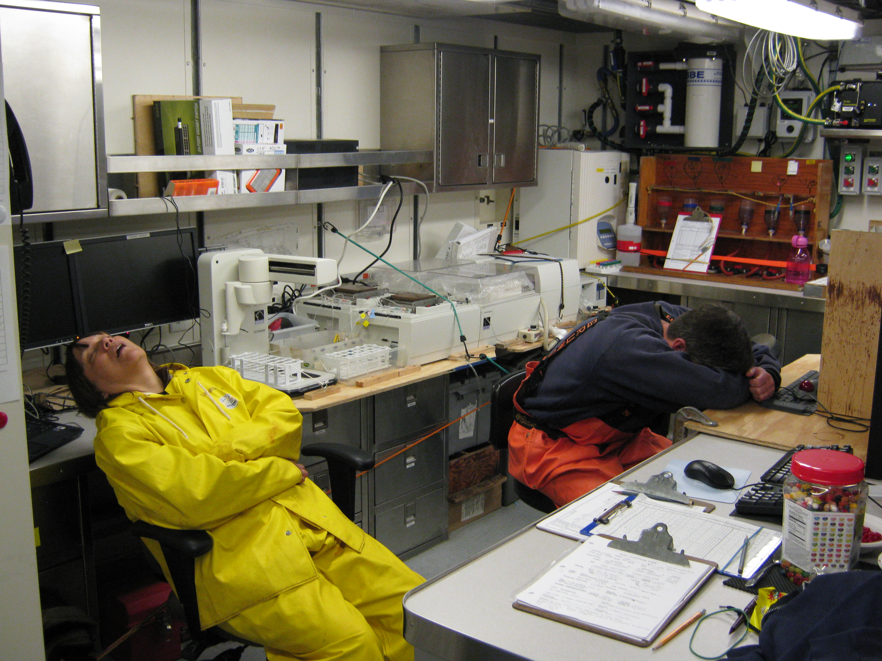
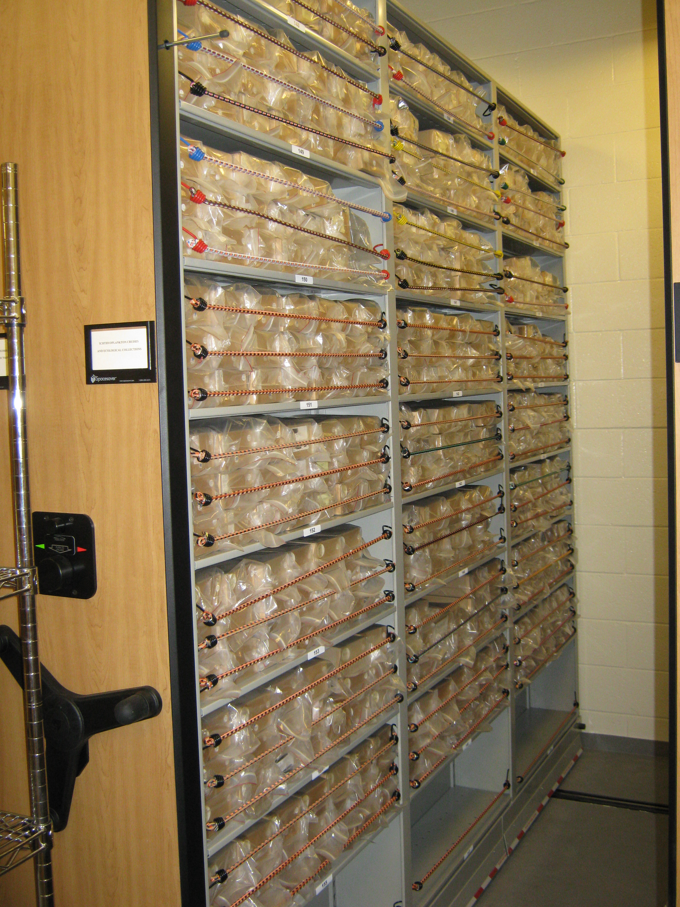








Future CalCOFI combined with ‘omics: “CalComics”
Traditional Approach (CalCOFI)
Utilizing ‘omics to more completely identify everything from viruses to vertebrates:
  more efficiently,
  more frequently, and
  can be implemented in other regions

Slide 22








Tollgate technologies: measure the stocks as they migrate

Slide 23


An emerging acoustics solution
Given new ships’ capabilities
WBAT
Acoustic moorings
+
Surface autonomous samplers
+
… what’s the best way to estimate pelagic stocks?
The three west coast science centers are collaborating on this effort

Slide 24




Existing/expected
glider lines/moorings
Additional
glider lines/moorings

Slide 25

Tollgate Demonstration Project: Partners
Acoustic Technology:
  SIO & SWFSC
  Industry Partner: Simrad
Ship Operations:
  SWFSC
Moorings:
  SIO & SWFSC
Wavegliders:
  NWFSC/SWFSC/SIO
Data Management:
  SCCOOS
POC done, awaiting a FFO to continue

Slide 26




Sensor development to identify acoustic and optical targets
  A test bed for:
  Remotely operated vehicles (ROVs)
  Autonomous underwater vehicles (AUVs)
  Instrumented buoys
  Active acoustics
  Passive acoustics
  Unmanned aerial vehicles (UAVs)
  Stereo cameras
  Light-field camera

Slide 27




Highly Migratory Species Climate Vulnerability in the North Pacific
23 species
4,300 tags
300,000 tracking days
>1M profiles
TAGGING OF
PACIFIC
PREDATORS
Block et al. (2011)

Slide 28

Dynamic Ocean Management
From years to hours
Predict at multiple scales
More catch, less bycatch

Slide 29


Thank you & Questions
SWFSC Mission: Generate the science necessary to manage and conserve the living marine resources of the California Current, the eastern tropical Pacific, and portions of the California watershed ecosystems, the N. Pacific, Pacific Islands, and Southern Ocean.

