Slide 1
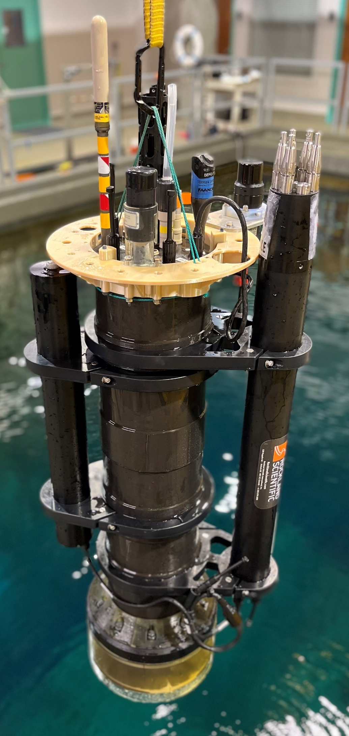
A New Profiling Float for Coastal and Upper Water Column Applications
Gene Massion, Kenneth Johnson, Chad Kecy, Eric Martin, Ed Mellinger, Paul McGill and Paul Coenen
Monterey Bay Aquarium Research Institute, Moss Landing, CA, United States
Argo COP Meeting, 26 July 2022
Notes:
Thanks very much for the opportunity to talk about MBARI’s coastal profiling float project
Describe what this project is

Slide 2

The Initial Motivation
"the widespread pattern of low returns along the West Coast for two species of salmon indicates an environmental anomaly [low nutrient production] occurred in the California Current in 2005."
Notes:
The initial motivation for this project came from a conversations I had with Ken Johnson, the PI of MBARI’s chemical sensor group
He showed me this press release from NOAA marine fisheries from 2008 when only a third of the expected Salmon returned to their breeding streams during the 2007 season and suggested it was primarily due to low food production in 2005
The problem was pretty clear; managing fisheries is a complex task, and data is sparse, real time or near real time data is even less available.
I was hooked even before I knew that ensuring sustainable fisheries is an explicit goal of the David and Lucille Packard foundation, which funds MBARI, makes this an even more compelling challenge

Slide 3


More Motivation
“Further development of event-scale observing capacity (e.g., novel autonomous platforms) in all continental margin systems to better quantify impacts of episodic events on coastal carbon budgets”
A Science Plan for Carbon Cycle Research in North American Coastal Waters 2016, Ocean Carbon and Bio. Program and NA Carbon Program
Navigating the New Arctic
“Current Arctic observations are sparse and inadequate for enabling discovery or simulation … to assess their impacts on the broader Earth system”
Notes:
Additional motivation include the Coastal Carbon Synthesis Group’s community workshop report where the recommended more development of observing systems for continental margins.
Community workshops sponsored by Ocean Carbon and Biogeochemistry Program and North American Carbon Program
NSF also published their 10 big ideas, the areas that will drive their research agenda for the near future. One of the 10 big ideas is Navigating the New Arctic and again, they point out the lack of data limiting our understanding.
While the arctic was not one of our initial research topics, we think it is within the capability of the CPF.

Slide 4
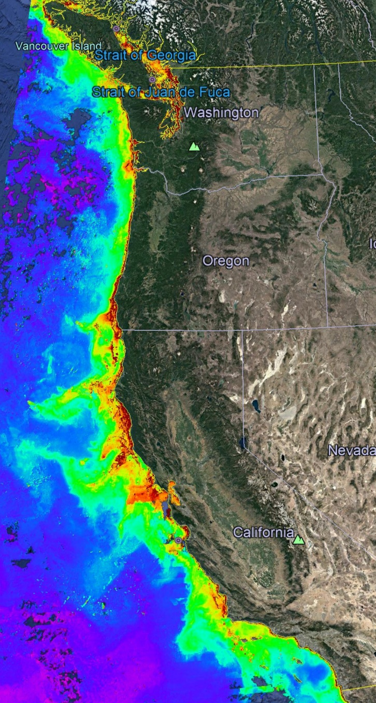
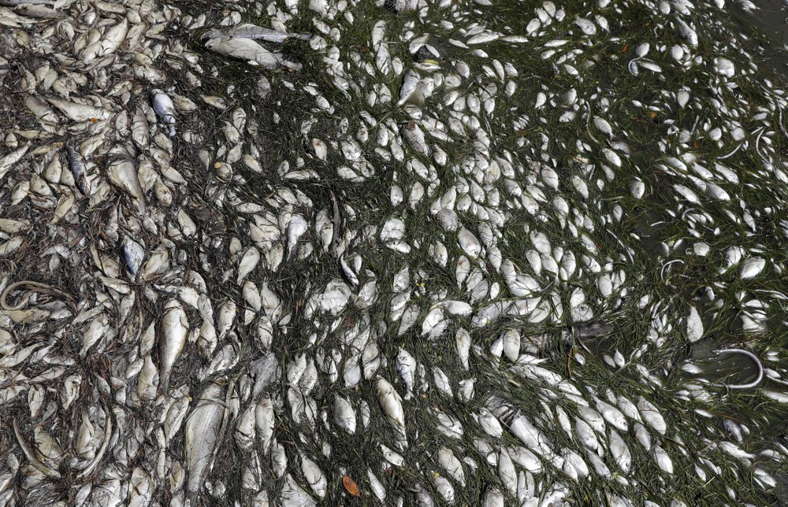
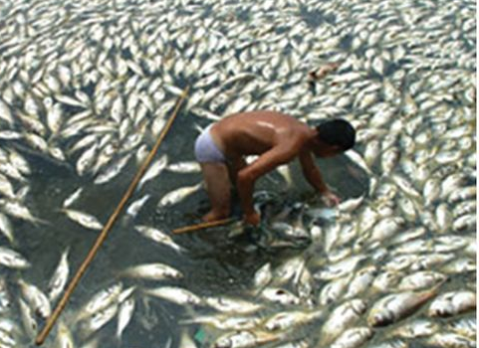
Science Requirements
MODIS Chlorophyll July 2019
A cost-effective, coastal ecosystem size observing system
Science targets: Fisheries, HABs, Oxygen Dead Zones, …
Spatial Scale: coastal ecosystem, e.g., the west coast of North America
Time Scale: Typically 4 profiles/day, max: 1/hour
100s of profiles spread over days to years
BGC Sensor suite: CTD, O₂, pH, Nitrate, FL/BB and Optical Radiation
Devastating toxic algae bloom plagues Florida’s Gulf Coast
By TAMARA LUSH (AP), August 10, 2018
Declining oxygen in the global ocean and coastal waters
Denise Breitburg,et. al., Science 05 Jan 2018: Vol. 359, Issue 6371
Notes:
We started the project with the usual process of defining specific science needs or requirements, identifying risks or more PC, challenges and developing concepts.
We have a fairly detailed document describing these but I can summarize them pretty briefly here.

Slide 5


Current CPF Version 2.1 and 2.2
Depth range = 0 to 350 meters
BGC Instrument Suite
Electronics
108 cm
Internal Oil Bladder
Oil Pump
External Oil Bladder
Notes:
Webb Apex Float = 1%, MRV S2-A Solo II = 3.4%, BSOP Modular = 3/82 = 3.7%, MRV Alamo = 4.2%
Talk about 2 versions: identical from the bottom end cap up

Slide 6
Current CPF Version 2.1 and 2.2
Depth range = 0 to 350 meters
ΔV/V = 3.5 l/40 l = 9%
  Working density gradient = 1000 kg/m³ / 1025 kg/m³ = 2.5%
  Vertical velocity = 0 to ~50 cm/sec
  Ability to anchor/de-anchor
  Enough reserve buoyancy to offset biofouling
BGC Instrument Suite
Electronics
108 cm
Internal Oil Bladder
Oil Pump
External Oil Bladder
Notes:
Webb Apex Float = 1%, MRV S2-A Solo II = 3.4%, BSOP Modular = 3/82 = 3.7%, MRV Alamo = 4.2%
Talk about 2 versions: identical from the bottom end cap up

Slide 7
Current CPF Version 2.1 and 2.2
Depth range = 0 to 350 meters
ΔV/V = 3.5 liters / 40 liters = 9%
Science Payload = 6 BGC sensors plus 3 more TBD
BGC Instrument Suite
Electronics
108 cm
Internal Oil Bladder
Oil Pump
External Oil Bladder
Notes:
Webb Apex Float = 1%, MRV S2-A Solo II = 3.4%, BSOP Modular = 3/82 = 3.7%, MRV Alamo = 4.2%
Talk about 2 versions: identical from the bottom end cap up

Slide 8
Current CPF Version 2.1 and 2.2
Depth range = 0 to 350 meters
ΔV/V = 3.5 liters / 40 liters = 9%
Science Payload: 9 sensor ports: currently 3 available ports
Iridium SBD and RUDICS communications
BGC Instrument Suite
Electronics
Internal Oil Bladder
108 cm
Oil Pump
Batteries
External Oil Bladder
Notes:
Webb Apex Float = 1%, MRV S2-A Solo II = 3.4%, BSOP Modular = 3/82 = 3.7%, MRV Alamo = 4.2%
Talk about 2 versions: identical from the bottom end cap up

Slide 9
Current CPF Version 2.1 and 2.2
Depth range = 0 to 350 meters
ΔV/V = 3.5 liters / 40 liters = 9%
Science Payload: 9 sensor ports: currently 3 available ports
Iridium SBD and RUDICS communications
Mission Duration Prediction:
  4 profile/day ~ 62 days
  1 profile/day ~ 248 days
  1 profile/2 days ~ 489 days
BGC Instrument Suite
Electronics
Internal Oil Bladder
108 cm
Oil Pump
Batteries
External Oil Bladder
Notes:
Webb Apex Float = 1%, MRV S2-A Solo II = 3.4%, BSOP Modular = 3/82 = 3.7%, MRV Alamo = 4.2%
Talk about 2 versions: identical from the bottom end cap up

Slide 10

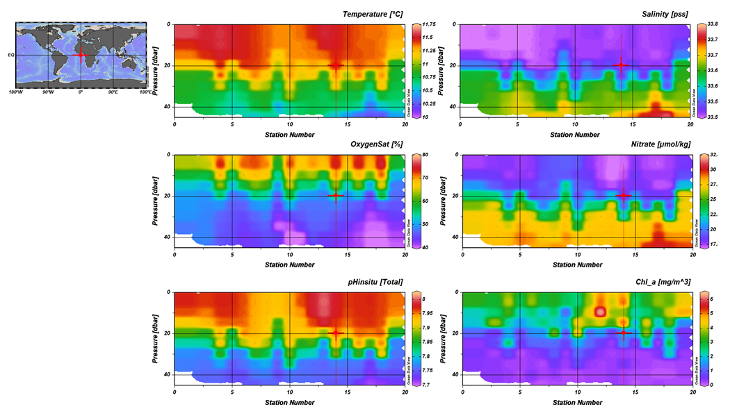
Science Data Products
Notes:
I used to work in the engineering department at MBARI, now I work in the chem sensor lab and one of the first lessons I learned was that our product was useful science data, and that a really well engineering platform isn’t of any value if it doesn’t produce useful science data. I don’t really understand this thinking but I do accept it, so we’ve been working on the shore side tools we need to effectively interpret the data the CPF acquires.
We can see a cold, low oxygen deep water mass roll up the shelf and presumably transport nutrients (we’ll know when we have the Nitrate sensor on.;

Slide 11
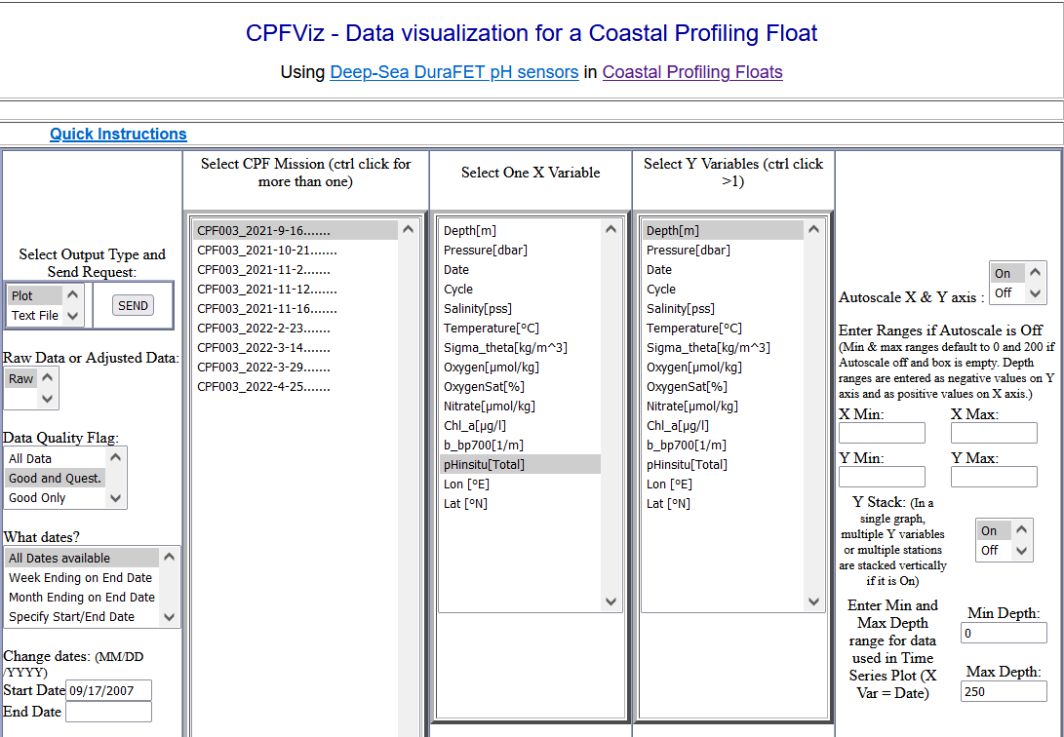
Data Are Publicly Available Through MBARI CPFViz https://www3.mbari.org/chemsensor/cpfviz.htm

Slide 12



Float Navigation
Experiment: Park the CPF at various depths and compare track to ROMS nowcast and previous missions that anchored on the bottom after every profile
ROMS Predicted Trajectories at 1 m (red, 20 m purple, 30 m yellow
March 2017 Un-navigated, 5km Anchor on Bottom Track
2 km
July 2017 Navigated, Park at User Specified Depth Track
Notes:
This slide is pretty dense, I’ll try to unpack it for you.
I talked about the challenge of keeping the CPF in the coastal zone and not on the beach of off-shore.
We identified this risk at the beginning of the project and suggested we could mitigate this risk to some extent using operational, 3D numerical current models.
The ROMS model runs every day and give a 3 day 3D forecast of currents in the Monterey Bay.
So if the CPF was drifting west, in many coastal zones there would be a high probability there is a sub-surface current heading roughly east and we could park at that depth to move back toward the target volume. This is much like the way Hot air balloons navigate.
So, we ran an experiment, here’s the target area …
Need to run ROMS at higher resolution particularly given the bathymetry
Maybe crop the ROMS window and add a velocity vs depth plot.

Slide 13


Engineering Results
2 m Dead Band
Std Dev = 0.90 m
Notes:
Working in shallow water is a challenge as I mentioned earlier. If you’re working in 20 meters of water you don’t want to spend 15 of those meters getting to a stable vertical velocity
The zoomed inset is for getting off the surface which is harder due to wave action and the fact that we descend at 20 cm/sec and ascend at 10 cm/sec
Sampling is typically done during park, anchor and ascent but can be done on descent if desired.
The depth control has a dead band which in this case is set for +/1 meter.
Tuned for maximum stability and noise rejection and moderate performance
6 meters of overshoot

Slide 14

More Engineering Results
Pressure (dBar)
No Dead Band
Std Dev = 0.14 m
Notes:
Exact same control algorithm with no dead band.
After trying several other subsurface Lagrangian floats, the MBARI BOG built 2 for their twice a year field deployments
Ballast in 350 gram increments in the test tank
Control algorithms designed for maximum stability and noise rejection and minimal performance
Pick up truck of the sea

Slide 15

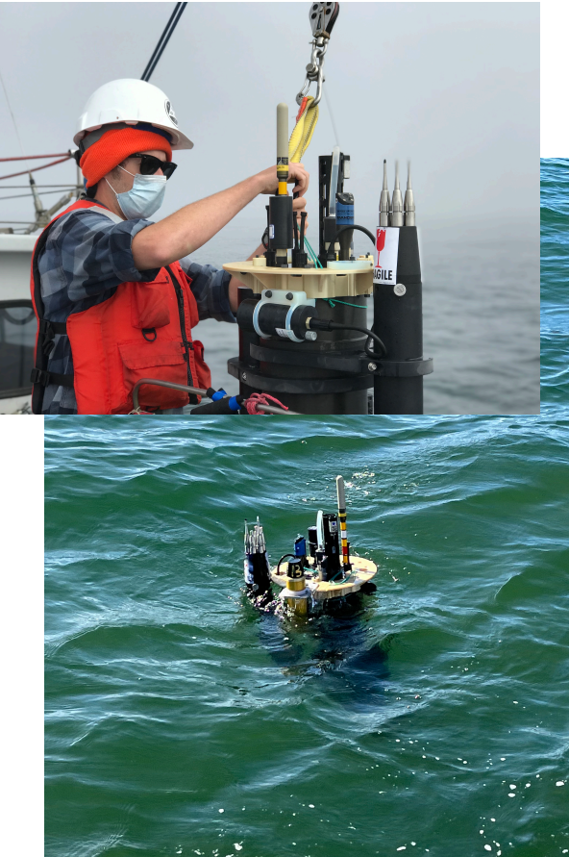

A Pickup Truck for the Sea?
CPF V2.1 with BGC instrument suite and MicroRider turbulence probe
CPF V1.1 with sediment trap and acoustic modem

Slide 16
Next Steps
  Run science missions with all (soon to be) 3 of our CPFs
    The influence of lateral nutrient transfer from upwelling plumes versus canyon upwelling on the development of high chlorophyll levels in the Monterey Bay “upwelling shadow”
Notes:
Use action verbs
The primary science focus will be the influence of lateral nutrient transport from upwelling plumes versus canyon upwelling on the development of high chlorophyll levels in the Monterey Bay “upwelling shadow”

Slide 17
Next Steps
  Run science missions with all 3 of our CPFs
  Extend the mission duration
    Li Primary pack: ~4X more energy
    Implement sleep between profiles
    Lower power uController
Notes:
Use action verbs

Slide 18
Next Steps
  Run science missions with all 3 of our CPFs
  Extend the mission duration
  Continue enhancing reliability
    Need >100 float-years of experience ASAP
Notes:
Use action verbs

Slide 19
Next Steps
  Run science missions with all 3 of our CPFs
  Extend the mission duration
  Continue enhancing reliability
  Supplement/replace ROMS current forecasts with Inertial Current Meter based on latest generation of small, low power moderately inexpensive tactical grade Inertial Measurement Units
Notes:
Use action verbs

Slide 20
Next Steps
  Run science missions with all 3 of our CPFs
  Extend the mission duration
  Continue enhancing reliability
  Replace/supplement ROMS model current forecasts with small, low power current sensor e.g. tactical grade MEMS Inertial Measurement Unit
  Develop collaborations with external labs
Notes:
Use action verbs

Slide 21
Next Steps
  Run science missions with all 3 of our CPFs
  Extend the mission duration
  Continue enhancing reliability
  Finish new battery pack with 4X higher energy per cm³
  Replace/supplement ROMS model current forecasts with small, low power current sensor e.g. tactical grade MEMS Inertial Measurement Unit
  Develop collaborations with external labs
  Make the CPF tech. available to the community
Notes:
Use action verbs

