Slide 1

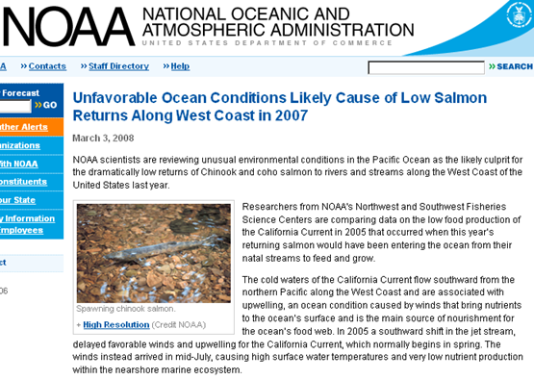
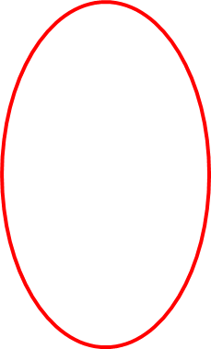
Development of a Coastal Profiling Float
The Problem
Scientists and Policy Makers need Net Community Production (NCP) data at the ecosystem level to understand and manage coastal issues
Existing observing systems are too costly to scale up to the size required to manage at the ecosystem scale
MODIS Chlorophyll June 28, 2011 http://podaac-tools.jpl.nasa.gov/soto/

Slide 2
How and why MBARI can contribute
The MBARI Chemical Sensor lab has been working with Argo profiling floats for 10+ years
  Argo is arguably one of the few (maybe the only) ocean observing systems that has scaled to provide data at the ecosystem level
  Argo is designed and optimized for open ocean environments
  NCP is a coastal issue (as are other important “health of the ocean” questions)
  Extending Argo technology to the coastal environment requires a new platform
The Chem Sensor lab has been developing a biogeochemical sensor suite and data analysis tools that is well suited for use on a coastal profiling float to address these important “health of the ocean” questions

Slide 3
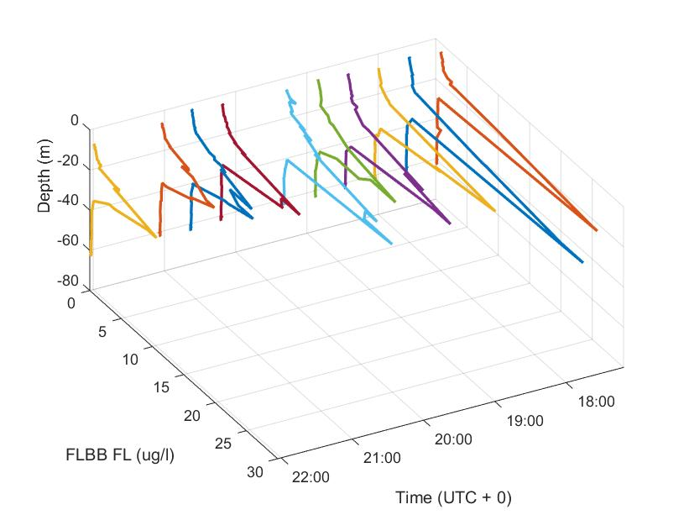
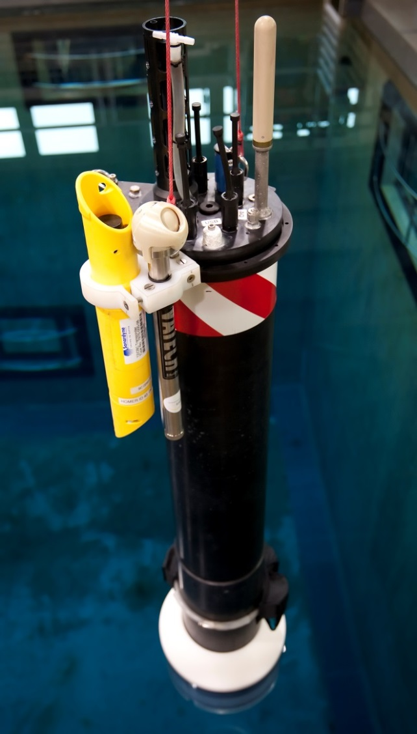
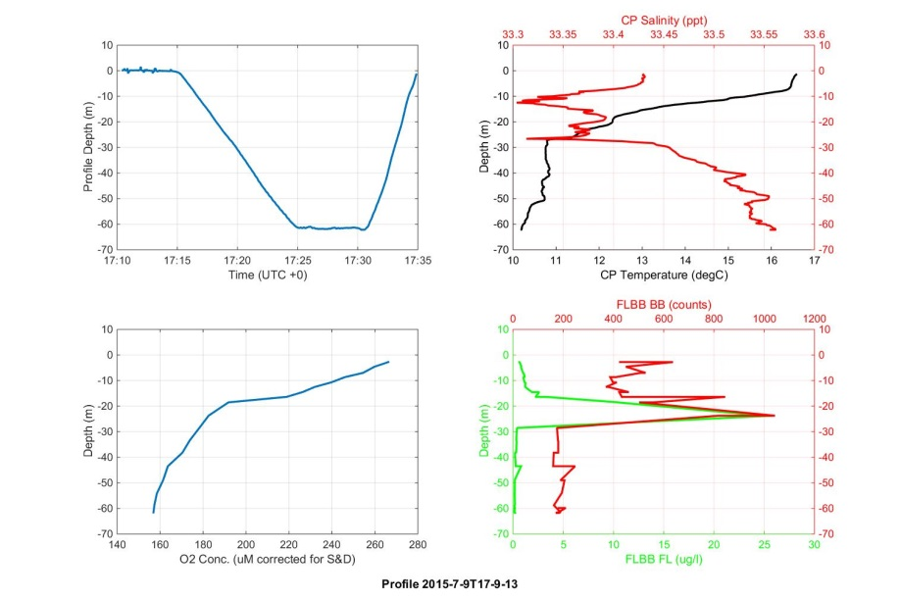
CPF Current Status
2 prototypes currently operational and undergoing at sea testing. 2 more coming on line.
10 profiles to 60m in 5 hours
Detailed, high resolution profiles of important biogeochemical properties

