Slide 1
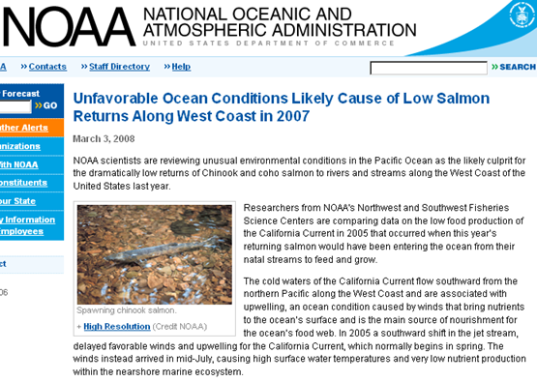

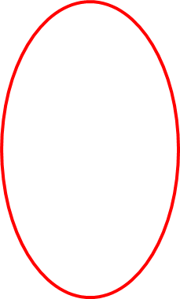
Development of a Coastal Profiling Float
The Science Motivation
Scientists and Policy Makers need plankton biomass and rate data (carbon stocks and production rates) in the coastal zone at the scale of large ecosystems, such as the California Current, for proper understanding and management.
  For example, the salmon fishery off the west coast of North America
MODIS Chlorophyll June 28, 2011 http://podaac-tools.jpl.nasa.gov/soto/

Slide 2
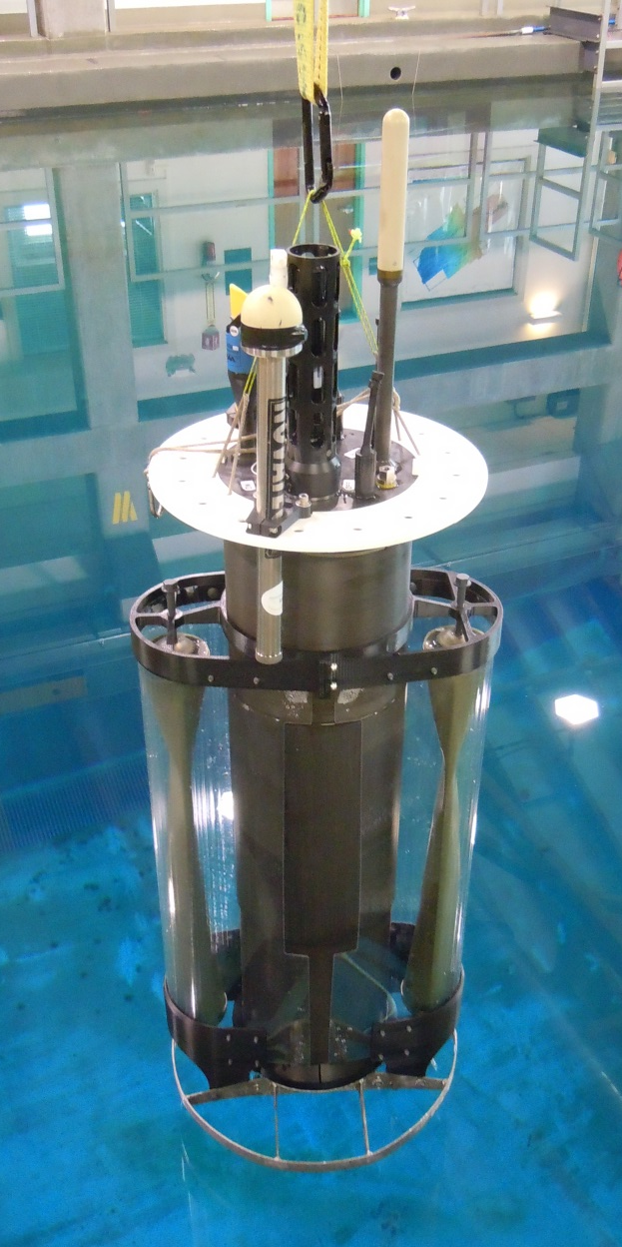
How and why MBARI can contribute
The MBARI Chemical Sensor lab has been working with Argo profiling floats for 10+ years
  Argo is arguably one of the few (maybe the only) ocean observing systems that has scaled to provide the needed data at the ocean basin level
  However, Argo is designed and optimized for open ocean, deep water
  Extending Argo technology to the coastal environment requires a new platform
The Chem Sensor lab has been developing a biogeochemical sensor suite and data analysis tools that are well suited for use on a coastal profiling float to address these important “health of the ocean” questions
Coastal Profiling Float Gen-2

Slide 3
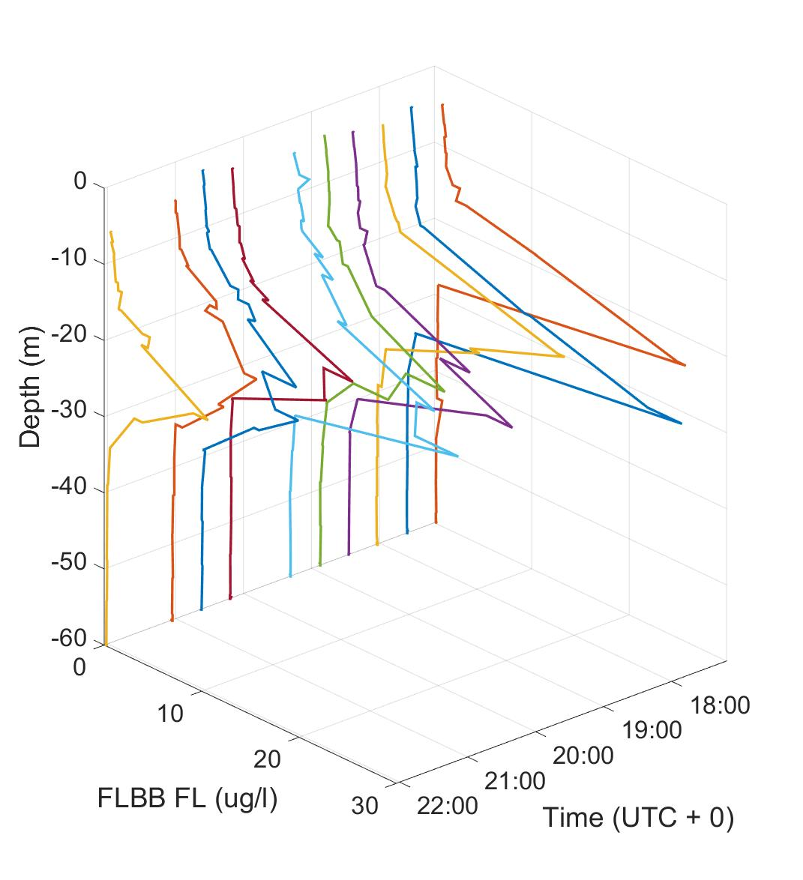
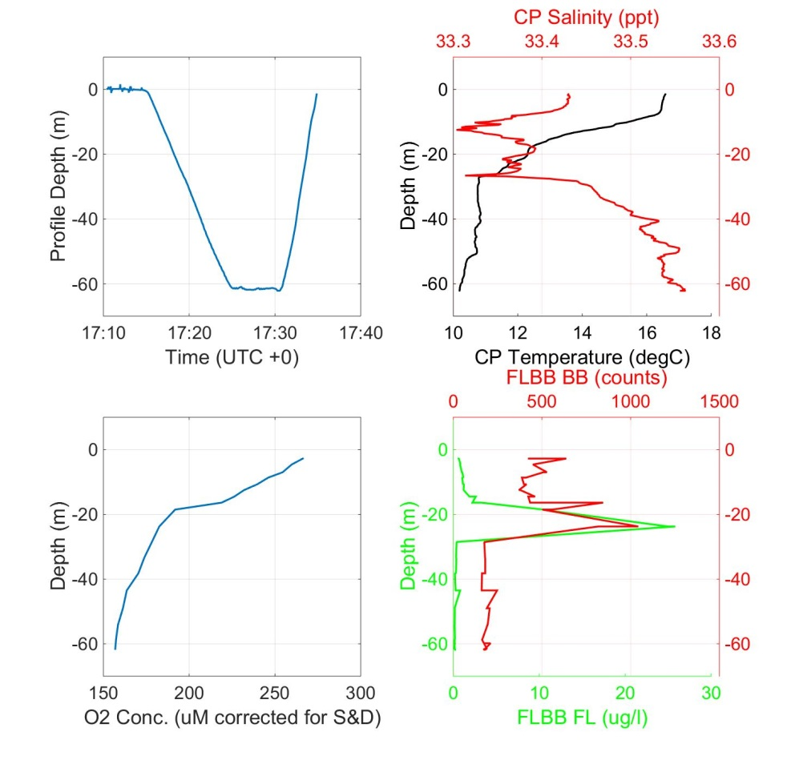
CPF Current Status
2 prototypes with extensive at sea testing, 1X Gen-1, 1X Gen-2 and 2 more coming on line.
Immediate goal: long term, unattended deployments
Long term goal: 1) Run a pilot experiment 2) License this technology to a commercial partner
Detailed, high resolution profiles of important biogeochemical properties
10 profiles to 60m in 5 hours

