Slide 1
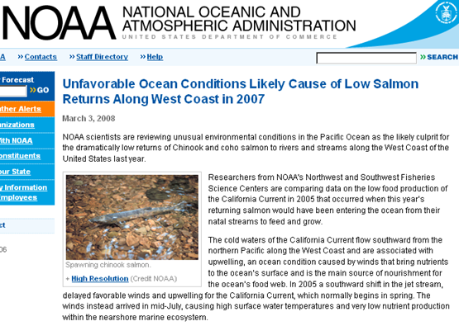


Slide 2
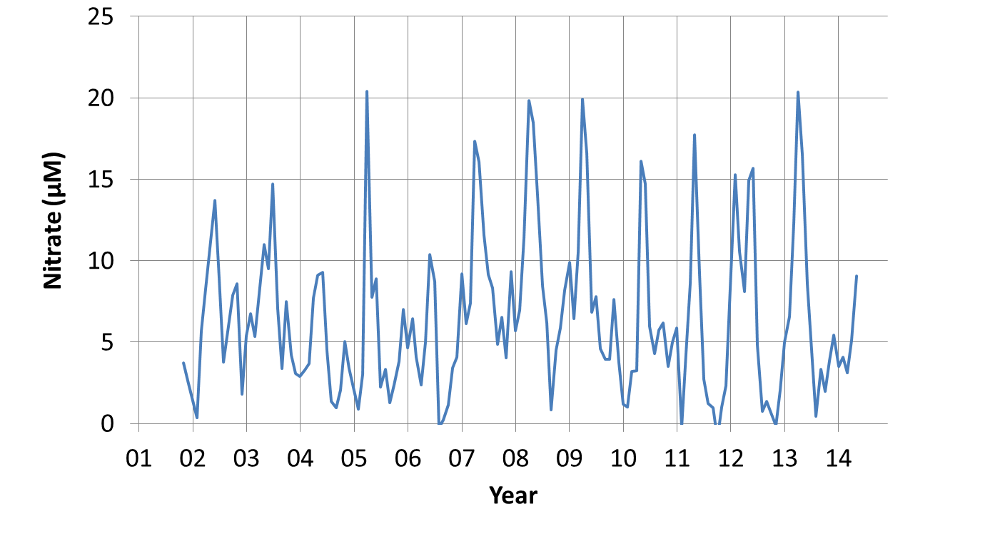
MBARI ISUS nitrate sensor on M1 mooring:
2004 – 2006 were low nutrient years
2014 off to slow start.
How do you scale sensor systems to a whole coast to provide managers the information they need?

Slide 3
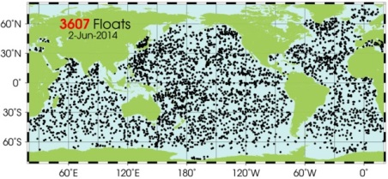
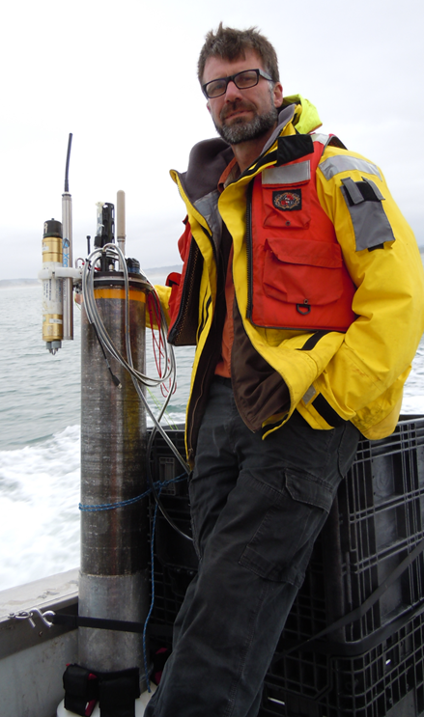
MBARI Coastal Profiling Float
The Argo array is one (maybe the only) example of an economically sustainable program capable of making large scale measurements
Argo does not target the coast because there is little heat stored in shallow water.
An opportunity exists to design and build a float optimized for the coast with biogoechemical sensors – oxygen, pH, nitrate, chlorophyll that enable ecosystem management.

Slide 4
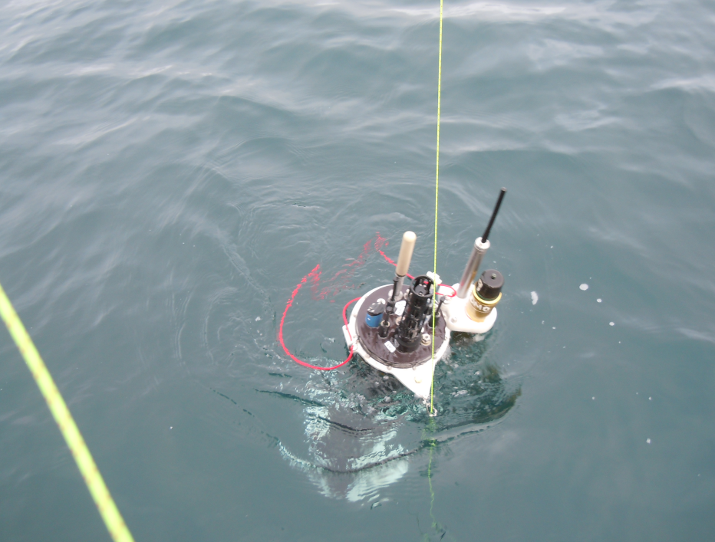
Requirements
Scalability – low cost, no maintenance
Endurance
  ~3 years at 100 m = 1100 profiles at 1/d
Depth limited to 500 m
Large buoyancy change

