Slide 1
CPF Oil Bladder Discussion

Slide 2
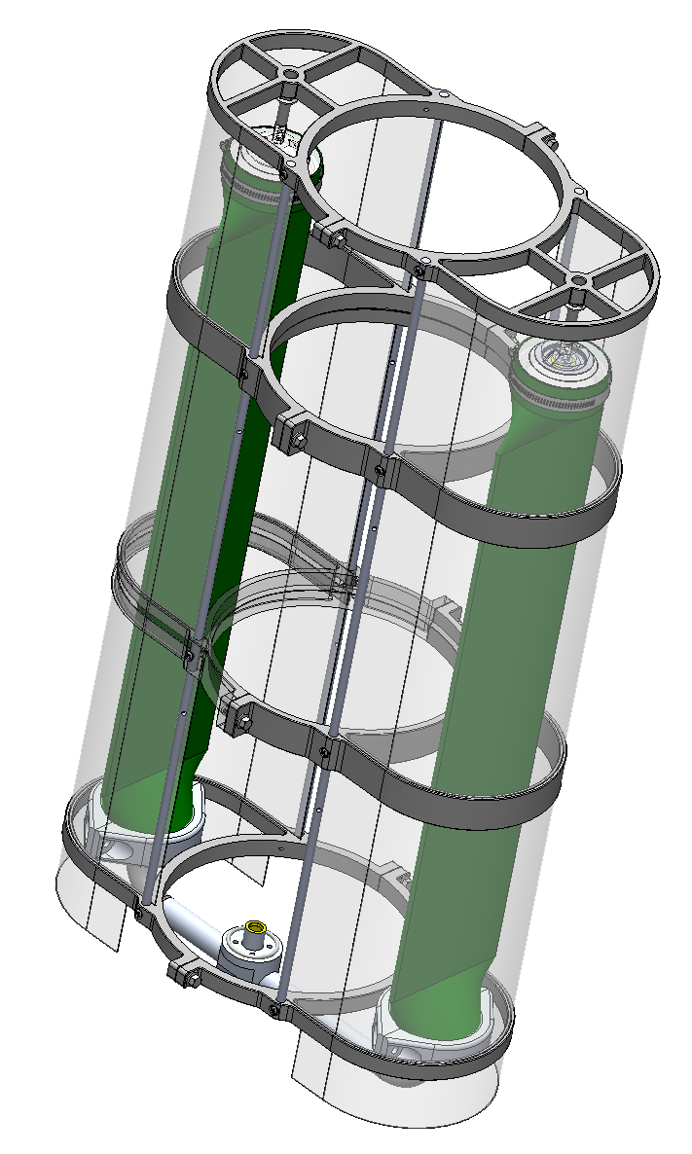
U-Tube External Bladder
Question: is this really better than the old corrugated bellows design?
Issues:
  Knocked the tube off the base twice
  Hose clamps loosen with time
  Transition from round to flat shape is unconstrained. Sharp corners and movement at pressure
  Physically vulnerable
Pros
  Less prone to accumulating mud
  Lighter weight
  Shorter overall height for CPF by ~ 9 cm (3.5”)
Fix:
  Can use a machined clamp to address hose clamp problem
  Base was designed to accept “transition insert” to control transition shape

Slide 3
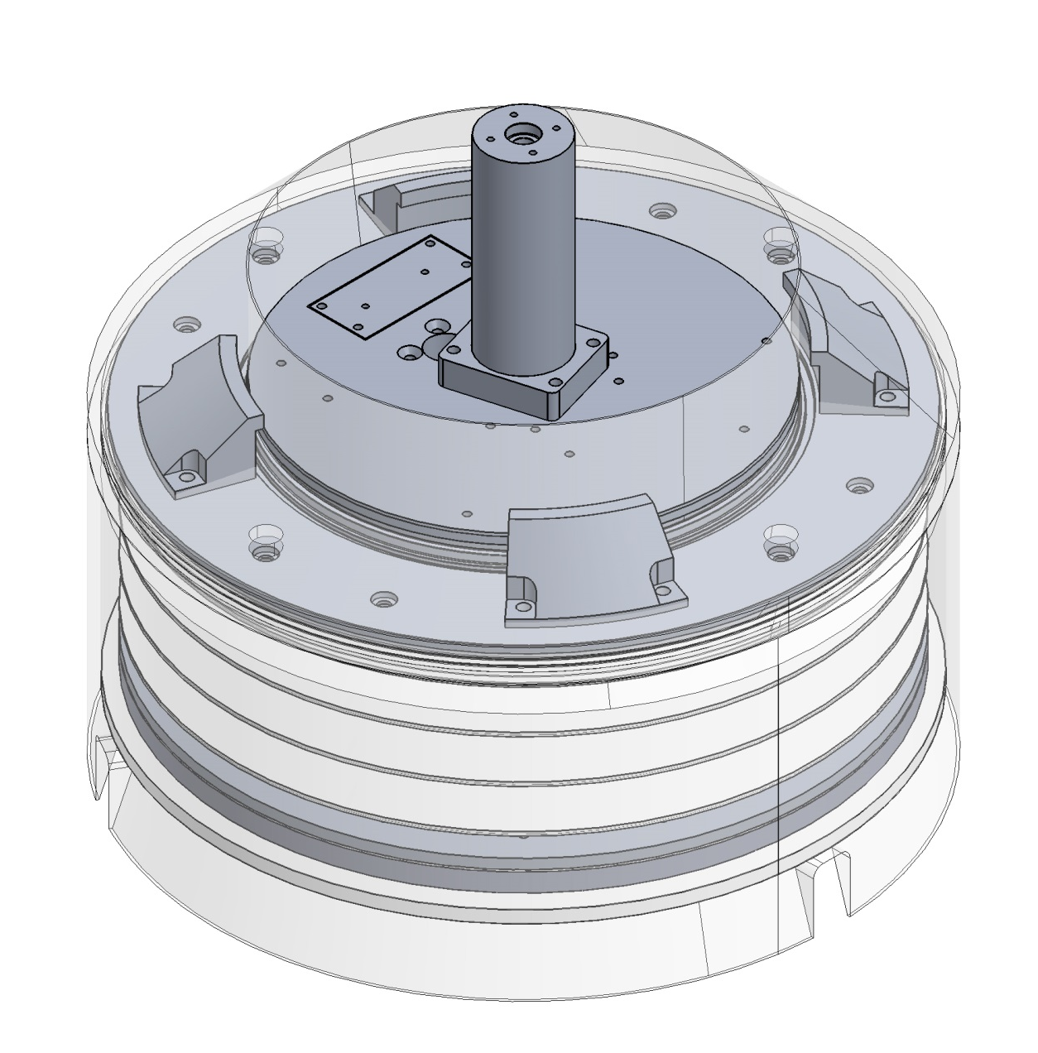
Bellows Bucket External Bladder
Cons
  More susceptible to filling up with mud
  Heavier 6.5 kgf vs 2.1 kgf
  More Parts
  Position transducer should be right in the center if inner bellows can’t support a position transducer

