Slide 1
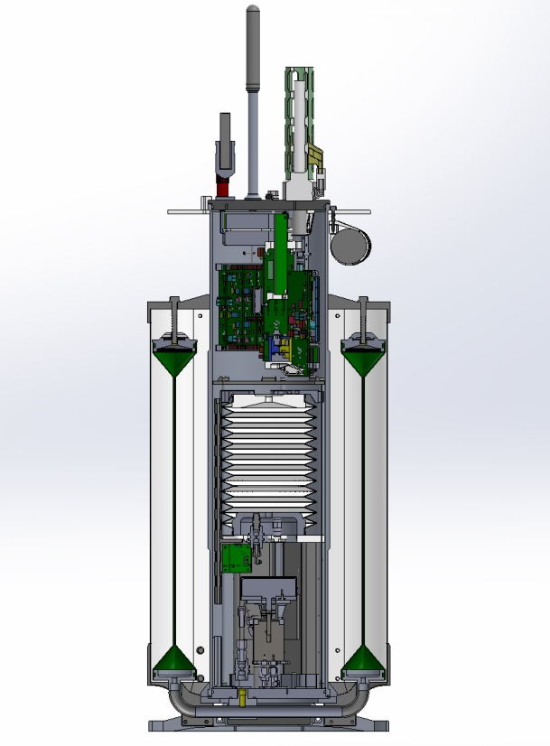
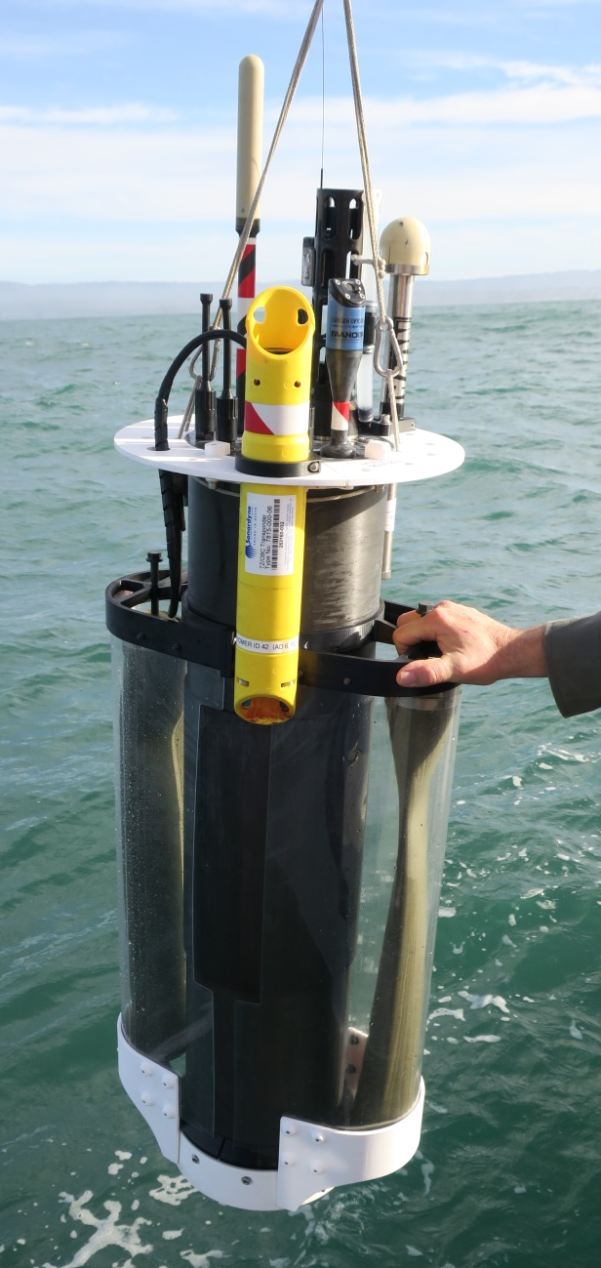
The Coastal Profiling Float (CPF)
Biogeochemical sensors
Electronics
Inner oil bladder (full)
Outer oil bladder (empty)
Hydraulic pump

Slide 2
